Slide 1
How to Quantitate a Markov Chain?
Chin-Ning,Chou Wei-chang,Lee
Stochastic Process Project1

Slide 2
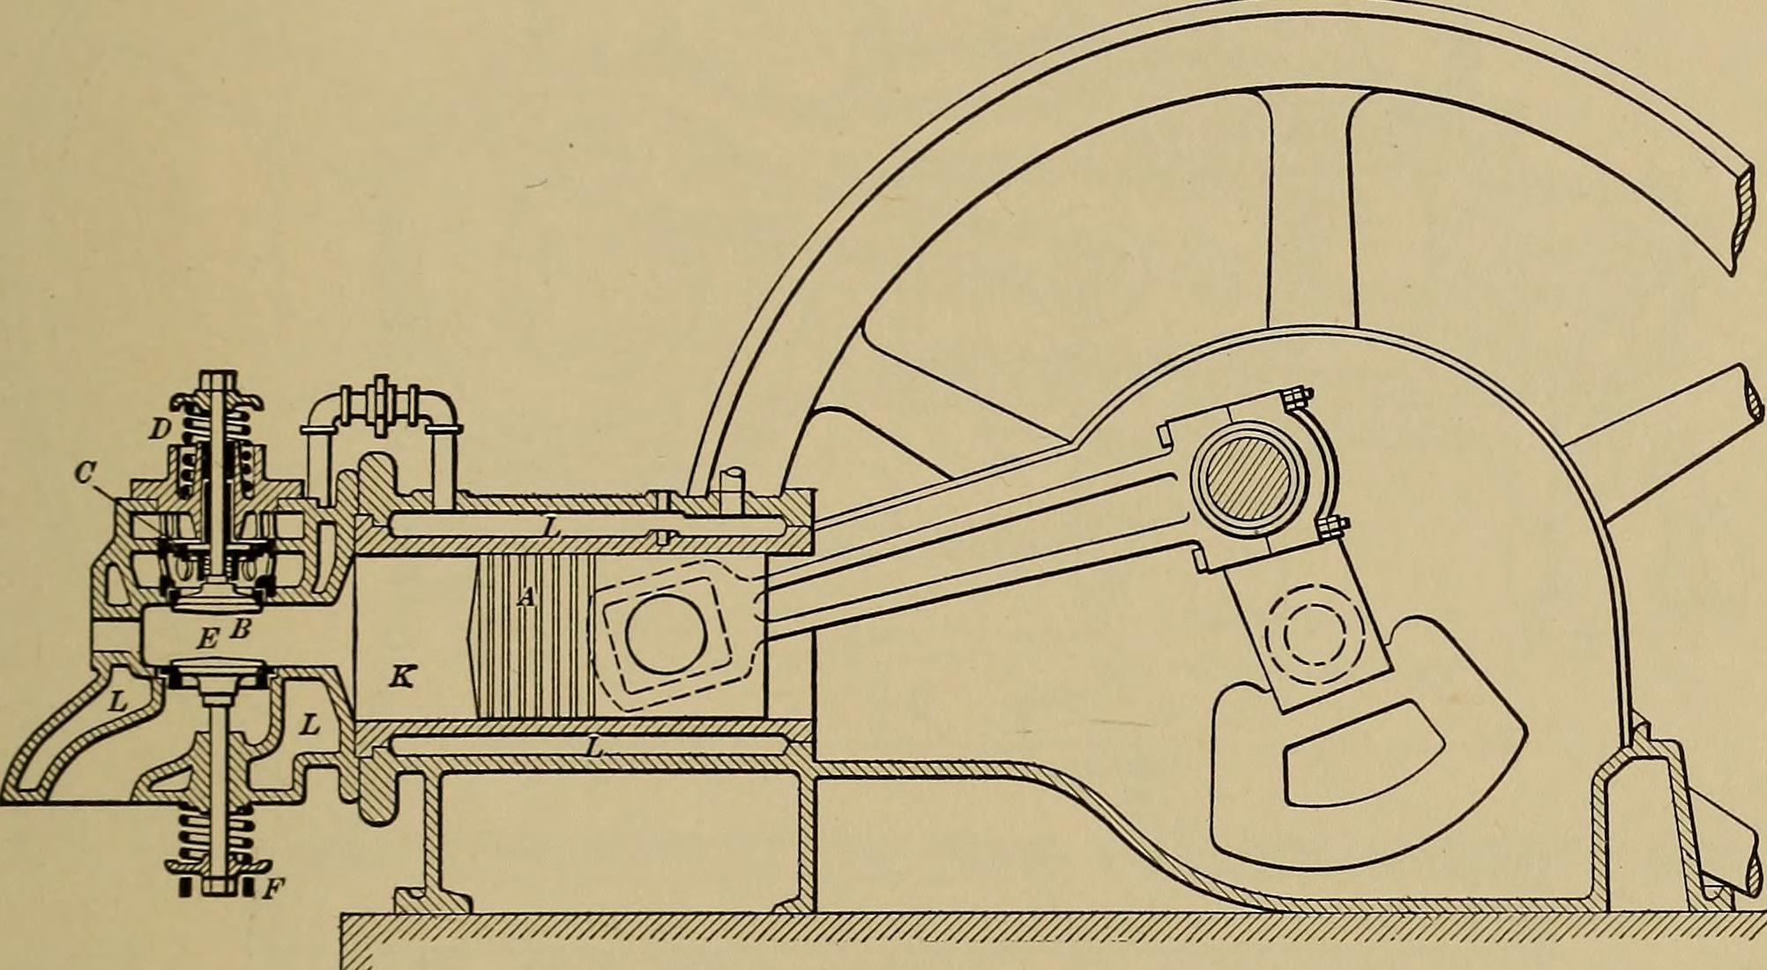

Slide 3
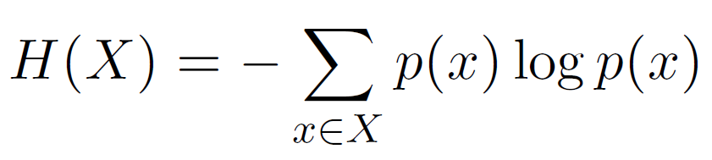
Shannon Entropy

Slide 4
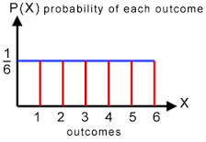
Maximizer of Shannon Entropy

Slide 5
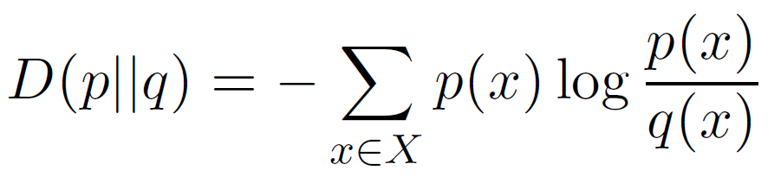
Kullback-Libler Divergence

Slide 6
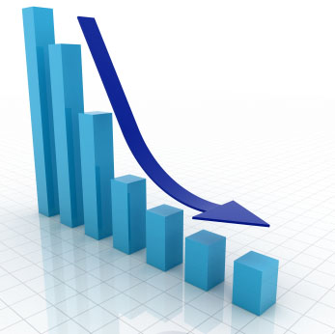
KL Divergence Will Monotonically Decrease

Slide 7
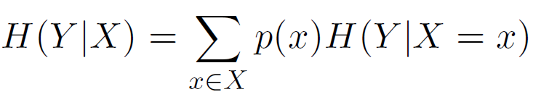
Conditional Entropy

Slide 8

Data processing inequality

Slide 9

Conditional Entropy Monotonically Increase

Slide 10
Simulation Time!

Slide 11
Conclusion

Slide 12
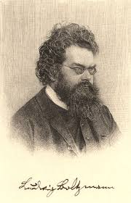
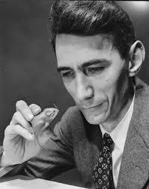
Two Different Views on Entropy
vs.

Slide 13
Thanks For Listening!

