Slide 1
Digital Forensic Linguistics
Charles Kronk

Slide 2
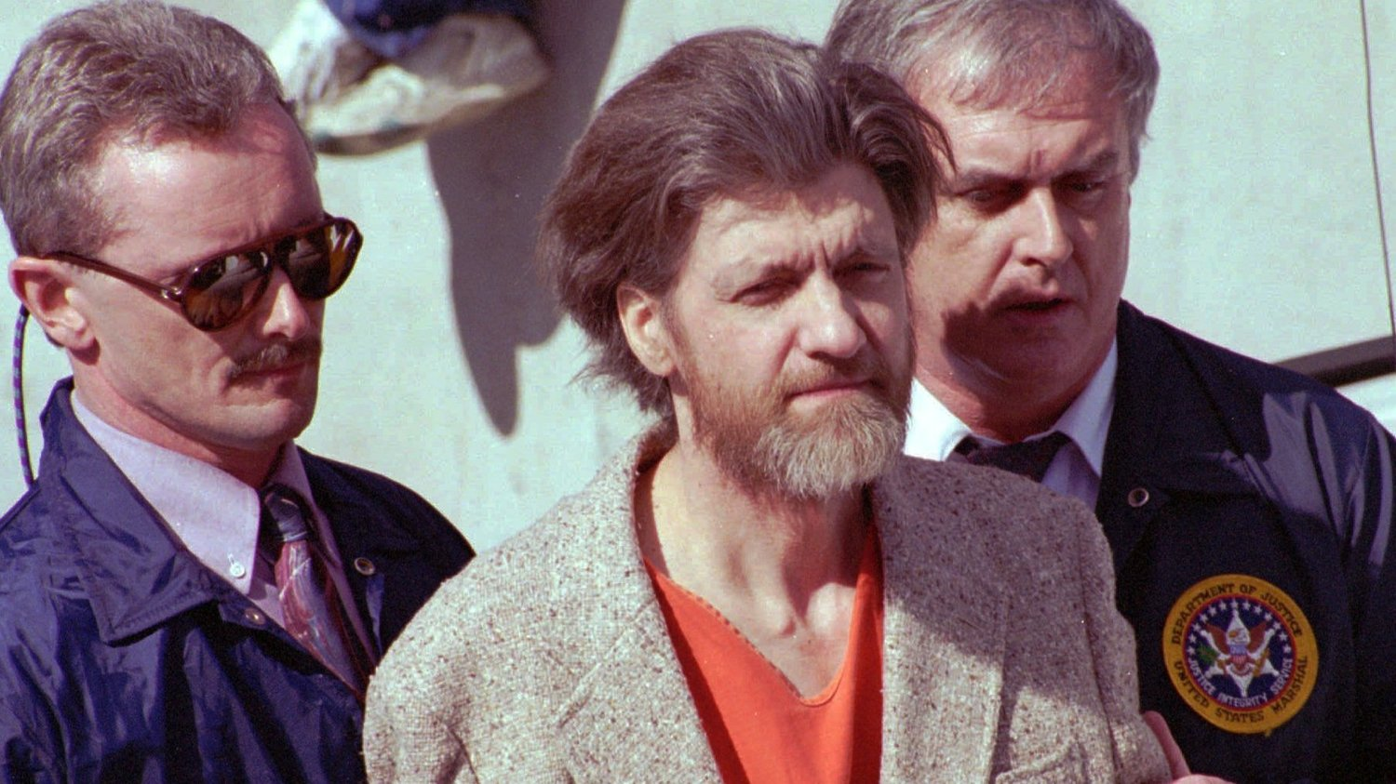
Forensic Linguistics
“I want to devote my time and energy to looking at the language in this case, and let’s see just what the heck I can make out of it.”
Demographic information obtained from specific language-use
FBI Profiler Says Linguistic Work was Pivotal In Capture of Unabomber

Slide 3
Programming Language Features
Primary programming languages used
Natural languages in comments and variable names
Distribution of language-specific keywords and reserved words
Placement of brackets/parentheses
Usage of tabs or spaces (and how many spaces)
Median/mean number of lines
Median/mean number of characters
Median/mean number of words
Median/mean number of spaces
Median/mean number of tabs

Slide 4
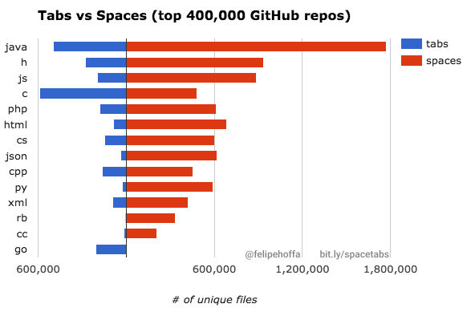
Spaces vs. Tabs

Slide 5
Implemented Pipeline
Randomly sample GitHub users
Obtain profile pictures from these users
Download all repos from these users
Identify facial features using Microsoft’s Azure Face API
Identify programming languages in repos
Identify keyword distributions from repos
Identify other statistical metrics from repos
Use these metrics and others in various machine learning algorithms (Random Forest, SVM, etc.)
Evaluate performance

Slide 6
How well did it work?
Preliminary analysis shows promise in predicting the country a programmer is from, based solely on the code itself.
Some aspects of age and gender can be predicted as well.
Additional parameters could likely increase accuracy and explained variance significantly.
Accuracies
 | Gender | Age | Country
Random Forest | 0.90 | 0.21 | 0.29
Linear SVM | 0.90 | 0.69 | 0.71
K-NN | 0.90 | 0.16 | 0.23

Slide 7
So What?
Although this is preliminary work and certainly has flaws, this approach could help law enforcement better identify perpetrators of cyber crime.
It should be noted that, due to time constraints, our sample size was only about 300 GitHub users, all having fewer than 10 public repositories.
Additionally, the majority of these users were male and from the United States, adding a slight bias towards these options.
However, both of these things could be mitigated given larger sample sizes.

Slide 8
Future Directions
Integrate keyword distributions, cases (camel-case, kebab-case, etc.), placement of brackets/parentheticals
Check other features: can look at hair color, presence of moustache, presence of beard, etc.
Work with larger sample sizes, definitely need more data!

