Slide 1
Employee Management System
Presented by
Shivam Anand
Amaranath
Sai Roshini
Vaishnavi
Shruthi

Slide 2

Contents
Introduction
Scope Of Change
Technology
Architecture Diagram
Control Flow
Conclusion

Slide 3
Introduction
This software application stores all the employee's information in a database. It is an application developed in Java and the database used is SQL. It contains employee information like employee id, name, date of joining, and basic pay.
It is an easy-to-use application and has a user-friendly interface. It is totally built at the administrative end which means that only the admin has access rights to change or modify any records. So, this makes it a safe and reliable application to use.
The main aim of developing this application was to reduce the errors that occur in the manual system. One can search the details easily by just entering an employee id. In earlier systems, there was not such a facility to do so. All the details are stored in an SQL database. It is easy to update any employee details. All the employee records are integrated and so this makes it a user-friendly and easy to use application.

Slide 4
Scope Of Change
We can add registration for new Employee. When new employee fill the registration details and it go to login page. once employee enter to login details ,it will go to home page. Then employee can able to enter the details like ID, D.O.J and basic pay .It shows the overall salary details TAX,DA,HRA,GROSS,NET.

Slide 5
Technologies
Backend : Spring Data JPA , Spring Boot-2.6.4
Frontend :Angular -8, CSS-3 , Html -5
Database : Oracle -11g
Server: Tomcat -8.5

Slide 6
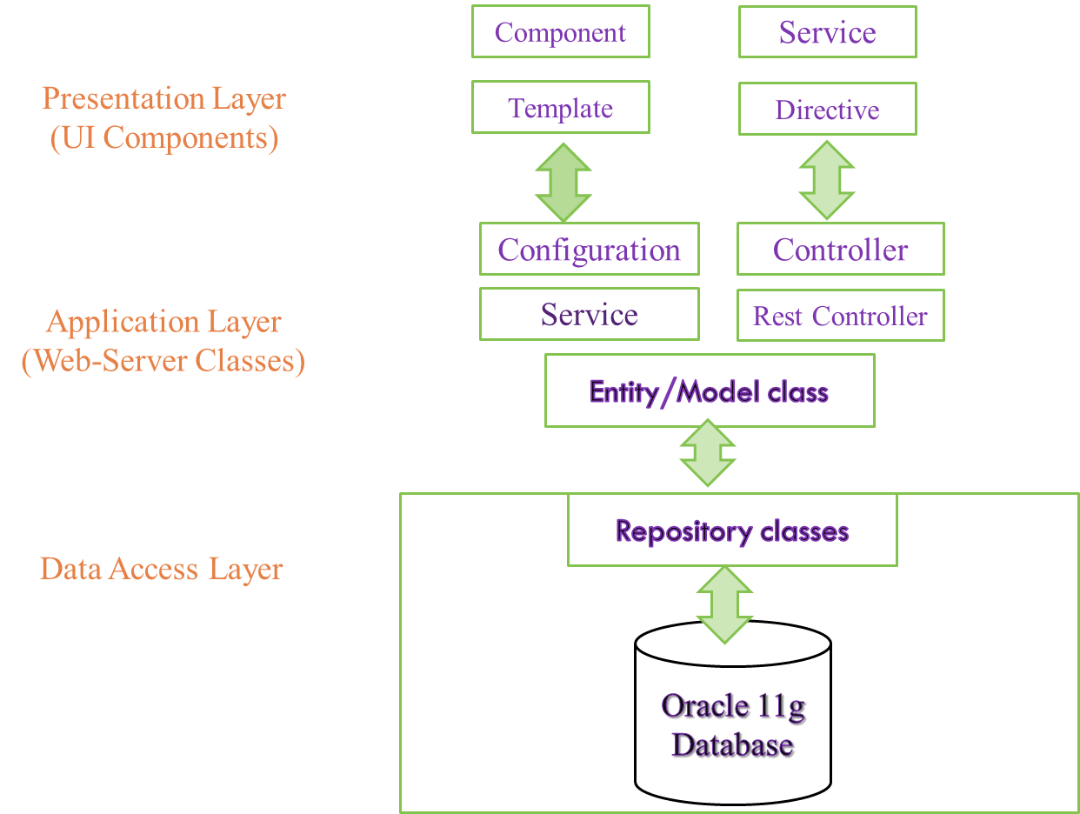
Architectural Diagram

Slide 7
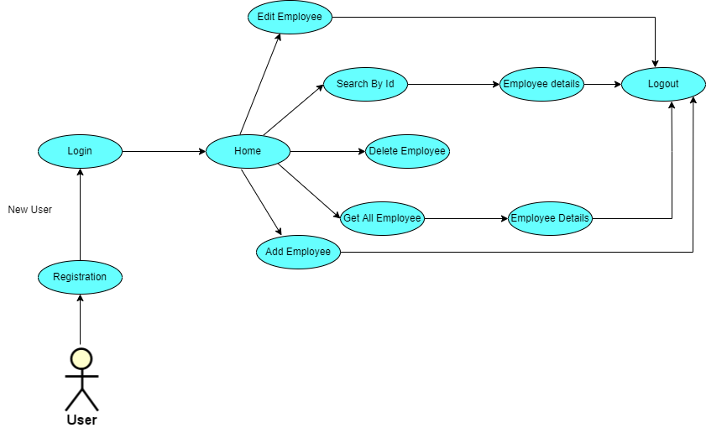
Control Flow

Slide 8
Conclusion
The entire implemented system mainly demonstrates the concept of Employee management system.
This project helps the user to get the user details including basic pay , DA, HRA , gross , Net and Tax.
The developed system perfectly met all the objectives conceived at the design phase of the system.

Slide 9
THANK YOU

