Slide 1
USACO Basic Flood Fill
SHSID OI Club

Slide 2

Warm-Up
Our great Führer has set the orders to do a bit of warm-up for our little OI session, for that its connected with a former lesson we had before (Greedy)
Here’s the problem:
Given an integer N, you are to write a program that would find and output the smallest resulting integer after removing k integers from the integer N. (ex. remove “3” from “123” would result in “12”)
Basic Idea: Start from the leftmost digit and go through the entire integer N. For every digit, check if the digit before it is smaller than it or not. If it is smaller than the digit before it, delete the digit before it. If you arrive at the rightmost digit and still doesn’t find one, delete the rightmost digit.

Slide 3

Basic Concepts
Flood fill is an algorithm in which you basically fill connected areas through making the values in connected areas the same (ex. painting them with a colour)

Slide 4
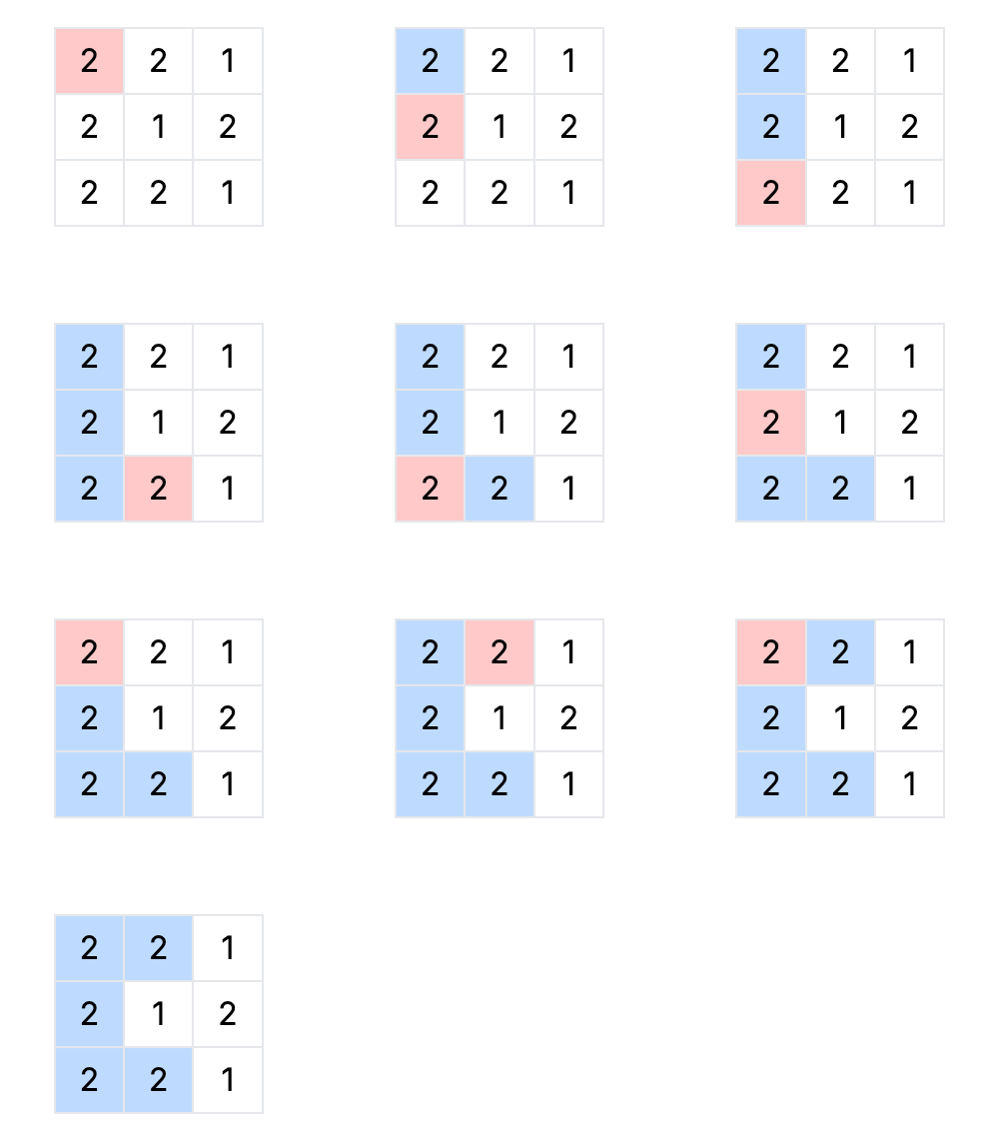
An example of flood-filling a small connected component
Notice we can use both bfs or dfs...

Slide 5
模版.
Given an N x M grid, each square with a number from 1 to K.
Find the number of connected components with the same number:
here CC’s mean connected by an edge, as seen previously.
Consider a DFS and a BFS approach; also, recall that we’ve done coloring before

Slide 6
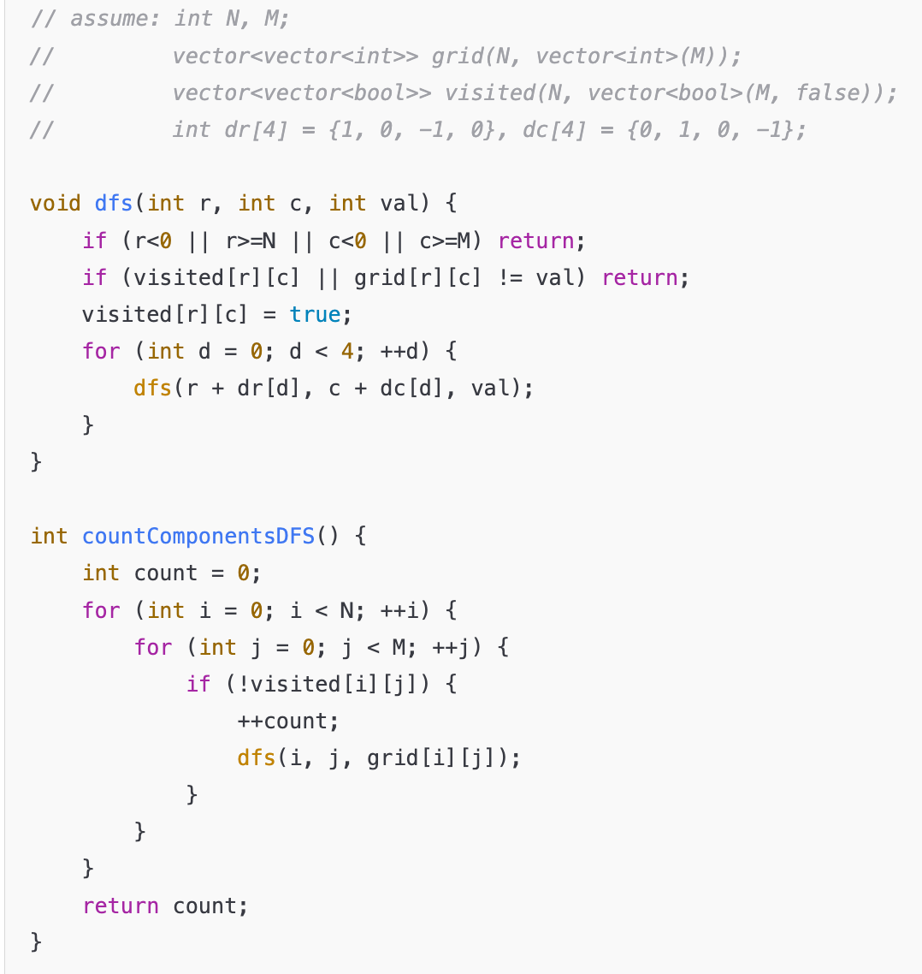
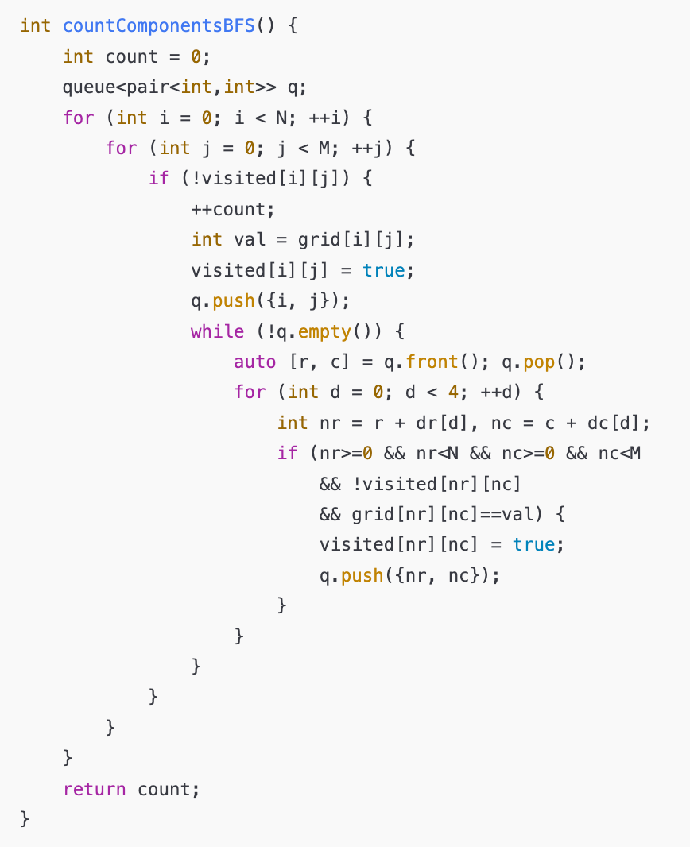
Notice the use of dr, dc

Slide 7
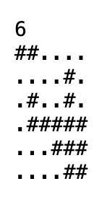
Icy Perimeter
Given an n x n grid, find the largest connected component, outputting its size and perimeter.
If there are multiple connected components tied for largest area, print the one with smallest perimeter.

Slide 8
Icy Perimeter
Flood fill across all elements is O(n^2), we don’t even have to store an array of component ID’s, we can directly compute the perimeter and area and compare at each time.

Slide 9
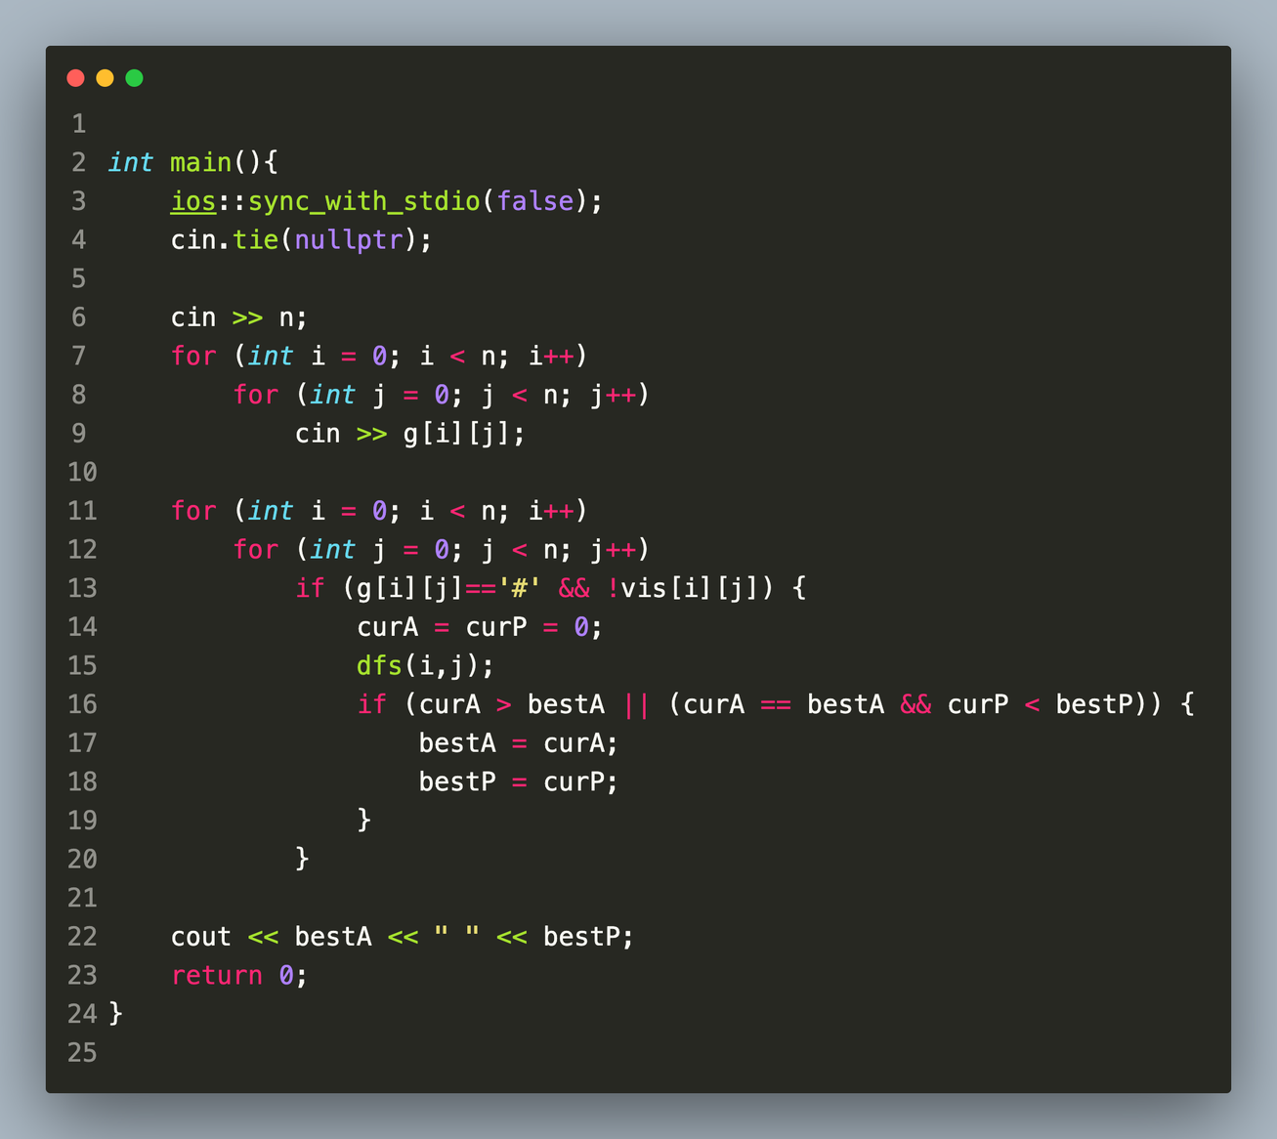
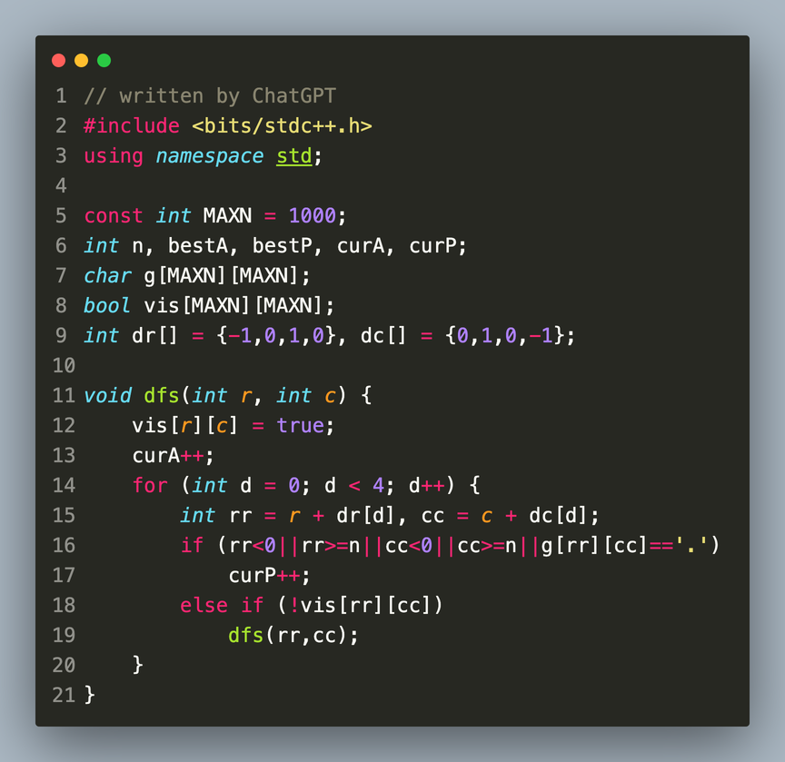
Icy Perimeter Solution
don’t store char’s for input as GPT did
use bool when can

Slide 10
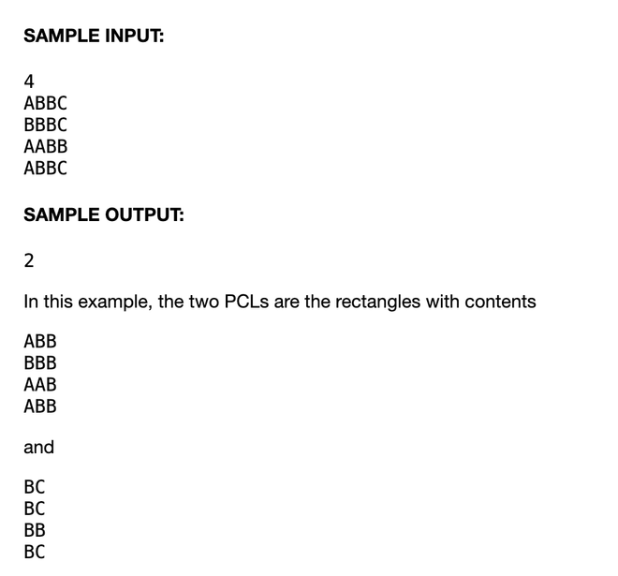
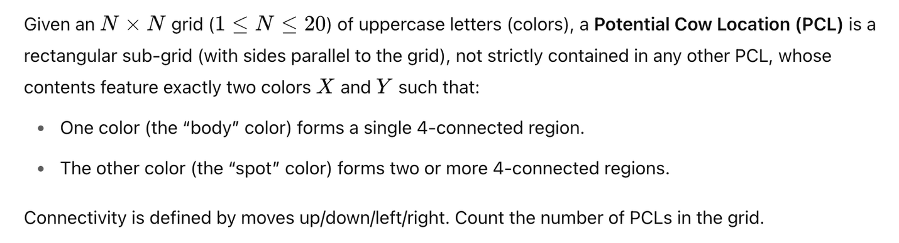
Where’s Bessie?
4-connected just means connected up/down/left/right, same as previous just worded weirdly.

Slide 11
Where’s Bessie? Solution Idea
For every possible rectangle (N^4), we run a flood fill (N^2). If that rectangle is valid, we store its information (the four boundary values) in an array.
Then, since we expect the number of valid rectangles to be quite small, we can simply check if each rectangle is valid using O((size of valid array)^2). Intuitively, this number can’t be huge and so it’ll pass.

Slide 12
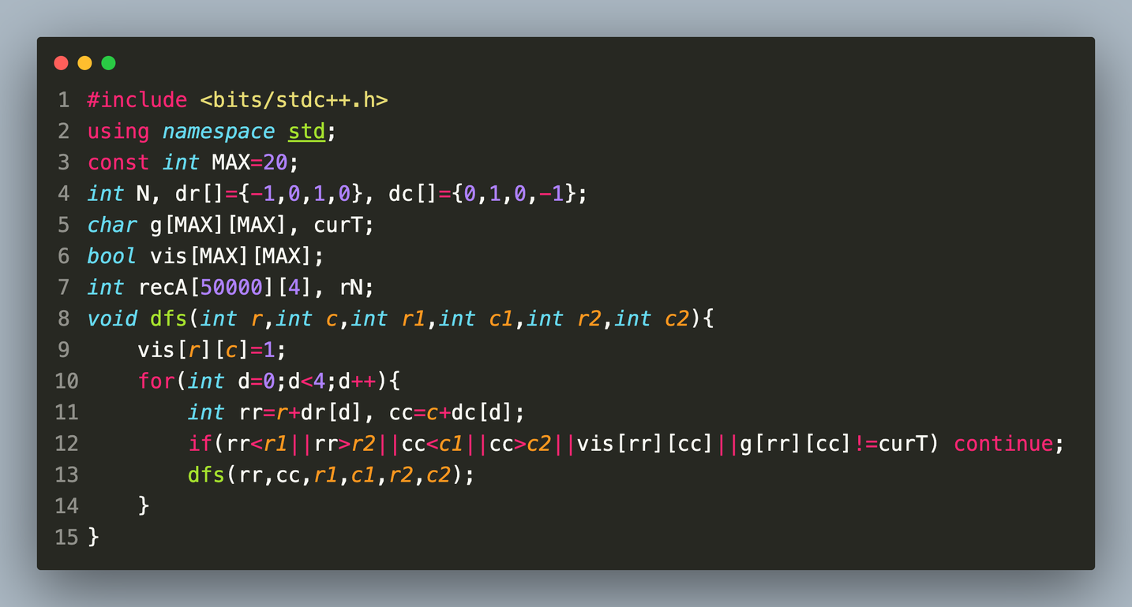
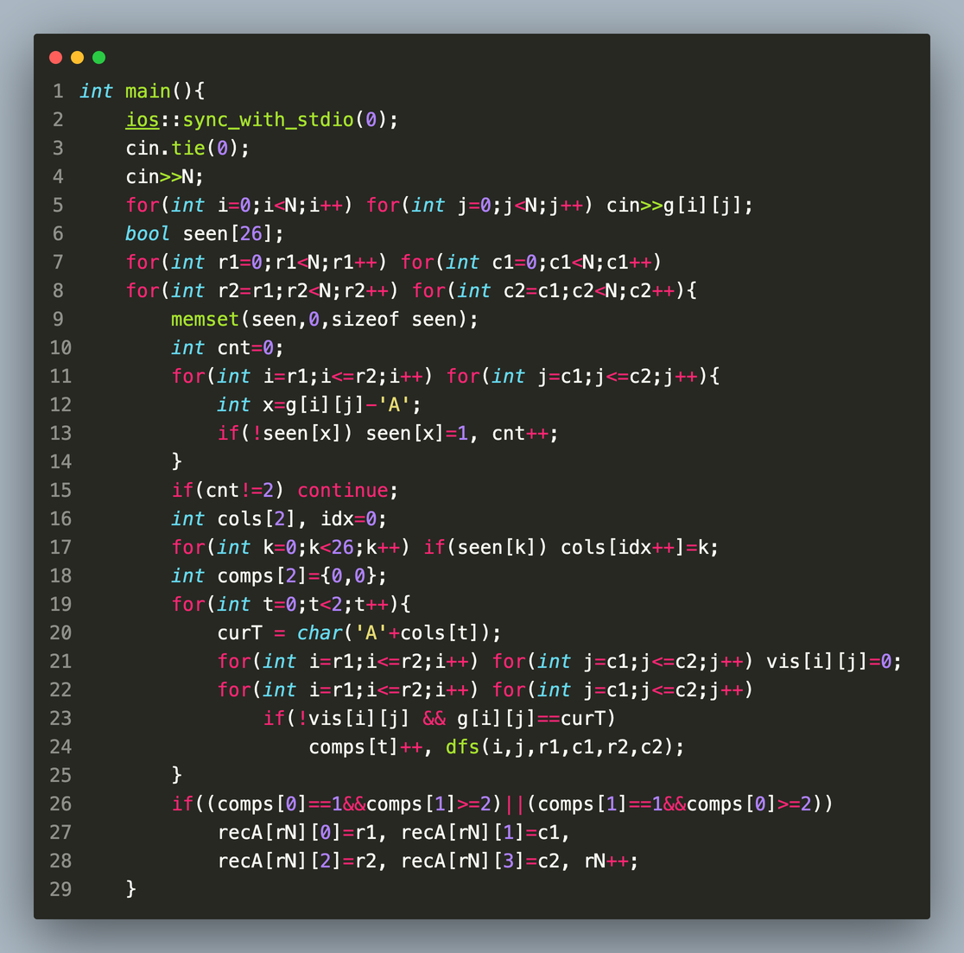
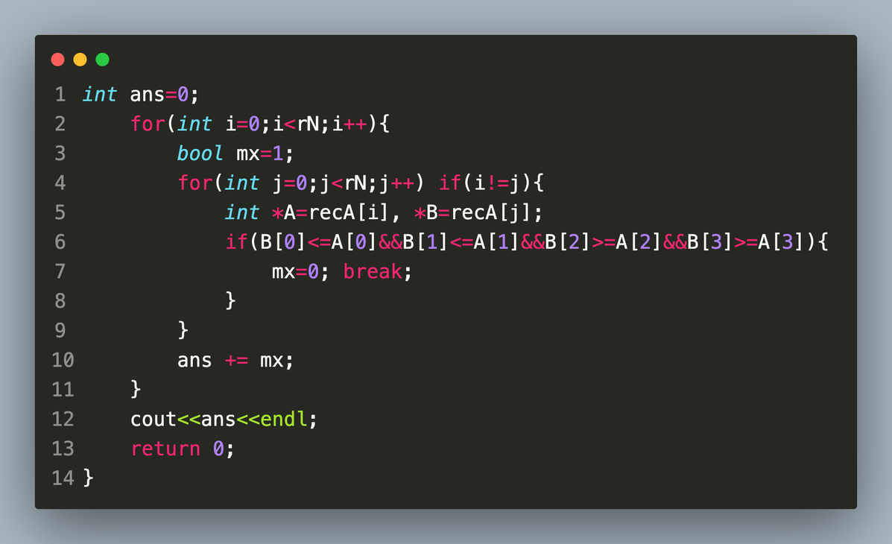
1
2
3

Slide 13
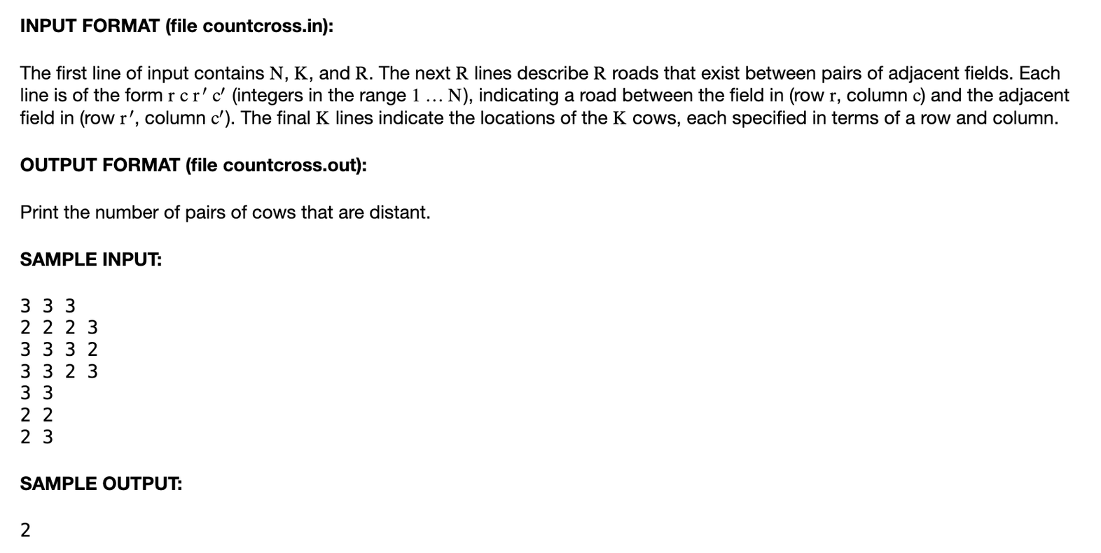
2017 Feb Silver P3
In this problem, we have a grid of squares (N x N), where it is generally possible to travel between two adjacent squares - some pairs of adjacent squares are blocked by roads (R roads total). There are K cows in some of the squares, and we want to know how many pairs of cows will not be able to be in the same square if they are permitted to travel as stated above.

Slide 14
We can determine the CC’s with a flood fill, treating roads as non-connections
Notice that if two cows are not in the same CC, then they are distant (and they can definitely reach each other, as they can then take any route...)
We can first run a flood fill across the board O(N^2), color labeling each CC.
We can first assume that all cows are distant and then subtract the number of cows in the same CC: for each color, find the number of cows with this color and subtract (this C 2).

Slide 15
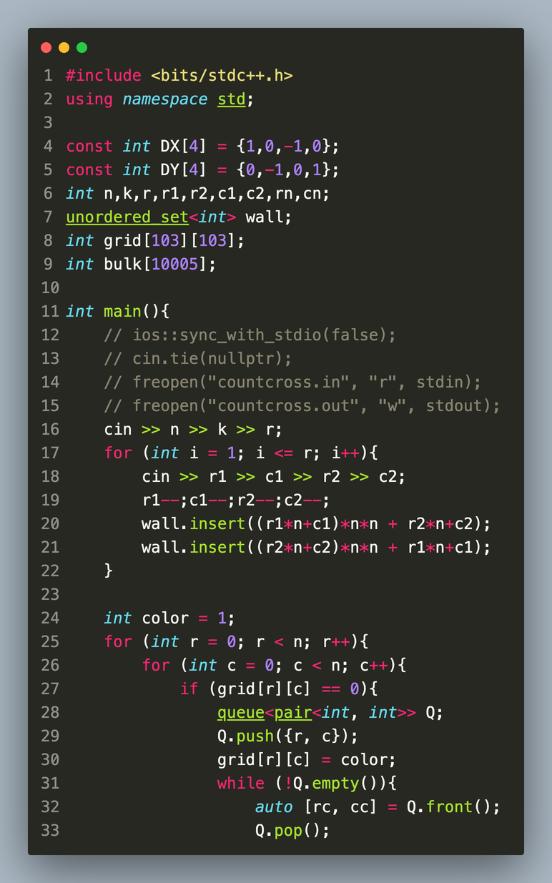
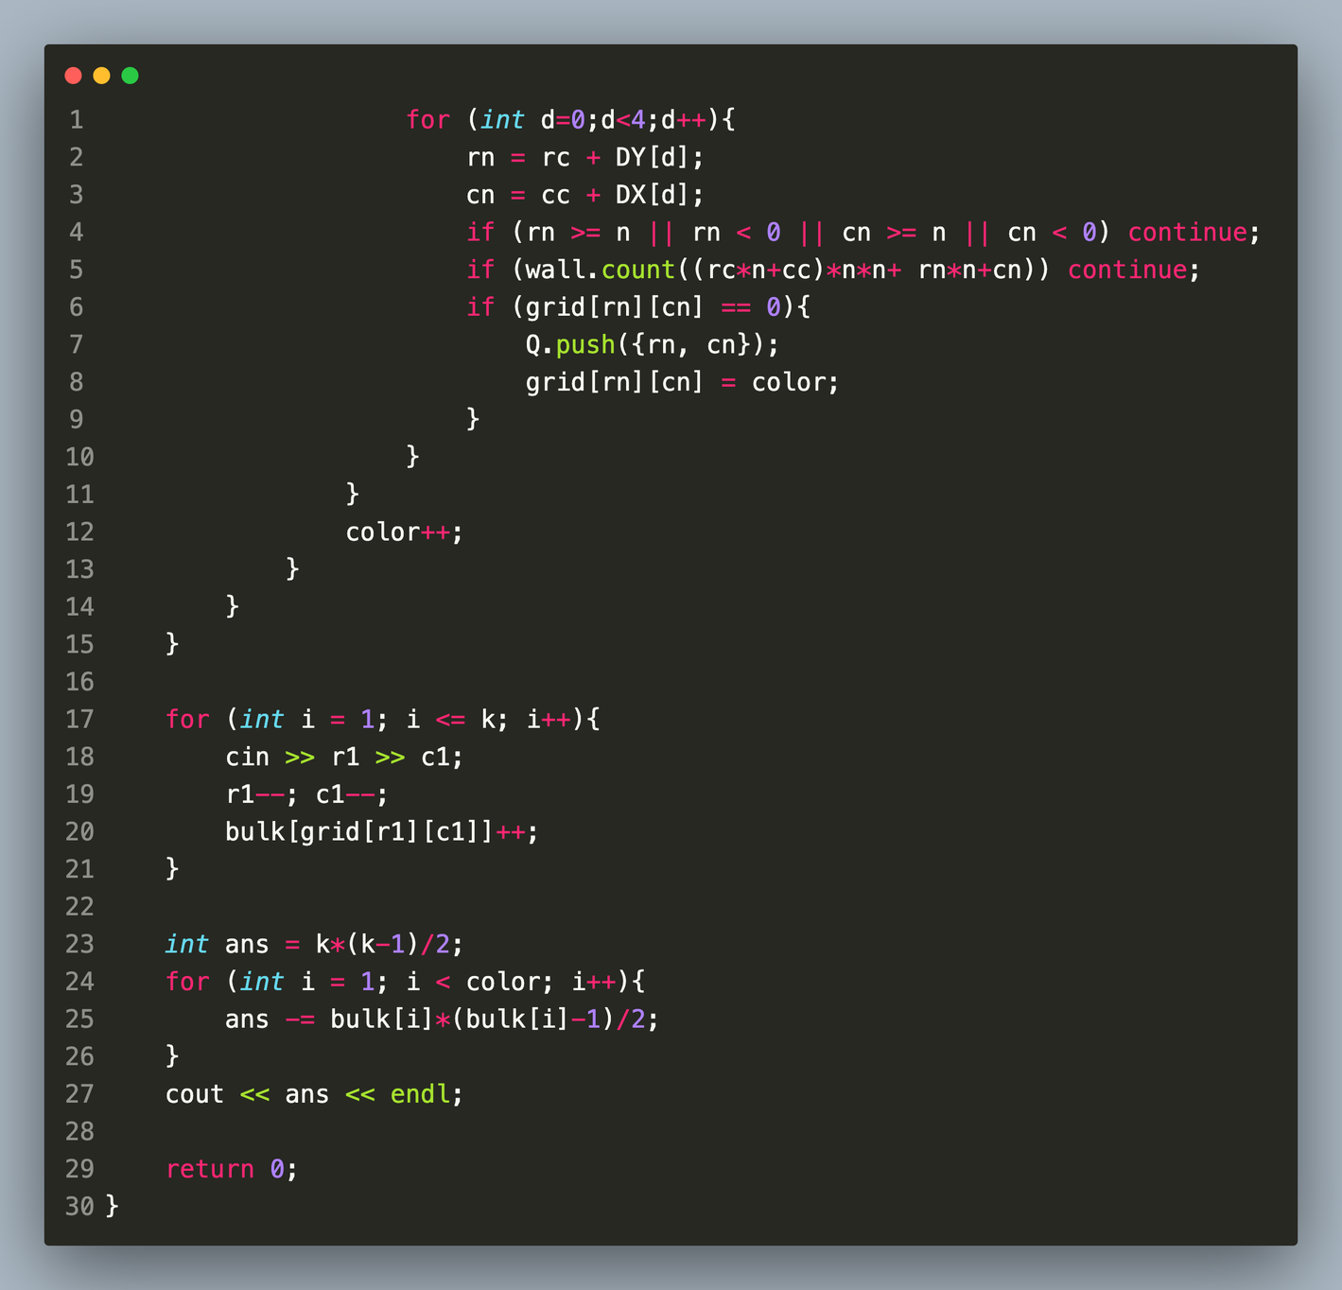

Slide 16
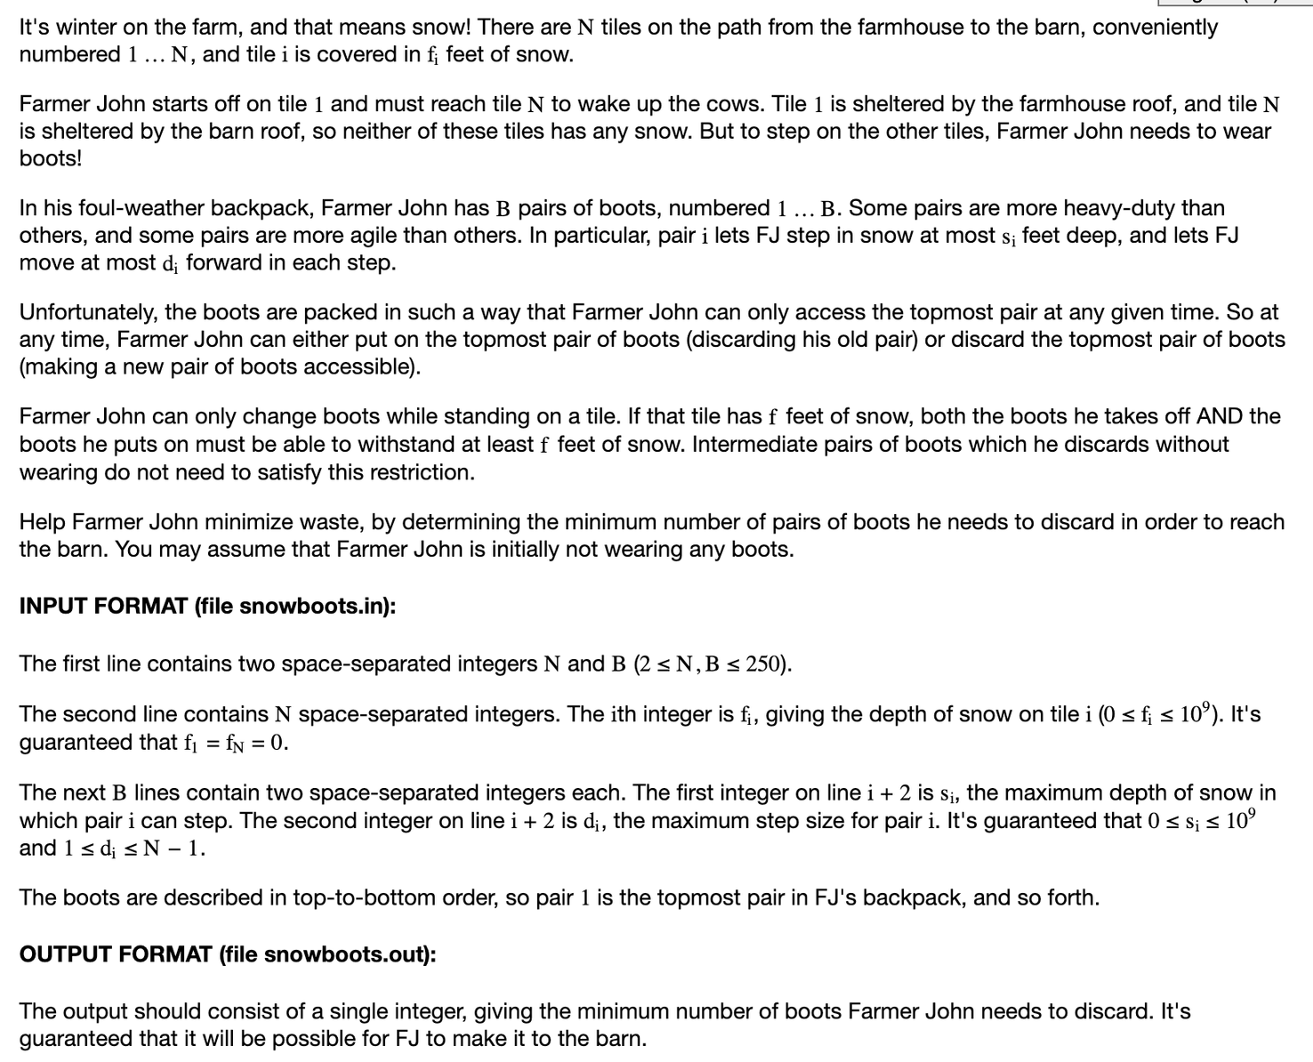

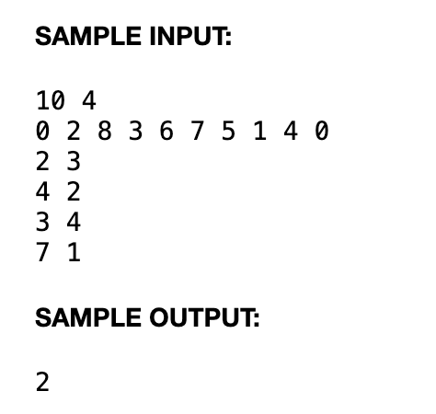
Snowboots

Slide 17
We can treat the states as a graph (gives dp vibes): each node is characterized by (pos, boots discarded)
At each node (p, b-1), we consider the following options:
(p+i, b) for i from 1 to max_dist[b+1], this means progressing with boot b
(p, i) for i from b+1 to B, this means discarding one or many boots.
Whenever the desired (N, ~) is reached, record and compare the number of boots discarded.
To analyze the time complexity, there are NB states, each taking (N+B) transitions. Hence O(NB(N+B)) √.

Slide 18
