Slide 1
USACO Basic Graph Traversal
SHSID OI Club

Slide 2
Introduction to Graphs
A graph is a set of vertices and a set of edges connecting them.
Analogous to a metro system: each station is a vertex, and each line connecting the stations is an edge.

Slide 3
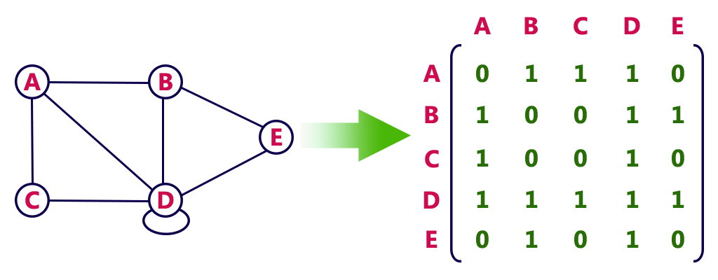
Adjacency Matrices
M[a][b] denotes whether there is a path from a to b. In an undirected graph, M[a][b] = M[b][a]
Could use M[a][b] as a weight of the path...

Slide 4
A vector of neighbors
using a data structure like
vector<int> G[N]
where G[i] stores all the neighbors of i.
Can extend the <int> to other data structures like pair<int, int> or a self defined structure.

Slide 5
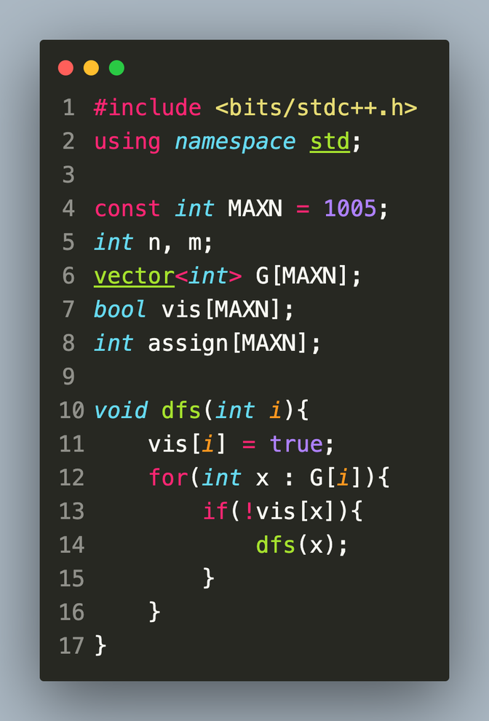
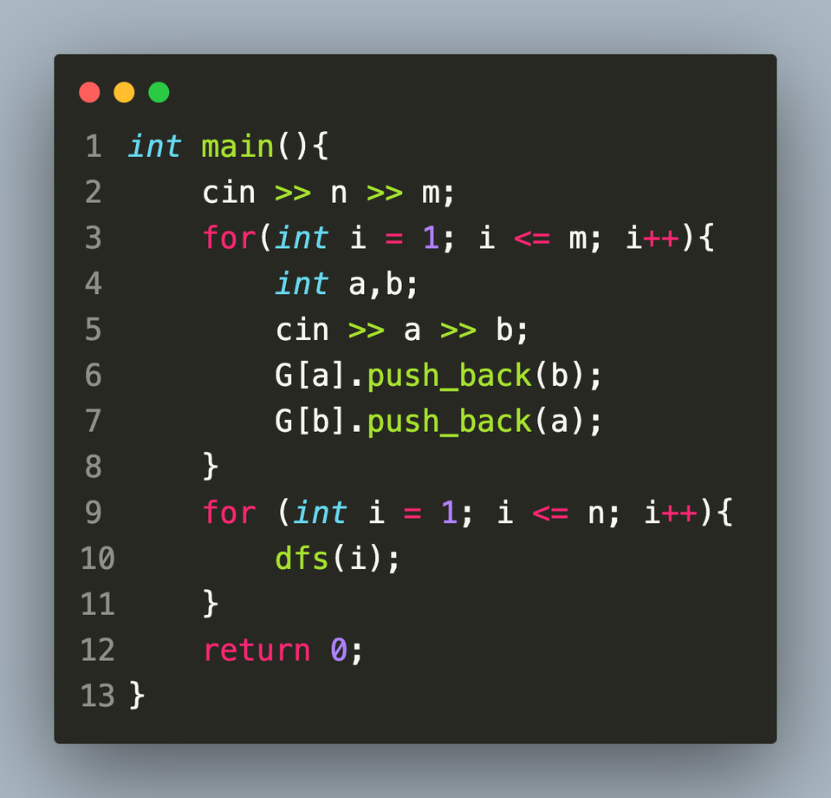
Traversing a Graph: DFS
Depth-First-Search: using recursion to reach the end before backtracking
Consider a stack data structure
Time complexity: O(V+E)
<-- a code that does nothing.

Slide 6
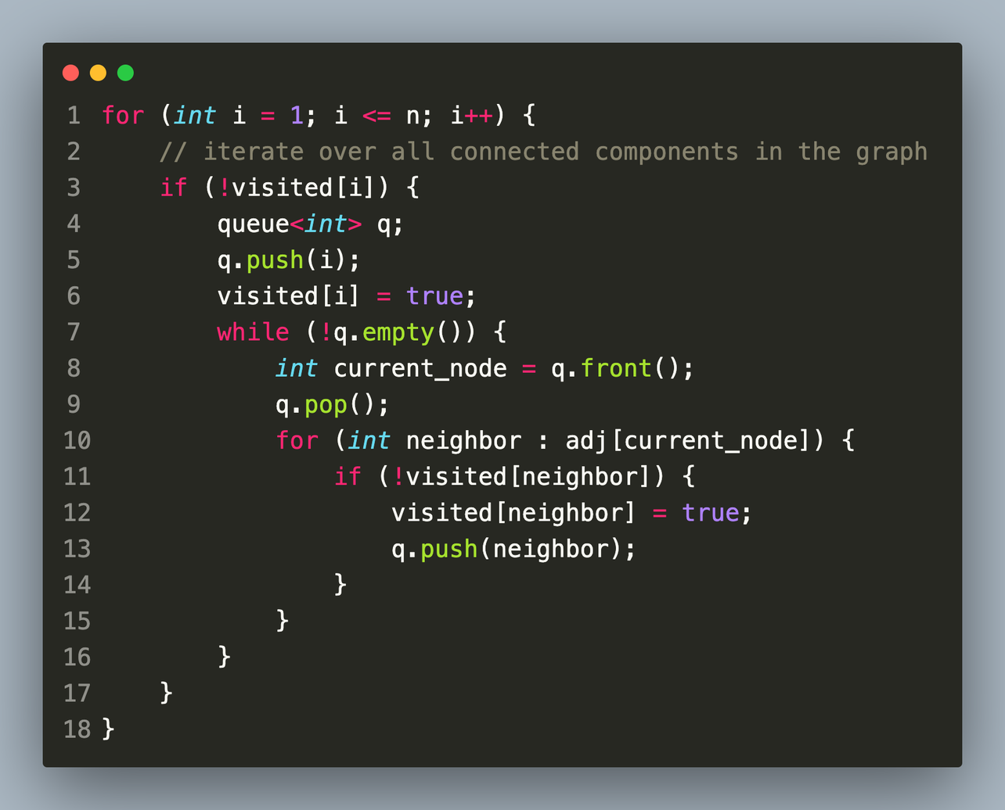
Traversing a Graph: BFS
Breadth-First-Search:
Using a queue:
First In First Out (FIFO)
Also O(V+E)
The nodes closer to the starting point will be traversed first

Slide 7
Ex. 1 Building Roads
Given N cities and M roads:
N M
a1 b1
a2 b2
...
aM bM
where a road exists between ai and bi
Find the least number of roads needed to make all of the ci connected component.
Hint: it is quite easy to notice that the answer is the number of connected components minus 1.
https://cses.fi/problemset/task/1666

Slide 8
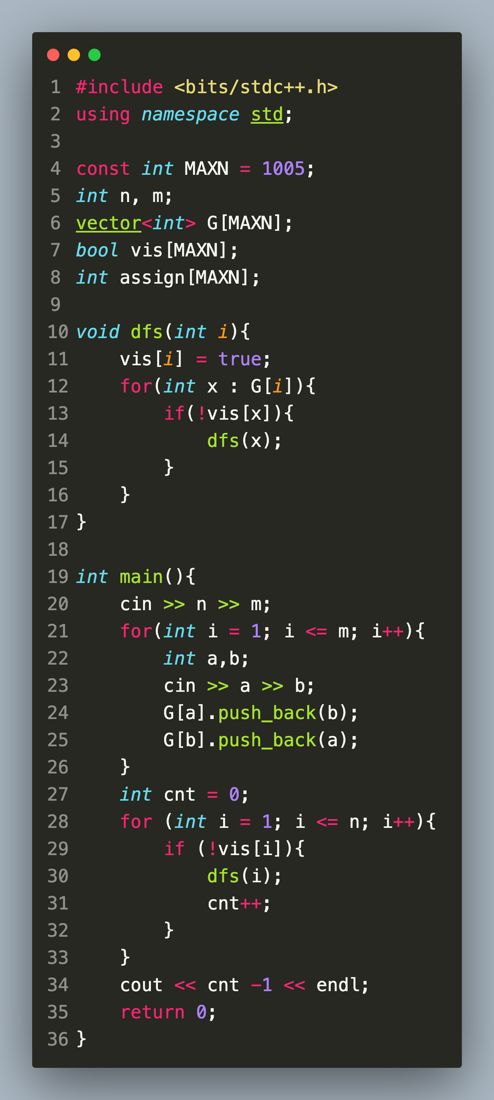
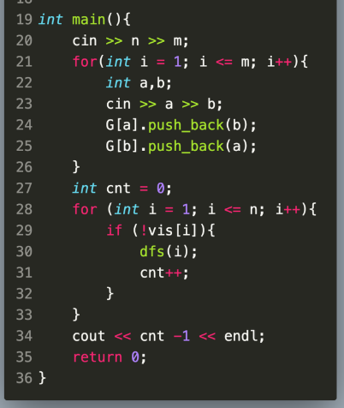
Ex. 1 Solution

Slide 9
Ex. 2 Building Teams
Same setup as Ex.1
Given N cities and M roads:
N M
a1 b1
a2 b2
...
aM bM
where an edge exists between ai and bi
Find a way to color the nodes using 2 colors such that each edge connects different colored nodes
Hint: in the dfs we could ‘remember’ the previous node that the current node came from...
https://cses.fi/problemset/task/1668

Slide 10
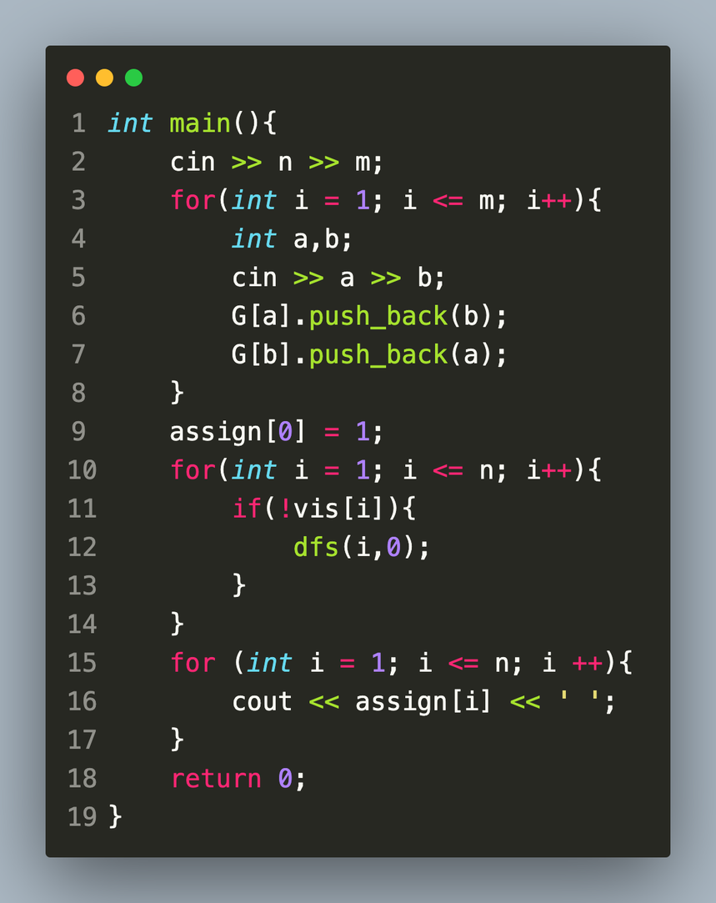
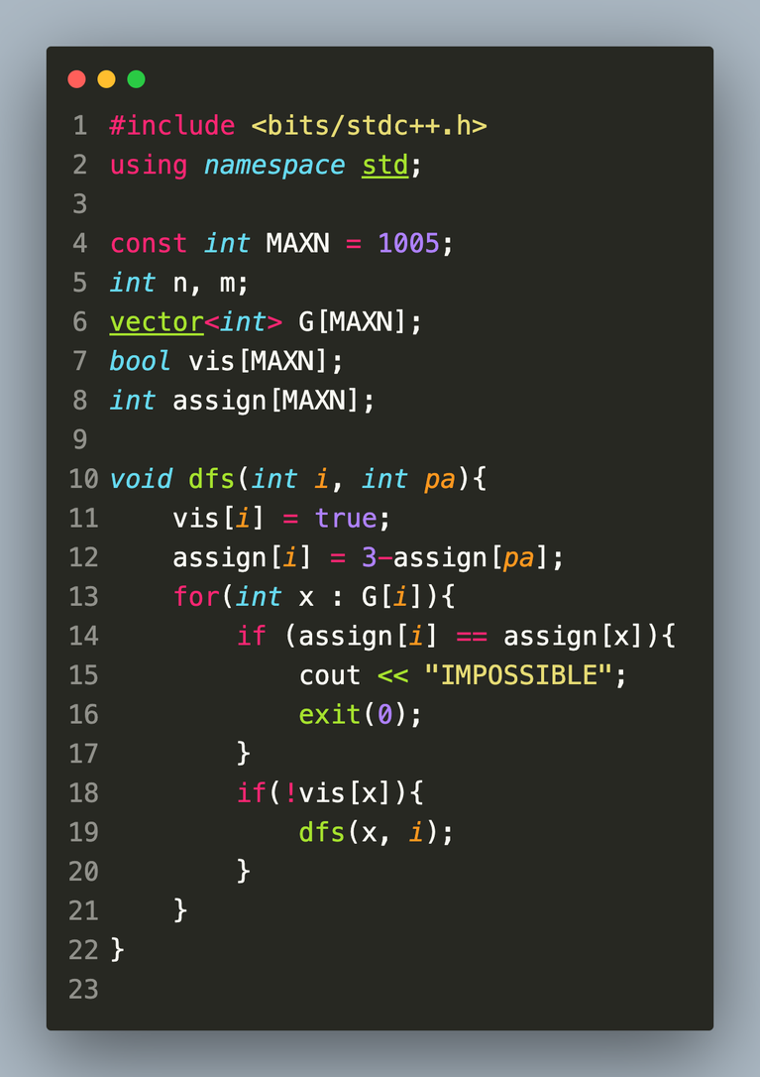
Ex. 2 Solution

Slide 11
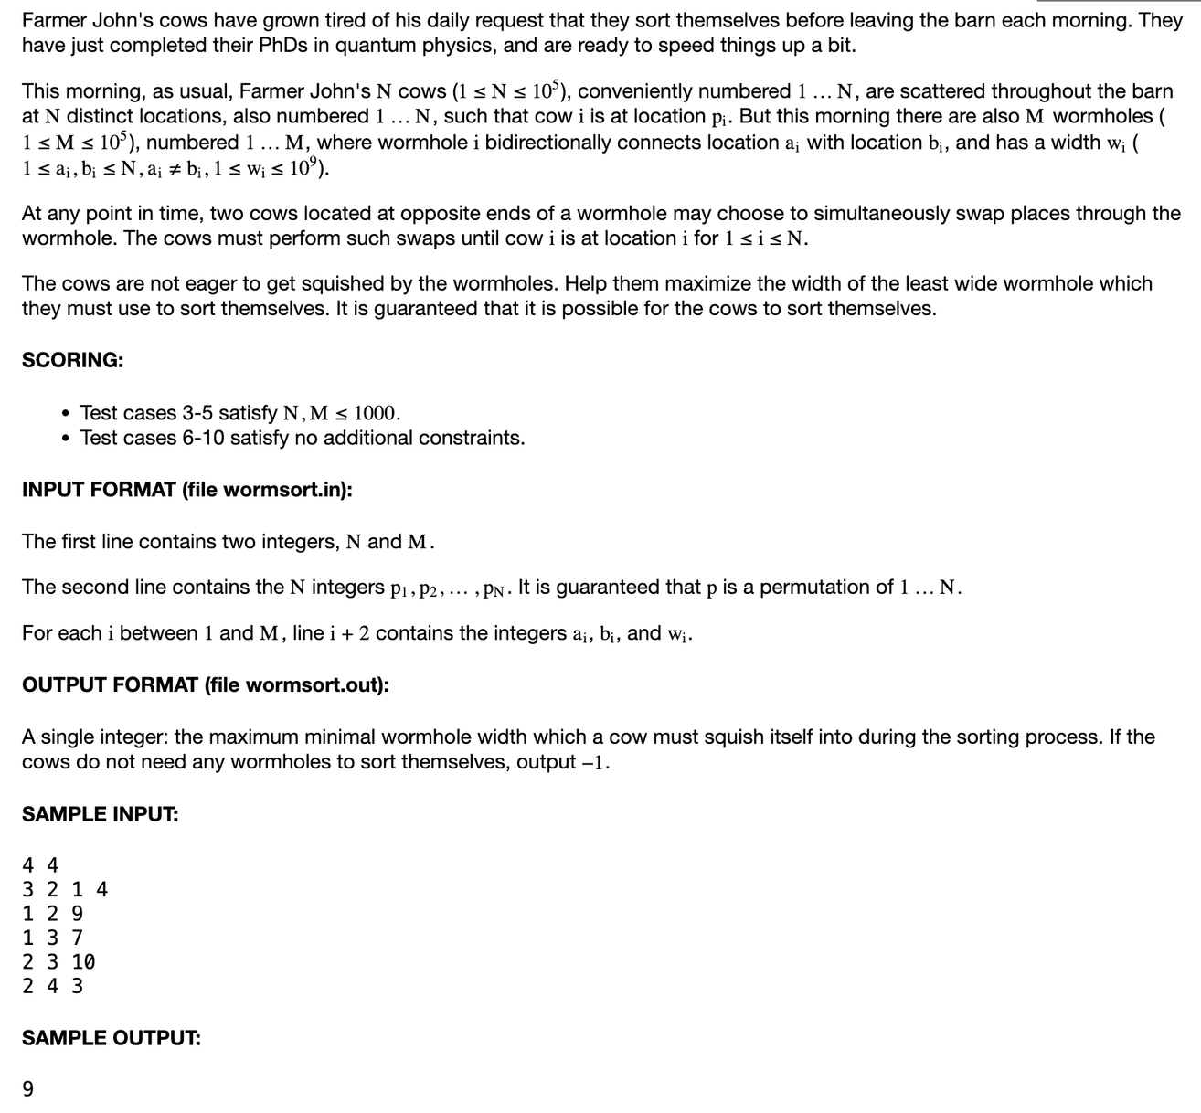
Ex. 3:
USACO 2020 January Contest, Silver
Problem 3. Wormhole Sort

Slide 12
Ex. 3 Solution
We consider the positions to be vertices and the wormholes as edges. Then, each cow needs to get from its initial position to its index position. As long as these two positions are in the same connected component, it is possible. We can keep track of this by coloring with DFS, with complexity (M+N).
To see that this is true, consider a spanning tree of a CC. We can always perform swaps until one of the barns that is a leaf in the tree contains the correct cow. Then remove this leaf from the tree and continue the process.
Perform a binary search on the smallest width to get a O((log 10^9) * (N+M))

Slide 13
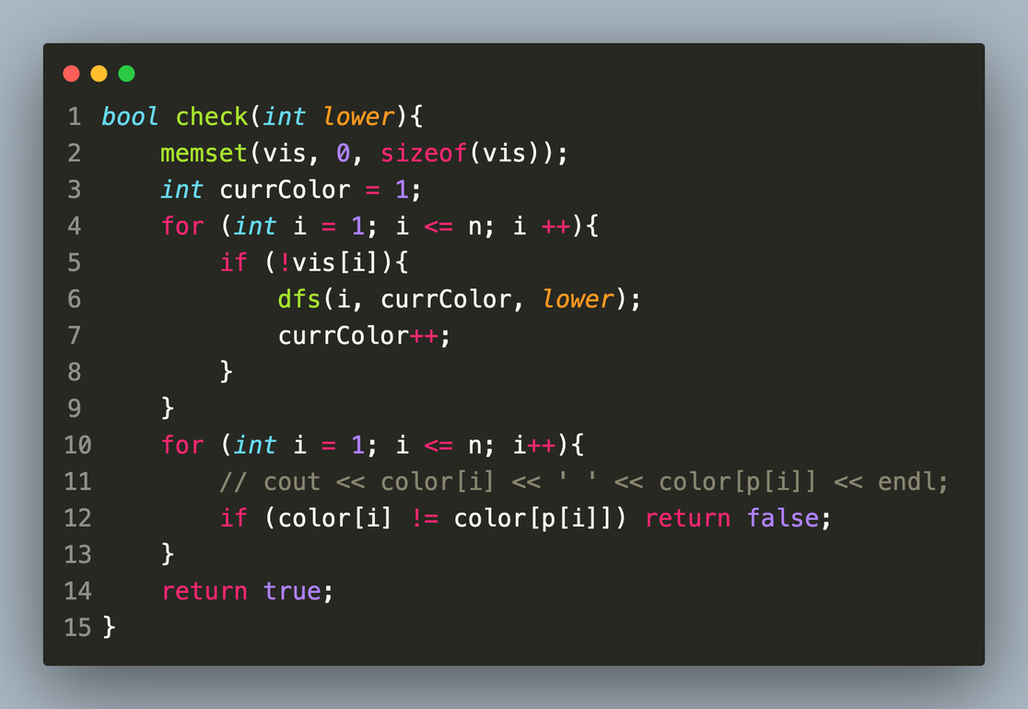
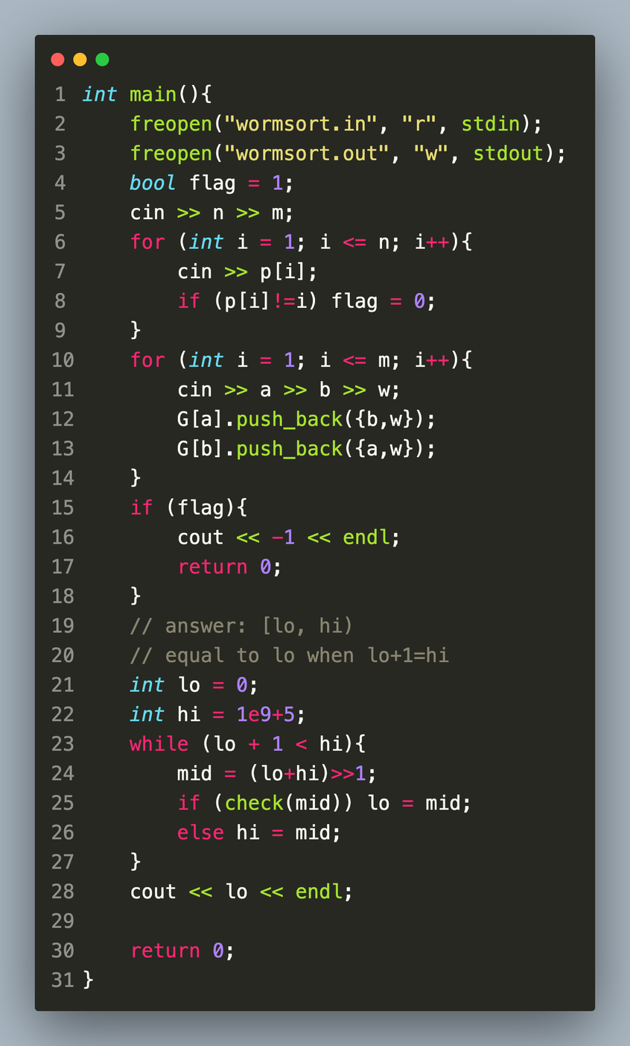
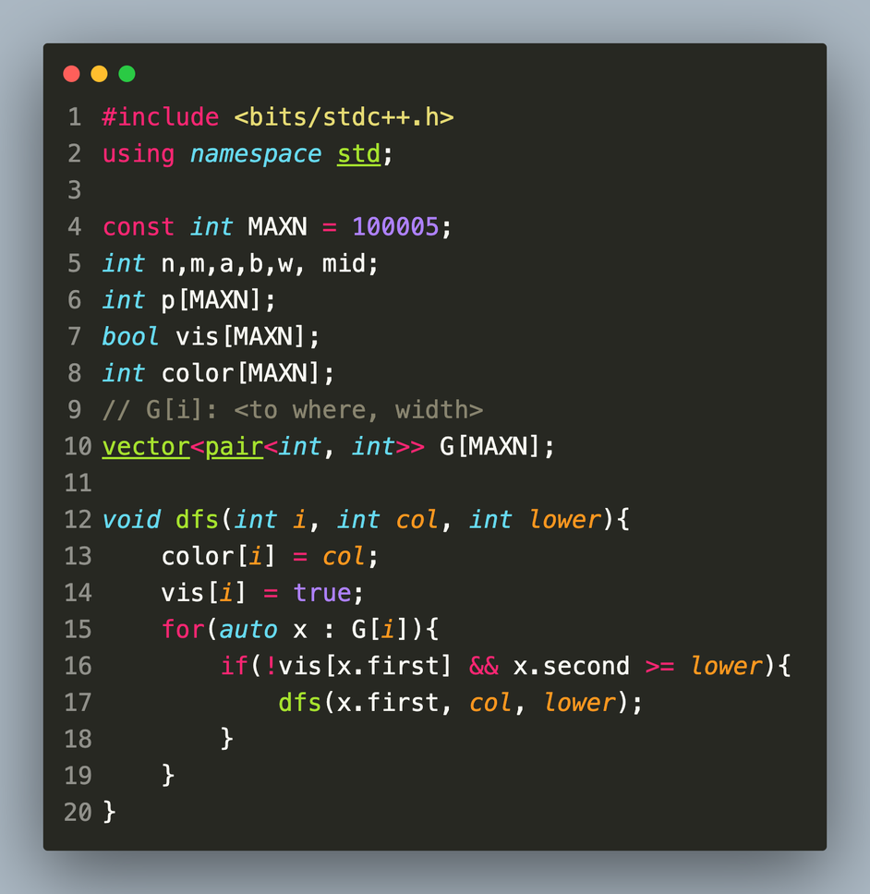

Slide 14
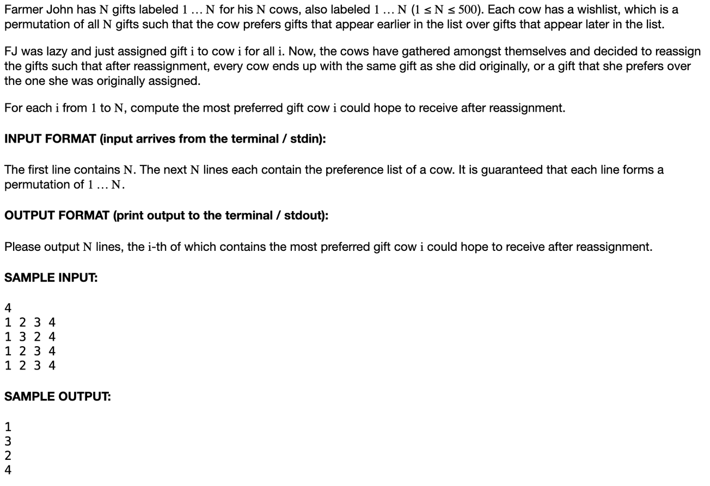
Ex. 4:
USACO 2022 February Contest, Silver Problem 1. Redistributing Gifts

Slide 15
Ex. 4 Solution
Consider a Directed Graph in which there is an edge from i to j if cow i can end up with gift j (that is, gift j is >= gift i in terms of cow i’s preference).
We notice that there exists a valid redistribution that gives gift j to cow i if and only if there exists an edge from i to j and a path from j to i (equivalent to a cycle containing i to j):
if: let the cycle be c1 = i, c2 = j ... cn = i. Then, cow ck can always get gift c(k+1).
only if: any distribution where cow i receives cow j corresponds to a partition of the vertices into some number of simple cycles containing the edge
Precompute which i’s have a path to j with DFS, store in adjacency matrix where reach[i][j] = 1 means there exists a path from i to j. This has complexity O(N^3).
For each i, for each connected node j (some edge from i to j), if reach[j][i] then can get j. O(N^2).
Overall Time Complexity O(N^3)

Slide 16
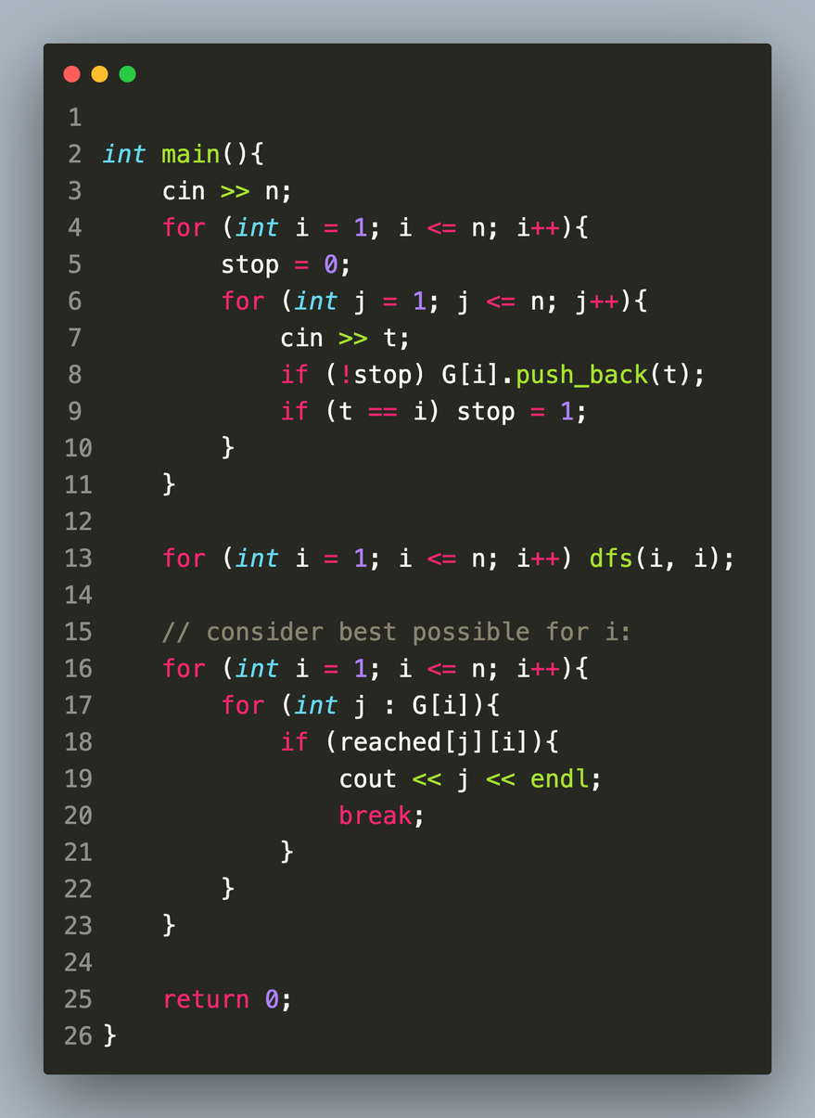
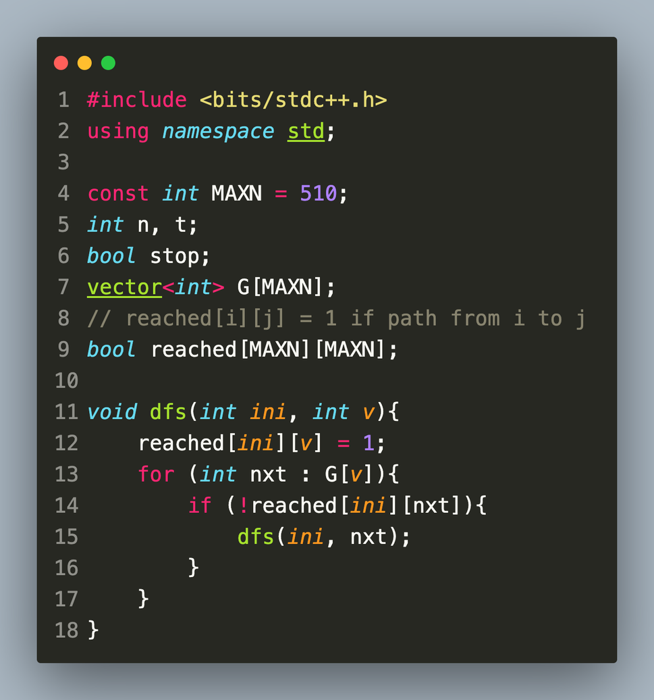

Slide 17
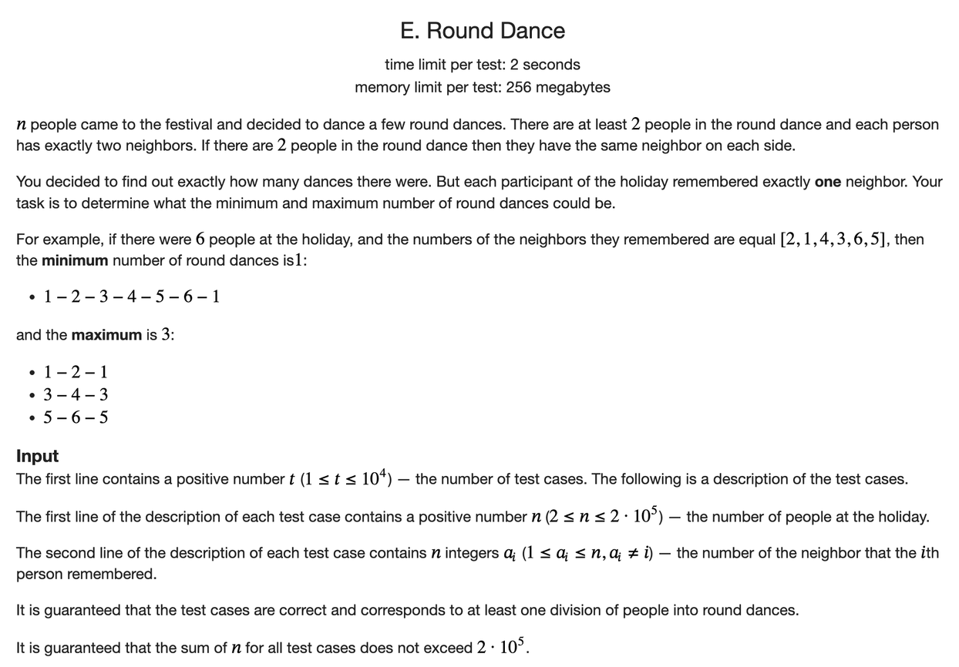
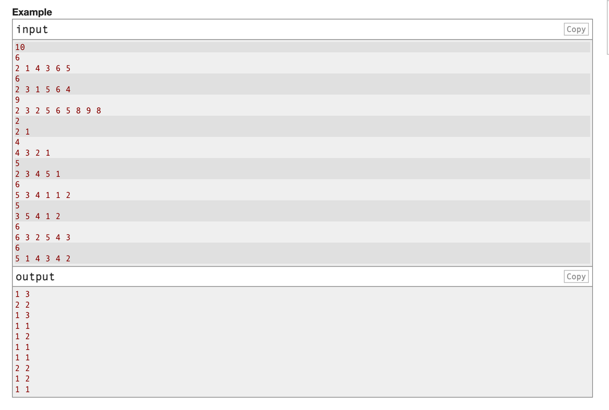
Ex. 5:
CodeForces R874 Div3 Problem E Round Dance

Slide 18
Ex. 5 Solution
Consider the undirected graph that has edges i to a_i
Since the degree of all nodes is at most 2, we have the following two possible connected components:
a cycle: this cannot be modified anymore
a line: the endpoints have degree 1 (this case includes single-node-islands)
Let there be C cycles and L lines. We can identify these using dfs easily.
For the minimum number of round dances, we can choose to combine all lines into a single cycle (the construction is easy to think of): C + min(1, L); for the maximum number of rounds, we can link each line back to itself, giving an answer of C + L.

Slide 20
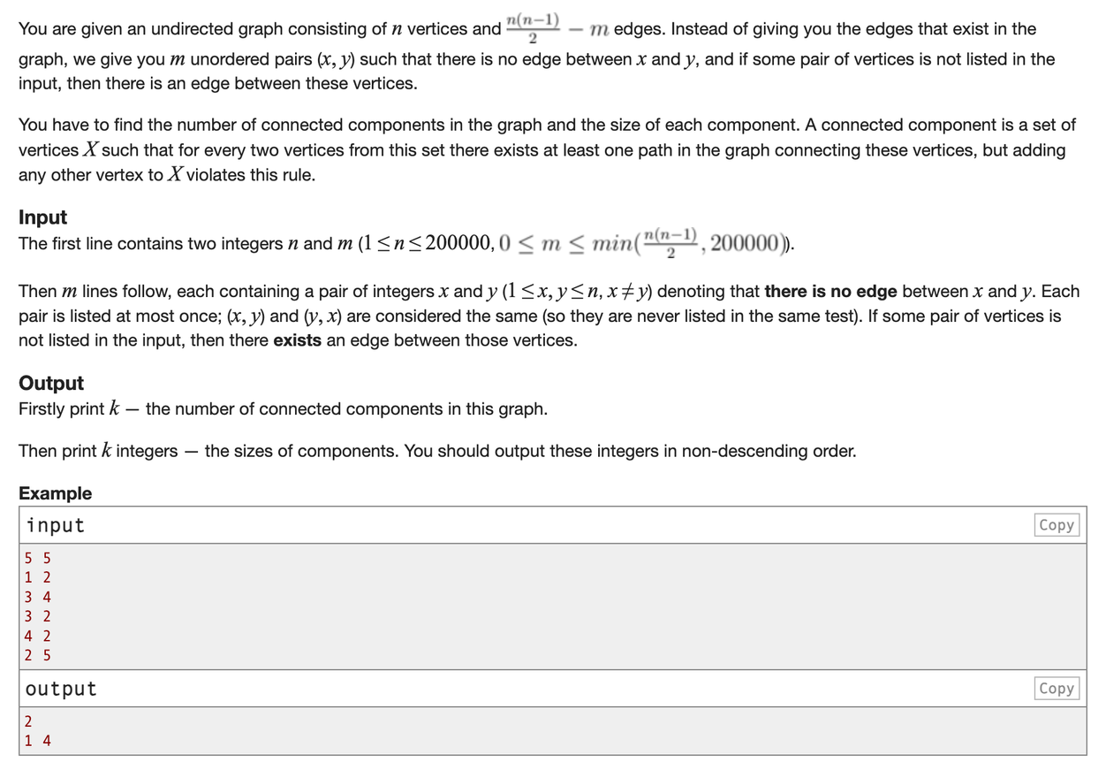
Ex. 6:
Educational Codeforces Round 37 (Rated for Div. 2)
Problem E: Connected Components?

Slide 21
Ex. 6 Solution
The graphs given are super super dense. We could simply store which nodes a node is not connected to. Notice that a classic dfs solution gives O(V+E), approximately N^2.
Firstly, we can use hashsets (unordered_set) to store these no-connections, so that each query takes O(1). Then, we maintain a set of unvisited nodes, removing any node whenever traversed in the dfs; then, for that node, we consider its neighbors by going up the set of unvisited nodes: if there is a connection, dfs down that neighbor and then jump to upper_bound(neighbor).
Consider time complexity on next page.

Slide 22
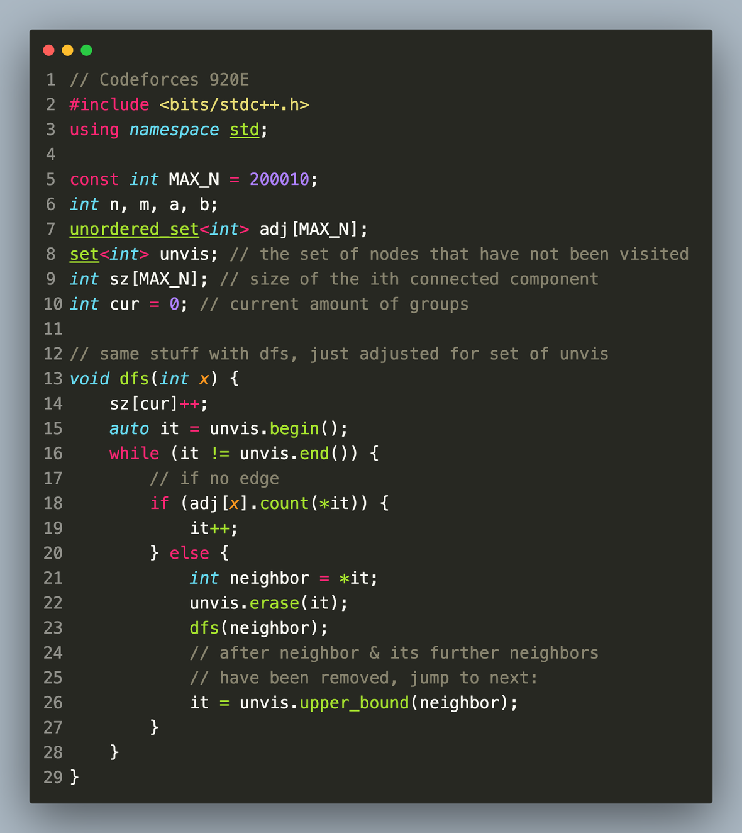
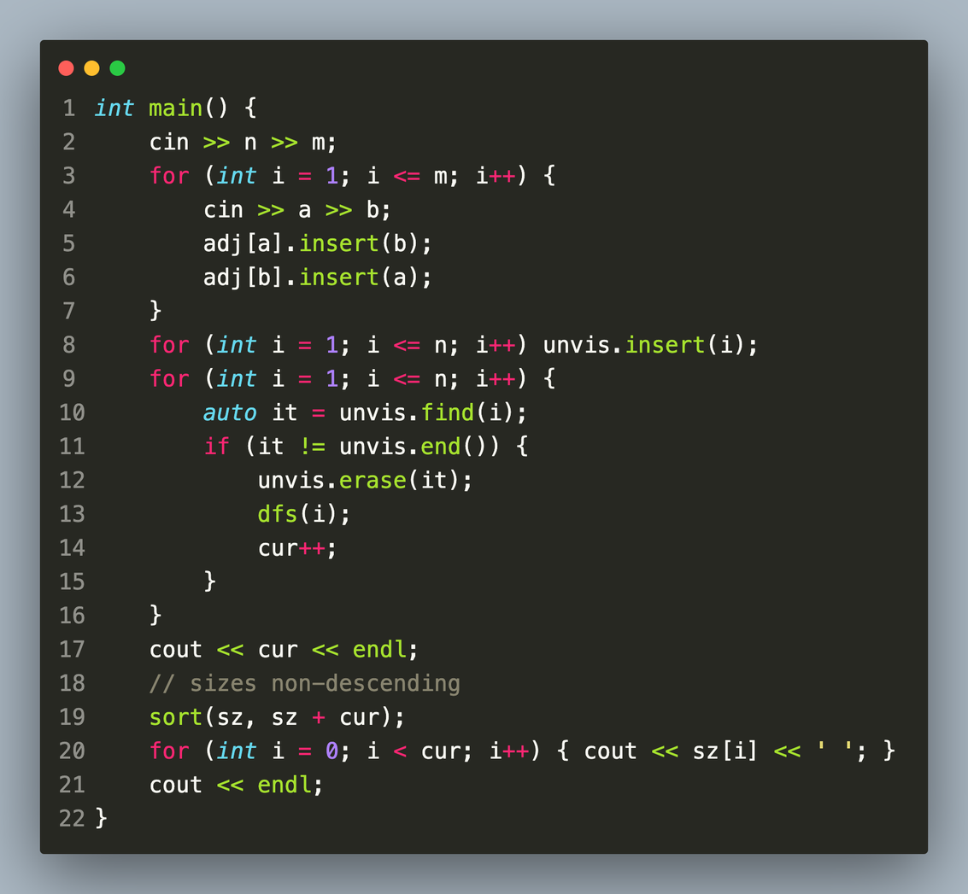

Slide 23
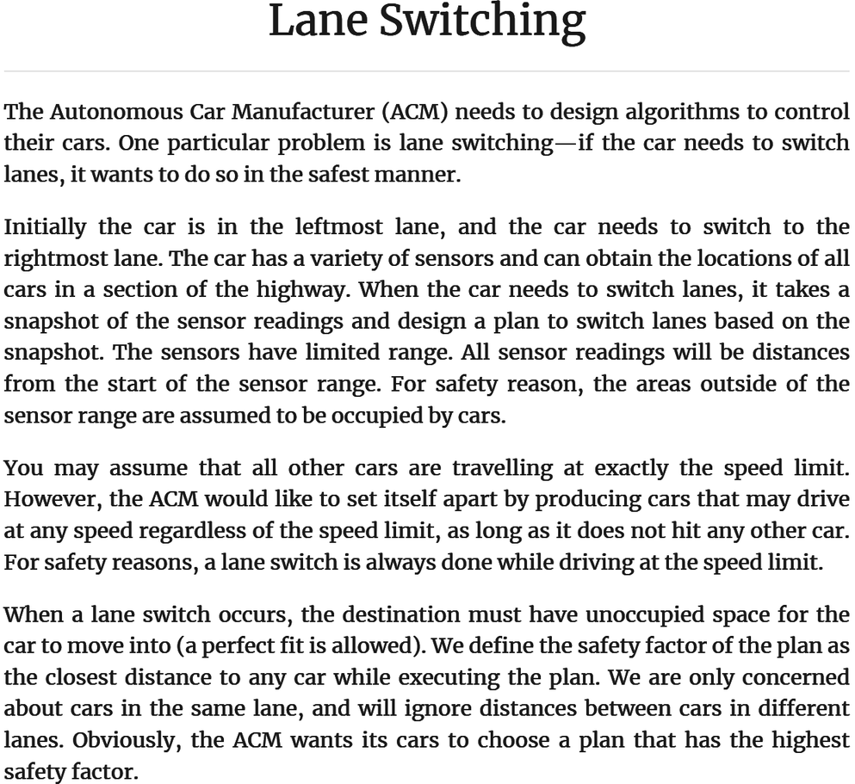

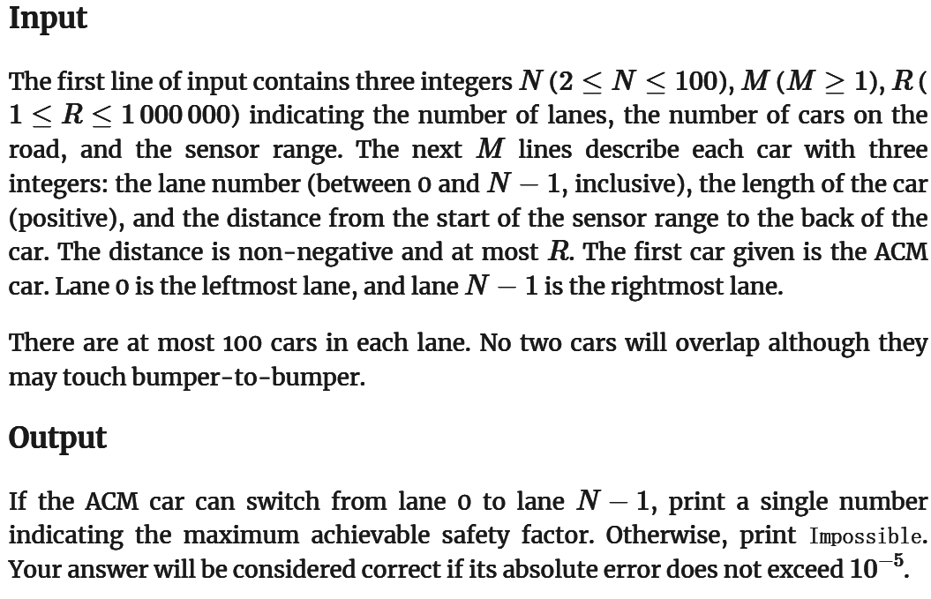
Ex. 7: Lane Switching
2017 Africa and Arab Collegiate Programming Championship
Here we need to find out how to receive the maximum safety factor for our cars

Slide 24
Ex 7. Solution
What we wish to do here is to see that we do binary search
We could first simply build a graph to store everything:
Vertexes: Unoccupied space on the road (so places where the sensors can’t sense don’t have vertices)
Edges exists between vertices if the car is able to pass
We then do a binary search through if the number is ok for the maximum safety factor
Use DFS go through the entire graph to check if a path exists from the ACM car's initial gap to any gap in the rightmost lane

Slide 25
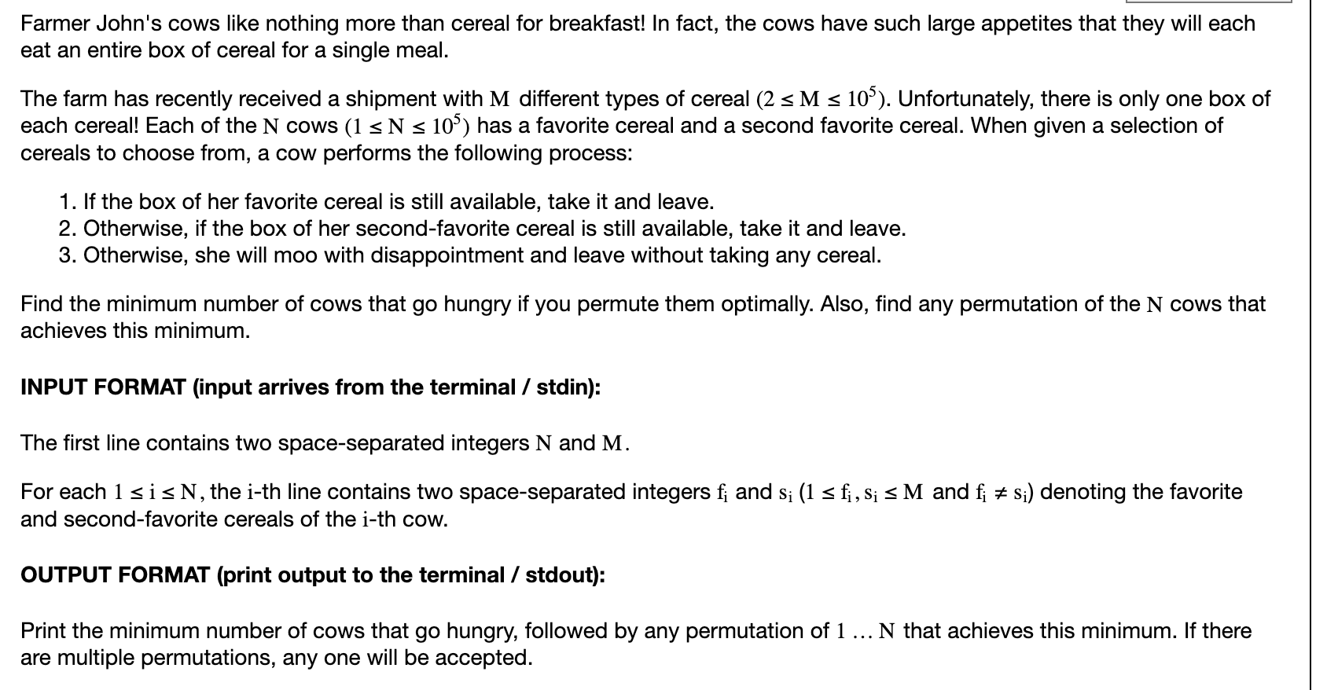
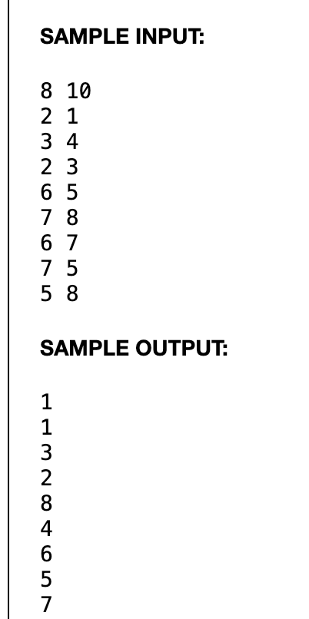
Ex. 8 2022 Jan Silver 3: Cereal 2

Slide 26
Ex 8. Solution
The cereals are nodes, cows are directed edges pointing from first to second. From the test case, we see that each connected component is independent. For a CC with V,E:
If E = V-1: a tree, arbitrarily choose a root, then select from top to bottom.
If E > V-1, then exactly V cows get satisfied, we select a tree and then an arbitrary edge outside the tree. Let the edge cow go first, then take the taken node as the root...

Slide 27
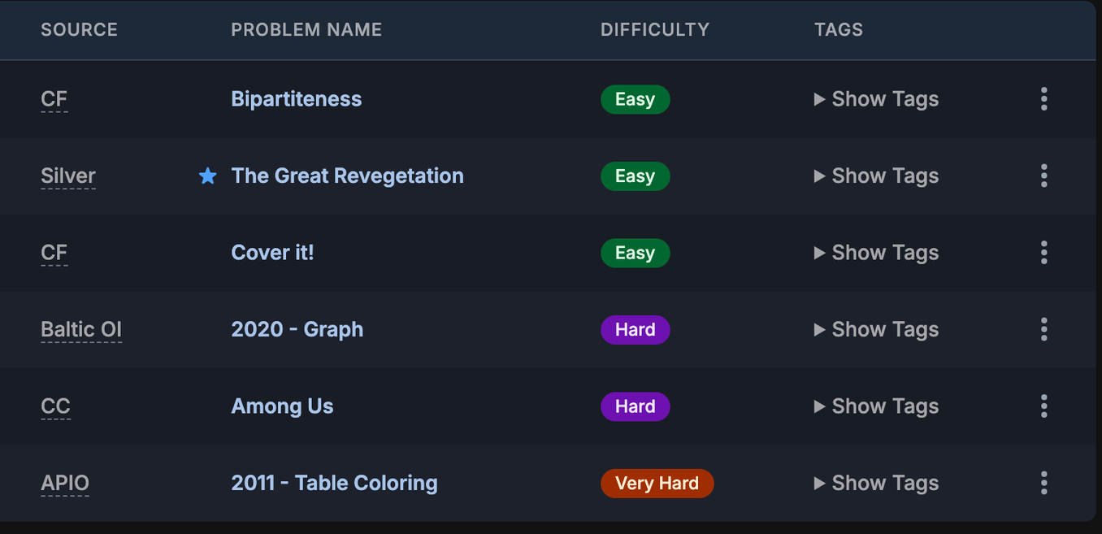
Two-coloring Problems

Slide 28
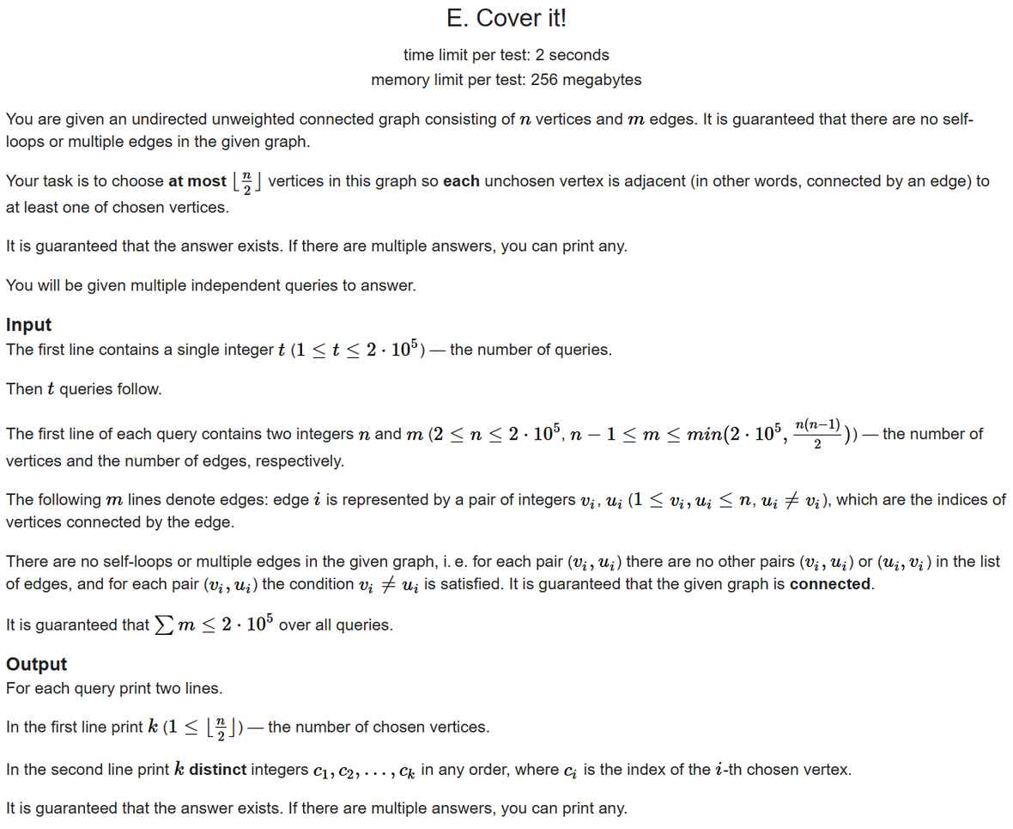
Ex. 9 CF-1176E Cover It!
In this problem you are supposed to choose n/2 points such that all points which aren’t chosen are connected to at least one point that is chosen.
Hint: Construct a graph and DFS

Slide 29
Ex. 9 Solution
DFS the entire graph. For each vertex, we set its value as 1 or 2 (the opposite of its “father” or the last vertex that we reached. Ex. if last vertex was 1 we set it as 2, if last one was 2 we set it as 1).
Then after we finish, we check if each vertex satisfies the problem’s conditions. If so, we sum the number of the two conditions up and return the smaller one (less than a half).

Slide 30
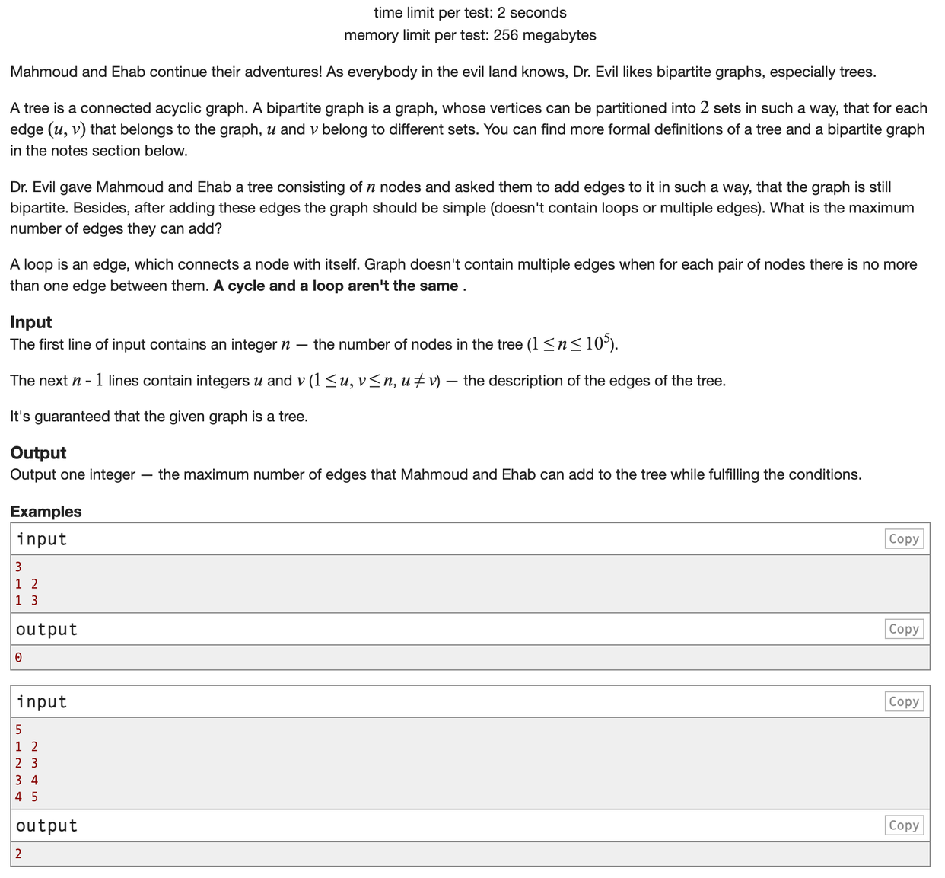
Ex. 10 CF-435B Mahmoud and Ehab and the bipartiteness
This problem asks for the minimum number of edges that can be added to a given tree such that the resulting graph contains no loops (an edge connecting a node to itself) nor any multiple edges (>1 edge between two nodes), and remains bipartite.
Hint: two-coloring of the graph

Slide 31
Ex. 10 Solution
First, DFS the entire tree and do a two-coloring on it. Then, for each pair of nodes, we check whether:
They are connected
They are of the same color.
If both are false, then we add an edge between the nodes.
Time complexity: O(n2)

Slide 32
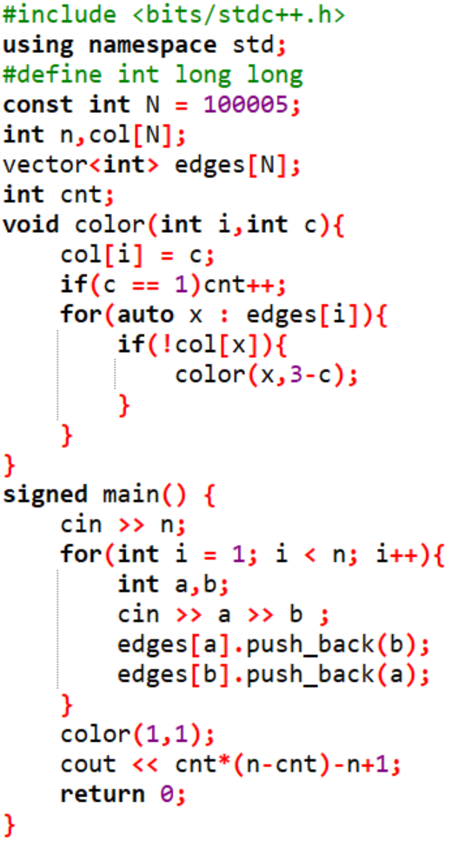
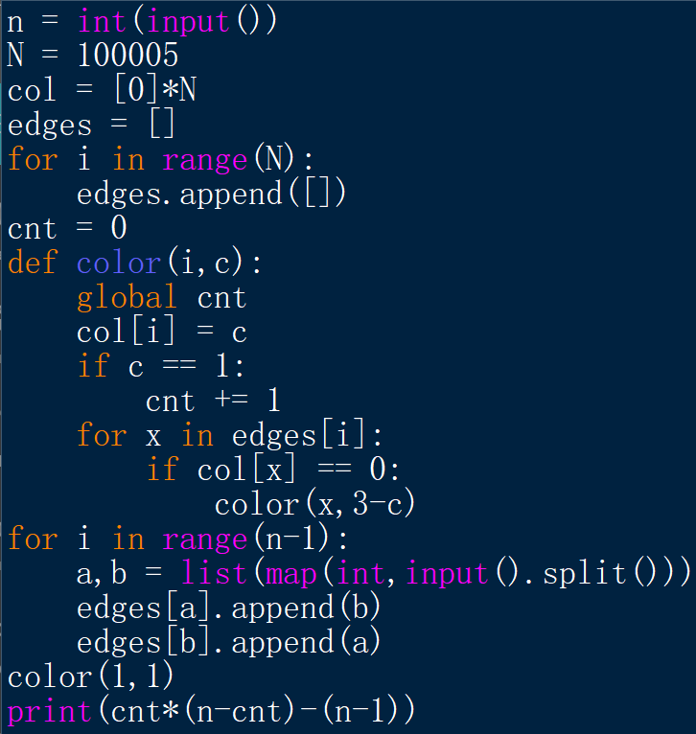
Ex. 10 Solution Code

Slide 33
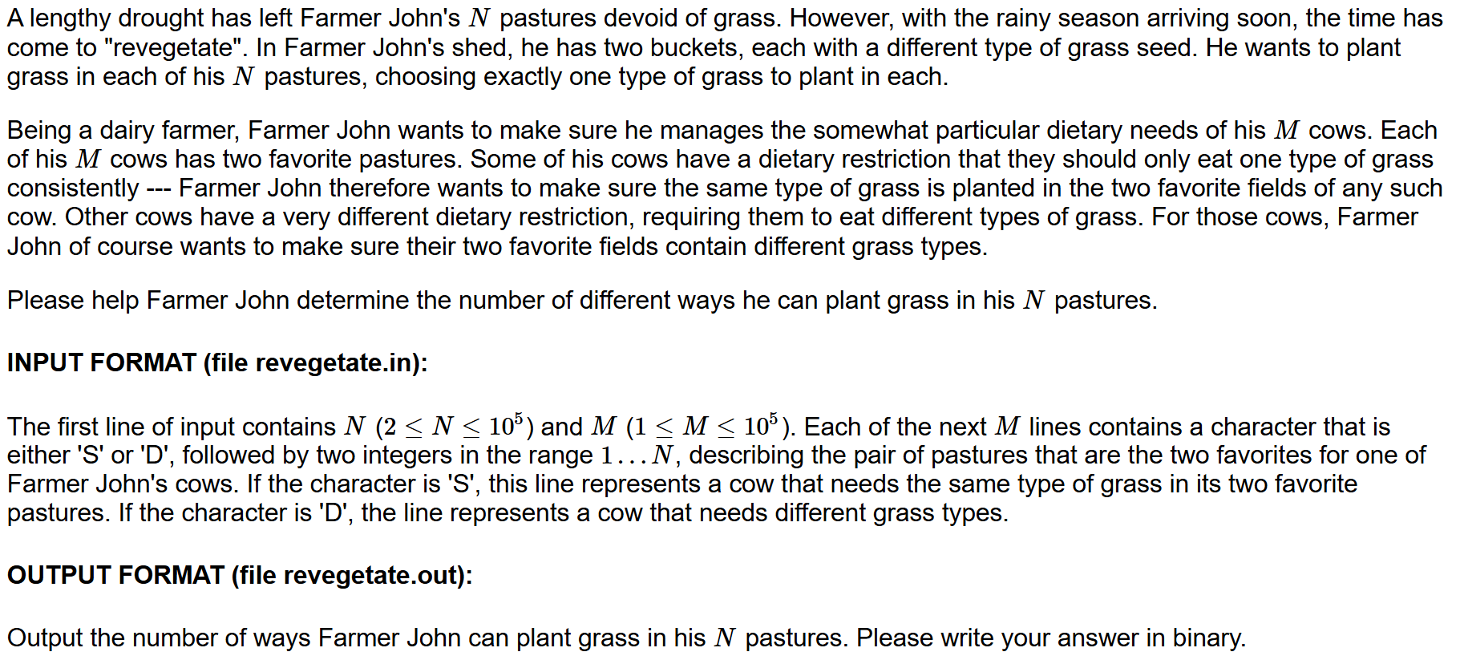
Ex. 11 The Great Revegetation

Slide 34
Ex. 11 Solution
We see that we can create a graph with the pastures as the vertices and the cows (S or D) as the edges. Each cow represents a link/connection between the pastures. We set one type of grass in a pasture as condition 0 (value 0 for the pasture) and the other type as condition 1 (value 1 for the pasture)
Each two pastures connected by a S has to have similar conditions (same type of grass), and vice versa for pastures connected by a D.
We then find the connected components (连通块）in the graph, and then check if everything is good with them (ex. a pasture can’t be required by two connections to have 0 and 1 at the same time).
If everything is good, we can find the total number of connected components (set as num) and print out 1 followed by num 0s (ex. num=3 then print out 1000). This is since the question give the total number in binary format and the total number of possible solutions is 2^num.

Slide 35
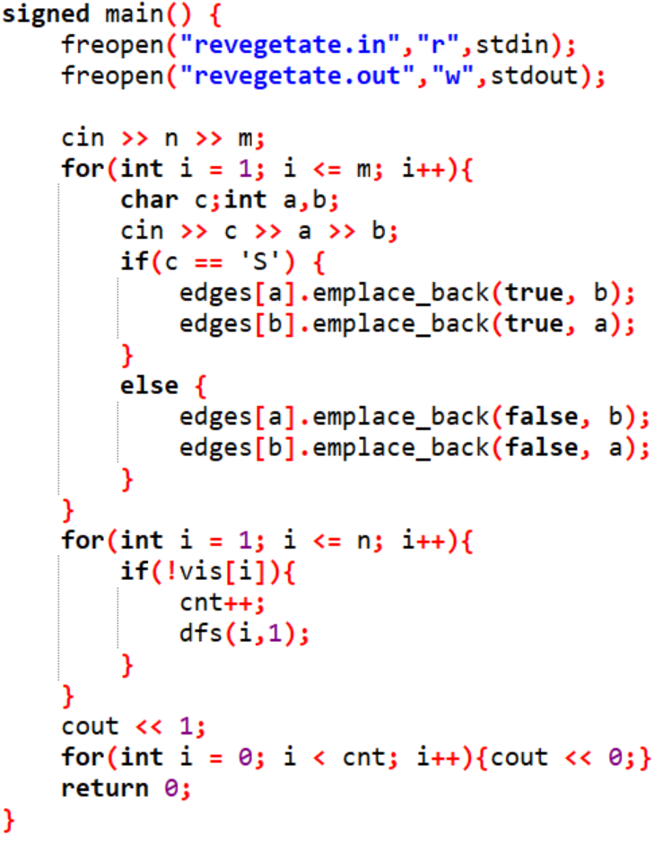
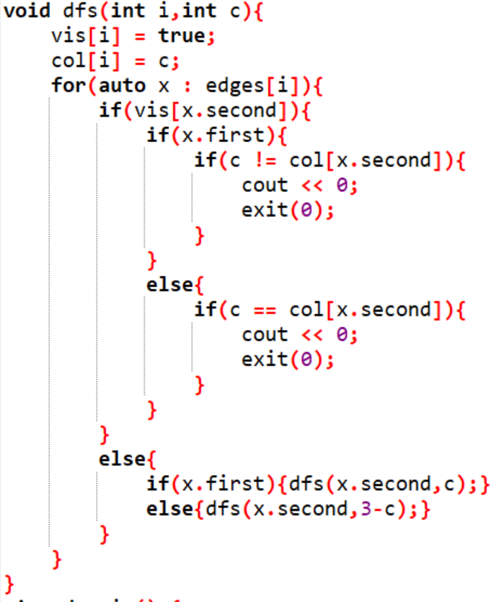
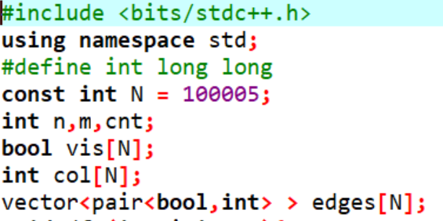
Ex. 11 Solution Code

Slide 36
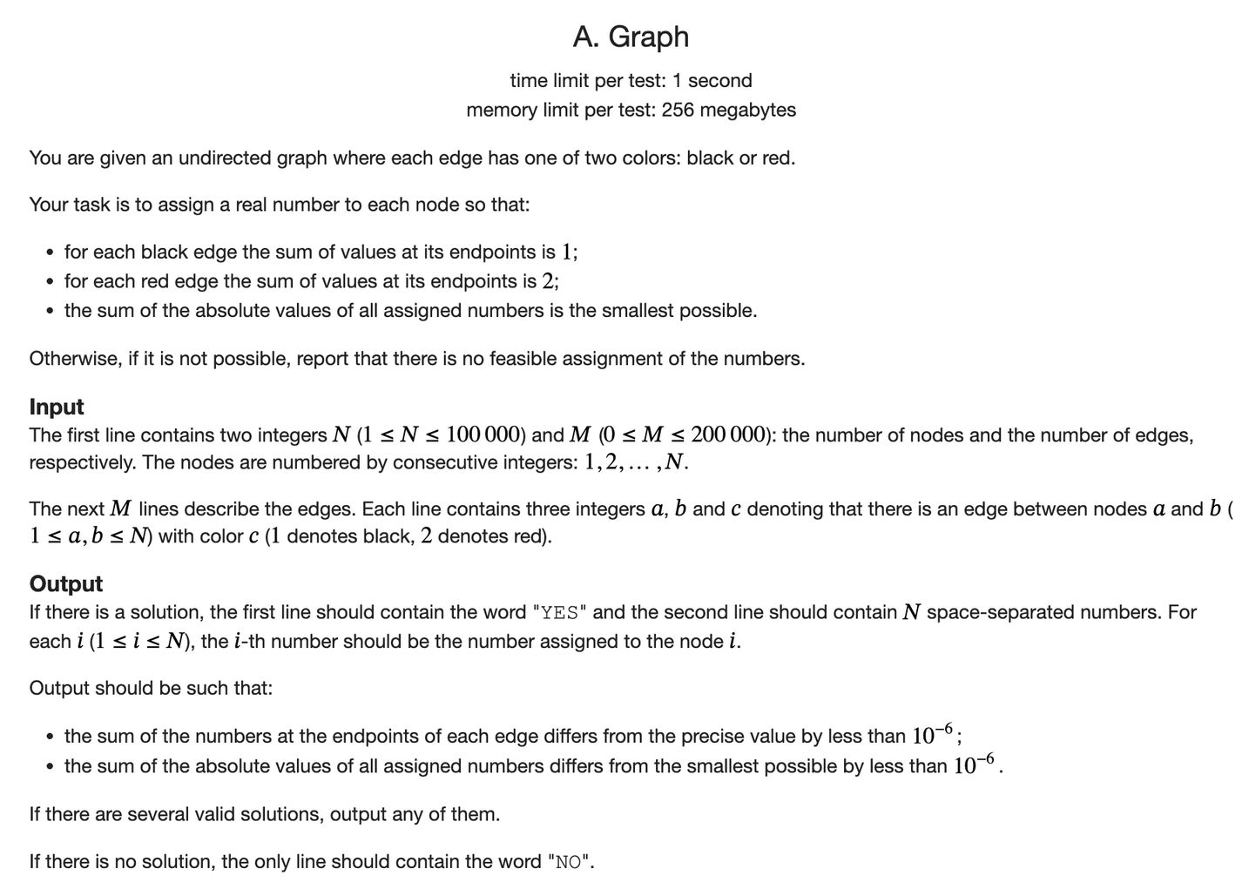
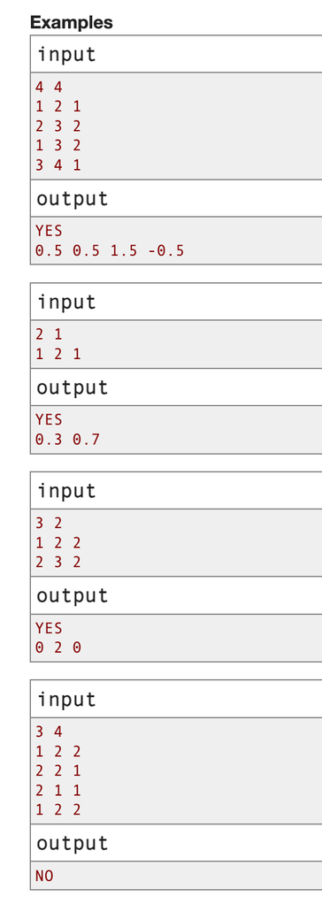
Ex. 12:
Baltic Olympiad in Informatics 2020, D2
Problem A: Graph.

Slide 37
Ex. 12 Solution
Each connected component is independent. We can represent all nodes’ values as c[i] x + d[i] for some c[i], d[i] for that node and x for its connected component. Then, we can easily transition between nodes:
If black edge: c[neighbor] = -c[i], d[neighbor] = 1-d[i]
If red edge: c[neighbor] = -c[i], d[neighbor] = 2-d[i]
Whenever we first enter a CC at a node, c[i] = 1, d[i] = 0
If the neighbor has been visited before, casework:
1) if c[i] and c[neighbor] are opposite, either N.S. or ignore
2) if c[i] and c[neighbor] are same, then x can be determined (if it has been determined at a disagreeing value, N.S.)
If x is not determined at the end of dfs, use a ternary search...

Slide 38
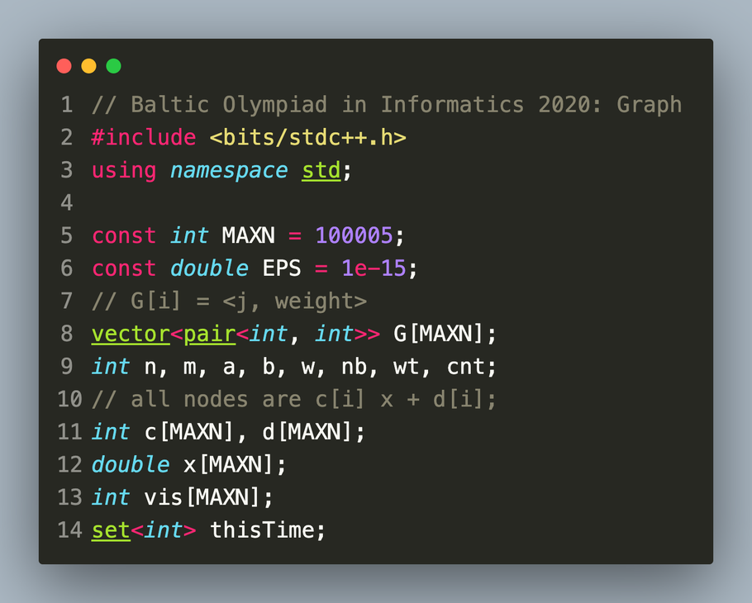
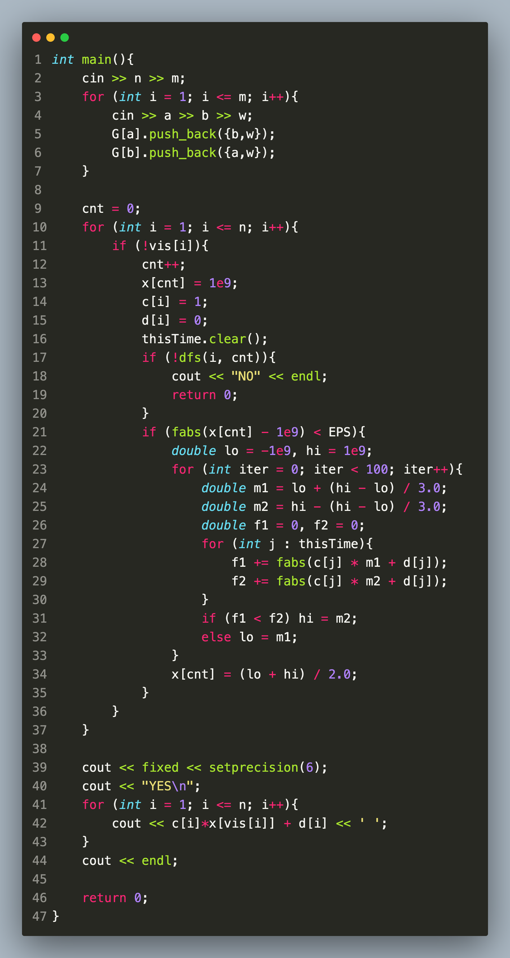
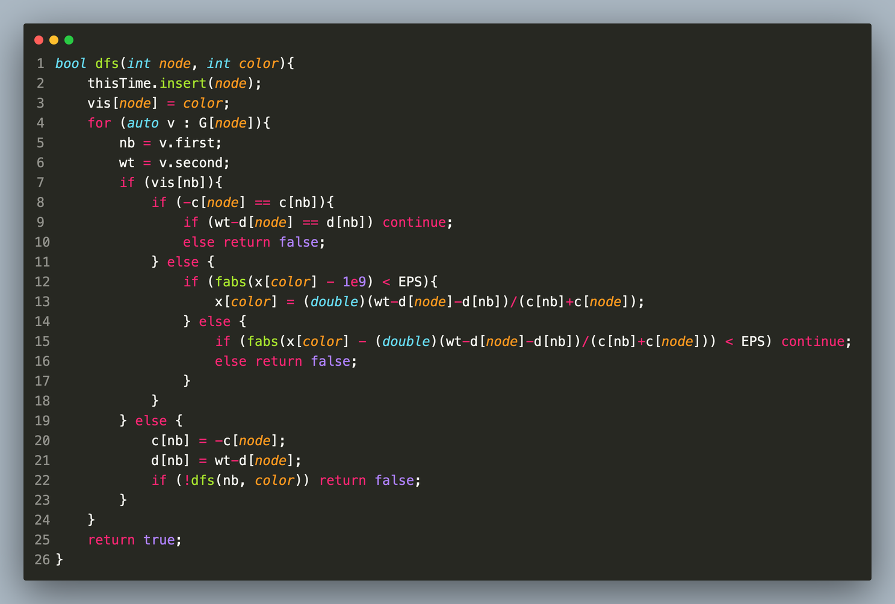

Slide 39
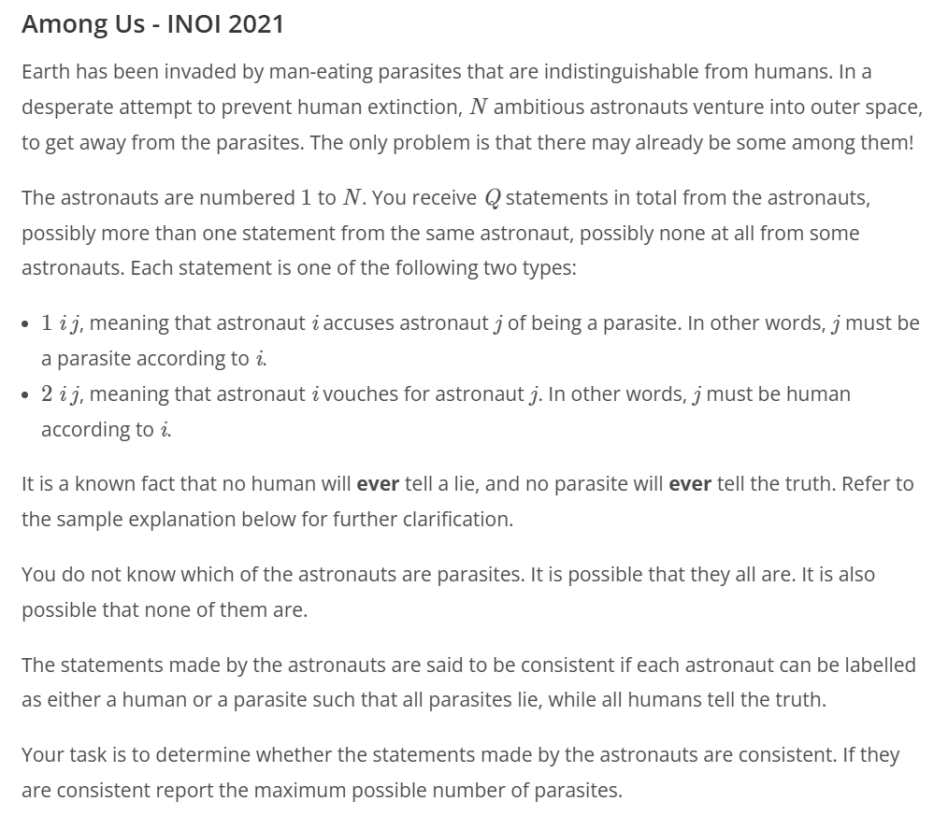
Ex. 13 INOI (India) 2021 - Among Us

Slide 40

INOI (India) 2021 - Among Us

Slide 41
INOI/ZCO (India) 2021 - Among Us
In this problem, we have impostas.
What you need to do is to find all the impostas out.
Crewmates and impostas would accuse/vouch for other astronauts.
Crewmates always tell the truth, and the impostas always tell lies.
All astronauts know if another astronaut is a parasite or not.

Slide 42
Solution
Disjoint set union (最喜欢并查集了) Sadly it isn’t today’s 主角
We do a DFS! (BFS is also fine I think)
We see that we can create a graph with the astronauts as vertices. Connect each astronaut with an edge: Type 1 connects vertices that are of opposite sides, Type 2 connects vertices that are of same sides. (Look at table for explanation)
We then can give the edges a weight and then we can assign a specific node a value (ex. 0 for crewmate). Then go on through the entire graph and see if there are contradictions (print -1 in this case)
We then count the number of parasites & humans
Print out the bigger ones (since parasites and humans
can be swapped)
 | Crewmate | Imposta
Crewmate | Vouch | Accuse
Imposta | Accuse | Vouch

Slide 43
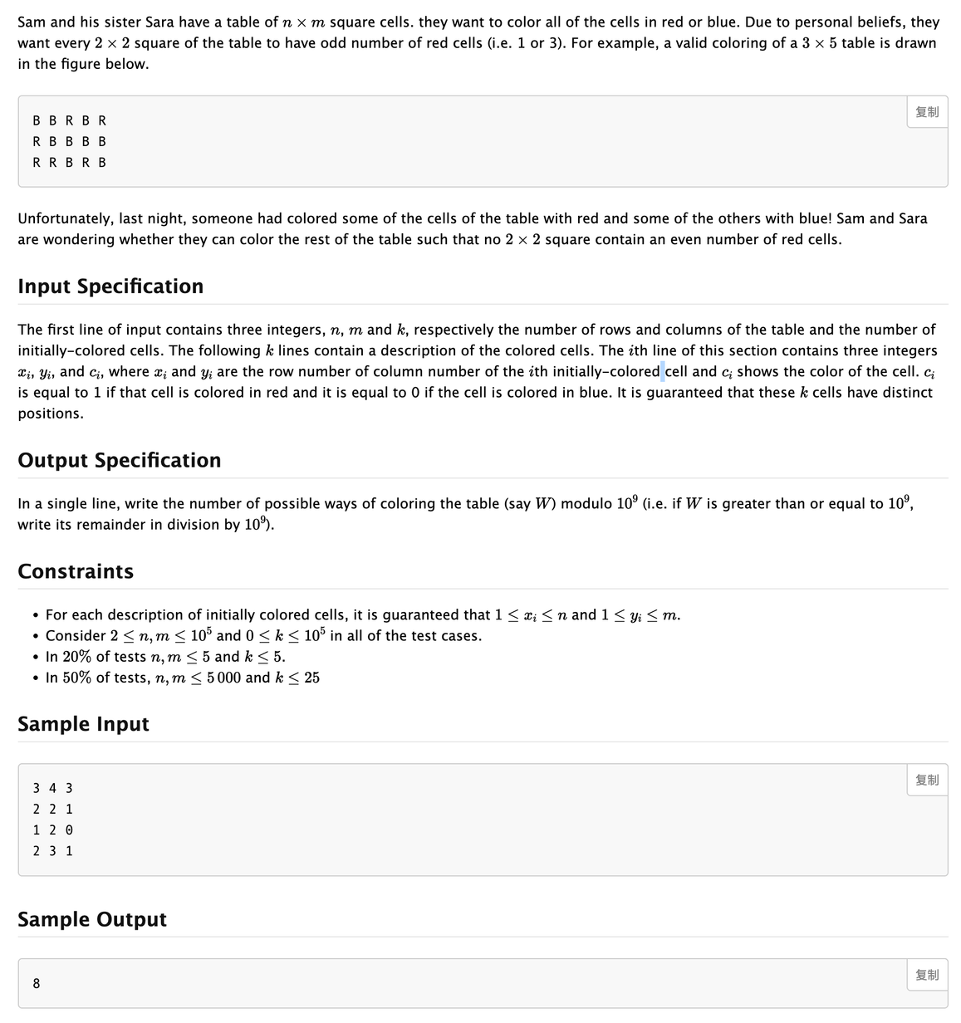
APIO '11 P1 - Table Coloring
In this problem, we want to know the number of ways to color an n*m table s.t. each cell is either blue or red and each 2x2 grid contains an odd number of blue cells.
Hint: math

Slide 44
Solution
Step 1: Observation as any normal human being does(
Let’s create an imaginary 0th row and column
Let f(x,y) = whether cell (x,y) is blue or not
We see that f(x,y) = !(f(x-1,y-1)^f(x-1,y)^f(x,y-1))
Then, by analysis, we have f(x,y) = (f(0,0)^f(0,y)^f(x,0)^((x*y)%2))
WLOG set f(0,0) to 0
⟶ all cells with x or y = 0 are independent except when f(x,y) is determined (in which case f(0,y) and f(x,0) are dependent)

Slide 45
Solution
Step 2: Create a graph
All (x,0),(0,y) are nodes
Each colored cell (x,y) is an edge connecting (x,0) and (0,y)
Now there exists K connected components, so answer is 2K-1 or 0.
Now, we split each node into two, and connect nodes with consistent colors
If any two nodes of the same origin are in the same connected component, answer is 0; otherwise, it is 2K-1.

Slide 46
Да здравствует заливка! Ура! Ура!

Slide 47
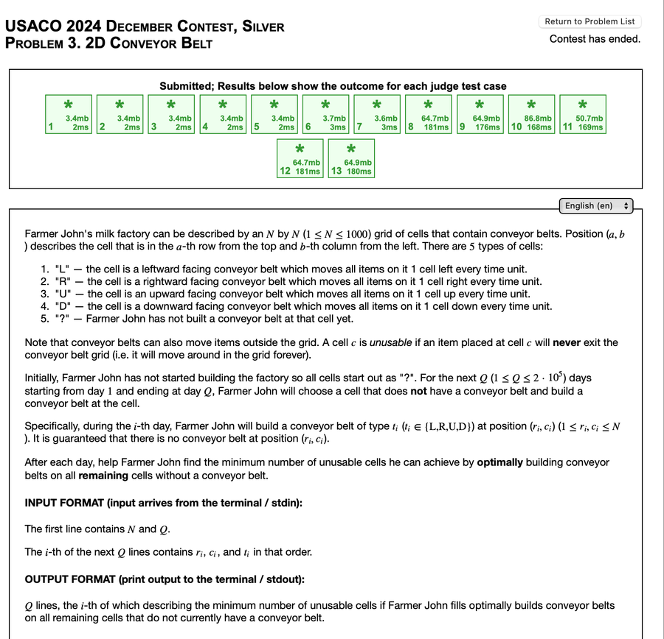
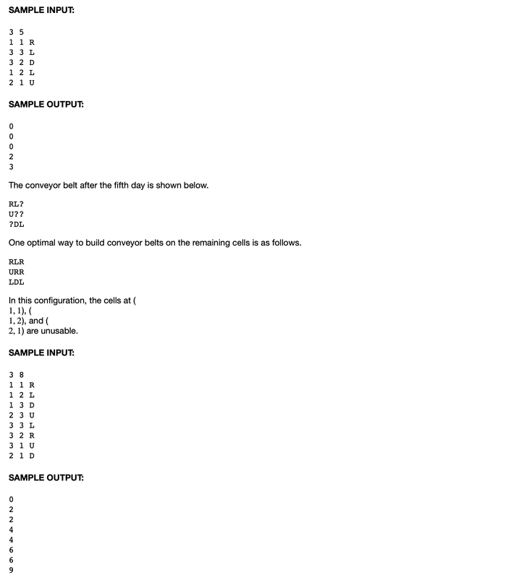
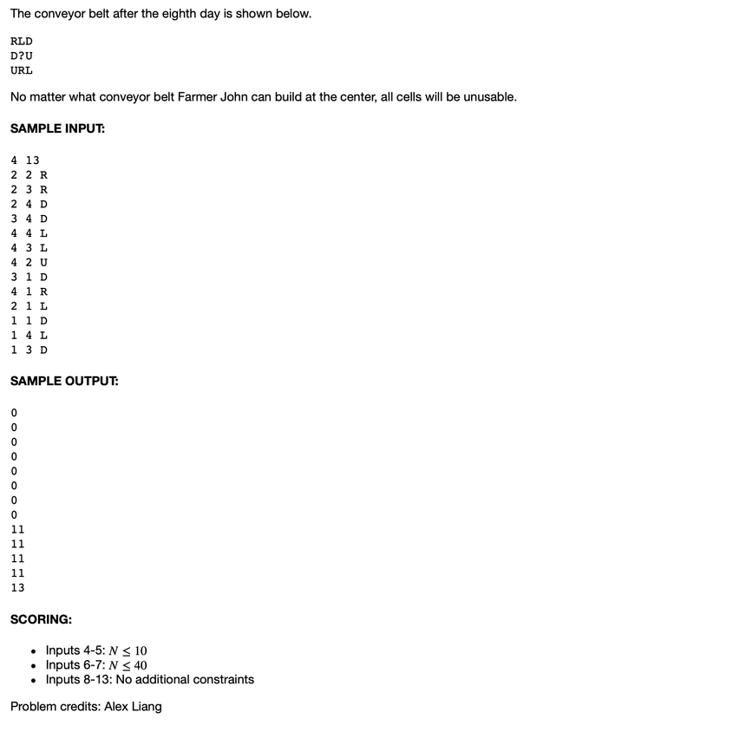
USACO Silver 2024 Dec. 2D Conveyer Belt
Farmer John invests in industry and starts building conveyer belts; for each time period find the min number of unusable cells (cells whose objects cannot escape the 2D conveyer belt grid

Slide 48
Solution
 | D |  | D | L
 | L | R | R | D
 | D |  |  | D
 | R | U | L | L
First fast-forward to after FJ has built all of his conveyer belts, and then do a flooding of the perimeter (every cell that can reach the outside of the border); we remember to include a “padding” denoting the outside of the grid

Slide 49
 | D |  | D | L
 | L | R | R | D
 | D |  |  | D
 | R | U | L | L
 | D |  |  | L
 | L | R | R | D
 | D |  |  | D
 | R | U | L | L
 | D
 | L | R | R | D
 | D |  |  | D
 | R | U | L | L
 | L | R | R | D
 | D |  |  | D
 | R | U | L | L
 |  | R | R | D
 | D |  |  | D
 | R | U | L | L
 |  | R | R | D
 | D |  |  | D
 |  | U | L | L

Slide 50
