Slide 1

Brute Force Basic Simulation
By 10-1 Hans Zhu, 10-8 Jingzhe Ai, 9-4 Andrew Wang

Slide 2
USACO Intro
USACO is one of the biggest CS competitions in the world
It is hosted in the US and faced towards everyone
Split into 4 separate tests (taking place from Dec. to Mar.), each lasting for 4 or 5 hours
Split into 4 tiers (Bronze, Silver, Gold, Platinum)
Each time you succeed in a test (Got full marks or got higher than the move-up score) you can move up a tier
If you are good enough such that you got full marks, you can move-up and re-test in your current tier

Slide 3
Introduction to Brute Force Basic Simulation
In many problems, we can simply simulate what we’re told to do by the problem statement.
The intent of the problem would then be to assess competence with one’s programming language of choice and knowledge of built-in data structures.
For USACO Bronze, when a problem statement says to find the end result of some process, or to find when something occurs, it’s usually a good way (saves your time for later problems) to simulate the process.

Slide 4

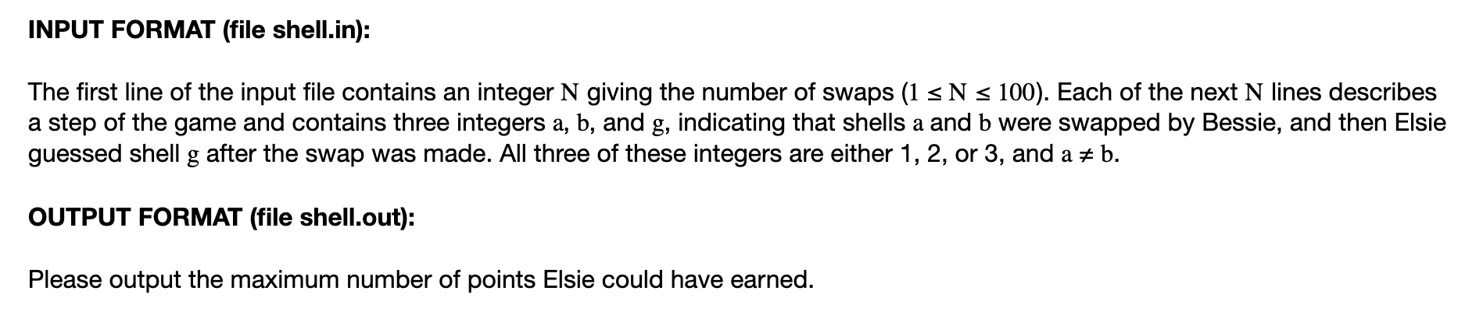
Example 1
Bessie has 3 cards, labeled 1, 2, 3, which are initially on positions 1, 2, 3. Guessing a correct card (only one is correct) earns a point (it can be any one of them). Given N swaps that swap the cards’ locations and Elsie’s guess of position after each swap, find the maximum number of points Elsie could have earned

Slide 5
Example 1 Solution Idea
It is very much obvious that we can simply brute force simulate this question
For each card, we assume that it is the card which can give out a point
We do a round of simulation for each card, resulting in 3 rounds of simulation
In each simulation, for each swap we make a record of which positions contain which cards, and see if Bessie’s guess is correct or not (if correct add 1 point)
We find the maximum of the points earned for each simulation and that’s our final answer
Time complexity: O(n)

Slide 6
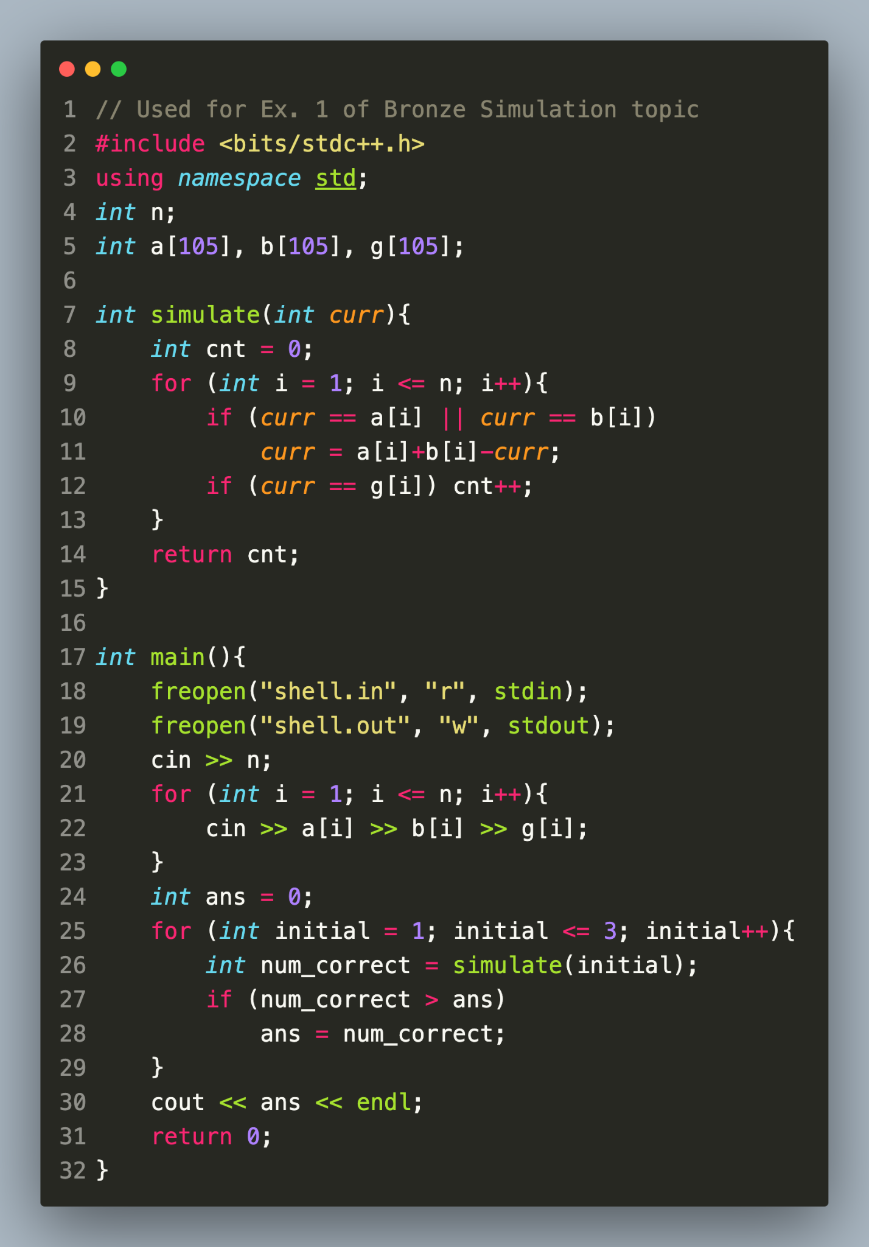
Example 1 Code
Parts of code to note:
105
freopen() - no longer necessary
Using a function: “simulate”

Slide 7

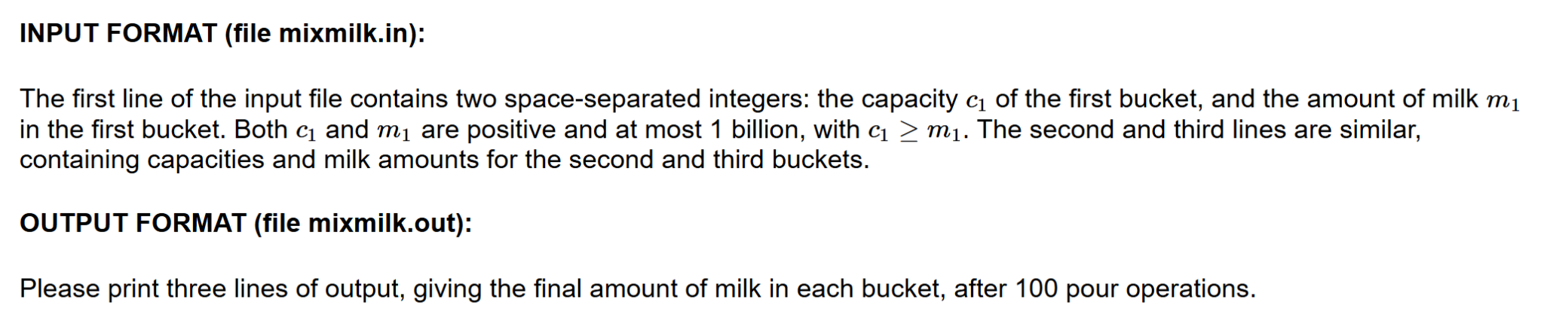
Example 2
Farmer John pours milk from one bucket to another in between three buckets (different sizes & limited space)
Will pour until the receiving bucket is full of milk or the giving bucket is empty of milk

Slide 8
Example 2 Solution Idea
The requirements only asks us to repeat this for a small amount of times
Due to this we can brute force do a basic sim.
This simply creates three variables, each to model a bucket
Use arbitrary precision arithmetic long long in case the final number
is out of integer bounds (Just to be careful)
Time Complexity: O(n)
A
3,6,9…3k…96,99
1,4,7…3k+1…94,97,100
C
B
2,5,8…3k+2…95,98

Slide 9
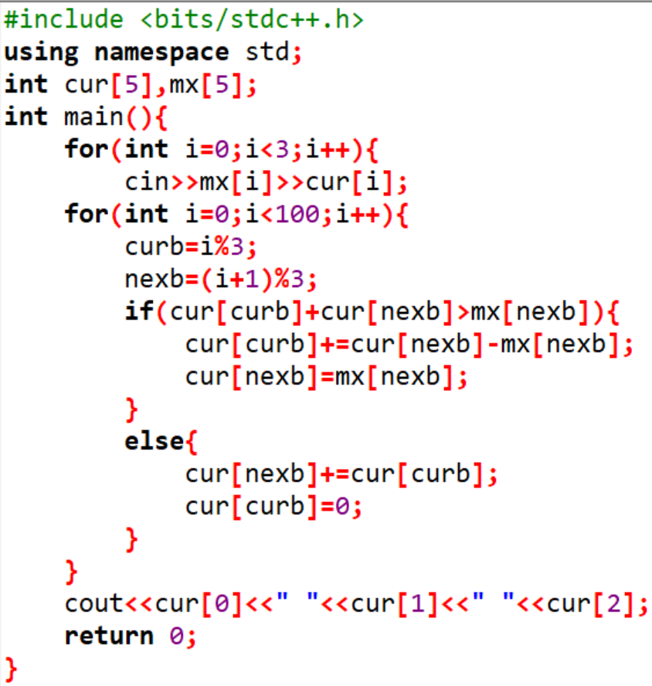
Example 2 Code
Split into three parts:
INPUT
SIMULATION
OUTPUT

Slide 10

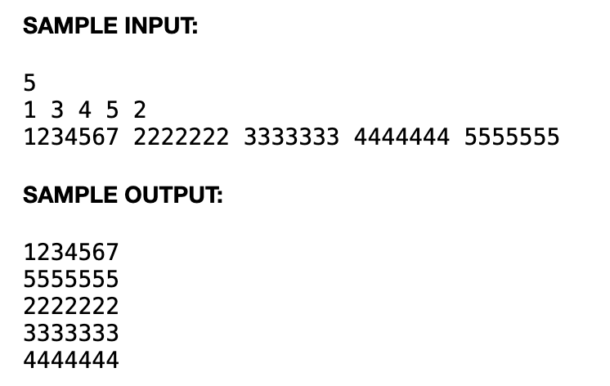
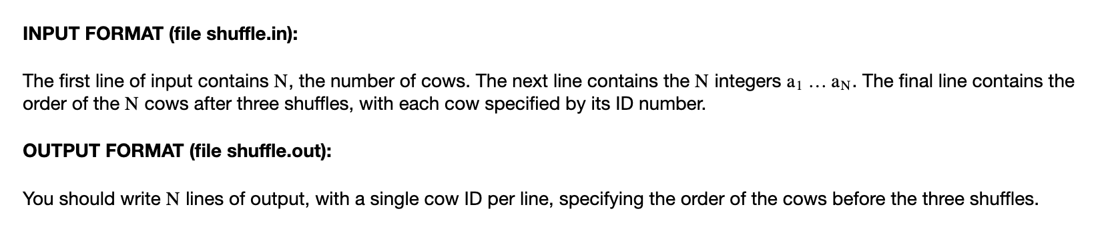
Example 3
N (<= 100) cows shuffled according to second line, the i th cow goes to position a_{i}. Given final positions (each cow has a 7-digit representation), find initial positions.

Slide 11
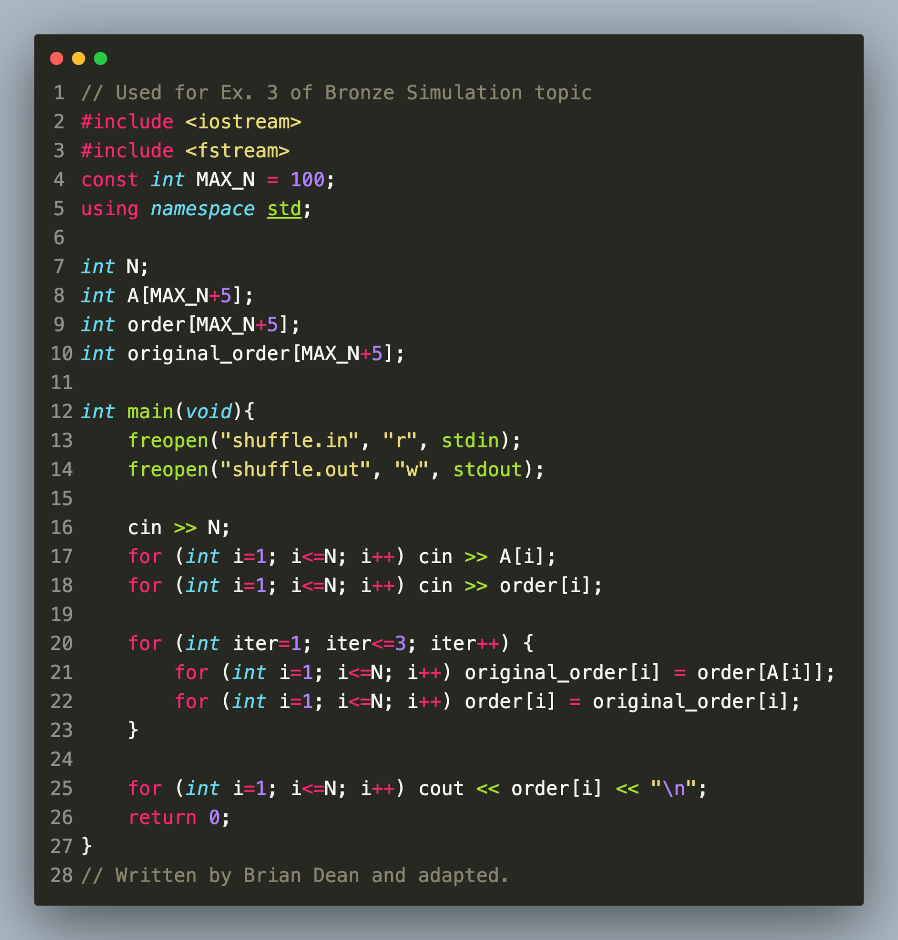
Example 3 Solution
Note that we are given the order of shuffling each turn, and want to reverse it thrice
Important use of alternating arrays (order and original_order)!
Again, freopen is unnecessary here and should be removed.
Time Complexity: O(n)

Slide 12
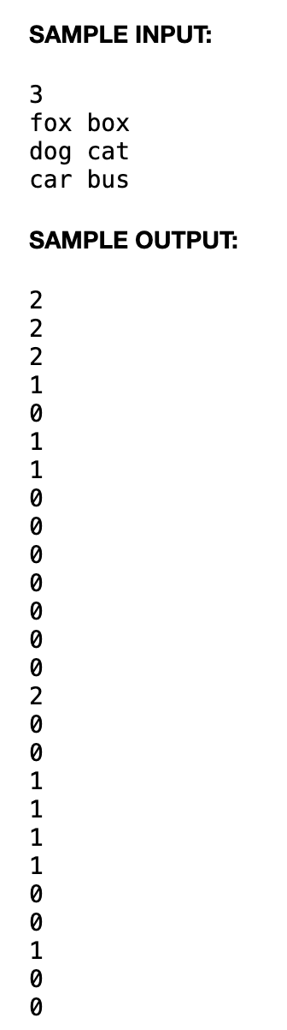

Example 4
Consider the sample input on the right. There are N (<= 100) pairs of words with length no greater than 10. Farmer John chooses one word of each pair. Find the minimal number of each alphabet block so FJ can always find sufficient blocks to spell all N words.

Slide 13
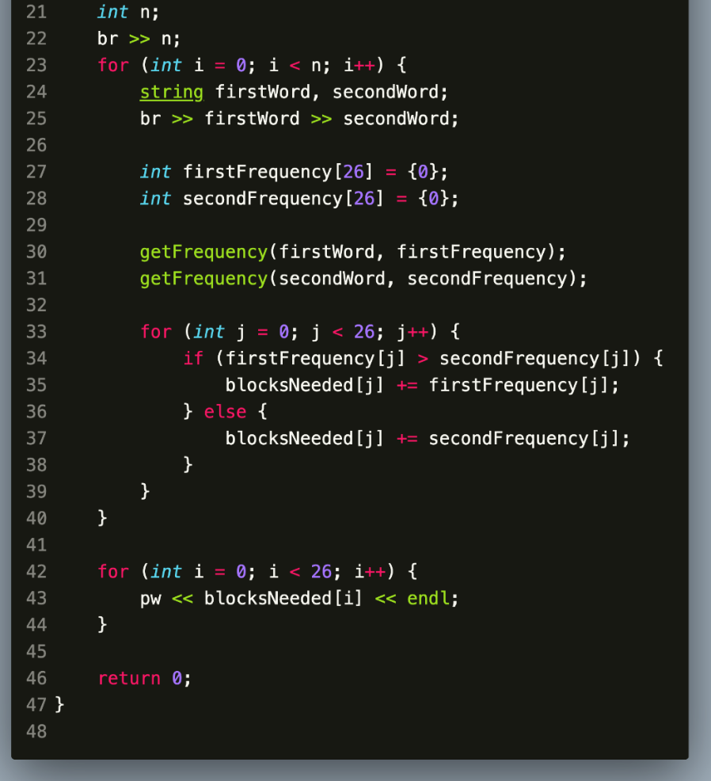
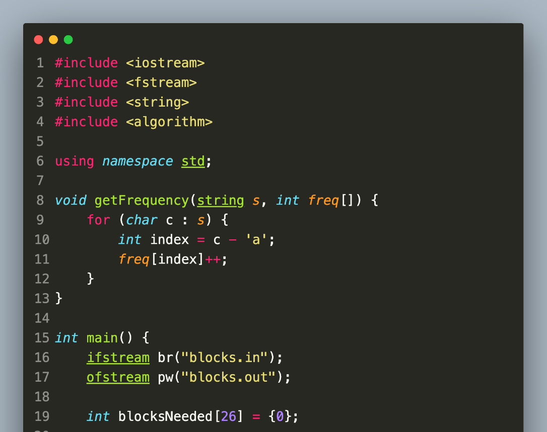
Example 4 Solution

Slide 14

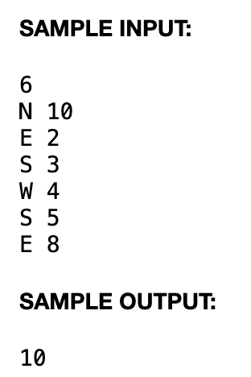
Example 5
Farmer John mows a 2D grid of cotton following N (<= 100) movement instructions (e.g., "W 10" means moving west for 10 time units, 1<= magnitude of move <= 10), cutting grass as he goes. Grass regrows x time units after being cut, and whenever he revisits a cell, at least x time units must have passed since his last visit to avoid stepping on already cut grass. Determine the maximum possible value of x such that John never steps on a cell where the grass hasn't regrown; if he never revisits a cell, output -1.

Slide 15
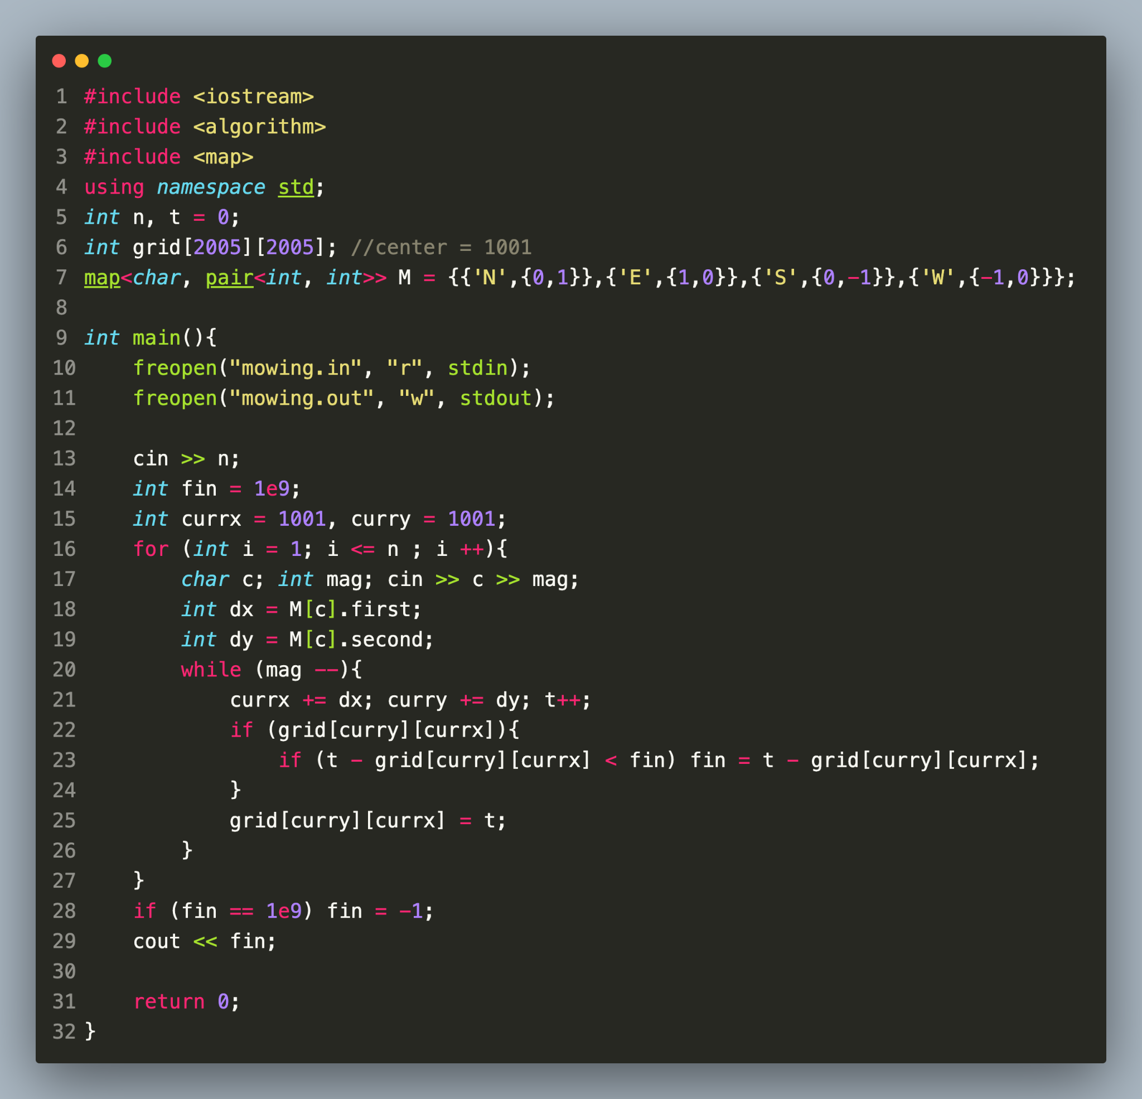
Example 5 Solution
We use grid[y][x] to record the time FJ last visited square (x, y)

Slide 16

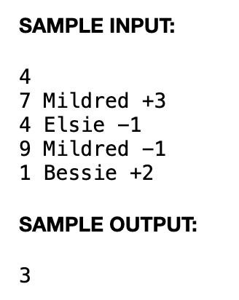
Example 6
Farmer John purchases three cows: Bessie, Elsie, and Mildred, each of whom initially produces 7 gallons of milk per day. The changes in production are given in input (N <= 100)
To keep his cows motivated, Farmer John proudly displays on the wall of his barn the picture of whichever cow currently has the highest milk output (if several cows tie for the highest milk output, he displays all of their pictures). Please determine the number of days on which Farmer John would have needed to change this display.

Slide 17
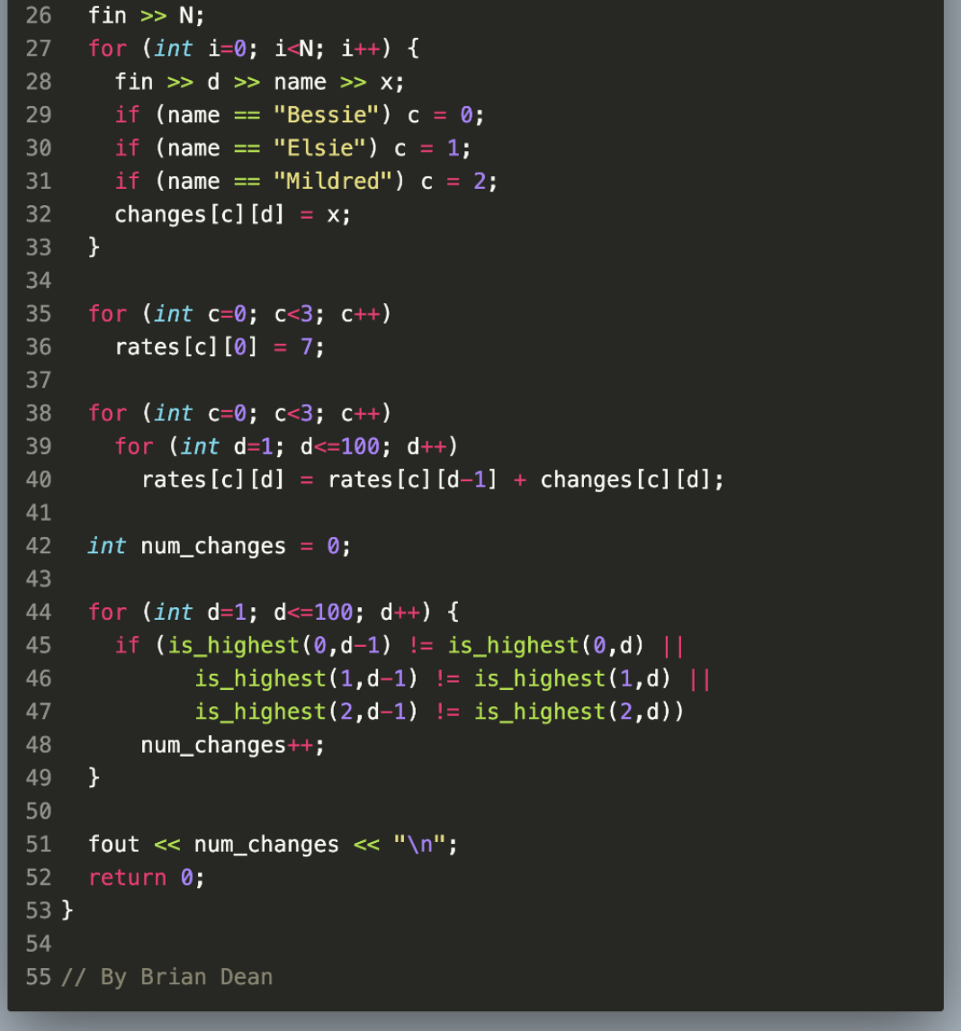
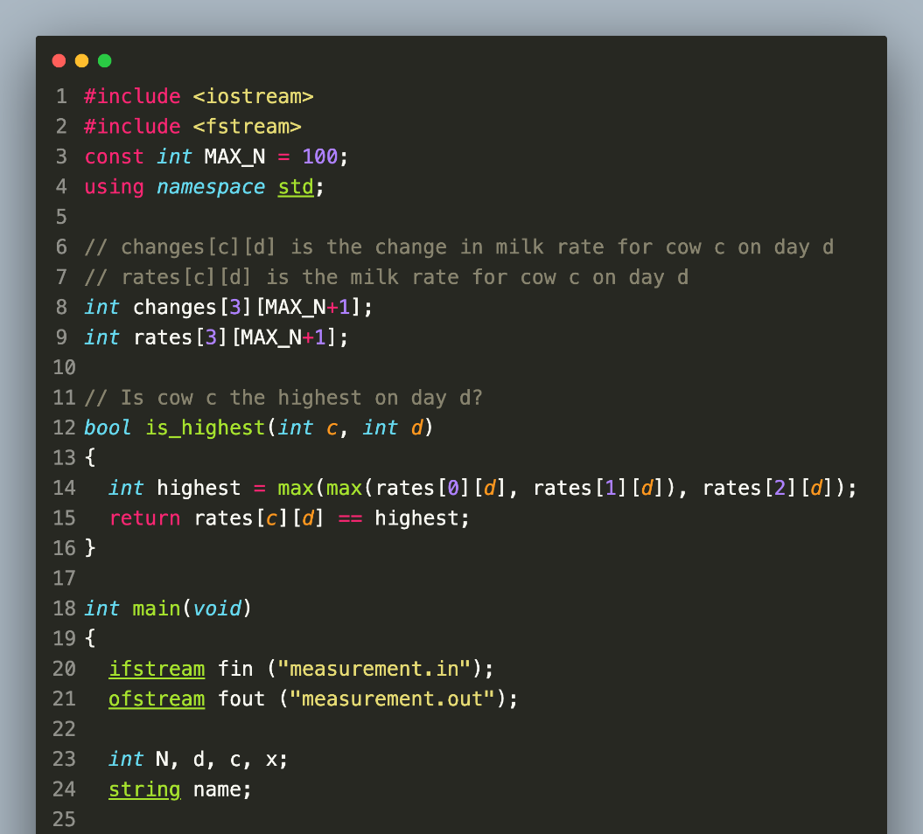
Example 6 Solution

Slide 18

Bonus Example
Farmer John tries to file his N e-mails into M folders. He could only scroll down his folder/email list (not up). There is going to be K files and K folders showing up the same time. John can only drag e-mails into predetermined folders. The only way he can achieve scrolling upwards is if he is viewing the last set of K e-mails in his email list, and he puts one of those into a folder. In this case, the email list will again show the last K e-mails that haven't yet been filed, effectively scrolling the top email up by one. If there are fewer than K e-mails remaining, then all of them will be displayed.

Slide 19
Bonus Example Solution Idea
We need to combine the ideas of brute force simulation and greedy algorithm. Since email folders can’t re-appear, a email folder that is at the top of the seen list must be filled with all of its emails before we scroll down. So, maintaining a list of all emails of each folder gives us a way to find the optimal time to scroll down the file list. For the emails, we need a list of seeable emails, emails that have been scrolled out of display, and emails that have not been seen before to effectively simulate the email list.

Slide 20
Homework Problems (optional ofc)
https://usaco.org/index.php?page=viewproblem2&cpid=526
https://usaco.org/index.php?page=viewproblem2&cpid=616
https://usaco.org/index.php?page=viewproblem2&cpid=831
Try to write codes by yourself if you had no prior C++ experience!

