Slide 1

Searching and Recursive Search
By 10-8 Jingzhe Ai, 10-1 Hans

Slide 2
Searching
Searching is to iterate through all the possibilities of a problem
Ex. When you are trying to find the maximum distance between a set of points, you iterate through every pair and find the maximum distance in between pairs
Try to be “smart” and save time whenever you can though (because a complete search may result in overtime)
Relates to later searching algorithms like BFS and DFS

Slide 3
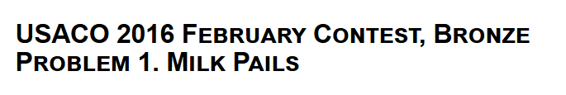
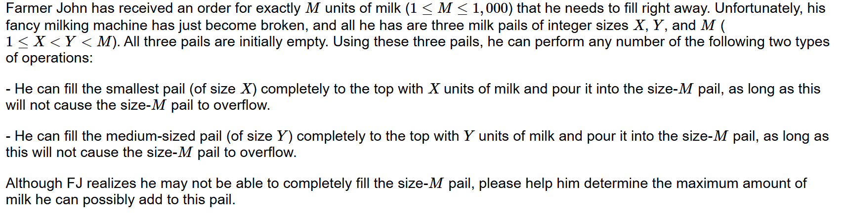
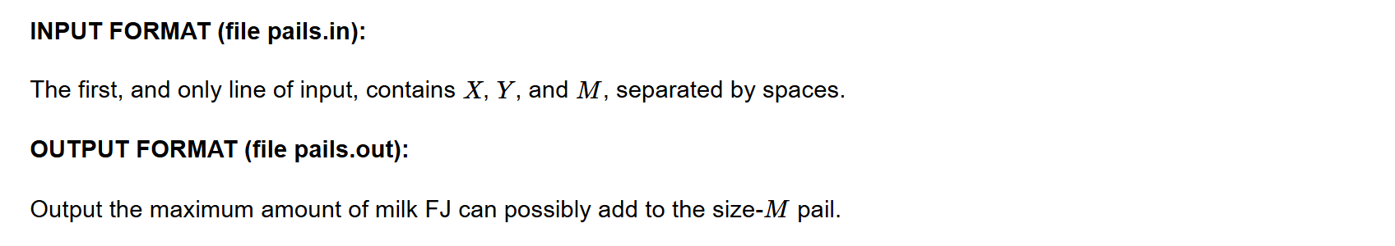
Example 1

Slide 4
Example 1 Solution Idea
We can easily see that the problem could be simplified to be that we would try to find the maximum value of AX+BY, where AX+BY<=M.
Since the constraints on M is less than 1000, we could simply just iterate A and B respectively both from 1 through M/X and M/Y respectively
We find the results and record the maximum of AX+BY, which would be the final answer.

Slide 5

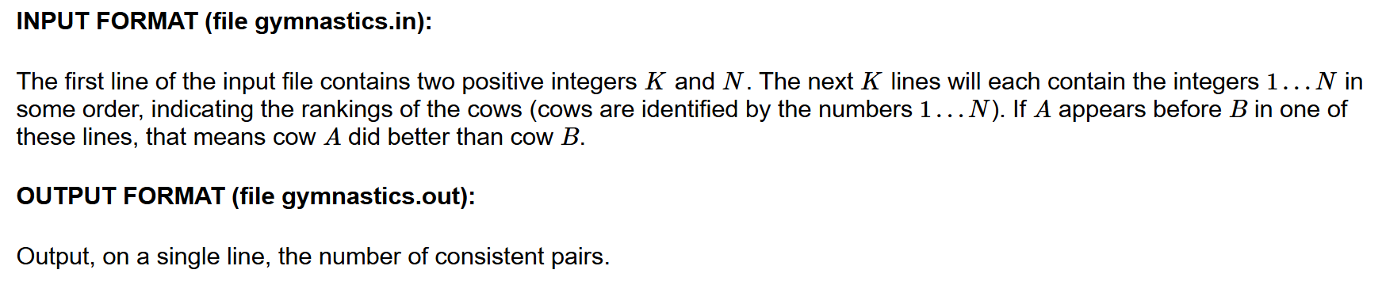
Example 2
Gives you N (N<=10) lists of at most K (K<=20) integers, ask to find how many pairs of integers have their relative positions remain the same throughout all of the lists.

Slide 6
Example 2 Solution Idea
We can iterate every pair of integers and find if their relative positions remain the same throughout the lists
Time Complexity: O(NK²)

Slide 7

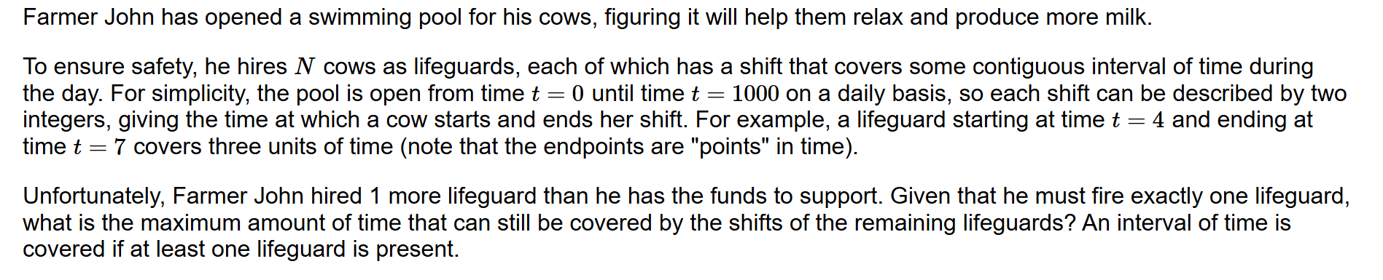
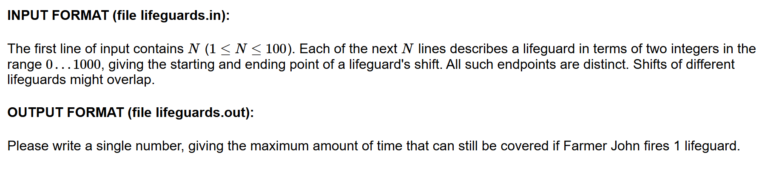
Example 3

Slide 8
Example 3 Solution Idea
We just simply create a list T of length 1000 (each representing one minute in the 1000 minutes).
We then, for each lifeguard, go through their shift time, and add a value of 1 into the corresponding position in T.
We then again go through each lifeguard’s shift time and find how many time will be uncovered if we fire this lifeguard.
We take the minimum of all these numbers and print that out as the final answer.

Slide 9

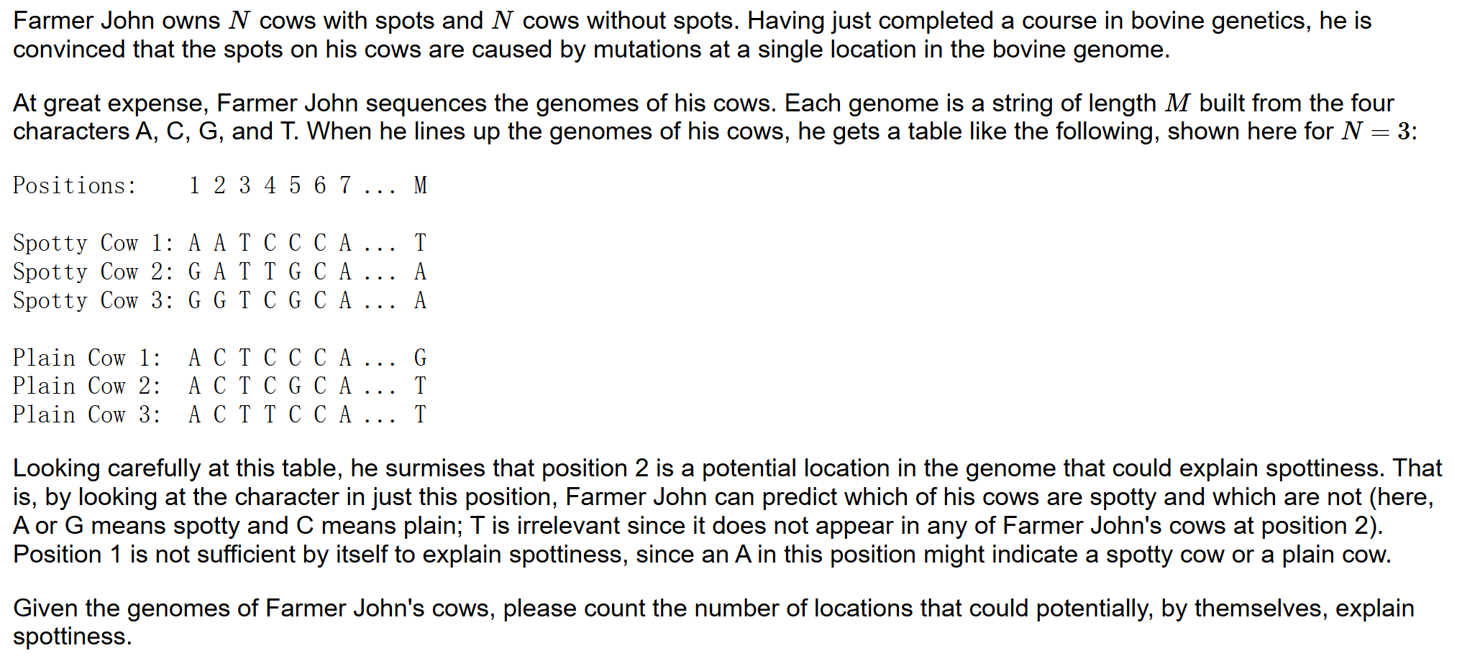
Example 4

Slide 10
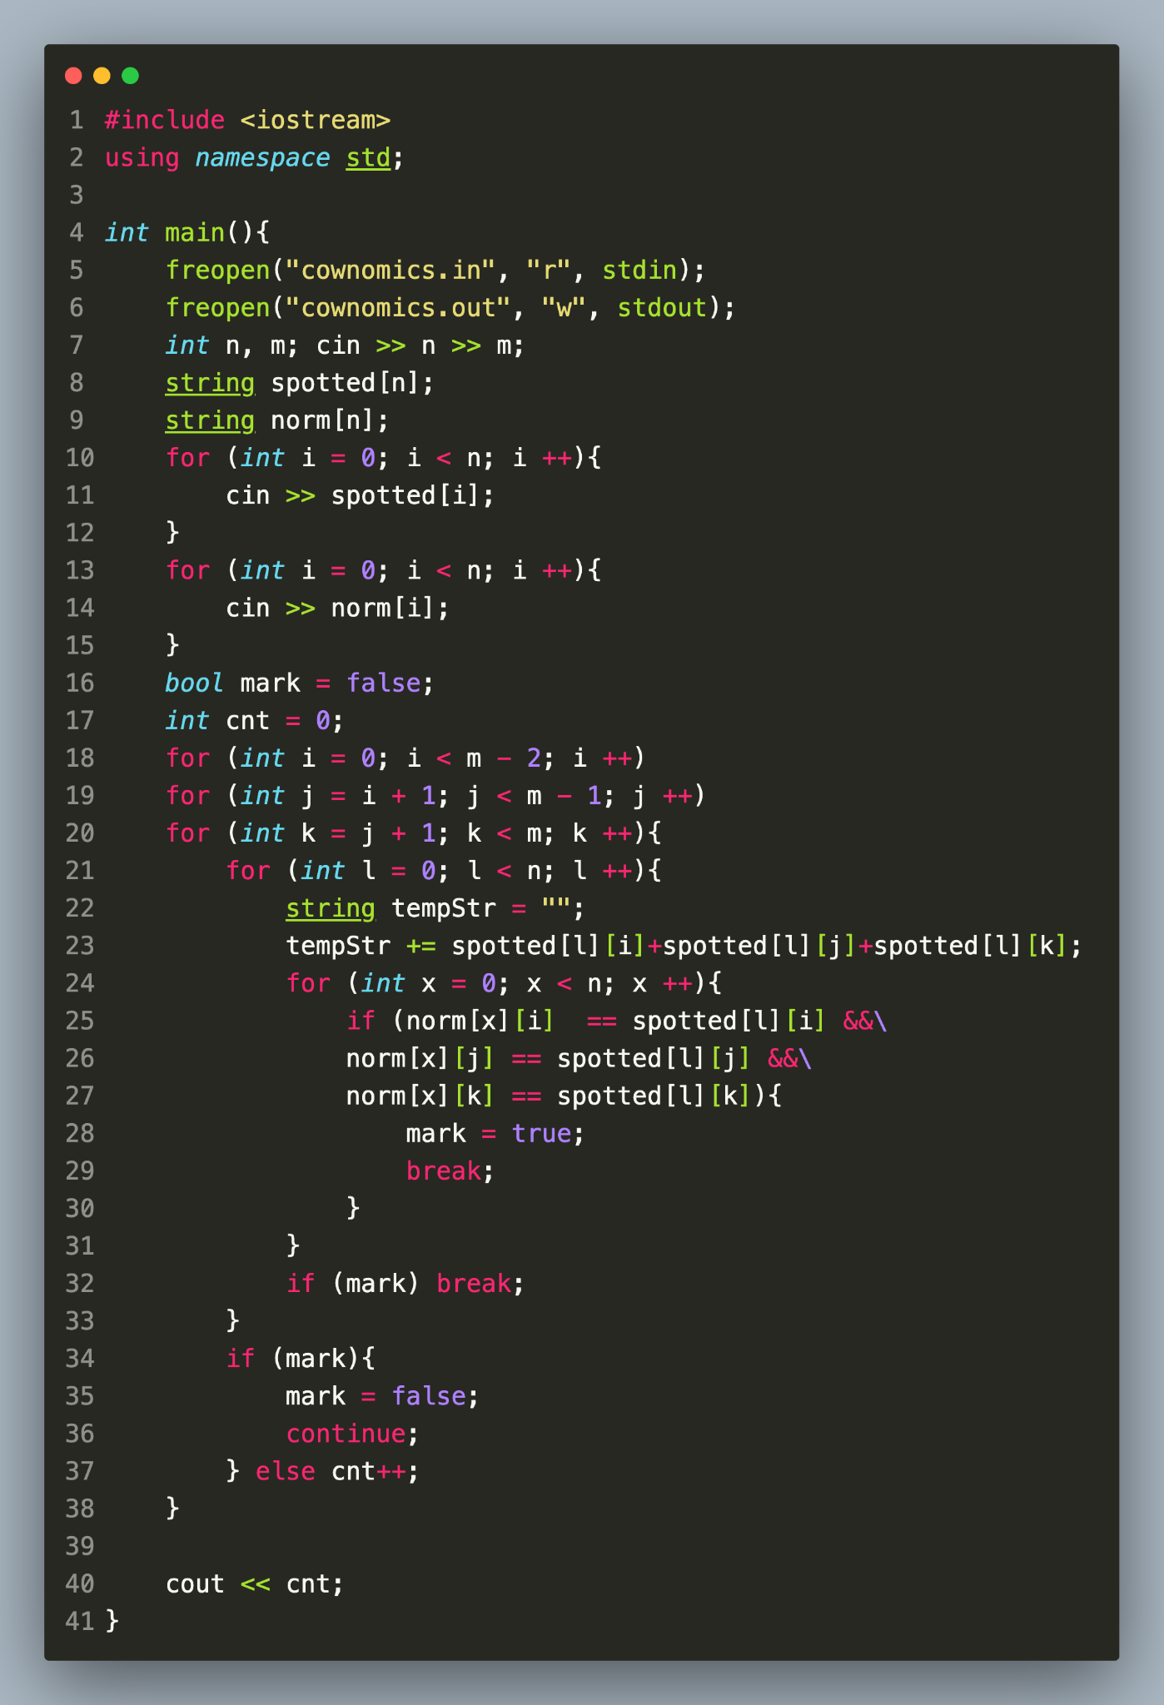
Example 4 Solution

Slide 11

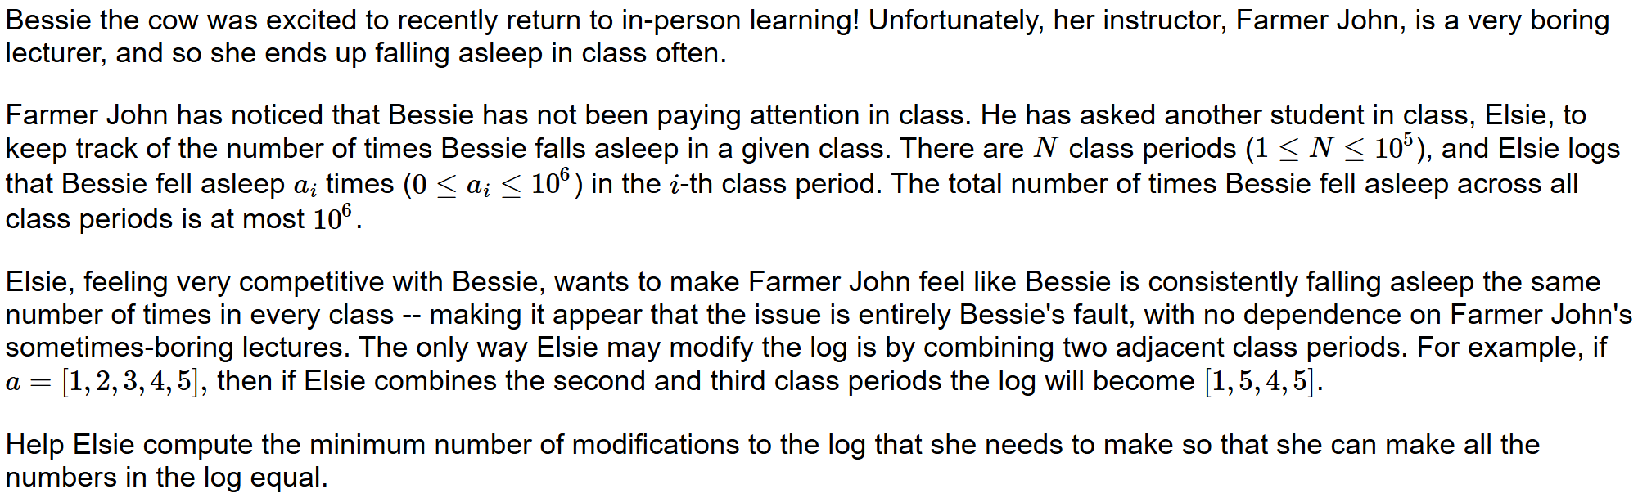
Example 5

Slide 12
Example 5 Solution Idea
We can search through the how many hours in each class after Elsie altered the things
We check each amount of hour to see if it is possible (combine the first one until it becomes the number of hours we guessed it would be)

Slide 13
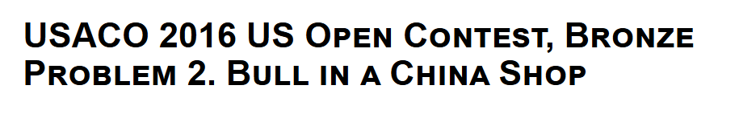

Example 6
You are given N, K, then K+1 NxN squares of characters (. are empty, # are filled). The first is the original square. Two of the K following square matrices can be shifted left, right, up or down (independently and without any # falling out) so that their union is exactly the original one. Find the indices of those two squares.
K <= 10, N <= 8.
https://usaco.org/index.php?page=viewproblem2&cpid=640

Slide 14
Example 6 Solution
Literally search through all possibilities:
10C2 for going through the solution pairs:
For each solution pair, there are (ways to shift a square matrix)^2 ways
Ways to shift a square matrix = ( at most 21 )^2
For each solution, each shift, we check the resulting image for 64 atm.
Rough estimate of 560,105,280 operations
I wrote the solution code a year ago… its very ugly so im not putting it here, pc me you want to see shit mountain.

Slide 15

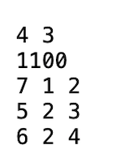
Example 7
Given N T in first line(N <= 100, T <= 250), N cows have T interactions. Interactions are given in the form of time, participant 1 and participant 2.
The end states are given on the second line.
A pandemic starts with a patient zero, and with every interaction, an infected person can infect the other if this interaction is within the first K interactions they’ve had after being infected themselves.
Output three numbers: the number of possible patient zeroes under any K, the minimal K and the maximal K (which might be infinity).

Slide 16
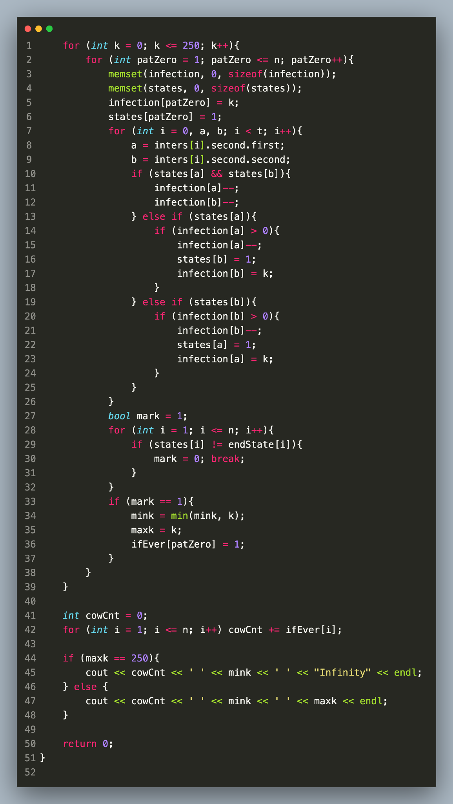
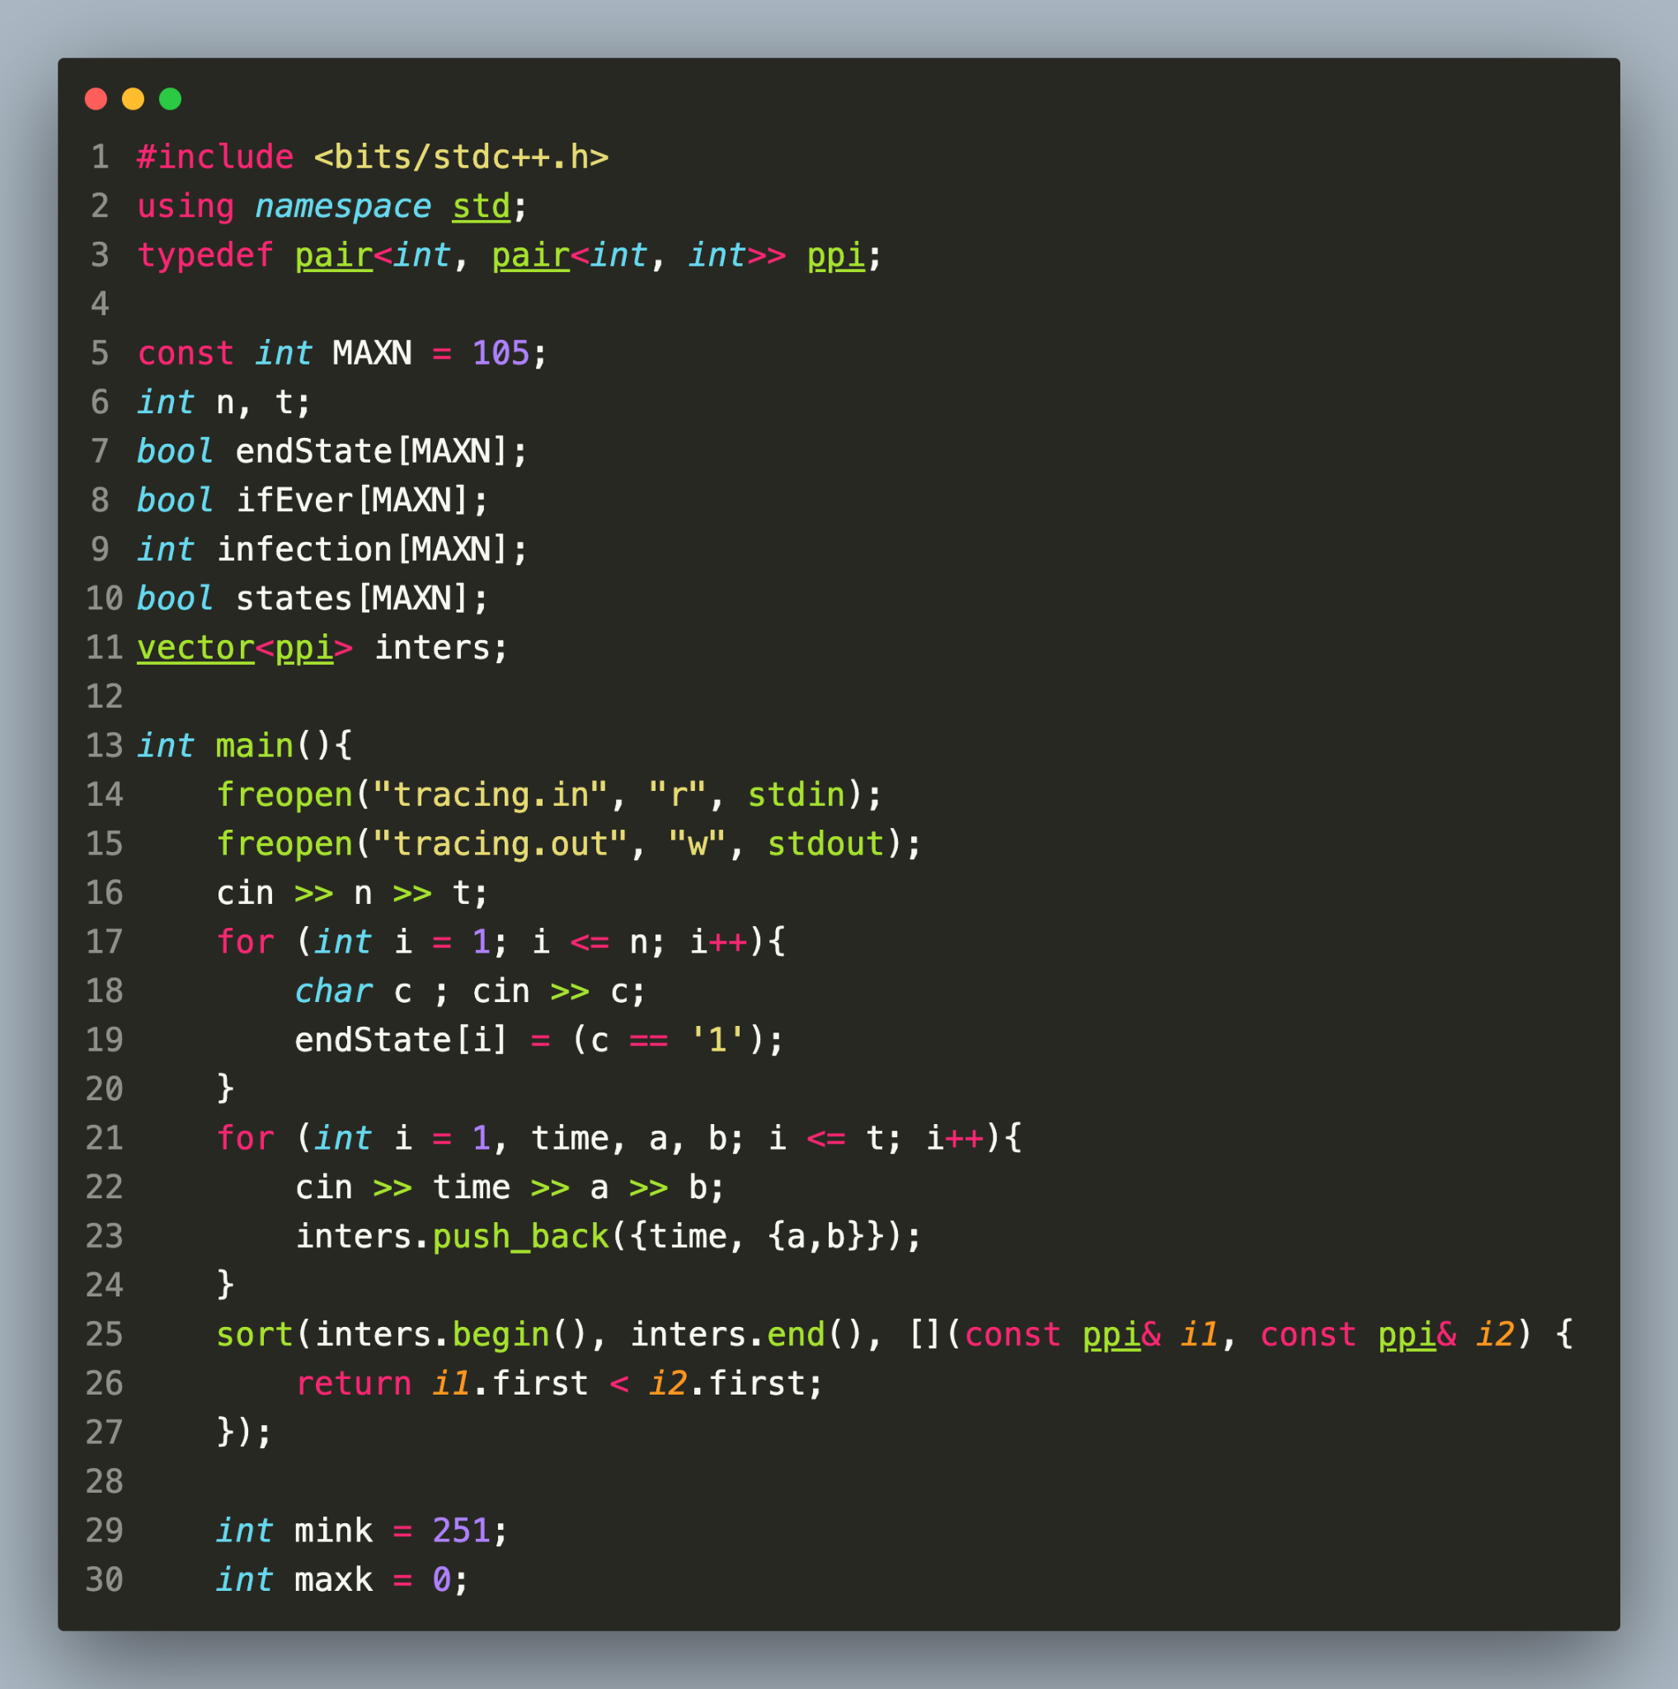
Example 7
Note that time is irrelevant, only the order. We first search through k & patient zero, then simulate using that condition.

Slide 17
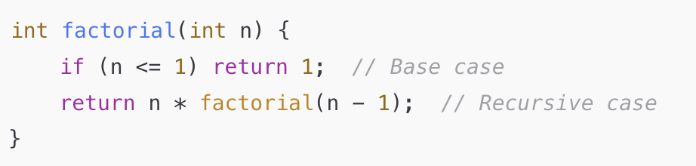
RECURSIVE SEARCH
Harder problems involving iterating through the entire solution space, especially for generating subsets and permutations. This is rare but the technique of recursion may be important later on.
Recursion is the technique of using a function to call itself:

Slide 18
Some more “technical terms”
Backtracking is an algorithmic technique for solving problems by trying out different possibilities and “backtracking” when a solution is not possible, often in an incremental way. It's a more specialized form of recursion used for problems where you explore all possible solutions and discard (backtrack) those that don’t work.
DFS is a graph traversal algorithm used to explore all nodes of a graph (or tree) by going as deep as possible along each branch before backtracking. It can be implemented using either recursion or an explicit stack.

Slide 19

Recursion Sample Problem
Sample Problem: This problem requires you to find the value of the n th digit of a really large string s₆₀. The string is defined recursively:
(s_{i} is the current string, s_{i+1} is the next string)
s_{i+1}=s_{i}+s_{i}[1:]+s_{i}[0]
We are given an original string s₀ and a number index n
Constraints: n<=10¹⁸, length of s₀ is at most 30

Slide 20
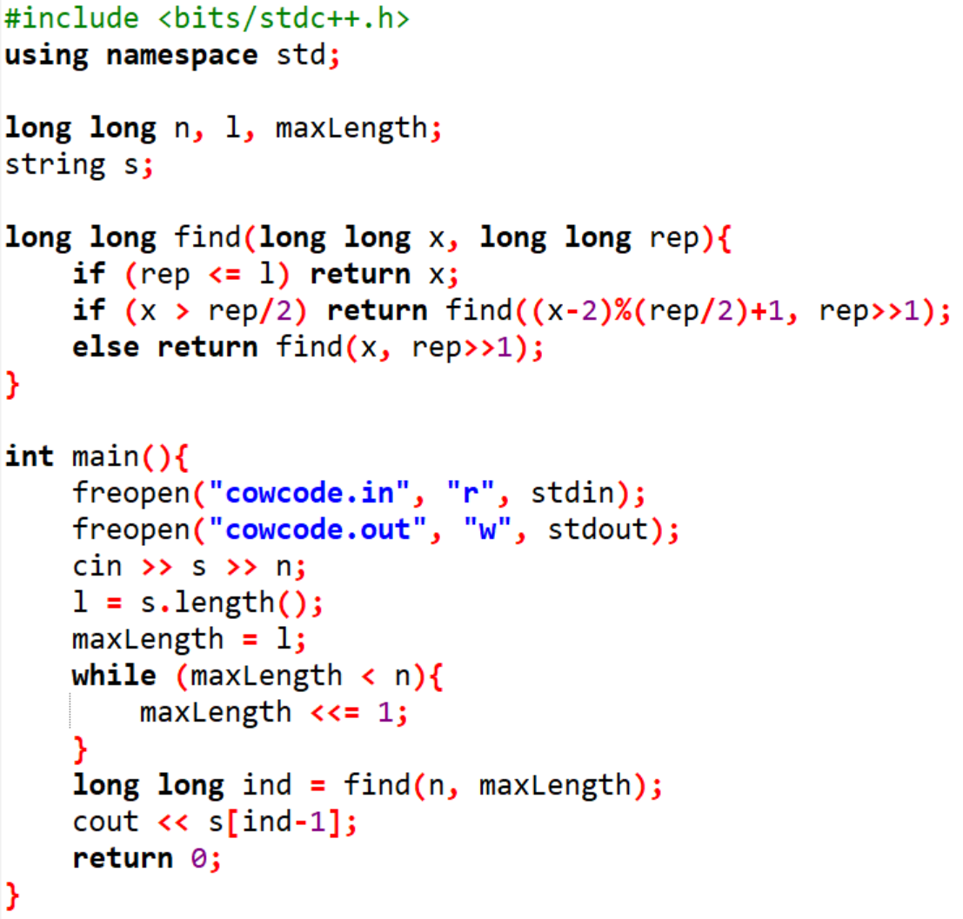
Recursion Sample Solution

Slide 21
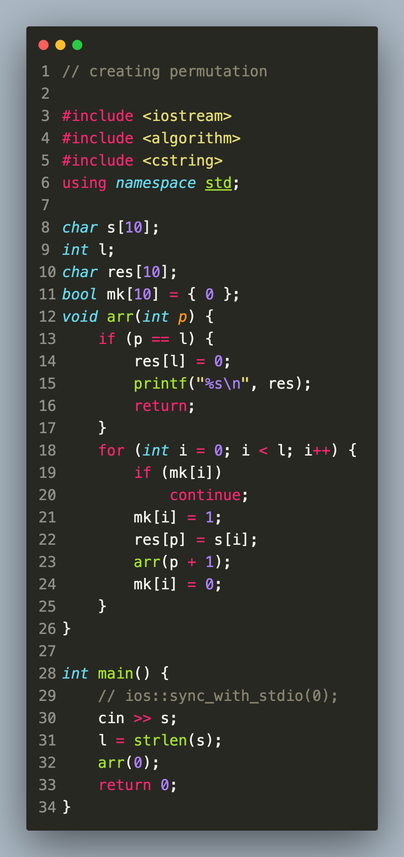
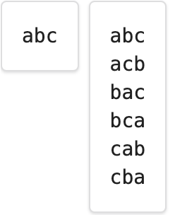
Permutations lead-in
Given an initial string of N distinct characters
Output all possible permutations in lexicographic order
N <= 10

Slide 22
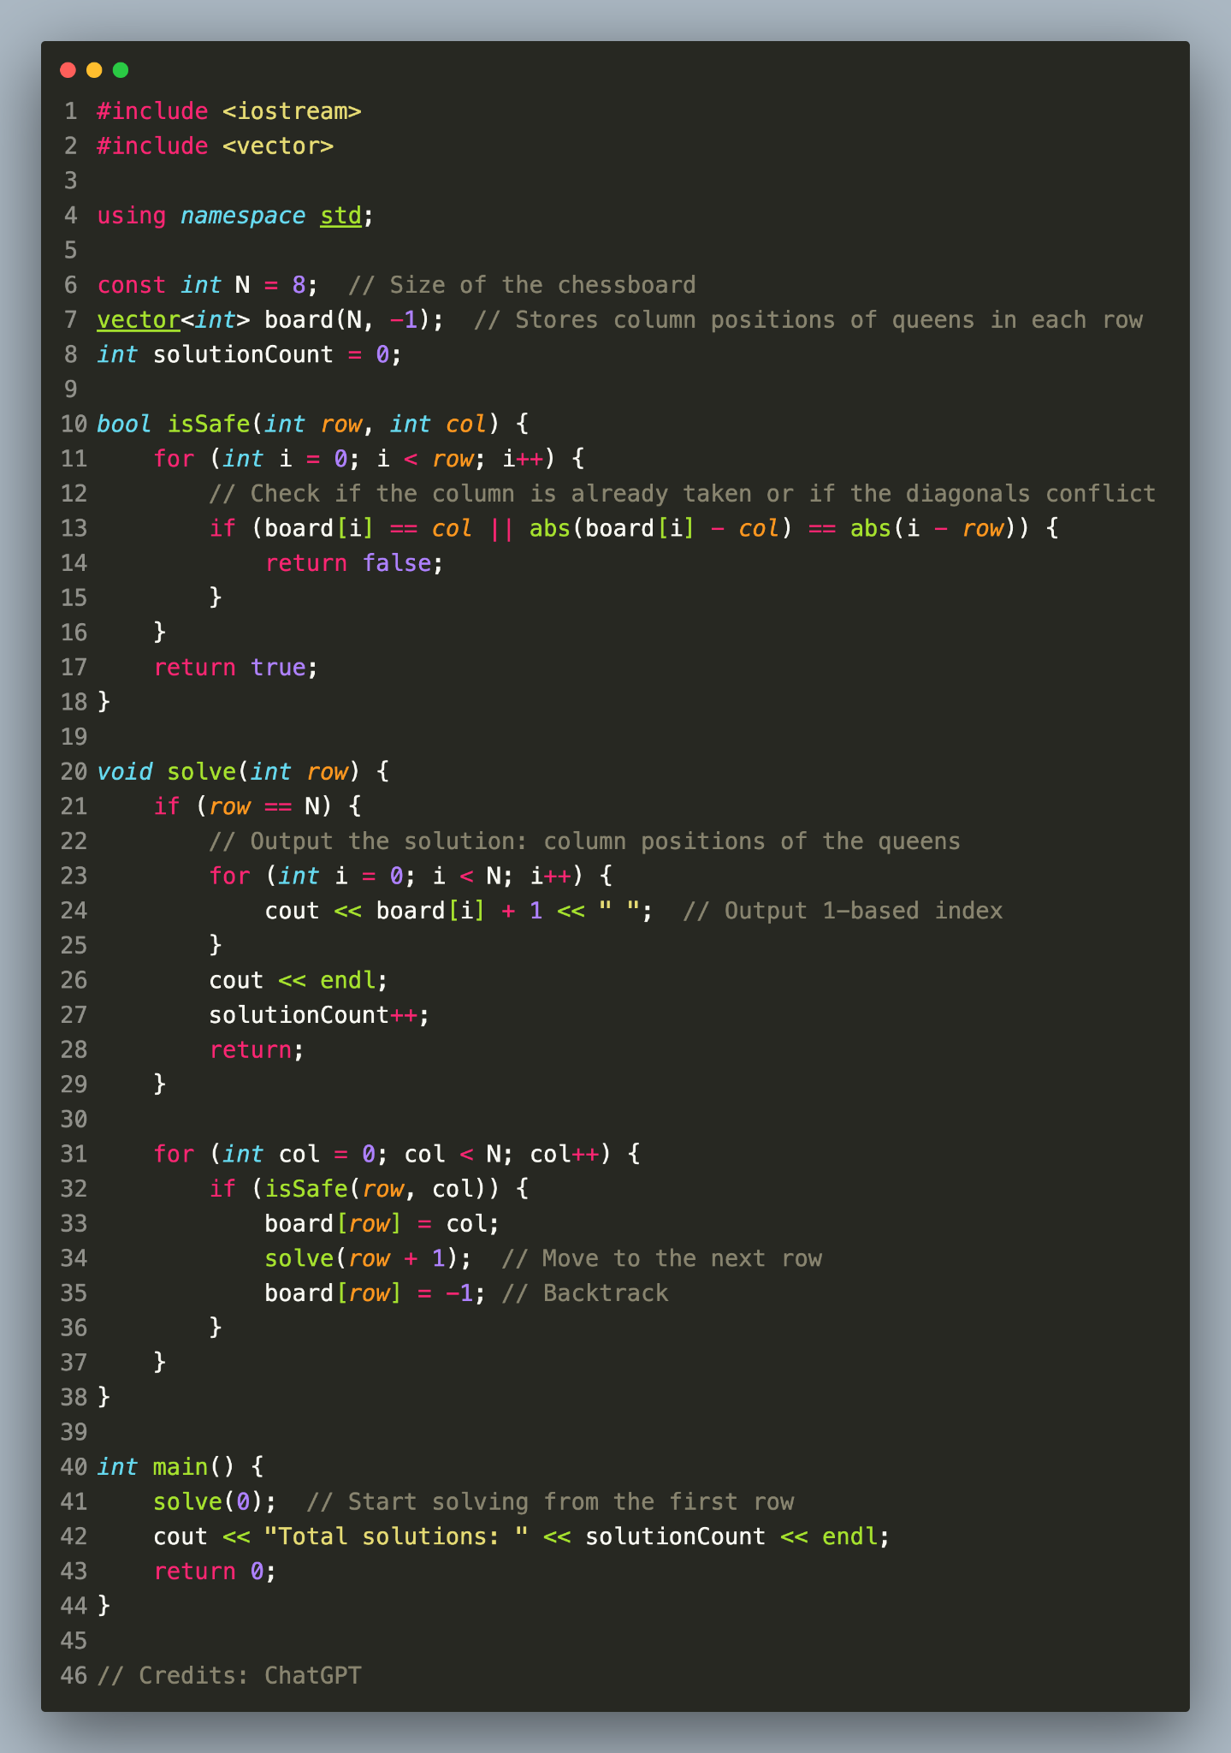
8 Queens
Print all the ways to arrange 8 queens
On the chessboard so that no pair can
Attack each other.

Slide 23
Additional Practice
Searching (and Recursion) in general: https://www.luogu.com.cn/training/112#problems
Also P1958, P1644, P1331, P3956, P2383, P1135, P1433, P1126 on Luogu
Feel free to ask us for help :)

