Slide 1
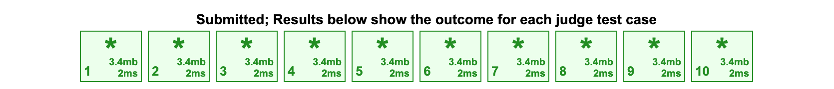
2023 Dec Bronze Problems
OI Club Session 3

Slide 2
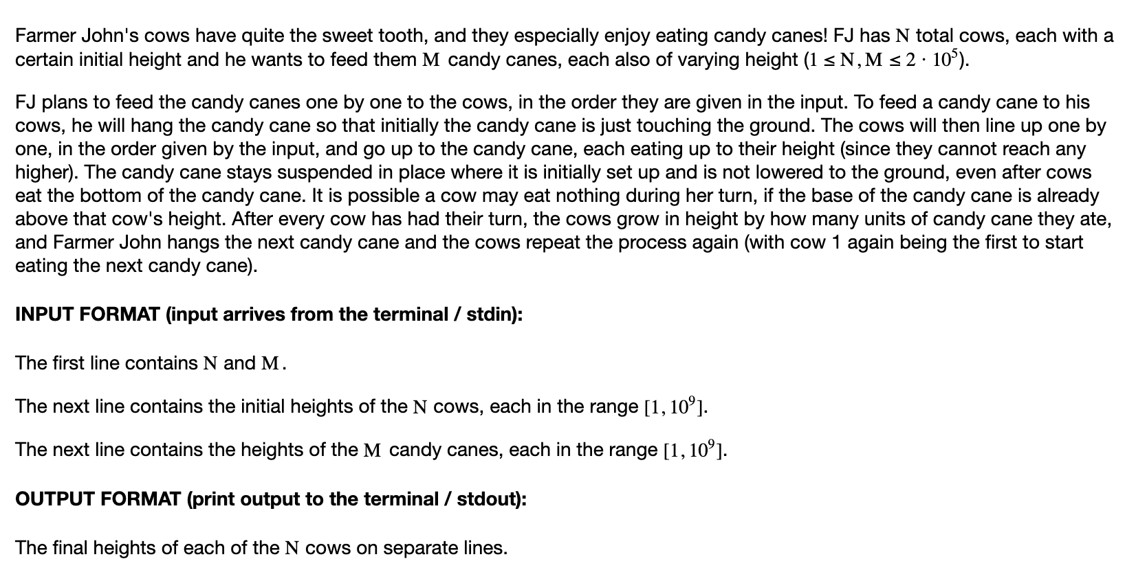
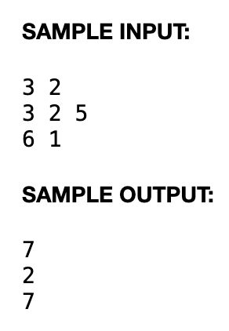
P1 Candy Cane Feast

Slide 3
Solution
Just simulate: O(MN) is about 4e10
BUT: notice the first cow: it ALWAYS DOUBLES in height until it exceeds 1e9, and then it will be the only cow that grows afterwards.
Complexity: around the first log_2 (1e9) = 30 might have full runs, then everything is just instantly done on the first cow. So around 30 + M.

Slide 4
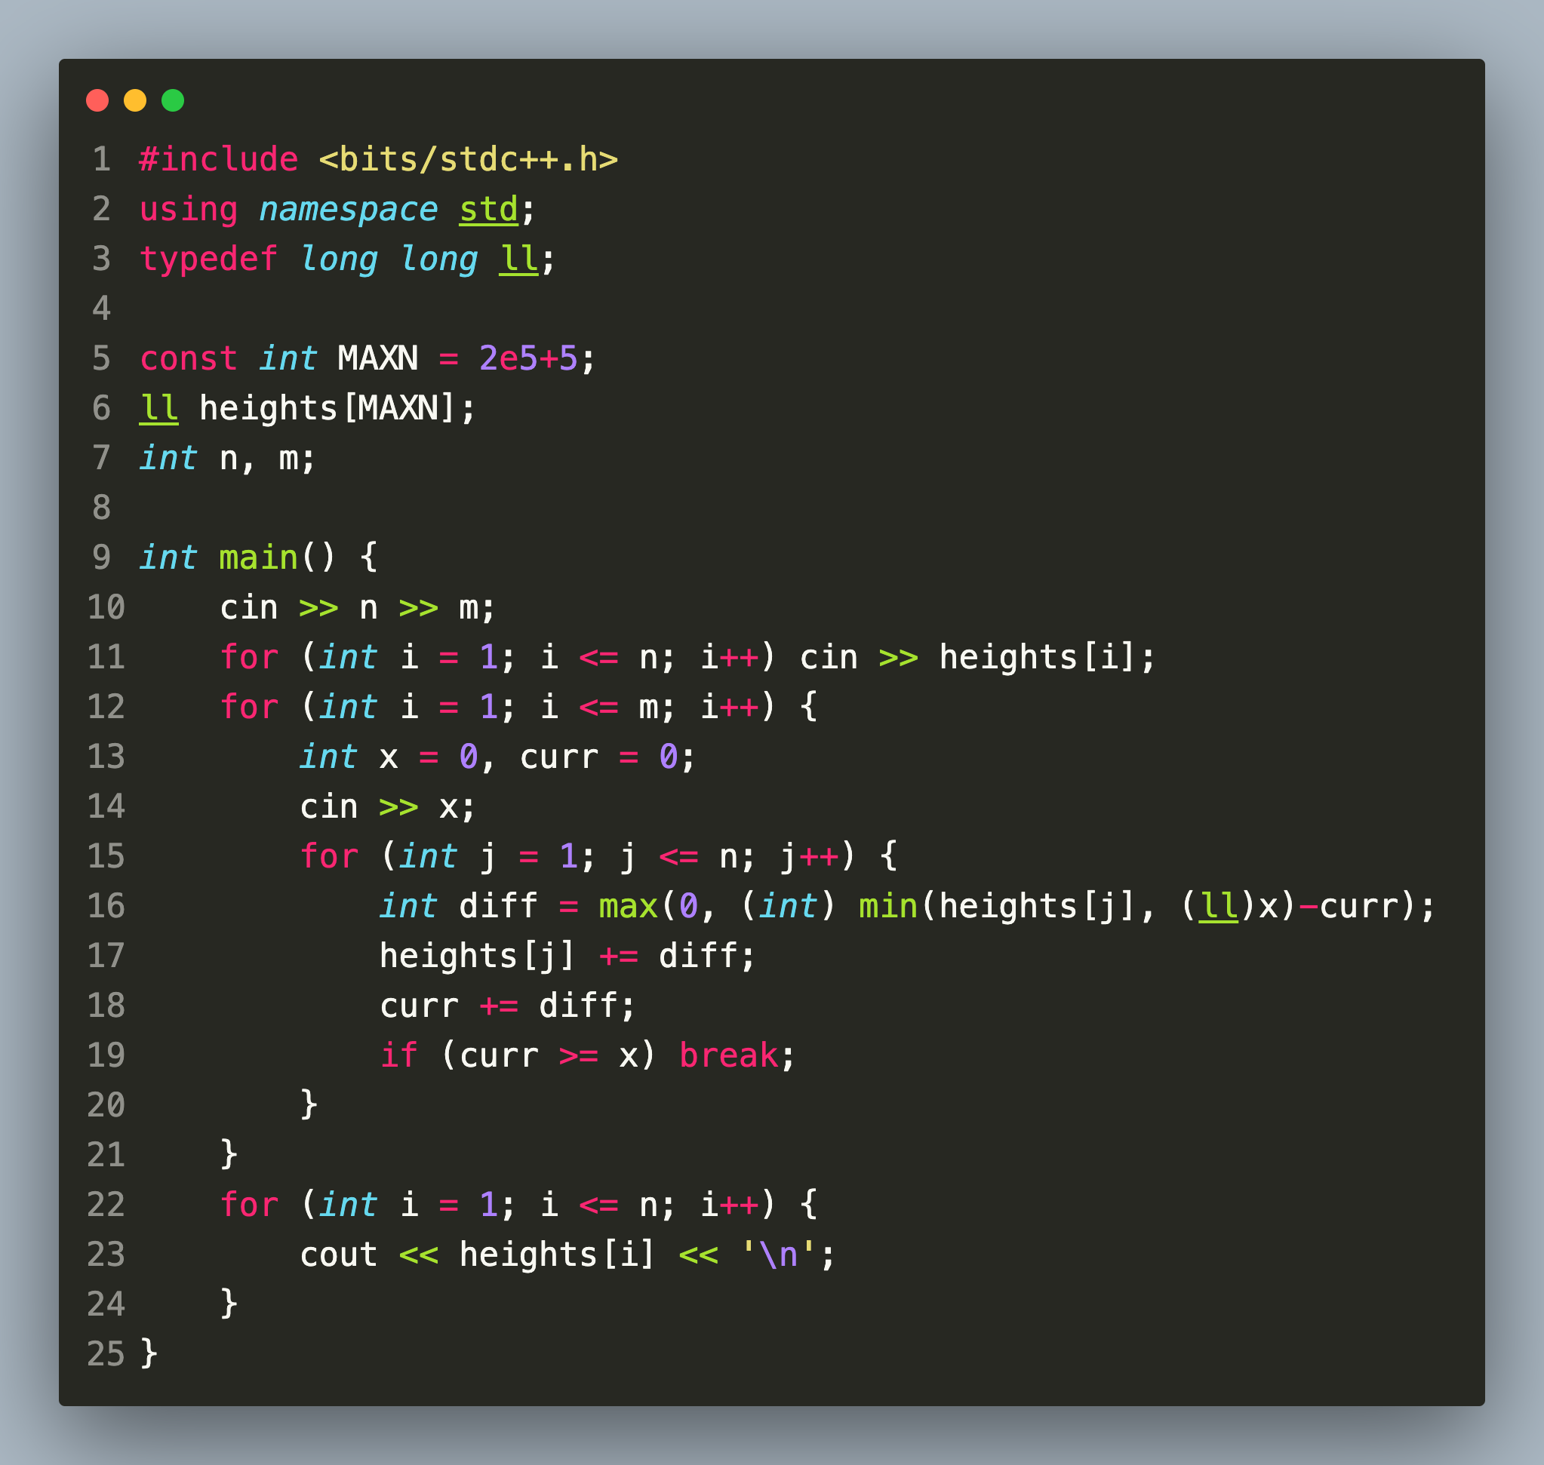
Code
Note line 16.

Slide 5
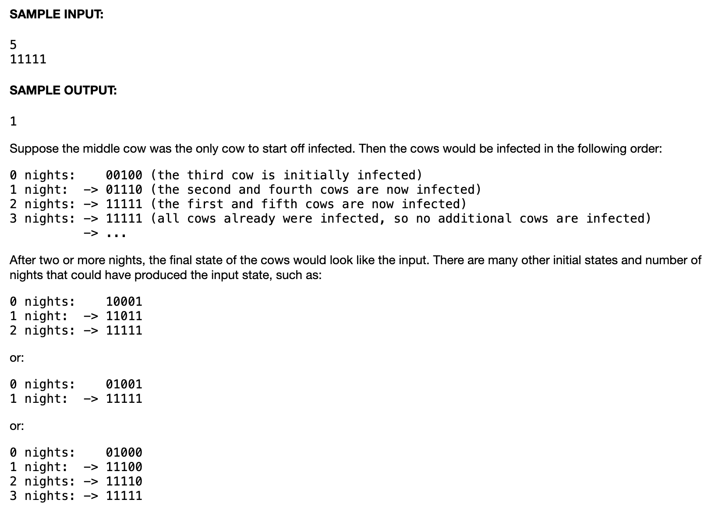
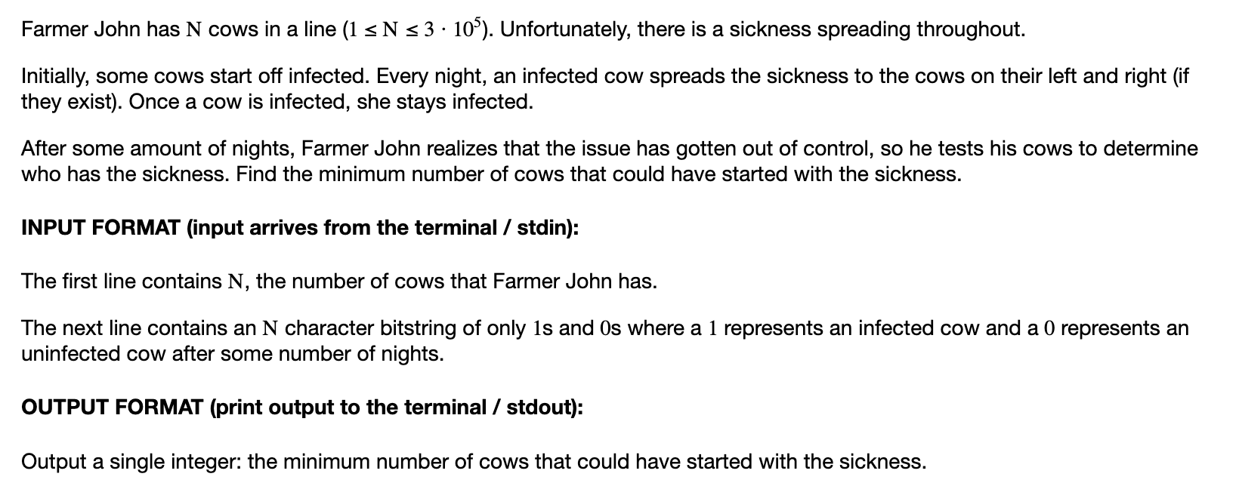
P2 Cowntact Tracing

Slide 6
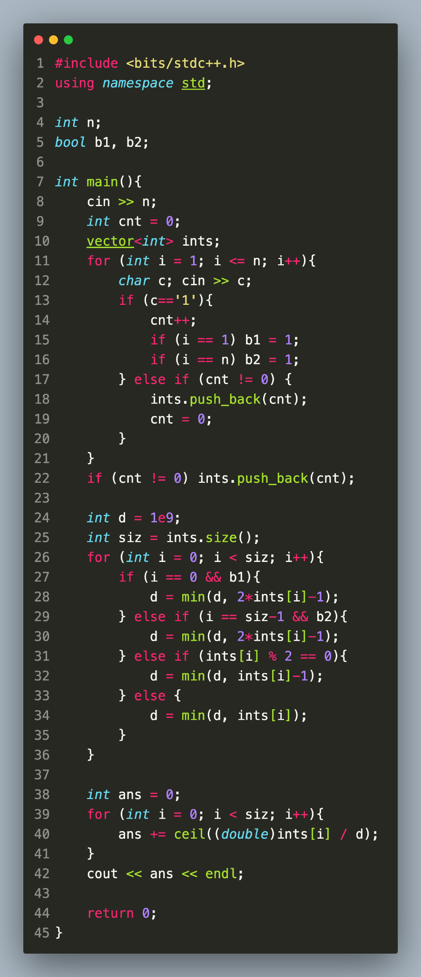
Solution & Code
Idea: note that all consecutive 1’s are independent components. We first find the largest interval that can cover all components without overflowing. Then, the answer would be
sum of ceil(Interval length / largest interval length).

Slide 7
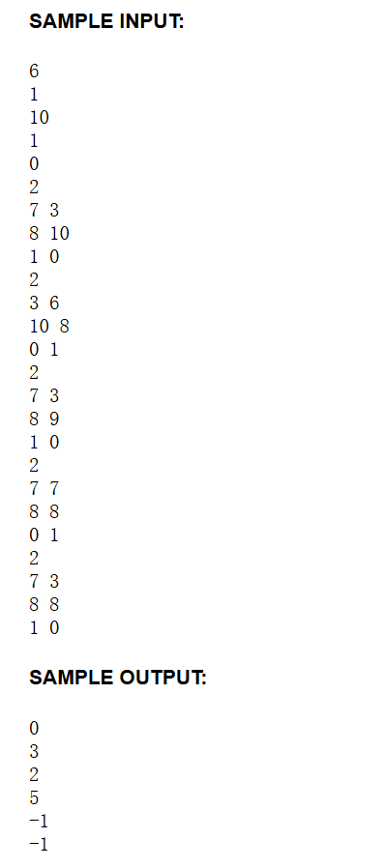
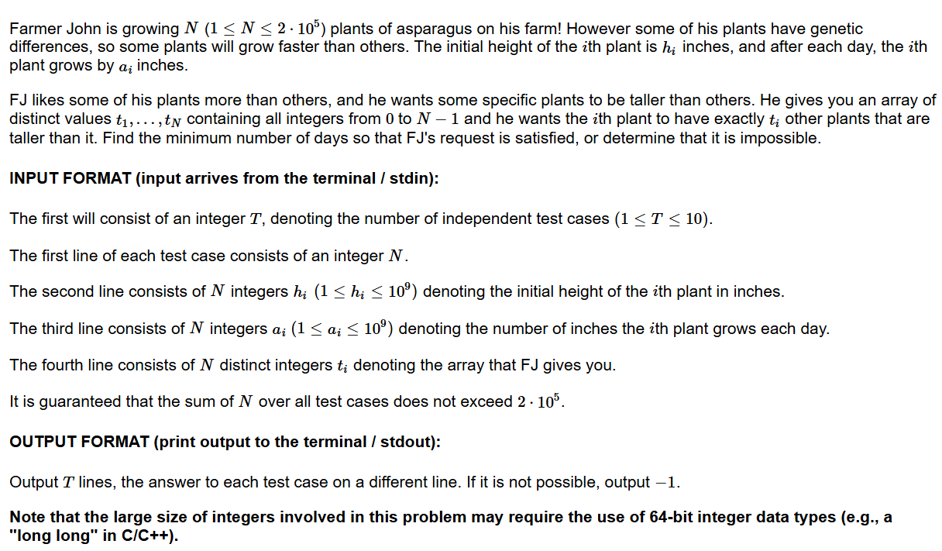
P3

Slide 8
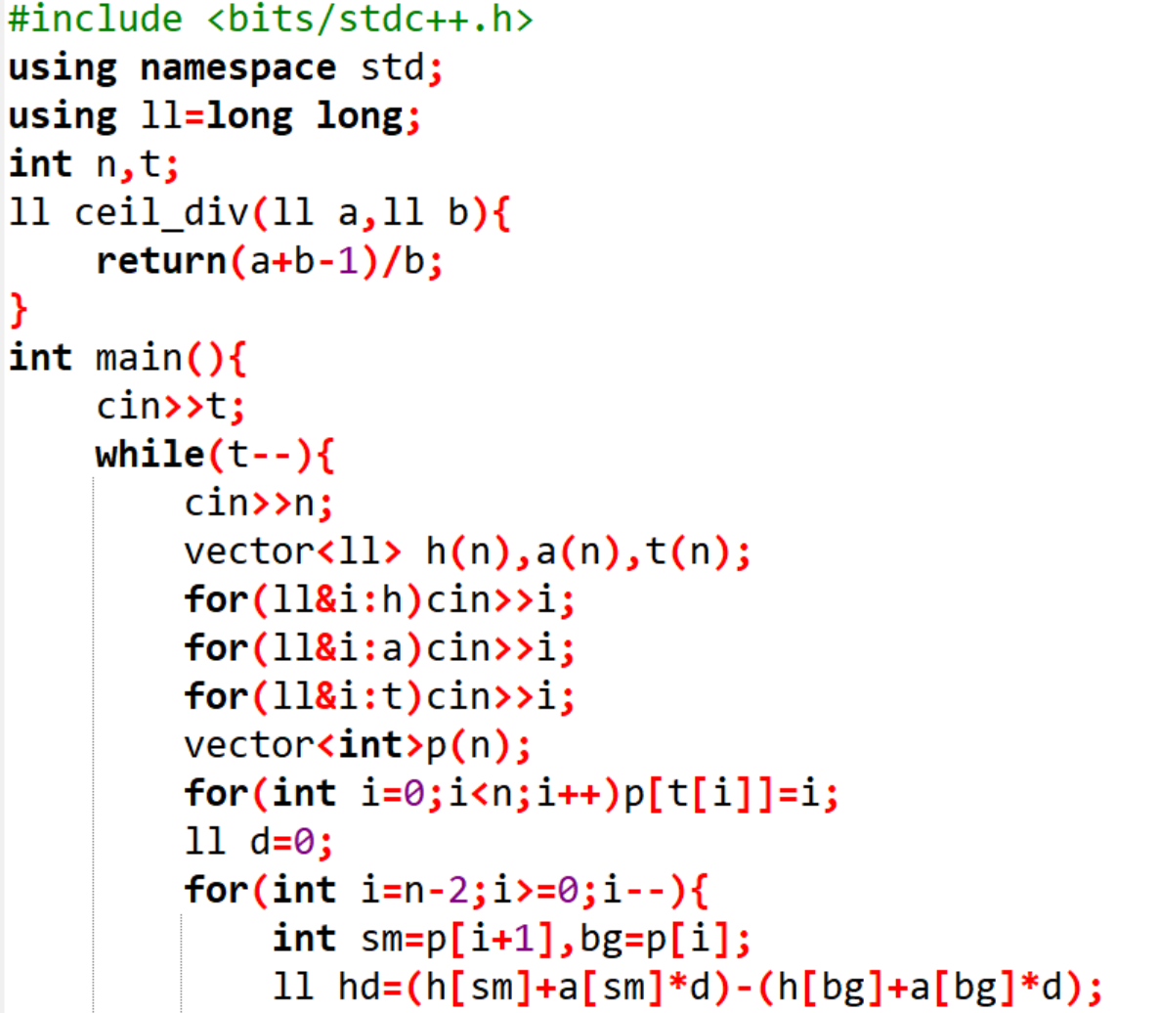
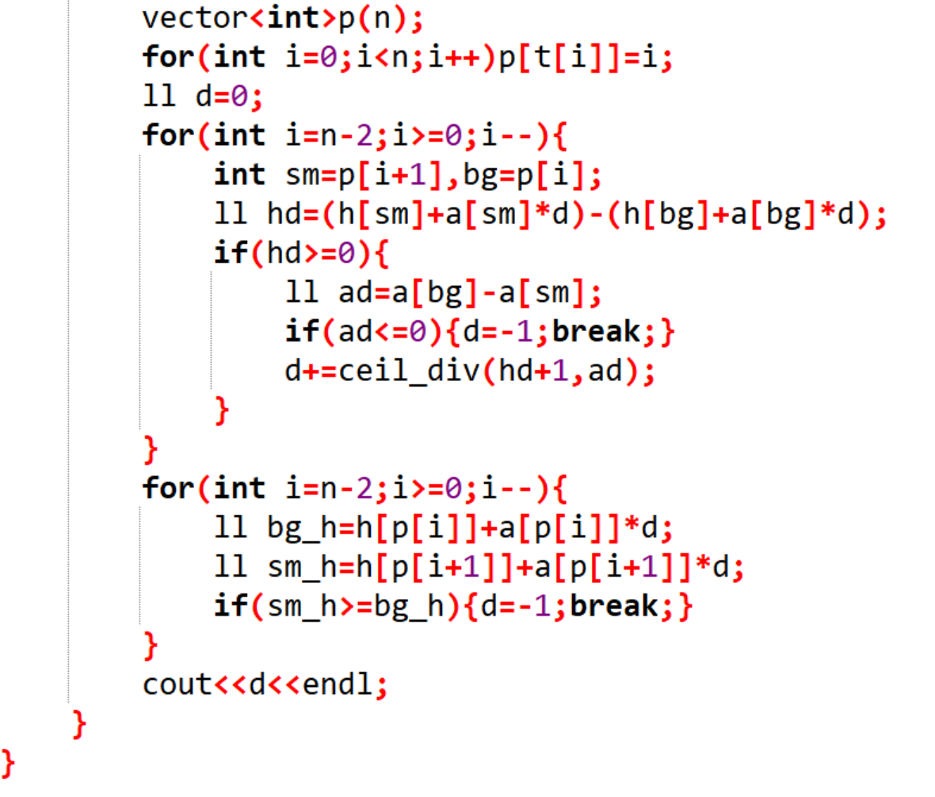

Slide 9
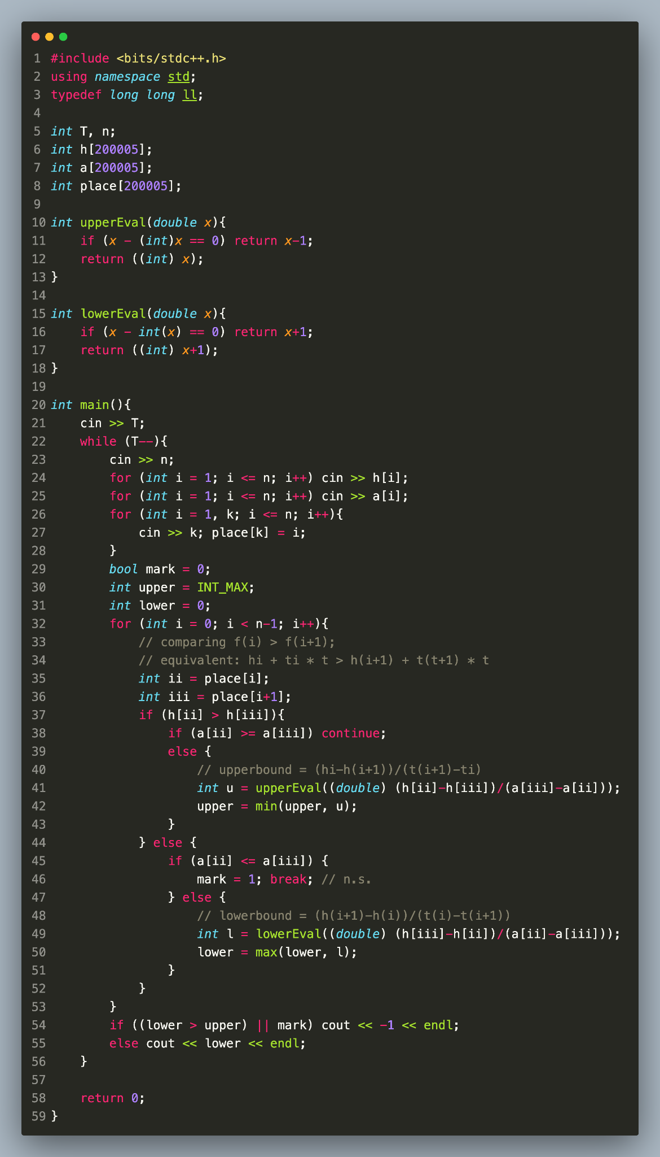
MacBook Solution
Yes, MacBook >>> Windows

