Slide 1
Prefix Sums
Last OI Club Topic of 2024

Slide 2
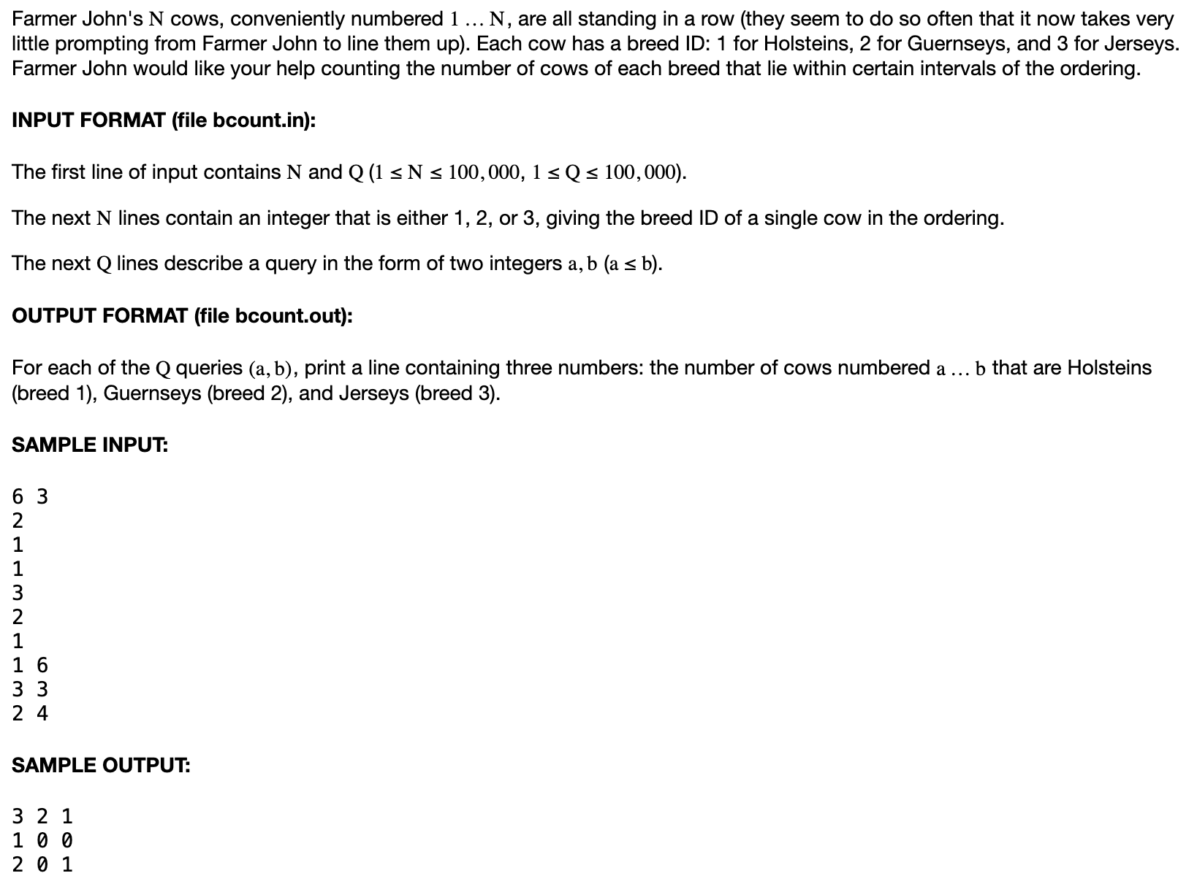

Example 1
Very simple prefix-sum example

Slide 3
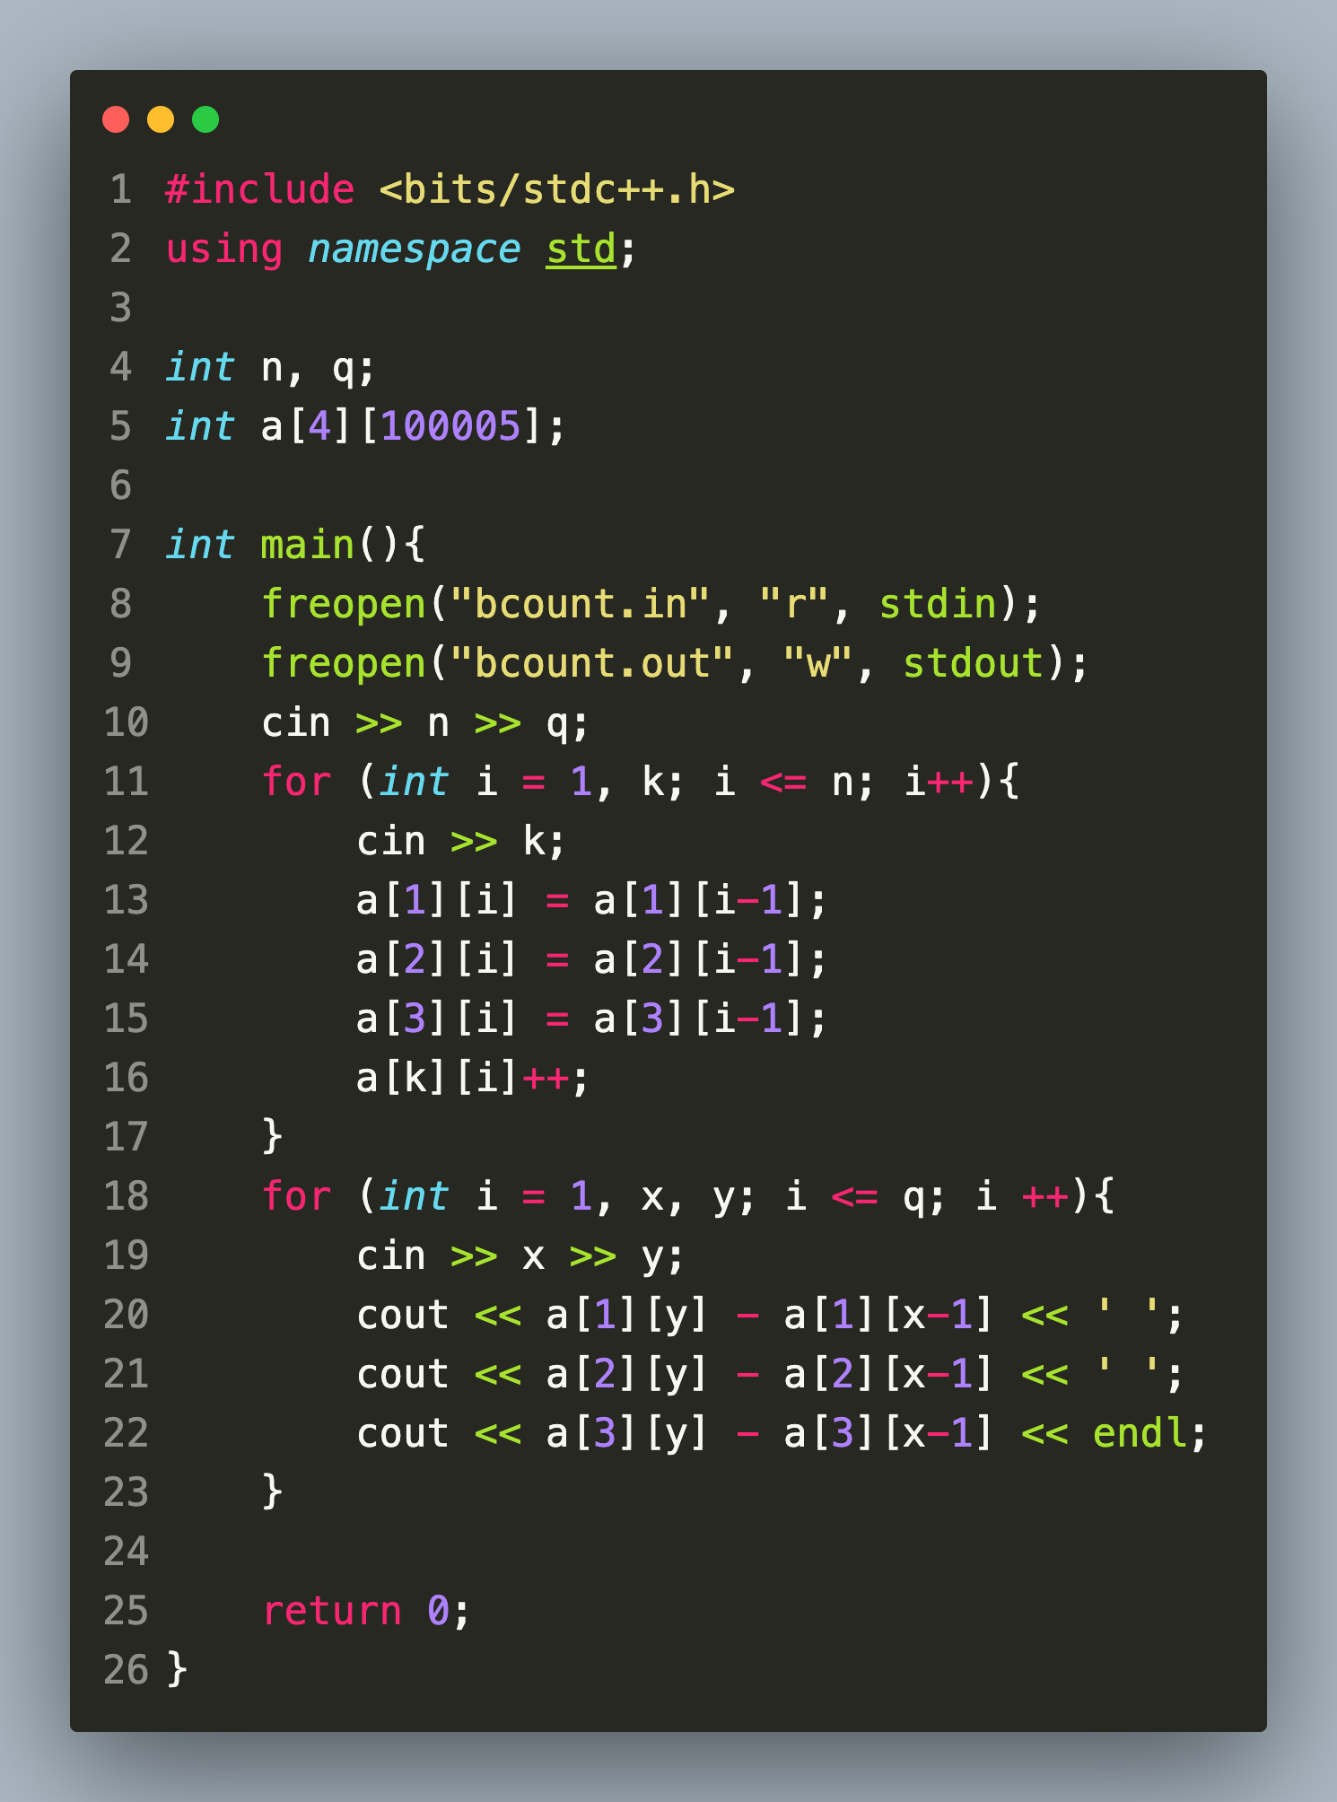
Example 1
Solution Code

Slide 4
Example

Slide 5
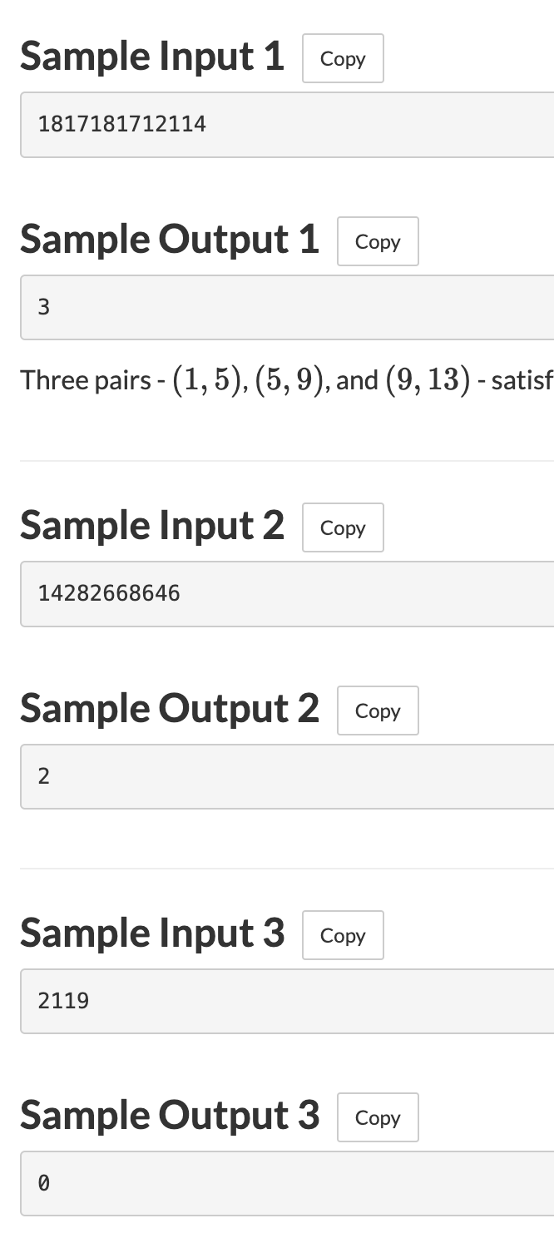
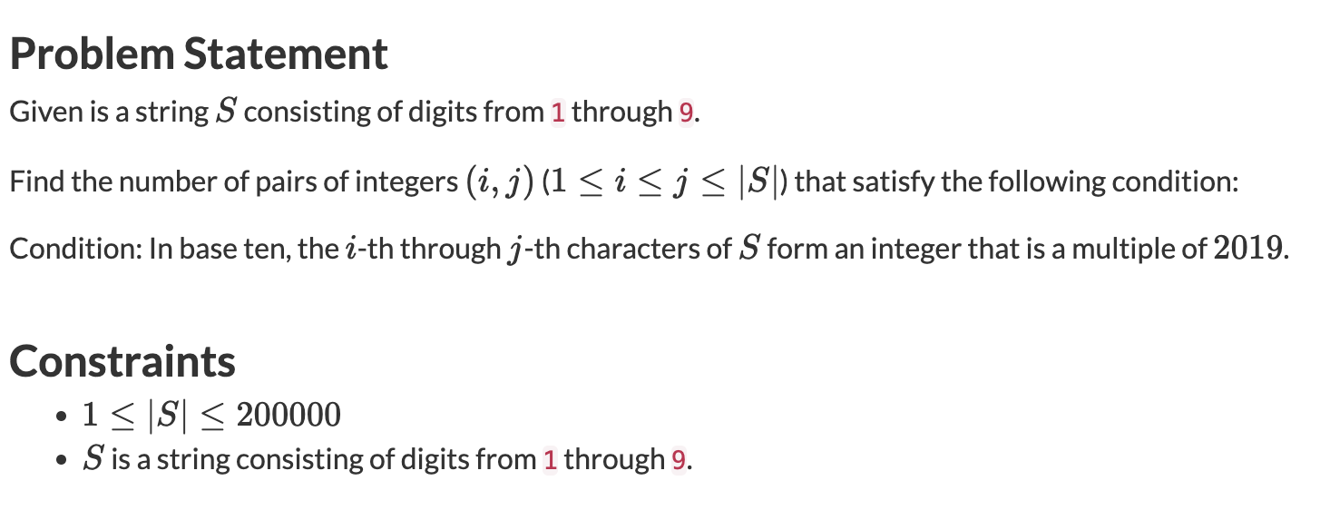
Example 7

Slide 6
Example 7 Solution Idea
Use prefix sums as follows, let T_i represent the value of the rightmost i digits. Then, value of string segment from i to j = T_j - T_(i-1) (mod 2019) needs to be equal to 0 (mod 2019).
Simply compute all T_i’s and store the result by adding 1 to the (mod 2019) position of an array, which in the end can be computed together for fr[i] C 2

Slide 7
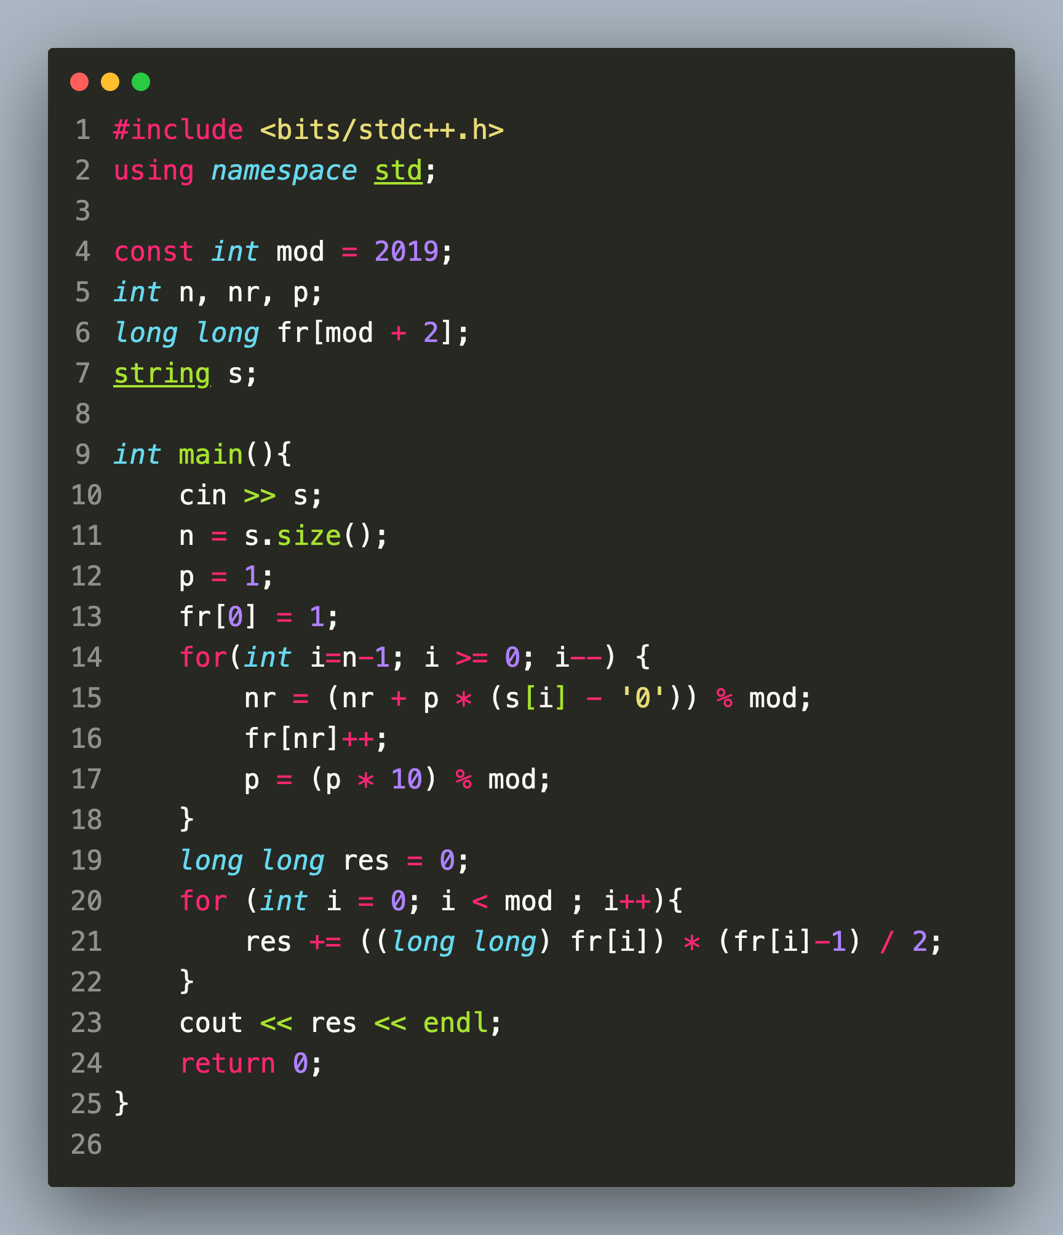
Example 7 Solution Code

