Slide 1
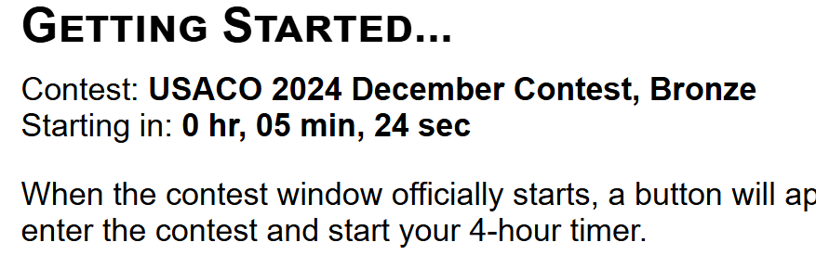
USACO 2024 December
Solutions of Bronze and Silver Problems

Slide 2
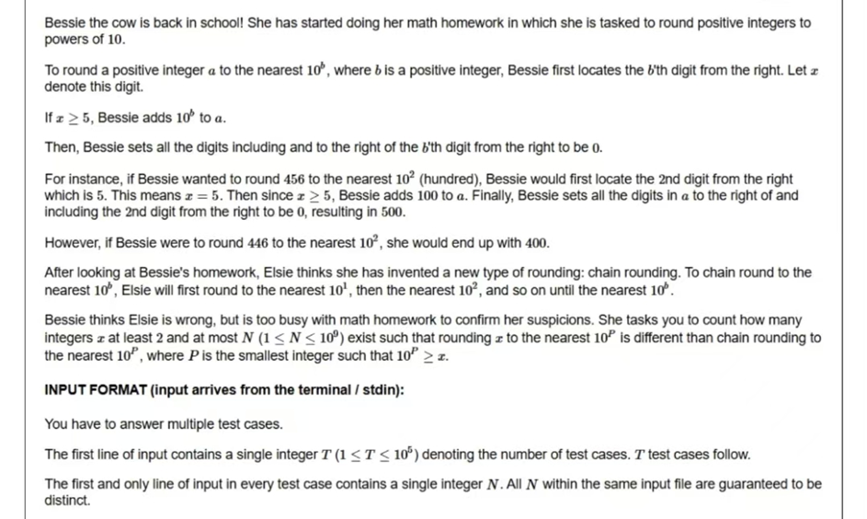
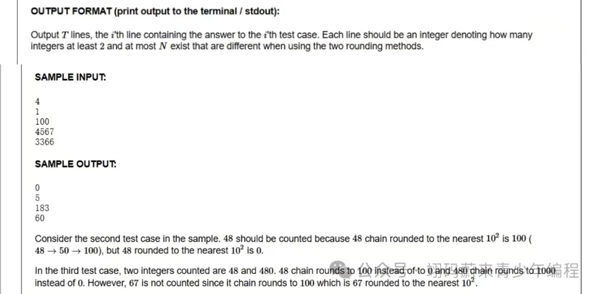
Bronze 1 - Problem (Sadly no pictures)
There is Elsie and Bessie, both of which are trying to round using 四舍五入.
Elsie starts from rounding from the last digit (rightmost) to the first (leftmost).
Bessie directly rounds the first digit (leftmost).
The question asks for how many numbers from 1 through N (inputted) would have a different result of rounding when Elsie rounds instead of Bessie.
There are T input cases.

Slide 3
Bronze 1 - Brute Force
We could try to iterate through all the numbers from 1 through N to see if each of these numbers would work.
The would be 10⁹ for each test case. There being a total of T (10⁵) test cases means that there will almost certainly be a time-out.
This solution would likely get around 30~50 points (if you did a bit of optimization)

Slide 4
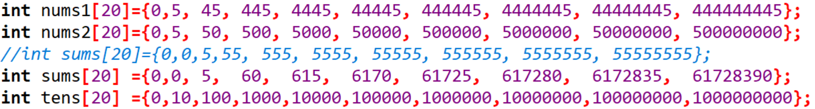
Bronze 1 - Solution
We could easily see from a mathematical point of view that for each 10^{n} through 10^{n+1}, a number that would have a different round would be from 444…445 (with n 4s) through 499…999 (with n 9s).
With that we can construct a O(T) method of solving the problem

Slide 5
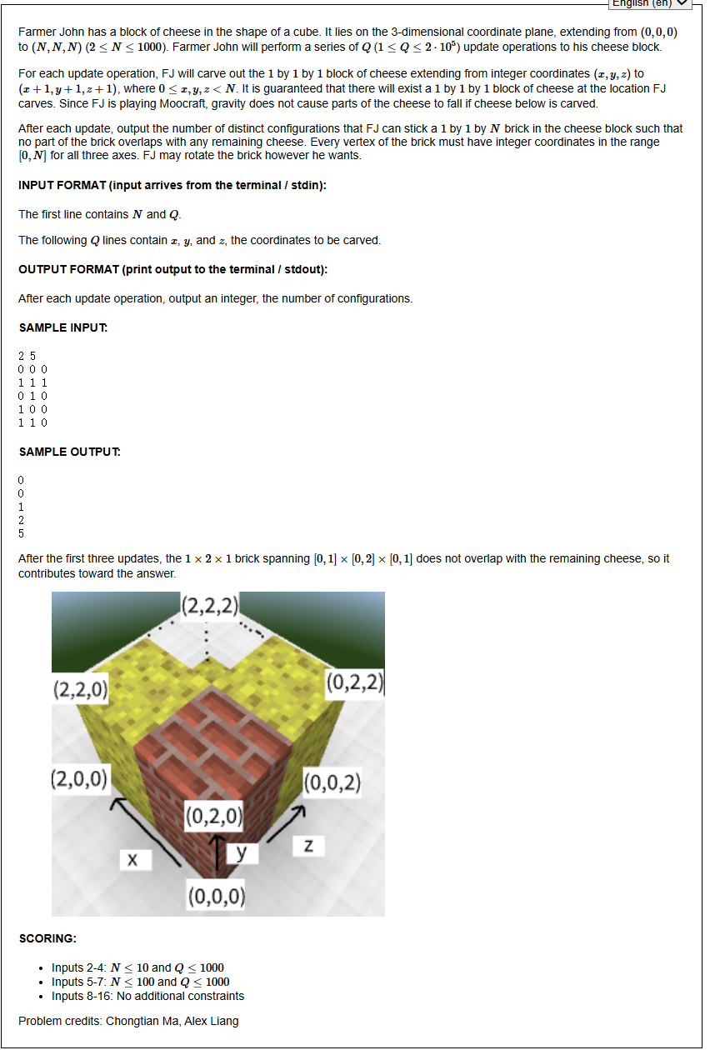
Bronze 2 - Problem
We place blocks of bricks in cheese for fun.
(Also Minecraft, hoorah)

Slide 6
Bronze 2 - Brute Force
For each cube removed, we can record on the three planes (xy, xz, and yz) that there was a cube removed here.
We can do a basic simulation that checks if each face’s each squares can fit a piece of brick inside it.
This would mean a total of O(N²Q)
(N² for checking each square on each face)
(Q for the total number of operations)
This should get around half of the points

Slide 7
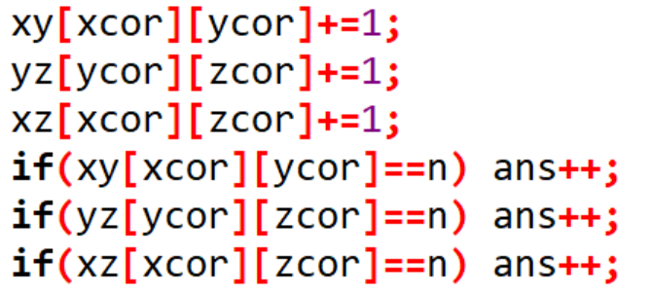
Bronze 2 - Solution
That method on the last slide was a bit slow, but we can optimize it.
We realize that we don’t exactly need to check each square, but instead only check the squares that were operated on.
This reduces the code’s time complexity to O(Q)

Slide 8
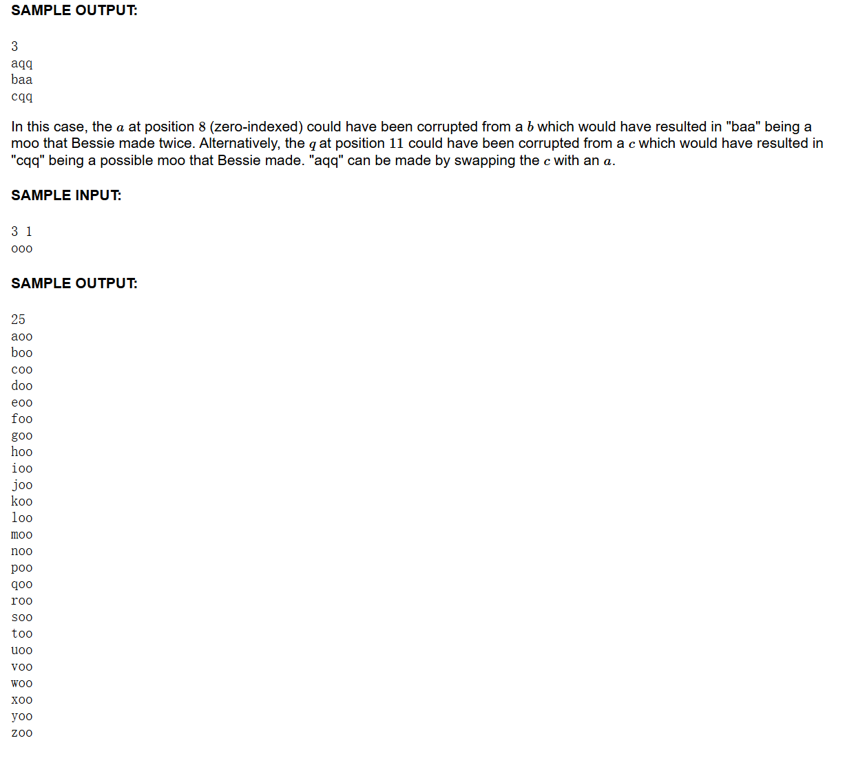
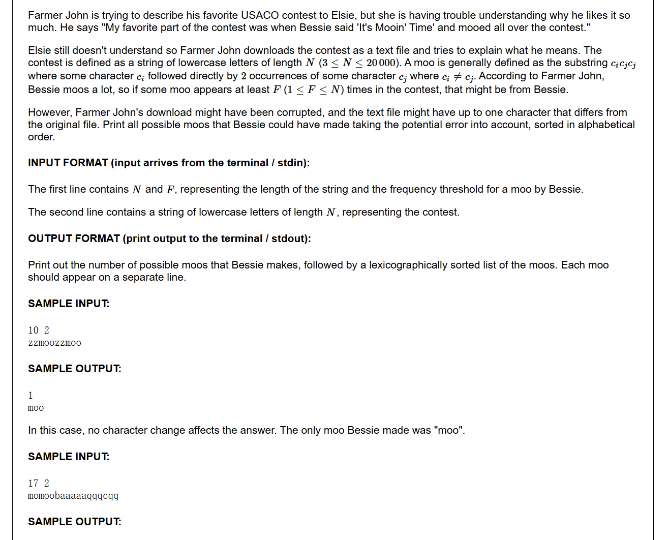
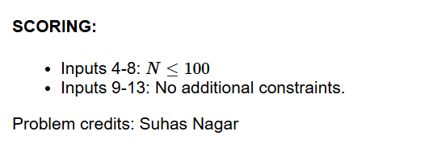
Bronze 3 - Problem

Slide 9
Bronze 3 - Solution
We could easily just simulate this process, with a bit of optimization.
We go through the entire string first and see how many types of moos (and their frequencies) there are
We store this frequency into a 30x30 2D array
Then we go through each character in the string again, replacing each character with another character in the alphabet and see how that would impact the frequency overall.
We record the moos that have a frequency more than F each time we change characters
(Can use method from T2, only focus on the moos that have their frequencies changed)

Slide 10
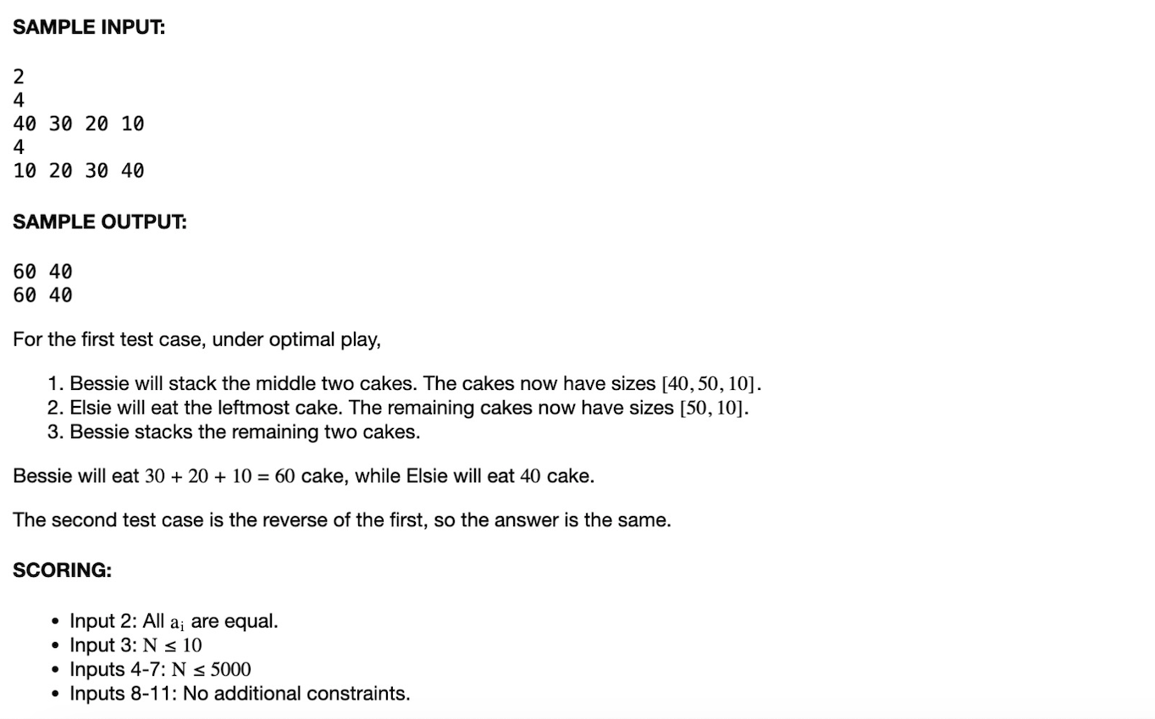
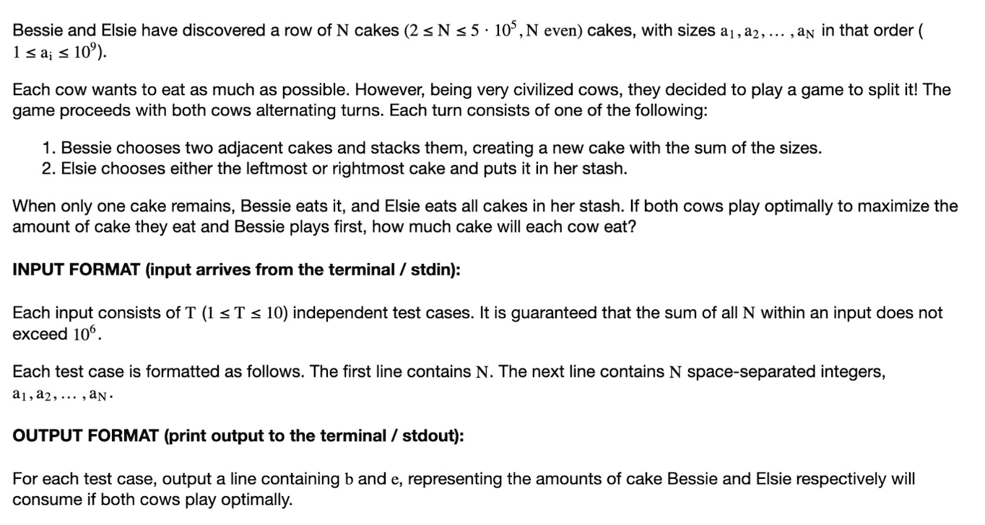
Silver 1 - Problem

Slide 11
Silver 1- Idea
We observe that Bessie wants to keep her stack for herself (if Elsie takes her stack of cakes, all of her work would be for nothing). We can then observe that to preserve her cake stack, Bessie must combine the middle two cakes, and the rest of her moves would be dictated by that of Elsie’s. Thus, we only need to look at Elsie’s optimal solution. This could be done via prefix and postfix sums.
Original
Prefix Sums
Postfix Sums
1
1
4
5
1
4
1
2
6
11
12
16
16
15
14
10
5
4
0 1 2 3 4 5 0 1 2 3 4 5 0 1 2 3 4 5

Slide 12
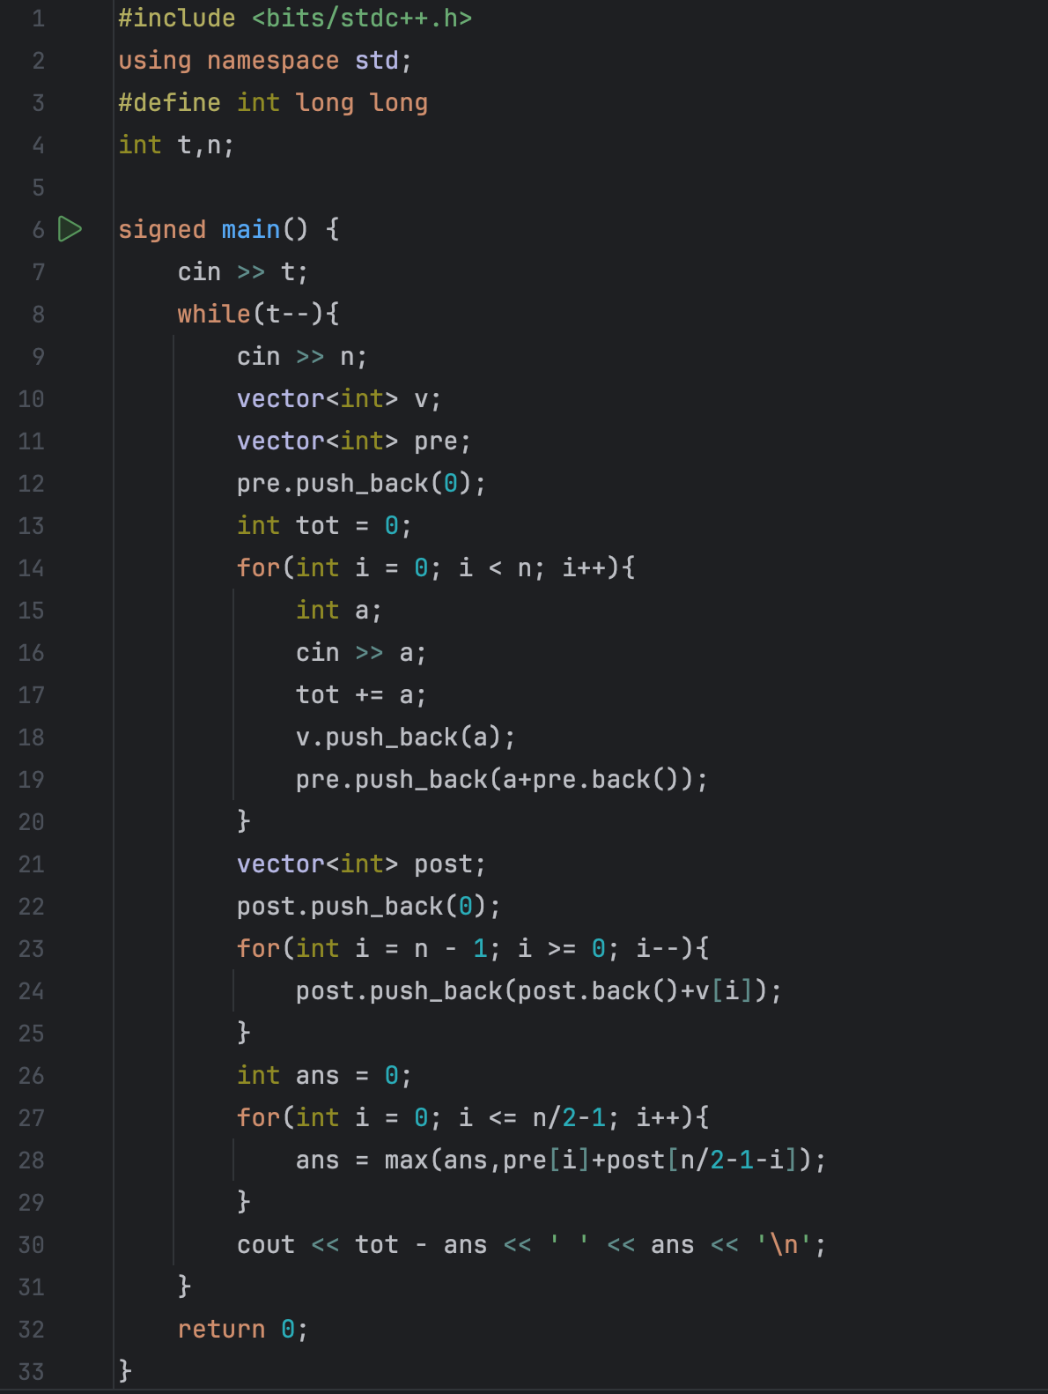
Silver 1 - Code

Slide 13
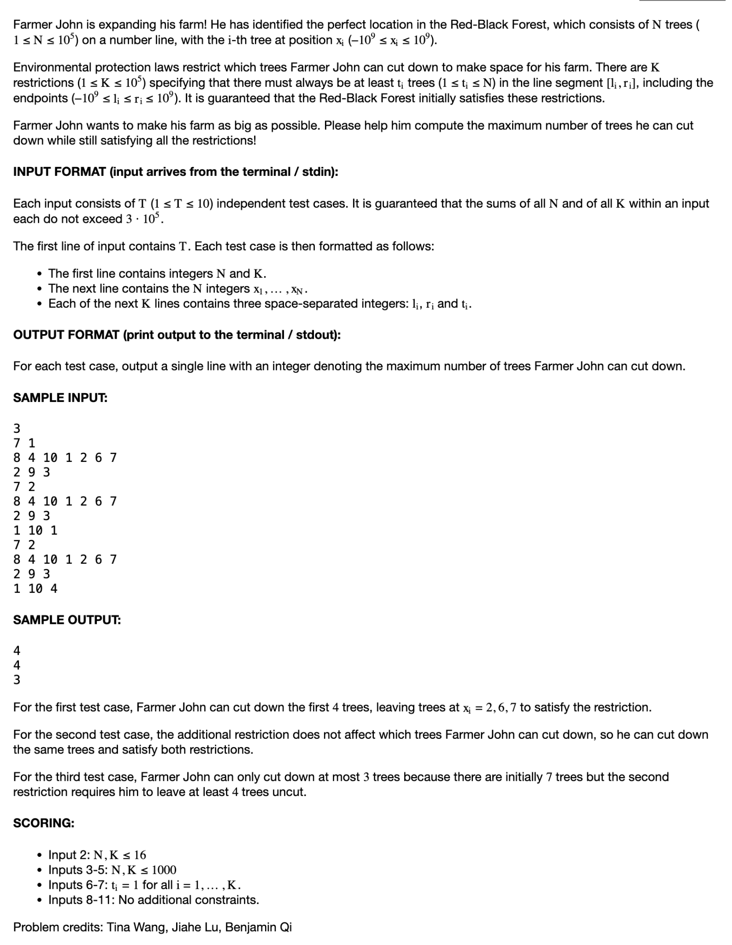
Silver 2 - Problem

Slide 14
Silver 2 - Solution
We sort all the intervals with restrictions by their RIGHT ENDPOINT
Then, we traverse these intervals from left to right according to their new order, looking for which trees to KEEP: we always choose the right-most [number of extra trees needed] trees.
We can use a Fenwick Tree to keep track of the chosen trees (and to quickly access range queries). Of course, there are other data structures that can update and find range query in log(n)...

Slide 15
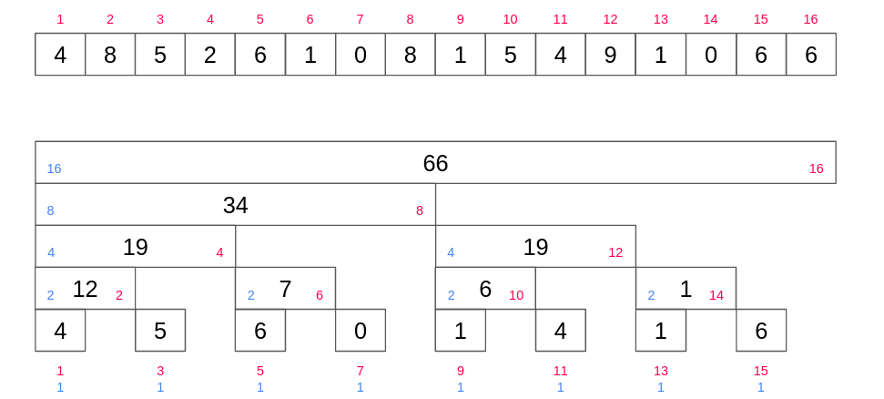
Silver 2 - Fenwick Trees
To change any element, we add to the line of intervals; keep adding the least significant set bit:
111011; 111100; 1000000;
To find the query sum ([1, k] prefix sum): keep flipping the least significant set bit
111011; 111010; 111000; 110000; 100000;

Slide 16
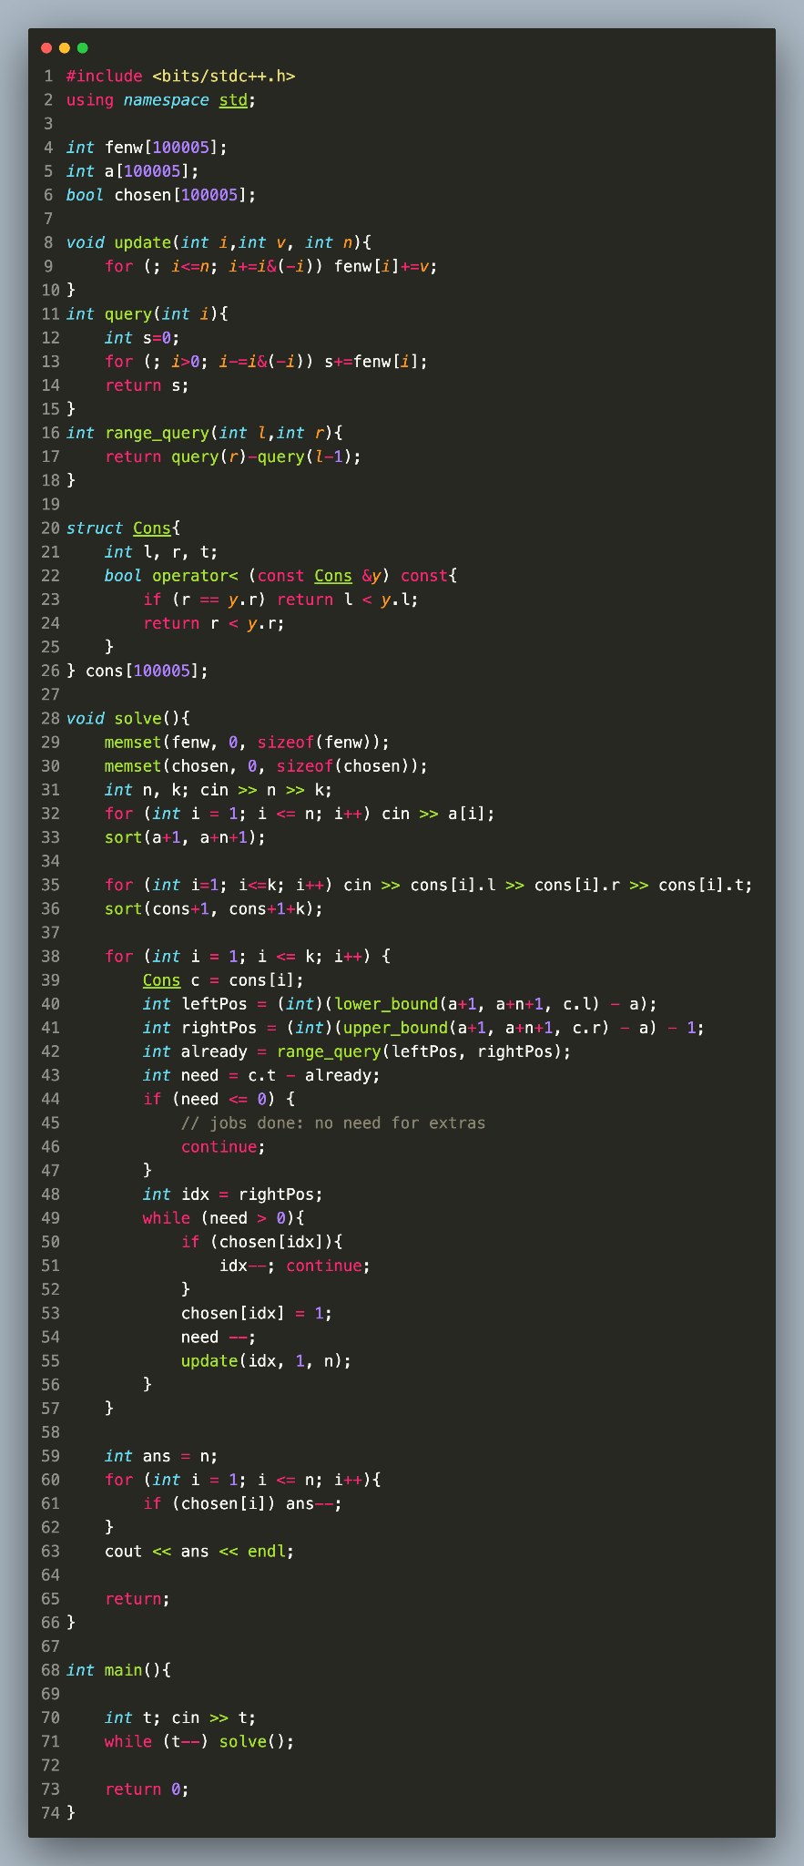
Silver 2- Solution Code

Slide 17
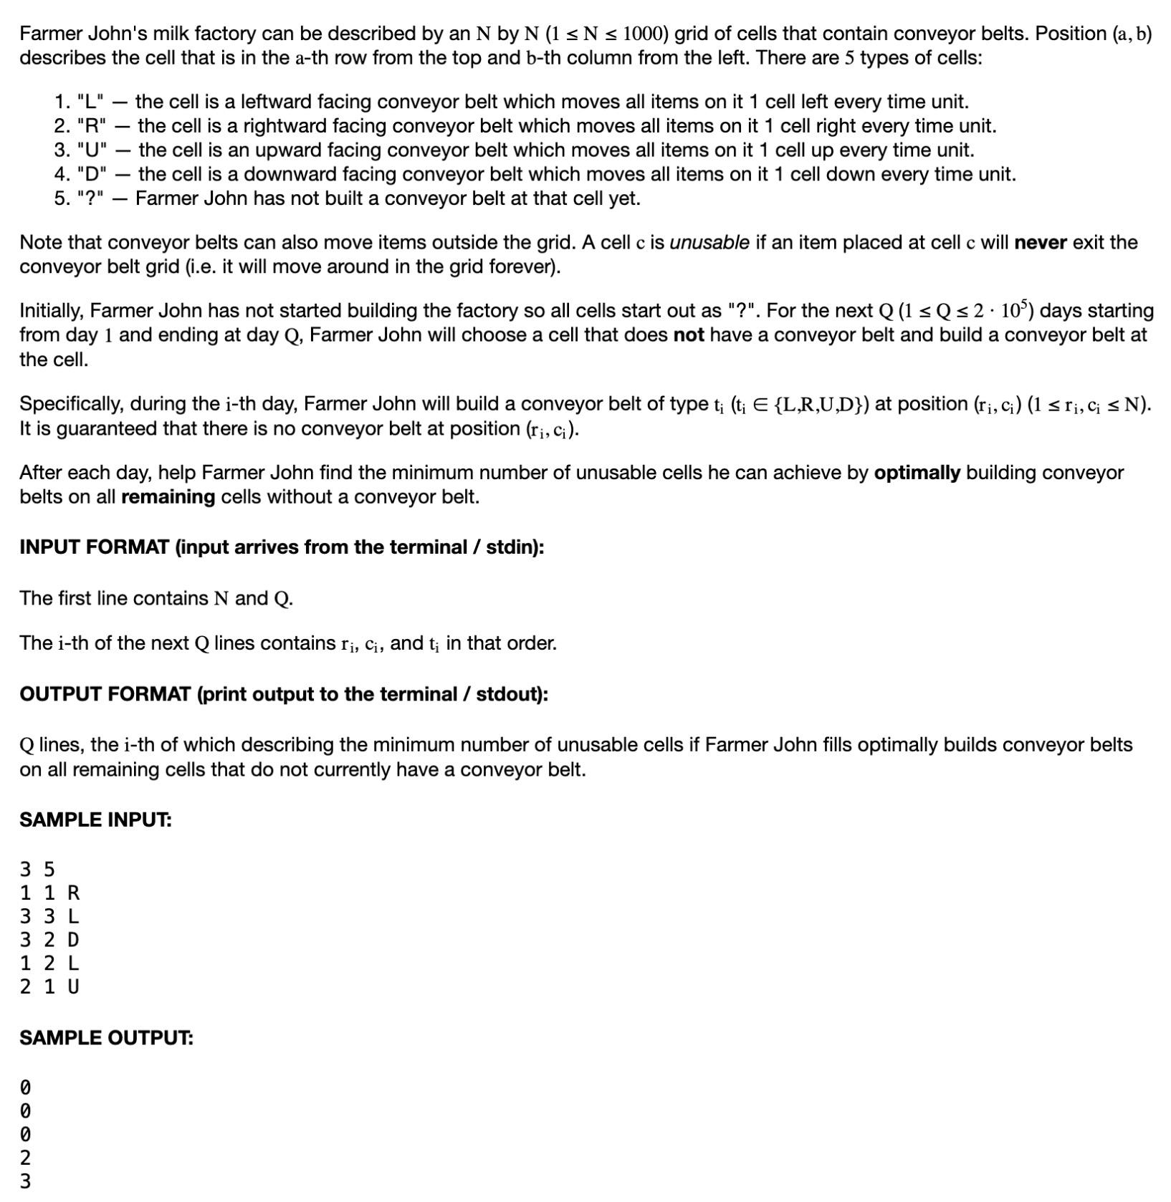
Silver 3 - Problem

Slide 18
Silver 3 - Idea
We can create a “border” around the conveyor belts (namely rows 0 and n + 1, and columns 0 and n + 1). First, we go to the ending position (after FJ has set up all the conveyor belts) and flood fill from (0,0) to get the last answer. Next, for every conveyor belt added (from the back), we check if any of the removed conveyor belt’s neighbors have been accessed in the flood fill. If so, then we continue a flood fill from the newly removed belt. Thus, we can solve this problem in only O(n^2) time (poor Hans), and since n <= 1000, the program could run way under the time limit.

Slide 20
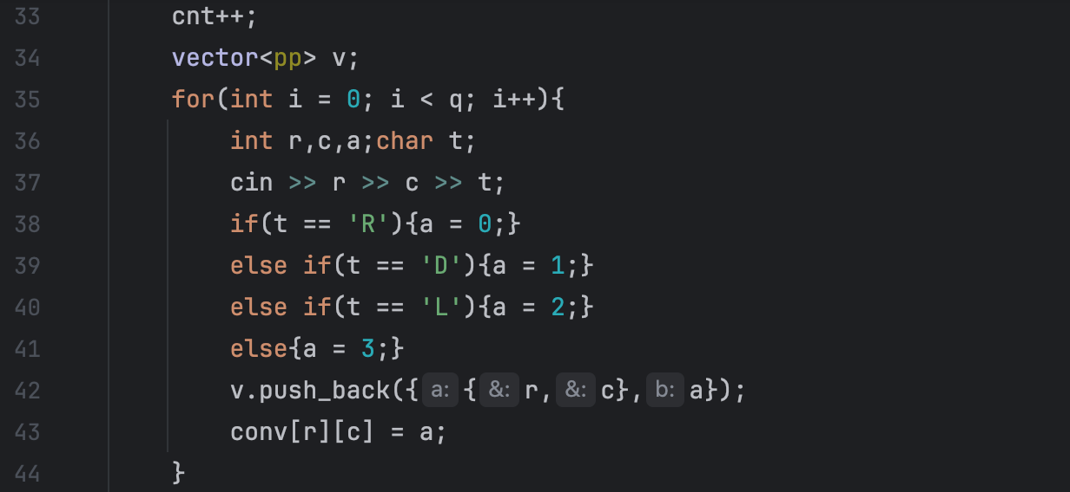
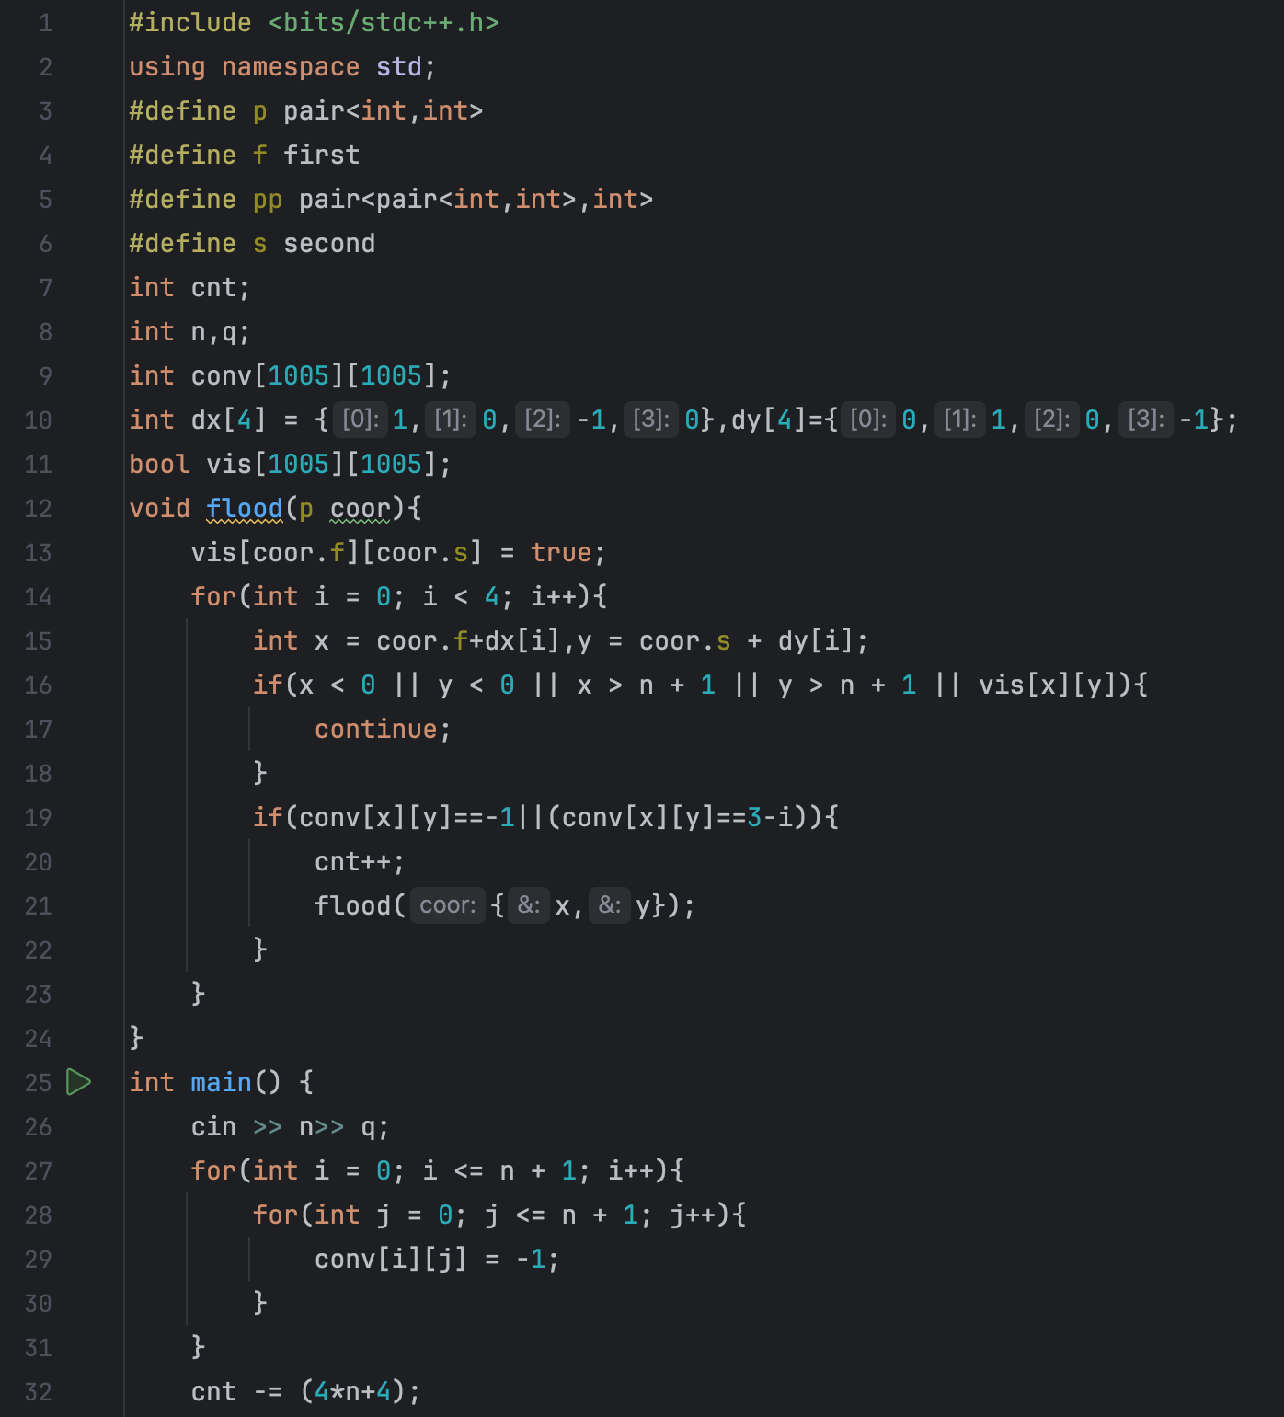
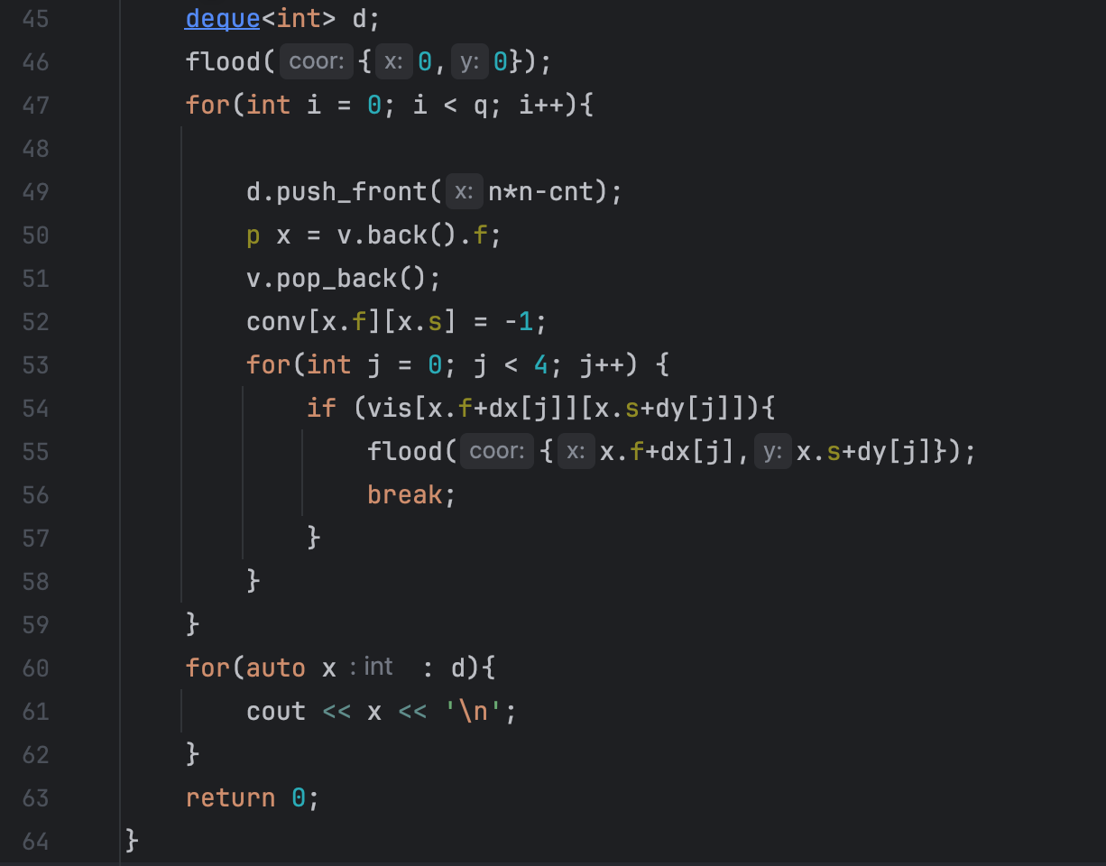
Silver 3 - Code

