Slide 1
AWS Fargate & EKS - Masterclass
Kalyan Reddy Daida

Slide 2

AWS EC2
Launch Templates

Slide 3
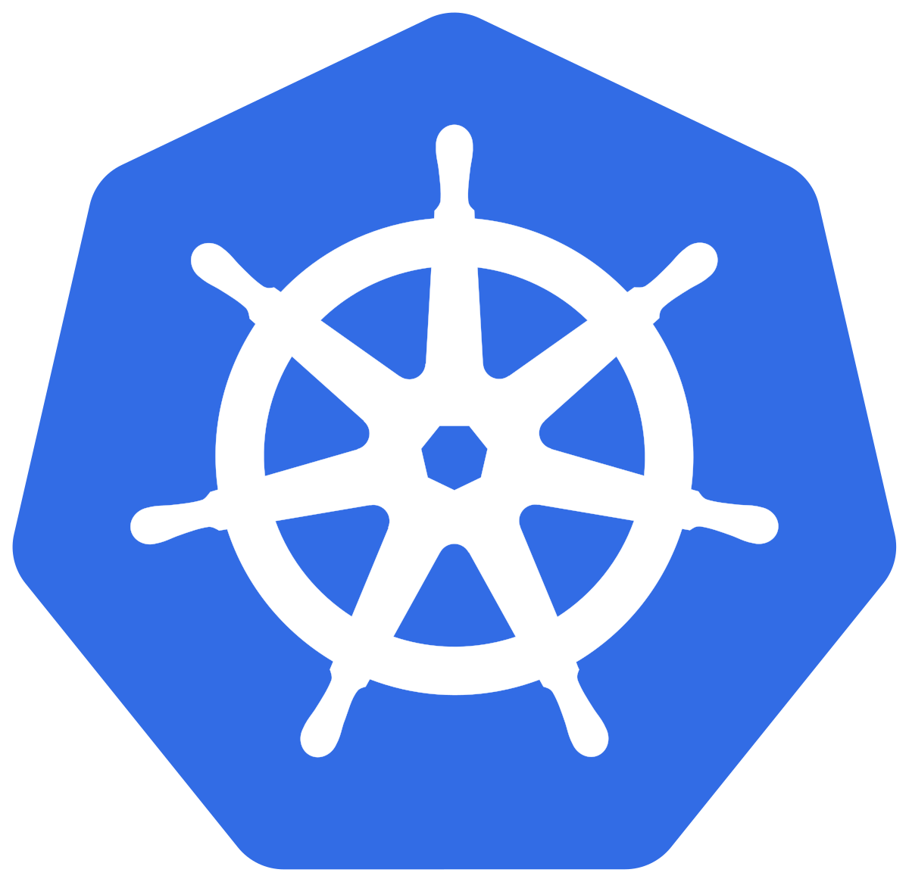
Kubernetes
Architecture

Slide 4
Why Kubernetes?

Slide 5
Kubernetes – Master & Worker Nodes

Slide 6
Kubernetes Architecture - Master
Master
kube-apiserver
It acts as front end for the Kubernetes control plane. It exposes the Kubernetes API
Command line tools (like kubectl), Users and even Master components (scheduler, controller manager, etcd) and Worker node components like (Kubelet) everything talk with API Server.
etcd
Consistent and highly-available key value store used as Kubernetes’ backing store for all cluster data.
It stores all the masters and worker node information.
kube-scheduler
Scheduler is responsible for distributing containers across multiple nodes.
It watches for newly created Pods with no assigned node, and selects a node for them to run on.
Kube Controller Manager
Cloud Controller Manager
kube-apiserver
etcd
kube-scheduler
Container Runtime (Docker)

Slide 7
Kubernetes Architecture - Master
Master
kube-controller-manager
Controllers are responsible for noticing and responding when nodes, containers or endpoints go down. They make decisions to bring up new containers in such cases.
Node Controller: Responsible for noticing and responding when nodes go down.
Replication Controller: Responsible for maintaining the correct number of pods for every replication controller object in the system.
Endpoints Controller: Populates the Endpoints object (that is, joins Services & Pods)
Service Account & Token Controller: Creates default accounts and API Access for new namespaces.
Kube Controller Manager
Cloud Controller Manager
kube-apiserver
etcd
kube-scheduler
Container Runtime (Docker)

Slide 8
Kubernetes Architecture - Master
Master
cloud-controller-manager
A Kubernetes control plane component that embeds cloud-specific control logic.
It only runs controllers that are specific to your cloud provider.
On-Premise Kubernetes clusters will not have this component.
Node controller: For checking the cloud provider to determine if a node has been deleted in the cloud after it stops responding
Route controller: For setting up routes in the underlying cloud infrastructure
Service controller: For creating, updating and deleting cloud provider load balancer
Kube Controller Manager
Cloud Controller Manager
kube-apiserver
etcd
kube-scheduler
Container Runtime (Docker)

Slide 9
Kubernetes Architecture – Worker Nodes
Worker Node
Kubelet
Kubelet is the agent that runs on every node in the cluster
This agent is responsible for making sure that containers are running in a Pod on a node.
Kube-Proxy
It is a network proxy that runs on each node in your cluster.
It maintains network rules on nodes
In short, these network rules allow network communication to your Pods from network sessions inside or outside of your cluster.
Kubelet
Kube-Proxy
Container Runtime (Docker)
Container Runtime
Container Runtime is the underlying software where we run all these Kubernetes components.
We are using Docker, but we have other runtime options like rkt, container-d etc.

Slide 10
Kubernetes - Architecture
Master
Worker Node
Kube Controller Manager
Cloud Controller Manager
Kubelet
Kube-Proxy
Container Runtime (Docker)
kube-apiserver
Worker Node
etcd
kube-scheduler
Kubelet
Kube-Proxy
Container Runtime (Docker)
Container Runtime (Docker)

Slide 11
a

