Slide 1
AWS EKS Kubernetes - Masterclass | DevOps, Microservices
Kalyan Reddy Daida

Slide 2
Kubernetes for Beginners
STACKSIMPLIFY
AWS EKS Kubernetes - Masterclass | DevOps, Microservices
Kubernetes
On
Cloud
Roadmap
Azure AKS Kubernetes - Masterclass | DevOps, Microservices
Google GKE Kubernetes - Masterclass | DevOps, Microservices

Slide 3
Kubernetes for Beginners On Cloud
STACKSIMPLIFY
AWS EKS Kubernetes - Masterclass | DevOps, Microservices
Kubernetes
On
Cloud
Roadmap
Azure AKS Kubernetes - Masterclass | DevOps, Microservices
Google GKE Kubernetes - Masterclass | DevOps, Microservices
Docker & Kubernetes for Java Spring Boot Developers on AWS

Slide 4
Kubernetes for Beginners On Cloud
AWS EKS Kubernetes - Masterclass | DevOps, Microservices
STACKSIMPLIFY
Azure AKS Kubernetes - Masterclass | DevOps, Microservices
Kubernetes
On
Cloud
Roadmap
Google GKE Kubernetes - Masterclass | DevOps, Microservices
Docker & Kubernetes for Java Spring Boot Developers on AWS
Master HELM3 with Kubernetes | DevOps, Microservices on AWS

Slide 5
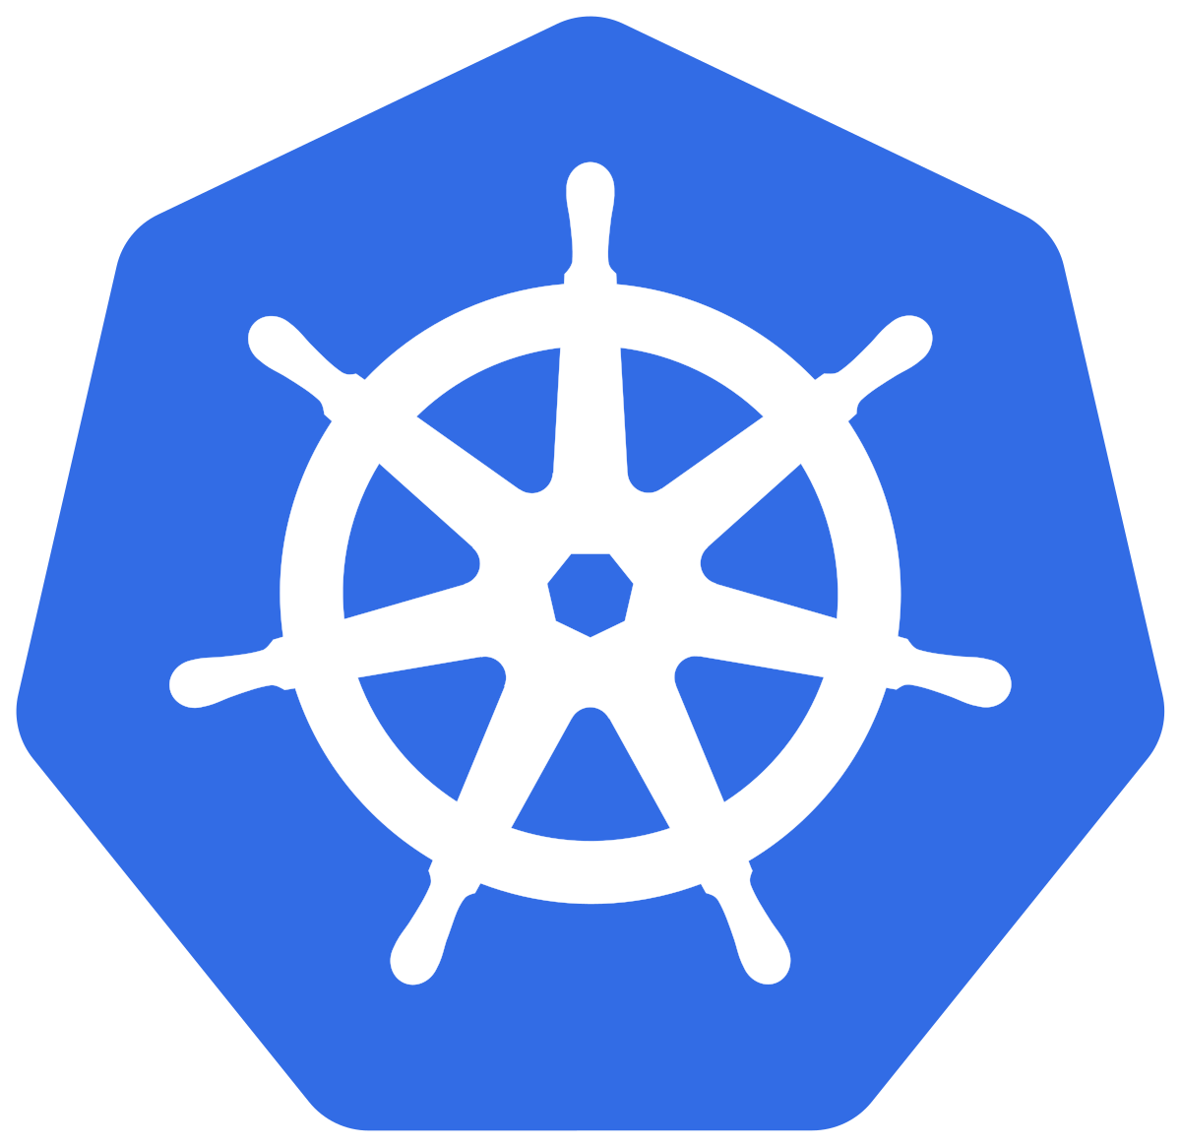

AWS EKS
CLIs

Slide 6
AWS EKS Cluster - CLIs
AWS CLI
We can control multiple AWS services from the command line and automate them through scripts.
CLIs
kubectl
We can control Kubernetes clusters and objects using kubectl
eksctl
eksctl is used for creating & deleting clusters on AWS EKS.
We can even create, autoscale and delete node groups.
We can even create fargate profiles using eksctl
In short, it is VERY VERY POWERFUL tool for managing EKS clusters on AWS.

Slide 7
AWS EKS
Cluster

Slide 8
AWS EKS – Core Objects
EKS Cluster
EKS Control Plane
Worker Nodes & Node Groups
Fargate Profiles
(Serverless)
VPC
Contains Kubernetes Master components like etcd, kube-apiserver, kube-controller.
It’s a managed service by AWS
Group of EC2 Instances where we run our Application workloads
Instead of EC2 Instances, we run our Application workloads on Serverless Fargate profiles
With AWS VPC we follow secure networking standards which will allow us to run production workloads on EKS.

Slide 9
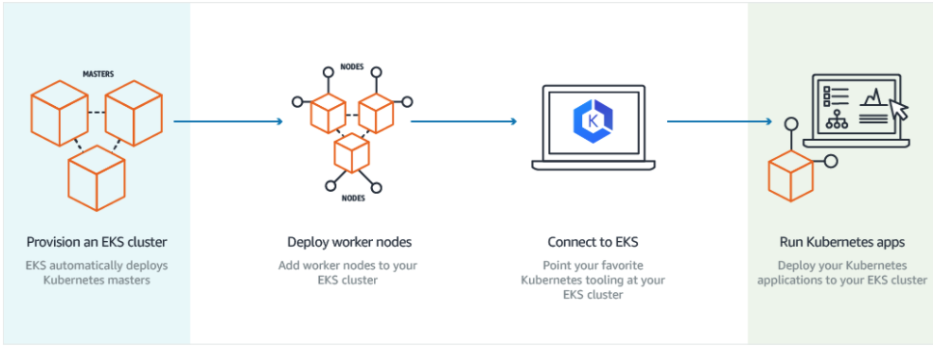
How does EKS work?
© Amazon

Slide 10
EKS Cluster – Core Objects Detailed
EKS Control Plane
EKS runs a single tenant Kubernetes control plane for each cluster, and control plane infrastructure is not shared across clusters or AWS accounts.
This control plane consists of at least two API server nodes and three etcd nodes that run across three Availability Zones within a Region
EKS automatically detects and replaces unhealthy control plane instances, restarting them across the Availability Zones within the Region as needed.
Worker Nodes
&
Node Groups
Worker machines in Kubernetes are called nodes. These are EC2 Instances
EKS worker nodes run in our AWS account and connect to our cluster's control plane via the cluster API server endpoint.
A node group is one or more EC2 instances that are deployed in an EC2 Autoscaling group.
All instances in a node group must
Be the same instance type
Be running the same AMI
Use the same EKS worker node IAM role

Slide 11
EKS Cluster – Core Objects Detailed
Fargate Profiles
AWS Fargate is a technology that provides on-demand, right-sized compute capacity for containers
With Fargate, we no longer have to provision, configure, or scale groups of virtual machines to run containers.
Each pod running on Fargate has its own isolation boundary and does not share the underlying kernel, CPU resources, memory resources, or elastic network interface with another pod.
AWS specially built Fargate controllers that recognizes the pods belonging to fargate and schedules them on Fargate profiles.
We will see more in our Fargate learning section.
VPC
EKS uses AWS VPC network policies to restrict traffic between control plane components to within a single cluster.
Control plane components for a EKS cluster cannot view or receive communication from other clusters or other AWS accounts, except as authorized with Kubernetes RBAC policies.
This secure and highly-available configuration makes EKS reliable and recommended for production workloads.

Slide 12
AWS EKS
Cluster

Slide 13
EKS Kubernetes - Architecture
Master
Worker Node -1
EKS Controller Manager
Fargate Controller Manager
Kubelet
Kube-Proxy
Container Runtime (Docker)
kube-apiserver
Worker Node - 2
etcd
kube-scheduler
Kubelet
Kube-Proxy
Container Runtime (Docker)
Container Runtime (Docker)
EKS Control Plane
EKS Node Group

Slide 14
EKS Limits

Slide 15
Kubernetes
Architecture

Slide 16
Kubernetes
Architecture

Slide 17
Why Kubernetes?

Slide 18
Kubernetes - Architecture
Master
Worker Node
Kube Controller Manager
Cloud Controller Manager
Kubelet
Kube-Proxy
Container Runtime (Docker)
kube-apiserver
Worker Node
etcd
kube-scheduler
Kubelet
Kube-Proxy
Container Runtime (Docker)
Container Runtime (Docker)

Slide 19
Kubernetes Architecture - Master
Master
kube-apiserver
It acts as front end for the Kubernetes control plane. It exposes the Kubernetes API
Command line tools (like kubectl), Users and even Master components (scheduler, controller manager, etcd) and Worker node components like (Kubelet) everything talk with API Server.
etcd
Consistent and highly-available key value store used as Kubernetes’ backing store for all cluster data.
It stores all the masters and worker node information.
kube-scheduler
Scheduler is responsible for distributing containers across multiple nodes.
It watches for newly created Pods with no assigned node, and selects a node for them to run on.
Kube Controller Manager
Cloud Controller Manager
kube-apiserver
etcd
kube-scheduler
Container Runtime (Docker)

Slide 20
Kubernetes Architecture - Master
Master
kube-controller-manager
Controllers are responsible for noticing and responding when nodes, containers or endpoints go down. They make decisions to bring up new containers in such cases.
Node Controller: Responsible for noticing and responding when nodes go down.
Replication Controller: Responsible for maintaining the correct number of pods for every replication controller object in the system.
Endpoints Controller: Populates the Endpoints object (that is, joins Services & Pods)
Service Account & Token Controller: Creates default accounts and API Access for new namespaces.
Kube Controller Manager
Cloud Controller Manager
kube-apiserver
etcd
kube-scheduler
Container Runtime (Docker)

Slide 21
Kubernetes Architecture - Master
Master
cloud-controller-manager
A Kubernetes control plane component that embeds cloud-specific control logic.
It only runs controllers that are specific to your cloud provider.
On-Premise Kubernetes clusters will not have this component.
Node controller: For checking the cloud provider to determine if a node has been deleted in the cloud after it stops responding
Route controller: For setting up routes in the underlying cloud infrastructure
Service controller: For creating, updating and deleting cloud provider load balancer
Kube Controller Manager
Cloud Controller Manager
kube-apiserver
etcd
kube-scheduler
Container Runtime (Docker)

Slide 22
Kubernetes Architecture – Worker Nodes
Worker Node
Kubelet
Kubelet is the agent that runs on every node in the cluster
This agent is responsible for making sure that containers are running in a Pod on a node.
Kube-Proxy
It is a network proxy that runs on each node in your cluster.
It maintains network rules on nodes
In short, these network rules allow network communication to your Pods from network sessions inside or outside of your cluster.
Kubelet
Kube-Proxy
Container Runtime (Docker)
Container Runtime
Container Runtime is the underlying software where we run all these Kubernetes components.
We are using Docker, but we have other runtime options like rkt, container-d etc.

Slide 23
Kubernetes - Architecture
Master
Worker Node
Kube Controller Manager
Cloud Controller Manager
Kubelet
Kube-Proxy
Container Runtime (Docker)
kube-apiserver
Worker Node
etcd
kube-scheduler
Kubelet
Kube-Proxy
Container Runtime (Docker)
Container Runtime (Docker)

Slide 24
Kubernetes
Fundamentals
Pod, ReplicaSet, Deployment & Service

Slide 25
Kubernetes - Fundamentals
Pod
A POD is a single instance of an Application.
A POD is the smallest object, that you can create in Kubernetes.
ReplicaSet
A ReplicaSet will maintain a stable set of replica Pods running at any given time.
In short, it is often used to guarantee the availability of a specified number of identical Pods
k8s Fundamentals
Deployment
A Deployment runs multiple replicas of your application and automatically replaces any instances that fail or become unresponsive.
Rollout & rollback changes to applications. Deployments are well-suited for stateless applications.
Service
A service is an abstraction for pods, providing a stable, so called virtual IP (VIP) address.
In simple terms, service sits Infront of a POD and acts as a load balancer.

Slide 26
Kubernetes - Imperative & Declarative
Kubernetes Fundamentals
Imperative
Declarative
kubectl
YAML & kubectl
Pod
Pod
ReplicaSet
ReplicaSet
Deployment
Deployment
Service
Service

Slide 27
Kubernetes
POD

Slide 28
Kubernetes - POD
With Kubernetes our core goal will be to deploy our applications in the form of containers on worker nodes in a k8s cluster.
Kubernetes does not deploy containers directly on the worker nodes.
Container is encapsulated in to a Kubernetes Object named POD.
A POD is a single instance of an application.
A POD is the smallest object that we can create in Kubernetes.
N
Nginx Container
Image
N
N
POD
POD
Worker Node
Worker Node
Node
Worker Node
Kubernetes Cluster

Slide 29

Kubernetes - POD
PODs generally have one to one relationship with containers.
To scale up we create new POD and to scale down we delete the POD.
N
N
N
N
POD
POD
POD
POD
Worker Node - 1
Worker Node - 2
Kubernetes Cluster

Slide 30
Kubernetes – PODs
We cannot have multiple containers of same kind in a single POD.
Example: Two NGINX containers in single POD serving same purpose is not recommended.
N
N
N
N
N
POD
POD
POD
POD
Worker Node - 1
Worker Node - 2
Kubernetes Cluster

Slide 31
Kubernetes – Multi-Container Pods
We can have multiple containers in a single POD, provided they are not of same kind.
Helper Containers (Side-car)
Data Pullers: Pull data required by Main Container
Data pushers: Push data by collecting from main container (logs)
Proxies: Writes static data to html files using Helper container and Reads using Main Container.
Communication
The two containers can easily communicate with each other easily as they share same network space.
They can also easily share same storage space.
Multi-Container Pods is a rare use-case and we will try to focus on core fundamentals.
N
H
POD
Worker Node
Kubernetes Cluster
Helper
Containers
Node

Slide 32
Kubernetes
PODs
Demo

Slide 33
Kubernetes
Services - NodePort

Slide 34

Kubernetes – Service - NodePort
We can expose an application running on a set of PODs using different types of Services available in k8s.
ClusterIP
NodePort
LoadBalancer
NodePort Service
To access our application outside of k8s cluster, we can use NodePort service.
Exposes the Service on each Worker Node's IP at a static port (nothing but NodePort).
A ClusterIP Service, to which the NodePort Service routes, is automatically created.
Port Range 30000-32767
http://<Worker-Node-IP>:<NodePort>
NodePort: 3xxx
User
Worker NodePort
Port: 80
Service
ClusterIP Service Port
targetPort: 80
Container Port in a POD
Node
N
POD
Worker Node
Worker Node
Worker Node
Node
Kubernetes Cluster

Slide 35
Kubernetes
POD & NodePort Service
Demo

Slide 36
Kubernetes
ReplicaSets

Slide 37
Kubernetes - ReplicaSets
High Availability or Reliability
Scaling
ReplicaSets
Load Balancing
Labels & Selectors

Slide 38
Kubernetes – ReplicaSet
A ReplicaSet’s purpose is to maintain a stable set of replica Pods running at any given time.
If our application crashes (any pod dies), replicaset will recreate the pod immediately to ensure the configured number of pods running at any given time.
Reliability
Or
High Availability
N
N
N
POD
POD
POD
ReplicaSet
Worker Node
Kubernetes Cluster

Slide 39

Kubernetes – ReplicaSet
Load Balancing
To avoid overloading of traffic to single pod we can use load balancing.
Kubernetes provides pod load balancing out of the box using Services for the pods which are part of a ReplicaSet
Labels & Selectors are the key items which ties all 3 together (Pod, ReplicaSet & Service), we will know in detail when we are writing YAML manifests for these objects
Service
N
N
N
N
POD
POD
POD
POD
ReplicaSet
Worker Node
Worker Node
Kubernetes Cluster

Slide 40
Kubernetes – ReplicaSet
Scaling
When load become too much for the number of existing pods, Kubernetes enables us to easily scale up our application, adding additional pods as needed.
This is going to be seamless and super quick.
Service
N
N
N
N
POD
POD
POD
POD
ReplicaSet
Worker Node
Worker Node
Kubernetes Cluster

Slide 41
Kubernetes
ReplicaSets
Demo

Slide 42
Kubernetes
Deployments

Slide 43
Kubernetes – Deployments
Service
N
N
N
N
POD
POD
POD
POD
ReplicaSet
Deployment
Worker Node - 1
Worker Node - 2
Kubernetes Cluster

Slide 44
Kubernetes - Deployment
Create a Deployment to rollout a ReplicaSet
Updating the Deployment
Rolling Back a Deployment
Deployments
Scaling a Deployment
Pausing and Resuming a Deployment
Deployment Status
Clean up Policy
Canary Deployments

Slide 45
Kubernetes
Deployments
Demo

Slide 46
Kubernetes
Services

Slide 47
Kubernetes - Services
ClusterIP
Used for communication between applications inside k8s cluster (Example: Frontend application accessing backend application)
NodePort
Used for accessing applications outside of of k8s cluster using Worker Node Ports (Example: Accessing Frontend application on browser)
Services
LoadBalancer
Primarily for Cloud Providers to integrate with their Load Balancer services (Example: AWS Elastic Load Balancer)
Ingress
Ingress is an advanced load balancer which provides Context path based routing, SSL, SSL Redirect and many more (Example: AWS ALB)
externalName
To access externally hosted apps in k8s cluster (Example: Access AWS RDS Database endpoint by application present inside k8s cluster)

Slide 48


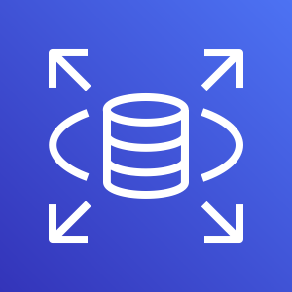
Services
Kubernetes Cluster
Frontend App – NodePort or LoadBalancer or Ingress Service
Users
N
N
N
POD
POD
POD
ReplicaSet
Deployment (app=frontend)
Backend App - ClusterIP Service
AWS Cloud
B
B
B
DB – ExternalName Service
POD
POD
POD
AWS RDS Database
ReplicaSet
Deployment (app=Backend)

Slide 49
Kubernetes
Services
Demo

Slide 50
Services Demo
Kubernetes Cluster
Frontend App – NodePort Service
Users
http://<workernode-public-ip>:<NodePort>/hello
N
POD
ReplicaSet
Deployment (app=frontend)
Backend App - ClusterIP Service
B
POD
ReplicaSet
Deployment (app=Backend)

Slide 51
Kubernetes
YAML Basics

Slide 52
YAML Basics

Slide 53
AWS EKS
Storage

Slide 54
EKS Storage
In-Tree EBS Provisioner
EBS CSI Driver
EFS CSI Driver
FSx for Luster CSI
Legacy
CSI means Container Storage Interface
Will be deprecated soon
Latest & Greatest available today & in Beta release & ready for production use
As on today, not supported on AWS EKS Fargate (Serverless)
Allows EKS Clusters to manage lifecycle of EBS Volumes for persistent storage, EFS File systems & FSx for Luster File systems
Supported for k8s 1.14 & later
Supported for k8s 1.16 & later

Slide 55
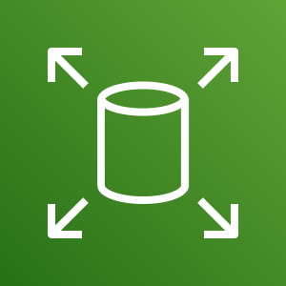
AWS EKS Storage
EBS CSI Driver

Slide 56
AWS Elastic Block Store - Introduction
EBS provides block level storage volumes for use with EC2 & Container instances.
We can mount these volumes as devices on our EC2 & Container instances.
EBS volumes that are attached to an instance are exposed as storage volumes that persist independently from the life of the EC2 or Container instance.
We can dynamically change the configuration of a volume attached to an instance.
AWS recommends EBS for data that must be quickly accessible and requires long-term persistence.
EBS is well suited to both database-style applications that rely on random reads and writes, and to throughput-intensive applications that perform long, continuous reads and writes.

Slide 57
EKS Storage EBS CSI Driver
EKS Cluster
MySQL – ClusterIP Service
AWS Elastic Block Store - EBS
Storage Class
Environment Variables
Persistent Volume Claim
Volumes
MySql
Config Map
Volume Mounts
POD
ReplicaSet
Deployment
Deployment (mysql)
ClusterIP Service

Slide 58
EKS Cluster
http://<workernode-public-ip>:<NodePort>/usermgmt/<apis>
UserMgmt – NodePort Service
Users
NodePort Service
REST API
Deployment
EKS Storage EBS CSI Driver
POD
Environment Variables
ReplicaSet
Deployment (UserMgmt)
MySQL – ClusterIP Service
AWS Elastic Block Store - EBS
Storage Class
Environment Variables
Persistent Volume Claim
Volumes
MySql
Config Map
Volume Mounts
POD
ReplicaSet
Deployment
Deployment (mysql)
ClusterIP Service

Slide 59
Elastic Block Store
AWS EKS Storage
EBS CSI Driver
Important k8s Concepts
for Application Deployments

Slide 60
EKS Cluster
http://<workernode-public-ip>:<NodePort>/usermgmt/<apis>
UserMgmt – NodePort Service
Secrets
Namespaces
Users
Init Containers
NodePort Service
Liveness & Readiness Probes
REST API
Deployment
EKS Storage EBS CSI Driver
Requests & Limits
POD
Environment Variables
ReplicaSet
Deployment (UserMgmt)
MySQL – ClusterIP Service
AWS Elastic Block Store - EBS
Storage Class
Environment Variables
Persistent Volume Claim
Volumes
MySql
Config Map
Volume Mounts
POD
ReplicaSet
Deployment
Deployment (mysql)
ClusterIP Service

Slide 61
Probes
Probes
Liveness Probe
Readiness Probe
Startup Probe
Kubelet uses liveness probes to know when to restart a container
Kubelet uses readiness probes to know when a container is ready to accept traffic
Kubelet uses startup probes to know when a container application has started
Liveness probes could catch a deadlock, where an application is running, but unable to make progress and restarting container helps in such state
When a Pod is not ready, it is removed from Service load balancers based on this readiness probe signal.
Firstly this proble disables liveness & readiness checks until it succeeds ensuring those pods don’t interfere with app startup.
This can be used to adopt liveness checks on slow starting containers, avoiding them getting killed by the kubelet before they are up and running.
Options to define Probes
Check using Commands
/bin/sh –c nc -z localhost 8095
Check using HTTP GET Request
httpget path:/health-status
Check using TCP
tcpSocket Port: 8095

Slide 62
Kubernetes
Namespaces

Slide 63
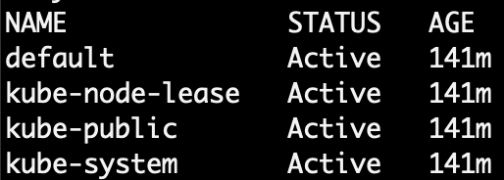
Namespaces - Introduction
Namespaces are also called Virtual clusters in our physical k8s cluster
We use this in environments where we have many users spread across multiple teams or projects
Clusters with tens of users ideally don’t need to use namespaces
Benefits
Creates isolation boundary from other k8s objects
We can limit the resources like CPU, Memory on per namespace basis (Resource Quota).

Slide 64
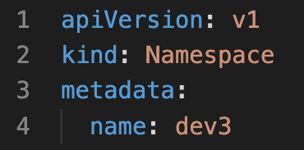
Namespaces
LoadBalancer Service
LoadBalancer Service
LoadBalancer Service
F
F
F
Pod
Pod
Pod
Namespace Manifest - Declarative
ReplicaSet
ReplicaSet
ReplicaSet
Deployment
Deployment
Deployment
ClusterIP Service
ClusterIP Service
ClusterIP Service
B
B
B
Pod
Pod
Pod
ReplicaSet
ReplicaSet
ReplicaSet
Deployment
Deployment
Deployment
Namespace: dev
Namespace: qa
Namespace: staging
Namespace Manifest - Imperative
Deployment

Slide 65
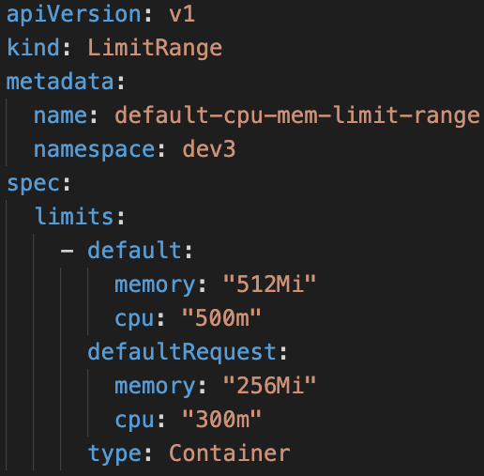
Limit Range
LoadBalancer Service
LoadBalancer Service
LoadBalancer Service
F
F
F
Pod
Pod
Pod
Limit Range Manifest
ReplicaSet
ReplicaSet
ReplicaSet
Deployment
Deployment
Deployment
ClusterIP Service
ClusterIP Service
ClusterIP Service
B
B
B
Pod
Pod
Pod
ReplicaSet
ReplicaSet
ReplicaSet
Deployment
Deployment
Deployment
Deployment
CPU
Memory
CPU
Memory
CPU
Memory
default
Min/Max
default
Min/Max
default
Min/Max
Limit Range (Per Container)
Limit Range (Per Container)
Limit Range (Per Container)
Namespace: dev
Namespace: qa
Namespace: staging

Slide 66
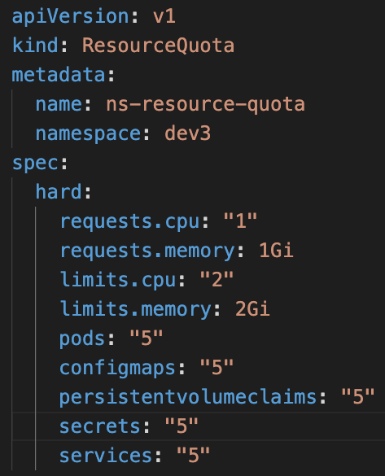
Resource Quota
LoadBalancer Service
LoadBalancer Service
LoadBalancer Service
F
F
F
Resource Quota Manifest
Pod
Pod
Pod
ReplicaSet
ReplicaSet
ReplicaSet
Deployment
Deployment
Deployment
ClusterIP Service
ClusterIP Service
ClusterIP Service
B
B
B
Pod
Pod
Pod
ReplicaSet
ReplicaSet
ReplicaSet
Deployment
Deployment
Deployment
Deployment
CPU
Memory
CPU
Memory
CPU
Memory
Pods
Services
Pods
Services
Pods
Services
Resource Quota
Resource Quota
Resource Quota
Namespace: dev
Namespace: qa
Namespace: staging

Slide 67
Amazon RDS
AWS EKS
&
RDS Database

Slide 68
EKS Cluster
http://<workernode-public-ip>:<NodePort>/usermgmt/<apis>
UserMgmt – NodePort Service
Users
NodePort Service
EKS Storage EBS CSI Driver
REST API
Deployment
POD
Environment Variables
ReplicaSet
Drawbacks of EBS CSI for MySQL DB
Deployment (UserMgmt)
Complex setup to achieve HA
MySQL – ClusterIP Service
StatefulSets
AWS Elastic Block Store - EBS
Complex Multi-Az support for EBS
Storage Class
Environment Variables
Complex Master-Master MySQL setup
Persistent Volume Claim
Volumes
Complex Master-Slave MySQL setup
MySql
No Automatic Backup & Recovery
Config Map
Volume Mounts
POD
No Auto-Upgrade MySQL
ReplicaSet
Deployment
Deployment (mysql)
ClusterIP Service

Slide 69
http://<workernode-public-ip>:<NodePort>/usermgmt/<apis>
EKS Cluster
UserMgmt – NodePort Service
Users
NoePort Service
REST API
Deployment
AWS
RDS Database
POD
Environment Variables
ReplicaSet
Deployment (UserMgmt)
ExternalName Service
MySQL – ExternalName Service
High Availability
Metrics & Monitoring
Backup & Recovery
Automatic Upgrades
Read Replicas
Amazon RDS
Multi-AZ Support

Slide 70




AWS Cloud
EKS Cluster Control Plane
VPC
Availability Zone: us-east-1a
Availability Zone: us-east-1b
Public subnet
Public subnet
http://<workernode-public-ip>:<NodePort>/usermgmt/<apis>
EC2 Worker Node-1
EC2 Worker Node-2
User Management – Node Port Service
Users
U
U
ReplicaSet
U
U
Pod
Pod
Pod
Pod
Deployment
MySQL – External Name Service
Private subnet
Private subnet
AWS EKS
Network Design
With
EKS Workload
&
RDS Database
Amazon RDS
Amazon RDS

Slide 71

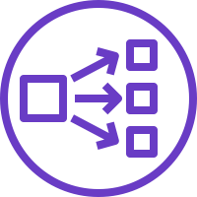


Classic
Load Balancer
Network
Load Balancer
Application
Load Balancer
AWS
Elastic Load Balancing
Overview

Slide 72
Elastic Load Balancing
Classic Load Balancer
Network Load Balancer
Application Load Balancer
https://aws.amazon.com/elasticloadbalancing/features/#compare

Slide 73
Elastic Load
Balancing
Classic
Load Balancer
Network
Load Balancer
Application
Load Balancer
Amazon RDS
AWS EKS
&
RDS & ELB
Classic Load Balancer

Slide 74
AWS Cloud
EKS Cluster Control Plane
VPC
Availability Zone: us-east-1a
Availability Zone: us-east-1b
Public subnet
Public subnet
http://<workernode-public-ip>:<NodePort>/usermgmt/<apis>
EC2 Worker Node-1
EC2 Worker Node-2
User Management – Node Port Service
Users
U
U
ReplicaSet
U
U
Pod
Pod
Pod
Pod
Deployment
MySQL – External Name Service
Private subnet
Private subnet
AWS EKS
Network Design
With
EKS Workload
&
RDS Database
Amazon RDS
Amazon RDS

Slide 75

AWS Cloud
VPC
EKS Cluster Control Plane
Availability Zone: us-east-1a
Availability Zone: us-east-1b
Users
Public subnet
Public subnet
Classic CLB DNS URL
Classic Load Balancer
User Management – Classic Load Balancer Service
NAT gateway
NAT gateway
Private subnet
Private subnet
EC2 Worker Node-1
EC2 Worker Node-2
U
U
ReplicaSet
U
U
Pod
Pod
Pod
Pod
Deployment
MySQL – External Name Service
AWS EKS
Network Design
With
EKS Workload
RDS & ELB
Classic Load Balancer
EKS Private NodeGroup
Amazon RDS DB
Amazon RDS DB

Slide 76
Elastic Load
Balancing
Classic
Load Balancer
Network
Load Balancer
Application
Load Balancer
Amazon RDS
AWS EKS
&
RDS & ELB
Network Load Balancer

Slide 77
AWS Cloud
VPC
EKS Cluster Control Plane
Availability Zone: us-east-1a
Availability Zone: us-east-1b
Users
Public subnet
Public subnet
NLB DNS URL
Network Load Balancer
User Management – Network Load Balancer Service
NAT gateway
NAT gateway
Private subnet
Private subnet
EC2 Worker Node-1
EC2 Worker Node-2
U
U
ReplicaSet
U
U
Pod
Pod
Pod
Pod
Deployment
MySQL – External Name Service
AWS EKS
Network Design
With
EKS Workload
RDS & ELB
Network Load Balancer
EKS Private NodeGroup
Amazon RDS DB
Amazon RDS DB

Slide 78
Elastic Load
Balancing
Classic
Load Balancer
Network
Load Balancer
Application
Load Balancer
Amazon RDS
AWS EKS
&
RDS & ELB
Application Load Balancer

Slide 79
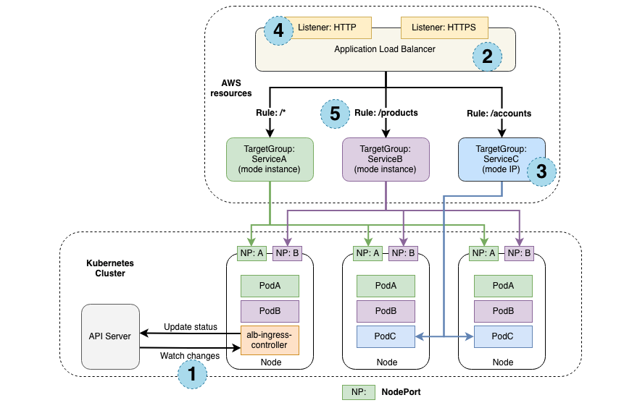
How Ingress Works?
https://kubernetes-sigs.github.io/aws-alb-ingress-controller/guide/controller/how-it-works/

Slide 80
k8s ClusterRole
k8s ClusterRoleBinding
k8s ServiceAccount
AWS IAM Policy
AWS IAM Role

Slide 81
ALB Ingress – Target Types
https://kubernetes-sigs.github.io/aws-alb-ingress-controller/guide/ingress/annotation/#target-type
Instane
IP

Slide 83
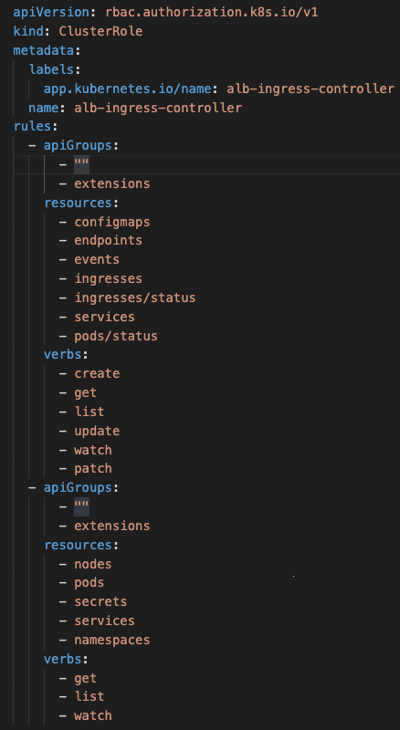
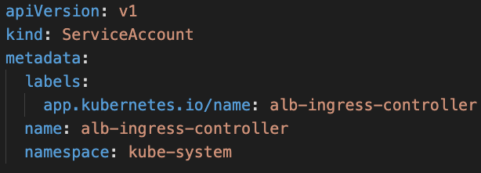
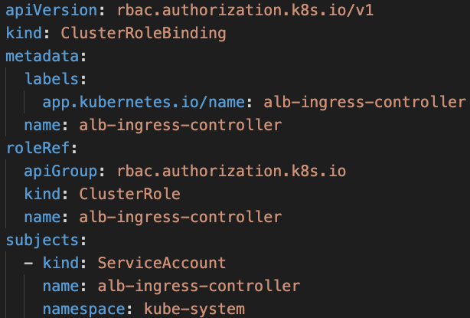
k8s ClusterRole
k8s ServiceAccount
k8s ClusterRoleBinding
AWS IAM Policy
https://raw.githubusercontent.com/kubernetes-sigs/aws-alb-ingress-controller/master/docs/examples/iam-policy.json

Slide 84
AWS IAM Role
AWS IAM Policy
k8s ServiceAccount

Slide 85
Ingress Controller

Slide 86

AWS Cloud
VPC
EKS Cluster Control Plane
Availability Zone: us-east-1a
Availability Zone: us-east-1b
Users
Public subnet
Public subnet
apps.stacksimplify.com
SSL Redirect
Application Load Balancer
users.stacksimplify.com
SSL
ExternalDNS
Route53
User Management – Application Load Balancer Service (Ingress)
NAT gateway
/app1*
/app2*
/*
NAT gateway
Ingress
Private subnet
Private subnet
EC2 Worker Node-1
EC2 Worker Node-2
N
N
U
Pod
Pod
Pod
ReplicaSet
ReplicaSet
ReplicaSet
Deployment: app1
Deployment: app2
Deployment: UMS
MySQL – External Name Service
AWS EKS
Network Design
With
EKS Workload
RDS & ELB
Application
Load Balancer
EKS Private NodeGroup
Amazon RDS DB
Amazon RDS DB

Slide 87
Elastic Load
Balancing
Classic
Load Balancer
Network
Load Balancer
Application
Load Balancer
Amazon RDS
AWS EKS
RDS & ELB
Application Load Balancer
Ingress Controller Basics

Slide 88
AWS Cloud
VPC
EKS Cluster Control Plane
Availability Zone: us-east-1a
Availability Zone: us-east-1b
Users
Public subnet
Public subnet
http://ALB-DNS-URL/usermgmt/users
Application Load Balancer
User Management – Application Load Balancer Service (Ingress)
NAT gateway
/*
NAT gateway
Ingress
Private subnet
Private subnet
EC2 Worker Node-1
EC2 Worker Node-2
User Management – Node Port Service
U
Pod
ReplicaSet
Deployment: UMS
AWS EKS
Network Design
With
EKS Workload
RDS & ELB
Application
Load Balancer
MySQL – External Name Service
EKS Private NodeGroup
Amazon RDS DB
Amazon RDS DB

Slide 89
Elastic Load
Balancing
Classic
Load Balancer
Network
Load Balancer
Application
Load Balancer
Amazon RDS
AWS EKS
RDS & ELB
Application Load Balancer
Ingress Context Path based Routing

Slide 90
AWS Cloud
VPC
EKS Cluster Control Plane
Availability Zone: us-east-1a
Availability Zone: us-east-1b
Users
Public subnet
Public subnet
http://ALB-DNS-URL/usermgmt/users
Application Load Balancer
http://ALB-DNS-URL/app1/index.html
http://ALB-DNS-URL/app2/index.html
User Management – Application Load Balancer Service (Ingress)
NAT gateway
/app1/*
/app2/*
/*
NAT gateway
Ingress
Private subnet
Private subnet
EC2 Worker Node-1
EC2 Worker Node-2
app1- NodePort SVC
app2 -NodePort SVC
User Management – Node Port Service
N
N
U
Pod
Pod
Pod
ReplicaSet
ReplicaSet
ReplicaSet
Deployment: app1
Deployment: app2
Deployment: UMS
AWS EKS
Network Design
With
EKS Workload
RDS & ELB
Application
Load Balancer
Context path based Routing
MySQL – External Name Service
EKS Private NodeGroup
Amazon RDS DB
Amazon RDS DB

Slide 91
Elastic Load
Balancing
Classic
Load Balancer
Network
Load Balancer
Application
Load Balancer
Amazon RDS
AWS EKS
RDS & ELB
Application Load Balancer
Ingress SSL

Slide 92

AWS Cloud
VPC
EKS Cluster Control Plane
Availability Zone: us-east-1a
Availability Zone: us-east-1b
Users
Amazon Route 53
Public subnet
Public subnet
SSL
Application Load Balancer
HTTP URLS
http://ssldemo.kubeoncloud.com/usermgmt/users http://ssldemo.kubeoncloud.com/app1/index.html http://ssldemo.kubeoncloud.com/app2/index.html
User Management – Application Load Balancer Service (Ingress)
NAT gateway
/app1/*
/app2/*
/*
NAT gateway
Ingress
Private subnet
Private subnet
HTTPS URLS
https://ssldemo.kubeoncloud.com/usermgmt/users https://ssldemo.kubeoncloud.com/app1/index.html https://ssldemo.kubeoncloud.com/app2/index.html
EC2 Worker Node-1
EC2 Worker Node-2
app1- NodePort SVC
app2 -NodePort SVC
User Management – Node Port Service
N
N
U
AWS Certificate Manager
Pod
Pod
Pod
ReplicaSet
ReplicaSet
ReplicaSet
Deployment: app1
Deployment: app2
Deployment: UMS
AWS EKS
Network Design
With
EKS Workload
RDS & ELB
Application
Load Balancer
Ingress SSL
MySQL – External Name Service
EKS Private NodeGroup
Amazon RDS DB
Amazon RDS DB

Slide 93
Elastic Load
Balancing
Classic
Load Balancer
Network
Load Balancer
Application
Load Balancer
Amazon RDS
AWS EKS
RDS & ELB
Application Load Balancer
Ingress SSL Redirect

Slide 94
AWS Cloud
VPC
EKS Cluster Control Plane
Availability Zone: us-east-1a
Availability Zone: us-east-1b
Users
Amazon Route 53
Public subnet
Public subnet
SSL
Application Load Balancer
HTTP → HTTPS
SSL Redirect
User Management – Application Load Balancer Service (Ingress)
HTTPS URLS
https://ssldemo.kubeoncloud.com/usermgmt/users https://ssldemo.kubeoncloud.com/app1/index.html https://ssldemo.kubeoncloud.com/app2/index.html
NAT gateway
NAT gateway
/app1/*
/app2/*
Ingress
/*
Private subnet
Private subnet
EC2 Worker Node-1
EC2 Worker Node-2
app1- NodePort SVC
app2 -NodePort SVC
User Management – Node Port Service
N
N
U
AWS Certificate Manager
Pod
Pod
Pod
ReplicaSet
ReplicaSet
ReplicaSet
Deployment: app1
Deployment: app2
Deployment: UMS
AWS EKS
Network Design
With
EKS Workload
RDS & ELB
Application
Load Balancer
Ingress SSL Redirect
MySQL – External Name Service
EKS Private NodeGroup
Amazon RDS DB
Amazon RDS DB

Slide 95
Elastic Load
Balancing
Classic
Load Balancer
Network
Load Balancer
Application
Load Balancer
Amazon RDS
AWS EKS
RDS & ELB
Application Load Balancer & Route53
Ingress & External-DNS

Slide 96
AWS Cloud
VPC
EKS Cluster Control Plane
Availability Zone: us-east-1a
Availability Zone: us-east-1b
Users
Amazon Route 53
Public subnet
Public subnet
SSL
Application Load Balancer
HTTP → HTTPS
SSL Redirect
external-dns
User Management – Application Load Balancer Service (Ingress)
dnstest1.kubeoncloud.com
dnstest2.kubeoncloud.com
NAT gateway
NAT gateway
/app1/*
/app2/*
Ingress
/*
HTTPS URLS
https://dnstest1.kubeoncloud.com/usermgmt/users https://dnstest1.kubeoncloud.com/app1/index.html https://dnstest1.kubeoncloud.com/app2/index.html
https://dnstest2.kubeoncloud.com/usermgmt/users https://dnstest2.kubeoncloud.com/app1/index.html https://dnstest2.kubeoncloud.com/app2/index.html
Private subnet
Private subnet
EC2 Worker Node-1
EC2 Worker Node-2
app1- NodePort SVC
app2 -NodePort SVC
User Management – Node Port Service
N
N
U
AWS Certificate Manager
Pod
Pod
Pod
ReplicaSet
ReplicaSet
ReplicaSet
Deployment: app1
Deployment: app2
Deployment: UMS
MySQL – External Name Service
AWS EKS
Network Design
With
EKS Workload
RDS & ELB
Application
Load Balancer & Route53
Ingress & External-DNS
EKS Private NodeGroup
Amazon RDS DB
Amazon RDS DB

Slide 97
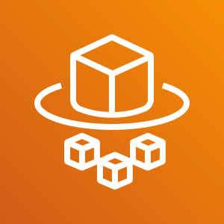
Elastic Load
Balancing
Classic
Load Balancer
Network
Load Balancer
Application
Load Balancer
Certificate
Manager
Route53
Elastic Block
Store
Amazon RDS
AWS EKS
Fargate Profiles
Fargate
Profiles

Slide 98
What is Fargate?

Slide 99
EKS Deployment Options
Managed EC2 Nodes
Only EC2 Node Groups
Unmanaged EC2 Nodes
Managed Nodes
EKS Deployment Options
Mixed
Unmanaged EC2 Nodes
Fargate Nodes
Only Fargate
Fargate Nodes

Slide 100


EKS Deployment Options – EC2 Node Groups
AWS Cloud
EKS Cluster
VPC
Availability Zone: us-east-1a
Availability Zone: us-east-1b
Public subnet
Public subnet
Auto Scaling group
EC2 Instance
EKS Public Managed Node Group
EC 2Instance
Private subnet
Private subnet
Auto Scaling group
EC2 Instance
EKS Private Managed Node Group
EC 2Instance
EKS Managed Node Groups

Slide 101
EKS Deployment Options – Only Fargate
EKS Cluster
AWS Cloud
VPC
EKS Fargate
EKS Fargate Profiles

Slide 102
EKS Deployment Options – Only Fargate
EKS Cluster
AWS Cloud
VPC
Availability Zone: us-east-1a
Availability Zone: us-east-1b
Public subnet
Public subnet
Private subnet
EKS Fargate
Private subnet
Fargate Profile
Fargate EC2 Instance
Fargate EC2 Instance
EKS Fargate Profiles

Slide 103
EKS Deployment Options - Mixed
EKS Cluster
AWS Cloud
VPC
Availability Zone: us-east-1a
Availability Zone: us-east-1b
Public subnet
Public subnet
Auto Scaling group
EC2 Instance
EKS Public Managed Node Group
EC 2Instance
Private subnet
Private subnet
EKS Fargate
Auto Scaling group
EC2 Instance
EKS Private Managed Node Group
EC 2Instance
EKS Managed Node Groups
EKS Fargate Profiles

Slide 104
EKS Deployment Options - Mixed
EKS Cluster
AWS Cloud
VPC
Availability Zone: us-east-1a
Availability Zone: us-east-1b
Availability Zone: us-east-1a
Availability Zone: us-east-1b
Public subnet
Public subnet
Public subnet
Public subnet
Auto Scaling group
EC2 Instance
EKS Public Managed Node Group
EC 2Instance
Private subnet
Private subnet
Private subnet
EKS Fargate
Private subnet
Auto Scaling group
Fargate Profile
EC2 Instance
EKS Private Managed Node Group
EC 2Instance
Fargate EC2 Instance
Fargate EC2 Instance
EKS Managed Node Groups
EKS Fargate Profiles

Slide 105
ALB Target Type : Instance vs IP

Slide 106
How can we use Fargate for AWS EKS?

Slide 107
Fargate vs Manged vs Unmanaged Nodes

Slide 108
EKS Fargate Profiles
Fargate is a serverless compute platform for containers on AWS

Slide 109
EKS Fargate Profiles
Mutli-AZ and Highly Available architecture by default
99.9% Service Level Agreement for every cluster
Integrations
Ingress
Security
Databases
Networking
Storage
Compute
Autoscaling Groups

Slide 110
EKS Fargate Profiles
Bring existing pods
Production Ready
Rightsized and integrated

Slide 111
Elastic Load
Balancing
Classic
Load Balancer
Network
Load Balancer
Application
Load Balancer
Certificate
Manager
Route53
Elastic Block
Store
Amazon RDS
AWS EKS
Fargate Profiles
Basics
Fargate
Profiles

Slide 112
EKS Deployment Options - Mixed
EKS Cluster
AWS Cloud
VPC
Availability Zone: us-east-1a
Availability Zone: us-east-1b
Public subnet
Public subnet
Auto Scaling group
EC2 Instance
EKS Public Managed Node Group
EC 2Instance
Private subnet
Private subnet
EKS Fargate
Auto Scaling group
EC2 Instance
EKS Private Managed Node Group
EC 2Instance
EKS Managed Node Groups
EKS Fargate Profiles

Slide 113

EKS Deployment Options - Mixed
Fargate Profiles can be deployed to EKS Cluster only when we have at least one private subnet
EKS Cluster
AWS Cloud
VPC
Availability Zone: us-east-1a
Availability Zone: us-east-1b
Availability Zone: us-east-1a
Availability Zone: us-east-1b
Public subnet
Public subnet
Public subnet
Public subnet
Auto Scaling group
EC2 Instance
EKS Public Managed Node Group
EC 2Instance
Private subnet
Private subnet
Private subnet
EKS Fargate
Private subnet
Auto Scaling group
Fargate Profile
EC2 Instance
EKS Private Managed Node Group
EC2 Instance
Fargate EC2 Instance
Fargate EC2 Instance
EKS Managed Node Groups
EKS Fargate Profiles

Slide 114
AWS Cloud
EKS Cluster Control Plane
VPC
Availability Zone: us-east-1a
Availability Zone: us-east-1b
Users
Amazon Route 53
Public subnet
Public subnet
SSL
Application Load Balancer
SSL Redirect
external-dns
fpdev.kubeoncloud.com
User Management – Application Load Balancer Service (Ingress)
https://fpdev.kubeoncloud.com/app1/index.html
NAT gateway
/*
NAT gateway
Ingress
Private subnet
Private subnet
Fargate Node-1
Fargate Node-2
N
ReplicaSet
N
AWS Certificate Manager
Pod
Pod
Deployment: app1
app1- NodePort Service
AWS EKS
Fargate Profiles
Basics
Fargate Profile: fp-dev

Slide 115
Elastic Load
Balancing
Classic
Load Balancer
Network
Load Balancer
Application
Load Balancer
Certificate
Manager
Route53
Elastic Block
Store
Amazon RDS
AWS EKS
Fargate Profiles
Advanced with YAML
Fargate
Profiles

Slide 116


EKS Deployment Options – Mixed Mode - 3 Apps
Users
AWS Cloud
app1. kubeoncloud.com
app2.kubeoncloud.com
ums.kubeoncloud,com
Amazon RDS DB
app1.kubeoncloud.com
app2.kubeoncloud.com
ums.kubeoncloud.com
Amazon Route 53
VPC
Availability Zone: us-east-1a
Availability Zone: us-east-1b
Availability Zone: us-east-1a
EKS Fargate
Availability Zone: us-east-1b
Public subnet
Public subnet
Private subnet
Private subnet
App1 - Ingress
UMS - Ingress
NS: ns-ums
MySQL – ExternalName Service
Fargate Profile: UMS
Ingress
App2 - Ingress
U
U
UMS Pod
UMS Pod
Private subnet
Private subnet
UMS - NodePort Service
NS: ns-app1
App1 - NodePort Service
NS: ns-app2
App2 - NodePort Service
Auto Scaling group
Fargate Profile: App2
N
N
N
N
App1 Pod
EKS Private Managed Node Group
App1 Pod
App2 Pod
App2 Pod
EKS Managed Node Groups
EKS Fargate Profiles
AWS Certificate Manager
EKS Cluster

Slide 117
EKS Deployment – Mixed – Ingress with Cross Namespaces
Users
app1. kubeoncloud.com
app2.kubeoncloud.com
ums.kubeoncloud,com
AWS Cloud
app1. kubeoncloud.com
app2.kubeoncloud.com
ums.kubeoncloud,com
Amazon RDS DB
Ingress with Cross Namespaces is not supported as on today
Amazon Route 53
VPC
Availability Zone: us-east-1a
Availability Zone: us-east-1b
Availability Zone: us-east-1a
EKS Fargate
Availability Zone: us-east-1b
Public subnet
Public subnet
Private subnet
Private subnet
App1 - Ingress
NS: ns-ums
MySQL – ExternalName Service
/app1/*
/ums/*
Fargate Profile: UMS
Ingress
/app2/*
U
U
UMS Pod
UMS Pod
Private subnet
Private subnet
UMS - NodePort Service
NS: ns-app1
App1 - NodePort Service
NS: ns-app2
App2 - NodePort Service
Auto Scaling group
Fargate Profile: App2
N
N
N
N
App1 Pod
EKS Private Managed Node Group
App1 Pod
App2 Pod
App2 Pod
EKS Managed Node Groups
EKS Fargate Profiles
AWS Certificate Manager
EKS Cluster

Slide 118

Elastic Load
Balancing
Classic
Load Balancer
Network
Load Balancer
Application
Load Balancer
Certificate
Manager
Route53
Elastic Block
Store
Amazon RDS
AWS EKS
ECR
Elastic Container Registry
Fargate
Profiles
Elastic Container
Registry

Slide 119
Elastic Container Registry - ECR
Elastic Container Registry (ECR) is a fully-managed Docker container registry that makes it easy for developers to store, manage, and deploy Docker container images.
ECR is integrated with Elastic Kubernetes Service (EKS), simplifying our development to production workflow.
ECR eliminates the need to operate our own container repositories or worry about scaling the underlying infrastructure.
ECR hosts our images in a highly available and scalable architecture, allowing us to reliably deploy containers for our applications.
Integration with AWS Identity and Access Management (IAM) provides resource-level control of each repository.
With Amazon ECR, there are no upfront fees or commitments. We pay only for the amount of data you store in your repositories and data transferred to the Internet.

Slide 120
Elastic Container Registry - ECR
Benefits
Full managed
Secure
Highly Available
Simplified Workflow

Slide 121




How ECR Works?
Developer
Docker Container
Push Images
Elastic Container Service - ECS
Pull Images and Run Containers
Docker Image
Docker Container
Pull Images
Elastic Container Registry - ECR
Elastic Kubernetes Service - EKS
Docker Container
On-Premise

Slide 122

EKS & ECR
Developer
Users
http://ecrdemo.kubeoncloud.com
AWS Cloud
ecrdemo.kubeoncloud.com
Push Images
EKS Cluster
Amazon Route 53
AWS Certificate Manager
VPC
Docker Image
Pull Docker Image from ECR
Availability Zone: us-east-1a
Availability Zone: us-east-1b
Public subnet
Public subnet
Ingress
Elastic Container Registry - ECR
NAT gateway
ECR Demo - ALB Ingress Service
NAT gateway
Private subnet
Private subnet
EC2 Worker Node-1
EC2 Worker Node-2
ECR Demo App - NodePort Service
N
N
Pod
Pod
EKS Private Managed Node Group

Slide 123
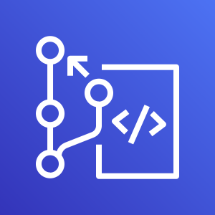
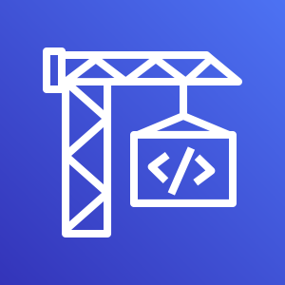

Elastic Load
Balancing
Classic
Load Balancer
Network
Load Balancer
Application
Load Balancer
Certificate
Manager
Route53
Elastic Block
Store
Amazon RDS
AWS EKS
&
AWS Developer Tools
Fargate
Profiles
Elastic Container
Registry
Code
Commit
Code
Build
Code
Pipeline

Slide 124
Stages in Release Process
Source
Build
Test
Production
Check-in source code
Peer review new code
Pull Request process
Compile Code & build artifacts (war ,jar, container images, Kubernetes manifest files)
Unit Tests
Integration tests with other systems.
Load Testing
UI Tests
Security Tests
Test Environments (Dev, QA and Staging)
Deployment to production environments
Monitor code in production to quickly detect errors
Deployment to production environments
Monitor code in production to quickly detect errors

Slide 125


Stages in Release Process
Source
Build
Test
Production

Slide 126
Continuous Integration
Source
Build
Test
Production
Automatically kick off a new release when new code is checked- in
Build and test code in a consistent, repeatable environment
Continually have an artifact ready for deployment

Slide 127
Continuous Delivery
Source
Build
Test
Production
Automatically deploy new changes to staging environments for testing
Deploy to production safely without affecting customers
Deliver to customers faster
Increase deployment frequency, and reduce change lead time and change failure rate

Slide 128
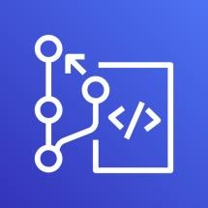


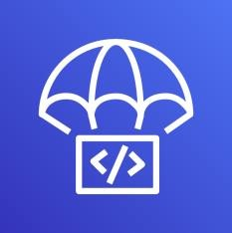
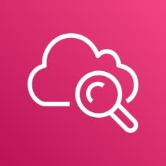

AWS Developer Tools or Code Services
Source
Build
Test
Deploy
Monitor
AWS CodeCommit
AWS CodeBuild
AWS CodeBuild + Third Party
CodeDeploy
Fargate
or ECS
Amazon CloudWatch
AWS CodePipeline

Slide 129
AWS Developer Tools or Code Services
Source
Build
Test
Deploy
Monitor
AWS CodeCommit
AWS CodeBuild
AWS CodeBuild + Third Party
Fargate
or ECS
Amazon CloudWatch
AWS CodePipeline

Slide 130

AWS CodeCommit

Slide 131
AWS CodeCommit - Introduction
Version Control Service hosted by AWS
We can privately store and manage documents, source code, and binary files
Secure & highly scalable
Supports standard functionality of Git (CodeCommit supports Git versions 1.7.9 and later.)
Uses a static user name and password in addition to standard SSH..

Slide 132








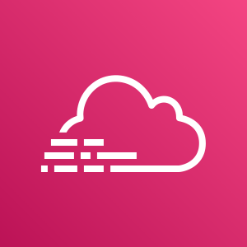

CodeCommit – Integration with AWS Services
AWS CodeStar
AWS CodeBuild
AWS CodePipeline
AWS Cloud9
AWS Amplify
AWS CloudFormation
AWS CodeCommit
Amazon Simple Notification Service
AWS Key Management Service
AWS Elastic Beanstalk
AWS CloudTrail
Amazon CloudWatch

Slide 133

CodeCommit - Steps
Developer
Local Git Repo
push
AWS Cloud
AWS CodeCommit

Slide 134
AWS CodeBuild

Slide 135
CodeBuild - Introduction
CodeBuild is a fully managed build service in the cloud.
Compiles our source code, runs unit tests, and produces artifacts that are ready to deploy.
Eliminates the need to provision, manage, and scale our own build servers.
It provides prepackaged build environments for the most popular programming languages and build tools such as Apache Maven, Gradle, and many more.
We can also customize build environments in CodeBuild to use our own build tools.
Scales automatically to meet peak build requests.

Slide 136
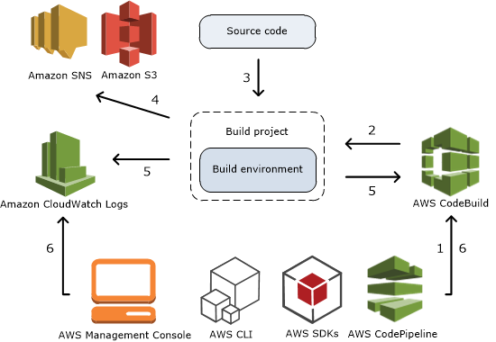
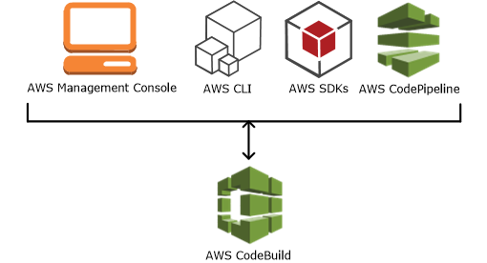
How to run CodeBuild?
How CodeBuild works?

Slide 137




Source
AWS CodeCommit
Amazon Simple Storage Service (S3)
GitHub
GitHub Enterprise
Bitbucket
AWS Managed Image
AWS CodeBuild
Amazon CloudWatch
Build Logs
Amazon EC2 Container Registry
Amazon Simple Notification Service
External Container Registry (Docker Hub)
Amazon Simple Storage Service (S3)
Build Notifications
Build Environment
Build Artifacts
AWS CodeBuild Architecture

Slide 138
CodeBuild - Steps
Developer
Commit code changes
Local Git Repo
push
AWS Cloud
AWS CodeCommit
AWS CodeBuild
Simple Storage
Service (S3)

Slide 139
AWS CodePipeline

Slide 140
CodePipeline - Introduction
AWS CodePipeline is a continuous delivery service to model, visualize, and automate the steps required to release your software.
Benefits
We can automate our release processes.
We can establish a consistent release process.
We can speed up delivery while improving quality.
Supports external tools integration for source, build and deploy.
View progress at a glance
View pipeline history details.

Slide 141
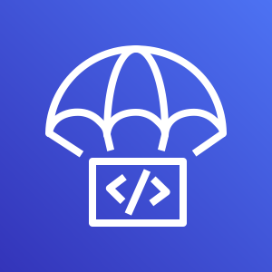

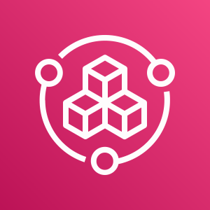
AWS CodePipeline Architecture
AWS CodePipeline
AWS CodeCommit
AWS CloudFormation
Amazon Elastic Container Service
AWS CodeBuild
Amazon CloudWatch
Amazon EC2 Container Registry
AWS CodeDeploy
Amazon Elastic Container Service (Blue/Green)
Simple Storage
Service (S3)
AWS Elastic Beanstalk
Jenkins
GitHub Webhooks
Simple Storage
Service (S3)
GitHub
AWS Service Catalog
Source
Build
Deploy
Monitor Source Changes

Slide 142
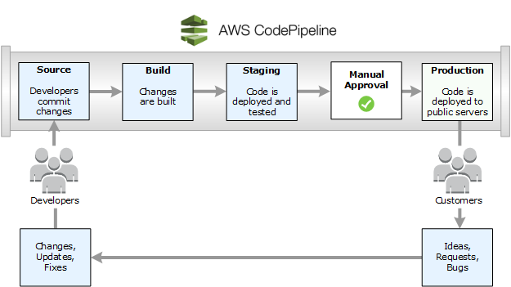
Continuous Delivery
©Amazon

Slide 143
AWS Cloud
CI CD Process
Developer
CloudWatch
CodePipeline
Commit code changes
Local Git Repo
push
S3
CodeCommit
CodeBuild
EKS Cluster
ECR
Worker Node-1
Worker Node -2
N
ReplicaSet
N
Pod
Pod
Deployment: app1
Elastic Kubernetes Service

Slide 145
Amazon Route 53
Elastic Load Balancing
Amazon Elastic Container Registry
CloudWatch
Simple Notification Service
Application load balancer
Classic load balancer
AWS CodeBuild
Network load balancer
AWS CodeCommit
AWS CodePipeline

Slide 146






AWS Cloud
AWS Cloud
Region
Availability Zone
Security group
Auto Scaling group
VPC
Private subnet
Public subnet
Server contents
Corporate
data center
Elastic Beanstalk container
EC2 instance contents
Spot Fleet
AWS Step Functions workflow
Generic group
Generic group

Slide 147
REST API
Pod
ReplicaSet
Deployment (UserMgmt)

Slide 148
Backup Slides

Slide 149

Amazon Elastic Block Store
Volume

Slide 150
Icons
D
B
N
H
N
N
D
B
H

Slide 151
Kubernetes - POD
N
N
N
N
N
POD
POD
POD
POD
Node
Node
Kubernetes Cluster

Slide 152
Kubernetes – Load Balancing & Scaling
a
N
N
N
N
POD
POD
POD
POD
Node
Node
Kubernetes Cluster

Slide 153
Kubernetes - POD
PODs generally have one to one relationship with containers.
To scale up we create new POD and to scale down we delete the POD.
In short, we cannot have multiple containers of same kind in a single POD.
Example: Two NGINX containers in single POD serving same purpose is not recommended.
N
N
N
N
N
POD
POD
POD
POD
Worker Node
Worker Node
Kubernetes Cluster

Slide 154
Kubernetes - Services
3-Tier App in k8s
Frontend App – NodePort or LoadBalancer or Ingress Service
N
N
POD
POD
ReplicaSet
Deployment (app=frontend)
Backend App - ClusterIP Service
Database
B
B
Node
DB - ClusterIP Service
POD
POD
ReplicaSet
Deployment (app=Backend)

Slide 155
Kubernetes - Services
3-Tier App in k8s
Frontend App – NodePort or LoadBalancer or Ingress Service
N
N
POD
POD
ReplicaSet
Deployment (app=frontend)
Backend App - ClusterIP Service
Database
B
B
Node
DB - ClusterIP Service
POD
POD
ReplicaSet
Deployment (app=Backend)

Slide 156
Kubernetes - Services
Kubernetes Cluster
Frontend App – NodePort or LoadBalancer or Ingress Service
N
N
N
POD
POD
POD
ReplicaSet
Deployment (app=frontend)
Backend App - ClusterIP Service
DB – externalName Service
AWS Cloud
B
B
B
POD
POD
POD
ReplicaSet
Amazon RDS Database
Deployment (app=Backend)

Slide 157
LoadBalancer Service
F
Pod
ReplicaSet
Deployment
F
ClusterIP Service
F
POD
POD
ReplicaSet
B
Pod
ReplicaSet
Deployment

Slide 158
EKS - Storage
EKS Storage
In-Tree EBS Provisioner
EBS CSI Driver
EFS CSI Driver
FSx for Luster CSI
Legacy
In future, this will be deprecated and we should use EBS CSI Driver
Latest & greatest & in Beta release
CSI – Container Storage Interface
Supports from k8s 1.14 and later
Allows EKS clusters to manage the lifecycle of EBS Volumes for persistent storage
As on today, not supported on AWS Fargate
Latest & greatest & in Beta release
CSI – Container Storage Interface
Supports from k8s 1.14 and later
Allows EKS clusters to manage the lifecycle of EFS file systems
As on today, not supported on AWS Fargate
Latest & greatest & in Beta release
CSI – Container Storage Interface
Supports from k8s 1.16 and later
Allows EKS clusters to manage the lifecycle of Amazon FSx for Lusture file systems
As on today, not supported on AWS Fargate

Slide 159
Dynamic Volume Provisioning
Dynamic volume provisioning allows storage volumes to be created on-demand.
Without dynamic provisioning, cluster administrators have to manually make calls to their cloud or storage provider to create new storage volumes, and then create PersistentVolume objects to represent them in Kubernetes.
The dynamic provisioning feature eliminates the need for cluster administrators to pre-provision storage. Instead, it automatically provisions storage when it is requested by users.

Slide 160
Dynamic Volume Provisioning
To enable dynamic provisioning, a cluster administrator needs to pre-create one or more StorageClass objects for users.
StorageClass objects define which provisioner should be used and what parameters should be passed to that provisioner when dynamic provisioning is invoked.
Users request dynamically provisioned storage by including a storage class in their PersistentVolumeClaim.

Slide 161
High Availability setup for MySQL DB is complex
MySQL Master-Master setup is going to be super complex ok k8s
We need to create custom scripts for Database Backups & even for recovery
AWS EBS service restricted to respective Availability Zone.
All the below will be out of the box with AWS RDS Service
High Availability & Read Replicas
Fast and predictable storage
Backup & Recovery
Monitoring & Metrics

Slide 162
AWS Cloud
EKS Cluster Control Plane
VPC
Availability Zone: us-east-1a
Availability Zone: us-east-1b
Public subnet
Classic Load Balancer
Public subnet
EC2 Worker Node-1
EC2 Worker Node-2
User Management – Classic Load Balancer Service
Users
U
U
ReplicaSet
U
U
Pod
Pod
Pod
Pod
Deployment
MySQL – External Name Service
Private subnet
Private subnet
AWS EKS
Network Design
With
EKS Workload
RDS & ELB
Classic Load Balancer
Amazon RDS
Amazon RDS

Slide 163
AWS Cloud
EKS Cluster Control Plane
VPC
Availability Zone: us-east-1a
Availability Zone: us-east-1b
Public subnet
Network Load Balancer
Public subnet
EC2 Worker Node-1
EC2 Worker Node-2
User Management – Network Load Balancer Service
Users
U
U
ReplicaSet
U
U
Pod
Pod
Pod
Pod
Deployment
MySQL – External Name Service
Private subnet
Private subnet
AWS EKS
Network Design
With
EKS Workload
RDS & ELB
Network Load Balancer
Amazon RDS
Amazon RDS

Slide 164
AWS Cloud
EKS Cluster Control Plane
VPC
Availability Zone: us-east-1a
Availability Zone: us-east-1b
Public subnet
Application Load Balancer
Public subnet
EC2 Worker Node-1
EC2 Worker Node-2
ALB DNS url
Application Load Balancer Service – Context Path based Routing
Users
/app1*
/app2*
/*
N
N
U
Pod
Pod
Pod
ReplicaSet
ReplicaSet
ReplicaSet
Deployment
Deployment
Deployment
MySQL – External Name Service
Private subnet
Private subnet
AWS EKS
Network Design
With
EKS Workload
RDS & ELB
Application Load Balancer
Amazon RDS
Amazon RDS

Slide 165
Users
AWS Cloud
EKS Cluster Control Plane
VPC
Availability Zone: us-east-1a
Availability Zone: us-east-1b
Public subnet
Application Load Balancer
Public subnet
EC2 Worker Node-1
EC2 Worker Node-2
apps.stacksimplify.com
users.stacksimplify.com
Application Load Balancer Service – Context Path based Routing
Route53
/app1*
/app2*
/*
N
N
U
Pod
Pod
Pod
ReplicaSet
ReplicaSet
ReplicaSet
Deployment
Deployment
Deployment
MySQL – External Name Service
AWS EKS
Network Design
With
EKS Workload
RDS & ELB
Application Load Balancer & Route53
Private subnet
Private subnet
Amazon RDS
Amazon RDS

Slide 166
AWS Cloud
VPC
EKS Cluster Control Plane
Availability Zone: us-east-1a
Availability Zone: us-east-1b
Users
Amazon Route 53
Public subnet
Public subnet
SSL
Application Load Balancer
SSL Redirect
external-dns
fpdev.kubeoncloud.com
User Management – Application Load Balancer Service (Ingress)
https://fpdev.kubeoncloud.com/app1/index.html
NAT gateway
/*
NAT gateway
Ingress
Private subnet
Private subnet
Fargate Node-1
Fargate Node-2
app1- NodePort Service
AWS Certificate Manager
N
ReplicaSet
N
Pod
Pod
Deployment: app1
Fargate Profile: fp-dev
AWS EKS
Fargate Profiles

Slide 167
AWS Cloud
VPC
Availability Zone: us-east-1a
EKS Cluster Control Plane
Availability Zone: us-east-1b
Users
Amazon Route 53
Public subnet
Public subnet
SSL
Application Load Balancer
SSL Redirect
external-dns
User Management – Application Load Balancer Service (Ingress)
app1.kubeoncloud.com
NAT gateway
NAT gateway
app2.kubeoncloud.com
/app1/*
/app2/*
Ingress
/*
ums1.kubeoncloud.com
http://app1.kubeoncloud.com/app1/index.html
Private subnet
Private subnet
http://app2.kubeoncloud.com/app2/index.html
EC2 Worker Node-1
EC2 Worker Node-2
http://ums1.kubeoncloud.com/usermgmt/health-status
app1- NodePort Service
N
EKS Private NodeGroup
N
app1-pod
app1-pod
Fargate Node-1
Fargate Node-2
app2 - NodePort Service
N
Fargate: fp-app2-profile
N
app2-pod
app2-pod
Fargate Node-1
Fargate Node-2
User management - NodePort Service
AWS EKS
Fargate Profiles
N
Fargate: fp-ums-profile
N
UMS-pod
UMS-pod
AWS Certificate Manager
Amazon RDS DB
MySQL – External Name Service
Amazon RDS DB

Slide 168
AWS Cloud
VPC
Availability Zone: us-east-1a
EKS Cluster Control Plane
Availability Zone: us-east-1b
Users
Amazon Route 53
Public subnet
Public subnet
SSL
Application Load Balancer
SSL Redirect
external-dns
User Management – Application Load Balancer Service (Ingress)
app1.kubeoncloud.com
NAT gateway
NAT gateway
app2.kubeoncloud.com
/app1/*
/app2/*
Ingress
/*
ums1.kubeoncloud.com
http://app1.kubeoncloud.com/app1/index.html
Private subnet
Private subnet
http://app2.kubeoncloud.com/app2/index.html
EC2 Worker Node-1
EC2 Worker Node-2
http://ums1.kubeoncloud.com/usermgmt/health-status
app1- NodePort Service
N
EKS Private NodeGroup
N
app1-pod
app1-pod
Fargate Node-1
Fargate Node-2
app2 - NodePort Service
N
Fargate: fp-app2-profile
N
app2-pod
app2-pod
Fargate Node-1
Fargate Node-2
User management - NodePort Service
AWS EKS
Fargate Profiles
N
Fargate: fp-ums-profile
N
UMS-pod
UMS-pod
AWS Certificate Manager
Amazon RDS DB
MySQL – External Name Service
Amazon RDS DB

Slide 169
EKS Deployment Options - Mixed
Users
AWS Cloud
EKS Cluster
Amazon Route 53
AWS Certificate Manager
VPC
Availability Zone: us-east-1a
Availability Zone: us-east-1b
Availability Zone: us-east-1a
Availability Zone: us-east-1b
Public subnet
Public subnet
Private subnet
Private subnet
Ingress Service
EKS Fargate
/ums/*
Fargate Profile: UMS
Ingress
/app1/*
/app2/*
U
U
UMS Pod
UMS Pod
Private subnet
Private subnet
App1 - NodePort Service
Fargate Profile: App2
Auto Scaling group
N
N
N
N
App2 Pod
App2 Pod
App1 Pod
EKS Private Managed Node Group
App1 Pod
EKS Managed Node Groups
EKS Fargate Profiles

Slide 170
Users
AWS Cloud
app1. kubeoncloud.com
app2.kubeoncloud.com
ums.kubeoncloud,com
Amazon RDS DB
app1.kubeoncloud.com
app2.kubeoncloud.com
ums.kubeoncloud.com
Amazon Route 53
VPC
Availability Zone: us-east-1a
Availability Zone: us-east-1b
Availability Zone: us-east-1a
EKS Fargate
Availability Zone: us-east-1b
Public subnet
Public subnet
Private subnet
Private subnet
App1 - Ingress
UMS - Ingress
NS: ns-ums
MySQL – ExternalName Service
Fargate Profile: UMS
Ingress
App2 - Ingress
U
U
UMS Pod
UMS Pod
Private subnet
Private subnet
UMS - NodePort Service
NS: ns-app1
App1 - NodePort Service
NS: ns-app2
App2 - NodePort Service
Auto Scaling group
Fargate Profile: App2
N
N
N
N
App1 Pod
EKS Private Managed Node Group
App1 Pod
App2 Pod
App2 Pod
EKS Managed Node Groups
EKS Fargate Profiles
AWS Certificate Manager
EKS Cluster

