Slide 1
AWS Elastic Kubernetes Service - Masterclass
Kalyan Reddy Daida

Slide 2
Kubernetes for Beginners
STACKSIMPLIFY
AWS EKS Kubernetes - Masterclass | DevOps, Microservices
Kubernetes
On
Cloud
Roadmap
Azure Kubernetes AKS - Masterclass | DevOps, Microservices
Google Kubernetes GKE - Masterclass | DevOps, Microservices

Slide 3
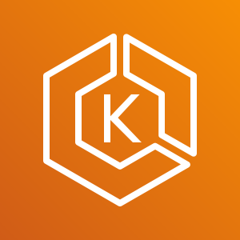
AWS EC2
Launch Templates

Slide 4
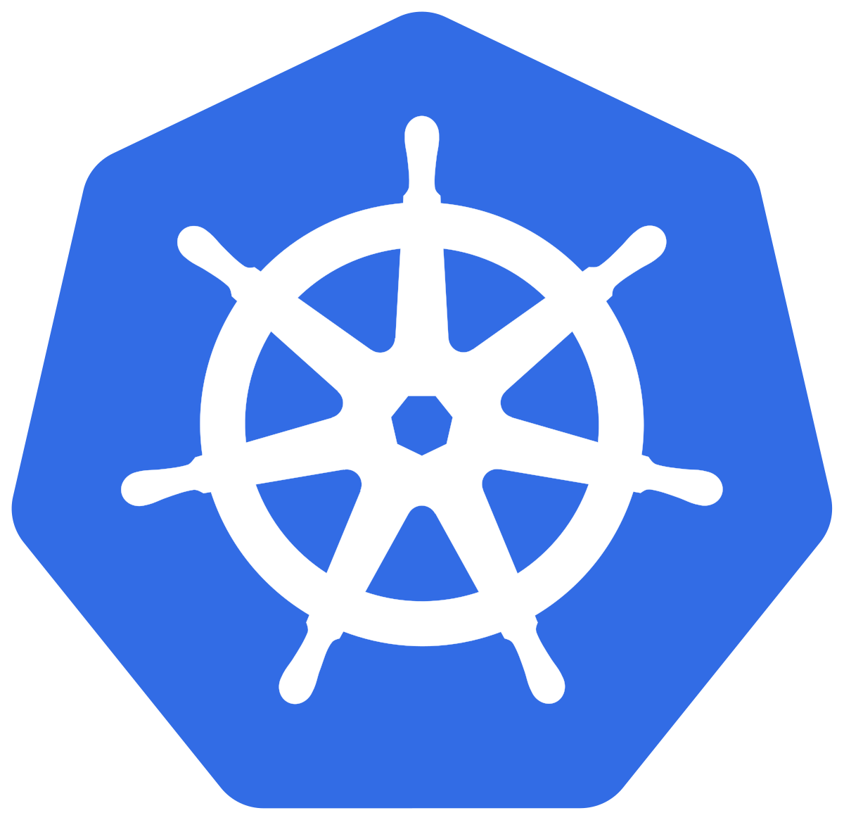
Kubernetes
Architecture

Slide 5
Kubernetes
Architecture

Slide 6
Why Kubernetes?

Slide 7
Kubernetes – Master & Worker Nodes

Slide 8
Kubernetes Architecture - Master
Master
kube-apiserver
It acts as front end for the Kubernetes control plane. It exposes the Kubernetes API
Command line tools (like kubectl), Users and even Master components (scheduler, controller manager, etcd) and Worker node components like (Kubelet) everything talk with API Server.
etcd
Consistent and highly-available key value store used as Kubernetes’ backing store for all cluster data.
It stores all the masters and worker node information.
kube-scheduler
Scheduler is responsible for distributing containers across multiple nodes.
It watches for newly created Pods with no assigned node, and selects a node for them to run on.
Kube Controller Manager
Cloud Controller Manager
kube-apiserver
etcd
kube-scheduler
Container Runtime (Docker)

Slide 9
Kubernetes Architecture - Master
Master
kube-controller-manager
Controllers are responsible for noticing and responding when nodes, containers or endpoints go down. They make decisions to bring up new containers in such cases.
Node Controller: Responsible for noticing and responding when nodes go down.
Replication Controller: Responsible for maintaining the correct number of pods for every replication controller object in the system.
Endpoints Controller: Populates the Endpoints object (that is, joins Services & Pods)
Service Account & Token Controller: Creates default accounts and API Access for new namespaces.
Kube Controller Manager
Cloud Controller Manager
kube-apiserver
etcd
kube-scheduler
Container Runtime (Docker)

Slide 10
Kubernetes Architecture - Master
Master
cloud-controller-manager
A Kubernetes control plane component that embeds cloud-specific control logic.
It only runs controllers that are specific to your cloud provider.
On-Premise Kubernetes clusters will not have this component.
Node controller: For checking the cloud provider to determine if a node has been deleted in the cloud after it stops responding
Route controller: For setting up routes in the underlying cloud infrastructure
Service controller: For creating, updating and deleting cloud provider load balancer
Kube Controller Manager
Cloud Controller Manager
kube-apiserver
etcd
kube-scheduler
Container Runtime (Docker)

Slide 11
Kubernetes Architecture – Worker Nodes
Worker Node
Kubelet
Kubelet is the agent that runs on every node in the cluster
This agent is responsible for making sure that containers are running in a Pod on a node.
Kube-Proxy
It is a network proxy that runs on each node in your cluster.
It maintains network rules on nodes
In short, these network rules allow network communication to your Pods from network sessions inside or outside of your cluster.
Kubelet
Kube-Proxy
Container Runtime (Docker)
Container Runtime
Container Runtime is the underlying software where we run all these Kubernetes components.
We are using Docker, but we have other runtime options like rkt, container-d etc.

Slide 12
Kubernetes - Architecture
Master
Worker Node
Kube Controller Manager
Cloud Controller Manager
Kubelet
Kube-Proxy
Container Runtime (Docker)
kube-apiserver
Worker Node
etcd
kube-scheduler
Kubelet
Kube-Proxy
Container Runtime (Docker)
Container Runtime (Docker)

Slide 13
Kubernetes
Fundamentals
Pod, ReplicaSet, Deployment & Service

Slide 14
Kubernetes - Fundamentals
Pod
A POD is a single instance of an Application.
A POD is the smallest object, that you can create in Kubernetes.
ReplicaSet
A ReplicaSet will maintain a stable set of replica Pods running at any given time.
In short, it is often used to guarantee the availability of a specified number of identical Pods
k8s Fundamentals
Deployment
A Deployment runs multiple replicas of your application and automatically replaces any instances that fail or become unresponsive.
Rollout & rollback changes to applications. Deployments are well-suited for stateless applications.
Service
A service is an abstraction for pods, providing a stable, so called virtual IP (VIP) address.
In simple terms, service sits Infront of a POD and acts as a load balancer.

Slide 15
Kubernetes
POD

Slide 16
Kubernetes - POD
With Kubernetes our core goal will be to deploy our applications in the form of containers on worker nodes in a cluster.
Kubernetes does not deploy containers directly on the worker nodes.
Container is encapsulated in to a Kubernetes Object named POD.
A POD is a single instance of an application.
A POD is the smallest object that we can create in Kubernetes.
N
Nginx Container
Image
N
N
POD
POD
Worker Node
Worker Node
Node
Worker Node
Kubernetes Cluster

Slide 17

Kubernetes - POD
PODs generally have one to one relationship with containers.
To scale up we create new POD and to scale down we delete the POD.
In short, we cannot have multiple containers of same kind in a single POD.
Example: Two NGINX containers in single POD serving same purpose is not recommended.
N
N
N
N
N
POD
POD
POD
POD
Worker Node
Worker Node
Kubernetes Cluster
Node

Slide 18
Kubernetes – Multi-Container Pods
We can have multiple containers in a single POD, provided they are not of same kind.
Helper Containers (Side-car)
Data Pullers: Pull data required by Main Container
Data pushers: Push data by collecting from main container (logs)
Proxies: Writes static data to html files using Helper container and Reads using Main Container.
Communication
The two containers can easily communicate with each other easily as they share same network space.
They can also easily share same storage space.
Multi-Container Pods is a rare use-case and we will try to focus on core fundamentals.
N
H
POD
Node
Kubernetes Cluster
Helper
Containers
Node

Slide 19
Kubernetes
PODs
Demo

Slide 20
Kubernetes
ReplicaSets

Slide 21
Kubernetes - ReplicaSets
High Availability or Reliability
Load Balancing
ReplicaSets
Scaling
Labels & Selectors

Slide 22
Kubernetes – ReplicaSet
A ReplicaSet’s purpose is to maintain a stable set of replica Pods running at any given time.
If our application crashes (any pod dies), replicaset will recreate the pod immediately to ensure the configured number of pods running at any given time.
Reliability
Or
High Availability
N
N
N
POD
POD
POD
ReplicaSet
Worker Node
Kubernetes Cluster

Slide 23

Kubernetes – ReplicaSet
Load Balancing
To avoid overloading of traffic to single pod we can use load balancing.
Kubernetes provides pod load balancing out of the box using Services for the pods which are part of a ReplicaSet
Service
N
N
N
N
POD
POD
POD
POD
ReplicaSet
Worker Node
Worker Node
Kubernetes Cluster

Slide 24
Kubernetes – ReplicaSet
Scaling
When load become too much for the number of existing pods, Kubernetes enables us to easily scale up our application, adding additional pods as needed.
This is going to be seamless and super quick.
Service
N
N
N
N
POD
POD
POD
POD
ReplicaSet
Worker Node
Worker Node
Kubernetes Cluster

Slide 25
Kubernetes
ReplicaSets
Demo

Slide 26
Kubernetes
Deployments

Slide 27
Kubernetes - Deployment
Create a Deployment to rollout a ReplicaSet
Updating the Deployment
Rolling Back a Deployment
Deployments
Scaling a Deployment
Pausing and Resuming a Deployment
Deployment Status
Clean up Policy
Canary Deployments

Slide 28
Kubernetes – Deployments
N
N
N
N
POD
POD
POD
POD
ReplicaSet
Deployment
Node
Node
Kubernetes Cluster

Slide 29
Kubernetes – Deployment Rollout & Versioning

Slide 30
Kubernetes – Deployment Strategy

Slide 31
Kubernetes – Deployment Upgrades

Slide 32
Kubernetes – Deployment Rollback

Slide 33
Kubernetes – Summarize Commands
Create
Get
Update
Status
Rollback

Slide 34
Kubernetes
Networking

Slide 36
Kubernetes
Services

Slide 38

Kubernetes - Services
Service
N
N
POD
POD
ReplicaSet
Deployment (app=frontend)
Service
Database
B
B
Node
Service
POD
POD
ReplicaSet
Deployment (app=Backend)

Slide 39
Backup Slides

Slide 40
Icons
D
B
N
H
N
N
D
B
H

Slide 41
Kubernetes - POD
N
N
N
N
N
POD
POD
POD
POD
Node
Node
Kubernetes Cluster

Slide 42
Kubernetes – Load Balancing & Scaling
a
N
N
N
N
POD
POD
POD
POD
Node
Node
Kubernetes Cluster

