Slide 1
Week 4 Project Updates
COMP 3601 - Libra

Slide 2
Revised Gantt Chart

Slide 3
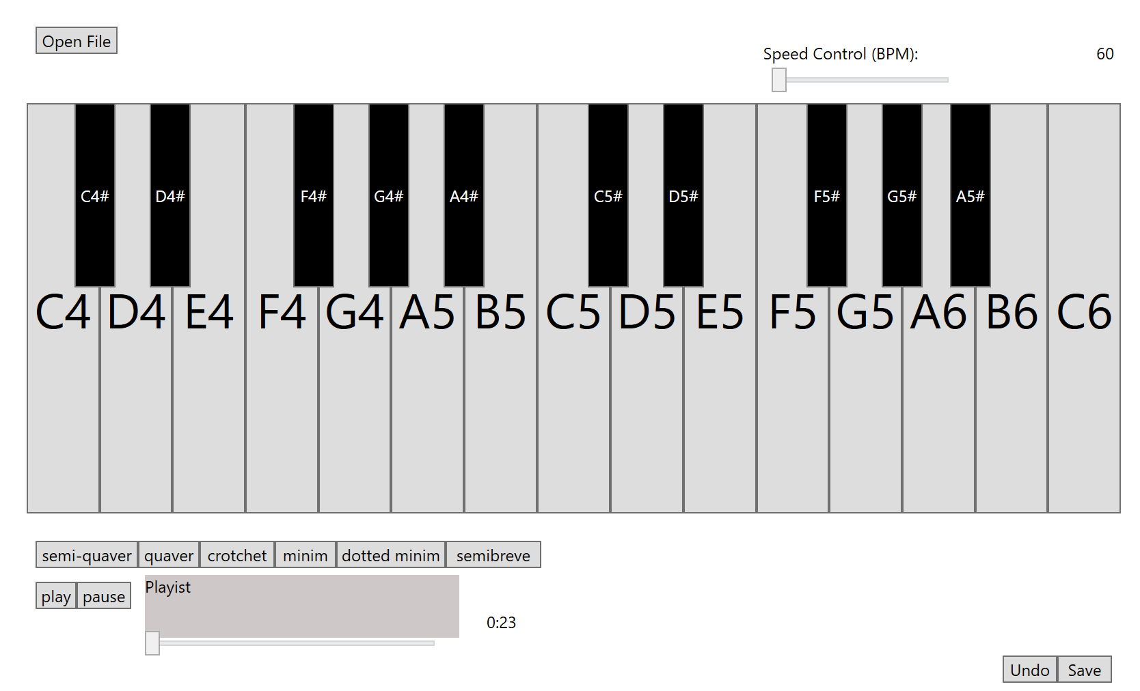
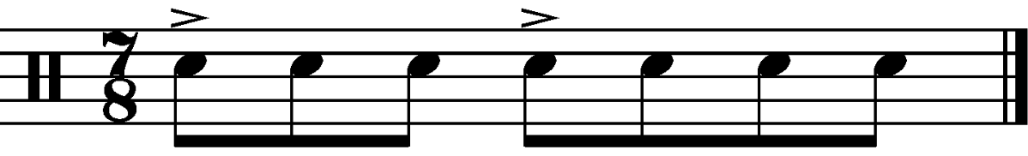
Software Development Progress
Add open file button to open music file
All basic button e.g. open file, undo, save are all working
Piano can be played
The next progress…
Will continue working on beat selection interface (user story 3.3)
Speed control
Will think about adding more functions e.g. adding quaver bar

Slide 4
Hardware Development Progress
Main progress : writing vhdl to interface with the hardware
Implementing memory, EPP for file transfer
Implementing binary to seven segment display converter
Hooking up ports to internal signals
The next progress…
Working on the integrator

