Slide 1
Week 5 Project Updates
COMP 3601 - Libra
Presenter: Ki Fung Kelvin Ting

Slide 2
Gantt Chart

Slide 3
Software Development Progress
(Staff)

Slide 4
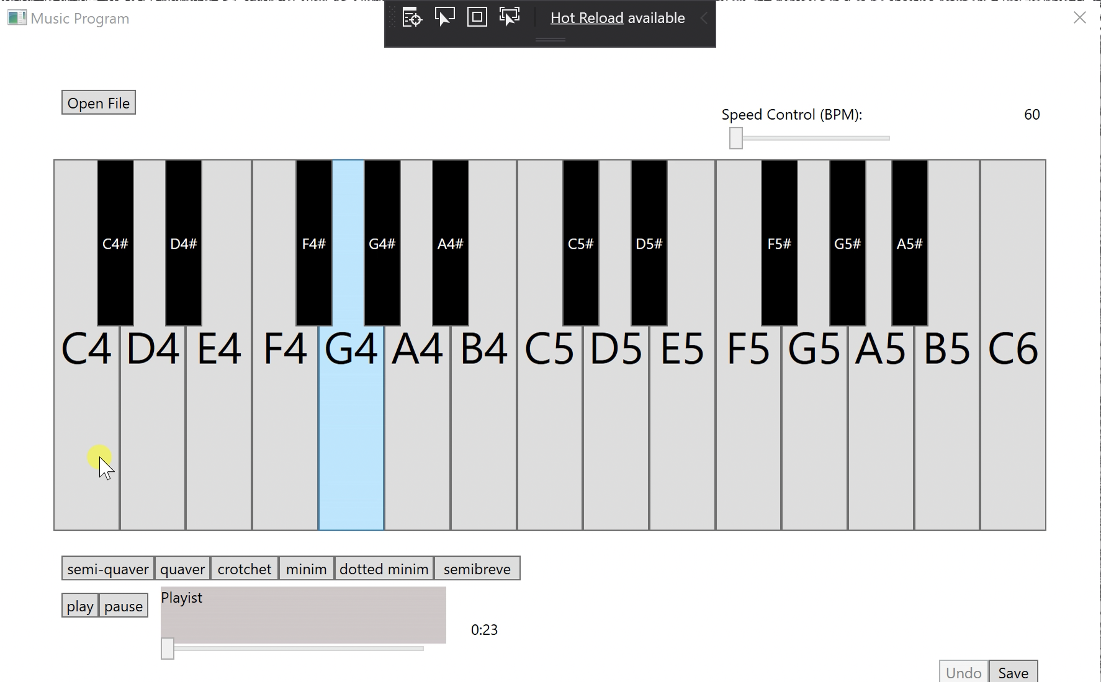
Software Development Progress
When pressing a key on the piano, it plays a sound
Use MIDI to play notes (useful for playback)
Multithreading (no need to wait on playing file)

Slide 5
Software Development Progress
Next Progress:
Ability to record songs and playback, such as “Record” button
Modify the methods of loading and saving files, and undoing changes
Problems:
One of our group members (Tingting) got sick so the progress is a little bit slow
Wasting time to figure out how to import images (solved)
Notes:
Build Action

Slide 6
Hardware Development Progress
Finish debugging FPGA
Music can be played through the speaker in the required speed
Next progress:
Building analogue, custom remote
Problems:
Yet to purchase control components (IR LED, IR photodiode, Op-Amp, wire, etc.)
Notes:
Initially: can’t play long music (repeating first note for some reason)
Everything works for tested case

