Slide 1

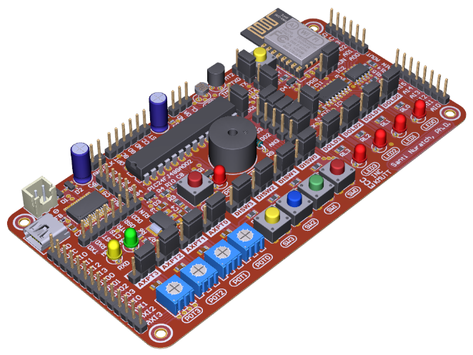


Embedded Real-Time Operating Systems
RTOS Programming for Embedded Developers
ดร.สันติ นุราช
Santi Nuratch., Ph.D.
Embedded Computing and Control Lab. @ INC-KMUTT
santi.inc.kmutt@gmail.com, santi.nur@kmutt.ac.th
Department of Control System and Instrumentation Engineering, King Mongkut’s University of Technology Thonburi, KMUTT

Slide 2

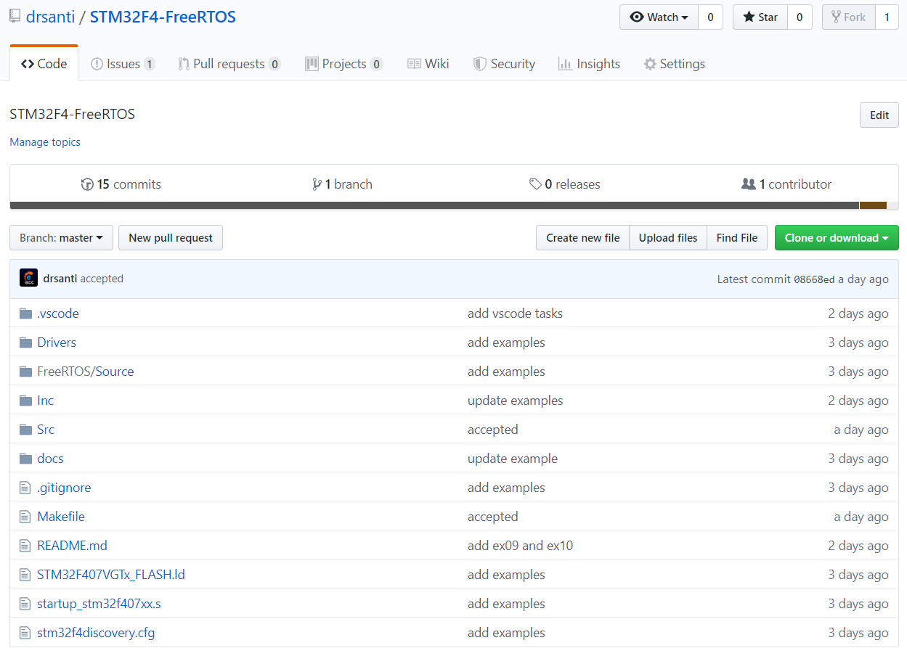
github.com/drsanti (all are there)

Slide 3
Tasks
Task States
Tasks in the Suspended state cannot be selected to enter the Running state, and do not have a time out. Instead, tasks only enter or exit the Suspended state when explicitly commanded to do so through the vTaskSuspend() and xTaskResume() API calls respectively.
When a task is actually executing it is said to be in the Running state. It is currently utilizing the processor. If the processor on which the RTOS is running only has a single core then there can only be one task in the Running state at any given time.
When a task is actually executing it is said to be in the Running state. It is currently utilizing the processor. If the processor on which the RTOS is running only has a single core then there can only be one task in the Running state at any given time.
A task is said to be in the Blocked state if it is currently waiting for either a temporal or external event. Tasks can also block to wait for queue, semaphore, event group, notification or semaphore event. Tasks in the Blocked state normally have a 'timeout' period, after which the task will be timeout, and be unblocked, even if the event the task was waiting for has not occurred.

Slide 4
Tasks
Task Priority
Each task is assigned a priority from 0 to configMAX_PRIORITIES-1 where configMAX_PRIORITIES is defined within FreeRTOSConfig.h
Low priority numbers denote low priority tasks. The idle task has priority zero (tskIDLE_PRIORITY)
The task placed into the Running state is always the highest priority task that is able to run
Ready state tasks of equal priority will share the available processing time using a time sliced round robin scheduling scheme.

Slide 5
Tasks
Idle Task & Idle Task Hook
It is imperative that the hook function does not call any API functions that might cause the idle task to block
It is common to use the idle hook function to place the microcontroller CPU into a power saving mode.
The idle task is created automatically when the RTOS scheduler is started to ensure there is always at least one task that is able to run. It is created at the lowest possible priority to ensure it does not use any CPU time if there are higher priority application tasks in the ready state.
An idle task hook is a function that is called during each cycle of the idle task. If you want application functionality to run at the idle priority then there are two options: 1) Implement the functionality in an idle task hook. 2) Create an idle priority task to implement the functionality

Slide 6
Queues, Mutexes, Semaphores
Queue (First In First Out, FIFO)
A queue can hold a finite number of fixed size data items. The maximum number of items a
queue can hold is called its ‘length’. Both the length and the size of each data item are set
when the queue is created.
There are two ways in which queue behavior could have been implemented:
Queue by copy: Queuing by copy means the data sent to the queue is copied byte for byte into the queue.
Queue by reference: Queuing by reference means the queue only holds pointers to the data sent to the queue, not the data itself
FreeRTOS uses the queue by copy method. Queuing by copy is considered to be simultaneously more powerful and simpler to use than queueing by reference
Queues are objects in their own right that can be accessed by any task or ISR that knows of their existence. Any number of tasks can write to the same queue, and any number of tasks can read from the same queue. In practice it is very common for a queue to have multiple writers, but much less common for a queue to have multiple readers

Slide 7
Queues, Mutexes, Semaphores
Queue (Accessing and Blocking)
xQueueSendFromISR ( )
xQueueReceiveFromISR ( )
Queue can be accessed by multiple tasks including ISRs
Queues can be grouped into sets, allowing a task to enter the Blocked state to wait for data to become available on any of the queues in the set
xQueueSend( )
xQueueReceive ( )
When a task attempts to read from a queue, it can optionally specify a ‘block’ time. This is the time the task will be kept in the Blocked state to wait for data to be available from the queue
Queues can have multiple readers, so it is possible for a single queue to have more than one task blocked on it waiting for data. When this is the case, only one task will be unblocked when data becomes available. The task that is unblocked will always be the highest priority
task that is waiting for data. If the blocked tasks have equal priority, then the task that has been waiting for data the longest will be unblocked
Just as when reading from a queue, a task can optionally specify a block time when writing to a queue. In this case, the block time is the maximum time the task should be held in the Blocked state to wait for space to become available on the queue
Queues can have multiple writers, so it is possible for a full queue to have more than one task blocked on it waiting to complete a send operation. When this is the case, only one task will be unblocked when space on the queue becomes available.

Slide 8
Queues, Mutexes, Semaphores
Queue (Sequence of Execution)
t0: Task_A runs first because it has the highest priority. It attempts to read from the queue. The queue is empty so the Task_A enters the Blocked state to wait for data to become available
t1: Task_B runs after the Task_A has blocked
t2: Task_B writes to the queue, causing the Task_A to exit the Blocked state. The Task_A has the highest priority so pre-empts Task_B
t3: Task_A empties the queue then enters the Blocked state again. This time Task_C runs after the Task_A has blocked
t4: Task_C writes to the queue, causing the Task_A to exit the Blocked state and pre-empt Task_C - and so it goes on

Slide 9
Queues, Mutexes, Semaphores
Queue (Sequence of Execution)
t1: Task_C executes and sends 5 data items to the queue
t2: The queue is full so Task_C enters the Blocked state to wait for its next send to complete. Task_B is able to run, so enters the Running state
t3: Task_B finds the queue is already full, so enters the Blocked state to wait for its first send to complete. Task_A is now able to run, so enters the Running state
Note: Task_B and Task_C have the same priority
t4: Task_B and Task_C are waiting for space to become available on the queue, resulting in Task_A being pre-empted as soon as it has removed one item from the queue. Task_B and Task_C have the same priority, so the scheduler selects the task that has been waiting the longest as the task that will enter the Running state
t5: Task_C sends another data item to the queue. There was only one space in the queue, so task Task_C enters the Blocked state to wait for its next send to complete. Task Task_A is again able to run so enters the Running state
t6: Both Task_B and Task_C have other items to be sent to the queue. This time Task_B has been waiting longer than Task_C, so Task_B enters the Running state (Task_A is pre-empted)
t7: Task_B sends data item to the queue. The, there was no space in the queue so Task_B enters the Blocked state to wait for its next send to complete. Both tasks Task_C and Task_B are waiting for space to become available on the queue, so task Task_A is the only task that can enter the Running state

Slide 10

ดร.สันติ นุราช
Santi Nuratch., Ph.D.
Embedded Computing and Control Lab. @ INC-KMUTT
santi.inc.kmutt@gmail.com, santi.nur@kmutt.ac.th
Department of Control System and Instrumentation Engineering, King Mongkut’s University of Technology Thonburi, KMUTT

