Slide 1
Recent Advances in Deep Learning in GIS – Spatiotemporal data mining and forecasting
A Thesis proposal & literature survey by
Supasin Wuthikulphakdi
ID# 608785068 Tamkang University

Slide 2
Introduction
Spatiotemporal data
a dataset collected in the space domain (a.k.a. a map over a location),
and the time domain (a.k.a. the time series).
Is a form of big data
Why we need to process ST-data?
Intelligent transport system (ITS)
automatic guidance, self-driving cars, traffic prediction, etc.
Weather forecast also need this form of data in the term of cloud/smog density
From overhead images
Problem: To manually collect, process, and forecast the ST data is a labourious task
Machine learning algorithms will do the job (i.e. SVM)
But ML architectures are not designed to extract feature representations autonomously
Deep learning algorithms are needed

Slide 3
Deep learning in ST-Data Mining
Artificial Neural Networks
capable of feature auto-extraction
CNN in space domain
RNN in time domain
CNN captures space features (i.e. heatmap, graph data (GCN), & data coordinates)
But not the time series (i.e. changes)
RNN-LSTM captures time features
But RNN has a problem of vanishing/exploding gradient
LSTM is preferred in later works

Slide 4
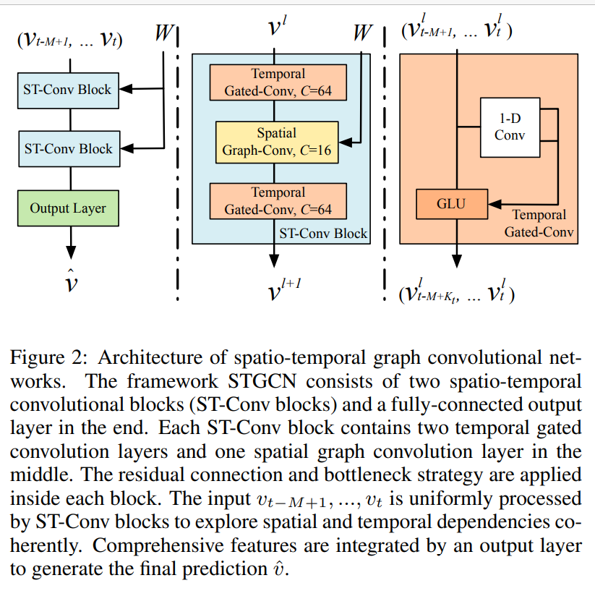
Literature Reviews
According to Li et al, 2018. [1], spatiotemporal forecasting
is a crucial task for a learning system that operates in a dynamic environment.
Useful in ITS & Smart cities
Diffusion Convolutional Recurrent Neural Network (DCRNN) model
Forecast the road traffic within a specific space and timeframe (The dataset was METR-LA, 2014). Diffusion convolution extracts the traffic features, and the RNN processes the traffic volumes in sequence.
Yu et al, 2018. [2] proposed a Spatiotemporal Graph Convolutional Networks (STGCN)
to tackle the time series prediction problem in traffic domain.
They formulated the problem on graphs and build the model with complete convolutional structures
enabling much faster training speed with fewer parameters.

Slide 5
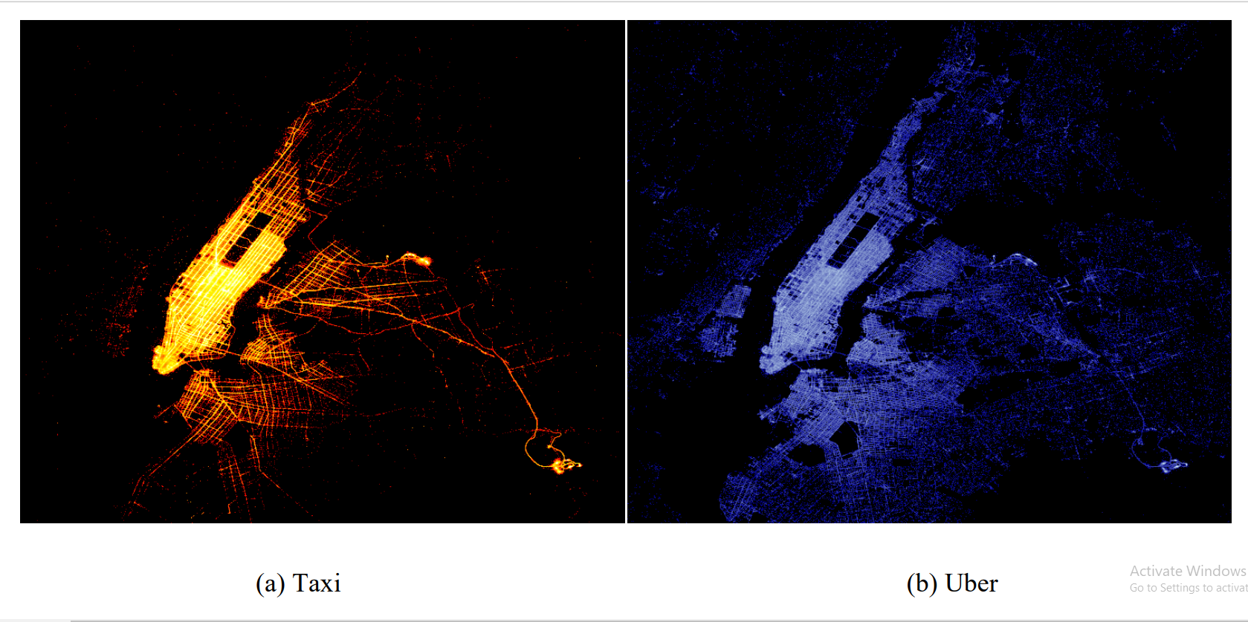
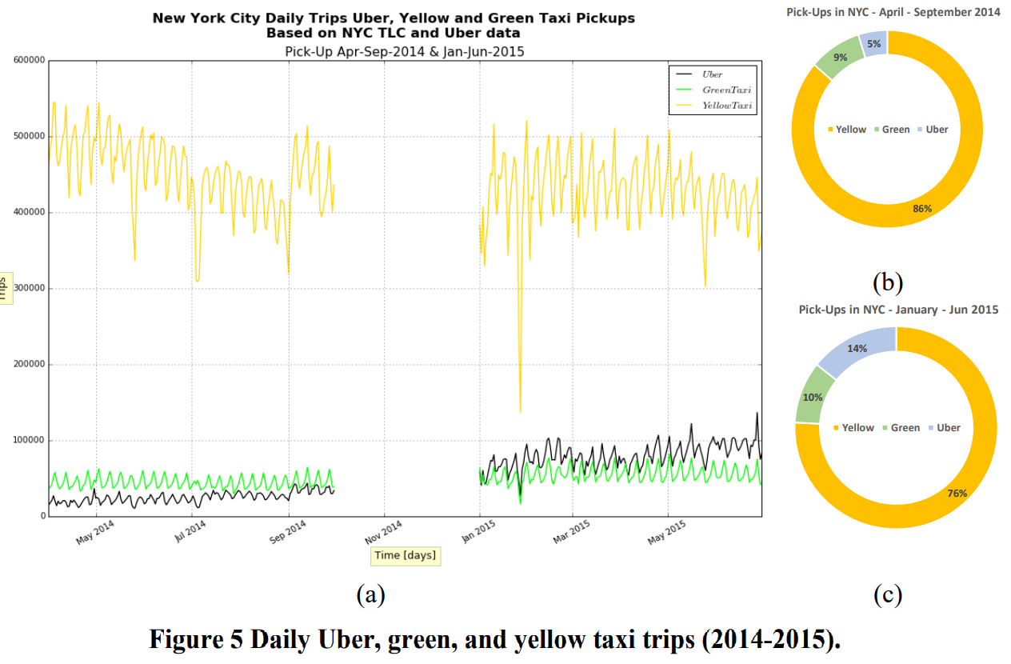
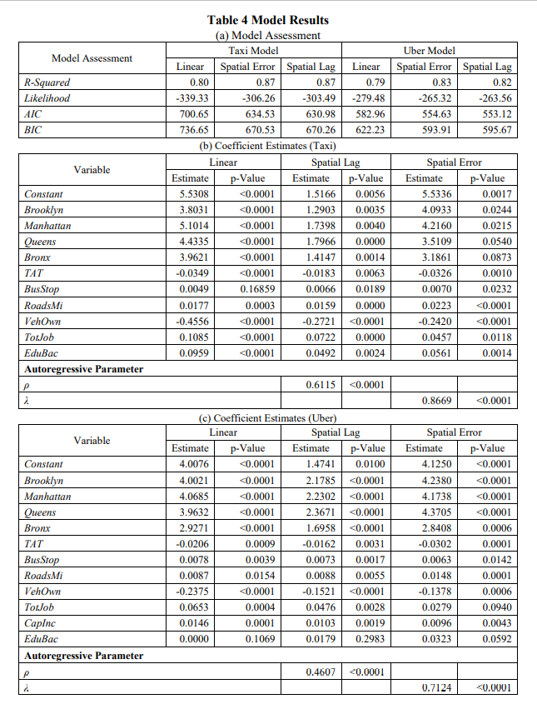
Literature Reviews
Correa et al, 2017 [3] performed a spatiotemporal data mining of Taxi vs Uber ridership in NYC, 2014+15.
According to the heatmap inside the paper, the ridership for both taxi systems depended on several factors
such as personal income, education, jobs, car ownership etc.
With 3 spatial models for ridership prediction – linear, spatial error and spatial lag models
the last one outperformed not only the first 2 algorithms, but also yielded a considerable accuracy and performance.
In the experiment, the presenter himself designed a Keras LSTM model

Slide 6
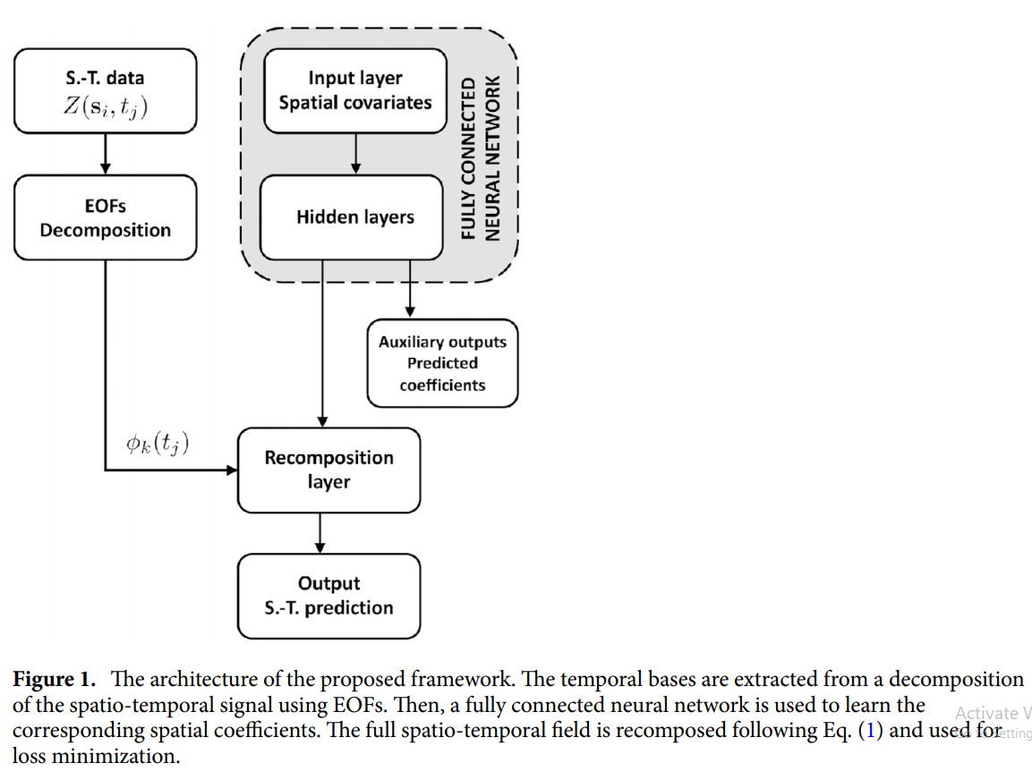
Literature Reviews
Amato et al. [4] designed a deep learning-based architecture called “Empirical Orthogonal Functions principal component analysis” EOF-PCA
in which the EOF framework decomposes the spatiotemporal input data
Then, the input layer spatial covariates are processed by a “Fully Connected Neural Network” (FCNN)
to obtain predictive coefficient to be recomposed altogether with the decomposed data stream, obtaining a spatiotemporal signal reconstruction.

Slide 7
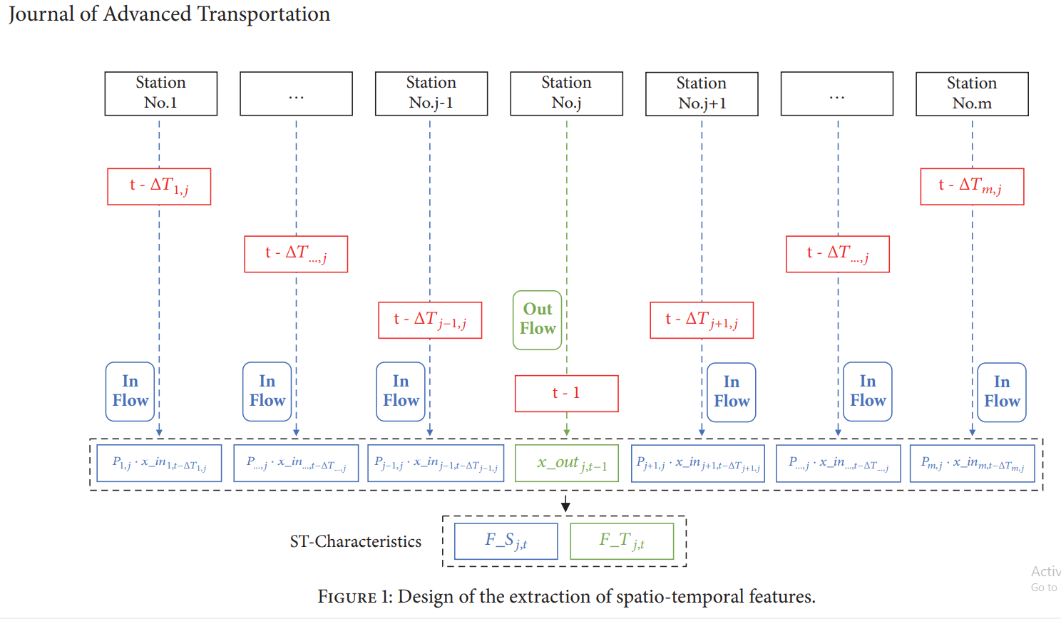
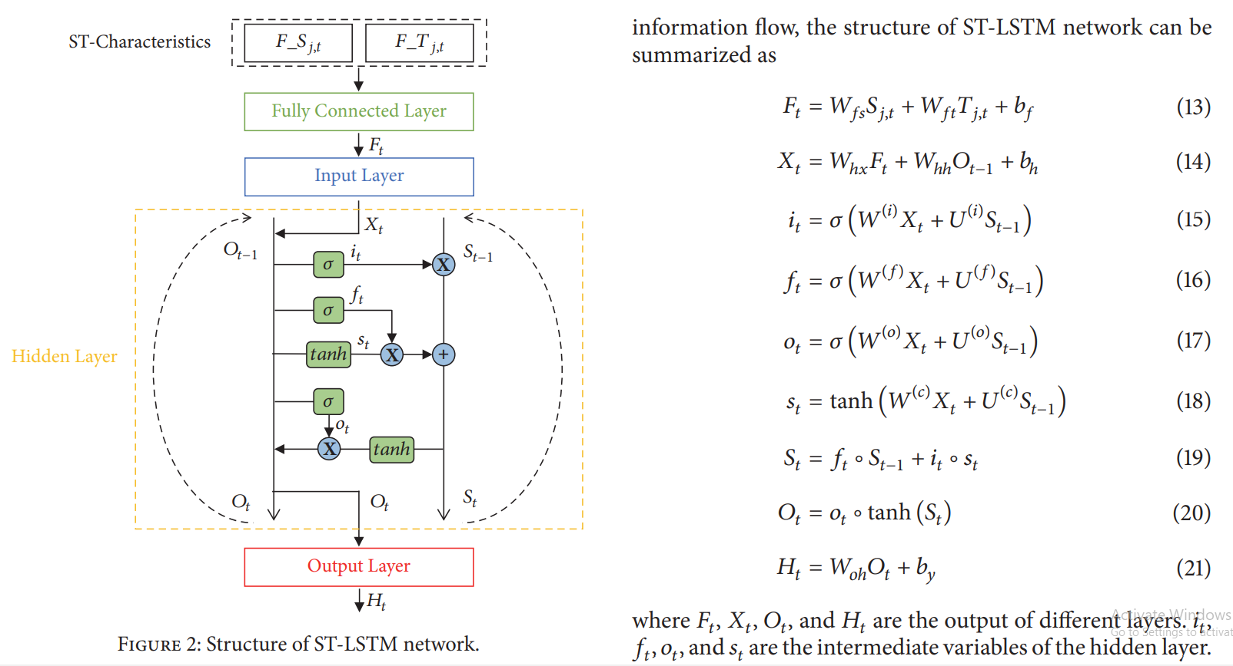
Literature Reviews
Tang et al. [5] designed an LSTM based framework to learn and forecast the rail traffic.
Accurate forecast can forewarn travel outburst, helping the passengers with their travel plans.
Even though the LSTM is notably effective in temporal data,
it cannot correlate the time domain with the space domain.
That is why we propose ST-LSTM.
Compared with other conventional models, ST-LSTM network can achieve a better performance in experiments.

Slide 8
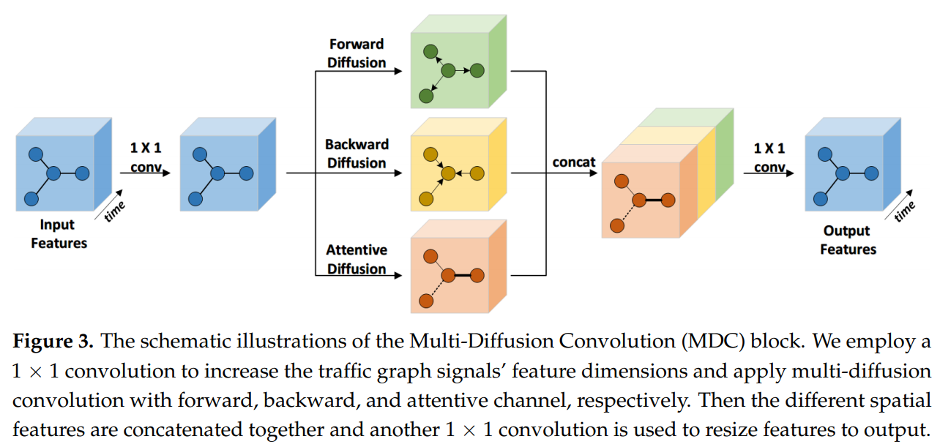
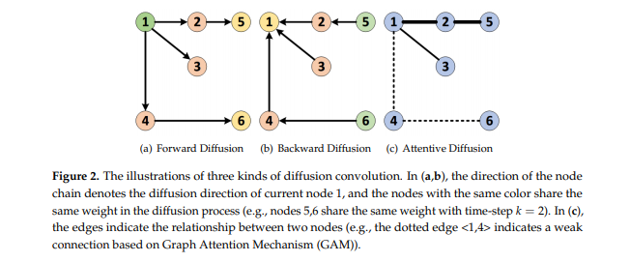
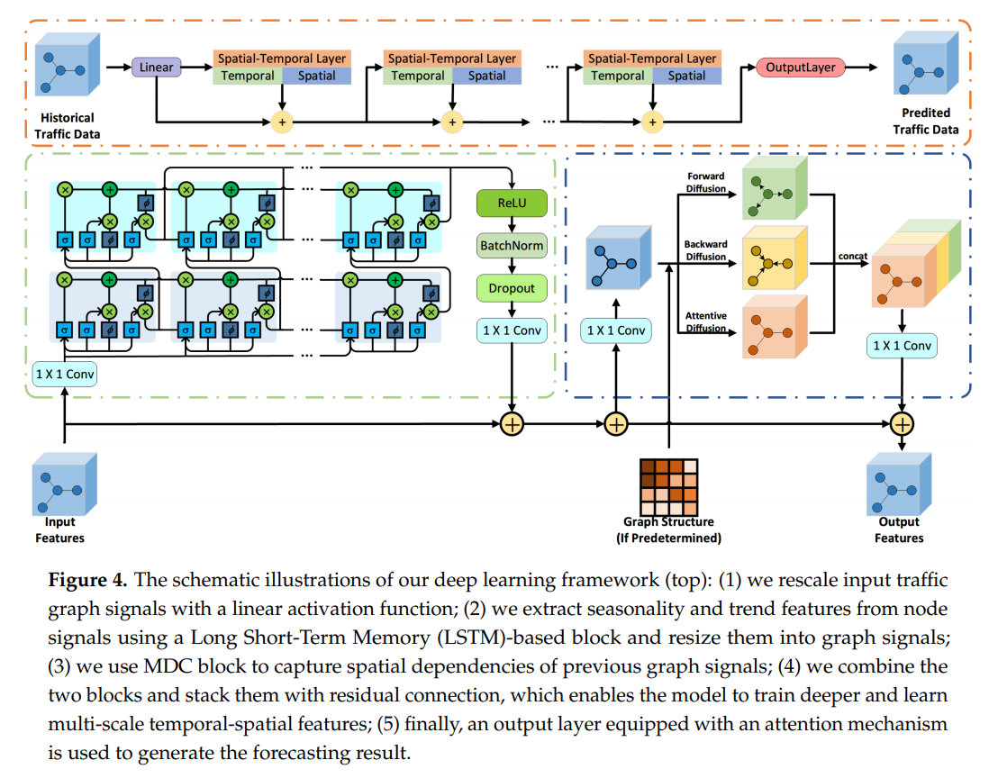
Literature Reviews
Lu et al. [6], designed a spatial-temporal deep learning network, termed ST-TrafficNet,
for traffic flow forecasting, whose architecture works as follows.
1. The Spatial Aware Multi-Diffusion Convolution Bloc (ADC-Block – who introduces Graph Attention Mechanism (GAM) into the MDC) uncovers unseen spatial dependencies from traffic graph signals automatically
2. From the data stream, the multi-diffusion convolution (MDC) block harvests ST-features of the spatial domain.
3. The ST-TrafficNet, an LSTM based framework, harvests the features of the temporal domain.
4. The output from both ANN are summed up to achieve convolutional results.
And 5. The ST-TrafficNet is evaluated on two benchmark datasets and compare it with various baseline methods for traffic forecasting.

Slide 9
Methodology
From each referred/surveyed paper
we will run the CNN+LSTM code written for each model and dataset.
Then, we will run the models in the reference
1. with their own datasets
2. with the Taxi-Uber dataset and compare them in the form of MAE & RMSE metrics
the less of them for each model, the better it performs in the term of learning and forecasting.
Finally, we will conclude which model does the best learning/forecast.
The Deep Learning models and ANNs
are written in Python with Keras as our preferred library/module.

Slide 10
Timeline
Project Phases:
May/June <-(CURRENT PHASE)
Perform Literature Reviews, Python coding & other essential skills
July
Perform even deeper LR + coding practice + Validation runs.
August/September
Custom Model Design, Training & Testing
October
Final Validation Runs
November
Result & Analysis + Writing a paper.
December
Finish the paper.
January
Defence oral exam

Slide 11
References
[1] Li, Y., Yu, R., Shahabi, C., & Liu, Y. (2017). Diffusion convolutional recurrent neural network: Data-driven traffic forecasting. arXiv preprint arXiv:1707.01926.
[2] Yu, B., Yin, H., & Zhu, Z. (2017). Spatio-temporal graph convolutional networks: A deep learning framework for traffic forecasting. arXiv preprint arXiv:1709.04875.
[3] Correa, D., Xie, K., & Ozbay, K. (2017). Exploring the taxi and Uber demand in New York City: An empirical analysis and spatial modeling. In 96th Annual Meeting of the Transportation Research Board, Washington, DC.
[4] Amato, F., Guignard, F., Robert, S., & Kanevski, M. (2020). A novel framework for spatio‑temporal prediction of environmental data using deep learning. Scientific Reports, 2020(10), 22243. doi:https://doi.org/10.1038/s41598-020-79148-7
[5] Tang, Q., Yang, M., & Yang, Y. (2019). ST-LSTM: A Deep Learning Approach Combined Spatio-Temporal Features for Short-Term Forecast in Rail Transit. Journal of Advanced Transportation, 2019, Article ID 8392592. doi:https://doi.org/10.1155/2019/8392592
[6] Lu, H., Huang, D., Song, Y., Jiang, D., Zhou, T., & Qin, J. (2020). ST-TrafficNet: A Spatial-Temporal Deep Learning Network for Traffic Forecasting. Electronics, 2020(9), 1474.

