Slide 1


MLP for Spatio-Temporal Traffic Volume Forecasting
Authors
Asimina Dimara, Dimitrios Triantafyllidis, Stelios Krinidis, Konstantinos Kitsikoudis, Dimosthenis Ioannidis, Efthalia Valkouma, Stilianos Skarvelakis Stavros Antipas, Dimitrios Tzovaras

Slide 2



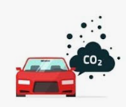
Traffic congestion problems
vehicular queueing
longer driving times
waste fuel
Increased emissions
air pollution

Slide 3

How to Solve traffic congestion
Enable traffic regulation
Traffic management
Intelligent Transportation Systems (ITS)
Models to simulate, forecast traffic

Slide 4
Traffic forecasting methods
Traffic forecasting
Machine learning
ANN
Regression models
Hardware
Cameras
Sensors
Fusion of models
Low error
High error
Low error many data
Minor error high cost
Minor error High cost

Slide 5




Suggested solution
Low-cost method
Use the least possible data
Gain awareness of data
Employ the greatest possible advantage

Slide 6
Data wrangling
Explain the process with thoroughness
Further information about the data
Clean and unify messy and complex data

Slide 7
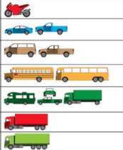
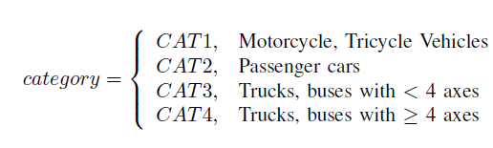
Vehicles classification

Slide 8
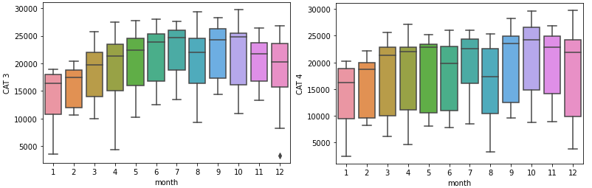
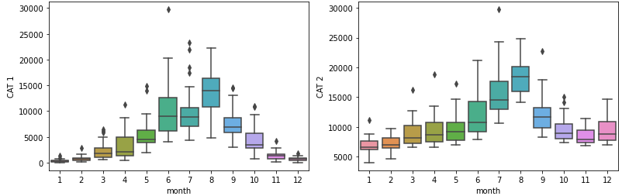
Vehicles Per month

Slide 9
Vehicles Per month

Slide 10
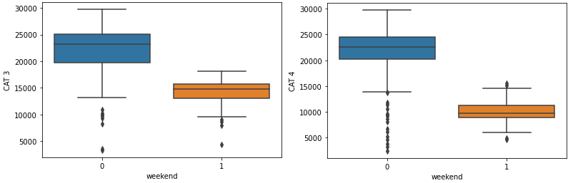
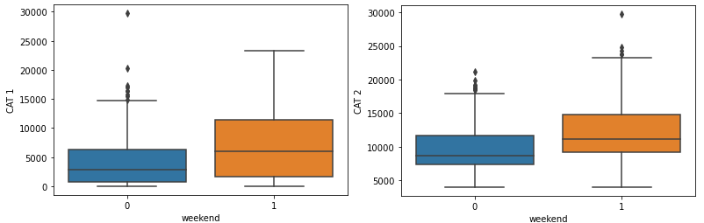
Vehicles Per weekend

Slide 11
Vehicles Per weekend

Slide 12
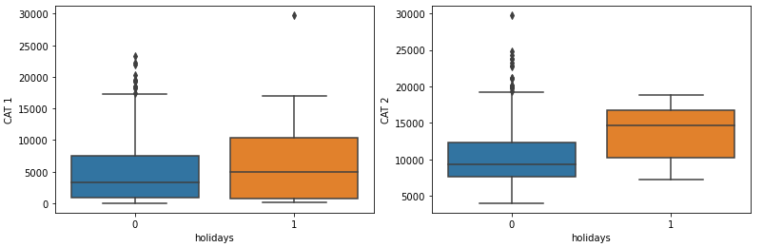
Vehicles Per holidays

Slide 13
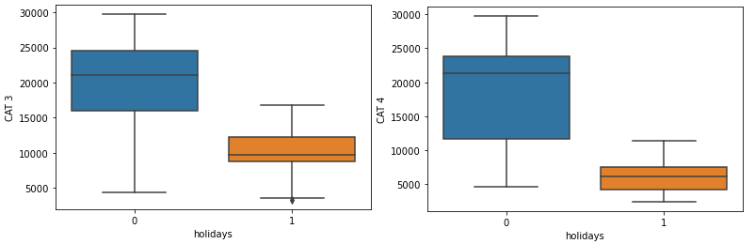
Vehicles Per holidays

Slide 14
Data preprocessing
Impute missing values
Feature Encoding
Outliers
Data modeling

Slide 15
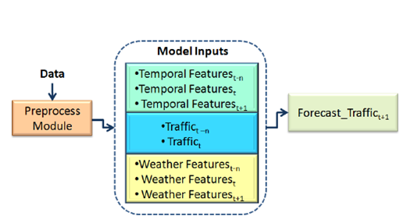
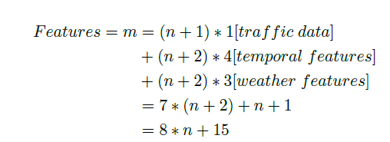
Data modeling

Slide 16
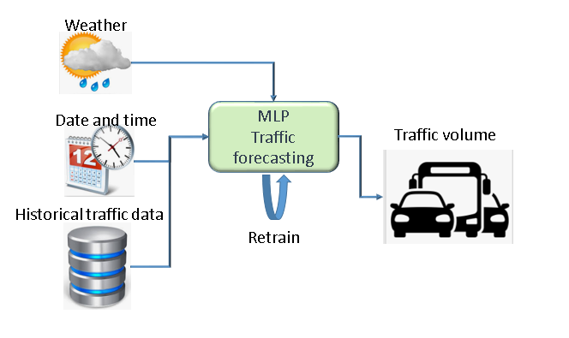
Systems conceptual architecture

Slide 17
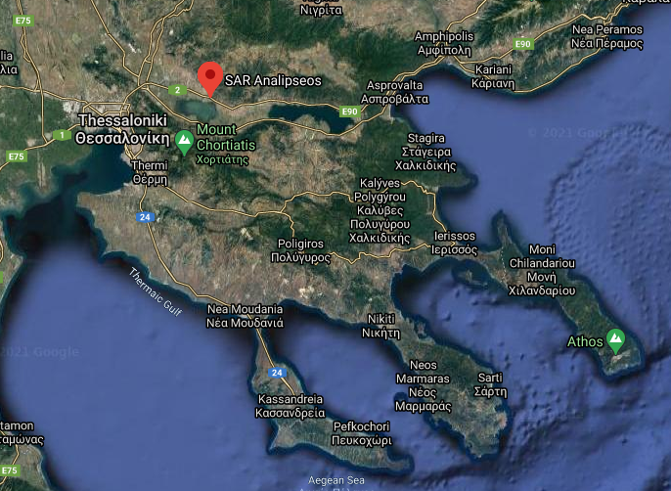
Use case

Slide 18
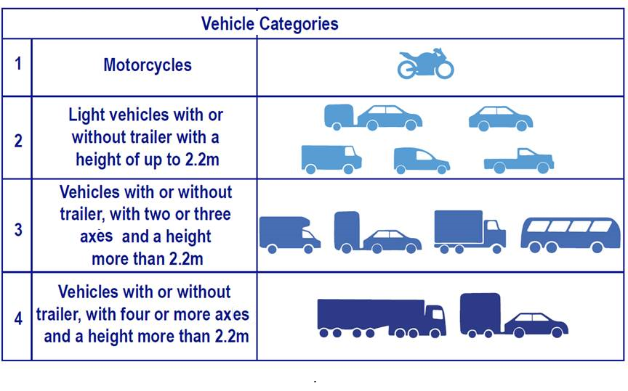
Use case

Slide 19
MLP architecture
Define the optimal topology for a neural network
Trial and error methods for the definition

Slide 20



No of Hidden layers and neurons
Hecht Nielsen
2. Huang
3. Accurate practice- based guides

Slide 21
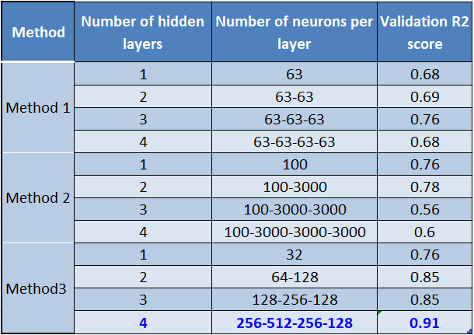
MLP trial and error phase

Slide 22
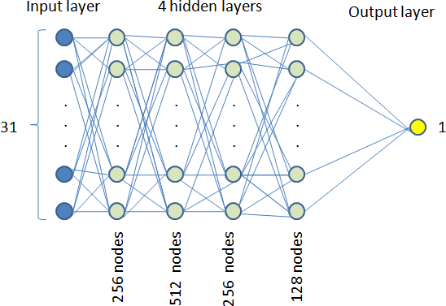

MLP architecture

Slide 23
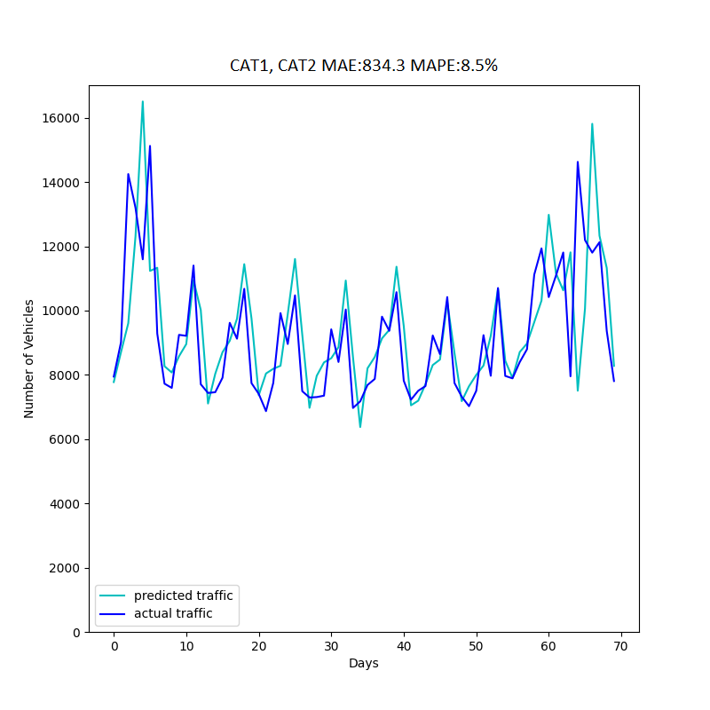
Light vehicles results

Slide 24
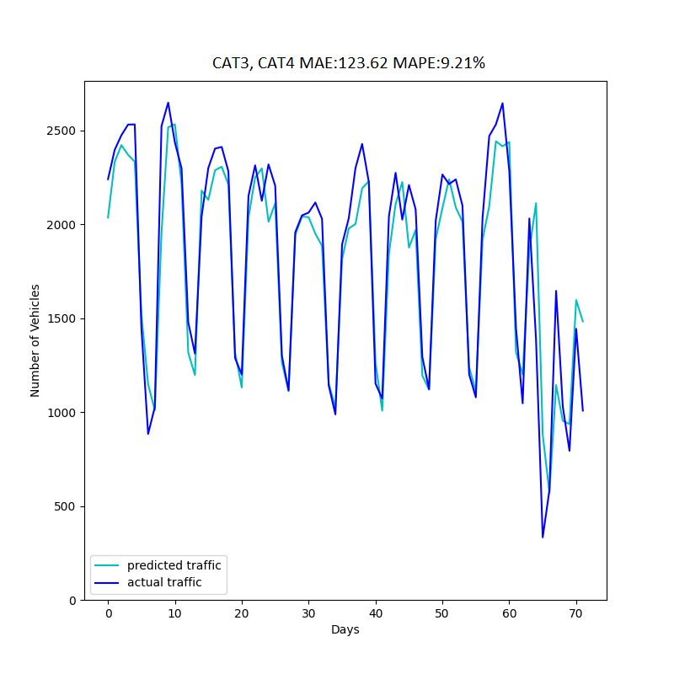
Heavy vehicles results

Slide 25
Conclusions
Toll for traffic volume forecasting at a specific toll plaza
Data are analyzed
Data preprocessing to better fit the model.
Accurate Traffic volume patterns
Non-intrusive
low-cost traffic volume forecasting tool
Information the traffic volume
Real-time traffic monitoring and management
Enhancing the management of road networks
Reduce traffic congestion.

Slide 26

International IOT, Electronics and Mechatronics Conference
21st- 24th April, 2021 at Toronto, Canada,
Thank you for watching
Any questions?
Authors
Asimina Dimara, Dimitrios Triantafyllidis, Stelios Krinidis, Konstantinos Kitsikoudis, Dimosthenis Ioannidis, Efthalia Valkouma, Stilianos Skarvelakis Stavros Antipas, Dimitrios Tzovaras

