Slide 1
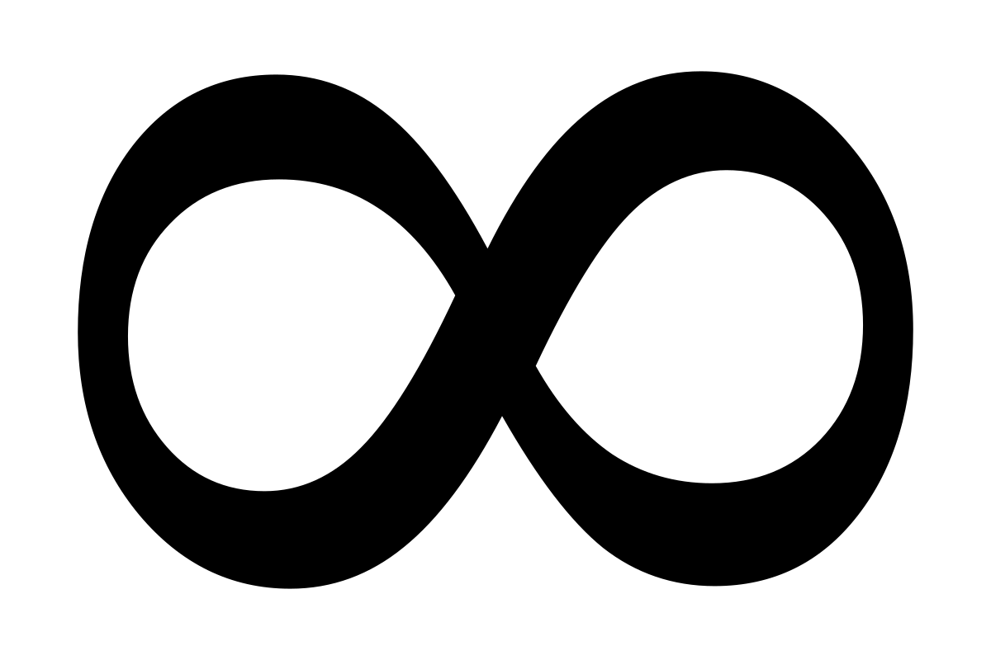
Infinite Scroll

Slide 2
What is Infinite Scroll?
You scroll down and before you reach the bottom, new content magically appears seemingly out of nowhere
Example: Twitter, Facebook, Google
Automatically add next page
Infinite Scrolling vs. Pagination
Infinite Scrolling Is Not for Every Website

Slide 3
Complexity
The technical challenge behind an infinite scroller, however, is harder than it seems
Stop Scrolling Event (Prevent from Multiple fire).
DOM Recycling/Re-use of DOM
Retrieve next or previous page using PageToken
Push/Add new Content in the Page.
Attach Event on Dynamic Content (newly added content).
SEO Friendly
Recursive Programming
Cross browsers Friendly
Ajax/no-Ajax implementation
infinite scrolling does not resonate with users if it does not support their goal on the website.

Slide 4
Working Example
100s of Plugin/Code available very few will meet the requirement, customize solutions need for a smooth lazy loading website based on your business requirement. Example Link URL: http://www.supplyusa.com/g/index.html
A modern way of implementing of infinite scroll discussed here URL: https://developers.google.com/web/updates/2016/07/infinite-scroller

Slide 5
Implementation
Vanilla JavaScript
jQuery
React/Redux
AngularJS

Slide 6

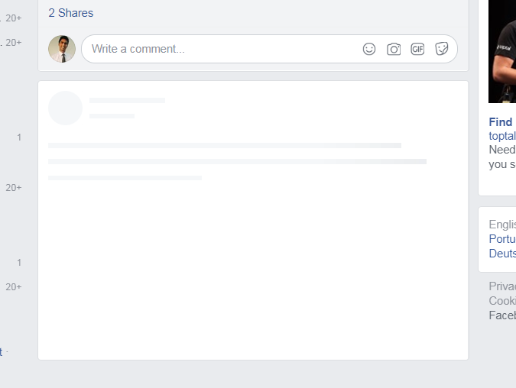
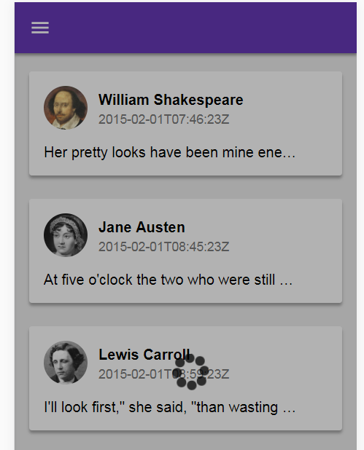
Loading Icon..
Overlay Modal
Loading Image
Tombstones Loading Content

Slide 7
It’s never perfect

