Slide 1
PAPER REPRODUCTION · CORRECTED EVALUATION
Reproducing and Improving
DoH Tunnel Detection
+4.73 pp
+4.40 pp
L1 best corrected F1
L2 best corrected F1
0.9179 → 0.9651
0.9425 → 0.9864
Evidence boundary
Capped, session-disjoint raw-PCAP experiment — not a full-dataset convergence claim.
MontazeriShatoori et al. (2020) · CIRA-CIC-DoHBrw-2020 · Project evidence, seed 42
01
Notes:
This project reproduces the two-layer DoH tunnel detector and then evaluates a mask-aware bidirectional GRU under a stricter protocol. In the capped, session-disjoint experiment, best-window F1 improves by 4.73 percentage points on layer one and 4.40 points on layer two. These are bounded comparative results, not a claim of full-dataset convergence.

Slide 2
01 · PROBLEM
Encryption hides content—not packet behavior
Encrypted payload
Observable sequence
DNS names and answers
Packet direction
Application semantics
Packet length
Tunnel commands and data
Timing and burst structure
Opaque inside HTTPS/TLS
Learnable without decryption
Core hypothesis:
DoH tunneling changes traffic shape enough to classify.
Source: original paper, Sections I–III
02
Notes:
DNS-over-HTTPS hides domain names, answers, and tunnel content inside TLS. It does not hide packet direction, packet length, timing, or burst structure. The paper’s central hypothesis is that these observable sequences remain discriminative without decrypting payloads.

Slide 3
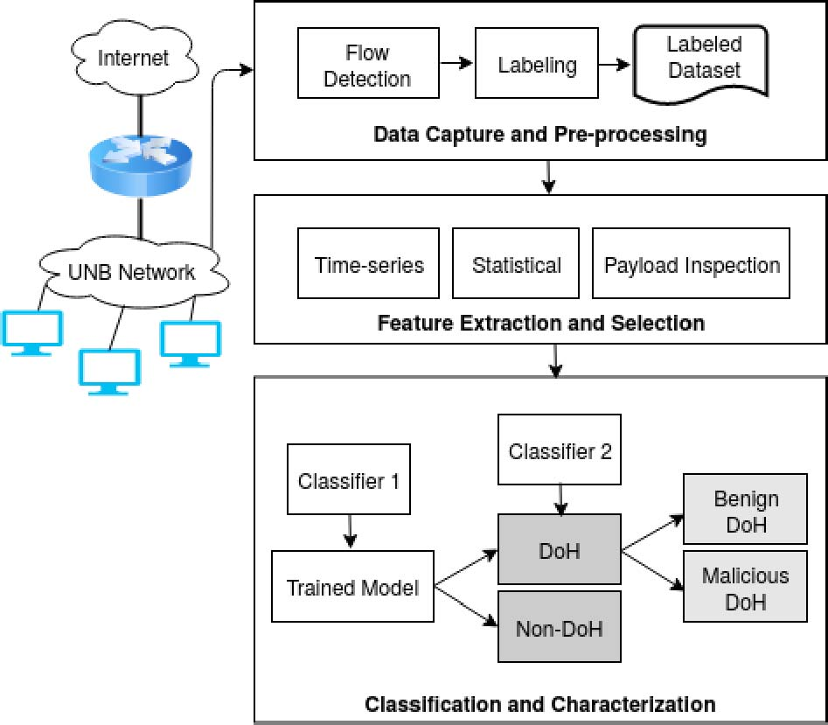
02 · ORIGINAL METHOD
A two-layer decision system
Encrypted traffic flow
LAYER 1
NON-DOH
DoH vs non-DoH
Stop
LAYER 2
Benign vs malicious
Original paper architecture
Figure reproduced without crop
Each layer is evaluated independently across statistical and sequence models.
Source: original paper, architecture figure
03
Notes:
The first layer separates DoH from ordinary HTTPS traffic. Only traffic classified as DoH proceeds to the second layer, which separates benign DoH from malicious tunnels. We reproduce these two decisions independently so that each result has a clear task definition and evidence boundary.

Slide 4
03 · CORE CONCEPT
Packet clumps convert traffic into a sequence
ORDERED PACKETS
client → resolver
resolver → client
A clump groups consecutive packets
Sequence model
same direction · bounded by direction change
[c₁, c₂, …, cₙ] → label
cᵢ = (direction, lengths, timing)
The first N clumps define the model window.
Longer windows trade latency for context.
This representation preserves order while avoiding payload inspection.
Source: original paper, packet-clump methodology
04
Notes:
A packet clump groups consecutive packets moving in the same direction until direction changes or the timeout is exceeded. Each clump preserves direction, packet lengths, and timing, and the first N clumps form a model window. Increasing N adds behavioral context but also delays the decision.

Slide 5
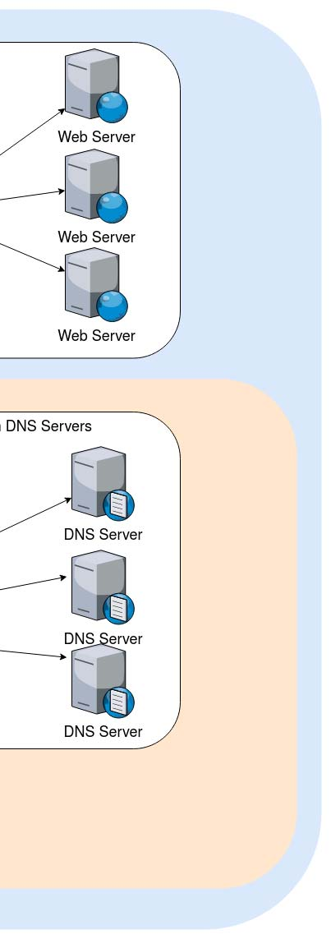
04 · DATASET
CIRA-CIC-DoHBrw-2020 provides both tables and packets
Three traffic classes
Non-DoH HTTPS
Benign DoH
Malicious DoH tunnels
Original capture environment
CSV supports statistical replication;
PCAP enables sequence reconstruction.
Paper figure · no crop
Evidence path:
CSV baseline first → raw PCAP session-disjoint experiment.
Sources: original paper; project manifests and raw-PCAP experiment audit
05
Notes:
The benchmark contains non-DoH HTTPS, benign DoH, and malicious DoH tunnel traffic. Published CSV features support the statistical replication, while raw PCAP files are required to reconstruct packet-clump sequences. Our evidence path therefore starts with the tabular baseline and then moves to a raw-PCAP session-disjoint experiment.

Slide 6
05 · ORIGINAL PIPELINE
The paper evaluates two representations in parallel
STATISTICAL PATH
Completed flow
28 summary features
RF · C4.5 · SVM · NB · DNN · 2D CNN
TIME-SERIES PATH
Packet stream
Directional clumps
4-layer LSTM · windows 1…10
Original evaluation: stratified 80/20 random split at flow level.
Source: original paper, Sections IV–V
06
Notes:
The statistical path waits for a completed flow, derives summary features, and evaluates classical and neural classifiers. The time-series path converts packet streams into directional clumps and sweeps LSTM windows from one through ten. The original work evaluates both paths with an eighty–twenty random split at flow level.

Slide 7
06 · STATISTICAL RESULTS
Flow-summary models reproduce near-perfect F1
F1 score · higher is better
PROJECT RF
1.000
0.9965
Layer 1 F1
0.990
0.9997
Layer 2 F1
0.980
Same flow-random protocol
Same leakage caveat
Replication succeeded—but protocol realism remains unresolved.
Sources: Paper Tables III–IV; reports/paper_comparison/statistical_models.csv
07
Notes:
The paper reports random-forest F1 of 0.993 for layer one and 0.999 for layer two. Our project random forest reaches 0.9965 and 0.9997 under the same flow-random paradigm. This reproduces the headline statistical performance, but it also inherits the same cross-session leakage risk.

Slide 8
07 · PAPER TIME-SERIES RESULTS
A few clumps recover most discriminative signal
F1 by number of observed clumps
1.00
0.574 s
L1 mean · l=6
0.90
0.502 s
0.80
L2 mean · l=3
Paper-selected points
≈99% F1
Paper claim: early sequence decisions can replace full-flow waiting.
Source: Paper Tables V–VI; paper-reported timing
08
Notes:
The paper’s LSTM improves rapidly as the model observes more clumps. Its selected operating points reach 0.993 F1 for layer one at six clumps and 0.991 for layer two at three clumps. The reported mean detection delays are 0.574 and 0.502 seconds, supporting the early-detection argument relative to waiting for full flows.

Slide 9
08 · REPRODUCTION CORRECTIONS
Reproducibility required fixing method and protocol gaps
PAPER GAP / RISK
PROJECT CORRECTION
Printed clump termination inversion
Stop on direction change or timeout
Out-of-bounds access after increment
Bounds check before packet indexing
Unspecified optimizer and seeds
Pinned configs, seed 42, immutable manifests
Flow-random train/test correlation
Session/scenario group-disjoint split
baseline: Dense(10) → LSTM(8×4) → Dense(1)
improved: mask → BiGRU → attention → classifier
All corrections are encoded in code, manifests, and regression tests.
Sources: paper Algorithm 1; project methodology and experiment manifest
09
Notes:
We corrected the printed clump termination condition and added a bounds check before packet indexing. We also pinned optimizer settings, seeds, manifests, and the source snapshot. Most importantly, we added a session-and-scenario group-disjoint split and a mask-aware BiGRU with attention as the improved sequence model.

Slide 10
09 · LEAKAGE AUDIT
Random flow splits overstate cross-session generalization
Paper architecture · F1 at paper-selected windows
What changed?
Random split can place
flows from one capture
0.5
session on both sides.
Group-disjoint split forces
unseen-session transfer.
0.0
Protocol—not architecture—
explains the collapse.
High random-split accuracy is not evidence of deployment generalization.
Source: reports/paper_comparison/leakage_audit.csv
10
Notes:
At the paper-selected windows, the replicated paper architecture scores 0.9784 and 0.9405 F1 under flow-random splits. Under session-disjoint evaluation, those values fall to zero and 0.1324. This collapse demonstrates that random flow accuracy cannot be interpreted as unseen-session generalization.

Slide 11
10 · RAW-PCAP EXPERIMENT
The corrected run is broad—but intentionally capped
13,754
97.1 GB
201,321
capture sources audited
uncompressed evidence
flows processed
13,150 session groups
one invalid PCAPNG skipped
1,325 retained for training
RETAINED CLASS BALANCE
500
non-DoH
325
benign DoH
500
malicious DoH
25-flow-per-capture cap: comparative evidence, not full-data convergence.
Source: data/manifests/timeseries_comprehensive_experiment.json
11
Notes:
The audit covers 13,754 capture sources, 13,150 session groups, and about 97.1 gigabytes of uncompressed evidence. It processes 201,321 flows and retains 1,325: five hundred non-DoH, 325 benign DoH, and five hundred malicious DoH. The cap of twenty-five flows per capture controls runtime, so these results remain comparative rather than converged full-data estimates.

Slide 12
11 · PAPER-WINDOW COMPARISON
The improved model is strong—but not at every selected window
Layer | Evidence | Split | l | F1
L1 | Paper reported | Flow-random | 6 | 0.9930
L1 | Project paper_v4 | Flow-random | 6 | 0.9784
L1 | Project paper_v4 | Session-disjoint | 6 | 0.0000
L1 | Improved BiGRU | Session-disjoint | 6 | 0.9153
L2 | Paper reported | Flow-random | 3 | 0.9910
L2 | Project paper_v4 | Flow-random | 3 | 0.9405
L2 | Project paper_v4 | Session-disjoint | 3 | 0.1324
L2 | Improved BiGRU | Session-disjoint | 3 | 0.5538
Paper-selected windows are not the improved model’s best operating points.
Sources: Paper Tables V–VI; comprehensive metrics manifest
12
Notes:
At the paper’s windows, the improved BiGRU reaches 0.9153 F1 on layer one and 0.5538 on layer two under the corrected split. These values substantially exceed the corrected paper architecture, but layer two is still far below the paper’s flow-random claim at three clumps. The table therefore keeps paper-reported, project-random, corrected-baseline, and improved evidence separate.

Slide 13
12 · CORRECTED BEST-WINDOW RESULT
Mask-aware BiGRU improves both detection layers
Best corrected session-disjoint F1
OBSERVED DELTA
1.00
+4.73 pp
Layer 1
+4.40 pp
Layer 2
FPR = 0 at both optima
Improvement holds under the corrected split within the capped sample.
Source: comprehensive metrics manifest; best windows selected independently per model
13
Notes:
When each model is compared at its own best corrected window, layer-one F1 increases from 0.9179 to 0.9651 and layer-two F1 from 0.9425 to 0.9864. The absolute gains are 4.73 and 4.40 percentage points, with zero observed false-positive rate at both improved optima. This is the project’s positive model result within the capped session-disjoint sample.

Slide 14
13 · LIMITATIONS
What the current evidence does—and does not—establish
01 · SAMPLE CAP
02 · CLASS AVAILABILITY
25 flows per capture
Benign DoH stops at 325 flows
Controls runtime; does not prove convergence.
Requested quotas cannot all be filled.
Next: larger caps + repeated seeds.
Next: report confidence intervals.
03 · DOMAIN SCOPE
04 · OPERATING POINT
One benchmark environment
Best window chosen post sweep
Unknown transfer to new resolvers and tools.
Window selection needs nested validation.
Next: cross-dataset external validation.
Next: locked holdout and calibration.
Claim only the bounded comparison the experiment supports.
Interpretation constrained by experiment manifest and provenance taxonomy
14
Notes:
Four limitations constrain interpretation. The per-capture cap limits convergence evidence, benign DoH availability stops at 325 retained flows, all traffic comes from one benchmark environment, and best windows are selected after the sweep. Larger caps, repeated seeds, confidence intervals, external datasets, and a locked holdout are the next required checks.

Slide 15
CONCLUSION
Preserve the baseline.
Fix the evaluation. Improve the sequence model.
01
02
03
Reproduce
Correct
Improve
Statistical and LSTM
Session-disjoint splits
Mask-aware BiGRU adds
baselines remain traceable.
test real generalization.
+4.73 / +4.40 pp F1.
Methodological validity is the primary result.
The model gain matters because it survives the stricter protocol.
DoH Tunnel Detection · Reproduction and Improvement
15
Notes:
The reproduction keeps the statistical and four-layer LSTM baselines traceable. The corrected protocol tests transfer to unseen sessions, and the mask-aware BiGRU improves both tasks under that protocol. The primary result is methodological validity; the model gain matters because it survives the stricter evaluation.

