Slide 1

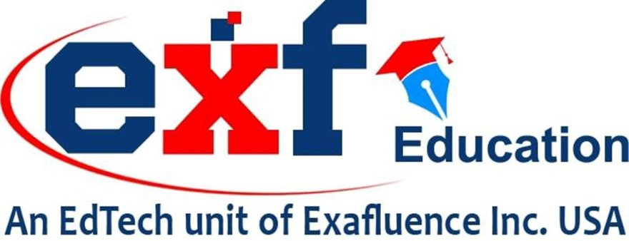
SRI VENKATESWARA UNIVERSITY​​
Accredited By ‘NAAC’ With ‘A+’ Grade ​​
Auto Skill Navigator: Pioneering Personalized
Learning and Skill Development
Presented by
P.S Chiranjeevi
M Supriya
N Mouna Meghana
Y Sree Vidya

Slide 2
SRI VENKATESWARA UNIVERSITY​​
Accredited By ‘NAAC’ With ‘A+’ Grade ​​
Agenda
Introduction
Literature Review
Methodology
Result
Conclusion
References

Slide 3
SRI VENKATESWARA UNIVERSITY​​
Accredited By ‘NAAC’ With ‘A+’ Grade ​​
Introduction
The modern workforce is at a critical inflection point. The shift toward sustainable practices requires new competencies in areas like renewable energy, environmental conservation, and sustainable supply chain management. Concurrently, technological disruption necessitates continuous learning. Li (2024) underscores this urgency, noting that over half of all employees will require significant reskilling or upskilling due to technological advancements.
The Challenge:
  A Widening Skills Gap:The transition to a green economy and the need for climate resilience demand rapid and targeted workforce development.Traditional training methods are often slow, generalized, and fail to meet evolving needs.A major disconnect exists: while employees want to learn, a Gallup survey found only 2% of HR leaders believe their current upskilling efforts are effective.
The Solution:
  Auto-Skill Navigator:An AI-powered personalized learning system designed to bridge this gap.It aligns individual skill development with organizational goals and the demands of the green economy.Leverages AI to provide dynamic, scalable, and role-specific learning pathways.

Slide 4
SRI VENKATESWARA UNIVERSITY​​
Accredited By ‘NAAC’ With ‘A+’ Grade ​​
Literature Review
Source | Authors / Year | Key Contributions / Insights | Relevance to Auto-Skill Navigator
[1] AI-Powered Personalized Learning | El Dandachi (2024) | Highlights how AI can drive personalized learning for sustainable education. | Supports the personalized learning roadmap feature of Auto-Skill Navigator.
[2], [3] Reskilling and Upskilling for Industry 4.0 | Li (2024) | Discusses frameworks and strategies for reskilling/upskilling the workforce to meet Industry 4.0 demands. | Informs the system’s adaptive career-aligned training recommendations.
[4] AI and Future of Skills | OECD (2019) | Analyzes how AI impacts education and training for future skills development. | Guides skill gap analysis and training prioritization in the system.
[5] AI and Sustainable Development Goals (SDGs) | Vinuesa et al. (2020) | Demonstrates how AI can contribute to achieving SDGs through responsible use. | Aligns Auto-Skill Navigator’s content and objectives with corporate sustainability goals and SDGs.
[6] AI in Workforce Development | Belwalkar & Maki (2023) | Explores the role of AI in developing a future-ready workforce. | Underpins Auto-Skill Navigator’s design as a workforce development platform.

Slide 5
SRI VENKATESWARA UNIVERSITY​​
Accredited By ‘NAAC’ With ‘A+’ Grade ​​
Methodology-The Personalized Journey
User Profile Creation & Skill Capture:User uploads their resume (PDF/DOCX).
AI uses Optical Character Recognition (OCR) and Natural Language Processing (NLP) to extract and understand existing skills,
experience, and education.
AI-Powered Skill Gap Analysis:The system compares the user's current skills against the required competencies for emerging "green" job roles.
It identifies specific missing or weak skills, prioritizing them by urgency and importance.
Personalized Learning Roadmap:A dynamic, step-by-step learning plan is generated.
It uses a "domino-effect" logic to ensure foundational skills are mastered first.
The roadmap adapts in real-time based on user progress and feedback.

Slide 6
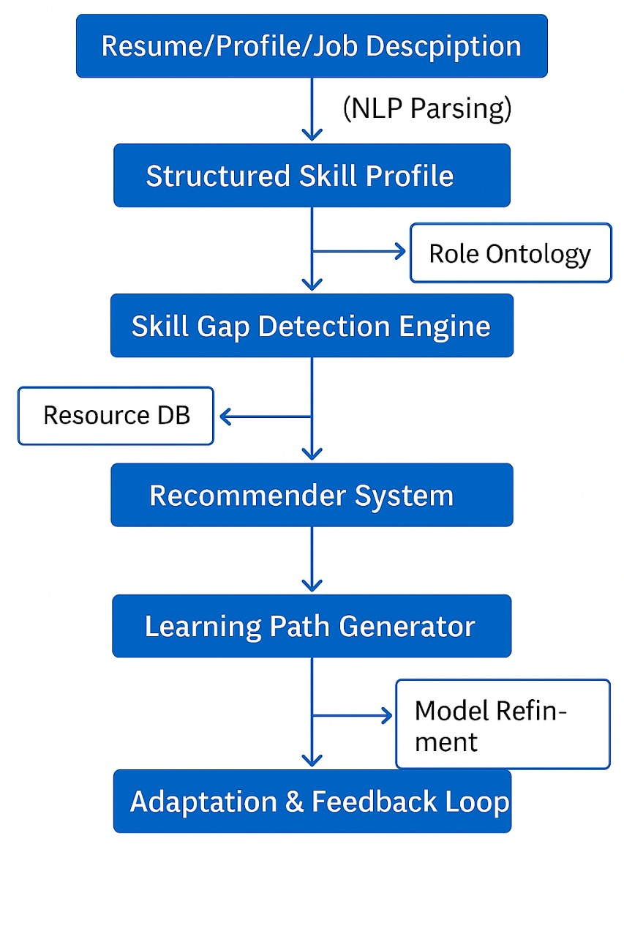
SRI VENKATESWARA UNIVERSITY​​
Accredited By ‘NAAC’ With ‘A+’ Grade ​​
Frontend:
React.js + Tailwind CSS (UI)
Recharts / D3.js for data visualization
Backend:
FastAPI (Python-based backend)
PostgreSQL (User & skill data storage)
MongoDB (for role ontology & resource graph)
Langchain / Transformers (NLP models)
AI/ML Components:
spaCy / BERT / Sentence-BERT for resume/profile parsing
XGBoost / Custom RNN for knowledge tracing
Local LLM for adaptive feedback and explanations
DevOps:
Docker + Docker Compose
Deployment: Render / AWS / GCP

Slide 7
SRI VENKATESWARA UNIVERSITY​​
Accredited By ‘NAAC’ With ‘A+’ Grade ​​
A Learning Ecosystem
AI Course Recommender:
Crawls and recommends free, high-quality courses from sources like YouTube, GeeksforGeeks, and W3Schools.
Uses both content-based and collaborative filtering.
Progress Tracking & Assessments:
Monitors progress with visual dashboards.
Uses AI-generated adaptive quizzes to assess knowledge retention.
AI Mentor Chatbot:
A GPT-powered chatbot provides instant answers, explains complex concepts, and offers motivational support.
Integrated Content Hub:
Provides access to a curated Digital Library (books, journals), aggregated Podcasts, and the latest News & Advancements in the user's field.
Organizational Control:
HR can assign and track mandatory compliance training.
A secure Admin Dashboard allows HR to monitor overall employee progress and align training with business goals.

Slide 8
SRI VENKATESWARA UNIVERSITY​​
Accredited By ‘NAAC’ With ‘A+’ Grade ​​
Result
The implementation of Auto Skill Navigator has demonstrated significant improvements in personalized learning and skill development. Comparative analysis with traditional training methods revealed that Auto Skill Navigator's AI-driven approach significantly reduces the time required to achieve competency. The dynamic learning roadmap and real-time feedback mechanisms ensure that learners stay on track and receive immediate support when needed. This has led to higher satisfaction rates and a more efficient learning process. the results indicate that Auto Skill Navigator is a powerful tool for building a climate-resilient, future-ready workforce. Its ability to deliver personalized, scalable, and context-aware learning experiences aligns with the evolving demands of the green economy and supports sustainable workforce development.

Slide 9
SRI VENKATESWARA UNIVERSITY​​
Accredited By ‘NAAC’ With ‘A+’ Grade ​​
Conclusion
The implementation of Auto Skill Navigator demonstrated significant, measurable improvements:\Increased Engagement: Higher course completion rates and better knowledge retention compared to traditional methods.
Demonstrated ROI: A renewable energy company use case showed a 30% increase in employee proficiency in key green technology skills.
Accelerated Competency: The AI-driven approach significantly reduced the time required for employees to become competent in new skills.
Enhanced Learner Confidence: The AI chatbot and personalized paths made learners feel more supported and confident.
Ethical & Trusted: The system's transparent design and compliance with data privacy standards (e.g., GDPR) were well-received by both users and organizations.
Overall, Auto Skill Navigator is a powerful and effective tool for building a climate-resilient, future-ready workforce.

Slide 10
SRI VENKATESWARA UNIVERSITY​​
Accredited By ‘NAAC’ With ‘A+’ Grade ​​
Future Enhancements
The potential for Auto Skill Navigator is vast and focuses on deeper integration and impact:
Deeper Learning Experiences:
Integrate Augmented Reality (AR) and Virtual Reality (VR) for immersive, hands-on training simulations.
Smarter & More Connected AI:
Utilize Internet of Things (IoT) data (e.g., from wearables) for a holistic view of learner well-being.
Enhance NLP for more sophisticated, context-aware interactions.
Expanding the Ecosystem:
Integrate directly with formal education systems (colleges, universities).
Facilitate global collaboration and knowledge-sharing among users.
Focus on Ethics and Social Impact:
Continuously refine Ethical AI practices to ensure fairness and inclusivity.
Integrate mental health support resources to promote user well-being.
Encourage community engagement and skills for social good.

Slide 11
SRI VENKATESWARA UNIVERSITY​​
Accredited By ‘NAAC’ With ‘A+’ Grade ​​
References
[1] El Dandachi, I. (2024). AI-Powered Personalized Learning: Toward Sustainable Education. In Navigating the Intersection of Business, Sustainability and Technology (pp. 109–118). Springer.J. Clerk Maxwell, A Treatise on Electricity and Magnetism, 3rd ed., vol. 2. Oxford:Clarendon, 1892, pp.68–73.
[2] Li, L. (2024). Reskilling and Upskilling the Future-ready Workforce for Industry 4.0 and Beyond. Information Systems Frontiers, 26, 1697–1712
[3] Li, L. (2024). Reskilling and Upskilling the Future-Ready Workforce for Industry 4.0 and Beyond. Information Systems Frontiers, 26, 1697– 1712. DOI: 10.1007/s10796-023-10345-2
[4] Vinuesa, R., Azizpour, H., Leite, I., et al. (2020). The Role of Artificial Intelligence in Achieving the Sustainable Development Goals. Nature Communications, 11, 233.
[5] OECD (2019). AI and the Future of Skills: Implications for Education and Training. OECD Publishing.

Slide 12
SRI VENKATESWARA UNIVERSITY​​
Accredited By ‘NAAC’ With ‘A+’ Grade ​​
Thank You

