Slide 1
Genome Wide Analysis of
A. thaliana for Motif Frequency
Satya Uppuganti
Jon Kirk BINF6211- 2016S - Final Presentation

Slide 2
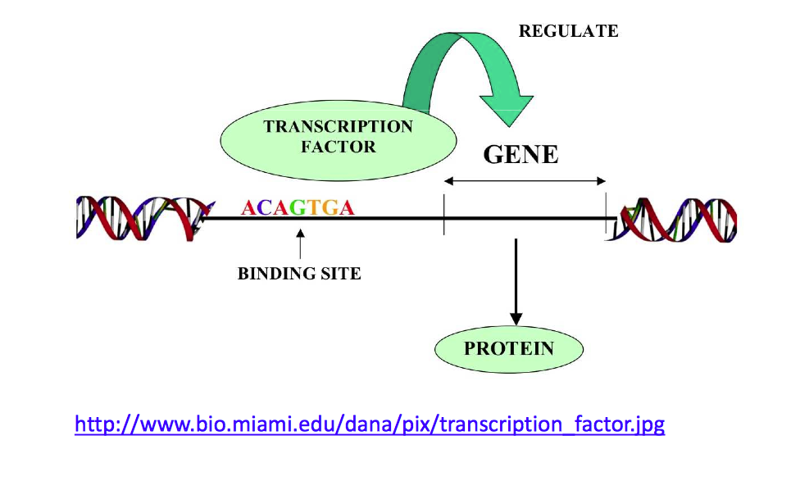
Background
Sequence Motif:
Short and recurring patterns in DNA - with biological function
Indicate sequence specific binding sites for proteins (TFs)
Important in studying gene regulation
Other processes: ribosome binding, mRNA processing, transcription termination
Notes:
Sequence motifs are short, recurring patterns in DNA that are presumed to have a biological function. Often they indicate sequence-specific binding sites for proteins such as nucleases and transcription factors (TF). Others are involved in important processes at the RNA level, including ribosome binding, mRNA processing (splicing, editing, polyadenylation) and transcription termination.

Slide 3
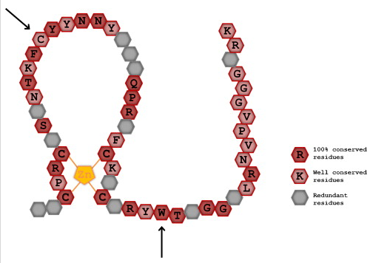
Background
DNA-Binding One Zinc Finger (DOF) transcription factor family
Plant Specific family
Implicated in wide range of processes
AAAG - core recognition site
Notes:
Dof proteins are members of a major family of plant transcription factors. The proteins have similar DNA-binding properties because of the highly conserved DNA-binding domain. However, recent studies are disclosing their diverse roles in gene expression when associated with plant-specific phenomena including light, phytohormone and defense responses, seed development and germination. Based on the structural diversity indicated by the complete catalog of Arabidopsis Dof proteins, Dof genes appear to have evolved multiple times, preceding and paralleling the diversification of angiosperms. Such gene multiplication might have led to the functional diversification of Dof proteins proceeding differently in distinct plant species.

Slide 4

Background
Arabidopsis thaliana
Small genome ~135 Mbp
A member of Brassicaceae family
Widely studied
Short life cycle
Complete genome availability
Has five chromosomes
Median GC% = 36.6%
Notes:
https://www.arabidopsis.org/portals/education/aboutarabidopsis.jsp

Slide 5
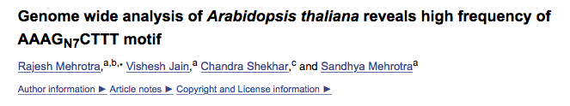
Motivation
A recent study has identified a motif consisting of the DOF core recognition site AAAG and its reverse complement TCCC separated by 7 nucleotides. We are interested in attempting to reproduce these results to confirm the prevalence of this motif, and then investigate possible implications and significance of this finding.
appear more frequently in the genome
b. Importance of understanding the relationship between frequency of certain motifs and their
role in gene regulation.

Slide 6
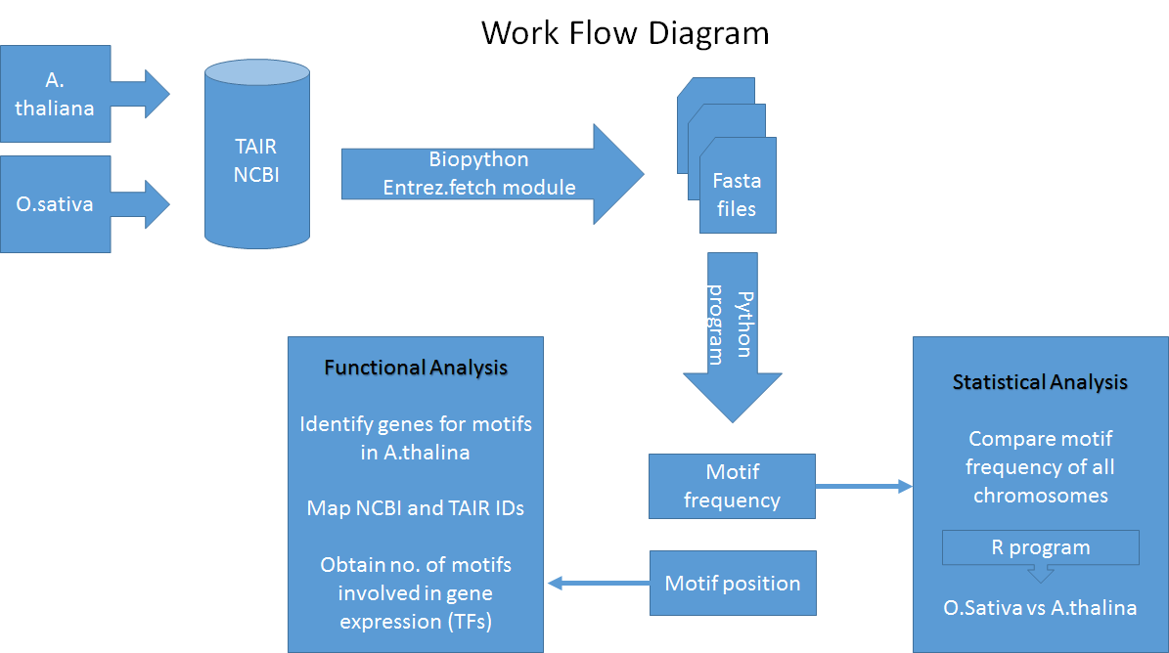
Enrichment factor analysis
Genes & plant ontologies

Slide 7
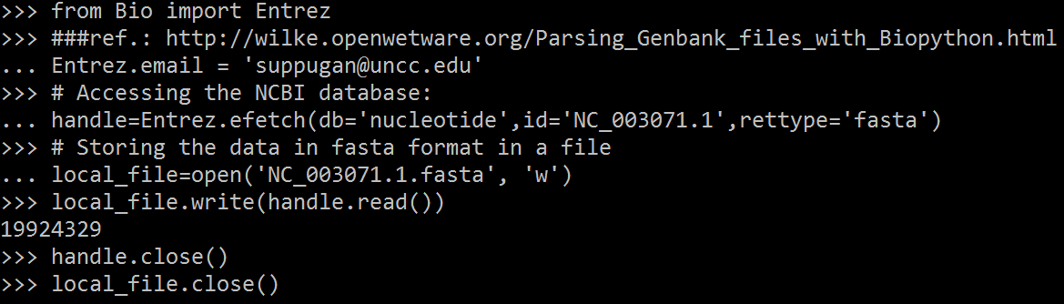
Methods - Biopython
Downloading complete sequences using Biopython:
Bio.Entrez.efetch is the module to access Genbank at the NCBI.

Slide 8
Methods
For Concatenating the sequences:
Unix command:
Grep: Searches files for the occurrence of regex
Awk: Processes rows and columns in a file
Ran this command on all the chromosome files to obtain a single line of sequence

Slide 9
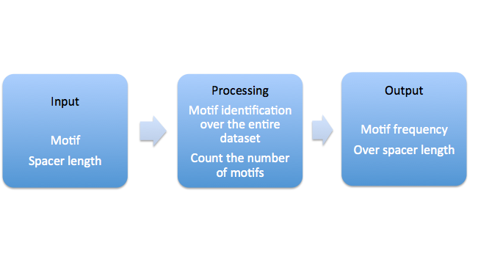
Python program
Use python code for motif identification
Determine the spacer length

Slide 10
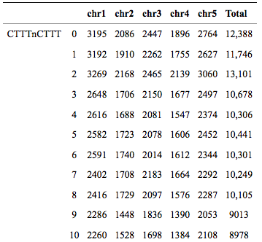
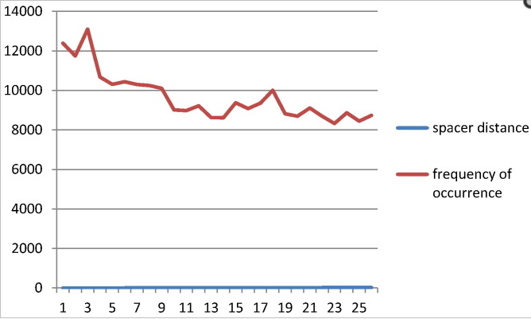
Re-creation of Results from Paper
Motifs analyzed - CTTTnCTTT, AAAGnAAAG, CTTTnAAAG, AAAGnCTTT, for values of n = 0 - 25.

Slide 11
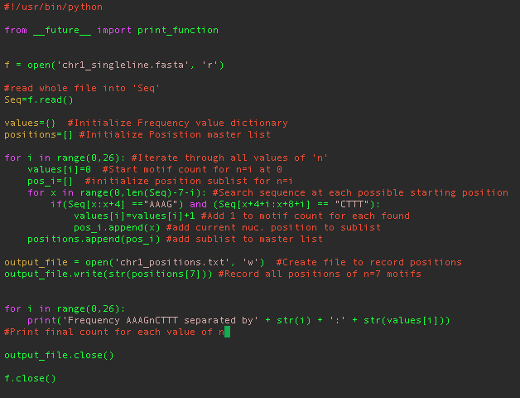
Python Program:

Slide 12
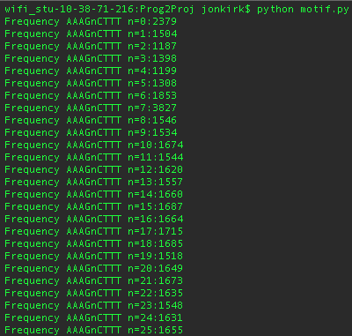
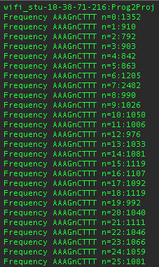
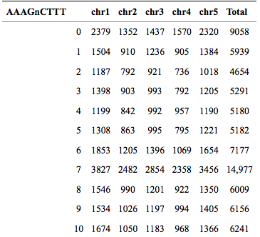
Motif Frequency Detection with Python
Repeated for all chromosomes, and all four motif varieties

Slide 13
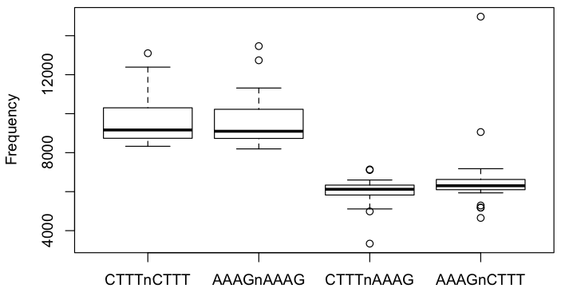
Analysis of Significance - Grubbs’ Outlier Test
P = 2.98e-09
P = 0.032
P = 0.017
Notes:
a statistical test used to detect outliers in a univariate data set assumed to come from a normally distributed population
Grubbs' test is based on the assumption of normality. That is, one should first verify that the data can be reasonably approximated by a normal distribution before applying the Grubbs' test.^{[2]}
Grubbs' test detects one outlier at a time.
Grubbs' test is based on the assumption of normality. That is, one should first verify that the data can be reasonably approximated by a normal distribution before applying the Grubbs' test.^{[2]}
Grubbs' test detects one outlier at a time.

Slide 14

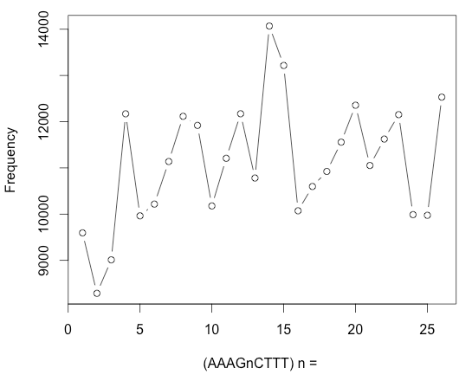
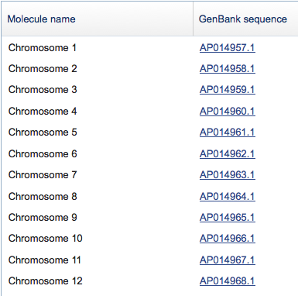
Oryza Sativa Comparison
P = 0.253
n = 7

Slide 15
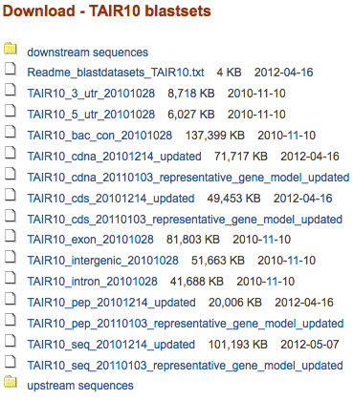
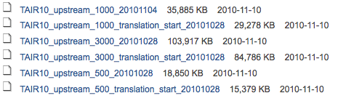
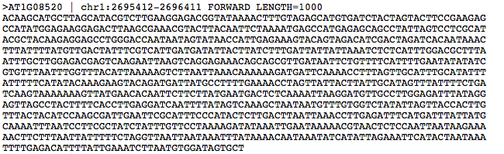
Determining Associated Genes
$awk '/^>/{print s? s"\n"$0:$0;s="";next}{s=s sprintf("%s",$0)}END{if(s)print s}' TAIR10_upstream_1000_20101104.fa > TAIR_upstream_singleline.fa
http://www.arabidopsis.org/download/index-auto.jsp?dir=%2Fdownload_files%2FSequences%2FTAIR10_blastsets%2Fupstream_sequences

Slide 16
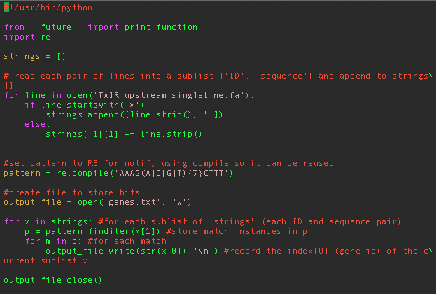
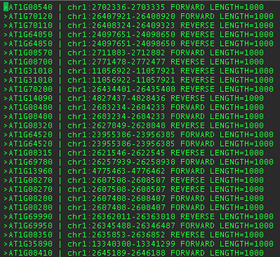
Determining Associated Genes

Slide 17
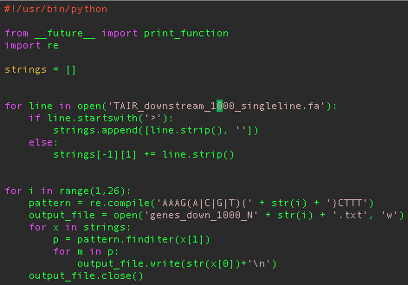
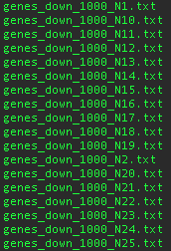

Genes associated with N7 vs genes associated with other spacer lengths
Notes:
Updated the code that searches the up/downstream regions to make it try motifs for all values of N -> and output a separate list of genes for each

Slide 18
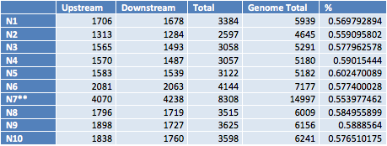
Background enrichment in gene flanking regions
Compared to other spacer lengths, is N7 overrepresented in gene flanking regions relative to its background frequency?

Slide 19
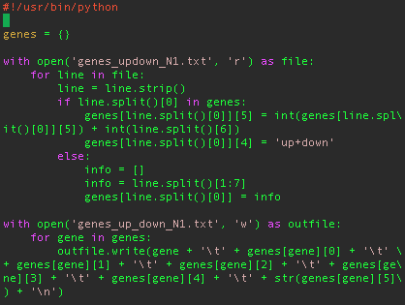
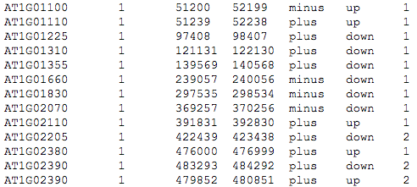
Upstream List
+
Downstream List

Slide 20
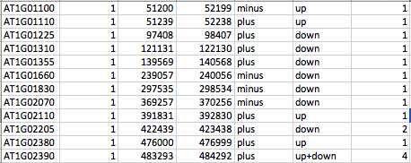
Combined upstream and downstream lists with total motif frequency for each gene (for each value of N)
Gene Name
Total Associated Motifs
AAAG(N1)CTTT
Is there any clear separation between genes associated with N7 compared to the genes associated with the other motifs? ….

Slide 21
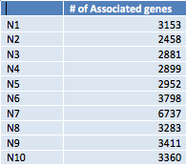
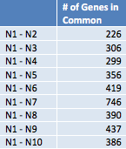
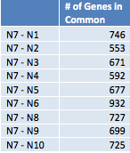
Total genes in A. Thaliana genome = 33,602
Notes:
It does not appear that there is any particular set of genes that sets N7 apart from the other motifs, so going forward we looked at the N7-associated gene set as a whole

Slide 22
Functional Analysis
Gene Set Enrichment Analysis
Set of genes defined by a common experimentally determined function or association
The enrichment factor represents the extent to which the gene set is overrepresented in genes with the motif. A high enrichment factor suggests a potential function of the motif.
# of genes belonging to set, with motif
Total # of genes with motif
Proportion of genes with motif
=
Enrichment Factor
Proportion of all genes
# of genes belonging to set in genome
Total genes in genome

Slide 23
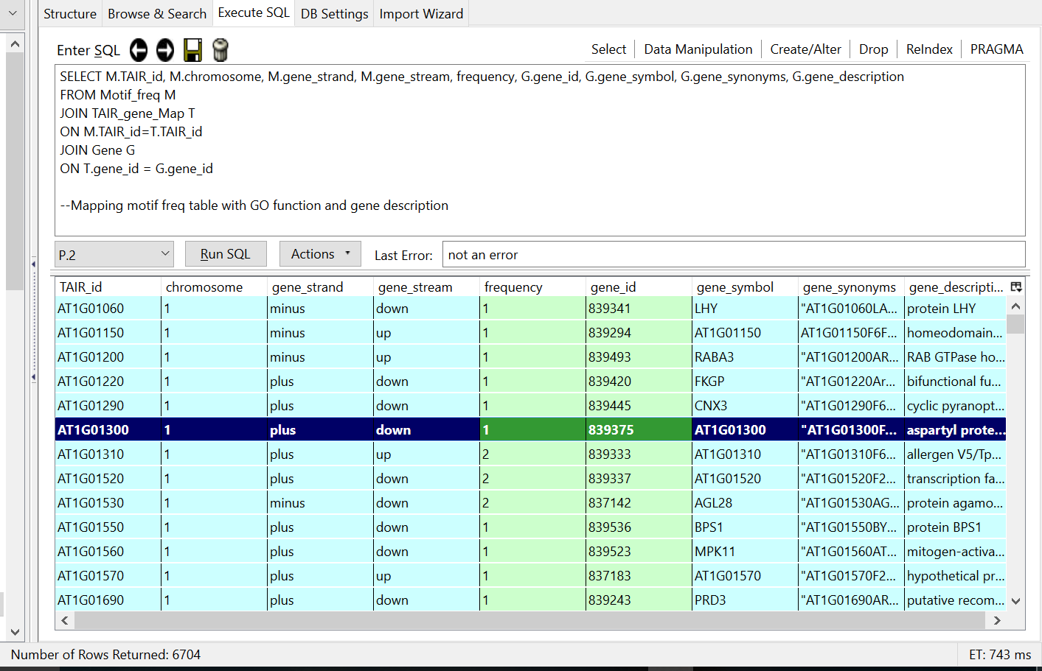
Gene descriptions
Mapping NCBI IDS with TAIR IDS to obtain more information about the genes
Notes:
It is estimated that 10% of whole genome consists of transcription factors

Slide 24
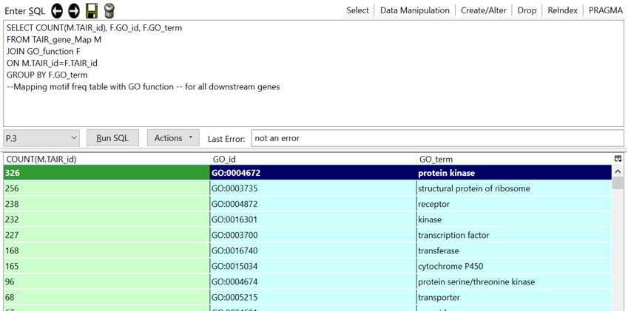
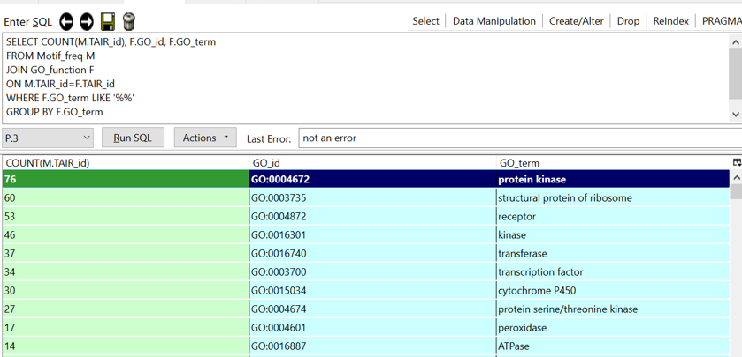
Gene ontologies
Notes:
Gene ontology (GO) is a major bioinformatics initiative to unify the representation of gene and gene product attributes across all species.
One of the main uses of the GO is to perform enrichment analysis on gene sets

Slide 25
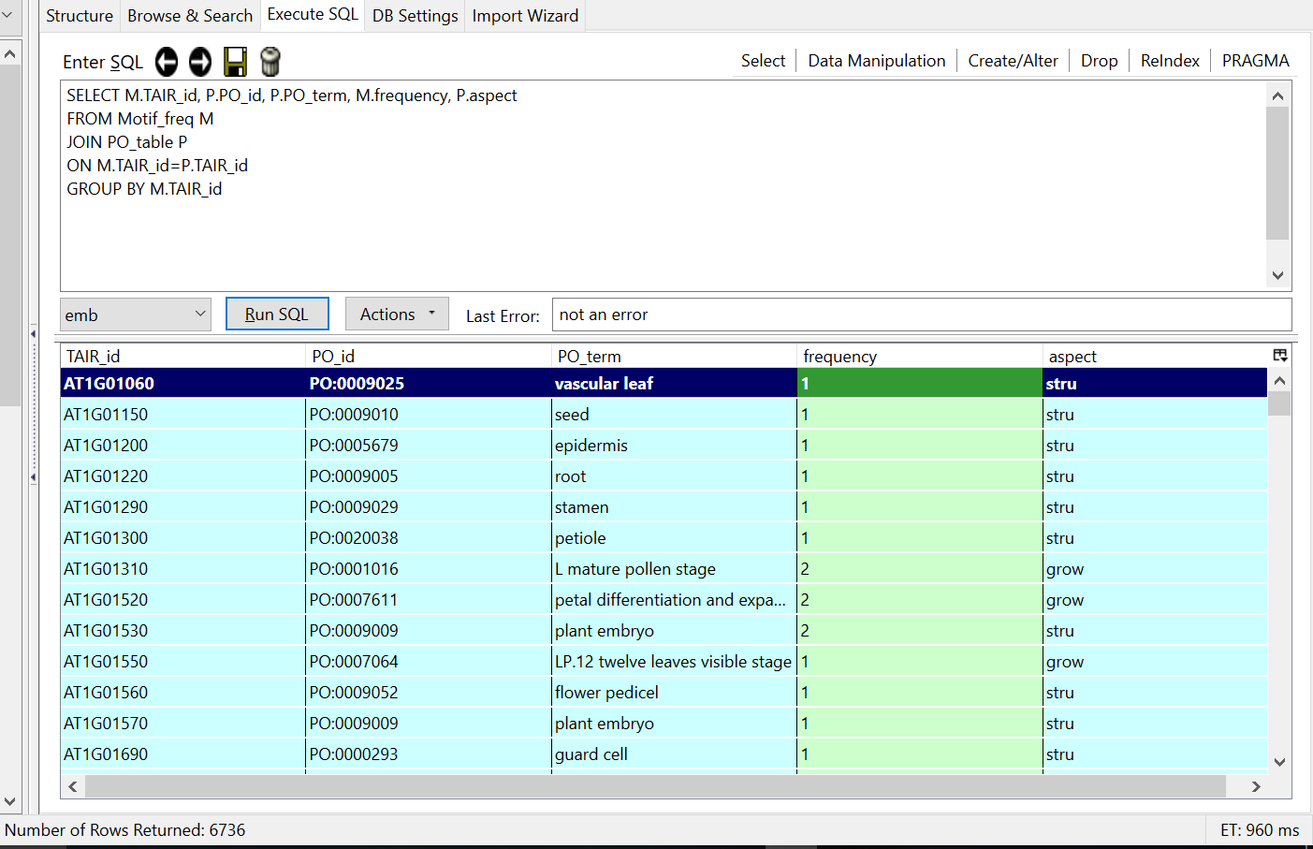
Plant ontologies
Plant ontologies describe anatomical structures and growth and developmental stages of the plant.
Genes with motif frequency were observed with plant ontologies
No definite pattern/relation was observed.

Slide 26
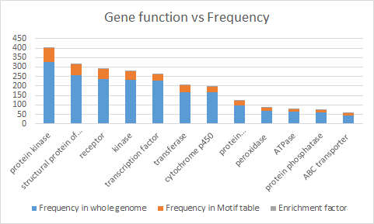
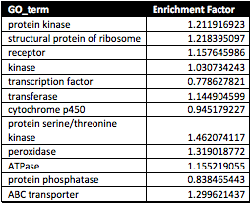
Enrichment factor results:

Slide 27
Conclusion
Confirmed that AAAGN7CTTT exists in significantly higher frequency in A.thaliana
Discovered genes associated with motifs of interest by locating in upstream and downstream regions
Determined that the N7 motif is not preferentially encoded in gene flanking regions
Built a comprehensive database of genes for functional analysis
Used gene ontology database to search for possible functions
Assessed plant ontology associations

Slide 28
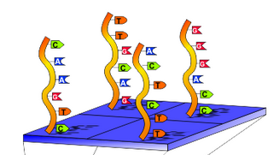
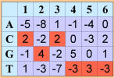
Possible Future Work
Assess motif as position weight matrix
Chromatin Immunoprecipitation (ChIP) Experimentation
Notes:
Position weight matrix - represents each position as a probability rather than a definite nucleotide; ChIP - investigates protein/DNA interactions

Slide 29
References
Biopython: Peter J. A. Cock, Christopher J. Fields, Naohisa Goto, Michael L. Heuer, Peter M. Rice: “The Sanger FASTQ file format for sequences with quality scores, and the Solexa/Illumina FASTQ variants”. Nucleic Acids Research 38 (6): 1767–1771 (2010). doi:10.1093/nar/gkp1137
Genome wide analysis of Arabidopsis thaliana reveals high frequency of AAAG N7 CTTT motif R Mehrotra, V Jain, C Shekhar, S Mehrotra - Meta gene, 2014 - Elsevier
Cis Regulatory Elements in Regulation of Plant Gene Expression: An Overview R Mehrotra, C Sangwan, ZH Khan, S Mehrotra - Gene Technology, 2015 - omicsgroup.org
Finding sequence motifs in prokaryotic genomes—a brief practical guide for a microbiologist Jan Mrázek
What are DNA sequence motifs? Patrik D'haeseleer
https://www.sqlite.org/docs.html
Gene set enrichment analysis: A knowledge-based approach for interpreting genome-wide expression profiles. A Subramanian, et al. - PNAS 102 (43): 15545 - 15550 (2005)
Notes:
http://bib.oxfordjournals.org/content/10/5/525.full - finding motifs in prokaryotic genomes
http://www.nature.com/nbt/journal/v24/n4/full/nbt0406-423.html seq motifs

