Slide 1
Orbit Wallet Assignment
Name: Ayush Kumar Email: ayush123kumar.ak@gmail.com phone number: 7677780889

Slide 2
Postman Collection is included for testing (Uploaded on github) https://github.com/SuprHUlk/orbitAss
Hosted on google cloud https://orbitass-447000.el.r.appspot.com/health

Slide 3
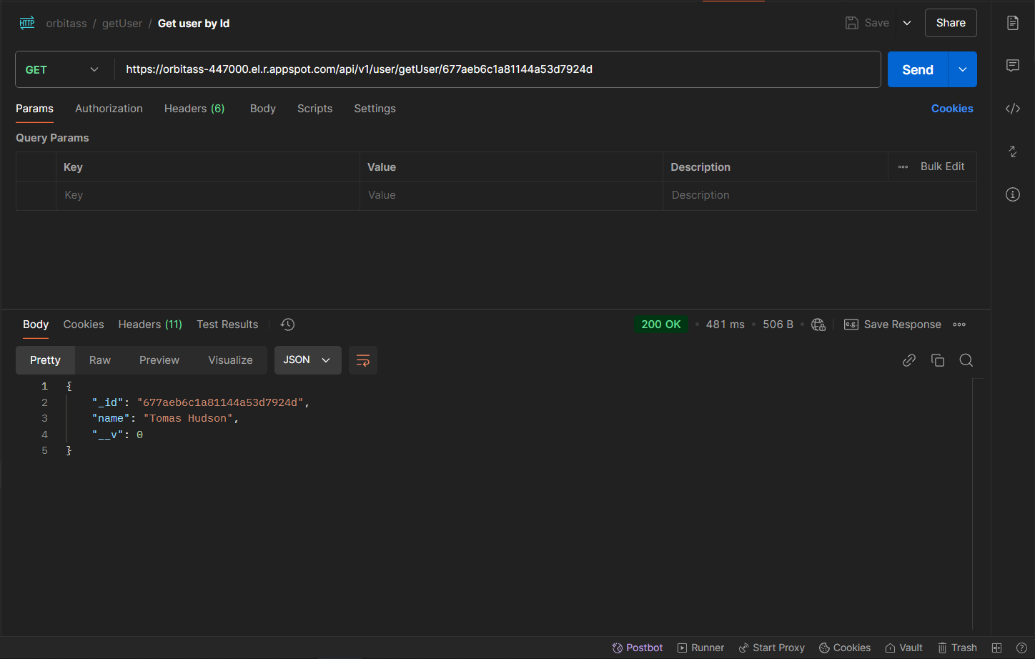
Api 1 (Get user by Id)

Slide 4
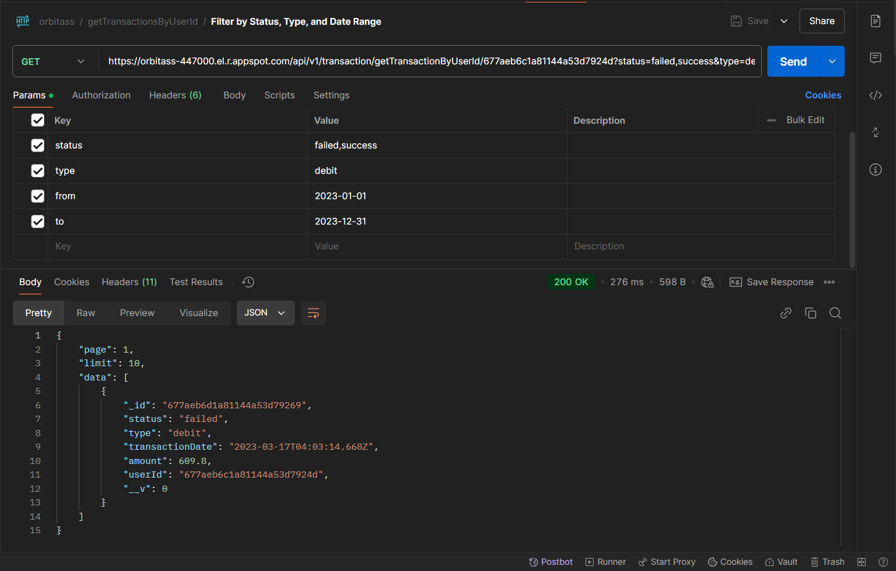
Api 2 (Get transaction detail by userId with filters)

Slide 5
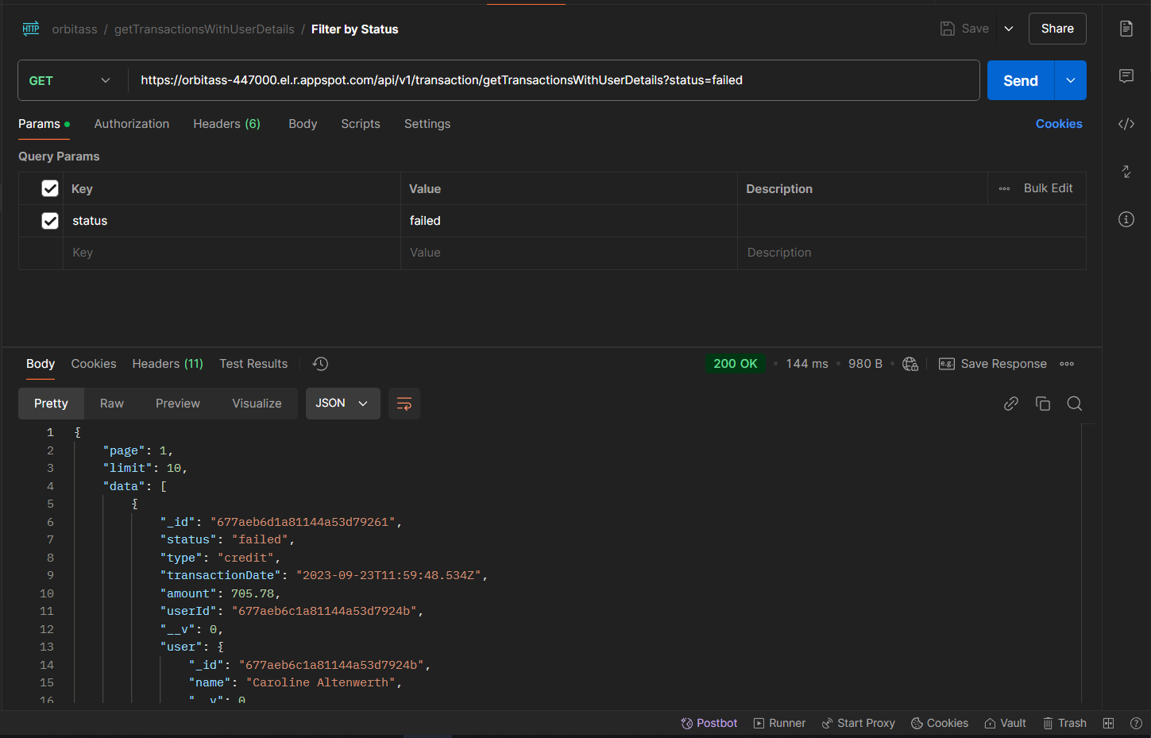
Api 3 (Get All transaction with filters)

Slide 6
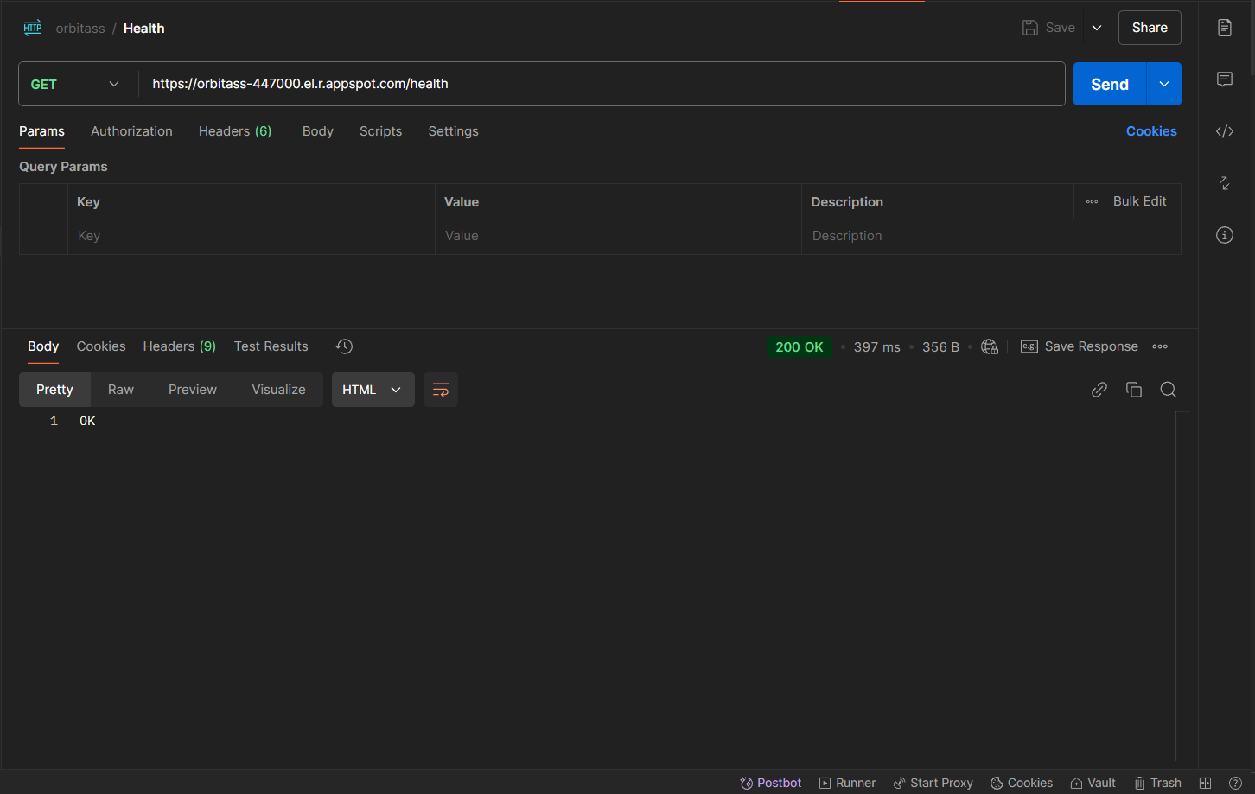
Api 4 (Health check)

