Slide 1

SE4003 – U2
Luke, Dominic, Justin, and Matt

Slide 2
Agenda
Background (Justin)
Requirements (Luke)
Lit Review (Luke)
Architecture (Dominic)
UI (Matt)
Code Re-use (Justin)
Conclusions (Matt)
Questions

Slide 3
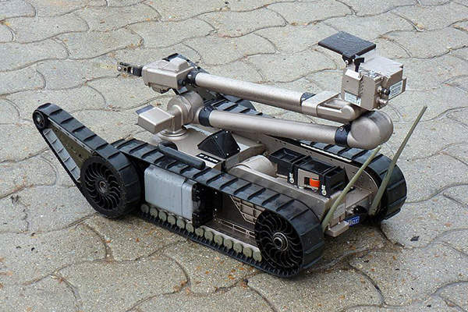
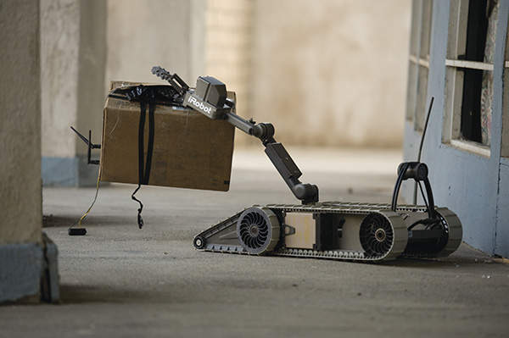
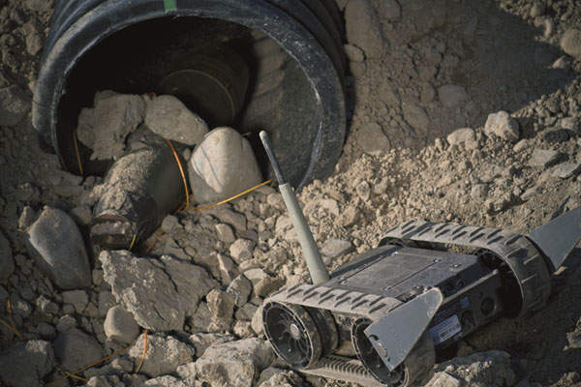
Lit Review
UGVs have been used military for explosive ordence disposal and exploration
Draw first contact
Increasingly used for logistics near front lines or attched to forward positions
iRobot has had some success developing and deploying UGVs to the US Army. The US Army has about 900 PackBot and 310s and FirstLooks in inventory.

Slide 4
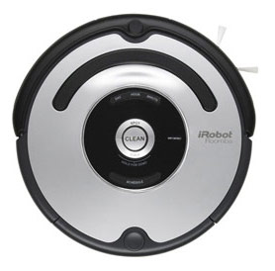
Lit Review
The Robot Operating System (ROS) provides a framework and some supporting infastrucutre to develop modular software for robots
ROS also has several simulations options to protype software
The iRobot Roomba open interface is available as a ROS package
Allows for integration of algorithms onto commercially available Roomba hardware and software.

Slide 5
Requirements
# | Name | Text | Functional
1 | ROS-based System | The system shall be controlled by ROS software | Non-Functional
2 | Python Language | The programming language of the system shall be python | Non-Functional
3 | Simulation | The system shall operate in simulation environment | Non-Functional
4 | iRobot Platform | The system proof of concept software shall be executed by iRobot Open Interface compatible Roomba | Non-Functional
5 | ROS Nodes | The system shall consist of ROS nodes | Non-Functional
6 | ROS Topics Documentation | The system internal interfaces shall be documented topics or service | Non-Functional

Slide 6
Requirements
# | Name | Text | Functional
7 | ROS Topics | The system shall subscribe and publish to relevant ROS topics | Functional
8 | ROS Position | The system shall determine position relative to start while exploring | Functional
9 | ROS Map | The system shall map topography of room | Functional
10 | ROS Log | The system shall log a time series log of topic commuication | Functional
11 | Wall | The system shall detect vertical obstacles of at least {XX} cm | Functional
12 | Terrain | The system shall assess navigation difficult of terrian when planning route | Functional
13 | Communication | The system shall communicate with operator | Functional
14 | Status | The system shall report completion or termination of assigned tasks | Functional
15 | Stuck | The system shall determine when movement is attempted but not change of position occurs | Functional

