Slide 1
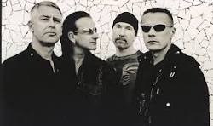
SE4003 – U2
Luke, Dominic, Justin, and Matt

Slide 2
Agenda
Background (Justin)
Requirements (Luke)
Lit Review (Luke)
Architecture (Dominic)
UI (Matt)
Code Re-use (Justin)
Conclusions (Matt)
Questions

Slide 3
Template Slide
Copy this to add content.

