Slide 1
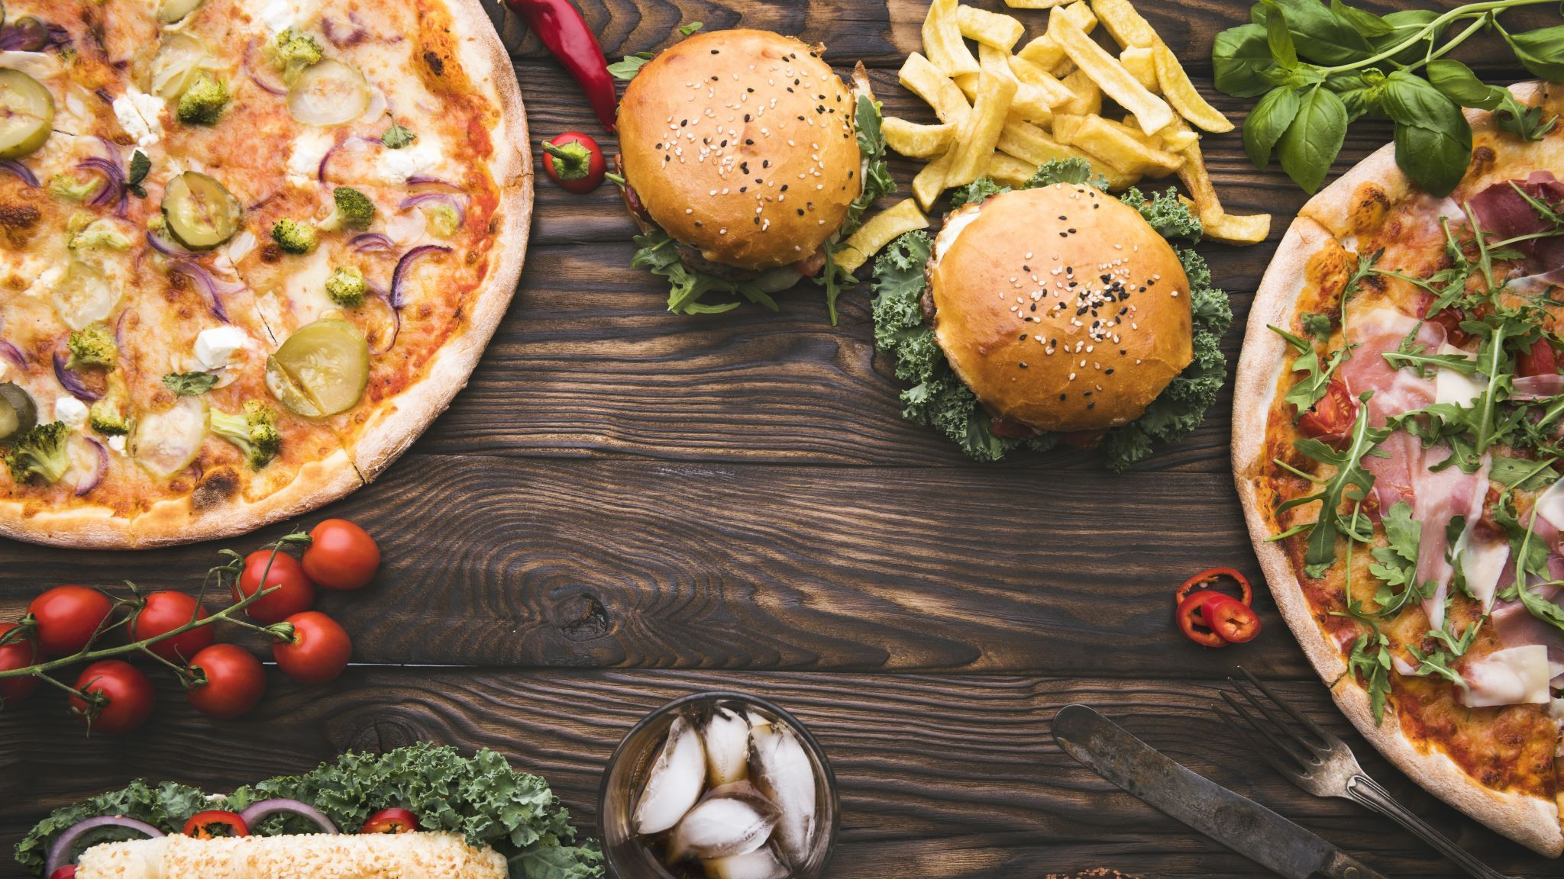
FOOD DEMAND FORECASTING

Slide 2
Contents:
Team Introduction
Problem Statement
Business Understanding
Data Understanding
Data Preparation
Proposed Solution

Slide 3




Meet the Team
Supraja Kodiganti
ML Engineer
Guna Jaswanth Reddy
Data Scientist
Sumanth Ganimalla
Cloud Engineer
Godswill Ikwan
Data Engineer

Slide 4
Problem Statement
Your customer is a food delivery service with locations in several cities. In these cities, they operate several fulfillment centers for delivering meal orders to clients. The client wants you to assist these facilities with demand forecasts for the following weeks so that they may organize their raw material supply properly. Most raw materials are replenished on a weekly basis, and because the raw materials are perishable, procurement planning is critical. Second, precise demand estimates are beneficial in the staffing of the centers.

Slide 5
Business Understanding
Demand forecasting is a key component to every growing online business.
Without proper demand forecasting processes in place, it can be nearly impossible to have the right amount of stock on hand at any given time.
A food delivery service must deal with a lot of perishable raw materials which makes it more important for such a company to accurately forecast daily and weekly demand.
Too much inventory in the warehouse means more risk of wastage, and not enough could lead to out-of-stocks - and push customers to seek solutions from your competitors.

Slide 6
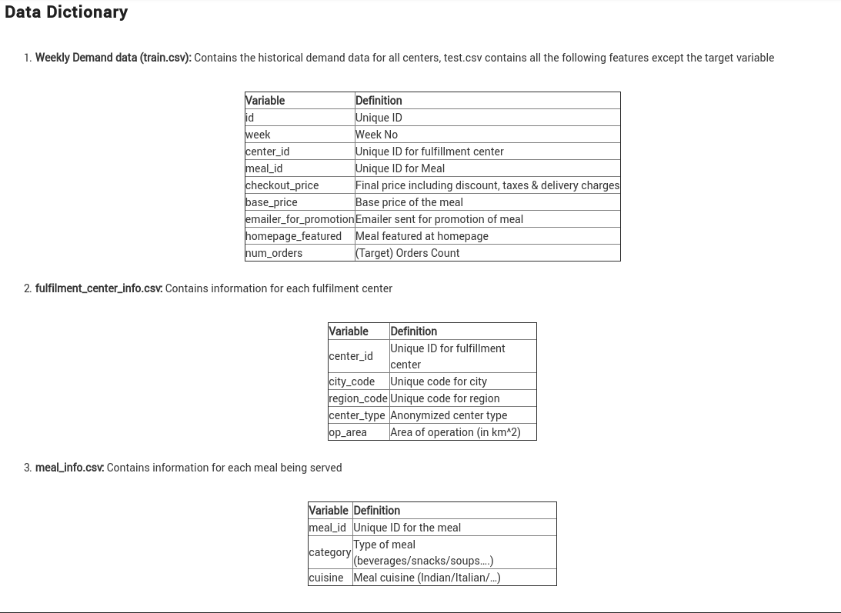
Data Understanding
The data comprises of a historical weekly data of orders from fulfilment centers that we can use to forecast demand
Three relational tables; weekly demand data, fulfillment_center_info.csv, meal_info.csv.

Slide 7
Data Preparation
Transform data and build a data pipeline.
Load into a data store
Ingest the data into our analytical and model training environment.
Cleaning the data to remove any dirty data
Exploratory Data Analysis.
Describe data
Feature selection and engineering

Slide 8
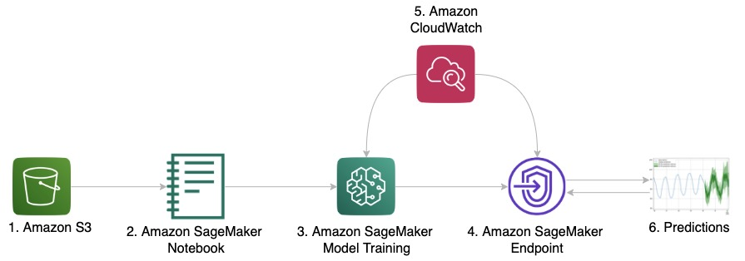
Proposed Solution
Iterating ML algorithms like xgboost, LightGBM, Linear Regression etc., to forecast food demand.
We are going to deliver a Machine Learning solution to forecast food demand for food delivering companies by using AWS.

Slide 9
THANK YOU

