Slide 1
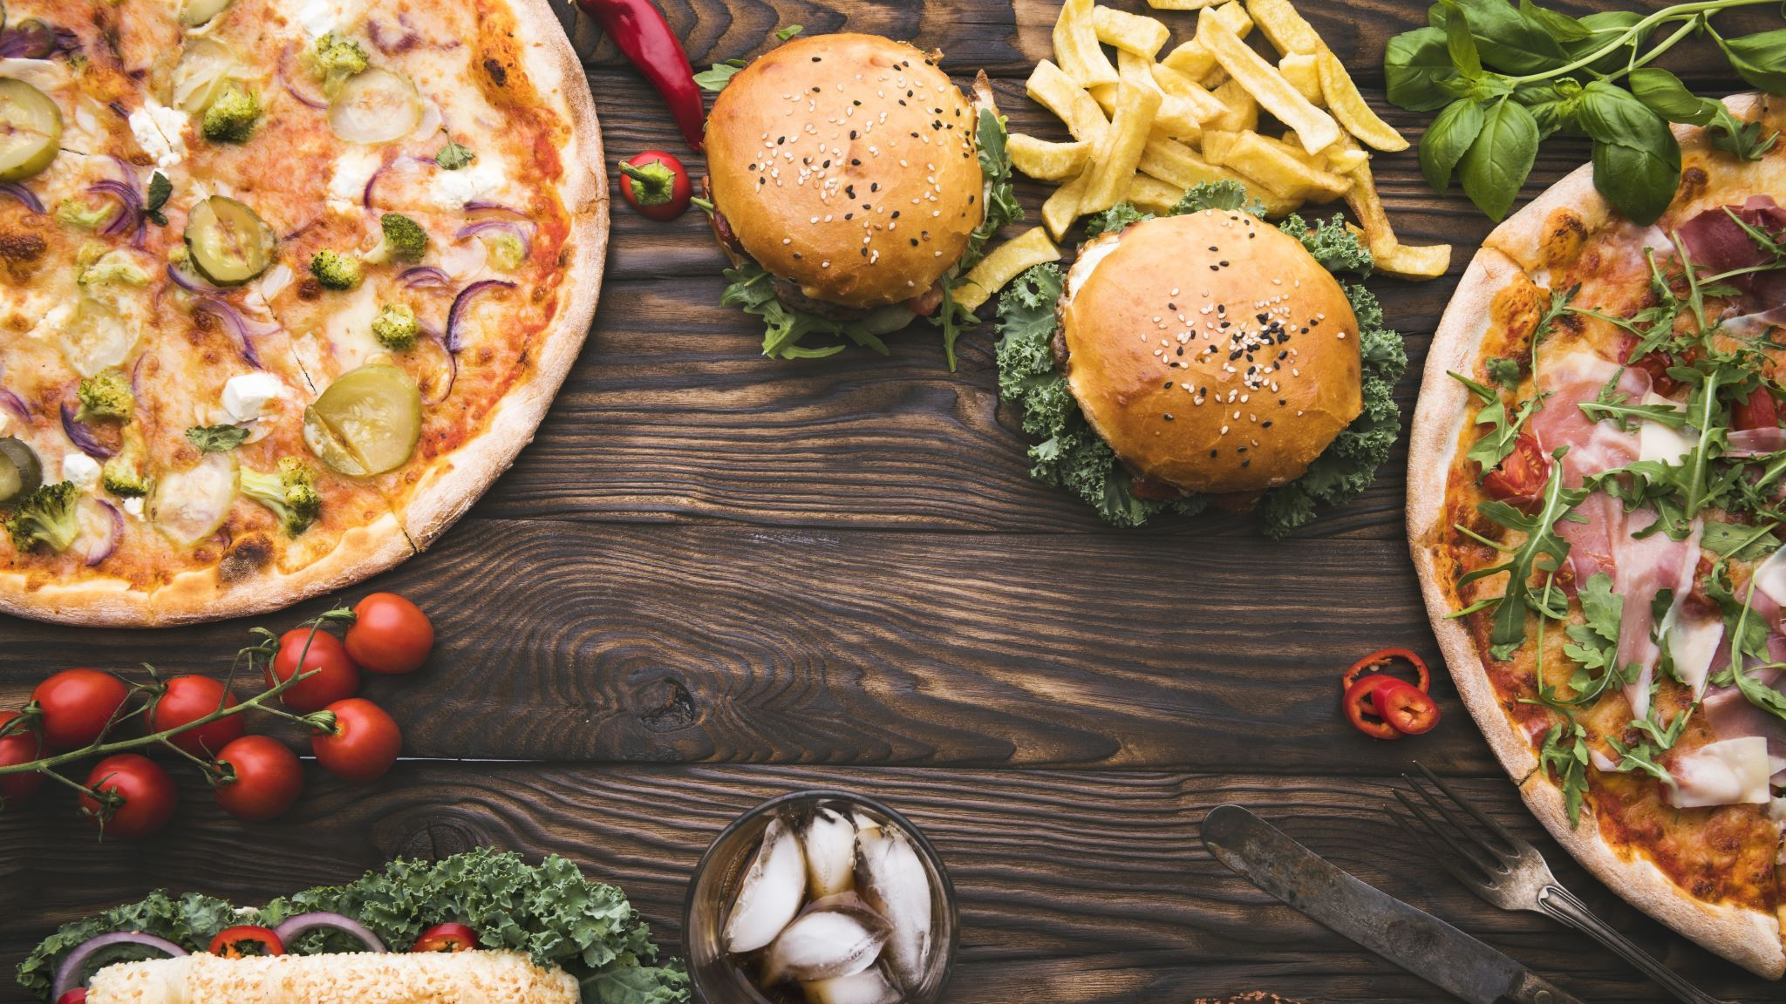

FOOD DEMAND FORECASTING

Slide 2
Contents:
Team Introduction
Problem Statement
Business Understanding
Proposed Solution
Data Understanding
Data Preparation
Measures of Success

Slide 3




Meet the Team
Supraja Kodiganti
ML Engineer
Team Lead
Guna Jaswanth Reddy
Data Scientist
Sumanth Ganimalla
Cloud Engineer
Godswill Ikwan
Data Engineer

Slide 4
Problem Statement
Food companies that have several fulfilment centers/branches spread across different locations nationally are often faced with the problem of planning the right/optimal stock/inventory of ingredients and food raw materials to prepare the optimal amount of food at these food fulfilment centers.
We address this problem by implementing an ML solution to forecast the demand for food on a weekly basis where these fulfilment centers are located.

Slide 5
Business Understanding
Demand forecasting is a key component to every growing online business.
Without proper demand forecasting processes in place, it can be nearly impossible to have the right amount of stock on hand at any given time.
A food service company/restaurant must deal with a lot of perishable raw materials which makes it more important for such a company to accurately forecast daily and weekly demand.
Too much inventory in the warehouse means more risk of wastage, and not enough could lead to insufficient resources and push customers to seek solutions from your competitors.

Slide 6
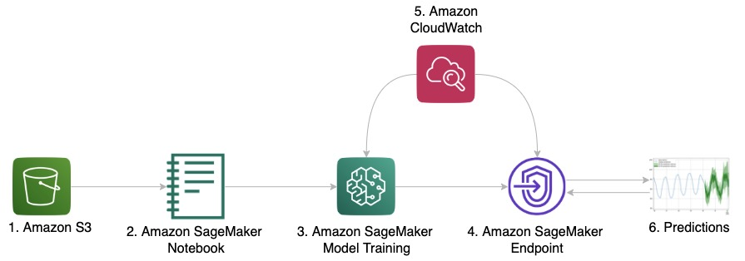
Proposed Solution
Iterating ML algorithms like xgboost, LightGBM, Linear Regression etc., to forecast food demand.
We are going to deliver a Machine Learning solution to forecast food demand for food delivering companies by using AWS.

Slide 7
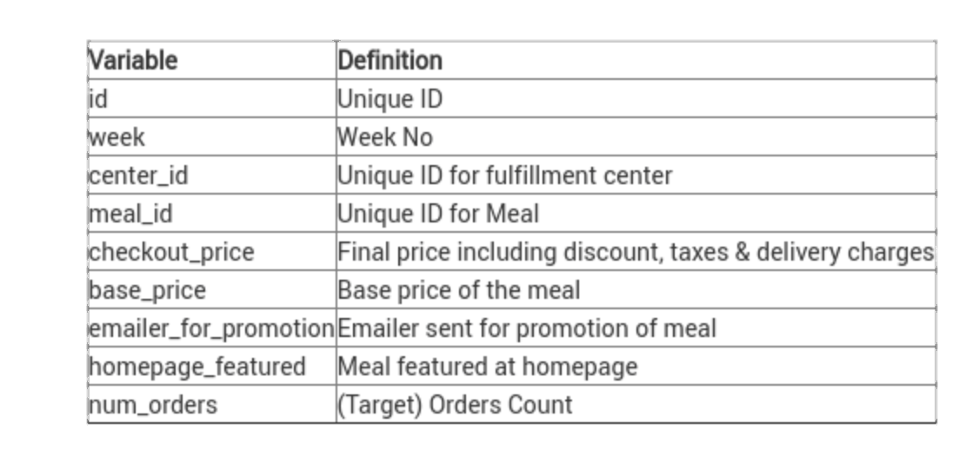
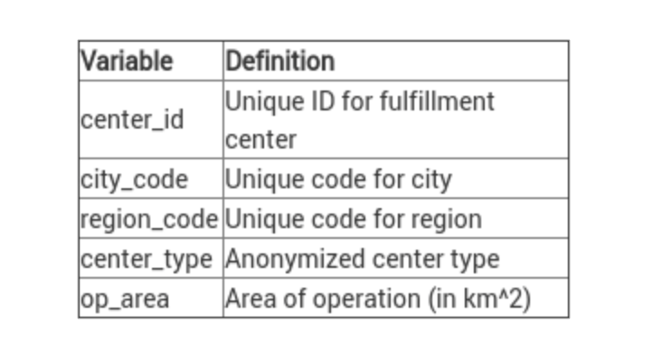
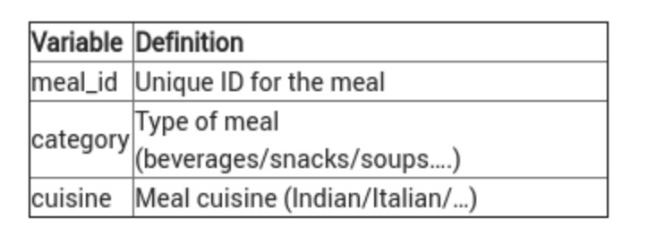
Data Understanding
The data comprises of a historical weekly data of orders from fulfilment centers that we can use to forecast demand
Three relational tables; weekly demand data, fulfillment_center_info.csv, meal_info.csv.

Slide 8
Data Preparation
Transform data and build a data pipeline.
Load into a data store
Ingest the data into our analytical and model training environment.
Cleaning the data to remove any dirty data
Exploratory Data Analysis.
Describe data
Feature selection and engineering

Slide 9
Measures of Success
Model Performance
RMSE or MSE or MAE
Successfully deploy & serve the model for prospective food businesses

Slide 10
THANK YOU

