Slide 1
Co2 emissions Predictions

Slide 2
Team members :
S. Manasa 19h61a05g5
P.jahanavi 19h61a05f7
T.Radhika. 19h61a05g9
G.dolly. 19h61a05d4
I. Malleshwari 19h61a05d9

Slide 3
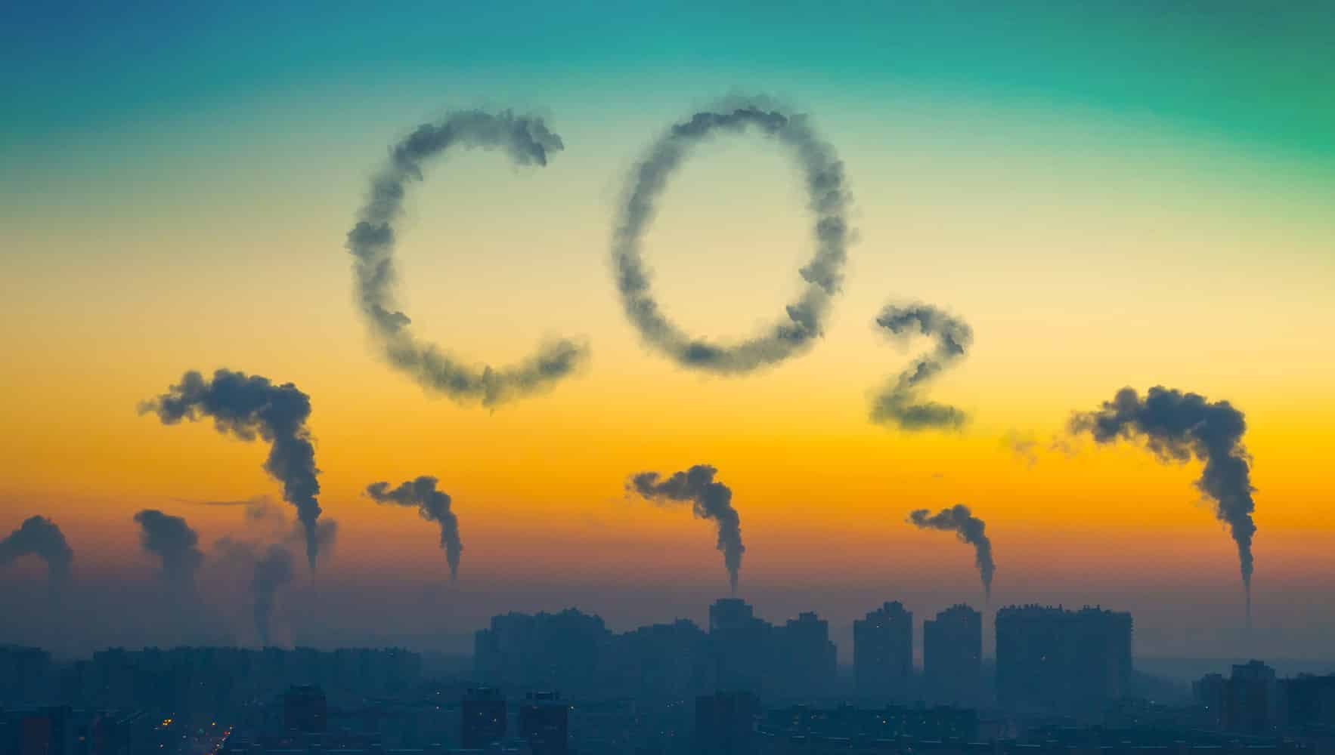
Introduction
Carbon dioxide emissions into the atmosphere, and the emissions of other GHGs, are often associated with the burning of fossil fuels, like natural gas, crude oil and coal. While this is harmful to the environment, carbon offsets can be purchased in an attempt to make up for these harmful effects.

Slide 4
History :
The roots of the greenhouse effect concept lie in the 19th century , when French mathematician Joseph fourier. calculated in 1824 that the Earth would be much colder if it had no atmosphere. In 1896, Swedish scientist Svante Arrhenius was the first to link a rise in carbondioxide gasfrom burning fossil fuels with a warming effect. Nearly a century later, American climate scientist James E. Hansen testified to Congress that “The greenhouse..

Slide 5
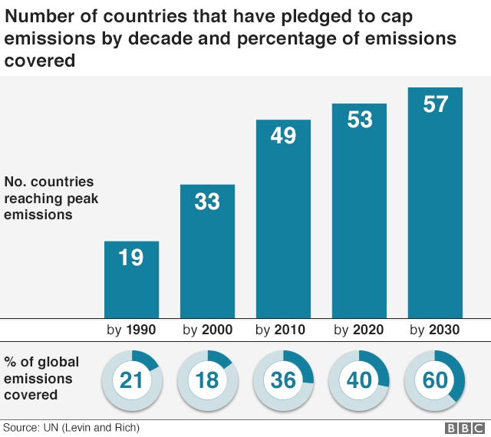
Impacts :
Impacts on the world
1) Air Quality.
2) Economic Growth.
3) Slowed Climate Change.
4) Cost Savings.
5) Improved External Relations.
6) Improved Stakeholder Relations.
7) Regulatory Compliance.

Slide 6
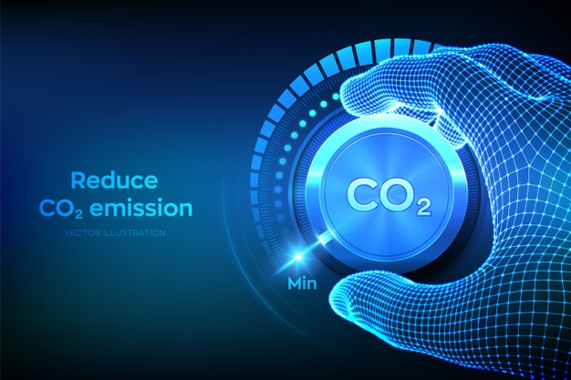
Effects :
Greenhouse gases have far-ranging environmental and health effects. They cause climate change by trapping heat, and they also contribute to respiratory disease from smog and air pollution. Extreme weather, food supply disruptions, and increased wildfires are other effects of climate change .
But those gases are now out of balance and threaten to change drastically which living things can survive on this planet—and where.Atmospheric levels of carbon dioxide—the most dangerous and prevalent greenhouse gas—are at the highest levels ever recorded.

Slide 7
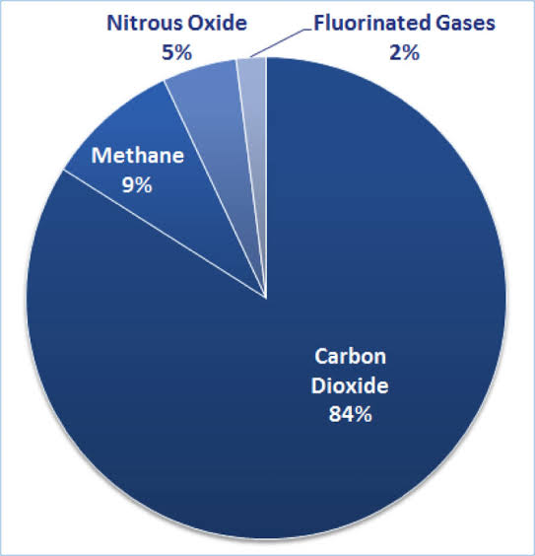
Consequences :
Carbon emissions contribute to climate change, which can have serious consequences for humans and their environment. According to the U.S. Environmental Protection Agency, carbon emissions, in the form of carbon dioxide, make up more than 80% of the greenhouse gases emitted in the United States. The burning of fossil fuels releases Carbondioxide . These carbon emissions raise global temperatures by trapping solar energy in the atmosphere.

Slide 8
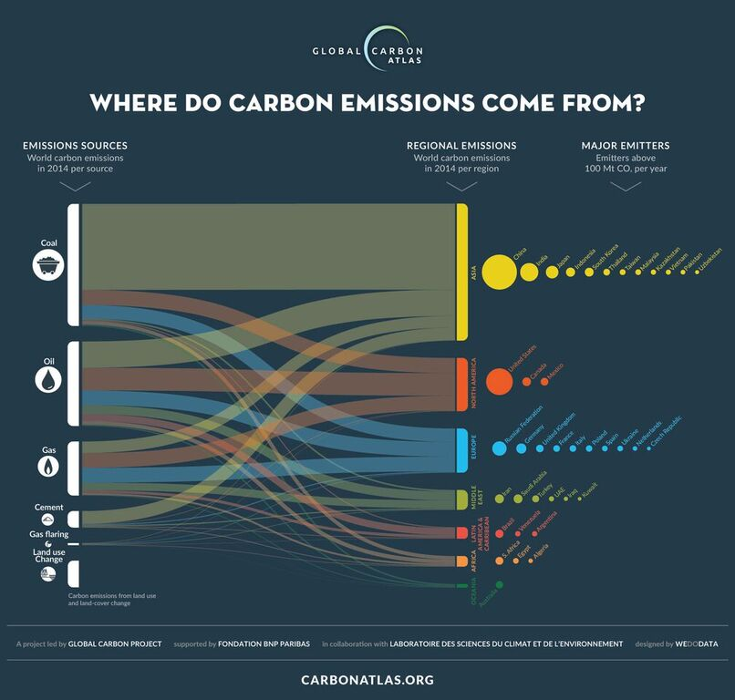

Slide 9
Solution :
AI seems destined to play a dual role.
On the one hand, it can help reduce the effects of the climate crisis, such as in smart grid design, developing low-emission infrastructure, and modelling climate change predictions.
On the other hand, AI is itself a significant emitter of carbonConverting this energy consumption in approximate carbon emissions and electricity costs, the authors estimated that the carbon footprint of training a single big language model is equal to around 300,000 kg of carbon dioxide emissions.

Slide 10
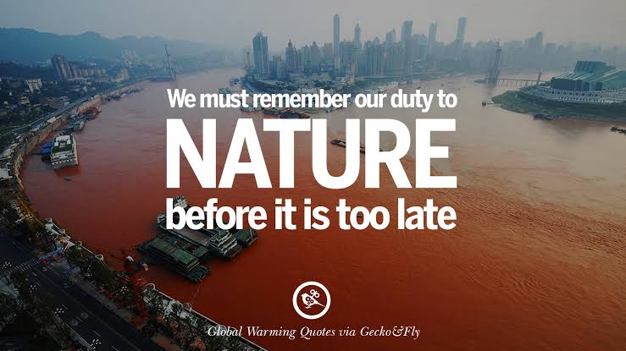

Slide 11
Thank you

