Slide 1

Resume Screening Application
BY
SUPRAJA BEKKEM
FALL 2024 SEMESTER
UNDER CHAOJI WANG SUPERVISION

Slide 2
INSIGHTS FOR RESUME SCREENING APPLICATION
Introduction to the Application.
Project Goals and Objectives
Data Collection and Structure
Exploratory Data Analysis (EDA)
Data Insights from EDA
NLP Techniques and Text Preprocessing
Model Training Overview
Performance Metrics for Models
Top Model Comparisons
Application Development and Deployment
Final Application Workflow
Benefits of the Application in Recruitment
Challenges and Limitations
Streamlit Application
Future Enhancements
Conclusion and Next Steps

Slide 3
Introduction to Resume Screening Application
Project Overview: A streamlined, NLP-powered solution to enhance recruitment efficiency by automating the resume screening process.
Objective: To assist hiring managers in quickly identifying top candidates by classifying and ranking resumes based on their alignment with job requirements.
Core Features:
Automated Resume Screening: Efficient processing of bulk resume uploads.
Relevance-Based Ranking: Prioritizes candidates by matching skills and experience with job descriptions.
Anticipated Impact:
Enhanced Efficiency: Reduces time spent on manual resume review.
Improved Accuracy: Delivers data-driven insights for better candidate selection.

Slide 4
Project Goals and Objectives:
This project aims to enhance recruitment efficiency by creating an automated resume screening tool that leverages Natural Language Processing (NLP) to classify and rank candidates based on job relevance. By reducing the manual effort.
Key objectives include:
Automated Resume Processing: Allow bulk uploads of resumes with automated classification using NLP.
Relevance-Based Ranking: Prioritize resumes by assessing alignment with job descriptions to highlight top matches.
Data-Driven Decision Support: Provide an objective, bias-reducing tool that aids hiring managers in making accurate and efficient hiring decisions.

Slide 5

Data Collection and Structure
Data Source: Collected resume datasets from online platform known as Kaggle.
Data Format: Text-based resumes, preprocessed for readability.
Key Attributes: Includes fields like Skills, Experience, Education, and Achievements.
Target Variable: category label acts as the target variable.

Slide 6
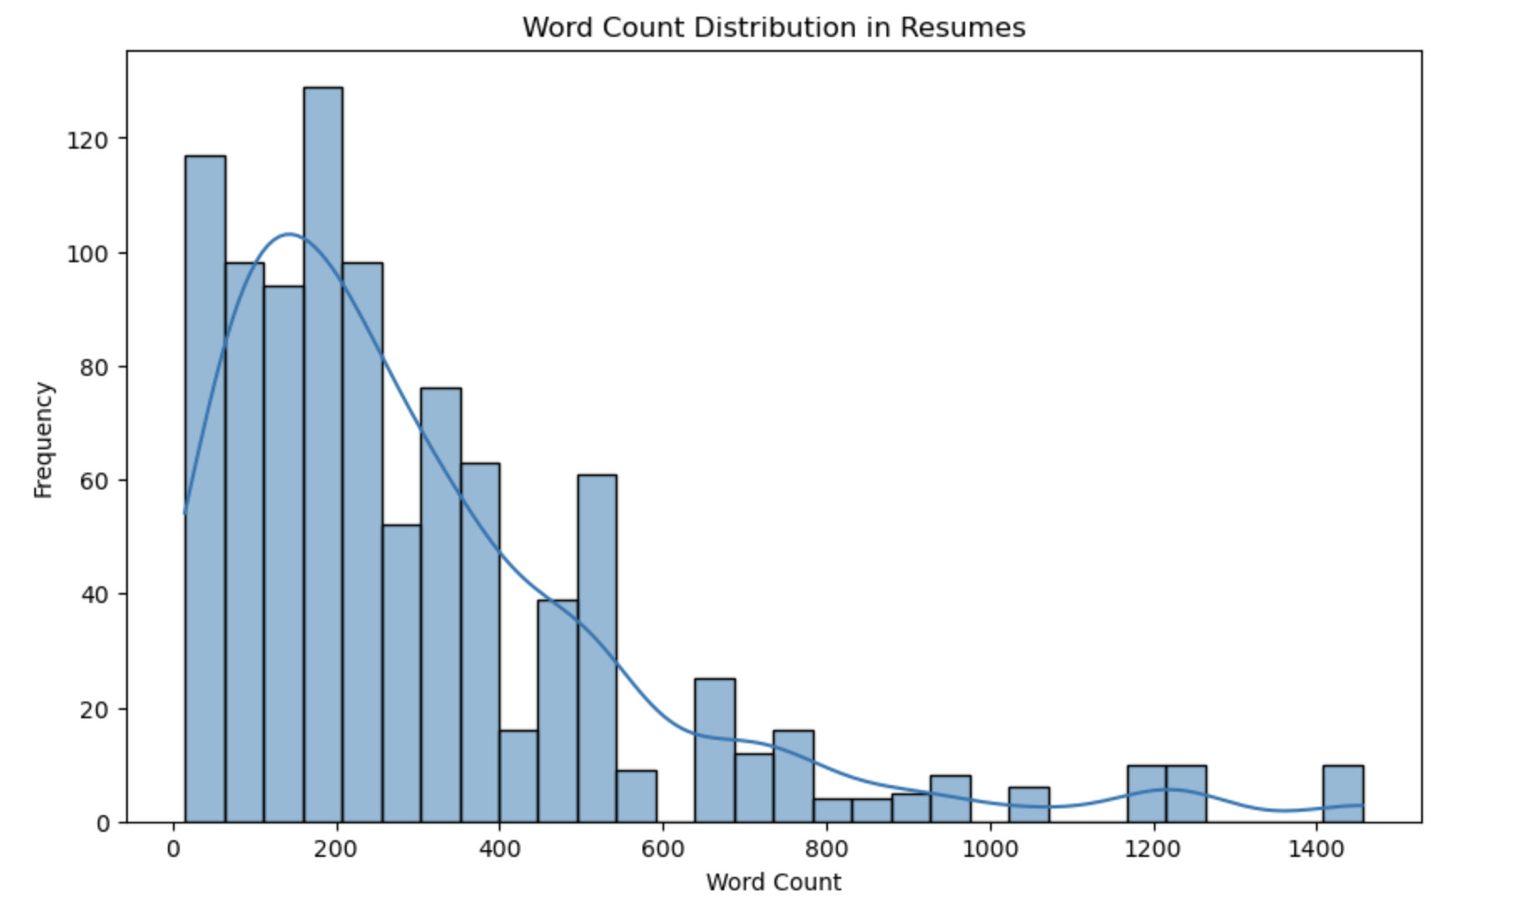
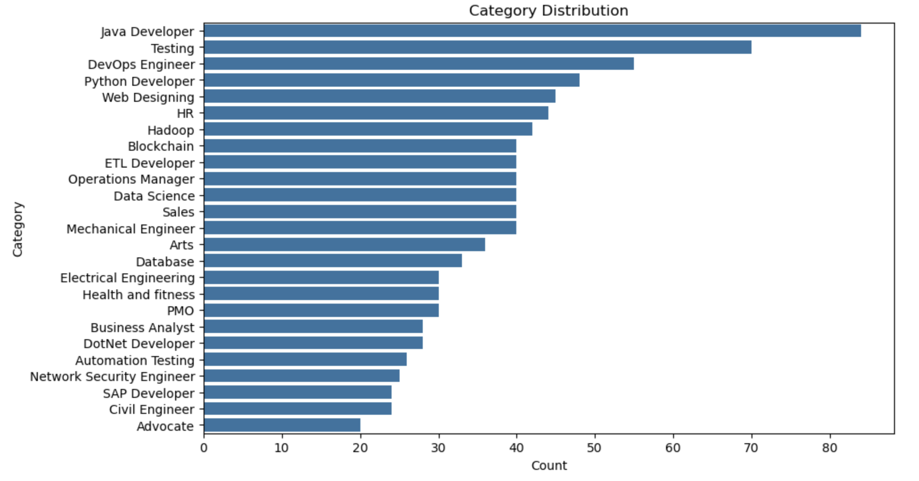
Exploratory Data Analysis (EDA)
Purpose of EDA: To understand the distribution, structure, and key patterns within the resume dataset, aiding in data preparation for the model.
Key Insights:
Category Distribution:
Visualized the distribution of resumes across different job categories using a count plot.
Identified imbalances in category representation, which may affect classification results.
Word Count Analysis:
Analyzed word counts within each resume to understand content length variability.
A histogram revealed a range of word counts, with most resumes clustered around a specific range, assisting in setting text processing limits.

Slide 7
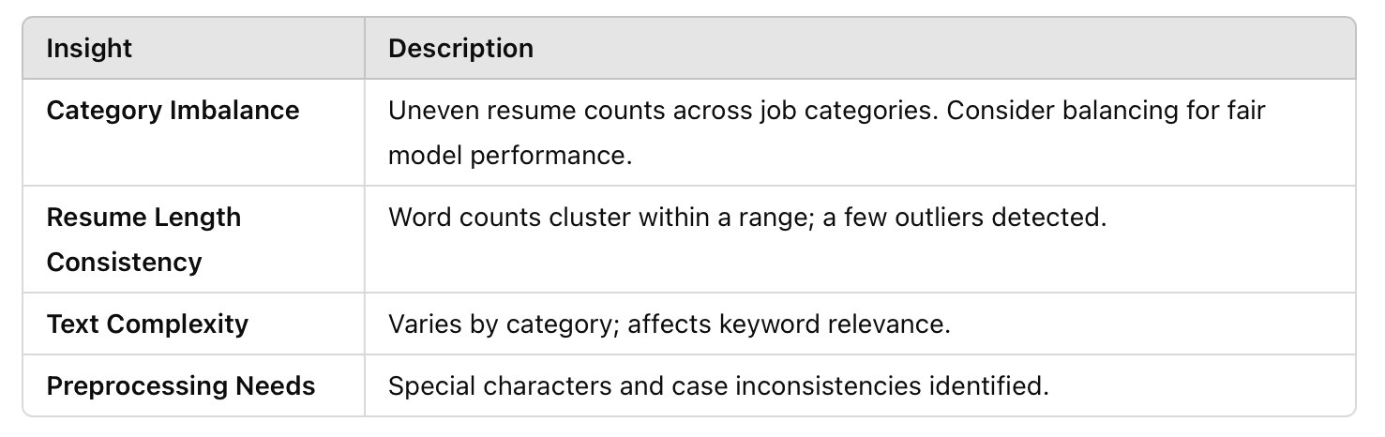
Data Insights from EDA

Slide 8
NLP Techniques and Text Preprocessing
Tokenization: Split text into individual words for analysis.
Stop Words: Remove common but non-informative words (e.g., "the").
Stemming/Lemmatization: Standardize words to their root forms for consistency.
Vectorization: Convert text to numerical format using TF-IDF.

Slide 9
Model Training Overview
Models Used:
Multinomial Naive Bayes: For probabilistic text classification.
K-Nearest Neighbors: For ranking resumes by similarity.
Logistic Regression: For relevance classification.
Support Vector Classifier: For clear class separation in high-dimensional data.
Purpose: Classify and rank resumes by relevance.
Feature Extraction: TF-IDF vectorization to turn text into numbers.
Training Method: Supervised learning with cross-validation for accuracy.

Slide 10
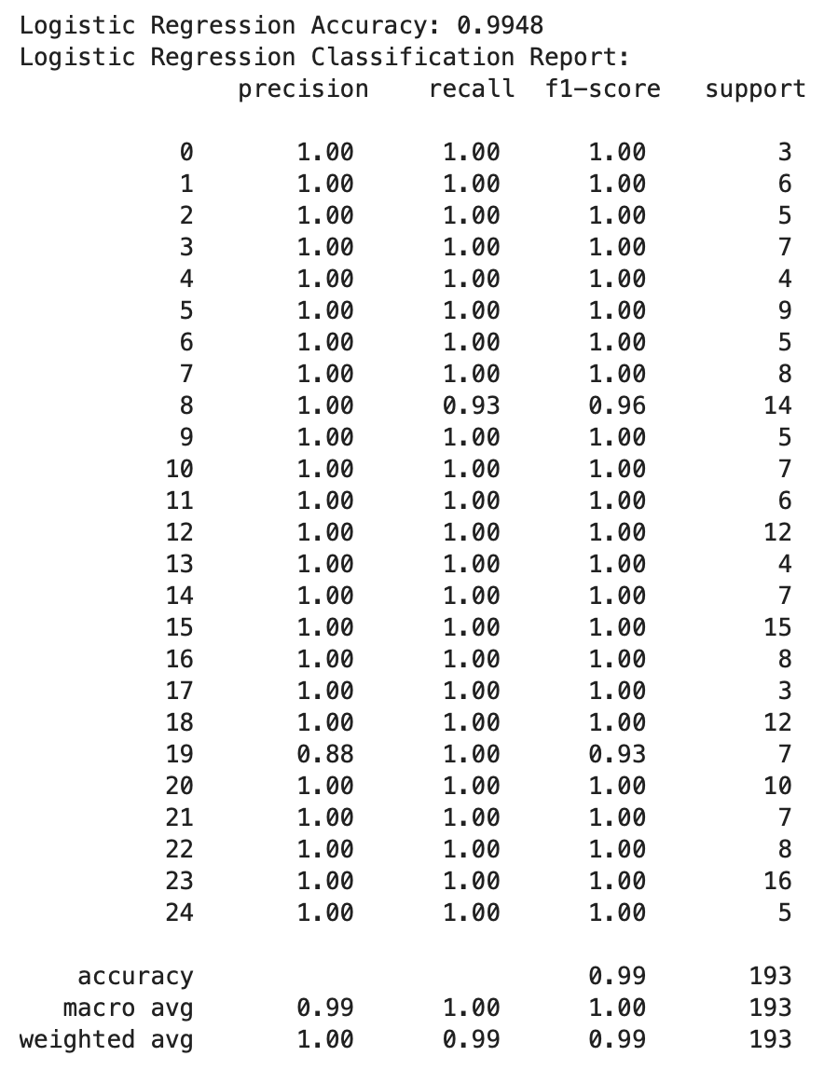
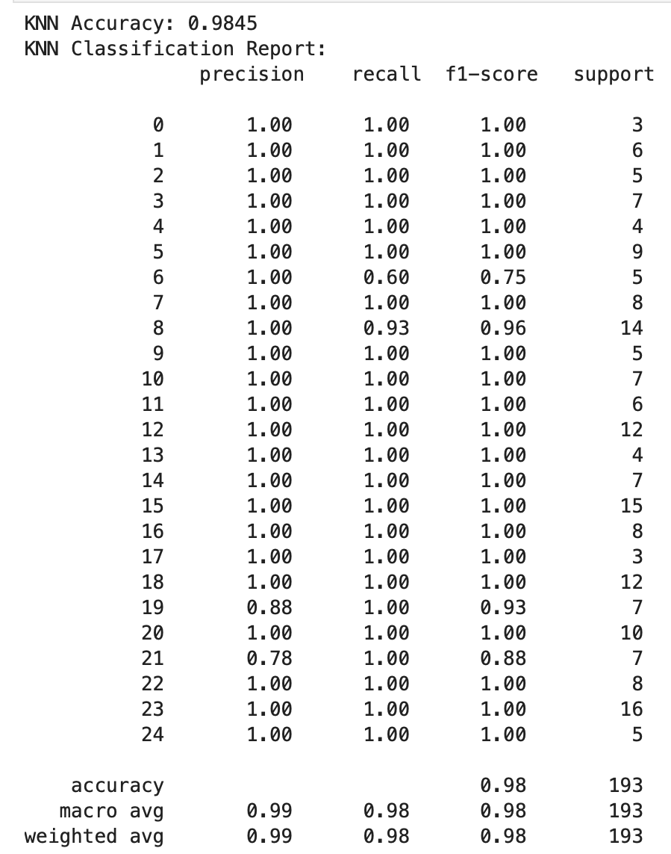
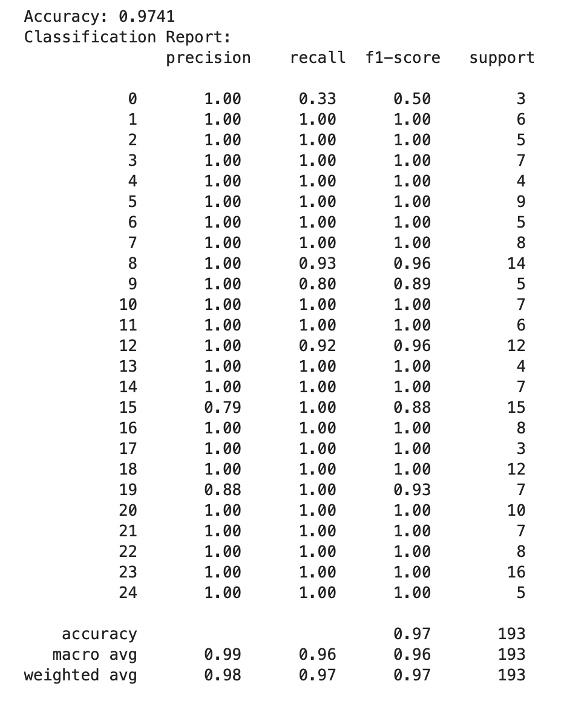
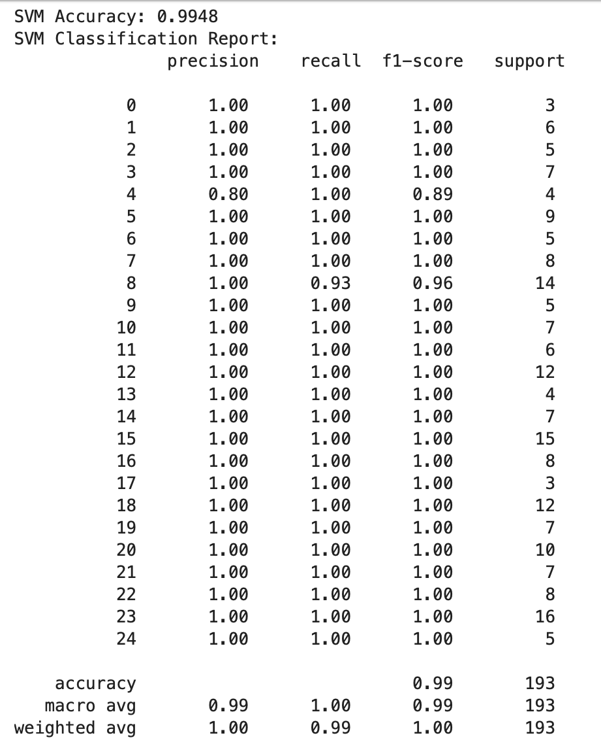
Performance Metrics for Models
Metrics Used:
Accuracy: Assessed for each model to measure overall classification performance.
Classification Report: Generated for each model, including Precision, Recall, and F1-Score to evaluate performance on individual classes.

Slide 11
Application Development and Deployment
Streamlit Deployment: The application leverages Streamlit for seamless deployment, providing an interactive and user-friendly interface.
Resume Upload Feature: Users can easily upload resumes in various formats, streamlining the initial candidate assessment process.
Job Description Input: Employers input job descriptions to align candidate qualifications with specific role requirements effectively.

Slide 12

Final Application Workflow
Resume Processing Workflow: Resumes undergo parsing, analysis, and ranking, creating a systematic flow for candidate assessment.
User Interface Design: The interface prioritizes usability, enabling intuitive navigation while displaying ranked results clearly for recruiters.
Access to Ranked Results: Recruiters can efficiently access prioritized candidate lists, significantly facilitating informed decision-making during recruitment.

Slide 13

Benefits of the applications
Time Efficiency in Screening
Improved Candidate Matching
Scalability for High-Volume Hiring
Enhanced Diversity and Inclusion
Data-Driven Insights and Analytics
Customization for Role-Specific Screening
Reduction in Administrative Workload
Enhanced Candidate Experience
Integration with Existing Hiring Tools
Improved Hiring Outcomes
Cost Savings

Slide 14
Challenges while doing the project.
Handling Imbalanced Data
Bias in Screening Algorithms
Ensuring Real-Time Performace
Data Privacy and Security
Handling Incomplete or Sparse Resumes
Keeping up with Industry Trends
Feature Extraction and Keyword Matching

Slide 15

Streamlit Application
https://app1py-wtczfunvqv55bav8xza3pf.streamlit.app
This will redirect you to the web application directly

Slide 16

Future Enhancements
Candidate Ranking and Fit Scoring
Experience and Education Filters
Interview Scheduling Integration
Reusable Job Profiles
Candidates Progress Tracking
Red Flags and Highlights
Recruiter Feedback and Learning Mechanism

Slide 17

Conclusion
Impact on Recruitment: The application significantly improves candidate screening efficiency, transforming traditional recruitment practices through automation and analytics.
Ongoing Improvements: Continuous updates focus on model debugging, bias detection refinement, and expanding data diversity for enhanced accuracy.

Slide 18

Thank you

