Slide 1


SMART INDIA HACKATHON 2024
TITLE PAGE
Problem Statement ID – SIH1585
Problem Statement Title- Development
of portable EMI / EMC, induction
measurement instruments.
Theme- Miscellaneous
PS Category- Hardware
Team ID-
Team Name- Frequency guardianz.

Slide 2
EMI/EMC , Induction Instrument
Frequency guardianz
Proposed Solution
Emitting EMI from one device that affect the sensitive devices and cause the device to malfunction.
Testing a device EMI / EMC to find the strength of the device by applying Interference .
Using AI with Microcontroller, the Microcontroller got the output from device and check the data that the device having noise and can’t withstand when interference applied .The AI automatically display the filters to avoid that particular noise and display the distorted wave output of the device .
Using this instrument we can rectify a noise in the device and can avoid malfunction of the devices.

Slide 3
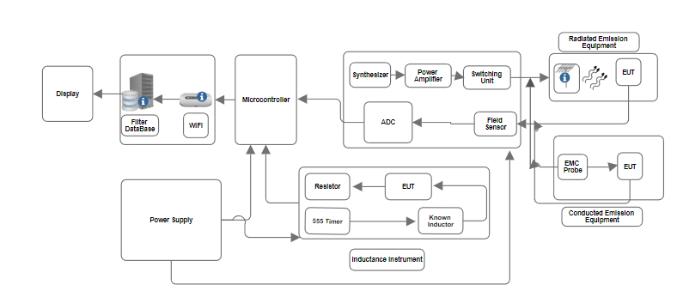
TECHNICAL APPROACH
Frequency guardianz
80 MHz - 1 GHz:
This range is typically used testing for electronic devices, especially for compliance with standards like CISPR 22 and FCC Part 15.
Devices like mobile phones, Wi-Fi routers, and general electronic equipment are tested within this range
2. 1.4 GHz - 2.0 GHz:
This range is used for testing the immunity of devices many modern devices, including mobile phones and Wi-Fi equipment
3. 2.0 GHz - 2.7 GHz:
It's important for testing modern communication devices, Bluetooth devices, and even some industrial, scientific, and medical equipment that may operate around the 2.45 GHz ISM band.

Slide 4
FEASIBILITY AND VIABILITY
Frequency Guardianz
Electromagnetic Compatibility (EMC)
Risk: Non-compliance with EMC standards can lead to regulatory issues and poor instrument performance.
Solution: Conduct EMC Testing and Compliance Checks
Testing: Perform EMC testing to verify that the instrument meets relevant standards (e.g., IEC, FCC). Use a professional test facility if necessary.
Compliance: Adjust the design based on testing results to meet EMC requirements. Ensure all components and assemblies are certified for EMC compliance.
Risk: Poor grounding and shielding can increase susceptibility to EMI and affect EMC performance.
Solution: Implement Effective Grounding and Shielding Techniques
Grounding: Use a solid grounding scheme with a common ground plane to avoid ground loops. Ensure all components share a proper ground connection.
Shielding: Employ shielding techniques for both the circuit and cables. Make sure shields are properly grounded to be effective.

Slide 5
IMPACT AND BENEFITS
Frequency Guardianz
Potential Impact on the Target Audience:
Precision Engineers and Technicians: Enhances measurement accuracy, leading to more reliable designs and troubleshooting.
Educational Institutions: Provides practical tools for teaching electronics and EMI/EMC principles.
Electronics Manufacturers: Improves quality control and reduces defects, boosting product quality.
Benefits of the Solution:
Social: Improves accuracy and reliability in electronic devices, benefiting end-users and enhancing educational experiences.
Economic: Reduces manufacturing costs and increases productivity through precise and reliable measurements.

Slide 6
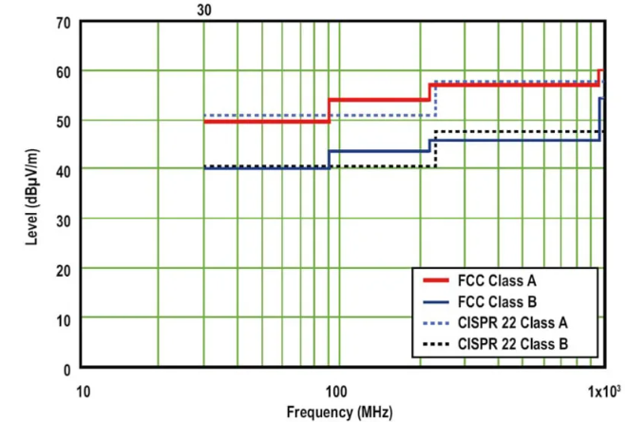
RESEARCH AND REFERENCES
Frequency Guardianz
1."Practical EMC for Designers: A Guide to Designing with EMC in Mind"
Description: A practical guide for designers to implement EMC considerations in their electronic designs.
Link: Electronics Weekly: Practical EMC
2. CISPR 22 / CISPR 32
CISPR 32 (supersedes CISPR 22):
Link to IEC Standards: IEC - CISPR 32 (Requires purchase or subscription)
General Information on IEC Standards: IEC Standards
FCC Part 15
FCC Part 15 Regulations:
Link to Electronic Code of Federal Regulations (eCFR): FCC Part 15
FCC Office of Engineering and Technology (OET) Information: FCC OET

