Slide 1
System Models
Introduction
Architectural Models
Fundamental Models
Summary

Slide 2
Introduction
An Architectural Model
How the components of systems interact with one another
Fundamental Model
Help to reveal key problems for the designers of distributed system.

Slide 3
Client Server Model
Architectural Models
The Web ,FTP, Mail and the DNS are based on this model.
Caching by clients and proxy servers is used to enhance the performance of a service.
Peer-to-peer model
In the peer-to-peer model, the processes all play similar roles, in exploiting the resources of large numbers of participating computers to carry out a common task.

Slide 4
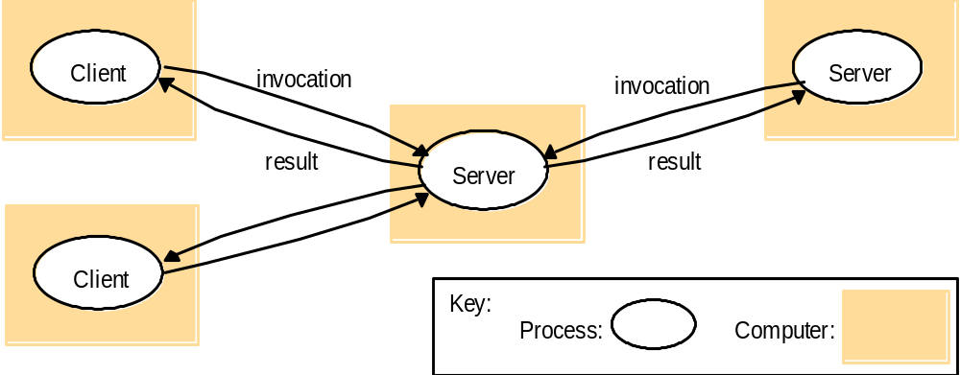
Clients invoke individual Servers

Slide 5
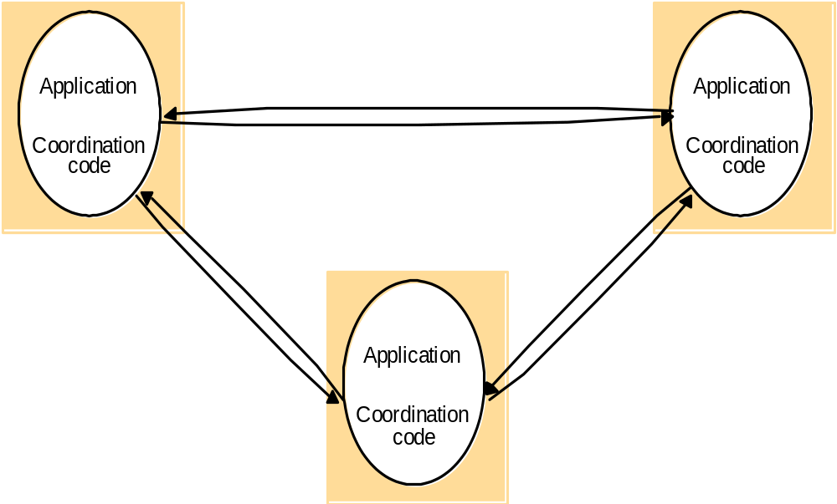
A Distributed Application based on Peer Processes

Slide 6






Client-Server Architecture Types
    Two-tier model (classic)
    Three-tier (when the server, becomes a client)
    Multi-tier (cascade model)
client
server
client
Server/client
server
server
client
Server/client
Server/client
server

Slide 7
Several Variations
Several variations of the models can be derived from the consideration of the following factors
The use of multiple servers and caches to increase performance.
The use of mobile code and mobile agents.
Users need for low-cost computers with limited hardware resources that are simple to manage.
The requirement to add and remove mobile devices in a convenient manner.

Slide 8
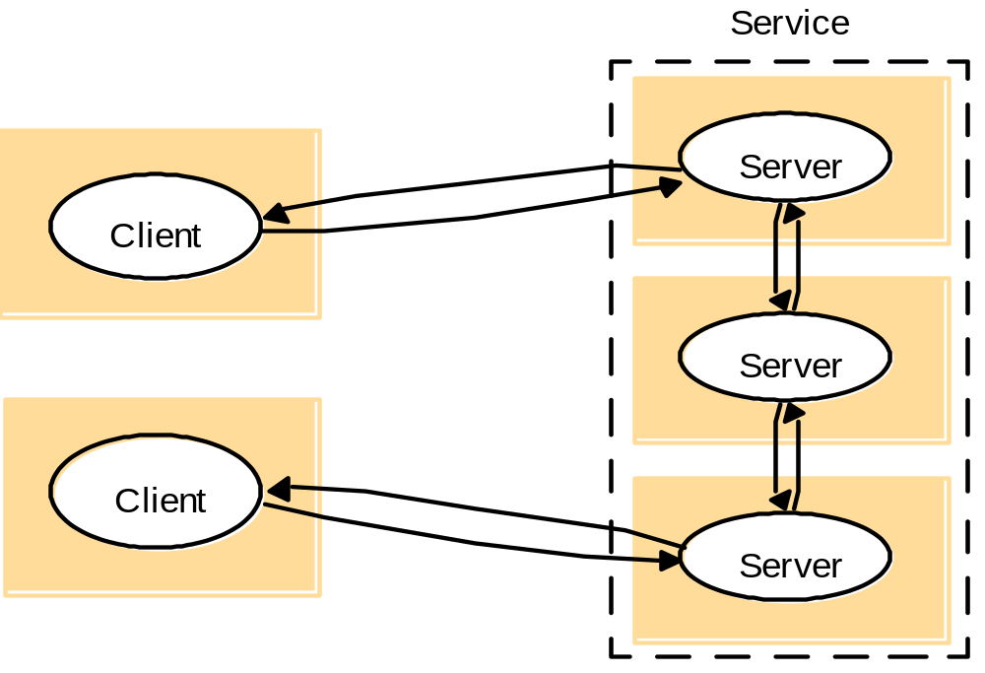
A service provided by multiple servers
Multiple servers use data partition and replication to enhance availability and fault tolerance.

Slide 9
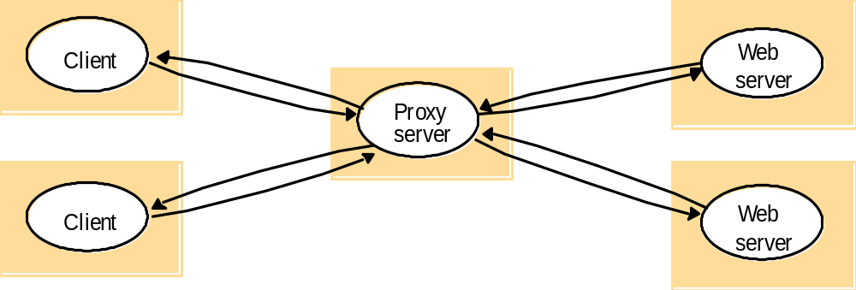
Web Proxy Server
Caching by clients and proxy servers is widely used to enhance the performance of a service.

Slide 10
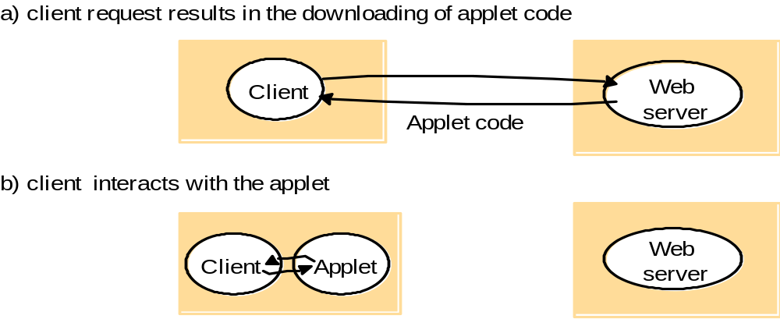
Mobile code
It is the ability to move code from one process to another process.
It does not suffer from the delay or variability of bandwidth.

Slide 11
Thin Clients and Compute Servers
The thin client refers to a software layer that supports a window-based user interface.
The compute server will typically be a multiprocessor or cluster computer.
Compute server
Network computer or PC
Thin
network
Application
Client
Process

Slide 12
Mobile devices and Spontaneous interoperation
The portable computers, PDAs and other digital devices and their integration into distributed systems.
Characteristic of mobile devices in a distributed system is that they connect and disconnect unpredictably.
Music
service
Alarm
gateway
service
Internet
Hotel wireless
Discovery
network
service
Camera
TV/PC
Laptop
PDA
Guests
devices

Slide 13
Fundamental Models
Interaction Model
Failure Model
Security Model

Slide 14
Fundamental Models
All of the above systems share some fundamental properties
Interaction Model
Communication takes place with delays and without a universal clock.
Failure Model
Correct operation of DS is threatened by various types of faults.
Security Model
The security model defines and classifies forms of attack.

Slide 15
Interaction Model
Two Variants
Synchronous Distributed System
The model assumes we can place bounds on time needed for process execution, communication.
Asynchronous Distributed Systems
The model assumes we can set no bounds on time for process execution and communication.
The internet fits this model well.

Slide 16
Failure Model
Processes may fail
Communication channels may fail
The failure model describes various types of failures

Slide 17
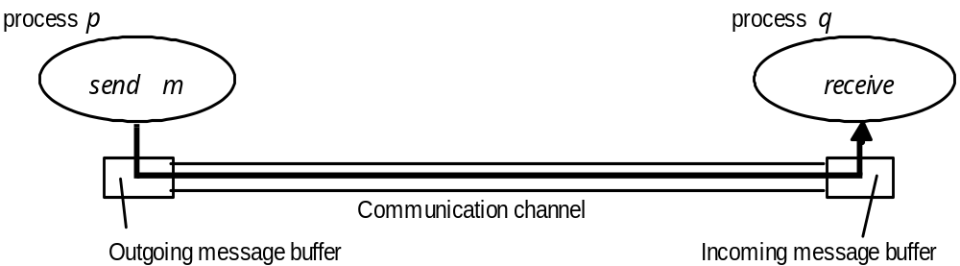
Processes and channels
Process Omission Failures
Communication Omission Failures
Arbitrary Failures
Timing Failures in Synchronized Systems

Slide 18
Omission and Arbitrary Failures
Class of failure
Affects
Description
Fail-stop
Process
Process halts and remains halted. Other processes may
detect this state.
Crash
Process
Process halts and remains halted. Other processes may
not be able to detect this state.
Omission
Channel
A message inserted in an outgoing message buffer never
arrives at the other end’s incoming message buffer.
Send-
omission
Process
A process completes a
send,
but the message is not put
in its outgoing message buffer.
Receive-
omission
Process
A message is put in a process’s incoming message
buffer, but that process does not receive it.
Arbitrary
Process or
Process/channel exhibits arbitrary behaviour: it may
(Byzantine)
channel
send/transmit arbitrary messages at arbitrary times,
commit omissions; a process may stop or take an
incorrect step.

Slide 19
Synchronous Model Timing Failures
Class of Failure
Affects
Description
Clock
Process
Process’s local clock exceeds the bounds on its
rate of drift from real time.
Performance
Process
Process exceeds the bounds on the interval
between two steps.
Performance
Channel
A message’s transmission takes longer than the
stated bound.

Slide 20
Security Model
Secure the processes
Secure the channels
Protect encapsulated objects from
unauthorized access

Slide 21
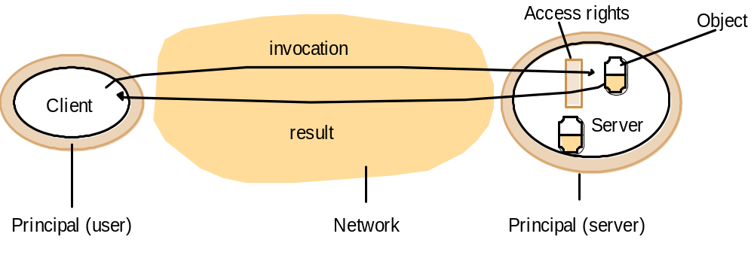
Objects and principals
Access rights specify who is allowed to read or write the object’s state.
Associated with each invocation and each result is an authority on which it is issued.
Such an authority is called a principal. A principal may be a user or process. Both the server and the client may check the identity of the principal behind each invocation or result to determine if access rights have been granted..

Slide 22
The enemy
Copy of
m
The enemy
m’
p
m
Process
q
Process
Communication channel
Lack of reliable knowledge of the identity of the source of a message is a threat to clients and servers.
An enemy can copy, alter or inject messages as they travel across the network.
An enemy can replay old messages.

Slide 23
Secure channels
Principal
B
Principal
A
p
Process
Secure channel
Process
q
Cryptography can be used for:
Encryption
Authentication

