Slide 1
Synchronization in Distributed Systems
In a centralized system: all processes reside on the same system utilize the same clock.
In a distributed system: like synchronize everyone’s watch in the classroom.

Slide 2
Lack of Global Time in DS
It is impossible to guarantee that physical clocks run at the same frequency
Lack of global time, can cause problems
Example: UNIX make
  Edit output.c at a client
  output.o is at a server (compile at server)
  Client machine clock can be lagging behind the server machine clock

Slide 3
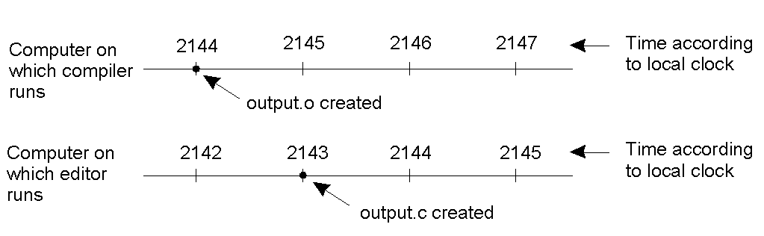
Lack of Global Time – Example
When each machine has its own clock, an event that occurred after another event may nevertheless be assigned an earlier time.

Slide 4
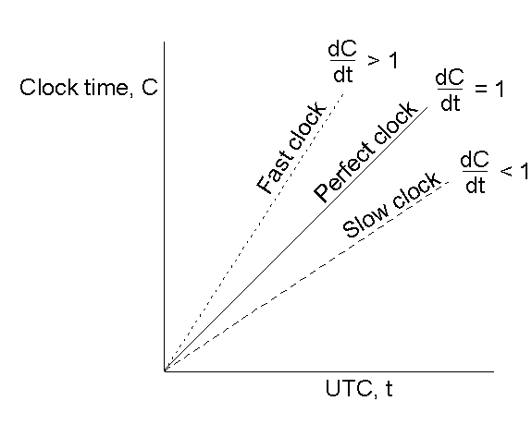
Clock Synchronization Algorithms
Computer timers go off H times/sec, and increment the count of ticks (interrupts) since an agreed upon time in the past.
This clock value is C.
Using UTC time, the value of clock on machine p is C_{p}(t).
For a perfect time, C_{p}(t) = t and dC/dt = 1.
For an ideal timer, H =60, should generate 216,000 ticks per hour.

Slide 5
Clock Synchronization Algorithms
Clock Skew versus Drift
  Clock Skew = Relative Difference in clock values of two processes
  Clock Drift = Relative Difference in clock frequencies (rates) of two processes
But typical errors, 10^{–5}, so the range of ticks per second will vary from 215,998 to 216,002.
Manufacturer specs can give you the maximum drift rate (ρ).
Every Δt seconds, the worst case drift between two clocks will be at most 2ρΔt.
To guarantee two clocks never differ by more than δ, the clocks must re-synchronize every δ/2ρ seconds using one of the various clock synchronization algorithms. In a DS, each process has its own clock.

Slide 6
Clock Synchronization Algorithms
Centralized Algorithms
  Cristian’s Algorithm (1989)
  Berkeley Algorithm (1989)
Decentralized Algorithms
  Averaging Algorithms (e.g. NTP)

Slide 7
Cristian's Algorithm
Assume one machine (the time server) has a WWV receiver and all other machines are to stay synchronized with it.
Every δ/2ρ seconds, each machine sends a message to the time server asking for the current time.
Time server responds with message containing current time, C_{UTC}.

Slide 8
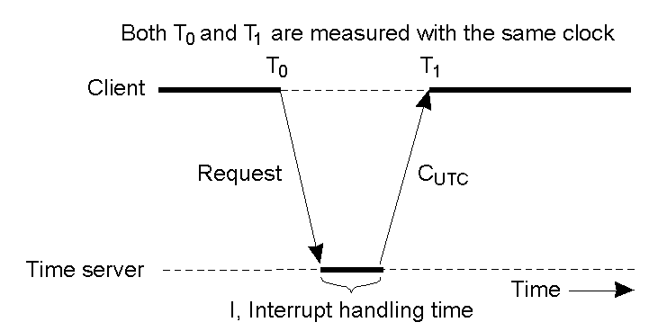
Cristian's Algorithm
Getting the current time from a time server

Slide 9
Cristian's Algorithm
A major problem – the client clock is fast ➔ arriving value of C_{UTC} will be smaller than client’s current time, C.
  What to do?
    One needs to gradually slow down client clock by adding less time per tick.

Slide 10
Cristian’s Algorithm
Minor problem – the one-way delay from the server to client is “significant” and may vary considerably.
  What to do?
    Measure this delay and add it to C_{UTC.}
    The best estimate of delay is (T₁ – T₀)/2.
  In cases when T₁ – T₀ is above a threshold, then ignore the measurement. {outliers}
  Can subtract off I (the server interrupt handling time).
  Can use average delay measurement or relative latency (shortest recorded delay).

Slide 11
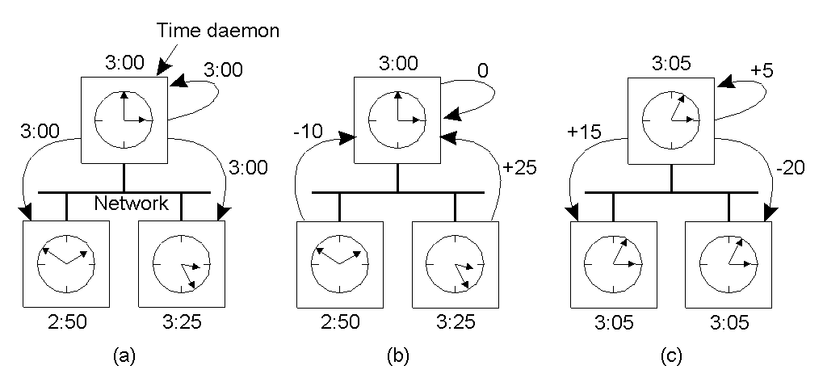
The Berkeley Algorithm
The time daemon asks all the other machines for their clock values.
The machines answer and the time daemon computes the average.
The time daemon tells everyone how to adjust their clock.

Slide 12
A client's clock reads 3:20:00. The server's clock reads 3:10:00 when they synchronize using the Centralized algorithms. Assume message delays are negligible. What is the time at the client after synchronization using a) Berkeley Algorithm b) Cristian Algorithm?
Compute the best estimate of delay for T0 value (Timestamp of request message sent to time server) as 10:10:25 and T1 value (Timestamp of response message received from time server) as 10:10:55 for Cristitan’s algorithm (T0: and T1 values are in hh:mm:ss format)

Slide 13
Averaging Algorithms (NTP)
Every R seconds, each machine broadcasts its current time.
The local machine collects all other broadcast time samples during some time interval, S.
The simple algorithm:: the new local time is set as the average of the value received from all other machines.

Slide 14
Averaging Algorithms
A slightly more sophisticated algorithm :: Discard the m highest and m lowest to reduce the effect of a set of faulty clocks.
Another improved algorithm :: Correct each message by adding to the received time an estimate of the propagation time from the i^{th} source.
  extra probe messages are needed to use this scheme.
One of the most widely used algorithms in the Internet is the Network Time Protocol (NTP).
  Achieves worldwide accuracy in the range of 1-50 msec.

Slide 15
NTP - Clock Synchronization Algorithm is
a) Passive, Averaging, Centralized
b) Active, Averaging, Distributed
c) Active, Averaging, Centralized
d) Passive, Averaging, Distributed

Slide 16
Logical Clocks
For a certain class of algorithms, it is the internal consistency of the clocks that matters. The convention in these algorithms is to speak of logical clocks.
Lamport showed clock synchronization need not be absolute. What is important is that all processes agree on the order in which events occur.

Slide 17
Lamport Timestamps [1978]
Lamport defined a relation ”happens before”. a → b ‘a happens before b’.
Happens before is observable in two situations:
If a and b are events in the same process, and a occurs before b, then a → b is true.
If a is the event of a message being sent by one process, and b is the event of the message being received by another process, then a → b is also true.

Slide 18
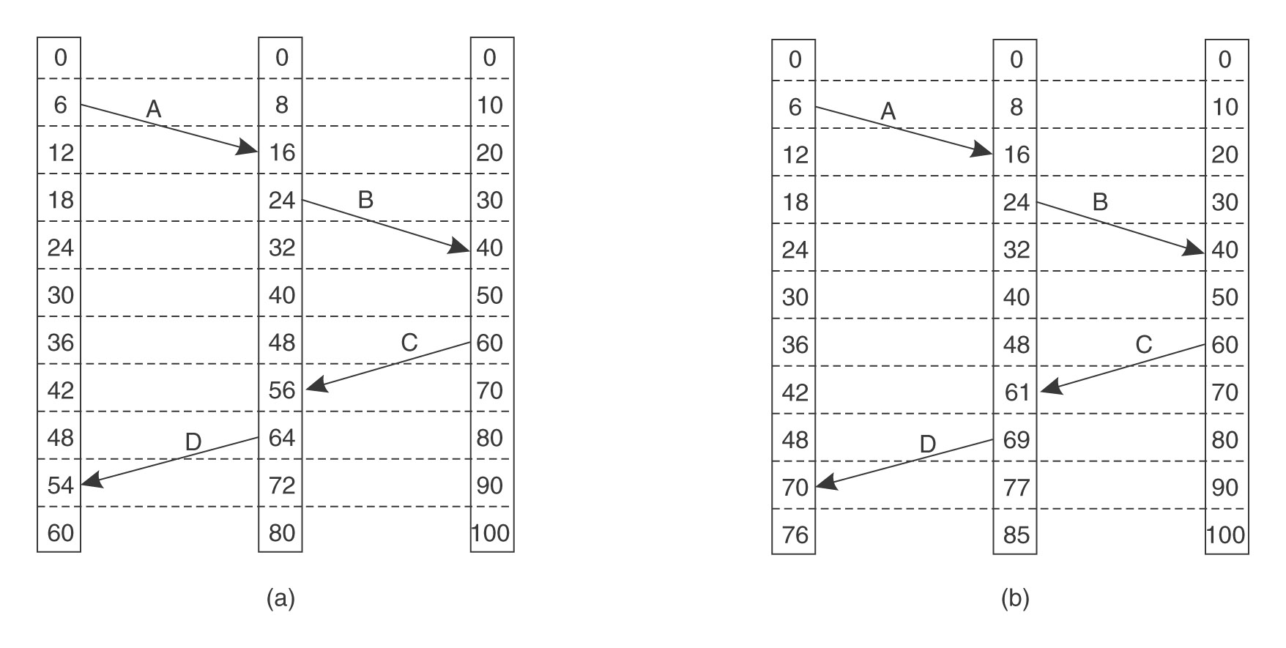
Lamport Timestamps
0 1 2 0 1 2
(impossible)
Each processes with own clock with different rates.
Lamport's algorithm corrects the clocks.
Can add machine ID to break ties

Slide 19
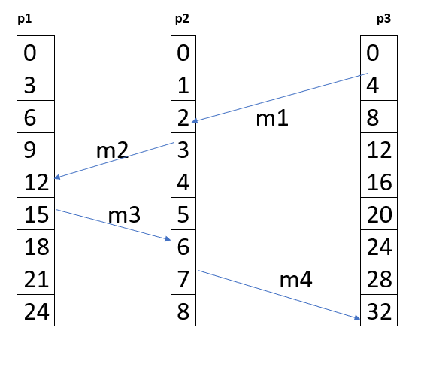
Analyze the following diagram and compute the value of timestamp for the receipt of message /m1’ at process p2 according to Lamport’s Logical clock

