Slide 1
Operating System Architecture and Distributed Systems

Slide 2
Operating System Architecture and Distributed Systems
Let us look into the architecture of a kernel suitable for a distributed system.
A key principle of DS is openness and with this in mind let us examine the major kernel architectures:
  Monolithic kernels
  Layered architecture-based kernels
  Micro-kernels

Slide 3
OS/Kernel Architecture
In Literature, we find predominantly 3 types of OS:
  Monolithic OS
  Layered OS
  Microkernel-based OS
The first two may be put under the same category as monolithic.
  The chambers 20th century dictionary definition of monolithic is: a pillar, column, of a single stone: anything that resembling a monolithic, massiveness.

Slide 4
Operating System Models
Three approaches to building OS....
  Monolithic OS
  Layered OS
  Microkernel based OS
Client server OS
Suitable for distributed systems
Simplicity, flexibility, and high performance are crucial for OS.

Slide 5
Monolithic Operating System
Application
Programs
Application
Programs
User Mode
Kernel Mode
System Services
Hardware
Better application Performance
Difficult to extend
Ex: MS-DOS

Slide 6





Layered OS
Application
Programs
Application
Programs
User Mode
Kernel Mode
System Services
Memory & I/O Device Mgmt
Process Schedule
Hardware
Easier to enhance
Each layer of code access lower level interface
Low-application performance
Ex : UNIX

Slide 7
Traditional OS
Application
Programs
Application
Programs
User Mode
Kernel Mode
OS
Hardware
OS Designer

Slide 8
Disadvantages of Monolithic OS
It is massive:
  It performs all basic OS functions and takes up in the order of megabytes of code and data
It is undifferentiated:
  It is coded in a non-modular way (traditionally) although modern ones are much more layered.
It is intractable:
  Altering any individual software component to adapt it to changing requirements is difficult.

Slide 9
New trend in OS design: Separating mechanisms and policies
Application
Programs
Servers
Application
Programs
User Mode
Kernel Mode
Microkernel
(very basic functions)
Hardware

Slide 10
Micro-kernel
Compared to monolithic, microkernel design provides only the most basic abstractions,
  principally address space, threads and local IPC.
All other system services are provided by servers that are dynamically loaded precisely on those computers in the DS that require them.
Clients access these system services using the kernel’s message-based invocation mechanisms.

Slide 11
Microkernel/Client Server OS
Client
Application
OS
Emulators
File
Server
Network
Server
Display
Server
User
Kernel
Microkernel
Send
Reply
Hardware
Tiny OS kernel providing basic primitive (process, memory, IPC)
Traditional services becomes subsystems
OS = Microkernel + User Subsystems
Ex: Mach, PARAS, Chorus, etc.

Slide 12
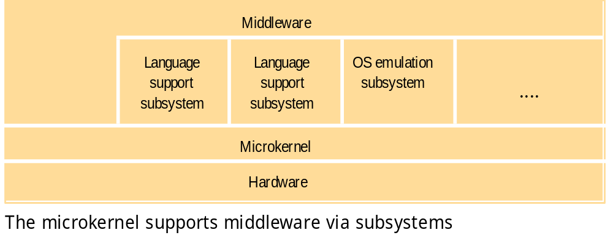
The role of the microkernel
MK appears as a layer between H/W and system systems. If performance, rather than portability is goal, then middleware may use facilities of MK directly.

Slide 13
Few Popular Microkernel Systems
MACH, CMU
  It supports different OS emulators including Unix and OS/2.
PARAS, C-DAC
Chorus
QNX,
Windows NT – original design.

Slide 14
Comparison: Monolithic and
Micro-kernel OS Design
The chief advantages of a MK-based OS:
  Extensibility and its ability to enforce modularity behind memory protection boundaries
  A relative small kernel is more likely to be free of bugs than one that is larger and complex.
The advantage of a monolithic OS:
  Relative efficiency with which operations can be invoked is high because even invocation to a separate user-level address space on the same node is more costly.

