Slide 1
Threading Concept
Thread
  Lightweight process (LWP)
  Threads of instructions or thread of control
  Shares address space and other global information with its process
  Registers, stack, signal masks and other thread-specific data are local to each thread
Threads may be managed by the operating system or by a user application

Slide 2
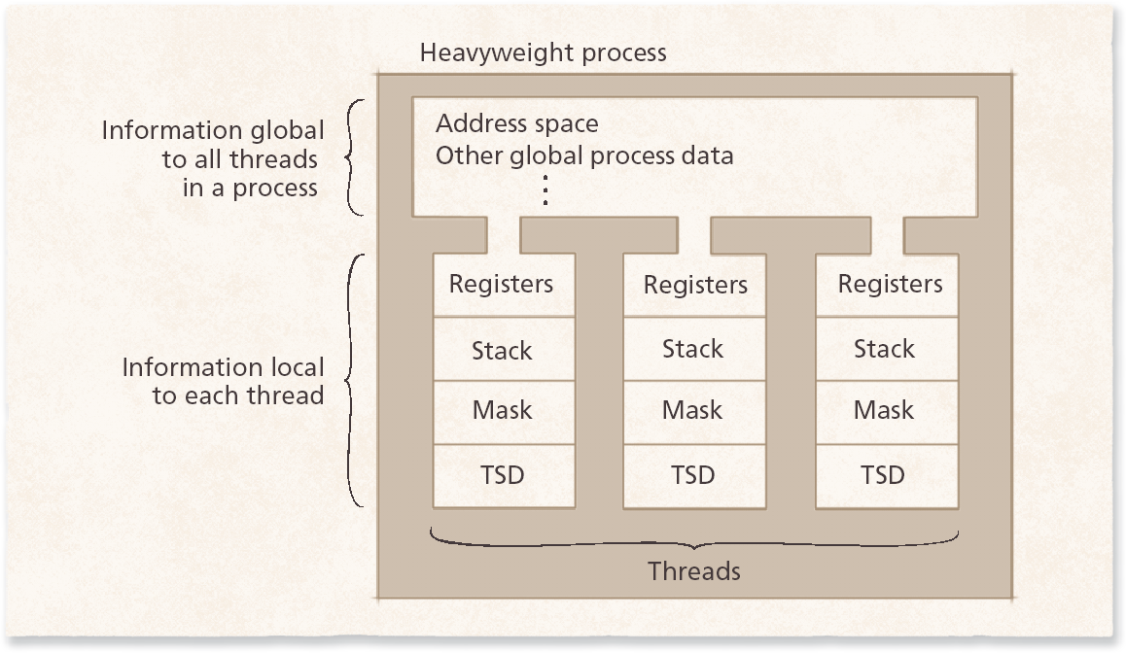
Definition of Thread
Thread Relationship to Processes.

Slide 3
Thread States: Life Cycle of a Thread
Thread states
  Born state
  Ready state (runnable state)
  Running state
  Dead state
  Blocked state
  Waiting state
  Sleeping state
    Sleep interval specifies for how long a thread will sleep

Slide 4
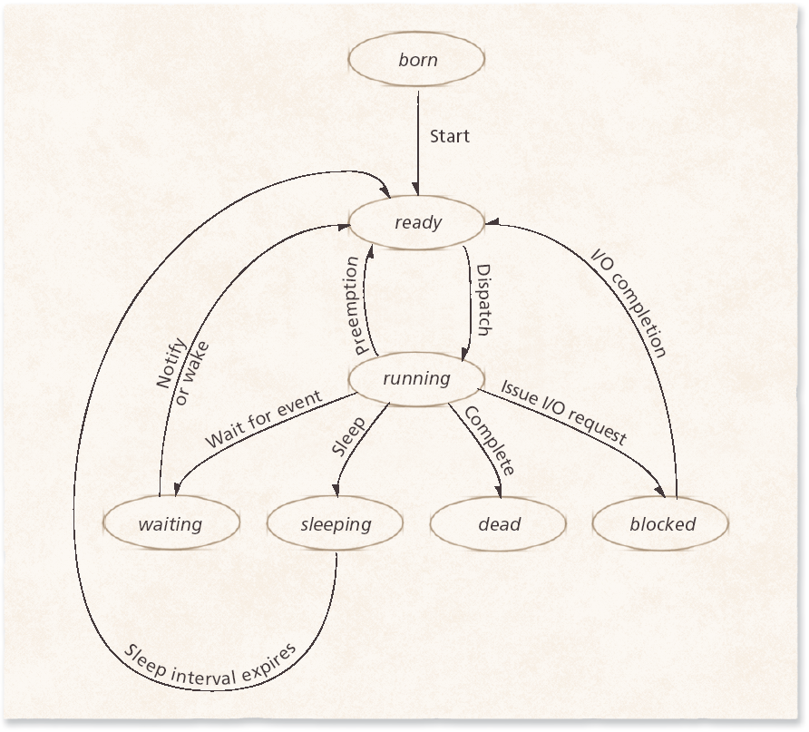
Thread States: Life Cycle of a Thread
Thread life cycle.

Slide 5
Threading Models
Three most popular threading models
  User-level threads
  Kernel-level threads
  Combination of user- and kernel-level threads

Slide 6
User-level Threads
User-level threads perform threading operations in user space
  Threads are created by runtime libraries that cannot execute privileged instructions or access kernel primitives directly
User-level thread implementation
  Many-to-one thread mappings
    Operating system maps all threads in a multithreaded process to single execution context
    Advantages
      User-level libraries can schedule its threads to optimize performance
      Synchronization performed outside kernel, avoids context switches
      More portable
    Disadvantage
      Kernel views a multithreaded process as a single thread of control
        Can lead to suboptimal performance if a thread issues I/O
        Cannot be scheduled on multiple processors at once

Slide 7
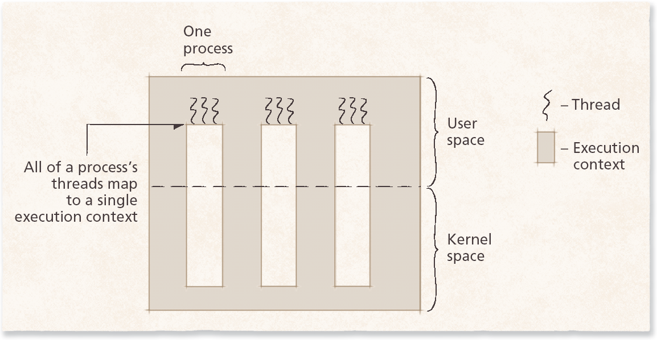
User-level Threads
User-level threads(Many to One Model)

Slide 8
Kernel-level Threads
Kernel-level threads attempt to address the limitations of user-level threads by mapping each thread to its own execution context
  Kernel-level threads provide a one-to-one thread mapping
    Advantages: Increased scalability, interactivity, and throughput
    Disadvantages: Overhead due to context switching and reduced portability due to OS-specific APIs
Kernel-level threads are not always the optimal solution for multithreaded applications

Slide 9
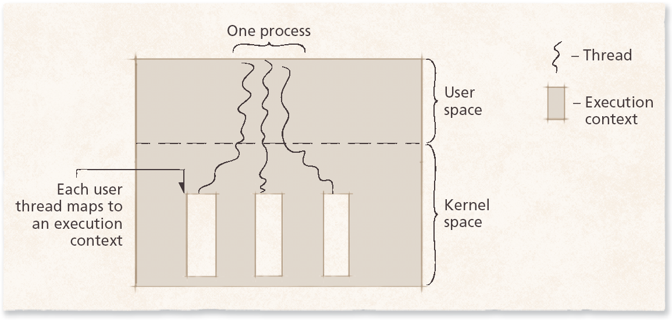
Kernel-level Threads
Kernel-level threads(One to One Model)

Slide 10
Combining User- and Kernel-level Threads
The combination of user- and kernel-level thread implementation
  Many-to-many thread mapping (m-to-n thread mapping)
    Number of user and kernel threads need not be equal
    Can reduce overhead compared to one-to-one thread mappings by implementing thread pooling
Worker threads
  Persistent kernel threads that occupy the thread pool
  Improves performance in environments where threads are frequently created and destroyed
  Each new thread is executed by a worker thread
Scheduler activation
  Technique that enables user-level library to schedule its threads
  Occurs when the operating system calls a user-level threading library that determines if any of its threads need rescheduling

Slide 11
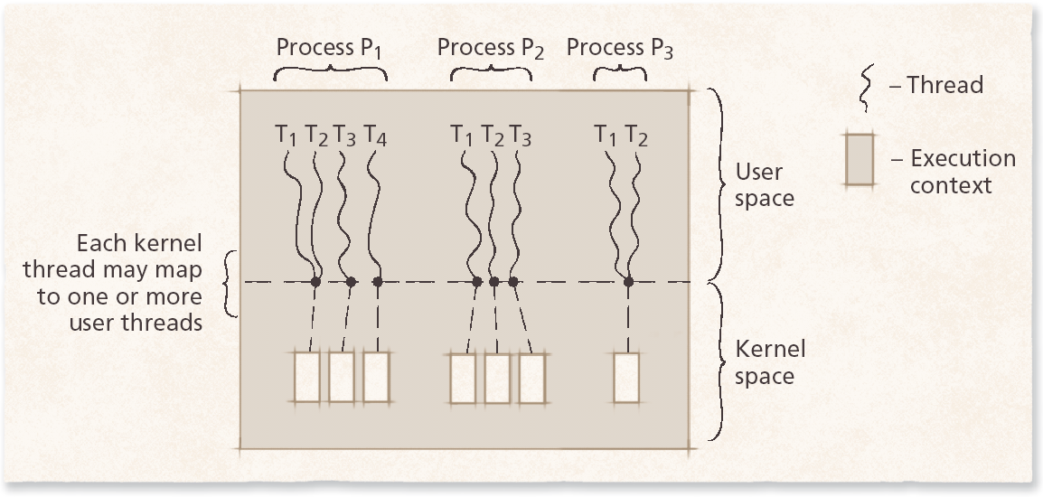
Combining User- and Kernel-level Threads
Hybrid threading model (Many to Many)

Slide 12
Linux Threads
Linux kernel supported the user threads since version 1.x.
The kernel thread supported was added only after version 2.x.
The difference between linux thread and other thread is that Linux does not distinguish between a process and a thread. A task represents the basic unit of work for linux.

Slide 13
Windows 2000 Threads
In Windows 2000, a process is composed of set of threads and a thread represents basic unit of execution.
As soon as the thread starts, window memory manager allocates memory to allow thread to run.
When thread terminates, it releases the memory used by it through the memory manager.
Windows 2000 implements one to one multithreading model.

