Slide 1
Consistency Protocol
Primary-based protocols (writes @primary replica)
- Remote – Write protocol
- Local Write protocol
Replicated write protocols (writes at multiple replica)
- Active replication protocol
- Quorum-Based protocol

Slide 2
Primary – Based Protocols
Each data item x has an associated primary, which is responsible for coordinating write operations on x
1. Remote - Write Protocols
  - Primary fixed at remote server, write operations done remotely
2. Local - Write Protocols
- Primary moves to process where write initiated, write operations done locally

Slide 3
Remote –Write Protocol
Typical
- Traditional client/server architecture
- All reads & writes carried out at remote server
Primary –backup
- Read locally, write at server

Slide 4
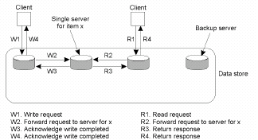
Remote-Write Protocols
(primary based remote – write protocol)
Primary –based remote-write protocol with a fixed sever
to which all read and write operations are forwarded.

Slide 5
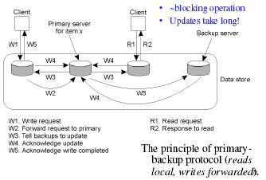
Remote-Write Protocols
(primary - backup remote – write protocol)

Slide 6
Local-Write Protocols
Single copy of data items x
- Single copy is transferred to process that wants to update
- consistency straight forward
- Keeping track of where the single copy is
Primary copy migrates to location of updates
- Primary copy migrates to process that wants to update
- Multiple reads at other local copies while writing

Slide 7
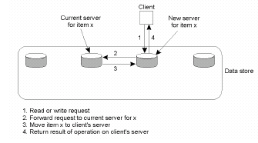
Local - Write Protocols
(primary based local – write protocol)
Primary based local-write protocol in which a single copy is migrated between process.

Slide 8
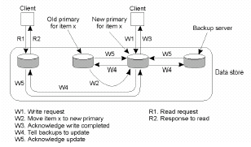
Local-Write Protocols
(primary backup local – write protocol)
Primary-backup protocol in which the primary copy
migrates to the process wanting to perform an update.

Slide 9
Replicated-Write Protocols
Preliminaries:
Writes can take place at multiple replicas, instead of on only a specific primary server.
Active replication protocol
– Operation is forwarded to all replicas
Quorum-Based Protocol (Majority voting)
- Before reading or writing ask a subset of all replicas

Slide 10
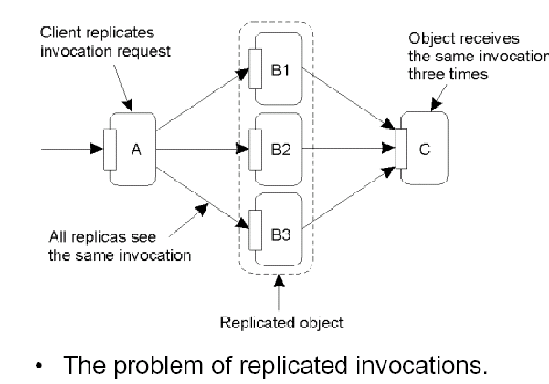
Active Replication (1)

Slide 11
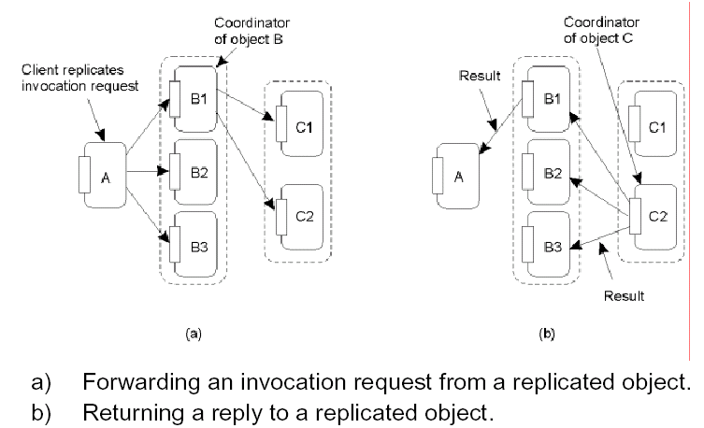
Active Replication (2)

Slide 12
Replicated-Write Protocols
Quorum Based Protocols (based on voting)
Clients request & acquire permission of multiple servers before either reading/writing replicated data
Write : contact at least 50%+ 1 servers
  Agree, update, change version #
Read: contact at least 50% + 1 servers
Get most recent version # of these

Slide 13
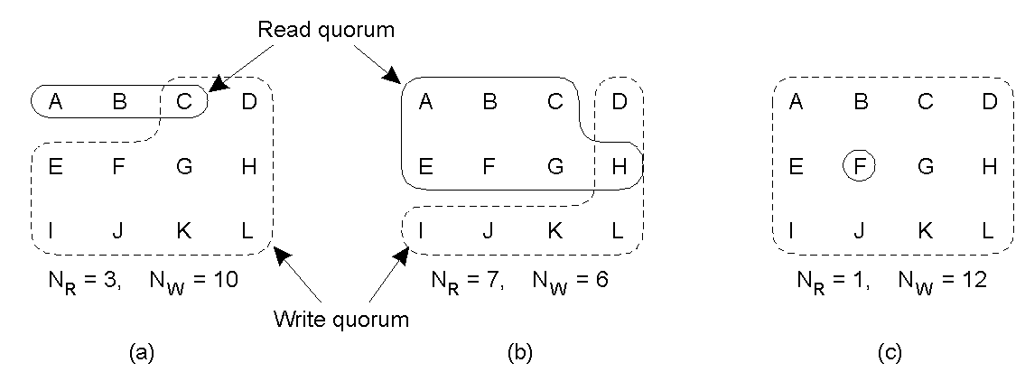
Example: Gifford’s Quorum-Based Protocol
Three examples of the voting algorithm:
A correct choice of read and write set
A choice that may lead to write-write conflicts (problem!)
  if WS_{client1}={ABCEFG} and WS_{client2}= {DHIJKL} then two different updates can go through with no problem!
A correct choice, known as ROWA (read one, write all)

Slide 14
Quorum-Based Protocols
Preliminaries:
If a client wants to read or write, it first must request and acquire permission of multiple servers.
Example:
A DFS with file F being replicated on N servers.
If a an update has to be made, demand, that the client first contacts half of the servers plus 1, and get them to agree to do his update.
Once, they have agreed, file F gets a new version number F(x.y)
To read file F, a client also must contact at least half of the servers and ask them, to hand out the current version number of F.

Slide 15
Gifford’s Quorum-Based Protocols
Gifford quorum scheme is a more general:
To read a file F a client must use a read-quorum, an
arbitrary assemble of Nr servers.
To write a file F, at least Nw servers –the write quorum- are required. The following must hold:
1. NR +NW > N
2. NW > N/2
1. Is used to prevent read-write conflicts
2. Is used to prevent write-write conflicts

