Slide 1
Distributed File Systems
Goal: allow multiple processes to share data
  long durations, securely, reliably
We will take a brief look at Sun’s NFS
  Network File System version 3
    read about version 4 (NSFv4) from on-line resources
Other File Systems
  Coda
    Support continuous operations even when network partitions
      mobile users

Slide 2
Issue | NFS | CODA
Design goals | Access transparency | High availability
Access model | Remote access model | Up/Download
Communication | RPC | RPC
Client process | Thin/Fat | Fat
Mount granularity | Directory | File system
Name space | Per client | Global
Sharing sem. | Session | Transactional
Cache unit | File(v4) | File
Cache consist | Write-back | Write-back
Fault tolerance | Reliable comm. | Replication & caching
Recovery | Client-based | Reintegration
Secure channels | Existing mechanisms | Needham-Schroeder
Access control | Many operations | Directory operations

Slide 3
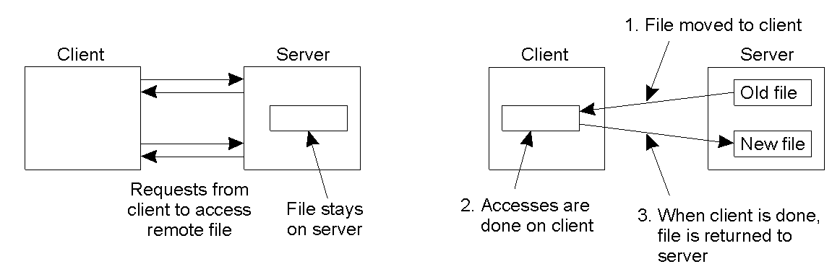
NFS Architecture (remote access model)
The remote access model
  Example: NFS model
The upload/download model
  Example: FTP

Slide 4
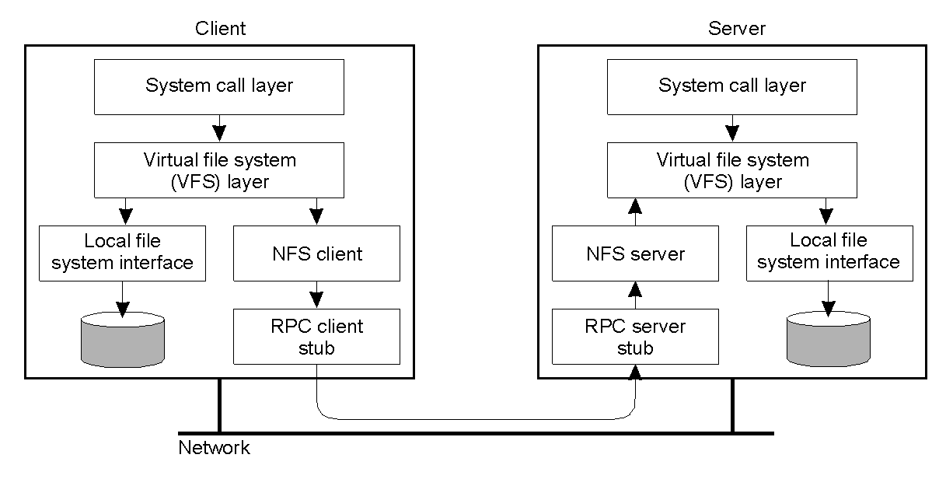
NFS Architecture
The basic NFS architecture for UNIX systems.

Slide 5
File System Model
Operation | v3 | v4 | Description
Create | Yes | No | Create a regular file
Create | No | Yes | Create a nonregular file
Link | Yes | Yes | Create a hard link to a file
Symlink | Yes | No | Create a symbolic link to a file
Mkdir | Yes | No | Create a subdirectory in a given directory
Mknod | Yes | No | Create a special file
Rename | Yes | Yes | Change the name of a file
Rmdir | Yes | No | Remove an empty subdirectory from a directory
Open | No | Yes | Open a file
Close | No | Yes | Close a file
Lookup | Yes | Yes | Look up a file by means of a file name
Readdir | Yes | Yes | Read the entries in a directory
Readlink | Yes | Yes | Read the path name stored in a symbolic link
Getattr | Yes | Yes | Read the attribute values for a file
Setattr | Yes | Yes | Set one or more attribute values for a file
Read | Yes | Yes | Read the data contained in a file
Write | Yes | Yes | Write data to a file
list of file system operations supported by NFS.

Slide 6
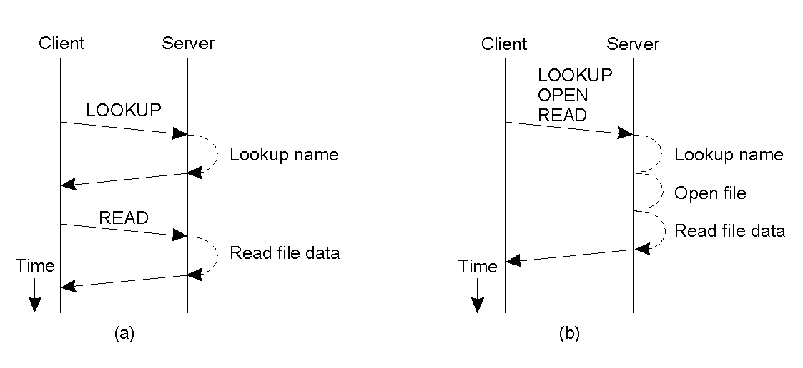
Communication (RPC)
Reading data from a file in NFS version 3.
Reading data using a compound procedure in version 4.

Slide 7
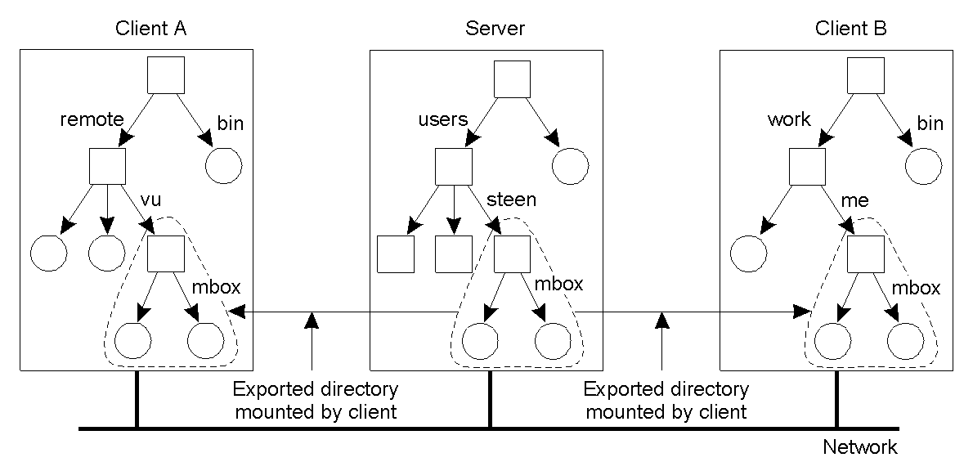
Naming (1)
Mounting (part of) a remote file system in NFS.

Slide 8
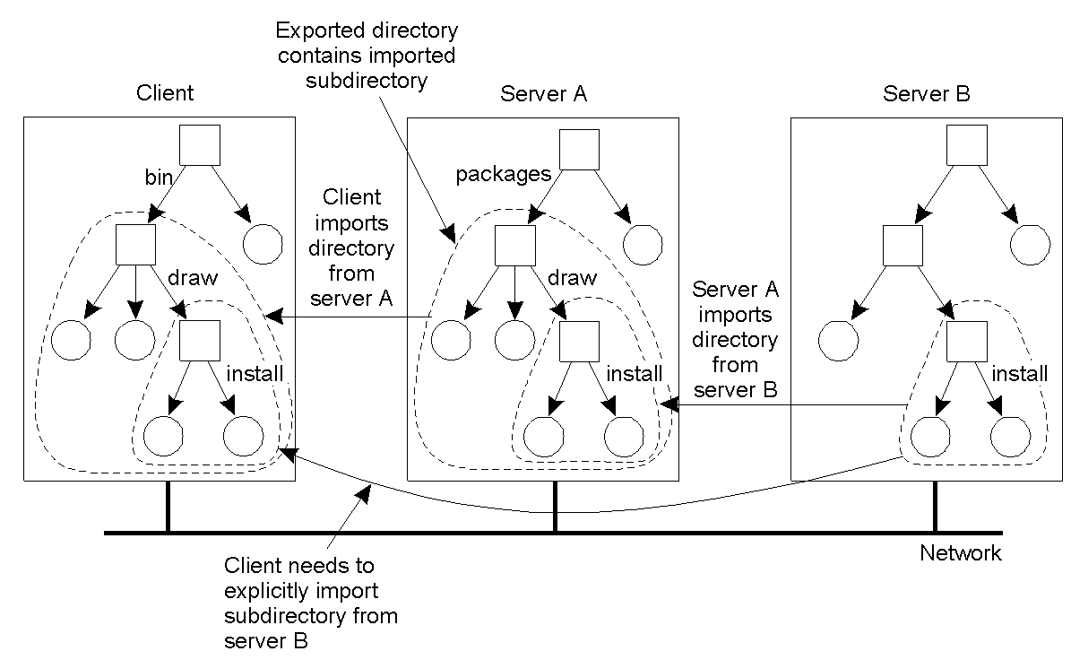
Naming (2)
Mounting nested directories from multiple servers in NFS.

Slide 9
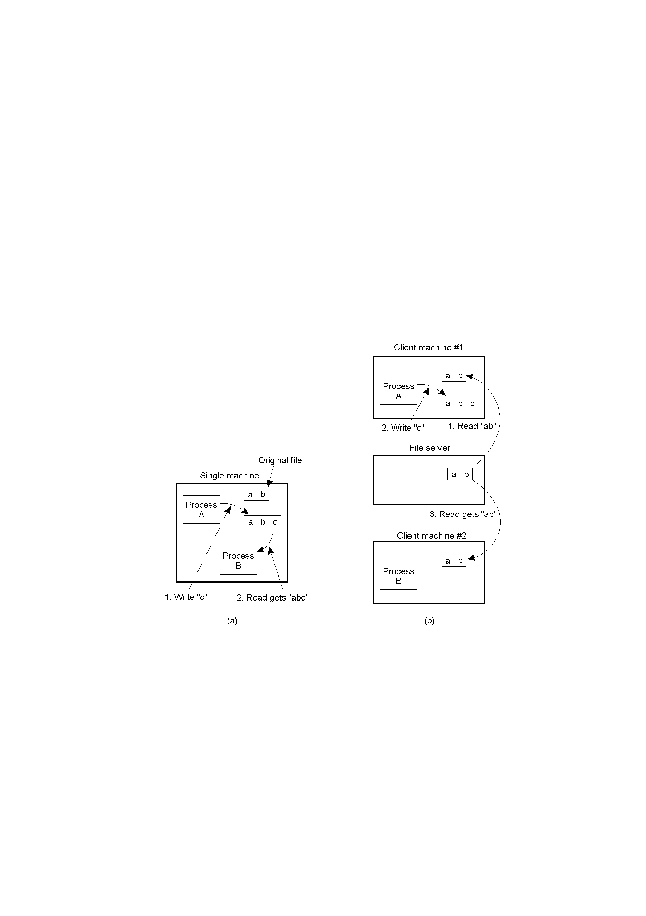
Semantics of File Sharing (Session semantics)
On a single processor, when a read follows a write, the value returned by the read is the value just written.
In a distributed system with caching, obsolete values may be returned.

Slide 10
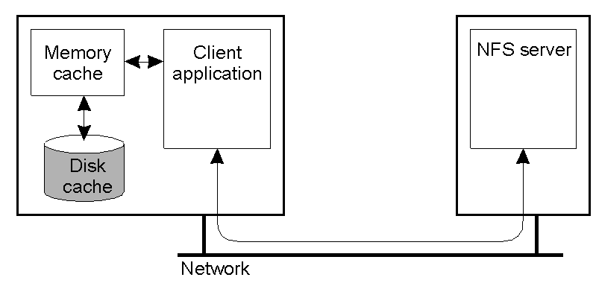
Client Caching (write back)
Client-side caching in NFS.

Slide 11
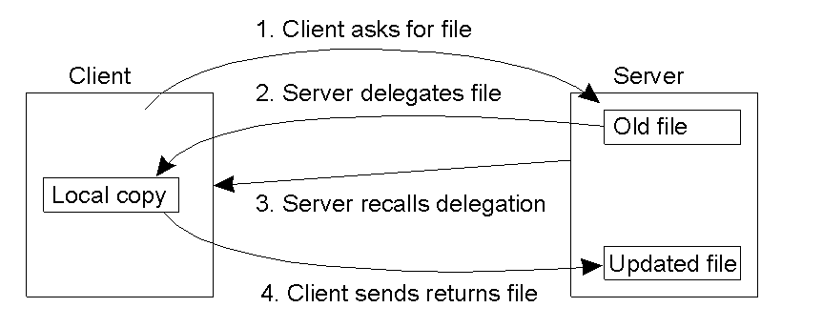
Client Caching (write back)
Using the NFS version 4 callback mechanism to recall file delegation.

Slide 12
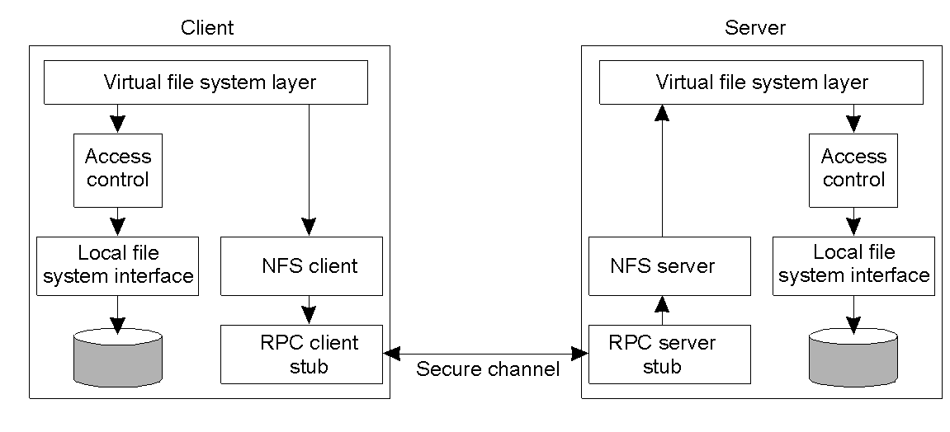
Security
The NFS security architecture.

Slide 13
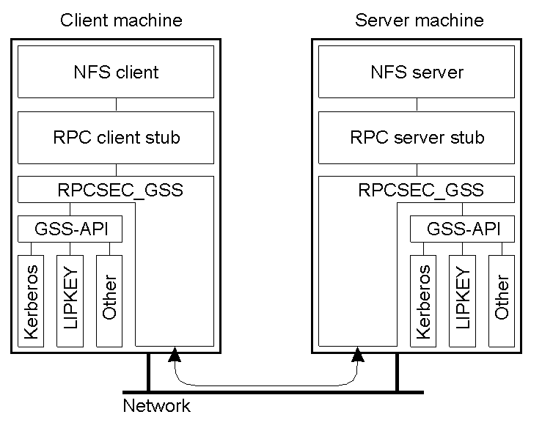
Secure RPCs
Secure RPC in NFS version 4.

Slide 14
Access Control
Operation | Description
Read_data | Permission to read the data contained in a file
Write_data | Permission to to modify a file's data
Append_data | Permission to to append data to a file
Execute | Permission to to execute a file
List_directory | Permission to to list the contents of a directory
Add_file | Permission to to add a new file t5o a directory
Add_subdirectory | Permission to to create a subdirectory to a directory
Delete | Permission to to delete a file
Delete_child | Permission to to delete a file or directory within a directory
Read_acl | Permission to to read the ACL
Write_acl | Permission to to write the ACL
Read_attributes | The ability to read the other basic attributes of a file
Write_attributes | Permission to to change the other basic attributes of a file
Read_named_attrs | Permission to to read the named attributes of a file
Write_named_attrs | Permission to to write the named attributes of a file
Write_owner | Permission to to change the owner
Synchronize | Permission to to access a file locally at the server with synchronous reads and writes
The classification of operations recognized by NFS with respect to access control.

