Slide 1
Secure Blockchain-Based Cloud Storage Using Post-Quantum Cryptography and AES Encryption
RUTHRAN R (211421205145)
SUPRATEEK S (211421205168)
SABARINATHAN V (211421205312)
Guide Name: Dr. K.RAMADEVI
Professor

Slide 2
Abstract
This project introduces a secure cloud storage system that integrates blockchain and encryption to ensure data protection and integrity. It provides a robust security framework by implementing AES-256 encryption, which secures files against unauthorized access. Additionally, public-private key cryptography is used for controlled access, ensuring that only authorized users can retrieve or share data. To further strengthen security, a salting method is applied to passwords, making them resistant to brute-force attacks.
A key feature of this system is blockchain-based storage, which records file transactions transparently, ensuring that stored data cannot be tampered with. Each file reference is immutably logged in the blockchain, enhancing accountability. A password manager securely stores encrypted credentials, preventing unauthorized access to user accounts. To optimize system performance, a software load balancer distributes network traffic efficiently, reducing congestion and ensuring smooth operation.

Slide 3
For encryption and decryption, a secure key management system is implemented, ensuring that sensitive data remains protected at all times. Additionally, post-quantum cryptography is incorporated to safeguard against emerging cyber threats in the future. A Flask-based UI enables easy file uploads and retrieval, providing a user-friendly experience with strong authentication mechanisms. Cloud storage integration ensures scalability, allowing the system to handle large volumes of data efficiently.
Through performance testing, the system demonstrates high reliability, low latency, and strong encryption efficiency. The combination of blockchain, encryption, and efficient access management makes this solution a secure, scalable, and future-ready cloud storage system.

Slide 4
Literature Survey
S.No | Paper Details | Methodology | pros | cons
1 | Blockchain-Based Secure Cloud Storage Using Decentralized Ledger | Utilizes blockchain to ensure data integrity, security, and decentralization in cloud storage. Implements smart contracts for automated access control. | 1) High security and data integrity 2) Decentralized and tamper-proof | 1) High computational cost 2) Scalability challenges

Slide 5
S.No | Paper Details | Methodology | pros | cons
2 | IPFS and Blockchain Integration for Secure Cloud Storage | Combines InterPlanetary File System (IPFS) with blockchain for distributed cloud storage, ensuring efficient data retrieval and storage security. | 1) Reduces storage redundancy 2) Improves retrieval efficiency | 1) Requires continuous network availability 2) Potential latency issues
3 | Smart Contract-Based Access Control in Blockchain Cloud Storage | Implements smart contracts to regulate and automate access permissions for cloud-stored data. | 1) Ensures transparency and security 2) Eliminates third-party intermediaries | 1) Vulnerability to smart contract bugs 2) High gas fees on public blockchains

Slide 6
S.No | Paper Details | Methodology | pros | cons
4 | Scalability Improvements in Blockchain-Based Cloud Storage | Introduces sharding and sidechain techniques to improve blockchain scalability for cloud storage applications. | 1) Reduces storage overhead 2) Enhances transaction throughput | 1) Complexity in implementation 2) Potential security risks in sidechains
5 | Hybrid Cloud Storage System Using Blockchain for Data Integrity | Proposes a hybrid model where sensitive data is stored on a private cloud, and blockchain records are used for verification and integrity checks. | 1) Enhanced data security 2) Flexible storage management | 1) Increased system complexity 2) Integration challenges with legacy systems

Slide 7
Existing System
The existing of file base application appears to be a blockchain-based cloud storage platform where users can upload, store, and retrieve files securely. It likely utilizes blockchain technology to maintain tamper-proof metadata for files, ensuring that records cannot be altered or deleted without authorization. The website may also use encryption techniques to secure uploaded files, though the strength of the would determine its level of protection.
If the system lacks public-private key encryption, it may not provide secure key exchange, making file transfers vulnerable. Additionally, if salting methods are not implemented for password management, users’ credentials could be at risk of brute-force attacks. Performance could also be affected if the system does not use load balancing, which helps manage network traffic efficiently.
Compared to your project, the existing website may have some security features but could lack enhanced encryption, password security, key management, and performance optimizations.

Slide 8
Proposed System: 1.Secure Password Manager with Salting & Encryption
Password Manager is designed to securely store and manage user credentials while preventing unauthorized access. In this system, passwords are encrypted using salting and encryption techniques, ensuring that even system administrators cannot view them.
Salting involves adding a random unique value to each password before hashing, making it resistant to brute-force and dictionary attacks. Even if two users have the same password, their stored hashes will be different due to the salt value, preventing attackers from using precomputed hash tables to crack passwords.
The encryption process ensures that only the user with the correct decryption key can retrieve and use the stored credentials. This enhances data security and privacy, ensuring that stored passwords remain confidential and protected from cyber threats.

Slide 9
2.Public-Private Key Encryption for Secure File Storage
To enhance security, the system implements public-private key encryption, ensuring that all files uploaded to the cloud are encrypted using a public key. Only the corresponding private key can decrypt and access the files, ensuring confidentiality and secure file exchange while preventing unauthorized access.
Unlike traditional systems where files are stored directly on cloud servers, this solution encrypts files before storage, making them unreadable without the correct decryption key. Additionally, only metadata is stored on the blockchain, ensuring tamper-proof records and decentralized verification. This approach guarantees data integrity, prevents unauthorized modifications, and enhances security by removing a single point of failure in the storage system.

Slide 10
3.Load Balancer for Performance & Scalability
To optimize system performance, a load balancer is integrated to distribute network traffic across multiple servers. This ensures fast access, minimal downtime, and system reliability by preventing any single server from becoming overloaded. By evenly distributing user requests, the load balancer enhances system scalability, allowing the platform to efficiently handle an increasing number of users without performance degradation. This approach ensures that file uploads and blockchain transactions remain fast and uninterrupted .With the combination of load balancing, encryption, and blockchain storage, the system provides a robust, secure, and scalable cloud storage solution that guarantees data confidentiality, integrity, and availability, while protecting against cyber threats and unauthorized access.

Slide 11
4.Encrypted File Storage in Blockchain
To ensure secure and tamper-proof file storage, all files are encrypted before being uploaded to the cloud. This encryption process ensures that even if unauthorized users access the storage, they cannot read the files without the correct decryption key.
Unlike traditional storage systems, where both files and metadata are stored in a central database, our solution stores only metadata (hash values and timestamps) on the blockchain. The hash value acts as a unique fingerprint of the file, making any unauthorized changes immediately detectable. The timestamp ensures that every file transaction is recorded and verifiable.
By leveraging blockchain technology, the system guarantees data integrity and transparency, preventing unauthorized modifications or deletions. Since blockchain is decentralized, no single entity can alter stored metadata, making the system highly secure and resistant to data tampering.

Slide 12
5.User-Friendly Interface for Secure Cloud Storage
To enhance usability, the system includes a user-friendly interface that simplifies secure file management. The interface is designed with an intuitive dashboard, allowing users to easily upload and manage encrypted files. It also provides a seamless password manager, enabling users to securely store and retrieve credentials without complexity.
The frontend is built using Flask, ensuring a lightweight and responsive design for smooth interaction. Users can also monitor file integrity and transaction history, ensuring transparency and security.
By integrating the system ensures security without sacrificing ease of use, making encrypted blockchain-based storage accessible to all users

Slide 13
Software & hardware Requirements
Hardware Requirements:
1 .Processor: Dual-core CPU (Intel i5 or AMD equivalent)
2.RAM: 4GB or higher
3.Storage: 100GB+ HDD/SSD
4.Internet: Stable broadband connection (10 Mbps or higher)
5.GPU (Optional): NVIDIA/AMD GPU for cryptographic acceleration.
Software Requirements:
1.Operating System: Windows, Linux (Ubuntu), or macOS
2.Cloud Storage Platforms: IPFS, Amazon S3, or Google Cloud Storage
3.Programming Languages: Python, JavaScript.
4.Database: MongoDB, PostgreSQL, or Firebase
5.Security Tools: AES-256 encryption, Post-Quantum Cryptography ( Development Tools: Visual Studio Code, PyCharm, Remix IDE
6.Version Control: Git, GitHub, or GitLab.

Slide 14
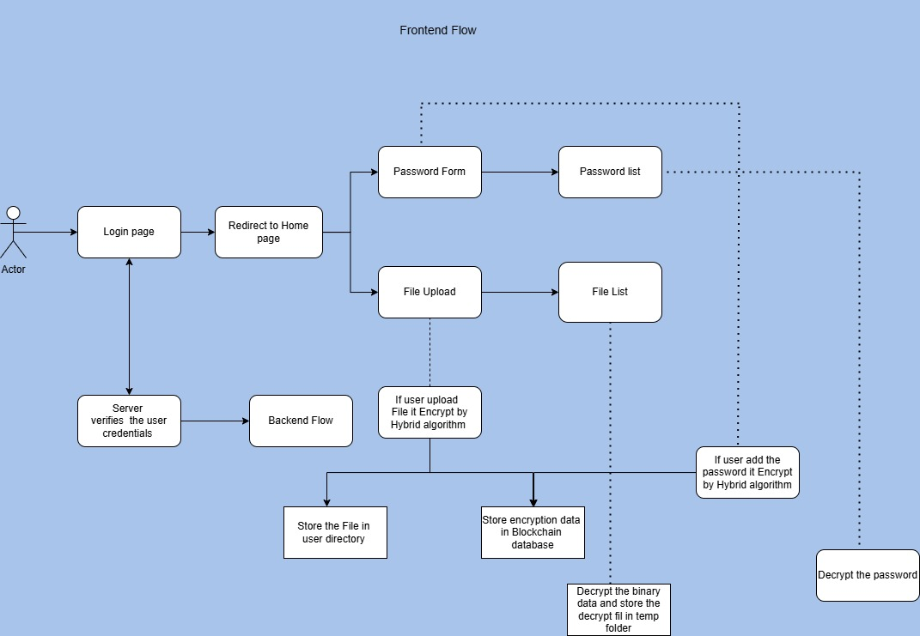
Architecture diagram

Slide 15
Algorithm/Methodology: 1.AES-256 Encryption
AES-256 (Advanced Encryption Standard) is a symmetric encryption algorithm used to secure files before uploading them to the cloud. It encrypts data using a 256-bit key, making it highly resistant to brute-force attacks. The same key is required for both encryption and decryption, ensuring that only authorized users can access stored files. By using AES-256, the system ensures confidentiality, preventing unauthorized access to user data. This encryption is widely used in government, financial, and cloud security applications due to its high level of security and efficiency.

Slide 16
2.Post-Quantum Cryptography Algorithm
Post-Quantum Cryptography (PQC) is used to protect encrypted data from future quantum computer attacks, which could break traditional encryption methods. Our system integrates quantum-resistant encryption techniques to ensure long-term data security.
One of the key techniques is Lattice-Based Cryptography, which relies on solving complex mathematical problems that even quantum computers cannot easily break. This ensures that files remain protected even as computing power advances.
By using post-quantum encryption, our project provides future-proof security for cloud storage, ensuring data integrity, confidentiality, and protection against cyber threats.

Slide 17
3.Public-Private Key Cryptography
Public-private key cryptography, also known as asymmetric encryption, ensures secure file exchange between users. In this system, each user has a public key (used for encryption) and a private key (used for decryption). When a file is uploaded, it is encrypted using the recipient’s public key, and only their private key can decrypt it. This prevents unauthorized access and ensures secure communication. Unlike symmetric encryption, where the same key is used for both encryption and decryption, public-private key cryptography eliminates the risk of key exposure, making it ideal for secure file sharing and authentication.

Slide 18
Novelty
This project introduces a secure and decentralized cloud storage system that enhances data protection using blockchain, encryption, and efficient access management. Unlike traditional centralized storage, it stores file metadata on the blockchain, ensuring tamper-proof and transparent records. AES-256 encryption and public-private key cryptography provide strong security, while a secure key management system prevents unauthorized access. A built-in password manager encrypts credentials, using salting techniques to resist brute-force attacks. A software load balancer optimizes network traffic, improving speed and scalability. Additionally, post-quantum cryptographic measures future-proof the system against emerging security threats. By integrating blockchain with cloud storage

Slide 19
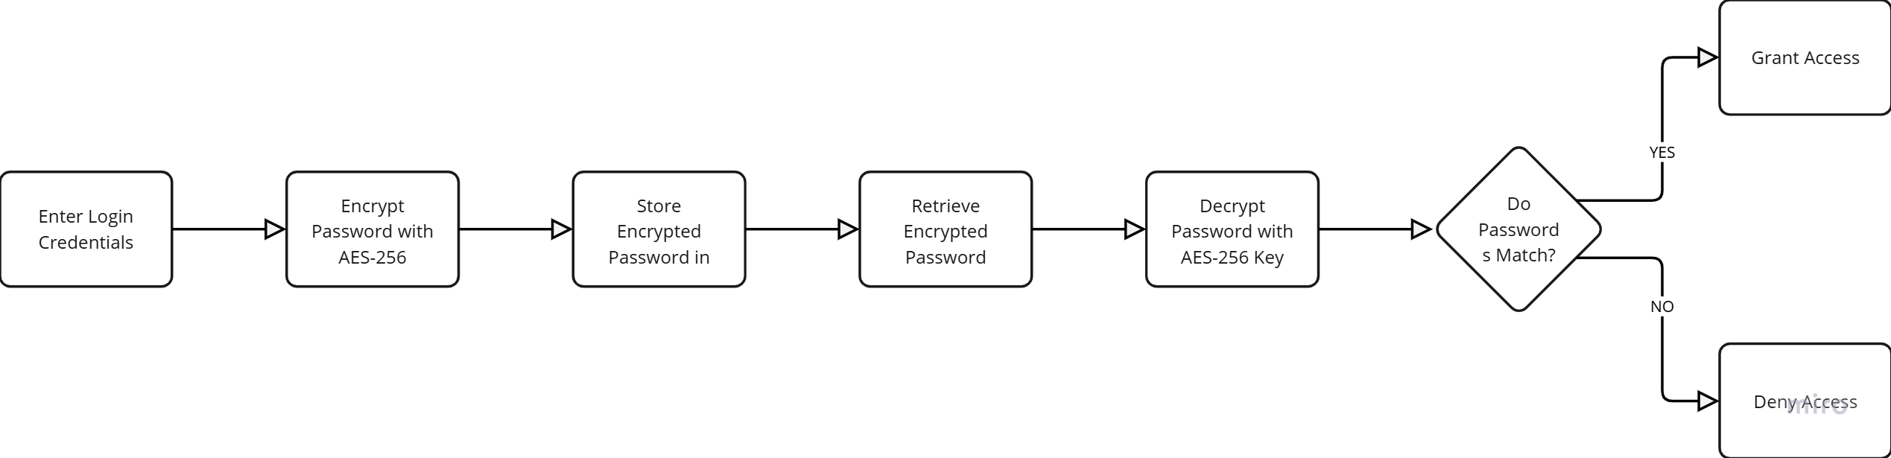
Modules Split up 1.Test Encryption for Login Page

Slide 20
AES-256 Based Login Encryption Flow
The login authentication system follows a secure encryption flow using AES-256 to protect user credentials. When a user enters their login credentials, the password is first encrypted using AES-256 before being stored in the database, preventing direct access to plaintext passwords. During authentication, the system retrieves the encrypted password and decrypts it using the AES-256 key. The decrypted password is then compared with the entered password. If they match, access is granted; otherwise, the login attempt is denied. This method ensures strong encryption, secure authentication, and protection against brute-force attacks, making the system highly secure.

Slide 21
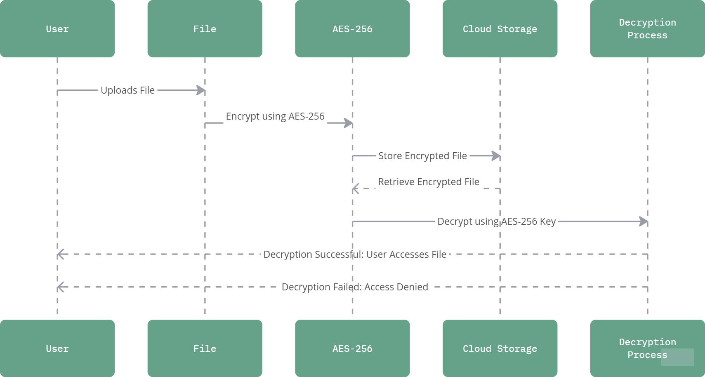
2.File Encryption Process

Slide 22
The file encryption process begins with the user uploading a file. The file is then encrypted using AES-256 before being stored in cloud storage. When a user requests access to the file, the encrypted file is retrieved from storage and sent for decryption using the AES-256 key. If the decryption process is successful, the user gains access to the original file. If the decryption fails, access is denied. This ensures secure file storage and retrieval while maintaining confidentiality through strong encryption.

Slide 23
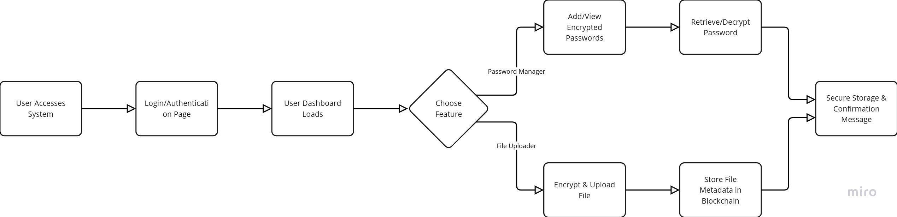
3.Front-End User Interface – Password Manager & File Uploader

Slide 24
This system flow outlines a secure platform where users log in to access a dashboard. From there, they can choose features such as managing encrypted passwords or securely uploading files. Passwords can be encrypted, retrieved, and decrypted, while uploaded files are encrypted and their metadata stored on a blockchain for enhanced security. The system ensures secure storage and provides confirmation messages upon successful operations.

Slide 25
4.Flask-Based Backend Development
The Flask-based backend acts as the system’s processing hub, managing authentication, encryption, and blockchain communication. It processes user requests, encrypts files, stores metadata, and ensures smooth interaction between the front-end and the blockchain. Flask provides a lightweight and efficient structure that helps handle requests quickly and securely. This module ensures that all file operations and user activities are processed correctly and efficiently.

Slide 26
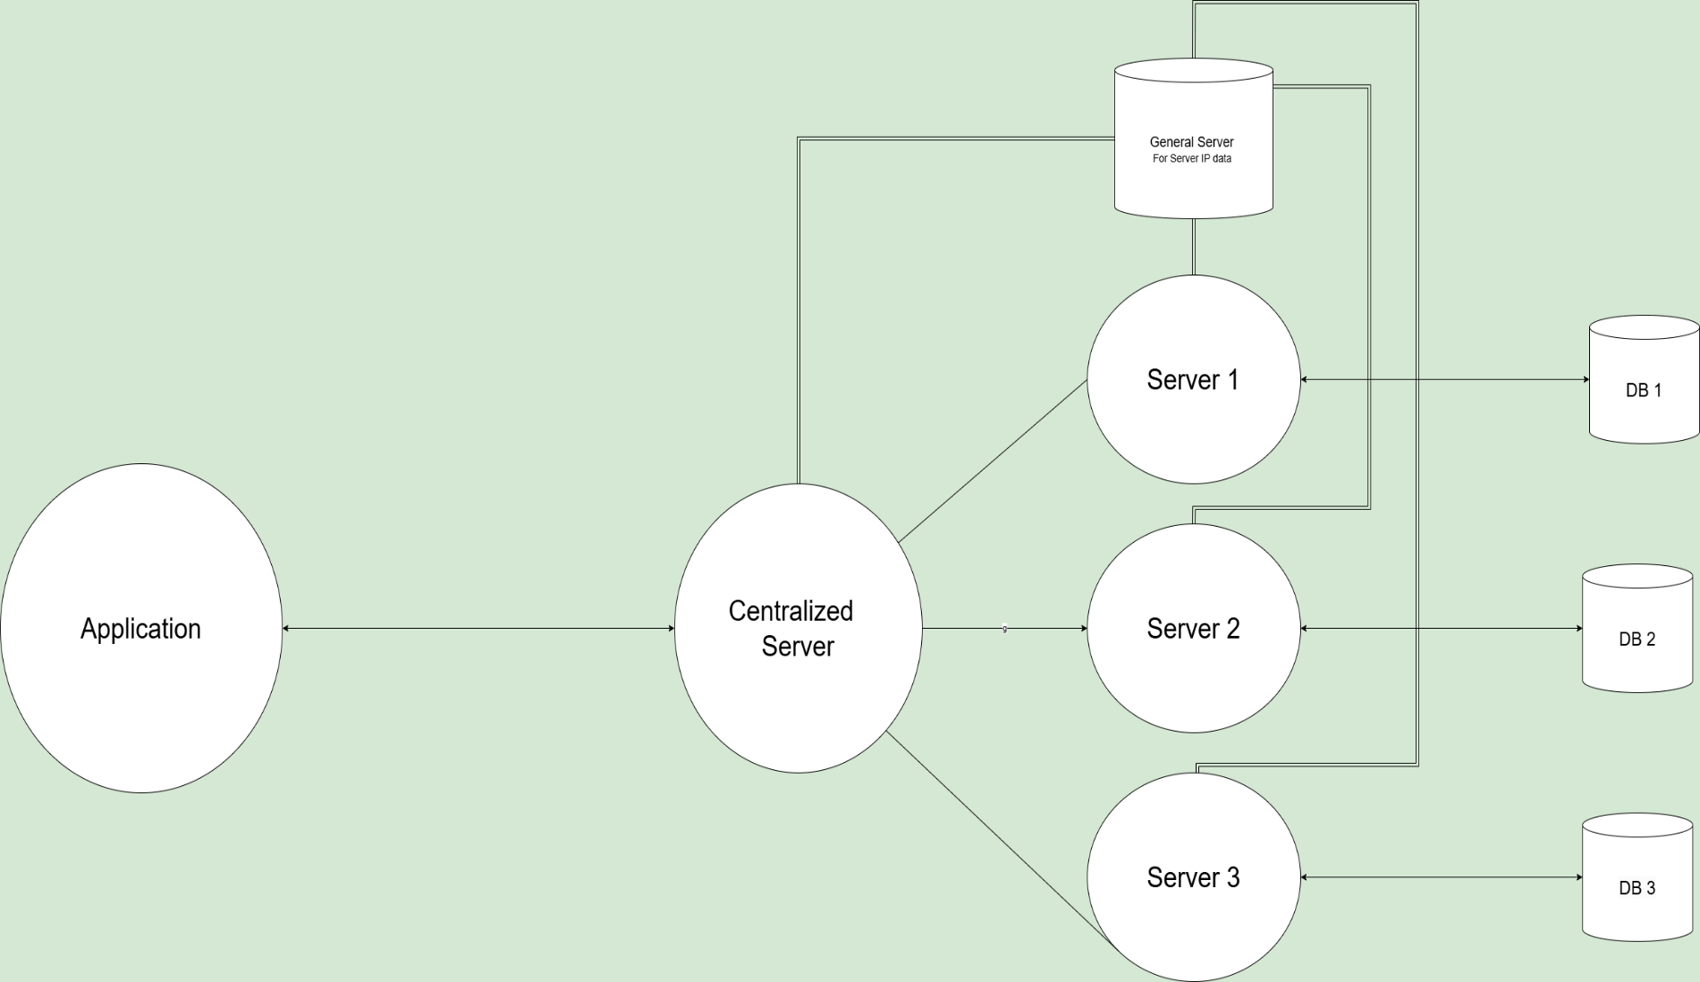
5.Blockchain Integration

Slide 27
The diagram illustrates a distributed server architecture where an application interacts with a centralized server, which manages communication with multiple servers (Server 1, Server 2, and Server 3). Each server has its own dedicated database (DB 1, DB 2, DB 3) for data storage. A general server stores IP data to help the centralized server route requests dynamically. The centralized server acts as a bridge, directing application requests to the appropriate server, ensuring load distribution, scalability, and fault tolerance. This architecture enhances efficiency by decentralizing processing while maintaining centralized control.

Slide 28
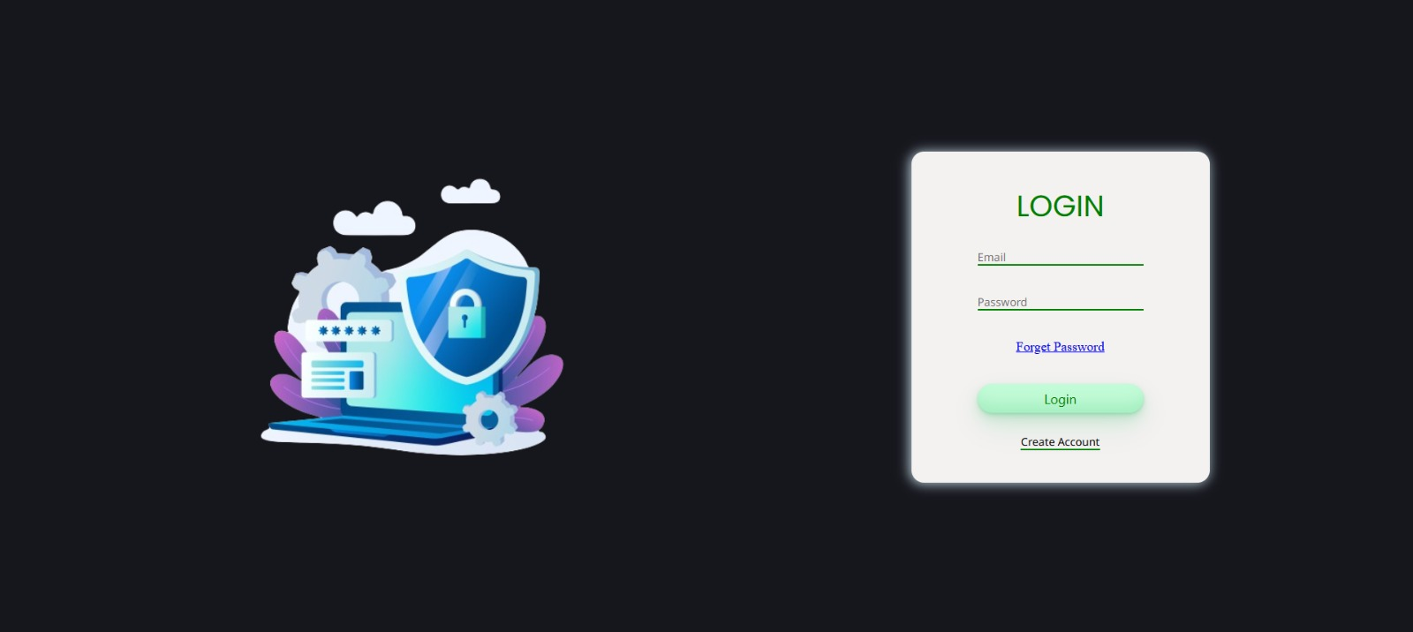
Snapshots

Slide 29
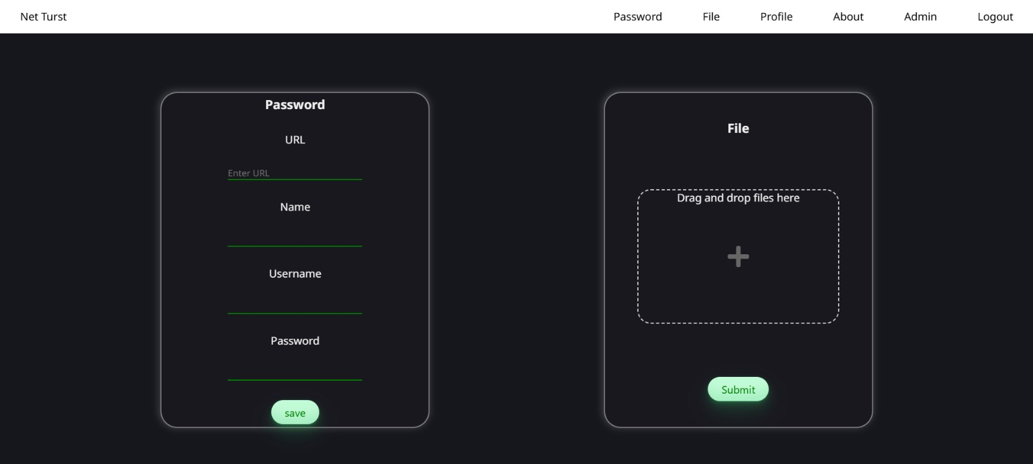

Slide 30
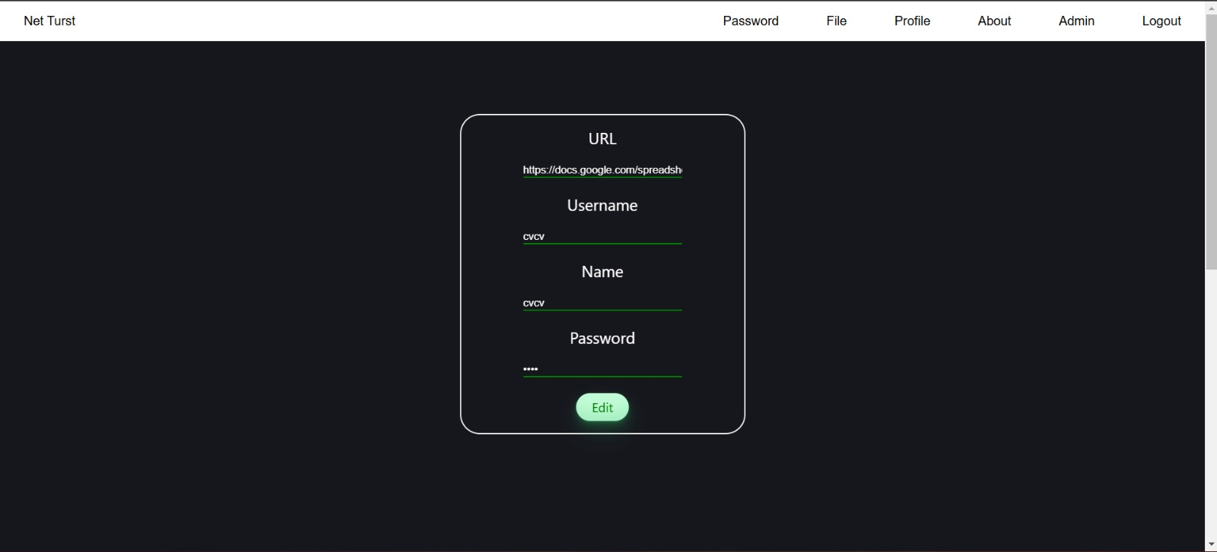

Slide 31


Slide 32
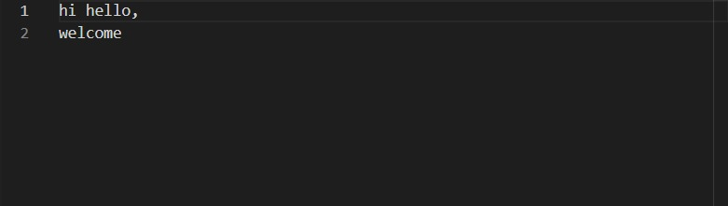
Before Encryption

Slide 33
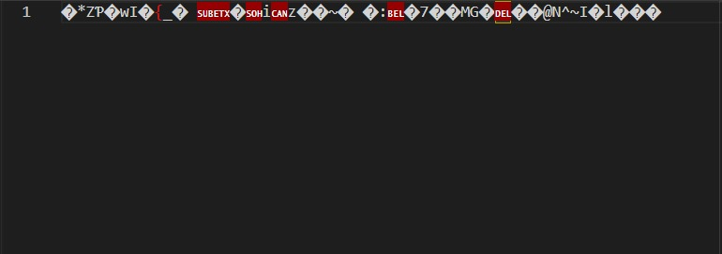
After Encryption

Slide 34
References
1. Fan, Xing, Niu, Baoning, and Liu, Zhenliang, "Scalable Blockchain Storage Systems: Research Progress and Models," Computing, Vol. 104, pp. 1497–1524, February 2022.
2. Mwamba Merlec, Mpyana, and In, Hoh Peter, "Blockchain-Based Decentralized Storage Systems for Sustainable Data Self-Sovereignty: A Comparative Study," Sustainability, Vol. 16, No. 17, Article 7671, September 2024.
3. Pourmajidi, William, Zhang, Lei, Steinbacher, John, Erwin, Tony, and Miranskyy, Andriy, "Immutable Log Storage as a Service on Private and Public Blockchains," arXiv preprint, arXiv:2009.07834, September 2020.
4. Perard, Doriane, Gicquel, Lucas, and Lacan, Jérôme, "BlockHouse: Blockchain-based Distributed Storehouse System," arXiv preprint, arXiv:2001.07016, January 2020.

Slide 35
5. Zhou, Zijian, Wang, Caimei, Deng, Xiaoheng, Lu, Jianhao, Wen, Qilue, Zhang, Chen, and Li, Hong, "Haina Storage: A Decentralized Secure Storage Framework Based on Improved Blockchain Structure," arXiv preprint, arXiv:2404.01606, April 2024.
6. Sankar, S. M. Udhaya, Selvaraj, D., Monica, G. K., and Katiravan, Jeevaa, "A Secure Third-Party Auditing Scheme Based on Blockchain Technology in Cloud Storage," arXiv preprint, arXiv:2304.11848, April 2023.
7. Loruenser, Thomas, Happe, Andreas, and Slamanig, Daniel, "ARCHISTAR: Towards Secure and Robust Cloud Based Data Sharing," 2015 IEEE 7th International Conference on Cloud Computing Technology and Science (CloudCom), pp. 371–378, November 2015.
8. Gaetani, Edoardo, Aniello, Leonardo, Baldoni, Roberto, Lombardi, Federico, and Margheri, Andrea, "Blockchain-Based Database to Ensure Data Integrity in Cloud Computing Environments," Sun SITE Central Europe, 2017.

