Slide 1

Diabetes detection
-Supratim kukri,ece under-grad at nit dgp

Slide 2
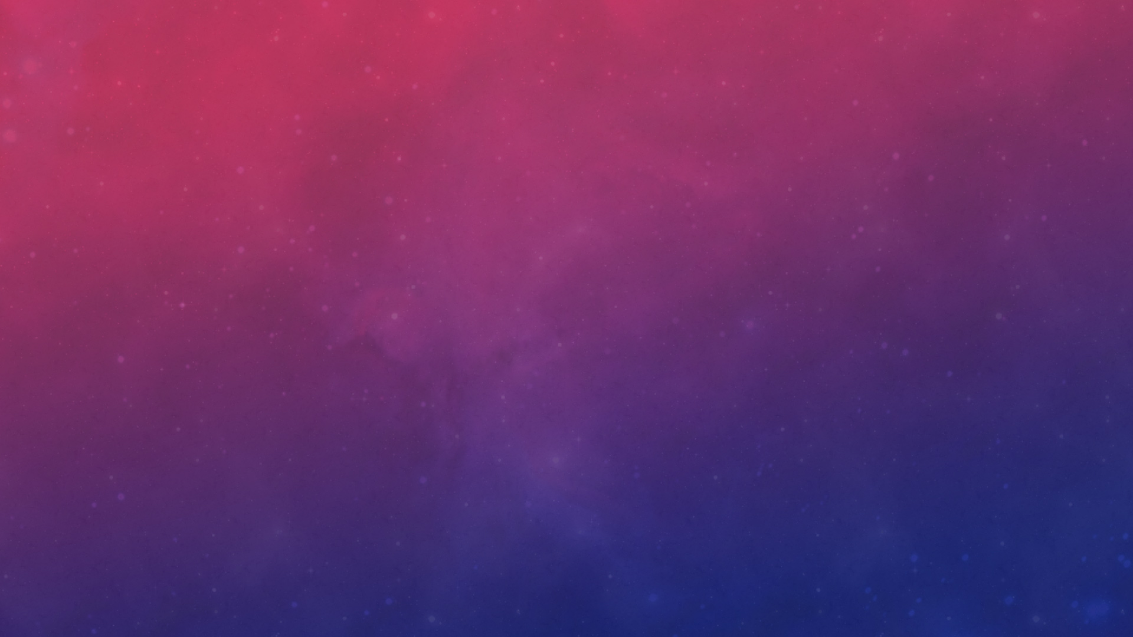

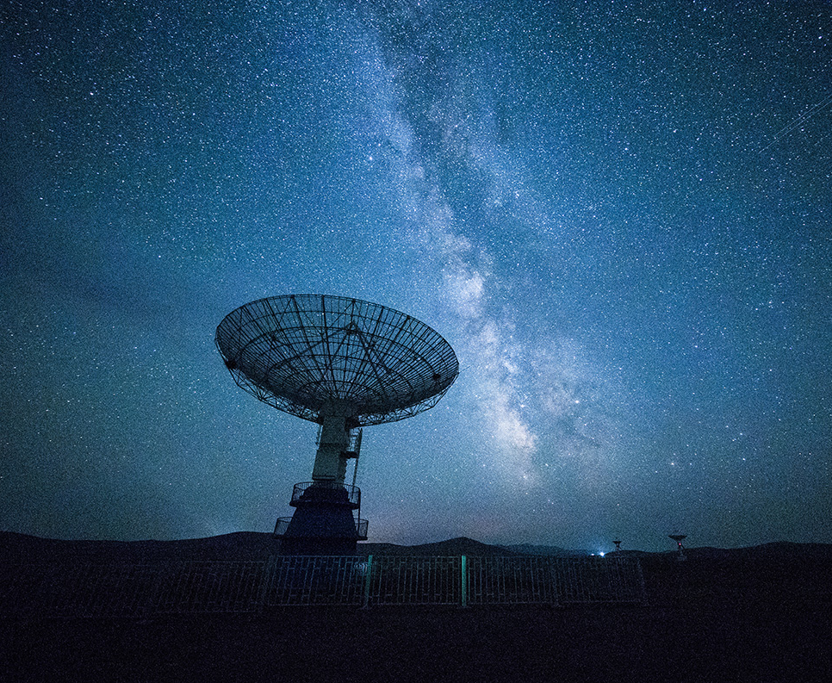
Features of my project
Machine Language
Hand Gesture Recognition
Print Prediction
Graphical Representation

Slide 3
ABOUT THE TOPIC- “DIABETES DETECTION”
Diabetes Detection is a critical field in modern healthcare that leverages medical data and technology
to identify individuals at risk of or currently living with diabetes. Early detection is vital because prolonged
high blood sugar levels can lead to severe complications, including heart disease, kidney failure, and
permanent vision loss.
In recent years, AI has revolutionized diabetes detection by identifying patterns in patient data that might
be invisible to the human eye
Predictive Modeling: Algorithms like XGBoost, Random Forest, and Neural Networks can analyze
historical health records to predict the likelihood of a patient developing diabetes.
Non-Invasive Testing: New technologies are being developed to detect diabetes through retinal scans,
skin sensors, or even vocal patterns, reducing the need for painful blood pricks.
Continuous Monitoring: Wearable devices (like Continuous Glucose Monitors) provide real-time data
streams that AI can analyze to alert patients of dangerous spikes before they happen.

Slide 4
Models used in my project:
XGBoost as the Machine-Language model to train my DataSet(Pima Indians Diabetes Database from kage)
Keras.Sequential model to train my Hand Gesture dataset

Slide 5
Steps of project
Download Pima Indian Diabetes Database from kaggle.com/datasets
Make a python file in the model directory and train it with the dataset and save the model and scale in pickle format.
Make another directory for training the Hand Gesture model.
Make a python file for Data collection using opencv ,tensorflow and csv.
Taking input of the label and the absolute position of the grid points ,convert it into relative and hence create data by scaling and henceforth save the data with label inside a csv file.
Make a file in the same directory for training the model.
Input the csv file and train the model with keras.Sequential and save the model as keras file.
Make another directory as server where our main Streamlit file Detection.py will be stored.
Make a Logic_file to store every functions related to diabetes detection like storing the user input,display graph,download the user given inputs with prediction and graphs etc.
In the detection file implement the Locking of app and other functions of the app.

Slide 6
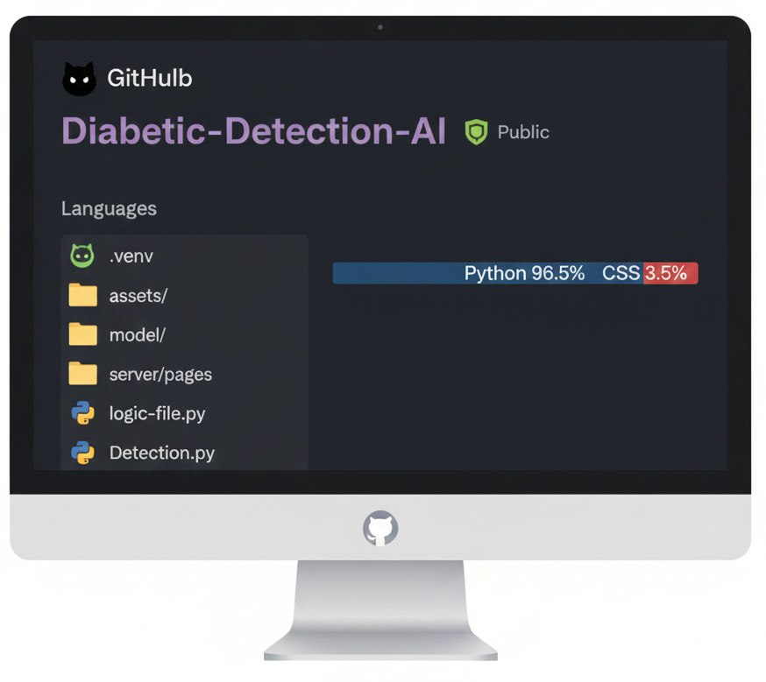
A outlook of my directory

Slide 7
WHY I CHOOSE XGBOOST AS ML MODEL FOR THE PROJECT
AND THE ACCURACY
GAVE THE HIGHEST ACCURACY PERCENTAGE AMONG LINEAR REGRESSION,LOGISTIC REGRESSION, DECISION TRESS,KNN,SVN AND RANDOM FOREST.
THE ACCURACY OF MY MODEL IS NEARLY EQUAL TO 81.5% .
THE MODERATE ACCURACY OF MY MODEL IS DUE TO DEFICIENT AMOUNT OF DATA PROVIDED.
THE OTHER DATASETS I NEED TO AVOID BECAUSE OF THE FEATURES WERE NOT SIMILAR TO THE LIST OF FEATURES PROVIED AT THE START OF PROJECT IN ACCORDANCE TO WHICH WE NEED TO TRAIN OUR MODEL.

Slide 8
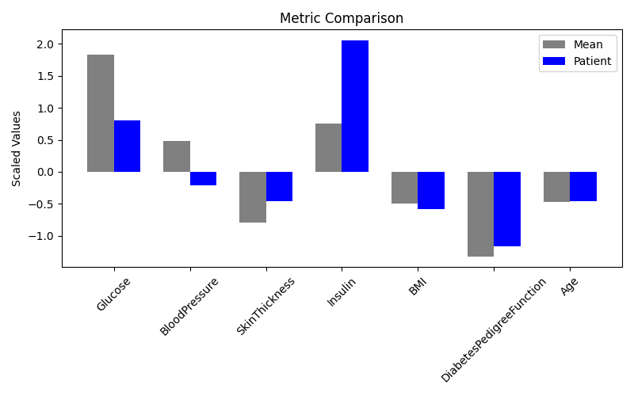
Visual Representation
I have used scaled values while making the plot between user given data and mean data because different scales are used to measure different components

Slide 9
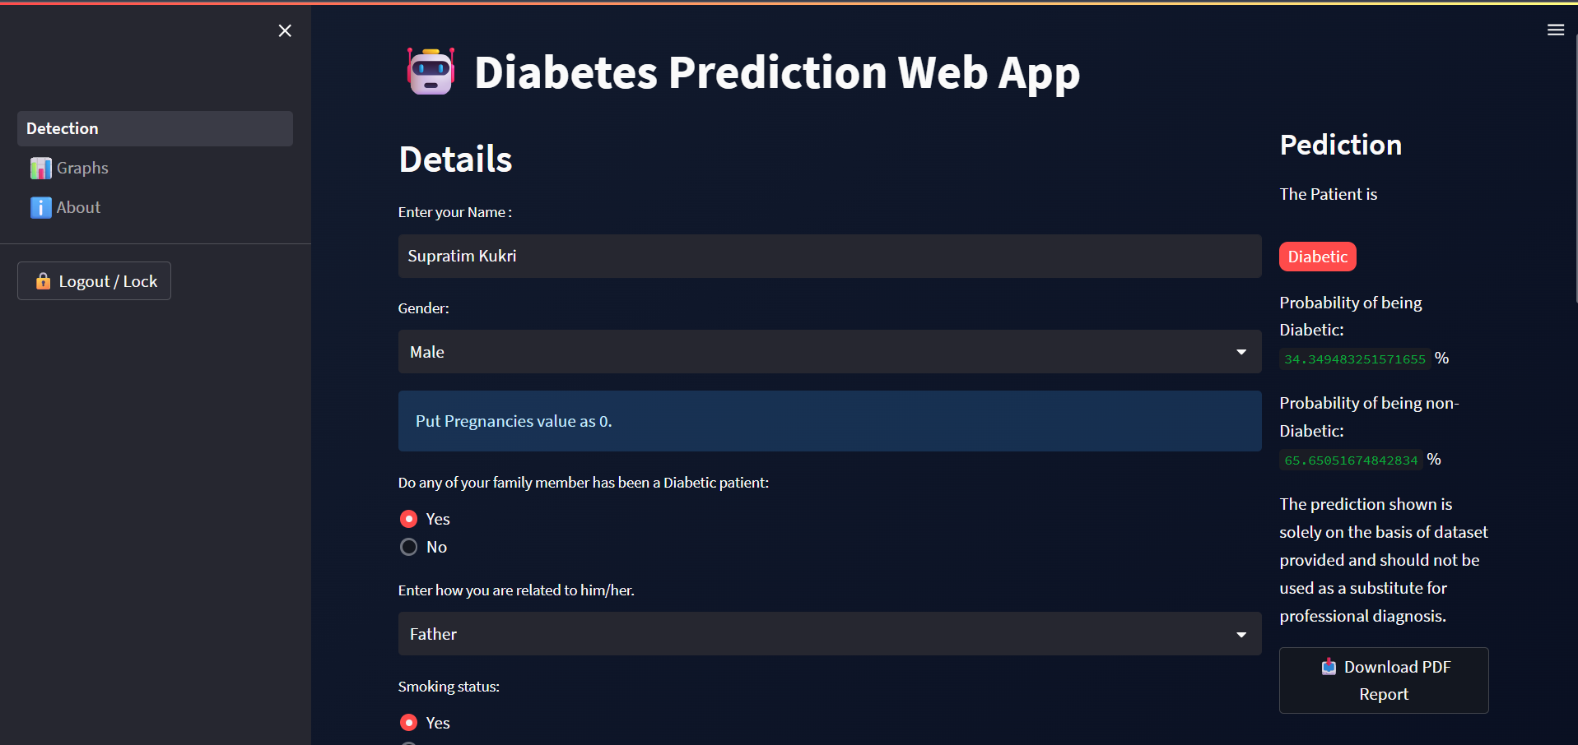
A short view of my project

Slide 10
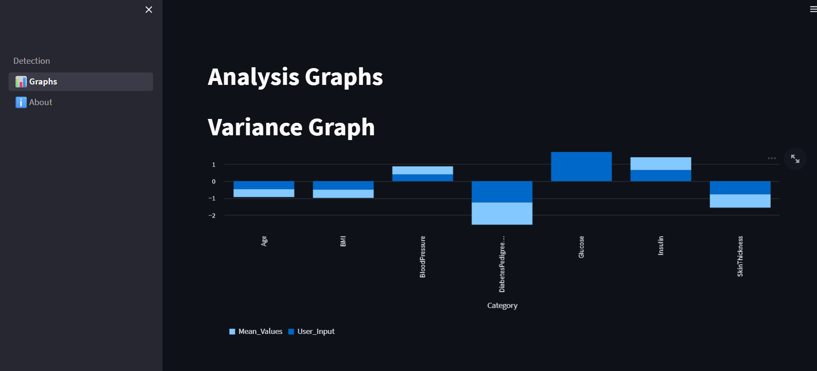
Graphs section

Slide 11
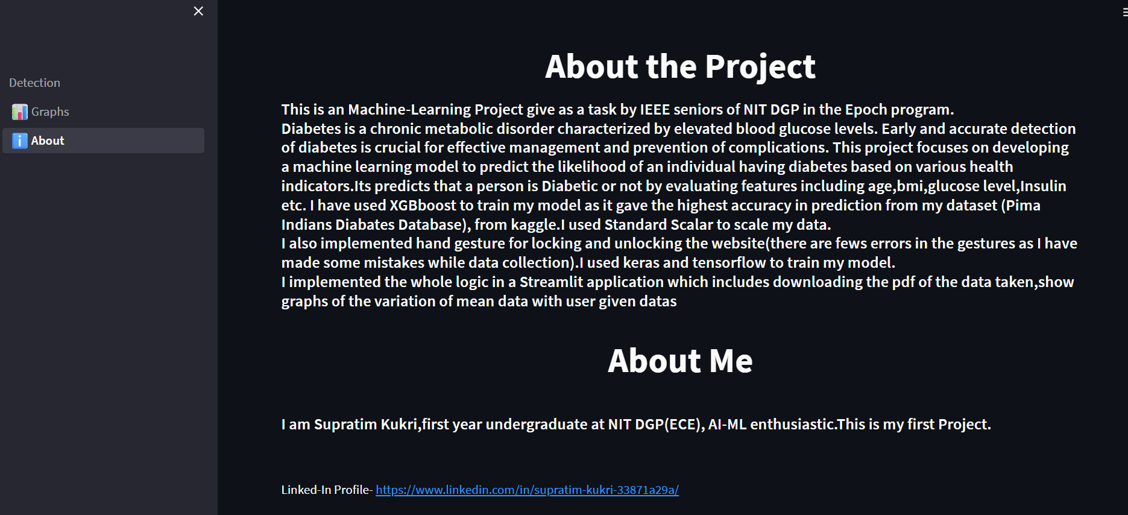
About section

Slide 12
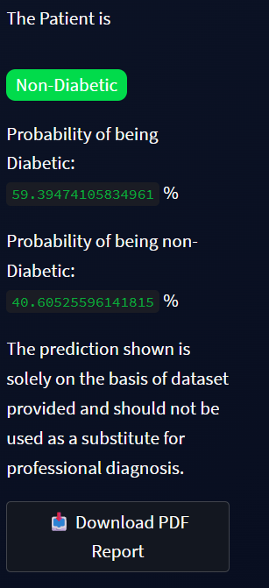
Download data as pdf
A download button is provided in the Detection page where we
can download the input details , prediction and graph as pdf file.

Slide 13
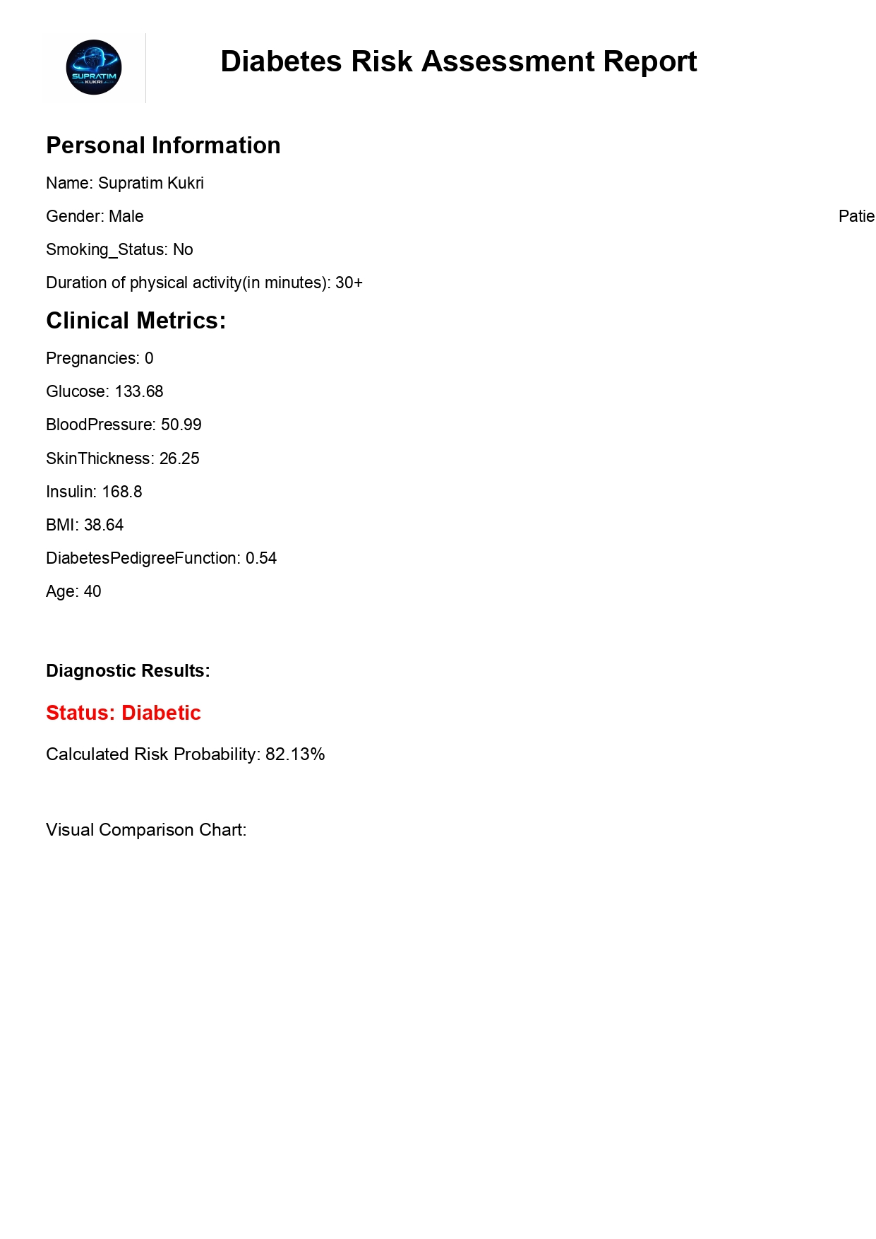
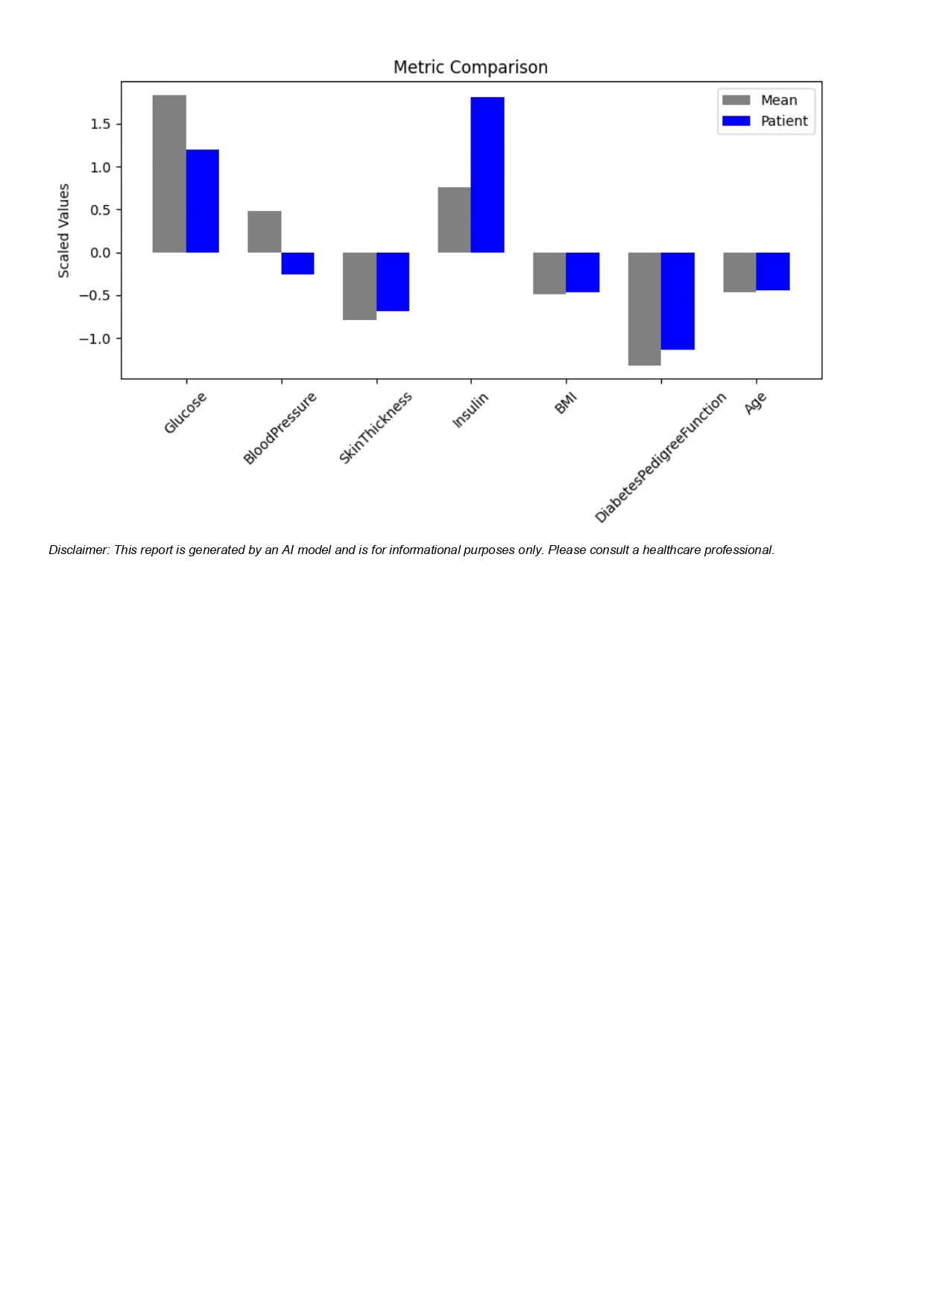
Demo PDF File

Slide 14

Thank You!

