Slide 1
Sign to speech gloves
Shunya Spartans

Slide 2
Sign to Speech Gloves
Introduction​
Problem & Objective
Design and diagram
Sensor Int & Communication Mod
Application
Meet Our Team
Thank You

Slide 3
introduction
A Project based on person who are verbally challenged and can’t speak to the whole world. A device used for this special category of people to help them talk like every individual does with other &help them.

Slide 4
Problem & Objective
Shunya Spartan

Slide 5
Design and diagram

Slide 6
Sensor Int & Communication Mod

Slide 7
Application

Slide 8

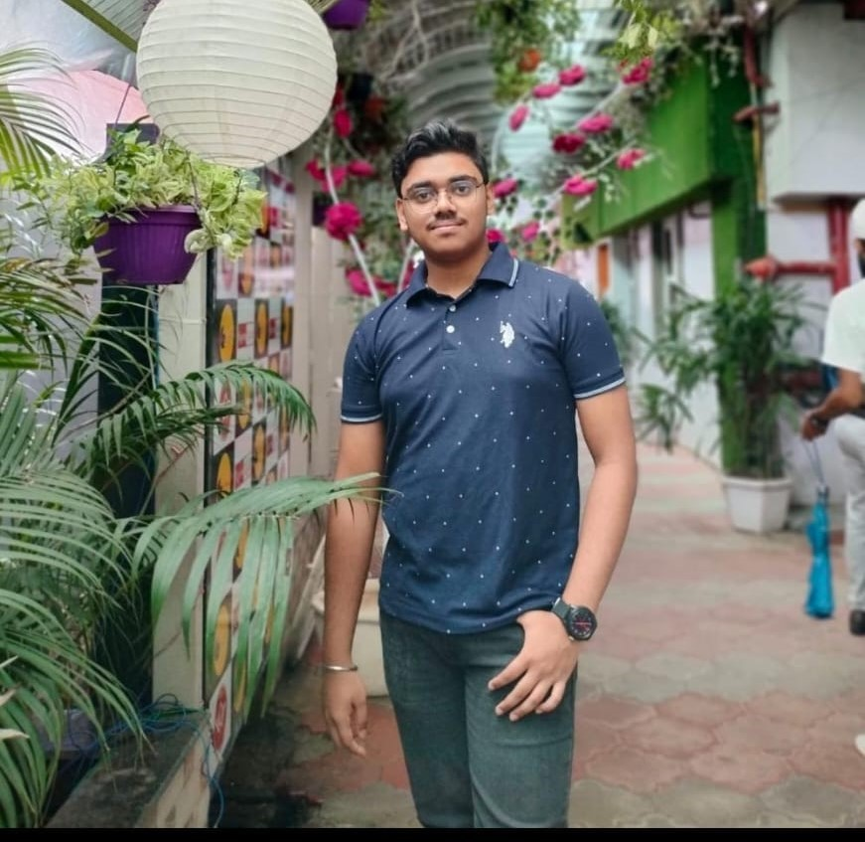
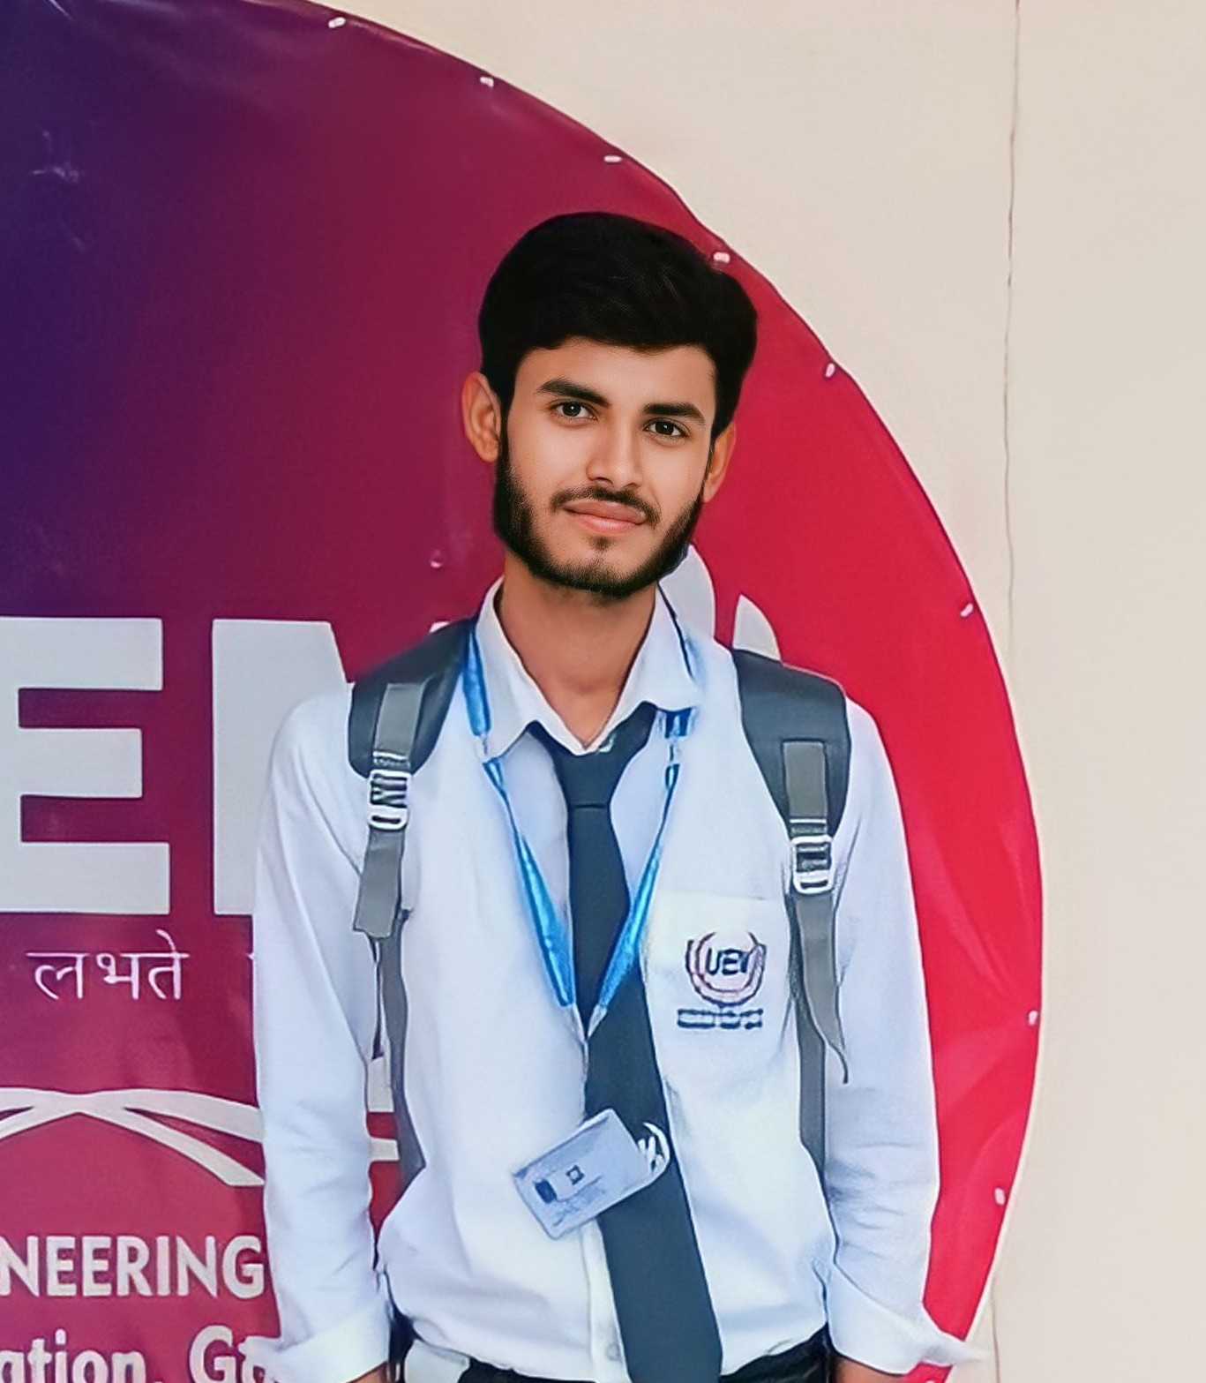
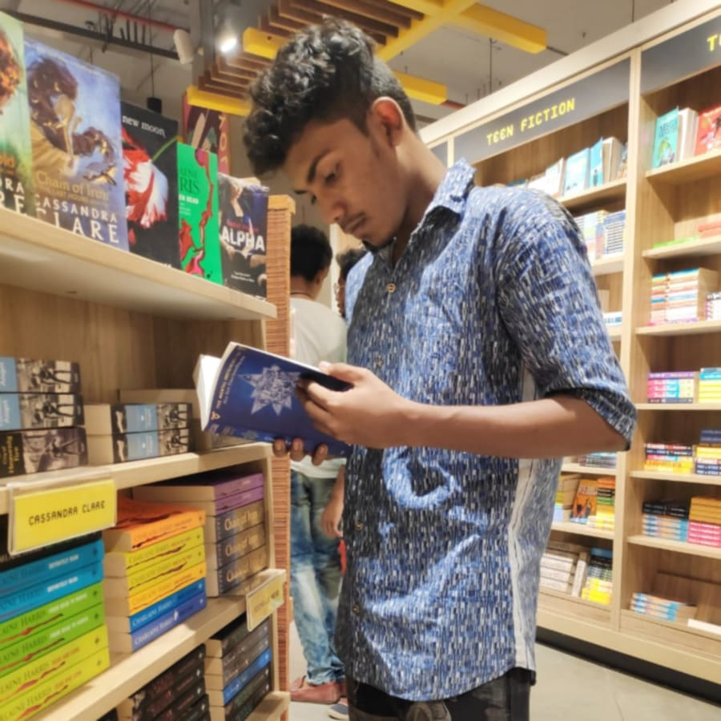
MEET OUR TEAM
Sounak Goswami
SUPRATIM MODAK
SAJAL MAITY​
ARPAN PARAMANIK
Hardware Designer
B.Tech CSE 1st Year
Tech Expert, Coder
Capitalizer
Designer

Slide 9
SOUNAK
GOSWAMI
(Leader & Hardware DESIGNER)
SUPRATIM MODAK
SAJAL MAITY
ARPAN PARAMANIK

Slide 10
SUPRATIM MODAK
(SOFTWARE DESGINER & TECHY HAT)
SOUNAK GOSWAMI
SAJAL MAITY
ARPAN PARAMANIK

Slide 11
SAJAL
MAITY
(Business & Management )
SOUNAK GOSWAMI
SUPRATIM MODAK
ARPAN PARAMANIK

Slide 12
ARPAN
PARAMANIK
(DESIGN THNIKING AND INNOVATION)
SOUNAK GOSWAMI
SUPRATIM MODAK
SAJAL MAITY

Slide 13

THANK YOU
Shunya Spartan
shunyaspartan@gmail.com

