Slide 1
Smart plant monitoring system using IOT

Slide 2
By:-
Subhajyoti Bhowmik
Supratim Mitra
Ayan Chakrabarty
Rupai Dutta
Dibyani kshetry
Siladitya Mandal
SOURADEEP GHOSH

Slide 3
INTRODUCTION:-
Our project deals about the plant monitoring mechanism which gives information about the temperature pressure, humidity. This can be done by using various sensors like temperature pressure and humidity sensing sensors. This will be enhancing the growth of plant. The two modes of operating system: a)When it detects if the plant need some water, it will be watering the plants. b)A manual mode where you can control the servos and relays manually.

Slide 4
Components used(Hardware):-
Nodemcu Esp8266 :- WIFI Internet of Things Development Board:-main microcontroller (Brain of the system).
DHT11:-Temperature & Humidity sensor:- measures Temperature & Humidity.
5v soil moisture sensor:- for measuring the soil moisture.
Water Pump :- for flowing water to tree(pump)
solderless 400 T-Points Breadboard:- for making all connections.
Relay Module:- it’s a electrical switch that can decide let current flow through the battery or not.
  9v battery :- power source for the pump.

Slide 5
Components (software):-
Arduino IDE:- for programming of the Nodemcu
Blynk:- Blynk is the software which we used for our project to calculate the temperature ,moisture & humidity by the hardware components.

Slide 6
Block Diagram:-

Slide 7
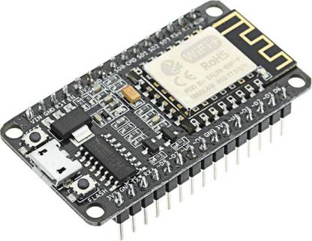
Nodemcu Esp8266 WIFI:-
Today, IOT applications are on the increase, and connecting objects are becoming more and more important. There are several ways to attach objects like Wi-Fi protocol.
Nodemcu is an open source platform supported ESP8266 which may connect objects and let data transfer using the Wi-Fi protocol. additionally, by providing a number of the foremost important features of microcontrollers like GPIO, PWM, ADC, and etc, it can solve many of the project’s needs alone.
The general features of this board are as follows:
Easy to use
Programmability with Arduino IDE or IUA languages
Available as an access point or station
practicable in Event-driven API applications
Having an inside antenna
Containing 13 GPIO pins, 10 PWM channels, I2C, SPI, ADC, UART, and 1-Wire.

Slide 8
DHT11 Temperature sensor:-
    DHT11 is a sensor to measure temperature .It is a cheap sensor and suitable for Arduino. You can use a more accurate sensor but the way to use it is the same.

Slide 9
5v soil moisture sensor:-
It gives a digital output of 5V when the moisture level is high and 0V when the moisture level is low in the soil. The sensor includes a potentiometer to set the desired moisture threshold. When the sensor measures more moisture than the set threshold, the digital output goes high and an LED indicates the output.

Slide 10
MINI PUMP:-
Micro DC 3-6V Micro Submersible Pump Mini water pump For Fountain Garden Mini water circulation System DIY project. This is a low cost, small size Submersible Pump Motor which can be operated from a 3 ~ 6V power supply. It can take up to 120 liters per hour with very low current consumption of 220mA. Just connect tube pipe to the motor outlet, submerge it in water and power it. Make sure that the water level is always higher than the motor. Dry run may damage the motor due to heating and it will also produce noise.

Slide 11
solderless 400 T-Points Breadboard:-
400 Tie Points Solderless Breadboard is a high-quality breadboard with power lanes and printed top face for easy prototyping.A breadboard is used to make up temporary circuits for testing or to try out an idea. No soldering is required so it is easy to change connections and replace components.

Slide 12
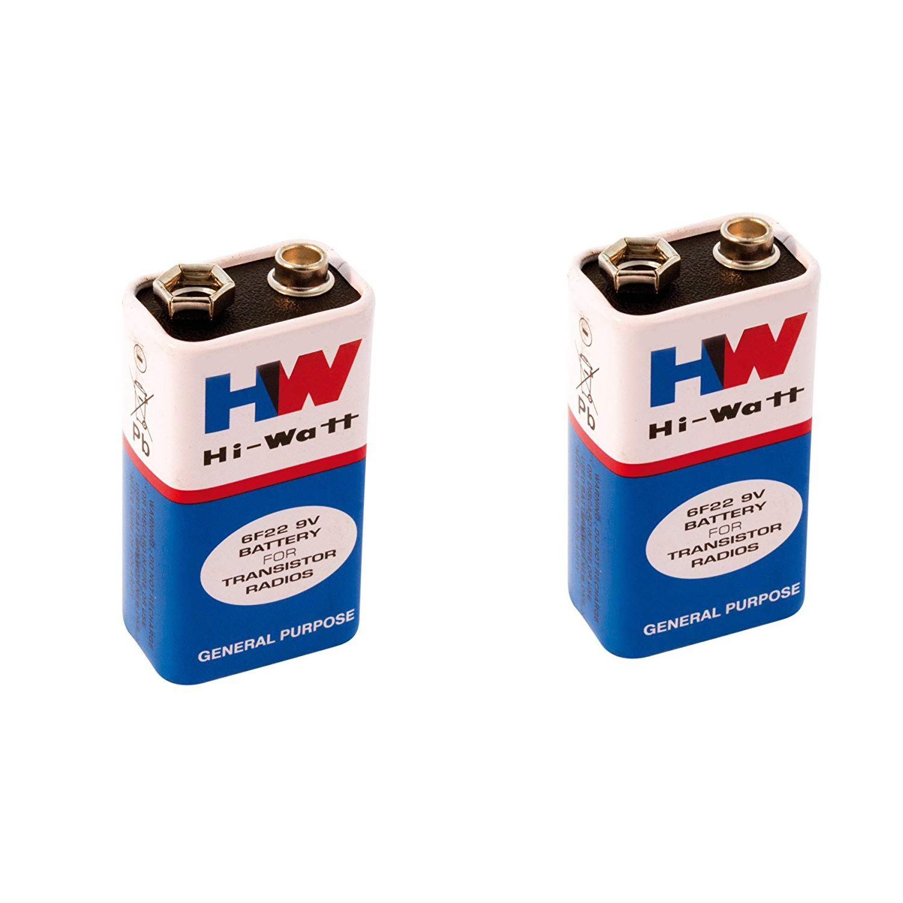
9v Battery:-
The nine-volt battery, or 9-volt battery, is a common size of battery that was introduced for early transistor radios. ... Most nine-volt alkaline batteries are constructed of six individual 1.5 V LR61 cells enclosed in a wrapper.

Slide 13
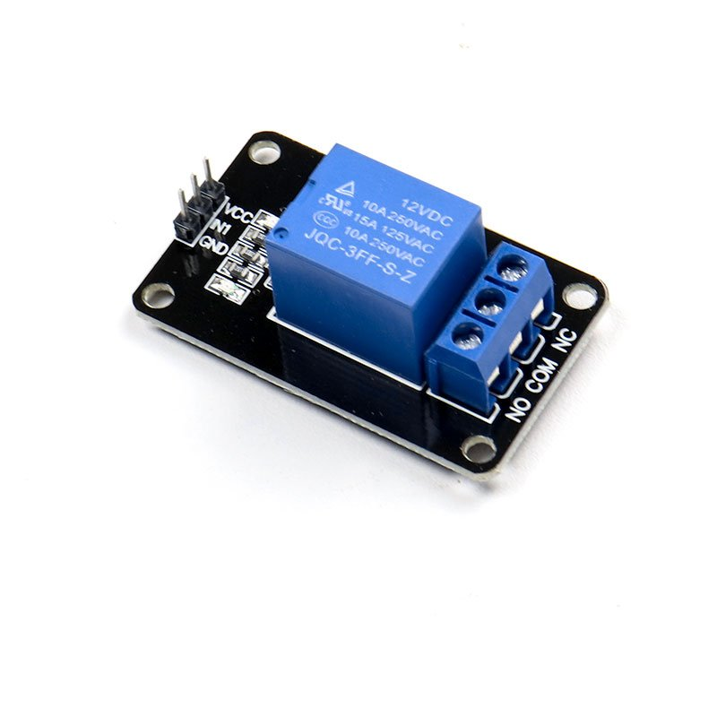
Relay Module:-
The relay module is an electrically operated switch that can be turned on or off deciding to let current flow through or not. They are designed to be controlled with low voltages like 3.3V like the ESP32, ESP8266, etc, or 5V like your Arduino.

Slide 14
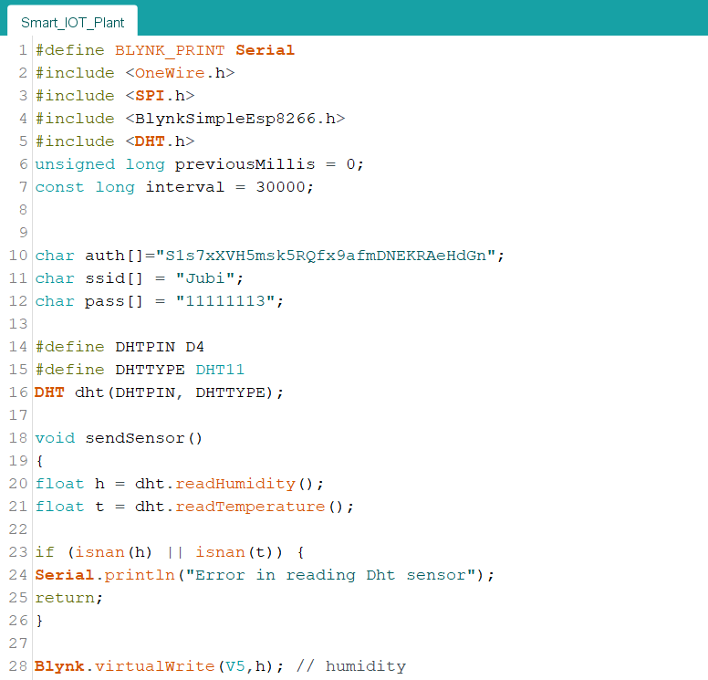
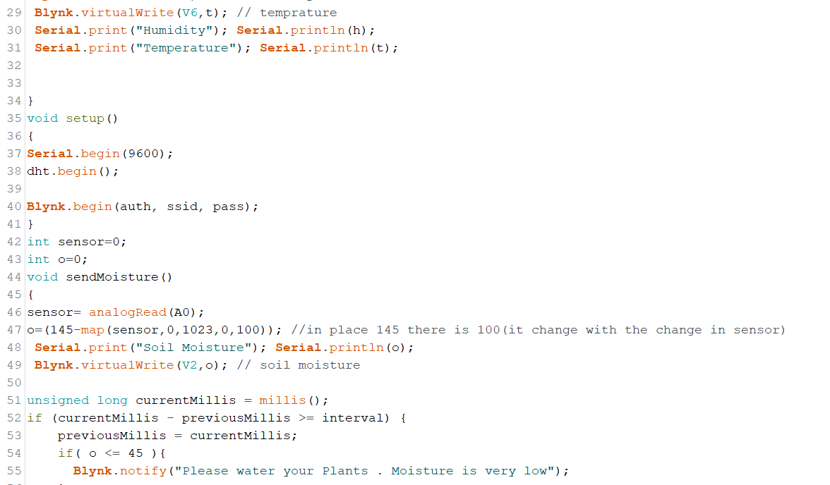
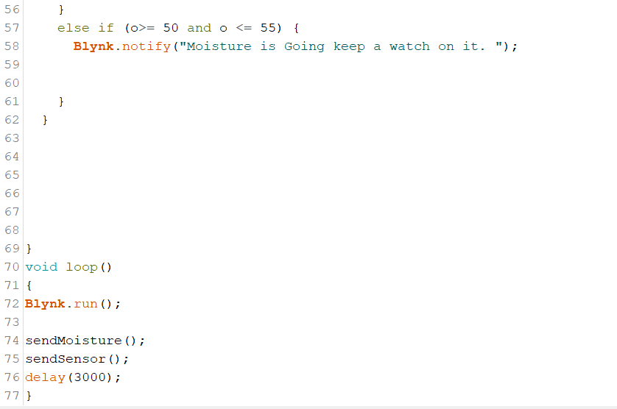
Program:-

Slide 15
Result:-
https://drive.google.com/file/d/1myj7TyWGeTTRmJnIKHmvrUzbsoCZ0EMQ/view?usp=drivesdk (Hardware Link)
https://drive.google.com/file/d/1nalVDVM3NQVBeHCvZ19DJt8ezUaFnHcP/view?usp=drivesdk (Software Link)

Slide 16
Conclusion:-
This whole project mainly focuses on two results. The first result is to help farmers to upgrade their agriculture – technical knowledge, act in accordingly with minimum requirements on environmental issues and mostly the basic function being prevented by major disasters and protect plants and nature from being ruptured. and thus, the second results of our project is to use technology to measure the humidity, temperature and moisture of the plant root and make the plant grow during a well suitable environment without the employment of soil as per the concept of hydroponics. The farmer or user receives the message regarding the status and thus helps in avoiding delay of plant watering and protect the plant to live during an acceptable environment. This proposed work is created to assist the farmers and make their harvest economical by helping them in security purpose travelling side, college and for each bodies etc. By this work, the wastage of water and therefore the consumption of power by motor will be reduced in order that they're conserved for the long run use. this method provides complete monitoring action of sensors in fields that's very easy to manage the sector. It also provides huge security to the plants.

Slide 17


