Slide 1



AGNI: IN-SITU, ISO-LATENCY STOCHASTIC-TO-BINARY NUMBER CONVERSION FOR IN-DRAM DEEP LEARNING
Supreeth Mysore¹, Sairam Vatsavi², Dr. Ishan G. Thakkar³, Dr. Salehi Ahmed⁴.
Ph.D. Candidate¹ ² , Assistant Professor³ ⁴
Dept. of Electrical and Computer Engineering
University of Kentucky, Lexington-KY(US)
Notes:
Hello everyone, I am Supreeth Mysore, a Ph.D. candidate in the Department of Electrical and Computer Engineering at the University of Kentucky in Lexington, KY, USA. The research presented in the paper “AGNI:IN-SITU, ISO-LATENCY STOCHASTIC-TO-BINARY NUMBER CONVERSION FOR IN-DRAM DEEP LEARNING”is part of my Ph.D. work.

Slide 2

Outline
Introduction
Preliminaries
Overview of Proposed AGNI substrate
Operation of AGNI
Evaluation
Conclusions

Slide 3
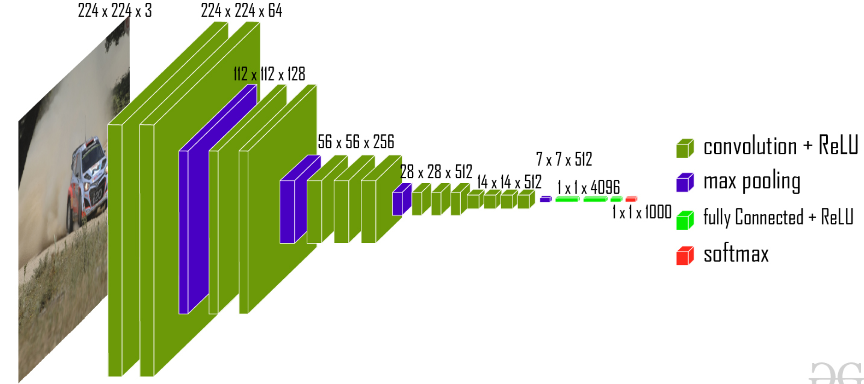
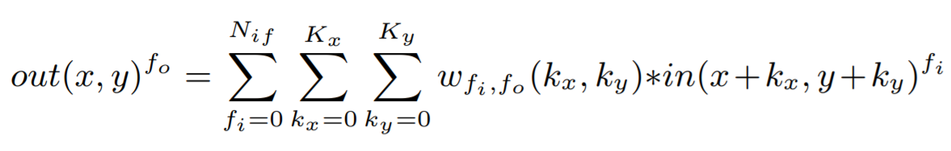
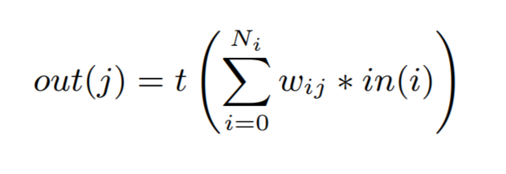
Convolutional Neural Networks (CNNs)
Feature Extraction
Classification
VGG16
The need for billions of MAC operations makes processing of a CNN a highly compute and memory intensive task
w_{fi},_{fo} (k_{x}, k_{y}) is the synaptic weight at kernel position (k_{x}, k_{y})
41 layers
~1.5 billion MAC operations
VGG-16 Architecture
~95% of the total MAC operations take place in the convolution layers
Computations for Convolution Layers
Computations for Fully Connected Layers
58.6million (5%)
1.08 billion MAC (95%)
3
MAC*= Multiply and accumulate
Introduction
Preliminaries
Proposed design
Operation of AGNI
Evaluation
Conclusion
Notes:
Regarding introduction, Convolutional Neural Networks (CNNs) have achieved remarkable progress in recent years, and they are being aggressively utilized in real-world applications related to Artificial Intelligence (AI) and machine learning. A CNN mainly consists of 1) [click] Convolution layers 2)[click] pooling layers , 3)[click] fully connected layers 4) [click] Softmax . Where the [click] features of the input image are extracted in the convolution and pooling layers. And [click] the classification is done in the fully connected + softmax layers. [click] The required computations for the convolution and fully connected layers involve multiply-accumate (MAC) operations, as can be seen from these equations. [click] For example, VGG-16 is shown which consists of 41 layers and approximately 1.5 billion MAC operations. [click] ~ 95% of the total MAC operations take place in the convolution layers. [click – the pop-up box that you will add should appear on this click] “The need for billions of MAC operations makes processing of a CNN a highly compute and memory intensive task"

Slide 4
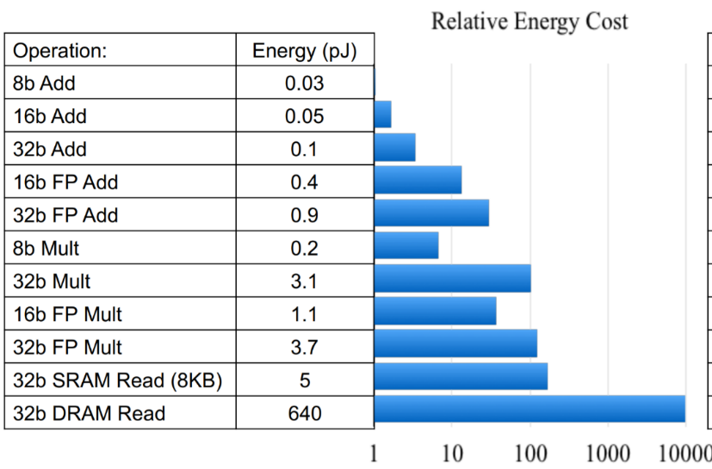
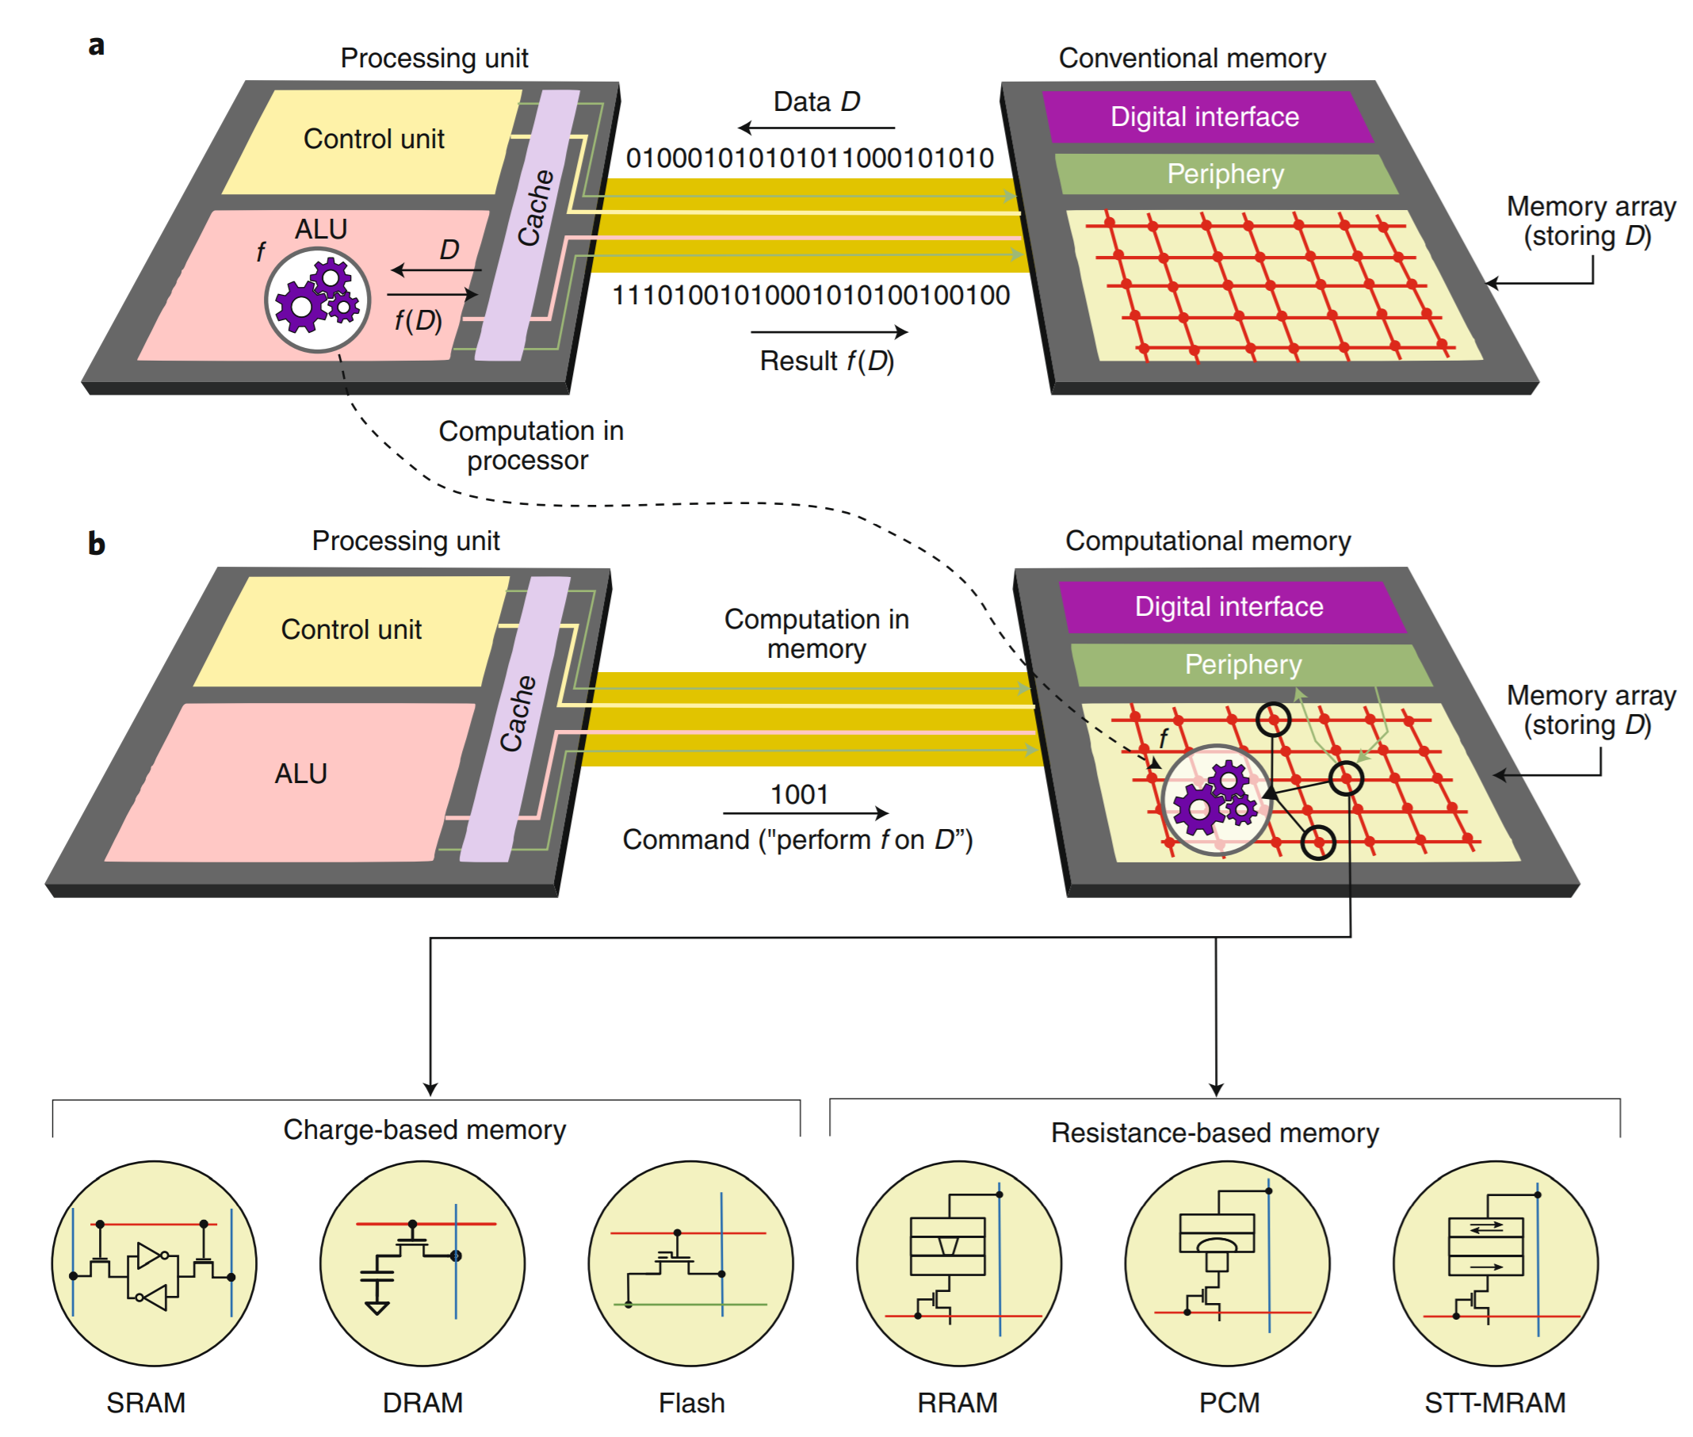
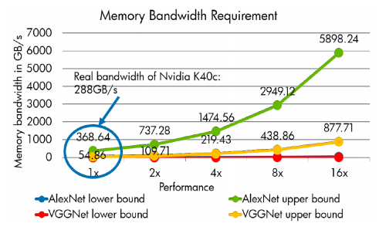

Processing CNNs using von Neumann Architectures
Presents enormous challenges
Challenges
Requires massive data movement → consumes extravagant energy
Demands very large memory bandwidth
Ref: Dally, Tutorial, NIPS’15
(a)
These challenges mandate the use of specialized accelerators for processing CNNs
von Neumann Architecture.
Deng et al, “Reduced-Precision Memory Value Approximation for Deep Learning”, HPL Report, 2015
Sebastian, A., et al. Memory devices and applications for in-memory computing. Nat. Nanotechnol.(2020)
Memory Bandwidth Requirement .
Introduction
Preliminaries
Proposed design
Operation of AGNI
Evaluation
Conclusion
Notes:
Von Neumann architecture is the design upon which many general purpose computers are based. The key elements of von Neumann architecture are:data and instructions are both stored as binary digits, data and instructions are both stored in primary storage instructions are fetched from memory one at a time and in order (serially) Therefore, processing CNNs using von Neumann architectures presents enormous challenges. [click] First, it requires massive data movement, which consumes extravagant amount of energy. For example, [click] a 32b DRAM read consumes at least 2 orders of magnitude more energy than a 32b floating point multiplication. [click] Second, it demands very large memory bandwidth. For example, the state-of-the-art CNNs such as AlexNet and VGGNet demand for the memory bandwidth to be in the terabytes per second. [click: the pop-up box that you will add should appear on this click] “These challenges mandate the use of specialized accelerators for processing CNNs.”

Slide 5
Processing-In-Memory (PIM) Accelerators
Minimize data movement by placing computation near data or in memory
PIM is a promising solution
Charge based memory
Resistance based memory
von Neumann
(a)
PIM
(b)
Sebastian, A., et al. Memory devices and applications for in-memory computing. Nat. Nanotechnol.(2020)
Introduction
Preliminaries
Proposed design
Operation of AGNI
Evaluation
Conclusion
Notes:
To overcome the data migration issue in the traditional von-Neumann architecture, Processing-in-memory (PIM) is an attractive approach. [click] Fig(a) shows the traditional von Neumann processing architecture. [click] on the other hand, in PIM approach as shown in Fig(b) [click] adding processing unit directly into memory substantially reduces data movement and saves related energy and time. [click] PIM can be implemented in charge-based memory such as DRAM, flash, and SRAM [Click] it can also be implemented in non-volatile resistance-based memories such as RRAM, PCM, and STT/MRAM

Slide 6
Processing-In-Memory (PIM) CNN Accelerators
Non-Volatile memory(NVM) crossbar-based PIM design → ISSAC [Sha-ISSCA’16], PRIME [Chi-ISCA’16],XNOR-RRAM[Sun-DATE’18]
Analog values of crossbar logic need to be converted into digital
Huge time delay for ADC conversion and high-power consumption
NVM such as PCM have less tolerance for the frequent writing of the partial results
NVM based PIM is not widely used because of not matured fabrication technique with the existing infrastructure
DRAM based accelerator is widely adopted because of the dominant memory technology for main memory in the current computing systems
DRAM latency is less than NVM
DRAM can tolerate frequent programming
On other hand, SRAM based PIM accelerators is also prevalent in current computing system
SRAM consumes more area
Less memory capacity with limited footprint of the memory chip
Not suitable for the large-scale CNN PIM accelerator
Hence Digital DRAM -based CNN accelerators is suitable for PIM designs
Introduction
Preliminaries
Proposed design
Operation of AGNI
Evaluation
Conclusion
Notes:
the challenges associated with using Non-Volatile Memory (NVM) crossbar-based Processing-in-Memory (PIM) designs, specifically ISSAC, PRIME, and XNOR-RRAM. These designs rely on analog values in the crossbar logic, which must be converted into digital values for computation. However, this conversion process introduces significant time delays and high-power consumption. Additionally, NVM technologies such as PCM have less tolerance for the frequent writing of partial results, which further limits their use in PIM designs.
[click]Despite these challenges, NVM-based PIM designs are not widely adopted in current computing systems. This is due to the lack of mature fabrication techniques and the existing infrastructure.
[click]Instead, DRAM-based accelerators are more prevalent due to the dominance of DRAM as the main memory technology in current computing systems. DRAM has lower latency than NVM and can tolerate frequent programming, making it a more suitable choice for PIM designs.
[click]On the other hand, SRAM-based PIM accelerators are also prevalent in current computing systems. However, SRAM consumes more area and has less memory capacity, making it less suitable for large-scale CNN PIM accelerators. Additionally, the footprint of the memory chip is also limited which is not suitable for the large scale computation.
Among these PIM CNN accelerator designs, DRAM based PIM is more favorable. This is because , compare to NVM, DRAM is more dominant memory technology for main memory in current computing systems. [Click] Which makes the DRAM-based PIM accelerators in current computing
systems naturally more appealing.

Slide 7
Related Work: Digital PIM Accelerators
DRAM based PIM implements in-situ MAC operations digitally
Break the single MAC into multiple memory operation cycles (MOCs)
An MOC is basically an Activation followed by a Precharge of a DRAM row
DRISA [Li-MICRO-2017] requires up to 222 MOCs per MAC
To reduce # of MOCs per MAC
DRAcc [Lei-DAC-2018] uses ternary computing → 13 MOCs per MAC
LAcc [Deng-DAC-2019] uses lookup tables (LUTs) → 11 MOCs per MAC
SCOPE [Li-MICRO-2018] uses stochastic computing → 25 MOCs per MAC
4. ATRIA [Supreeth-ISVLI-2021] uses stochastic computing → 5/16 per MAC
Digital PIM accelerators still have very high latency and energy, as one MOC can incur up to 49 ns latency and up to 4 nJ of energy consumption
Introduction
Preliminaries
Proposed design
Operation of AGNI
Evaluation
Conclusion
Notes:
Now will discuss some of related work. Here the DRAM-based PIM designs implement in-situ MAC operations digitally, for which [click] they break a single MAC operation into multiple functionally complete memory operation cycles (MOCs). An MOC is basically an activation followed by a Precharge of a DRAM row as described in the previous slide. [click] DRISA requires up to 222 MOCs per MAC. [click] To reduce the required number of MOCs, SCOPE [2], DRACC [21], and LACC [3] employ light-weight optimizations that simplify the in-DRAM implementation of MAC operations. [click] DRAcc uses ternary computing to achieve 13 MOCs per MAC. [click] LAcc uses lookup tables to achieve 11 MOCs per MAC. [click]
SCOPE and ATRIA adopts stochastic arithmetic to implement approximate multiplication, requiring a reduced number of up to 25 and 5/16 MOCs per MAC. [click] “Digital PIM accelerators still incur very high latency and energy consumption as one MOC can incur up to 49 ns latency and up to 4 nJ of energy consumption” and will explain how the stochastic computing is less hardware intensive and more error tolerant which will be explained in next slides

Slide 8
Time Hungry Stochastic-to-Binary(StoB) Conversion
Despite the advantage of low power and high error tolerance of SC in ATRIA and SCOPE for CNN acceleration
Require frequent StoB conversion for every point in the per-layer output tensor
StoB conversion consumes substantial latency and energy
ATRIA[Supreeth-ISVLSI’21] and SCOPE[Li-MICRO’18] use different methods for StoB conversion:
Parallel pop counter (Parallel PC) used by SCOPE→ require FA’s
Serial pop counter (Serial PC)-based StoB conversion used by ATRIA → sequential
Even though ATRIA’s StoB operations are hidden from the critical path to some extent
CONS
Parallel pop counter requires enormous full adder circuits
consumes non-trivial area of the DRAM periphery
Serial PC circuits require high-speed counters
Implementations of full adders and counters in DRAM cannot be optimized for area, latency and energy
DRAM cannot be optimized for area, latency and energy, due to the constraints of DRAM fabrication processes are significantly different from the standard CMOS logic processes
As a result, the advantages of using stochastic arithmetic are severely diminished in ATRIA and SCOPE
8
Introduction
Preliminaries
Proposed design
Operation of AGNI
Evaluation
Conclusion
StoB*= Stochastic to Binary
Notes:
[click] -The use of stochastic arithmetic in ATRIA and SCOPE for CNN acceleration requires frequent stochastic-to-binary (StoB) number conversions, [click] which consume substantial latency and energy.
-ATRIA and SCOPE use different methods for StoB conversion: Parallel pop counter (Parallel PC) and Serial pop counter (Serial PC)-based StoB conversion, respectively.
-Parallel PC circuits require full adders, which can take up non-trivial area in DRAM peripherals
. -Serial PC circuits require high-speed counters.
-The implementations of full adders and counters in DRAM cannot be optimized for area, latency and energy due to constraints of DRAM processes which are significantly different from the standard CMOS logic processes.
[click]-As a result, the advantages of using stochastic arithmetic are severely diminished in ATRIA and SCOPE.

Slide 9
Preliminaries I
Stochastic coded unary number
1’s in the bit-stream do not appear in a group
Transition coded unary number
1’s in the bit-stream appear in group
9
Introduction
Preliminaries
Proposed design
Operation of AGNI
Evaluation
Conclusion
StoB*= Stochastic to Binary
Notes:
To understand the working of the AGNI substrate we need to provide some background insights
consider In unipolar format of unary computing, a unary number W is a bit-stream of N bits that represents a real-valued variable υ ∈ [0, 1] by encoding υ through the ratio N1/N, where N1 is the number of 1’s in W.
A unary number can be presented in the stochastic format or in the transition-coded unary format.
In the stochastic format, the '1's in the bit-stream do not appear in a group, whereas in the transition-coded unary format the '1's in the bit-stream appear in group.

Slide 10
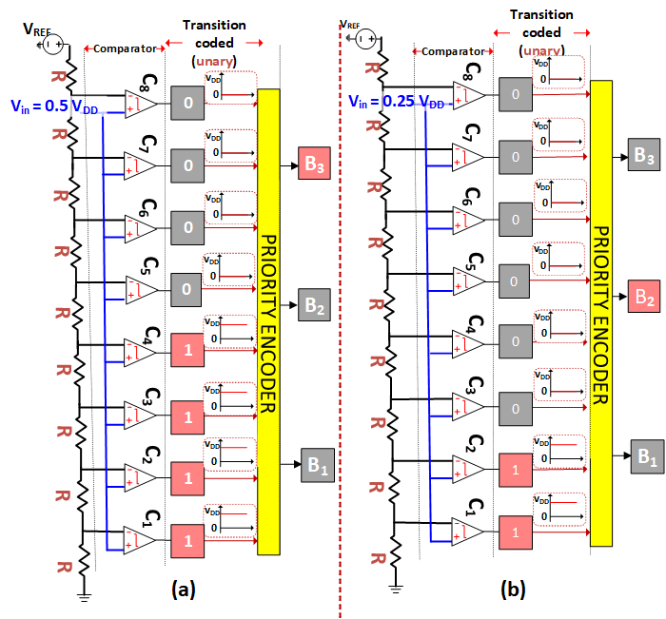
Preliminaries II
The AGNI substrate can re-purpose the sense amplifiers in DRAM tiles for the first phase of analog to binary conversion
Flash ADC with (a) Vin = 0.5VDD, and (b) Vin = 0.25VDD.
10
10
Introduction
Preliminaries
Proposed design
Operation of AGNI
Evaluation
Conclusion
StoB*= Stochastic to Binary
Notes:
This figure shows a schematic of two flash ADCs which is an analog-to-digital converter that has a 3-bit binary output. It demonstrates the conversion of two example input values. A flash ADC uses one voltage divider, 2^B comparators and a 2B:B priority encoder. The circuit has 8 voltage comparators, and the positive terminals of the comparators are connected to the input voltage, while the negative terminals are connected to a reference voltage. The output of the priority encoder is binary and the output of the comparators is in transition-coded unary format. A flash ADC converts analog to binary in two phases: firstly through comparators, and secondly through priority encoders.
[click]The AGNI substrate can re-purpose the sense amplifiers in DRAM tiles for the first phase of analog to binary conversion

Slide 11
Proposing : AGNI : In-situ, Iso-latency Stochastic-to-binary Number Conversion For In-dram Deep Learning
This paper presents a new substrate for in-DRAM StoB number conversion called AGNI.
AGNI makes minor modifications in DRAM peripherals, to divide the StoB conversion process into four distinct steps:
(i) DRAM row activation,
(ii) Stochastic to analog conversion,
(iii) Analog to transition-coded unary conversion,
(iv) Transition-coded unary to binary conversion
11
11
Introduction
Preliminaries
Proposed design
Operation of AGNI
Evaluation
Conclusion
StoB*= Stochastic to Binary
StoB*= Stochastic to Binary
Notes:
Read as it is

Slide 12
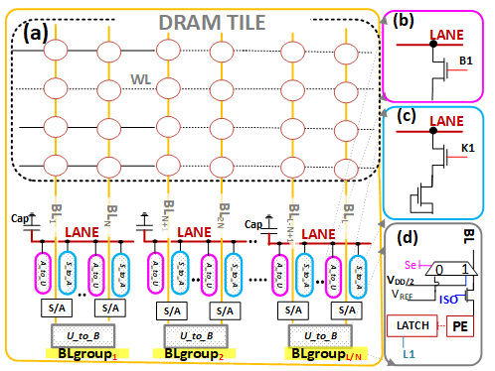
Overview of AGNI Substrate
Schematic layout of AGNI substrate and employed peripherals. Illustration of (a) an AGNI-modified DRAM tile, (b) an A to U peripheral unit, (c) an S to A peripheral unit, and (d) a U to B peripheral unit.
Introduction
Preliminaries
Proposed design
Operation of AGNI
Evaluation
Conclusion
StoB*= Stochastic to Binary
Notes:
Figure shows the modified AGNI DRAM tile and periphery units AtoU ,StoA and UtoB
-The AGNI substrate enables in-situ conversion of input stochastic operands (bit-vectors) into binary numbers by employing modifications in the structure of each tile of a commodity DRAM module.
-The AGNI substrate groups the bitlines of each DRAM tile into multiple bitline groups (BLgroups), each corresponding to an input stochastic operand, resulting in L/N logical BLgroups in a tile.
-To enable stochastic-to-binary number conversion, AGNI employs additional peripherals in each DRAM tile atop the already existing sense amplifiers (SAs), including per-bitline S to A units, per-bitline A to U units, per-BLgroup U to B units and per-BLgroup analog lanes.
-The N S to A units of a BLgroup enable stochastic-to-analog number conversion; the N A to U units of the same BLgroup enable analog-to-unary (transition coded unary) number conversion; and the U to B unit of the same BLgroup enables unary-to-binary number conversion.
-Thus, the AGNI substrate enables L/N stochastic-to-binary number conversions in-parallel per DRAM tile.

Slide 13
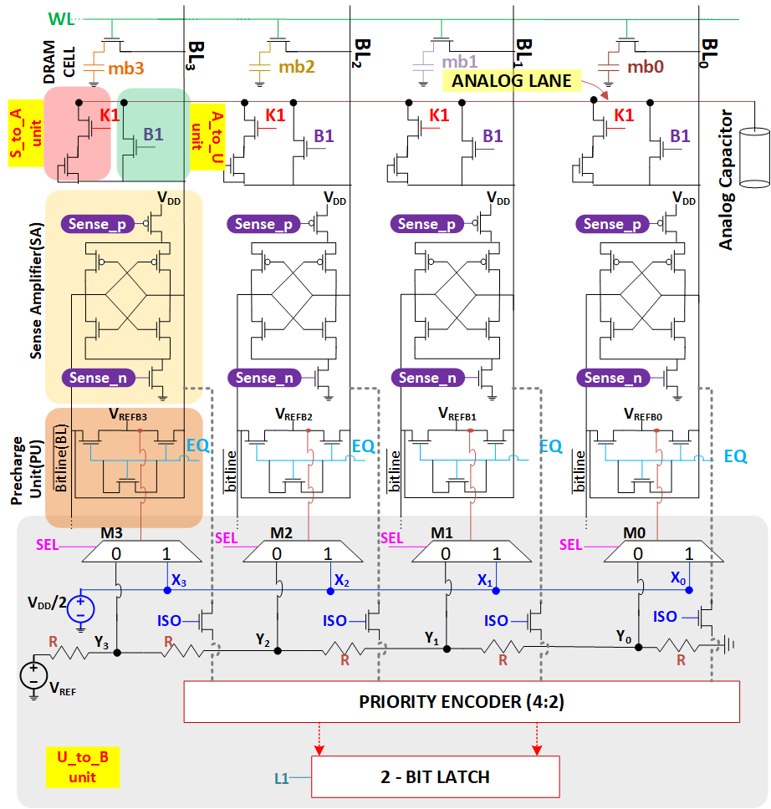
Operation of AGNI
(STEP 1) DRAM Row Activation
(STEP 2)
Stochastic to Analog Conversion (STEP 3)
Analog to Unary Conversion
(STEP 4)
Unary to Binary Conversion
StoB*= Stochastic to Binary
Schematic of AGNI substrate for N = 4, consisting of peripherals such as S to A units, A to U units and U to B unit.
Introduction
Preliminaries
Proposed design
Operation of AGNI
Evaluation
Conclusion
StoB*= Stochastic to Binary
Notes:
The proposed AGNI design perform the stoB operation in mainly 4 steps 1. DRAM Row Activation (Step 1) 2. S to A Conversion (Step 2) 3. A to U Conversion (Step 3) 4. U to B Conversion (Step 4)
Lets discuss this operation one by one in the next few slides using the [click] 4 to 2 StoB conversion and the circuit is as shown

Slide 14
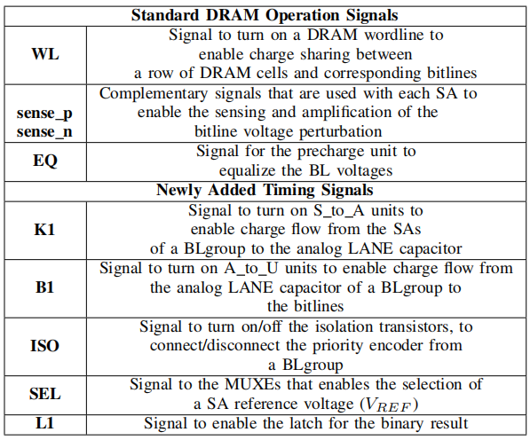
Various Timing signals employed by AGNI substrate and time
Introduction
Preliminaries
Proposed design
Operation of AGNI
Evaluation
Conclusion
StoB*= Stochastic to Binary
StoB*= Stochastic to Binary
Notes:
Table shows the standard DRAM and newly added timing signal employed by AGNI substrate.

Slide 15
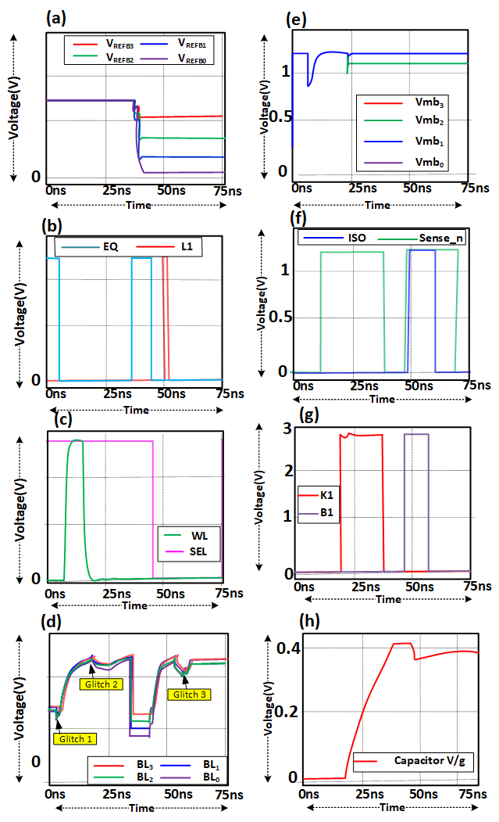
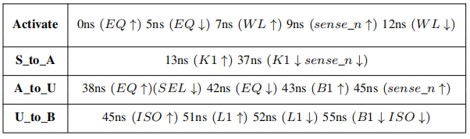
Signal evolution traces from SPICE simulations of AGNI substrate (N = 4)
StoB*= Stochastic to Binary
(a) voltages of the precharge units (VREF ), (b) equalizer (EQ) and Latching (L1) signals, (c) wordline (WL) and SEL signals, (d) bitline (BL) voltages, (e) DRAM cell capacitor voltage, (f) sense n and isolation (ISO) signals, (g) K1 and B1 signals, and (h) analog capacitor voltage.
TOGGLE TIME STAMPS (↑ OR ↓) FOR VARIOUS TIMING SIGNALS TO
REALIZE THE FOUR OPERATIONAL STEPS OF OUR AGNI SUBSTRATE.
Introduction
Preliminaries
Proposed design
Operation of AGNI
Evaluation
Conclusion
StoB*= Stochastic to Binary
Notes:
The following actions are performed assuming the data is read and stored in the DRAM cells mb0 to mb3 as shown
step 1
The DRAM row activation step employs EQ, WL, and sense n/p signals to read input operands into the SAs of their corresponding BL groups.
EQ is toggled ON at 0 ns, precharging the bitlines to VDD/2
EQ is toggled OFF at 5 ns, WL is toggled ON at 7 ns, connecting the DRAM cells to the bitlines to start charge sharing
Sense n/p is toggled ON at 9 ns, amplifying the perturbed bitline voltage to full swing
SAs complete replenishing DRAM cell voltage at 11 ns
WL is toggled OFF at 12 ns, marking the end of the DRAM row activation step
Bitline voltage evolution encounters transient noise at two events: when EQ is toggled OFF [click](glitch 1) and when WL is toggled OFF (click)(glitch 2)
Step2 S to A conversion S to A conversion step (Step 2) uses sense n, sense p, and K1 signals to convert stochastic operands into analog voltage levels.
Analog voltage levels are accrued on individual analog capacitors, one per BLgroup.
The S to A unit of each BLgroup consists of a pass transistor and a diode.
Only SAs storing VDD can connect to the analog capacitor, resulting in a voltage level proportional to the number of logic '1' in the stochastic operand.
K1 is toggled ON at 13 ns and kept ON for 24 ns with sense n and sense p, during which the SAs accrue a voltage level on the analog capacitor.
At 37 ns, both K1 and sense n/p are toggled OFF, ending Step 2.
The duration of 24 ns was chosen based on a coarse observation and is sufficient to provide N distinguishable voltage levels on the analog capacitor for N values of 4 to 256.
Step3 A to U Flash ADC performs analog-to-digital (binary) conversion in two stages
First stage: input analog voltage is converted to equivalent transition-coded unary number using voltage comparators
Second stage: unary number is converted to corresponding binary number using a priority encoder
AGNI substrate implements second stage of flash ADC by repurposing the SAs as comparators
Repurposing of SAs as comparators is done in three phases of the A to U step of AGNI substrate
Signals EQ, SEL, B1, and sense n (sense p) are used in the phases
SEL is toggled OFF to select VREF values from voltage divider circuit in precharge units of all N SAs of a BLgroup
EQ is toggled ON/OFF to precharge the bitlines of all N SAs to their respective VREF values
B1 is toggled ON to connect LANE and analog capacitor to the bitlines for mutual charge sharing
Sense n (sense p) is toggled ON to sense and amplify perturbation on the bitlines
As a result, some of the N SAs store logic ’1’ and others store logic ’0’, providing unary representation of voltage on the analog capacitor
Change in positions of ’1’s in unary representation compared to input stochastic operand favors the use of priority encoder to convert to binary number format
Step 4 utoB
Step 4 of AGNI converts unary number stored in SAs to binary number using ISO, L1, B1 signals, and priority encoder.
ISO is turned ON at 45 ns to connect bitlines to priority encoder.
The stored unary number reaches the priority encoder at 50 ns.
Priority encoder starts providing binary number output at 51 ns.
L1 is toggled ON at 51 ns to latch the binary number output.
L1, B1, and ISO are toggled OFF at 55 ns marking the end of AGNI's operation cycle.
AGNI converts input stochastic number to binary in 55 ns, regardless of input size.
Each BLgroup of AGNI becomes available to convert new stochastic operand after 55 ns.
Bitline voltages experience glitch3 [click] at 55 ns due to toggling OFF of B1 that disconnects bitlines from LANE and capacitor.

Slide 16
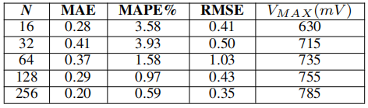
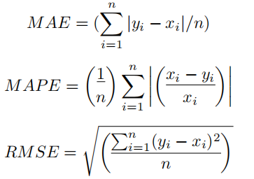
Accuracy and Overhead Calculation
AGNI substrate modeled using 2D DDR4 512 DRAM organization at 45 nm technology node
Each DRAM cell consumes 6F² area, bitline pitch is 3F
SA, Precharge unit and write driver stripe heights are 117F, 90F, and 27F respectively
Peripheral unit heights of AGNI: S to A - 27F, A to U - 27F, U to B - 110F
Effective height of AGNI substrate per 2D DDR4 DRAM tile is 164F
Total area overhead of AGNI is 492F²
Mean Absolute Error (MAE) , Mean Absolute Percentage Error (MAPE) , Root Mean Square Error (RMSE)
yi is the predicted value, xi is the actual value, and nis the total number of data points.
Introduction
Preliminaries
Proposed design
Operation of AGNI
Evaluation
Conclusion
StoB*= Stochastic to Binary
Notes:
we evaluated the mean absolute error (MAE) (Eq. 1), mean absolute percentage error (MAPE) , and Root mean
square error (RMSE) for our simulated stochastic to binary conversions. In these equations , [Click] yi
is the predicted value, xi is the actual value, and n is the total number of data points. Errors in AGNI substrate mainly
emanate from the noise fluctuations during the charge-sharing phases, whenever such fluctuations are larger than the tolerable
margins. MAE, MAPE, RMSE, and VMAX values for AGNI substrate for different BLgroup sizes (N) are shown in Table

Slide 17
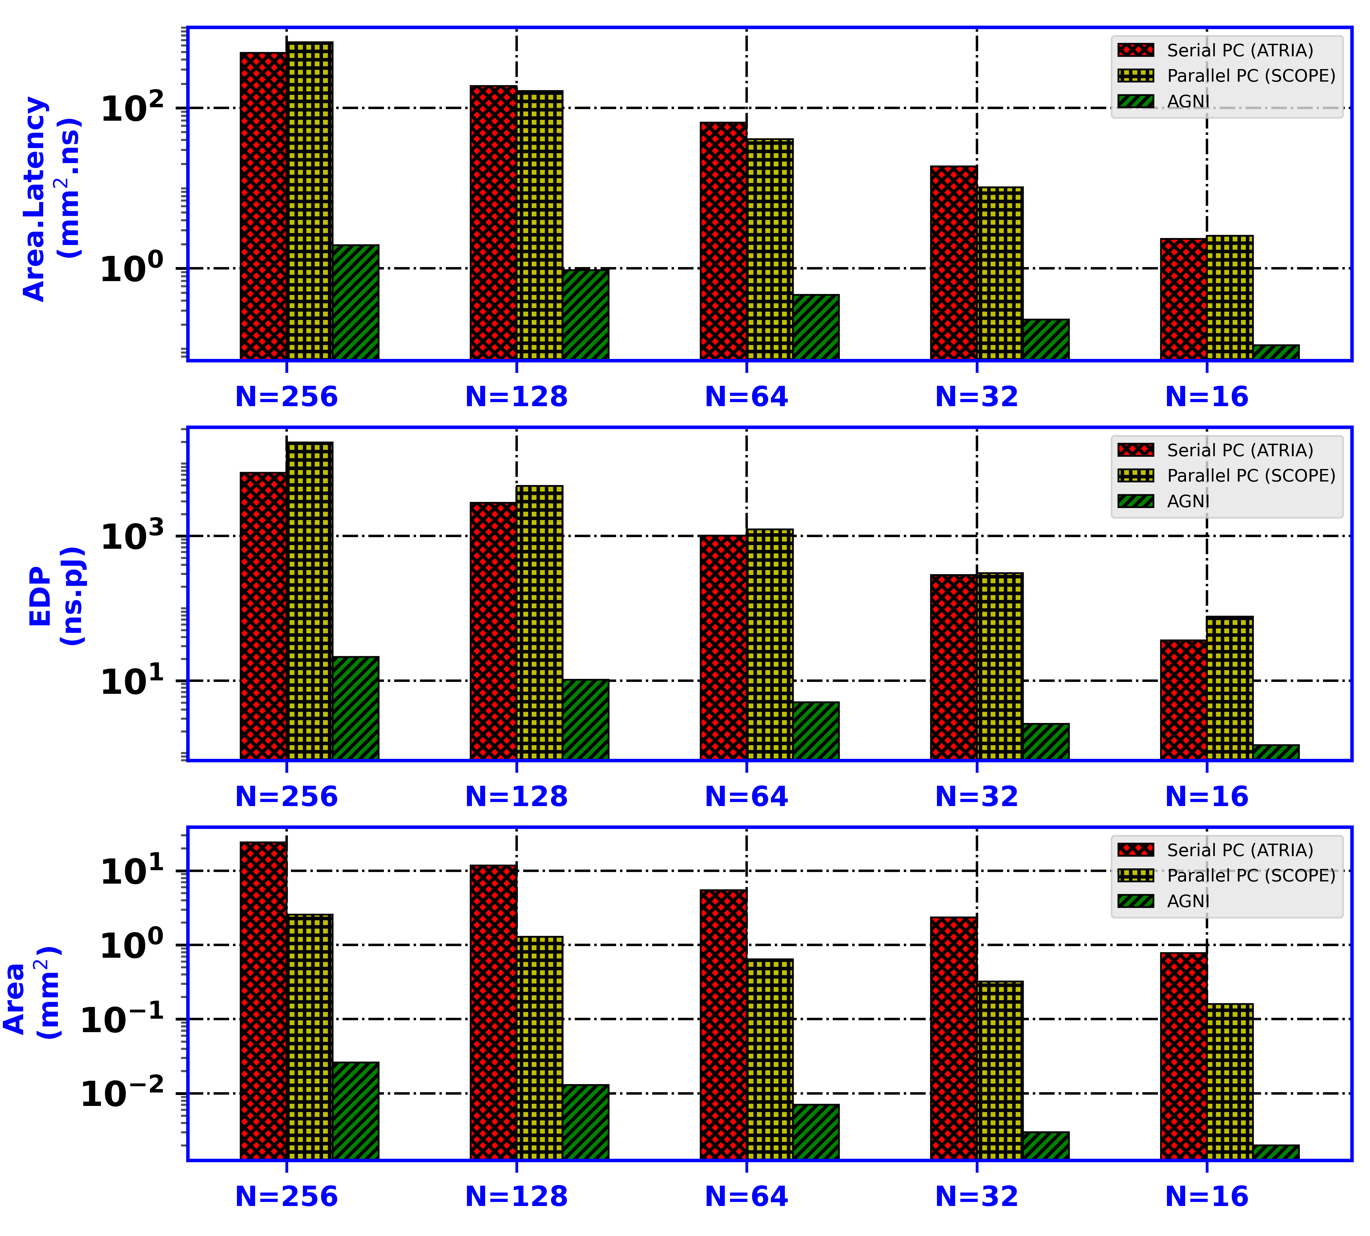
Results
AGNI achieves 390× less area, 21× less area × latency, and 28× less EDP compared to Parallel PC for N=16.
for N=256, AGNI has 923× less area, 247× less area × latency, and 350× less EDP compared to Parallel PC.
Introduction
Preliminaries
Proposed design
Operation of AGNI
Evaluation
Conclusion
StoB*= Stochastic to Binary
StoB*= Stochastic to Binary
Notes:
AGNI achieves [click] 390× less area, 21× less area × latency, and 28× less EDP compared to Parallel PC for N=16. For higher values of N i.e, 256, [click] AGNI showed significantly greater savings in area, area×latency, and EDP. For example, for N=256, AGNI has 923× less area, 247× less area × latency, and 350× less EDP compared to Parallel PC.

Slide 18
System-level results for four CNNs
AGNI achieves 3.9x better latency than Serial PC on Gmean
THE BETTER EPB RESULTS FOR AGNI CONFIRMS ITS ADVANTAGES OVER PARALLEL PC AND SERIAL PC
Normalized EDP
AGNI achieves 397x better energy than Parallel PC on Average
AGNI achieves 1048x better latency than Serial PC on Average
Introduction
Preliminaries
Proposed design
Operation of AGNI
Evaluation
Conclusion
Gmean*= Geometric mean
StoB*= Stochastic to Binary
Notes:
AGNI achieves 3.9× less latency than Serial PC on Gmean. Further,
[Click] AGNI achieves 397× and 1048× better EDP than Parallel PC and Serial PC, respectively, on average across all considered CNNs.
[click] The better EPB results for AGNI confirms its advantages over Parallel PC and Serial PC

Slide 19
Conclusions
A novel DRAM-based substrate called AGNI is presented for in-situ StoB number conversion for deep learning applications
The structure and operation of AGNI is discussed, using results from conducted SPICE simulations
Detailed performance analysis results and overheads for AGNI are presented
Evaluations show that AGNI can achieve significant savings in area (atleast 8X), energy-delay product (EDP) (atleast 28X), and area×latency compared to prior works
Future work includes potential for further reducing latency and exploring ways to maximize analog voltage range and noise margin through capacitance value of analog capacitor and physical implementation of analog LANE.
Introduction
Preliminaries
Proposed design
Operation of AGNI
Evaluation
Conclusion
Gmean*= Geometric mean
StoB*= Stochastic to Binary
Notes:
1. In this paper, we introduce a novel DRAM-based substrate, AGNI, for in-situ stochastic-to-binary (StoB) number conversion in deep learning applications. The AGNI substrate is comprised of a combination of analog and digital circuits, which enable the efficient conversion of stochastic numbers to binary representations.
2. We detail the structure and operation of AGNI through a thorough analysis of the results obtained from SPICE simulations. These simulations were conducted to verify the functionality and performance of the proposed substrate.
3. To evaluate the performance of AGNI, we present detailed analysis of the area, energy-delay product (EDP), and area×latency metrics. Our results demonstrate that AGNI is able to achieve significant savings in these metrics, with at least 8× reduction in area, 28× reduction in EDP, and 21× reduction in area×latency compared to two in-DRAM stochastic-to-binary conversion circuits from prior works.
4. In terms of future work, we identify opportunities for further latency reduction by tightly packing various timing signals of AGNI substrate in a narrower window of time. Additionally, we propose exploring the capacitance value of the analog capacitor and the physical implementation of the analog LANE as potential avenues for maximizing the analog voltage range and noise margin.

Slide 20
BACKUP SLIDES

Slide 21
Drawbacks
CNN PIM Accelerator
Output tensor size for per-layer of CNNs significantly high
Consequently, need frequent StoB conversion → To reduce the memory overhead
Even though some accelerator hide this StoB conversion overhead from critical path
Substantial amount of latency and energy consumed for StoB conversion
To reduce the latency, SCOPE[Li-DAC-2018] uses Parallel Pop Counter [Kim-ISOCC-2015] → enormous full adder to compute partial sums
However, area overhead ATRIA [Supreeth-ISVLSI’2021] uses Serial Pop Counter [Kim-ISOCC-2015] → Reduce area overhead
But the Serial Pop Counter latency penalties are high
Process technique of the DRAM and ASIC CMOS logic are different → fabrication cost skyrockets
To address these shortcomings, this paper presents a new substrate for in-DRAM StoB number conversion called AGNI
21
21
21
Introduction
Preliminaries
Proposed design
Operation of AGNI
Evaluation
Conclusion
StoB*= Stochastic to Binary
Notes:
To summarize [click] CNN accelerator [click] Output tensor size for per-layer of CNNs significantly high
[Click] Consequently, need frequent StoB conversion → To reduce the memory overhead
[click] Even though some accelerator hide this StoB conversion overhead from critical path
[click] Substantial amount of latency and energy consumed for StoB conversion
[click] To reduce the latency, SCOPE uses Parallel Pop → enormous full adder to compute partial sums
[click] However, area overhead ATRIA [Supreeth-ISVLSI’2021] uses Serial Pop Counter [Kim-ISOCC-2015] → Reduce area overhead
[click] But the Serial Pop Counter latency penalties are high
[click] Process technique of the DRAM and ASIC CMOS logic are different → fabrication cost skyrockets
[click] To address these shortcomings, this paper presents a new substrate for in-DRAM StoB number conversion called AGNI

Slide 22
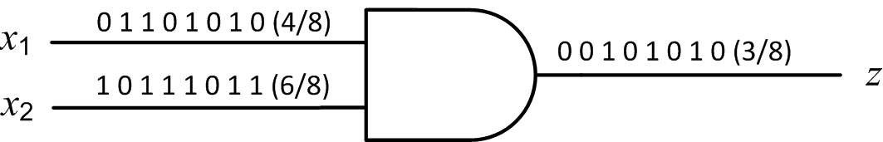
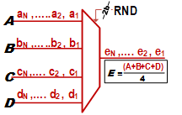
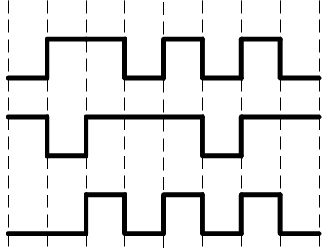
Stochastic Computing(SC) for CNN PIM Accelerators
Stochastic computing (SC) offers low power and high error tolerance
Random bit streams are used to represent operands
The magnitude of a number is modeled by the probability of having logical ‘1’s in its bit stream
Complex arithmetic operations implemented by simple logic circuits
Bit-Serial Stochastic Multiplication
Bit-Serial, Scaled Stochastic Accumulation
Using a 4-input MUX
Incurs exponential latency overhead
Z = X₁× X₂
3/8 = 4/8 × 6/8
X₁
4/8
X₂
6/8
Time required ∝ input bit-stream length N
Z
3/8
Introduction
Preliminaries
Proposed design
Operation of AGNI
Evaluation
Conclusion
Notes:
Since our research focus on using stochastic computing technique let’s cover some background on this promising paradigm for PIM accelerators. [click] Stochastic computing uses random bit-streams to represent operands. The magnitude of a number is modeled by the probability of having logical ‘1’s in its bit stream. [click] Stochastic circuits can be implemented with very simple logic cells. [click] A simple example shown here is a BIT serial fixed-point number multiplication executed by a single AND gate. As you can see, the probability of seeing a one at the output of the AND gate is the probability of seeing one at x₁ (i.e., 4/8) times the probability of seeing a one at x₂ (6/8), if the probabilities are independent. In this case, the product result is three-eighth, which is the multiplication of x1 and x2. [click] Similarly, to perform a scaled accumulation, the bit-streams of the input stochastic operands are applied to a MUX to generate the output bit-stream that represents a scaled accumulation. [click] For such bit-serial stochastic computing, time required for multiplication is directly proportional to input bit-stream length N, which [click] incurs exponential latency overhead.

Slide 23
Overhead of Serial and Parallel Pop Counter(PC) in DRAM
ATRIA and SCOPE uses serial and parallel pop counter(PC) for StoB conversion
Parallel pop counter requires enormous full adder circuits
consumes non-trivial area of the DRAM periphery
Serial PC circuits require high-speed counters
Implementations of full adders and counters in DRAM cannot be optimized for area, latency and energy
DRAM cannot be optimized for area, latency and energy, due to the constraints of DRAM fabrication processes are significantly different from the standard CMOS logic processes
23
Introduction
Preliminaries
Proposed design
Operation of AGNI
Evaluation
Conclusion
StoB*= Stochastic to Binary
Notes:
As discussed earlier ATRIA and SCOPE uses serial and parallel pop counter(PC) for StoB conversion.

