Slide 1
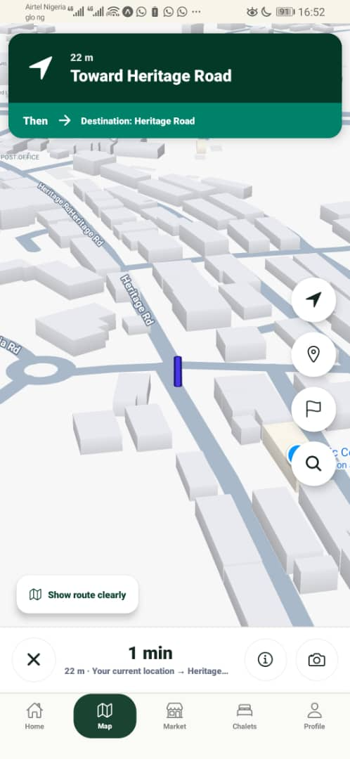
WORKING MOBILE MVP // LOCAL NAVIGATION + SERVICES
Redemption City
Navigator
A practical mobile platform for finding places, services, chalets, vendors and movement options inside Redemption City.
Built for residents, worshippers, visitors and service providers who need confident movement inside camp.
200+
4
places and road references ready for offline discovery
service pillars: navigate, stay, buy, move
REDEMPTION CITY NAVIGATOR

Slide 2
THE PROBLEM
Movement inside camp is harder than it should be.
1
Ask strangers
Redemption City has roads, landmarks, ministries, chalets, vendors and services that are not always easy to locate quickly, especially for first-time visitors.
2
Miss roads
3
Waste time
• People depend on repeated verbal directions.
• Visitors struggle to find chalets, churches, vendors and facilities.
• Sunday movement creates avoidable pressure when transport is limited.
• Local vendors lack a unified discovery and delivery channel.
4
Unclear vendors
REDEMPTION CITY NAVIGATOR

Slide 3
THE SOLUTION
A local operating layer for Redemption City.
The Navigator combines searchable places, internal route guidance, chalets, vendors, Sunday Shuttle and delivery into one mobile experience.
⌖
Navigate
⌂
Chalets
RCN
₦
Market
↗
Delivery
One app turns fragmented camp movement into a single, usable service layer.
S
Sunday Shuttle
REDEMPTION CITY NAVIGATOR

Slide 4
PRODUCT EXPERIENCE
From “where is it?” to “I can get there.”
The MVP keeps the experience focused: search, route, discover, request, and move.
01
02
03
04
05
Search
Route
Stay
Buy
Deliver
Find roads, churches, chalets and landmarks offline.
Show internal route guidance to selected destinations.
Discover chalet options and location context.
Browse vendors and local products.
Move orders to doorsteps through local riders.
DESIGNED FOR MOBILE-FIRST CAMP USAGE
The interface is deliberately simple: users should not need training before using it inside camp.
REDEMPTION CITY NAVIGATOR

Slide 5
CORE FEATURES
Four pillars make the product useful beyond a map.
Offline Search
Internal Routes
⌕
↱
Places, aliases, roads and landmarks are searchable without relying fully on internet data.
Saved local route corridors guide users to important points inside Redemption City.
Market Hub
Chalets + Shuttle
₦
⌂
A multi-vendor directory brings products and services into one camp marketplace.
Users can locate chalet areas and access Sunday movement support from within the app.
REDEMPTION CITY NAVIGATOR

Slide 6
DELIVERY + LOCAL JOB CREATION
Commerce becomes more valuable when delivery is built in.
When a user orders from a vendor, the system supports delivery to the user’s doorstep, creating practical earning opportunities for people inside Redemption City.
Customer orders
Vendor confirms
Local delivery
Doorstep arrival
Select product or service
Order is prepared
Rider/runner picks up
User receives order
New income
Better reach
Safer orders
for verified riders, runners and helpers
for small vendors inside camp
through structured fulfillment and records
REDEMPTION CITY NAVIGATOR

Slide 7
SYSTEM DESIGN
Offline-first architecture keeps the MVP usable in real camp conditions.
Mobile UI
Expo Router screens, search, maps, market, chalets
Local Data Layer
places.ts, verifiedRoutes.ts, vendors, chalets
Route Engine
destination matching, route selection, distance estimates
Service Modules
market, delivery, Sunday Shuttle, feedback, orders
Cloud Expansion
Supabase/API, admin tools, vendor onboarding
The design allows the product to function as a local prototype today while scaling into a managed services platform.
REDEMPTION CITY NAVIGATOR

Slide 8
BUSINESS MODEL
A sustainable local-services model, not just a navigation app.
Vendor commission
Delivery fee
Small percentage on fulfilled marketplace orders.
Transparent fee that supports local delivery workers.
Premium listings
Institutional support
Verified vendors and chalets can improve discovery.
Partnership with camp units, hospitality and service departments.
LOW FRICTION • LOCAL VALUE • SCALABLE PARTNERSHIPS
REDEMPTION CITY NAVIGATOR

Slide 9
IMPACT
Better movement creates better experience, safer commerce and local work.
Visitors
Residents
Vendors
Find places faster with less confusion
Access vendors, chalets and movement support
Gain discovery, orders and delivery reach
Youth / Riders
Organizers
Earn through local delivery and errands
Improve information flow and camp navigation
REDEMPTION CITY NAVIGATOR

Slide 10
MVP READINESS
The foundation is already in place.
The submission package is backed by a GitHub repository, mobile prototype, architecture documentation and business design.
GitHub
Expo
Docs
Demo
public repository with source code
mobile MVP running on device
architecture and GTM documents ready
screen-recorded walkthrough for judges
Repository: github.com/Supreme5050/redemption-city-navigator
REDEMPTION CITY NAVIGATOR

Slide 11
ROADMAP
From MVP to deployment-ready city assistant.
Now
Next
Scale
Extend
Mobile MVP, offline data, local services, demo-ready screens
Route calibration, verified vendor onboarding, delivery operations
Admin dashboard, live service data, wallet/escrow, analytics
AR guidance, AI assistant, integrations with official departments
The system is designed to start with navigation and grow into a trusted local-services platform.
REDEMPTION CITY NAVIGATOR

Slide 12
SUBMISSION READY
Redemption City
Navigator
Submission assets
• Architecture / Design PDF
• Business Design / GTM PDF
• Pitch Deck PDF
• GitHub repository
• Demo video and screenshots
Helping people find places, access services, order locally and move with confidence inside Redemption City.
Team Lead: Kenneth Samuel
GitHub: Supreme5050/redemption-city-navigator
REDEMPTION CITY NAVIGATOR

