Slide 1
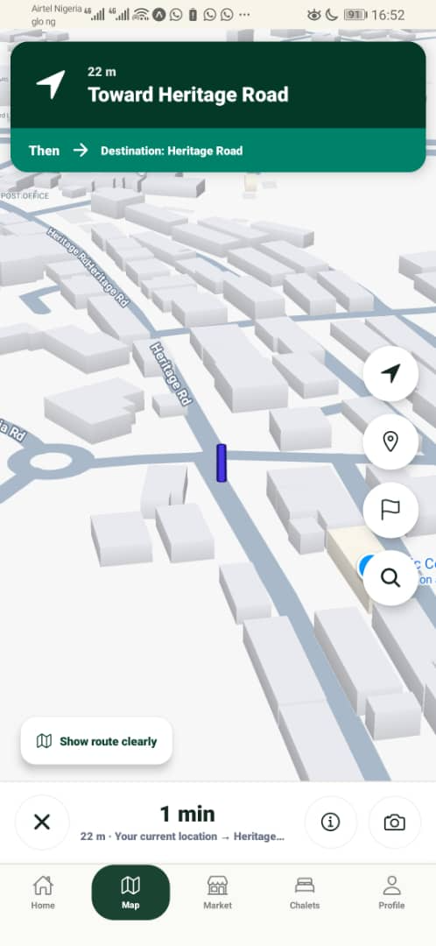
WORKING MOBILE MVP // NAVIGATION, COMMERCE & LOCAL DELIVERY
Redemption City
Navigator
A mobile-first platform that helps people find places, access services, order locally and move with confidence inside Redemption City.
Built for residents, worshippers, visitors, vendors and service teams who need a simple, reliable way to navigate and transact inside camp.
200+
4
location records and route references for offline-first discovery
service pillars: navigate, stay, buy, deliver
REDEMPTION CITY NAVIGATOR

Slide 2
THE PROBLEM
Finding your way inside camp should not depend on guesswork.
1
Ask strangers
Redemption City is large, active and constantly moving. Visitors and residents need a reliable way to find roads, chalets, churches, vendors and essential services without depending on repeated verbal directions.
2
Miss roads
3
Waste time
• Visitors spend time asking for directions instead of moving with confidence.
• Chalets, churches, vendors and facilities are not always easy to discover quickly.
• Sunday movement creates pressure when transport options are limited.
• Local vendors need a structured way to receive orders and deliver to customers.
4
Unclear vendors
REDEMPTION CITY NAVIGATOR

Slide 3
THE SOLUTION
A practical digital guide for movement, services and local commerce.
Redemption City Navigator combines offline-first place discovery, internal route guidance, chalets, vendors, Sunday Shuttle and doorstep delivery in one mobile experience.
⌖
Navigate
⌂
Chalets
RCN
₦
Market
↗
Delivery
One app turns scattered location information into a usable service layer for the entire camp environment.
S
Sunday Shuttle
REDEMPTION CITY NAVIGATOR

Slide 4
PRODUCT EXPERIENCE
From “where is it?” to “I know where to go.”
The product keeps the experience direct: search, route, discover, order and move.
01
02
03
04
05
Search
Route
Stay
Buy
Deliver
Find roads, churches, chalets, landmarks and services with offline-first data.
Display internal route guidance to selected destinations inside camp.
Discover chalet areas and location context before moving.
Browse vendors, products and local services.
Deliver orders to users through local riders, runners and helpers.
DESIGNED FOR MOBILE-FIRST CAMP USAGE
The interface is intentionally simple so users can open the app and act immediately inside camp.
REDEMPTION CITY NAVIGATOR

Slide 5
CORE FEATURES
The product is useful beyond navigation because it connects movement, stay, commerce and delivery.
Offline Search
Internal Routes
⌕
↱
Places, aliases, roads and landmarks are searchable with offline-first local records.
Verified local route corridors guide users toward important points inside Redemption City.
Market Hub
Chalets + Shuttle
₦
⌂
A multi-vendor marketplace brings camp products and services into one trusted directory.
Users can locate chalet areas and access Sunday Shuttle support from within the same app.
REDEMPTION CITY NAVIGATOR

Slide 6
DELIVERY + LOCAL JOB CREATION
Local commerce becomes more useful when delivery is built into the experience.
When a user orders from a vendor, the delivery section supports doorstep fulfillment through local riders, runners and helpers. This gives vendors wider reach while creating practical earning opportunities for people inside Redemption City.
Customer places order
Vendor prepares order
Local rider/runner assigned
Doorstep delivery
Select product or service from a vendor
Order is accepted and packaged
Pickup and delivery are tracked
Customer receives order at location
New income
Better reach
Safer orders
for local riders, runners and helpers
for vendors and service providers inside camp
through structured order and delivery records
REDEMPTION CITY NAVIGATOR

Slide 7
SYSTEM DESIGN
The architecture is designed for real camp conditions: mobile-first, lightweight and offline-aware.
Mobile App
Expo Router screens for search, maps, market, chalets and shuttle
Local Data Layer
Places, routes, vendors, chalets and local service records
Route Engine
Destination matching, route selection and distance estimates
Service Modules
Market, delivery, Sunday Shuttle, feedback and orders
Cloud Expansion
Supabase/API, admin tools and vendor onboarding
The structure supports a working mobile MVP today and provides a clear path into a managed local-services platform.
REDEMPTION CITY NAVIGATOR

Slide 8
BUSINESS MODEL
A sustainable local-services model built around movement, commerce and fulfillment.
Vendor commission
Delivery fee
Small commission on completed marketplace orders.
Transparent delivery fee that supports local riders and runners.
Premium listings
Institutional support
Verified vendors and chalet operators can improve visibility.
Partnerships with camp units, hospitality teams and service departments.
LOCAL VALUE • PRACTICAL REVENUE • SCALABLE OPERATIONS
REDEMPTION CITY NAVIGATOR

Slide 9
IMPACT
Better movement improves visitor experience, strengthens local commerce and creates work.
Visitors
Residents
Vendors
Find places faster and move with confidence
Access vendors, chalets, routes and delivery
Gain visibility, orders and delivery reach
Youth / Riders
Organizers
Earn through delivery, errands and support services
Improve information flow, movement and service coordination
REDEMPTION CITY NAVIGATOR

Slide 10
SUBMISSION EVIDENCE
The submission is backed by working product evidence.
The project includes a public GitHub repository, mobile prototype evidence, architecture documentation, GTM document, pitch deck and screenshots.
GitHub
Expo
Docs
Demo
public repository with source code
working mobile MVP demonstrated on device
architecture and GTM documentation included
screen-recorded walkthrough and screenshots
Repository: github.com/Supreme5050/redemption-city-navigator
REDEMPTION CITY NAVIGATOR

Slide 11
ROADMAP
From working MVP to city-scale local services infrastructure.
Now
Next
Scale
Extend
Mobile MVP, offline data, local service modules and demo-ready screens
Route calibration, verified vendor onboarding and delivery operations
Admin dashboard, live service data, wallet/escrow and analytics
AR guidance, AI assistant and integrations with official departments
The product starts with navigation and grows into a trusted local-services platform for Redemption City.
REDEMPTION CITY NAVIGATOR

Slide 12
READY FOR REVIEW
Redemption City
Navigator
Submission assets
• Architecture / Design PDF
• Business Design / GTM PDF
• Pitch Deck PDF
• GitHub repository
• Demo video and screenshots
A practical mobile platform helping people find places, access services, order locally and move with confidence inside Redemption City.
Team Lead: Priest Samuel
GitHub: Supreme5050/redemption-city-navigator
REDEMPTION CITY NAVIGATOR

