Slide 1



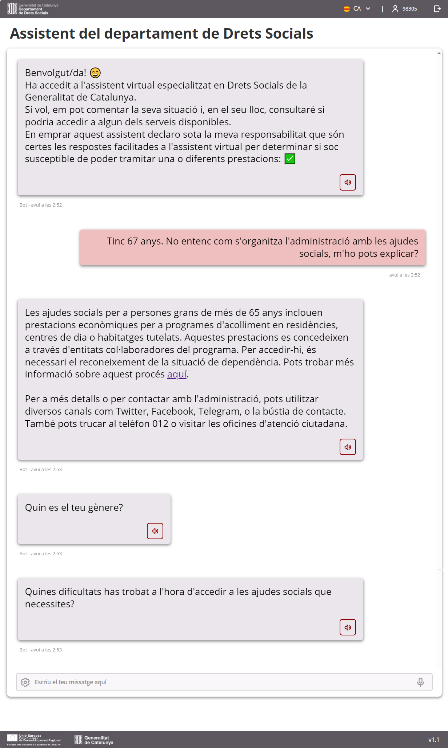
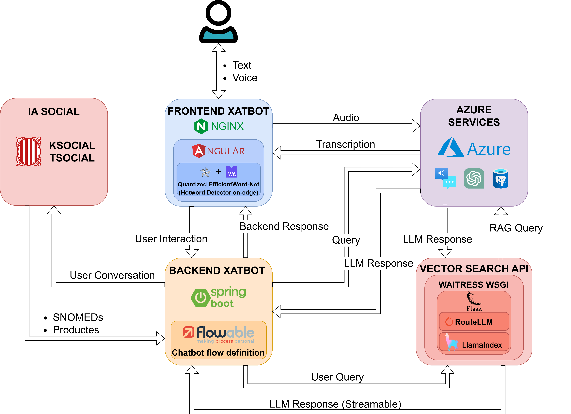
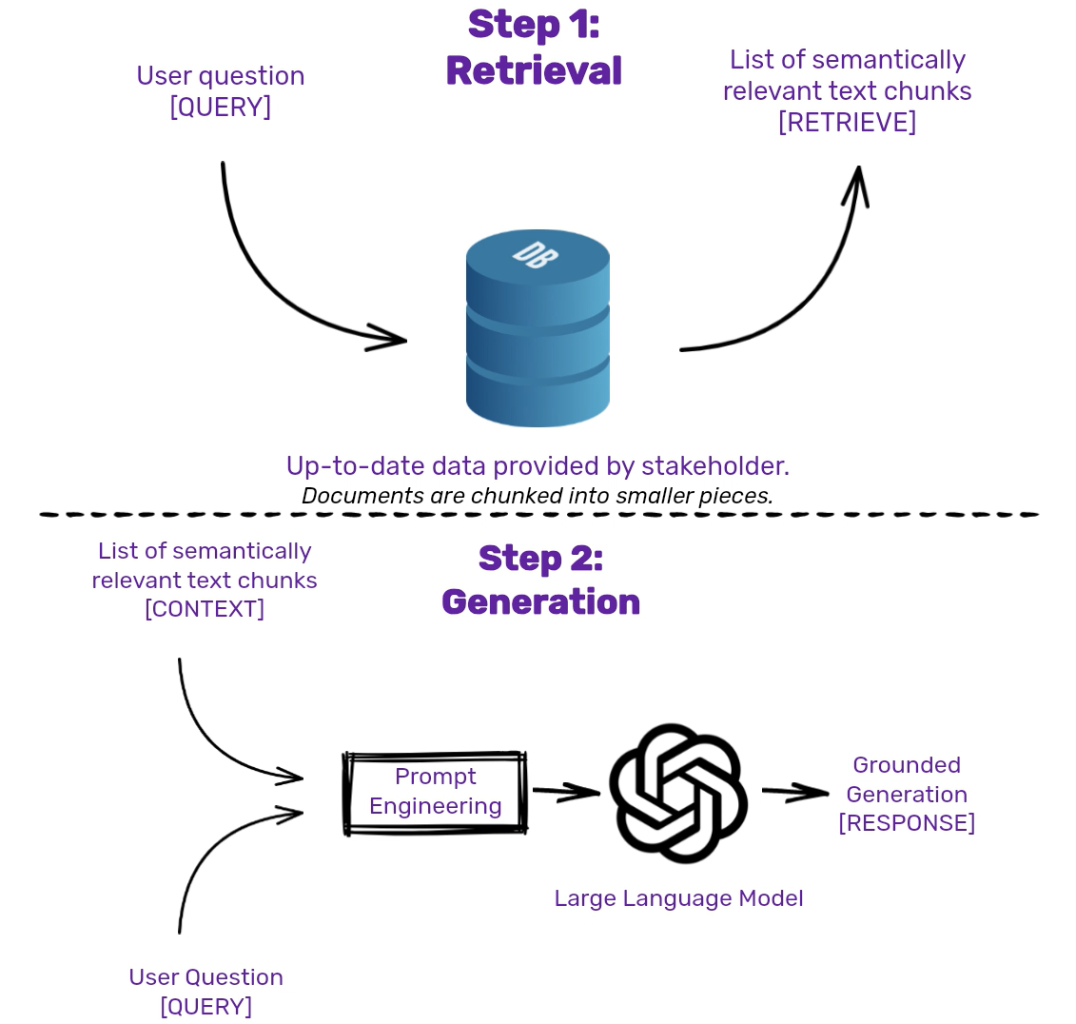
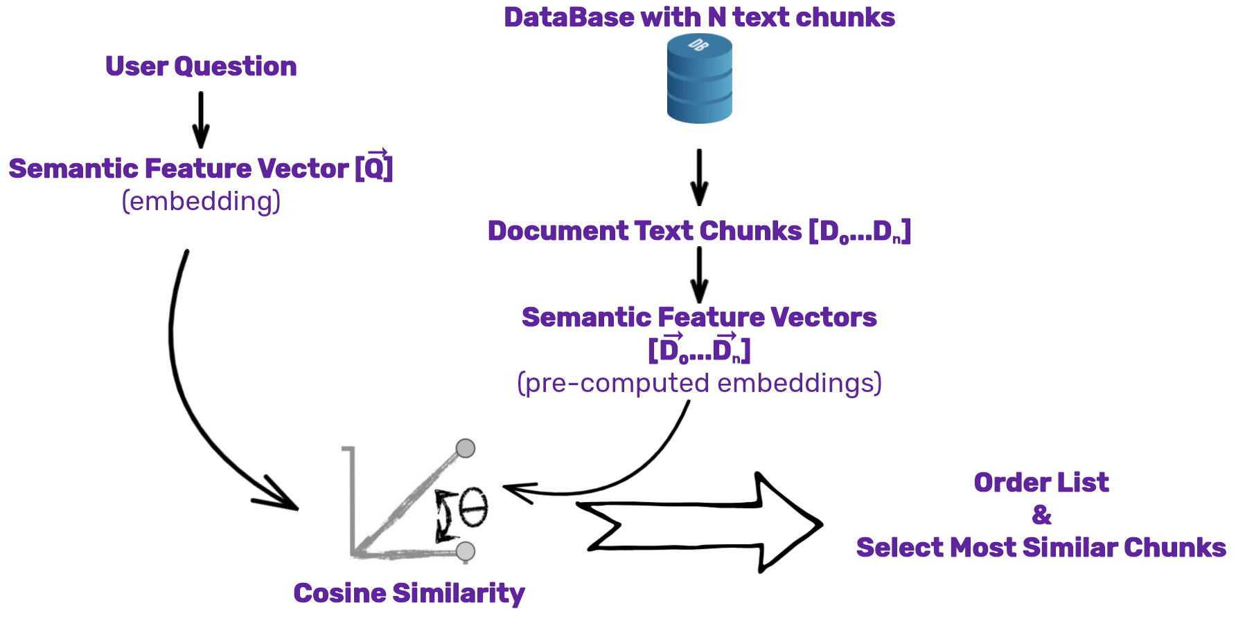
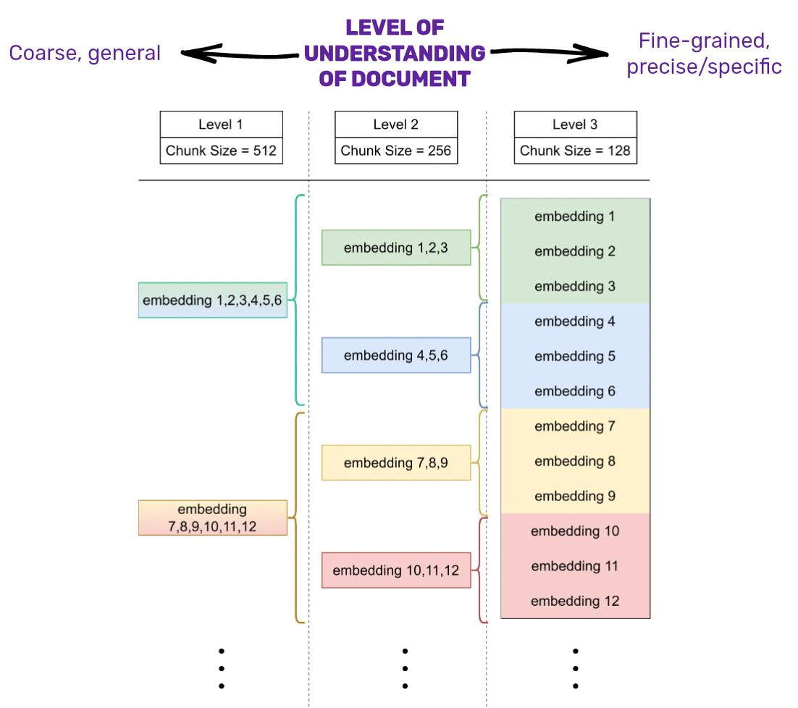
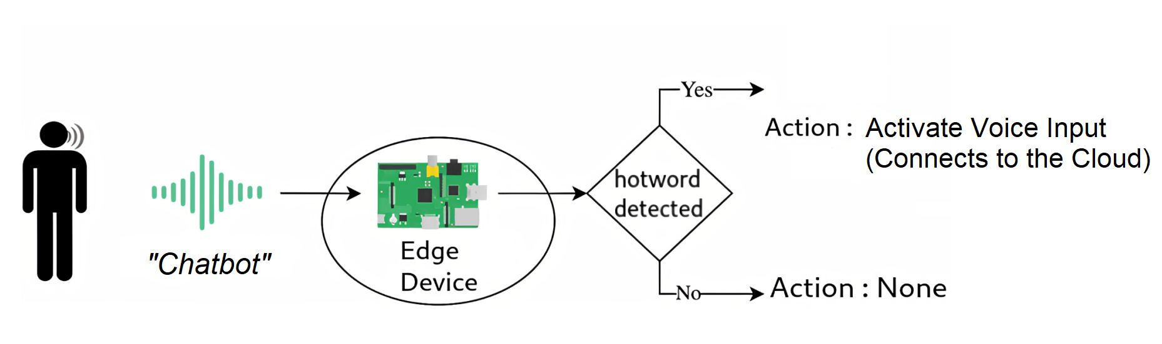

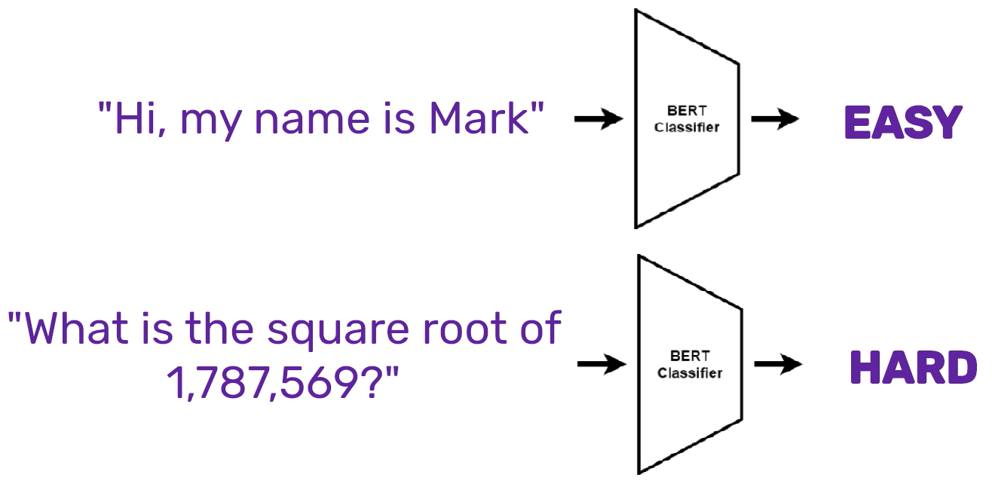
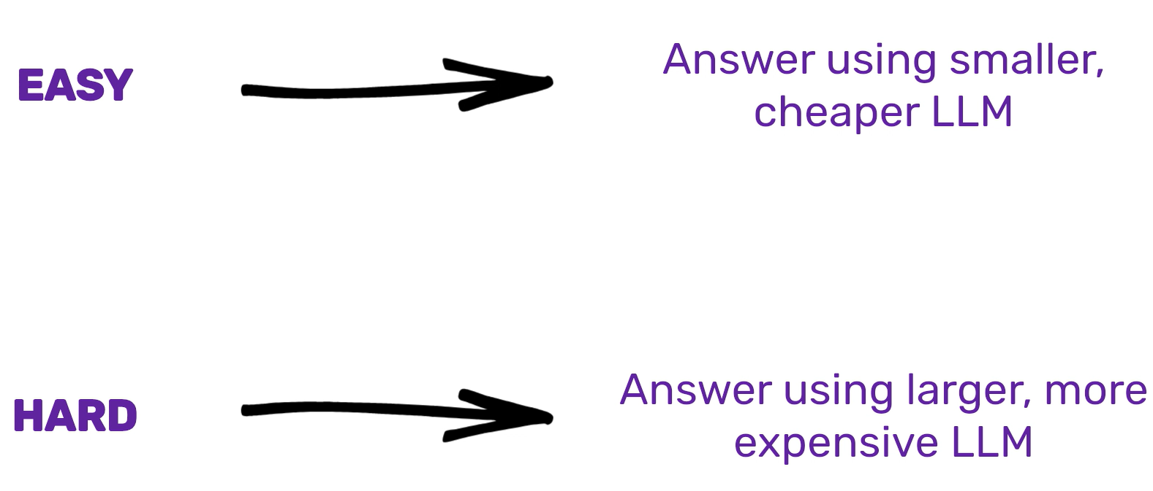

Martí Mas Fullana Professor/a tutor/a: Dr. Josep Suy Franch
Màster en Ciència de Dades Dept. INFORMÀTICA, MATEMÀTICA APLICADA I ESTADÍSTICA
Tuning a Generative Language Model for the Creation of Customized Chatbots for Public Administrations
In collaboration with DXC Technology we develop a customized chatbot system for public administrations in Catalonia. The chatbot integrates GPT and Retrieval Augmented Generation (RAG) technologies to aid with social rights and benefits. It utilizes a modular architecture with a frontend in Angular, a backend for conversational flow management, and Azure services for speech recognition and data handling. The system aims to enhance user satisfaction, accuracy, and cost-efficiency, with potential for future improvements in accessibility, multilingual support, and performance optimization.
The Frontend UI allows users to easily interact with the Chat system either through keyboard + mouse or voice commands + voice input.
We design an advanced system architecture able to easily be adapted to the needs and constraints of different stakeholders. Through integration with Flowable we can quickly implement new business processes.
30a. Edició Premis Patronat Politècnica. Projectes Final de Carrera
1. Retrieval Augmented Generation
2. Improving Retrieval
The system retrieves stakeholder provided documents from the database to ground its responses. With this, we ensure the correctness and truthfulness of the responses, avoiding common pitfalls such as hallucinations or lack of knowledge.
3. Accessibility
Machine Learning deployed on-edge runs continuously on the user’s machine, listening for the keyword “Chatbot”. This allows a user to go fully handsfree, using just their voice to interact with the sys-
Small-To-Big-Retrieval (STBR) uses hierarchical embeddings to traverse the database and retrieve information more accurately. This allows multiple semantic levels of understanding to be considered during retrieval. We observed a 14% increase in accuracy on our question answering benchmarks, from 65% to 79%, when using STBR vs vanilla RAG.
-tem, while keeping all data private by processing it locally. We brought this feature from a purely research environment to a fully deployable one, for the first time.
4. Reducing Costs
A Machine Learning component intelligently choses between a Strong and a Weak LLM conditioned on the user’s query, to reduce costs and speed up responses. It identifies the complexity of the query to pick between them. The classifier model is based on the BERT architecture. This allows us to maintain response quality while reducing costs on average. The classification is performed on-the-fly for each user query. This system is called RouteLLM.
Amb el suport de:

