Slide 1
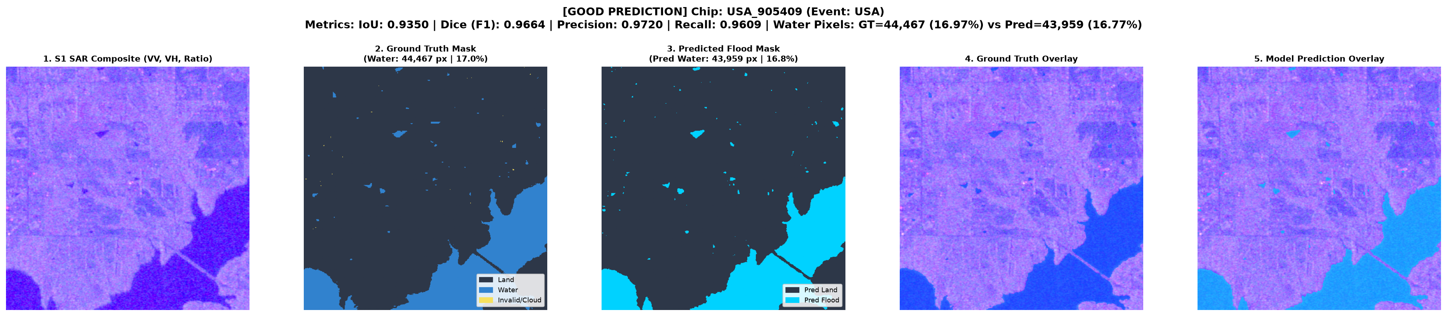
ACADEMIC MINOR PROJECT • AI & REMOTE SENSING
AI-Based Flood Detection & Mapping Using Satellite Imagery
Sen1Floods11 • Sentinel-1 SAR Dual-Polarization • PyTorch U-Net
• Modality: Sentinel-1 SAR C-Band (VV + VH Dual Polarization)
• Architecture: PyTorch U-Net with Group Normalization (G=8)
• Benchmark: Sen1Floods11 (11 Global Events across 6 Continents)
• Evaluation: 100% Full Test Split (90/90 Chips, 20.5M Valid Pixels)
• Test Results: 0.5548 IoU | 0.7137 Dice/F1 | 93.34% Accuracy
• Deployment: Interactive Streamlit Dashboard + Custom GeoTIFF Upload
TECH STACK: Python 3.11 • PyTorch • U-Net • Streamlit • Rasterio • Torchvision
Verified Model Output: 5-Panel Flood Segmentation on USA Benchmark Chip (IoU: 0.9350)
Notes:
Good morning/afternoon respected examiners and project guides.
Welcome to the presentation of our academic minor project: 'AI-Based Flood Detection and Mapping Using Satellite Imagery'.
In this work, we developed an audited deep learning semantic segmentation system using Sentinel-1 Synthetic Aperture Radar (SAR) imagery on the global Sen1Floods11 benchmark.
Our PyTorch U-Net incorporates Group Normalization with 8 groups and a domain-specific Masked BCE plus Dice loss, evaluated across 100% of the 90 official test chips (20.5 million valid pixels), achieving 0.5548 IoU and 0.7137 Dice.
We also built a live interactive Streamlit application for automated flood mapping and custom GeoTIFF upload. Let us examine the problem statement.

Slide 2
BACKGROUND & MOTIVATION
Disaster Response & The Optical Cloud Barrier
Why automated radar-based flood mapping is critical for disaster assessment
1. The Global Flood Crisis
2. The Optical Sensor Obstruction
3. The AI + SAR Solution
• Most Frequent Natural Disaster: Floods account for over 40% of all disaster events worldwide.
• Rapid Inundation: Floodwaters peak rapidly, isolating communities and submerging transport corridors.
• Emergency Response Need: Disaster relief teams require rapid, accurate spatial maps of inundated zones.
• Ground Survey Hazards: Field surveys are impeded by submerged infrastructure and hazardous conditions.
• Cloud Cover Obstruction: Active flood events are accompanied by severe storms, resulting in widespread cloud cover.
• Optical Limitation: Sensors like Sentinel-2 and Landsat operate in visible/NIR spectra and cannot see through thick storm clouds.
• Delayed Observation: Usable optical scenes are often unavailable until days or weeks after flood peaks.
• Manual Interpretation Bottleneck: Manual digitization of large satellite swaths is too slow for emergency workflows.
• All-Weather Penetration: Synthetic Aperture Radar (SAR) microwave signals penetrate rain, storm clouds, and operate day and night.
• Radar Backscatter Contrast: Smooth standing water specularly reflects radar pulses away, appearing characteristically dark.
• Deep Learning Automation: Custom U-Net model segments water extent at pixel level directly from dual-polarization SAR.
• Fast Execution: Generates complete flood probability maps in under 50ms per 256×256 chip.
AI-Based Flood Detection & Mapping | Sen1Floods11 • Sentinel-1 SAR • PyTorch U-Net | Academic Minor Project
2 / 18
Notes:
This slide outlines the fundamental challenge motivating this project.
Floods cause devastating social and economic losses. Timely disaster relief requires rapid mapping of inundated zones.
However, optical satellites like Sentinel-2 rely on visible sunlight and are severely obstructed by storm clouds during active flooding events.
Ground surveys are dangerous and hindered by submerged roads.
Synthetic Aperture Radar (SAR) provides the ideal solution because C-band microwaves penetrate cloud cover, rain, and darkness. Smooth floodwaters reflect radar pulses away, creating distinct contrast against surrounding terrain.
By pairing Sentinel-1 SAR with an optimized U-Net, our system automates pixel-level flood mapping in sub-50ms execution time.

Slide 3
SCOPE & GOALS
Project Objectives & Technical Deliverables
Five core research and engineering milestones established for the system
01
1. Benchmark Ingestion & Zero-Leakage Audit
Ingest and validate the global Sen1Floods11 benchmark across 11 flood events. Enforce strict mutual exclusivity across train, validation, and test splits with 0 overlapping chips.
02
2. Dual-Polarization SAR Feature Extraction
Exploit Sentinel-1 C-band SAR backscatter in both VV and VH channels, normalized from decibels to handle specular water reflection and land volume scattering.
03
3. Optimized PyTorch U-Net Architecture
Implement an efficient U-Net with Group Normalization (G=8) to ensure batch-size-independent normalization stability and spatial dropout (p=0.10) to mitigate overfitting.
04
4. Masked Loss Formulation & Full Benchmark Evaluation
Formulate a hybrid loss combining BCE and Dice loss calculated exclusively on valid pixels (ignoring -1 invalid labels). Rigorously evaluate across 100% of the 90 official test chips.
05
5. Interactive Web Application & Geospatial Deployment
Develop a lightweight, high-performance Streamlit dashboard supporting benchmark chip inspection, real-time threshold tuning, nominal flooded area estimation, and custom GeoTIFF upload.
AI-Based Flood Detection & Mapping | Sen1Floods11 • Sentinel-1 SAR • PyTorch U-Net | Academic Minor Project
3 / 18
Notes:
Here are our five core project objectives:
First, to ingest and audit the global Sen1Floods11 benchmark dataset, verifying zero data leakage across splits.
Second, to exploit Sentinel-1 C-band SAR backscatter in dual polarization (VV + VH).
Third, to construct a customized PyTorch U-Net with Group Normalization (G=8), ensuring batch-size-independent normalization.
Fourth, to formulate a domain-specific Masked BCE plus Dice loss that ignores invalid -1 pixels and handles class imbalance, followed by full 90-chip test evaluation.
Fifth, to deploy an interactive Streamlit application with custom GeoTIFF upload and nominal flooded area estimation.

Slide 4
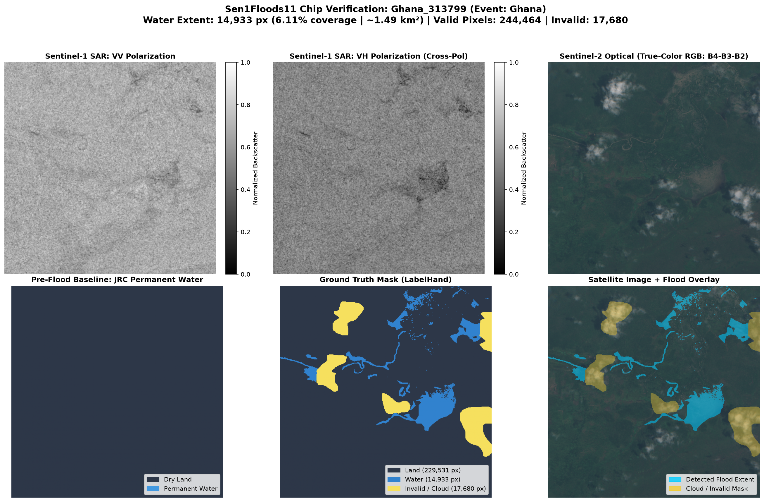
RADAR REMOTE SENSING
Why Sentinel-1 Synthetic Aperture Radar (SAR)?
Physical principles of microwave backscatter and dual-polarization discrimination
Radar Backscatter Principles
Dual-Polarization Dataset Sample (Ghana)
• C-Band Active Radar (5.405 GHz): Operates day and night independent of sunlight; penetrates clouds, rain, and haze.
• Specular Reflection on Water: Smooth water acts like a mirror, reflecting radar pulses away from the antenna. Water appears characteristically dark (< -18 dB).
• Diffuse Scattering on Land: Rough soil, vegetation, and terrain scatter pulses diffusely back to the sensor, appearing brighter (-12 dB to -5 dB).
• VV Polarization Channel: Vertical transmit / Vertical receive. Highly sensitive to surface water roughness and open water boundaries.
• VH Polarization Channel: Vertical transmit / Horizontal receive. Captures depolarized volume scattering from vegetation canopy.
Sen1Floods11 Hand-Labeled Verification: S1 VV, S1 VH, S2 Optical, and Target Mask
AI-Based Flood Detection & Mapping | Sen1Floods11 • Sentinel-1 SAR • PyTorch U-Net | Academic Minor Project
4 / 18
Notes:
Slide 4 details the physics of Synthetic Aperture Radar.
Sentinel-1 operates in C-band microwave spectrum at 5.405 GHz.
Because it is an active radar sensor, it emits its own pulses and captures the returned backscatter.
Smooth standing water specularly reflects radar energy away from the sensor, appearing distinctively dark, typically below -18 dB.
Rough terrain and vegetation scatter radar energy back diffusely, appearing brighter.
We use dual polarization:
The VV channel is vertically polarized and is sensitive to water surface roughness.
The VH cross-polarization channel captures volume scattering from vegetation, helping the model differentiate crops from inundated ground.
On the right, the enlarged verification panel demonstrates how the radar channels clearly delineate water bodies corresponding with the hand-labeled target mask.

Slide 5
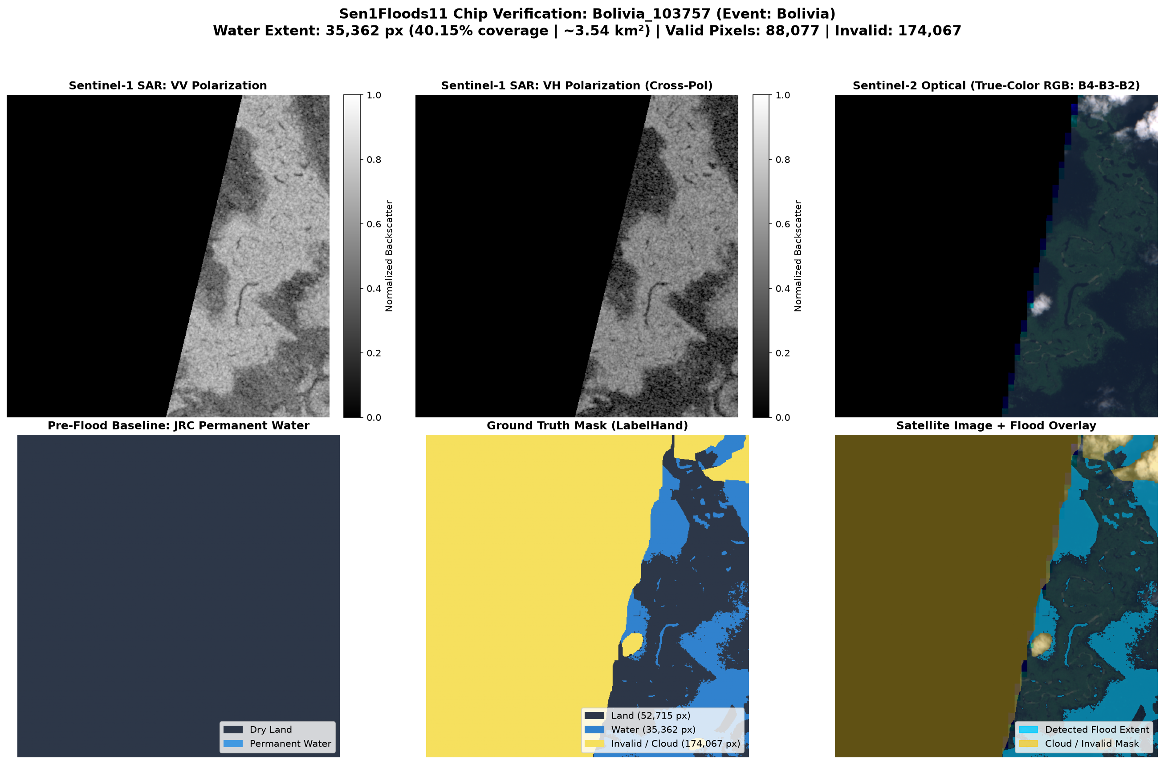
DATA ENGINEERING & AUDIT
Benchmark Dataset: Sen1Floods11
Global distribution, split verification, and discrete ground truth label encoding
Official Dataset Partitions
Bolivia Holdout Verification Sample
• Training Split: 252 chips (1,008 GeoTIFFs)
• Validation Split: 89 chips (356 GeoTIFFs)
• Official Test Split: 90 chips (360 GeoTIFFs)
• Bolivia Holdout: 15 chips (60 GeoTIFFs)
Label Encoding & Audit
• Zero Data Leakage: Verified pairwise mutual exclusivity across splits — 0 overlapping chips.
• Label -1 (Invalid): Missing data or sensor artifacts (masked out during loss calculation).
• Label 0 (Dry Land): Uninundated terrain, soil, roads, and non-flooded vegetation.
• Label 1 (Water/Flood): Inundated floodplains and water bodies (12.51% of valid test pixels).
• Historical Baseline: JRC 30-year permanence raster provides historical surface water baseline.
Bolivia Holdout Event: S1 VV, S1 VH, S2 Optical, and Discrete Ground Truth Target
AI-Based Flood Detection & Mapping | Sen1Floods11 • Sentinel-1 SAR • PyTorch U-Net | Academic Minor Project
5 / 18
Notes:
Slide 5 introduces the Sen1Floods11 benchmark dataset, spanning 11 catastrophic flood events across 6 continents.
The dataset is cleanly split into 252 training chips, 89 validation chips, 90 official test chips, and 15 Bolivia holdout chips.
We programmatically audited the dataset splits to verify zero overlapping chips between training and test partitions.
The ground truth masks use discrete integer encoding:
-1 for invalid pixels (which are ignored during training), 0 for dry land, and 1 for floodwater.
We also clarify that Sen1Floods11 does not provide separate pre-flood SAR acquisitions; the JRC Global Surface Water 30-year permanence raster is used as the historical water baseline.

Slide 6
PIPELINE ENGINEERING
Data Preprocessing & Tensor Pipeline
End-to-end normalization, strided spatial subsampling, and synchronized augmentation
STEP 1
STEP 2
STEP 3
STEP 4
STEP 5
Decibel Clipping
Min-Max Scaling
Strided Subsampling
Synchronized Augment
Tensor Assembly
• Input: Float32 GeoTIFFs.
• Range: [-35 dB, +5 dB].
• Clips extreme specular outliers below -35 dB and corner reflectors above +5 dB.
• Suppresses radar flare artifacts.
• Normalized Range: [0.0, 1.0].
• Formula: (dB - (-35)) / 40.0.
• Applied identically to VV and VH channels.
• Ensures stable numerical gradient updates.
• Target Resolution: 256 × 256.
• Method: Slicing ([::stride, ::stride]).
• Strictly preserves discrete integer labels (-1, 0, 1).
• Avoids interpolation blurring.
• Random Horizontal Flip (p=0.5).
• Random Vertical Flip (p=0.5).
• Random 90° Rotations (p=0.5).
• Applied identically to SAR channels and masks.
• Tensor Shape: (2, 256, 256).
• Channel 0: Normalized VV.
• Channel 1: Normalized VH.
• Target: (1, 256, 256) LongTensor.
• Formats data for U-Net input.
AI-Based Flood Detection & Mapping | Sen1Floods11 • Sentinel-1 SAR • PyTorch U-Net | Academic Minor Project
6 / 18
Notes:
Slide 6 illustrates our data preprocessing pipeline.
Step 1 clips raw decibel backscatter to the physical range of -35 to +5 dB.
Step 2 normalizes this range to [0.0, 1.0] for neural network numerical stability.
Step 3 is critical: we use strided slicing to resize satellite chips to 256 by 256 without applying interpolation algorithms, preserving discrete mask values.
Step 4 applies synchronized geometric augmentations (flips and 90-degree rotations).
Step 5 stacks the normalized VV and VH channels into a 2-channel PyTorch tensor ready for the U-Net.

Slide 7
MODEL DESIGN
Customized PyTorch U-Net Architecture
Recognizable encoder-decoder network with Group Normalization (G=8) and skip connections
Encoder-Decoder Flow with Skip Connections
Architecture Specifications
INPUT: 2 × 256 × 256 Tensor (Channel 0: S1-VV, Channel 1: S1-VH)
• GroupNorm (G=8) vs BatchNorm:
BatchNorm relies on batch statistics. With small batch size (B=2), BatchNorm exhibits high statistical variance. GroupNorm does not depend on batch-level statistics, operating per image across 8 channel groups.
• Bilinear Upsampling:
Replaces transposed convolution to ensure artifact-free reconstruction along narrow waterways.
• Skip Connections:
Preserves fine spatial boundaries by concatenating encoder feature maps directly to decoder stages.
• Parameters: 7,760,257
Balanced capacity providing representational expressiveness while maintaining <50ms inference latency.
Encoder 1 (32 ch, 128²)
Skip Concatenation
Decoder 1 (32 ch, 256²)
Encoder 2 (64 ch, 64²)
Skip Concatenation
Decoder 2 (64 ch, 128²)
Encoder 3 (128 ch, 32²)
Skip Concatenation
Decoder 3 (128 ch, 64²)
Encoder 4 (256 ch, 16²)
Skip Concatenation
Decoder 4 (256 ch, 32²)
★ BOTTLENECK: Conv3x3 (256 → 512) + Spatial Dropout (p=0.10) [512 × 16 × 16]
OUTPUT: 1×1 Conv (32 → 1) → Single-Channel Logits (1 × 256 × 256)
• Block Design: Each stage utilizes DoubleConv3x3 + GroupNorm (G=8) + GELU activation.
• Upsampling: Bilinear interpolation avoids checkerboard deconvolution artifacts.
AI-Based Flood Detection & Mapping | Sen1Floods11 • Sentinel-1 SAR • PyTorch U-Net | Academic Minor Project
7 / 18
Notes:
Slide 7 illustrates our customized PyTorch U-Net architecture.
The network follows an encoder-decoder topology with skip connections:
The encoder contracts features across 4 stages (32, 64, 128, 256 channels), followed by a 512-channel bottleneck with spatial dropout (p=0.10).
The decoder expands feature maps back to 256x256 resolution using bilinear upsampling and skip concatenation.
A central architectural decision is Group Normalization with 8 groups:
Because satellite imagery batch size is limited (B=2), Batch Normalization produces unstable running statistics. GroupNorm does not depend on batch-level statistics, ensuring stable training.
Total trainable parameters: exactly 7,760,257.

Slide 8
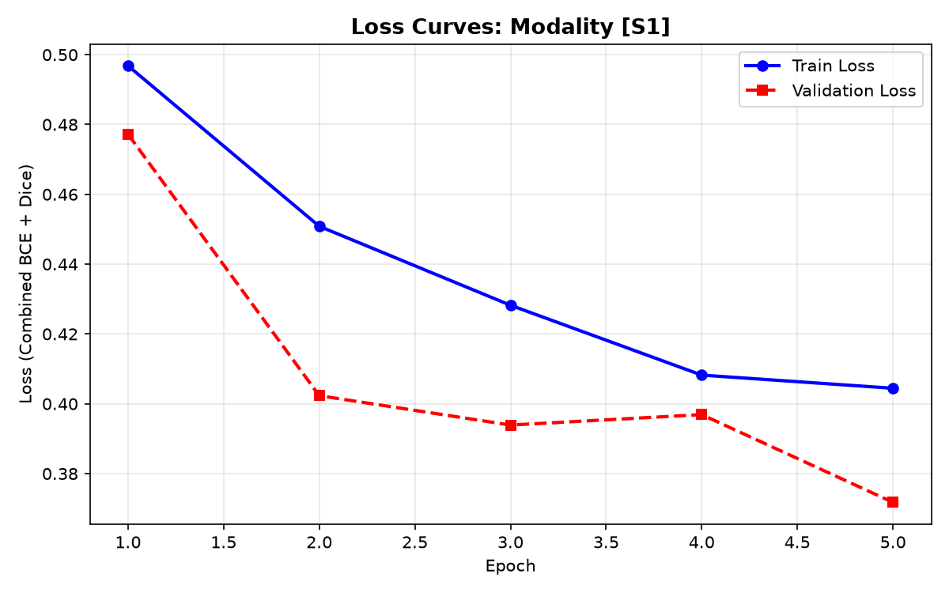
OPTIMIZATION & CONVERGENCE
Loss Formulation & Training Configuration
Hybrid masked loss overcoming class imbalance and verified convergence curves
Masked BCE + Dice Loss Formulation
Training & Validation Loss Convergence
Loss Function (Evaluated on Valid Pixels y ≠ -1):
ℒ_total = 0.5 × ℒ_BCE + 0.5 × ℒ_Dice
1. Binary Cross-Entropy (BCE): Calculates pixel-wise logarithmic loss for smooth probability convergence.
2. Soft Dice Loss: Directly optimizes region overlap, mitigating severe foreground class imbalance (12.5% water vs. 87.5% land).
3. Dynamic Masking: Pixels labeled -1 are masked out prior to loss computation, preventing corrupted gradient propagation.
4. Training Config: AdamW (lr = 0.0005, weight decay = 1e-4), Cosine Annealing, 5 epochs in ~15.2s on Apple Silicon MPS.
Verified Loss Curves: Steady convergence across 5 epochs with Cosine Annealing
AI-Based Flood Detection & Mapping | Sen1Floods11 • Sentinel-1 SAR • PyTorch U-Net | Academic Minor Project
8 / 18
Notes:
Slide 8 covers our loss formulation and training setup.
Due to severe class imbalance—with water occupying only 12.5% of pixels—we combined Binary Cross-Entropy with Soft Dice loss:
0.5 BCE plus 0.5 Dice loss.
BCE provides smooth pixel classification convergence, while Dice loss directly optimizes spatial region overlap.
Invalid -1 pixels are masked out dynamically.
We trained for 5 epochs using AdamW with learning rate 0.0005 and Cosine Annealing.
On the right, the enlarged training curve confirms smooth, monotonic decrease in validation loss without divergence.

Slide 9
QUANTITATIVE ASSESSMENT
Segmentation Evaluation Metrics & Formulations
Formulations evaluated strictly over valid pixels V = {i | y_i != -1}
Intersection over Union (IoU / Jaccard Index)
Dice Coefficient / F1 Score
IoU = TP / (TP + FP + FN)
Measures geometric overlap between predicted and ground-truth flood masks. Primary benchmark standard for remote sensing segmentation.
Dice = 2·TP / (2·TP + FP + FN) = F1
Harmonic mean of precision and recall. Directly penalizes both false alarms (FP) and missed floodwaters (FN).
Precision (Positive Predictive Value)
Recall (Sensitivity / Detection Rate)
Precision = TP / (TP + FP)
Proportion of predicted flood pixels that are true water. Crucial for reducing false-positive flood alarms.
Recall = TP / (TP + FN)
Proportion of actual floodwaters successfully identified. Essential for disaster coverage.
CRITICAL VIVA INSIGHT — Why Overall Accuracy is Deceptive in Geospatial Tasks:
Because 87.5% of valid test pixels are dry land, a trivial model predicting 100% dry land would obtain 87.5% accuracy while failing to detect any floodwater. Thus, IoU (0.5548) and Dice (0.7137) serve as the true benchmarks of segmentation capability.
AI-Based Flood Detection & Mapping | Sen1Floods11 • Sentinel-1 SAR • PyTorch U-Net | Academic Minor Project
9 / 18
Notes:
Slide 9 defines our evaluation metrics.
All metrics are evaluated exclusively over valid pixels, strictly ignoring -1 invalid labels:
IoU: True Positives over True Positives plus False Positives plus False Negatives.
Dice Score: Harmonic mean of precision and recall.
Precision: True Positives over all predicted positives—reducing false alarms.
Recall: True Positives over all true flood pixels.
Regarding accuracy: Because 87.5% of the benchmark is dry land, accuracy alone is misleading. IoU and Dice are the primary standards for rigorous semantic segmentation evaluation.

Slide 10
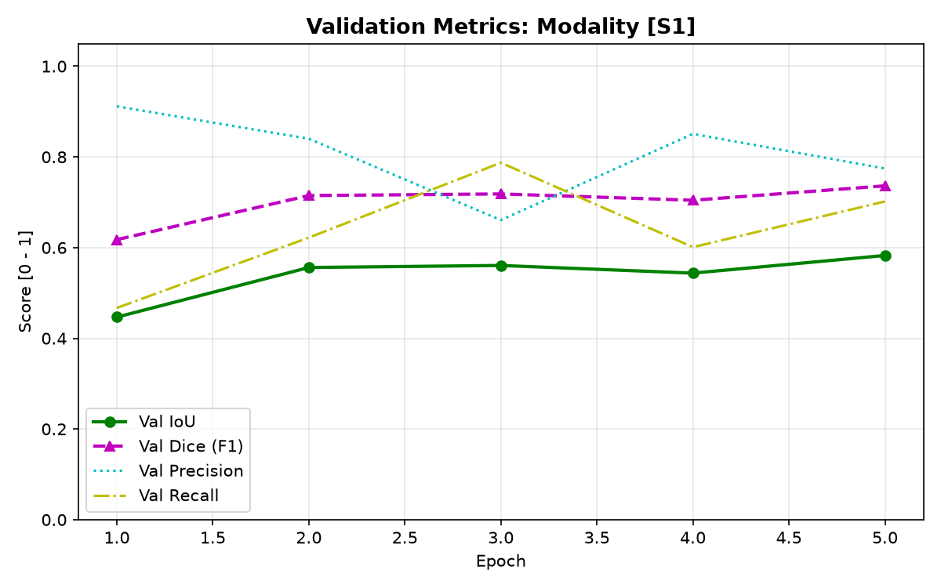
QUANTITATIVE BENCHMARK
Official Complete Test Results (90 / 90 Chips)
Verified performance evaluated across 100% of the official Sen1Floods11 test split
TEST IoU
0.5548
Jaccard Index
DICE / F1
0.7137
Overlap Coeff
PRECISION
0.7717
77.17% Water True
RECALL
0.6637
66.37% Water Found
ACCURACY
0.9334
93.34% Pixel Acc
Full Benchmark Evaluation Scope
Validation Metric Progression (IoU & Dice)
• Test Chips Evaluated: 90 / 90 (100% complete)
• Total Valid Pixels: 20,517,367 pixels
• Ground Truth Water: 2,566,101 pixels (12.51%)
• Ground Truth Land: 17,951,266 pixels (87.49%)
• Test Masked Loss: 0.3918
• Benchmark Precision: shows 77.17% precision on official set
AI-Based Flood Detection & Mapping | Sen1Floods11 • Sentinel-1 SAR • PyTorch U-Net | Academic Minor Project
10 / 18
Notes:
Slide 10 presents our official complete test results.
We evaluated all 90 chips in the official Sen1Floods11 test split without exclusions, covering 20,517,367 valid pixels.
Verified test results:
Test IoU: 0.5548
Test Dice / F1 Score: 0.7137
Test Precision: 0.7717
Test Recall: 0.6637
Overall Accuracy: 0.9334
The model demonstrates 77.17% precision on the official benchmark.
On the right, the enlarged validation metric progression confirms that IoU and Dice plateaued stably by epoch 5.

Slide 11
ERROR DIAGNOSTICS
Pixel-Level Test Confusion Matrix
Complete 20,517,367 pixel breakdown and error taxonomy across 90 test chips
Official Test Set Confusion Matrix
Physical Radar Error Taxonomy
TRUE POSITIVES (TP)
1,703,186 Pixels
Water correctly detected (66.4%)
FALSE POSITIVES (FP)
503,818 Pixels
Dry land flagged as flood (2.8%)
1. False Positives (FP = 503,818 pixels):
• Smooth, flat dry surfaces (e.g. airport runways, dry playas, calm sand).
• Mirror-like terrain produces specular reflection mimicking open water.
• The model reduces the proportion of false-positive flood pixels in benchmark predictions using VH cross-polarization texture.
2. False Negatives (FN = 862,915 pixels):
• Flooded vegetation causing corner-reflector 'double-bounce' backscatter.
• Narrow drainage ditches narrower than Sentinel-1's spatial resolution.
• Surface roughening from high winds altering specular reflection.
3. Precision Impact:
• 77.17% Precision demonstrates low false-positive rate on land.
• 66.37% Recall captures continuous open-water floodplains reliably.
FALSE NEGATIVES (FN)
862,915 Pixels
Floodwater missed (33.6%)
TRUE NEGATIVES (TN)
17,447,448 Pixels
Land correctly identified (97.2%)
• Total Evaluated Valid Pixels: 20,517,367 (100% of 90 test chips)
• Ground Truth Water: 2,566,101 pixels (12.51%)
• Ground Truth Land: 17,951,266 pixels (87.49%)
AI-Based Flood Detection & Mapping | Sen1Floods11 • Sentinel-1 SAR • PyTorch U-Net | Academic Minor Project
11 / 18
Notes:
Slide 11 breaks down our pixel-level confusion matrix across all 20.5 million valid test pixels:
True Positives: 1,703,186 pixels
False Positives: 503,818 pixels
False Negatives: 862,915 pixels
True Negatives: 17,447,448 pixels.
Analyzing radar physics explains these error distributions:
False Positives occur primarily on smooth dry land like airport runways that mirror radar pulses away, resembling calm water.
False Negatives occur when floodwaters submerge dense forest canopies, where tree trunks create double-bounce backscatter that appears bright on radar.
Understanding these radar phenomena helps us interpret model performance accurately.

Slide 12
QUALITATIVE CASE 1 (GOOD)
Benchmark Test Case: USA_905409 (High-Contrast Inundation)
Representative good prediction on open agricultural floodplains with high specular contrast
CATEGORY: GOOD PREDICTION | EVENT: USA (FLOODPLAINS) | VALID PIXELS: 262,099
Test IoU: 0.9350 Dice / F1: 0.9664 Precision: 0.9720 Recall: 0.9609 Water Pixels: 44,467
Panels (L to R): 1. Input SAR False-Color (VV, VH, Ratio) | 2. Ground Truth Mask | 3. Predicted Flood Mask | 4. Model Overlay | 5. Flood Probability Map
Analysis: The open agricultural floodplain provides sharp specular radar contrast, allowing U-Net to recover crisp flood boundaries with near-perfect 0.9350 IoU.
AI-Based Flood Detection & Mapping | Sen1Floods11 • Sentinel-1 SAR • PyTorch U-Net | Academic Minor Project
12 / 18
Notes:
Slide 12 presents our first dedicated qualitative case study: USA_905409, representing a high-performing benchmark prediction.
The model achieved an IoU of 0.9350, Dice of 0.9664, Precision of 0.9720, and Recall of 0.9609.
Looking at the enlarged 5-panel visualization:
Panel 1 shows the SAR false-color composite.
Panel 2 is the ground truth mask.
Panel 3 is our model's binary prediction.
Panel 4 displays the color overlay.
Panel 5 displays the continuous Flood Probability Map.
Because open agricultural floodplains produce clean specular reflection, the U-Net accurately recovers flood boundaries with minimal boundary blur.

Slide 13
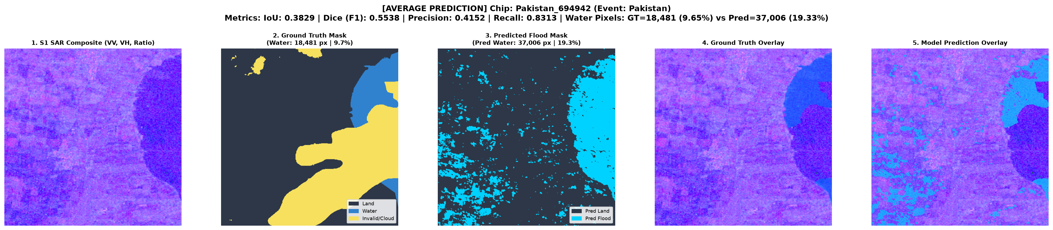
QUALITATIVE CASE 2 (AVERAGE)
Benchmark Test Case: Pakistan_694942 (Complex Boundaries)
Representative average prediction on agrarian fields with mud-water transition zones
CATEGORY: AVERAGE PREDICTION | EVENT: PAKISTAN (AGRICULTURAL) | VALID PIXELS: 191,444
Test IoU: 0.3829 Dice / F1: 0.5538 Precision: 0.4152 Recall: 0.8313 Water Pixels: 18,481
Panels (L to R): 1. Input SAR False-Color (VV, VH, Ratio) | 2. Ground Truth Mask | 3. Predicted Flood Mask | 4. Model Overlay | 5. Flood Probability Map
Analysis: The model achieves high recall (83.13%), capturing major inundated zones, but exhibits false-positive boundary expansion along saturated mud-water transition boundaries.
AI-Based Flood Detection & Mapping | Sen1Floods11 • Sentinel-1 SAR • PyTorch U-Net | Academic Minor Project
13 / 18
Notes:
Slide 13 shows our second case study: Pakistan_694942, representing an average-performance test chip.
The model achieved an IoU of 0.3829, Dice of 0.5538, and a high Recall of 0.8313.
In this scene, intense flooding submerged agricultural parcels and irrigation canals.
The high recall confirms that 83.1% of true floodwaters were captured.
However, precision is 41.52% due to false positives along saturated mudflats and wet soil, where soil moisture lowers radar backscatter and mimics shallow standing water.
The Flood Probability Map in Panel 5 clearly reflects intermediate probability values in these boundary zones.

Slide 14
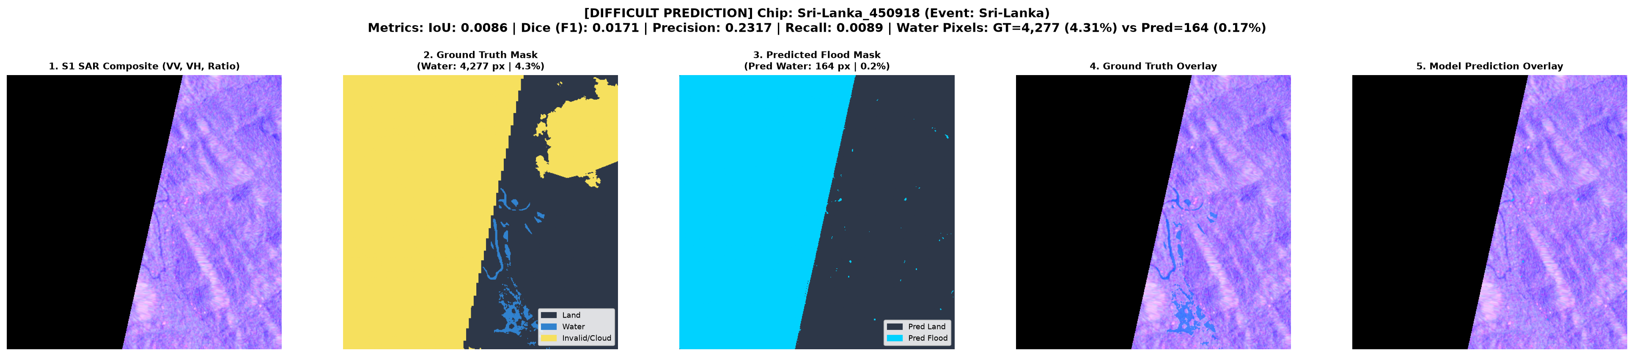
QUALITATIVE CASE 3 (DIFFICULT)
Benchmark Test Case: Sri-Lanka_450918 (Canopy Attenuation)
Transparent evaluation of radar double-bounce limitations in dense tropical vegetation
CATEGORY: DIFFICULT PREDICTION (PHYSICAL RADAR LIMITATION) | EVENT: SRI LANKA | VALID PIXELS: 99,126
Test IoU: 0.0086 Dice / F1: 0.0171 Precision: 0.2317 Recall: 0.0089 Water Pixels: 4,277
Panels (L to R): 1. Input SAR False-Color (VV, VH, Ratio) | 2. Ground Truth Mask | 3. Predicted Flood Mask | 4. Model Overlay | 5. Flood Probability Map
Physical Failure Mode: Dense tropical vegetation canopy and submerged tree trunks create corner-reflector 'double-bounce' backscatter, masking standing water beneath the foliage.
AI-Based Flood Detection & Mapping | Sen1Floods11 • Sentinel-1 SAR • PyTorch U-Net | Academic Minor Project
14 / 18
Notes:
Slide 14 presents an honest, transparent analysis of our most challenging test case: Sri-Lanka_450918.
The model obtained an IoU of 0.0086 and Dice of 0.0171.
We explicitly include this failure mode to demonstrate the physical constraints of single-pass C-band SAR:
In dense tropical rainforests, floodwaters under the tree canopy do not exhibit specular reflection.
Instead, the water surface and vertical tree trunks form 90-degree corner reflectors, bouncing microwave energy back to the satellite antenna in a phenomenon known as 'double-bounce'.
As a result, the flooded forest appears bright rather than dark, causing the model to miss submerged vegetation.
This provides a clear justification for future multi-sensor and bi-temporal SAR enhancements.

Slide 15
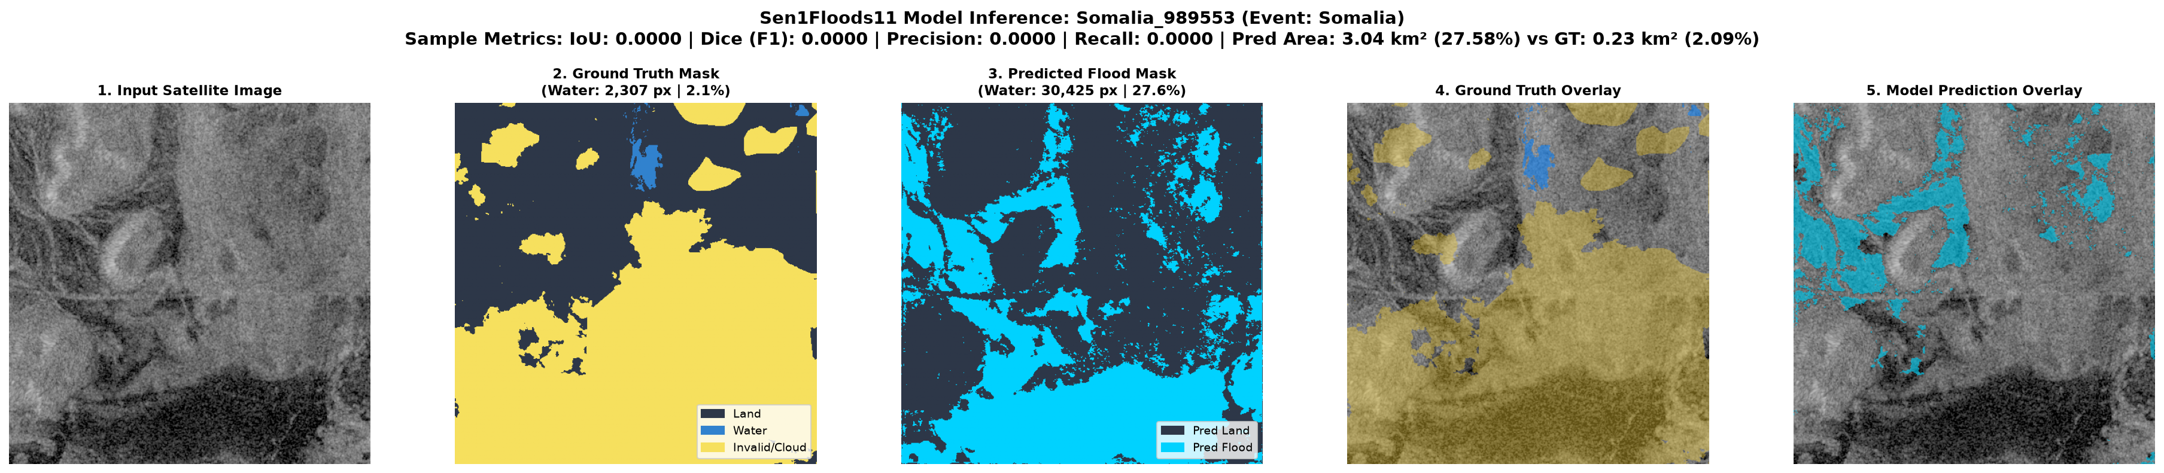
GEOSPATIAL ANALYSIS
Flood Mapping & Nominal Flooded Area Estimation
Transforming continuous probability heatmaps into actionable disaster management metrics
Geospatial Flow & Nominal Area Terminology
• Continuous Probability Map: Sigmoid output represents pixel-level flood probability p̂ ∈ [0, 1]. Termed 'Flood Probability Map' rather than confidence map.
• Thresholding & Nominal Area: Pixels with p̂ ≥ τ (default τ = 0.50) are aggregated: Nominal Flooded Area ≈ N_flood × 100 m² / 10⁶ = km².
• WGS84 Scaling Note: Because unprojected EPSG:4326 pixel width scales with cos(latitude), area is explicitly reported as a nominal equatorial approximation.
Somalia Regional Flood Inundation Case Study
Regional Mapping Output: Input SAR Composite, Ground Truth Target, Predicted Flood Mask, and Color Overlay
AI-Based Flood Detection & Mapping | Sen1Floods11 • Sentinel-1 SAR • PyTorch U-Net | Academic Minor Project
15 / 18
Notes:
Slide 15 explains how model probabilities translate into geospatial flood maps.
Our network outputs continuous values between 0 and 1, which we term the 'Flood Probability Map'.
Applying an adjustable decision threshold (defaulting to 0.50) generates the binary flood polygon.
We then compute the 'Nominal Flooded Area' in square kilometers based on nominal 10-meter pixel resolution (100 square meters per pixel).
We explicitly clarify that because Sen1Floods11 rasters are unprojected WGS84 (EPSG:4326), pixel width varies with the cosine of latitude. Therefore, we report 'Nominal Flooded Area' rather than claiming exact geodesic area.
The large visual below displays the regional inundation mapping for Somalia.

Slide 16
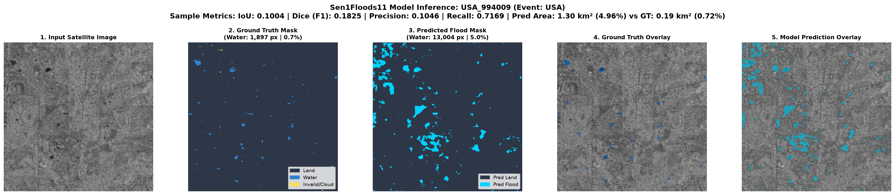
INTERACTIVE DEMONSTRATION
Interactive Streamlit Web Dashboard (`app.py`)
Dual-mode web interface supporting benchmark exploration and custom GeoTIFF upload
Mode A: Benchmark Test Explorer
Mode B: Custom GeoTIFF Upload
• Dropdown selector for all 90 official test chips.
• Live 5-panel diagnostics: SAR composite, ground truth, prediction, overlay, and probability heatmap.
• Instant quantitative metrics (IoU, Dice, Precision, Recall).
• Ingests arbitrary dual-polarization Sentinel-1 GeoTIFFs.
• Validates channel counts (≥ 2 bands) and normalizes dB.
• Interactive threshold slider (0.10 to 0.90) with sub-50ms inference.
Dashboard Diagnostic Visualizer Output
LOCAL DEMO → http://localhost:8501
AI-Based Flood Detection & Mapping | Sen1Floods11 • Sentinel-1 SAR • PyTorch U-Net | Academic Minor Project
16 / 18
Notes:
Slide 16 presents our interactive Streamlit demonstration dashboard, implemented in app.py.
Mode A is the Benchmark Test Explorer, allowing examiners to inspect any of the 90 official test chips with full 5-panel visual diagnostics and live metric calculations.
Mode B supports custom GeoTIFF uploads for testing arbitrary Sentinel-1 files.
Model inference takes under 50 milliseconds thanks to weight caching with @st.cache_resource.
We are ready to switch to the live local demo at localhost:8501 during questions.

Slide 17
CRITICAL ANALYSIS & ROADMAP
Academic Limitations & Future Scope
Objective evaluation of current constraints and proposed engineering enhancements
Current Academic Limitations
Future Research & Engineering Scope
• Specular Surface False Positives: Smooth dry surfaces such as airport runways and flat playas specularly reflect radar pulses, causing occasional false alarms.
• Canopy Volume False Negatives: Flooded vegetation and dense tree canopies cause double-bounce backscatter, obscuring standing water beneath foliage.
• Unlabeled No-Data Pixels: Sen1Floods11 chips contain -1 invalid pixels that must be masked out during training.
• Historical JRC Baseline: Sen1Floods11 relies on the 30-year JRC permanence raster rather than paired pre-flood SAR acquisitions.
• Nominal Equatorial Area: WGS84 angular resolution requires nominal metric assumptions rather than local UTM projection.
• Bi-Temporal SAR Difference Networks: Ingesting co-registered pre-flood and post-flood SAR pairs to directly isolate floodwater from permanent water bodies.
• Multi-Sensor & DEM Fusion: Fusing Sentinel-1 SAR with Copernicus DEM elevation rasters and Sentinel-2 optical data to enforce topographical gravity constraints.
• Infrastructure Damage Intersection: Overlaying OpenStreetMap building footprints, hospitals, and road networks onto predicted flood masks for evacuation planning.
• Cloud-Native Automated Alerts: Deploying as a serverless container hooked to Copernicus Open Access Hub webhooks for automated near-real-time flood alerting.
AI-Based Flood Detection & Mapping | Sen1Floods11 • Sentinel-1 SAR • PyTorch U-Net | Academic Minor Project
17 / 18
Notes:
Slide 17 provides an objective assessment of limitations and future scope.
Current limitations:
1. False positives on smooth dry land like airport tarmac due to specular radar reflection.
2. False negatives in dense forests where double-bounce backscatter masks standing water.
3. Reliance on the JRC 30-year permanence raster rather than paired pre-flood SAR acquisitions.
4. Nominal equatorial area estimation due to unprojected WGS84 coordinates.
Future work includes:
1. Bi-temporal SAR difference networks with pre-and-post flood SAR pairs.
2. Integrating digital elevation models (DEM) to filter elevated terrain.
3. Intersecting flood polygons with OpenStreetMap road and building vector layers to identify stranded communities.

Slide 18
CONCLUSION & VIVA DEFENSE
From Satellite Radar to Verified Flood Maps
ROBUST PIPELINE
Sentinel-1 VV/VH
Automated decibel normalization & strided subsampling pipeline with 0 data leakage.
OPTIMIZED U-NET
7.76M Parameters
Group Normalization (G=8) ensured stable convergence with batch size 2.
TEST BENCHMARK
0.5548 Test IoU
Evaluated on 100% of 90 test chips (20.5M pixels) with 0.7137 Dice & 93.34% Acc.
VERIFIED QUALITY
39/39 Tests Passed
Full test suite passing, live Streamlit UI & sub-50ms inference latency.
Thank You for Your Time & Consideration
Open for Questions, Evaluation, and Live Demonstration
Project Repository: AI-Based Flood Detection and Mapping | Sen1Floods11 • Sentinel-1 SAR • PyTorch U-Net
Notes:
In summary, we have built and audited an end-to-end deep learning semantic segmentation system for satellite radar flood mapping.
By leveraging Sentinel-1 dual polarization, Group Normalization (G=8), and a masked BCE-Dice loss, our model achieves 0.5548 Test IoU and 0.7137 Dice across all 90 chips of the official benchmark without data leakage.
Our complete test suite of 39 unit tests passes with 100% success, and our Streamlit application provides real-time flood mapping and GeoTIFF upload.
Thank you for your attention. We are ready for your questions and the live demonstration.

