Slide 1




Multi-Intent Classification in Chatbots Final VIVA
Project Guide
Dr. E. Sivasankar
Project Team Members
106118058 Asif
106118085 Sampurn
106118116 Supria

Slide 2
Introduction
Goals :
To implement various intent classification algorithms and compare their performance on datasets with the aim of deciding the best approach and implementing the said algorithm to develop a chatbot for our institute's website.
To Experiment and improve on the performance of the mentioned techniques by adapting Google’s Bidirectional Encoding Representations using Transformers (BERT)
Analyze, Evaluate and compare the mentioned techniques using appropriate metrics
Why Chatbot for the institute?
Helps an organization to reach out to its daily visitors of official website
Solve issues at the earliest without any hassle
As queries from the users might not always be clear, intent classification aims to understand the user’s goals in order to deliver the suitable response.
Concepts:
NLP; Chat-Bot; Multi-Intent Classification ; Neural Networks; Word Embeddings; ML

Slide 3
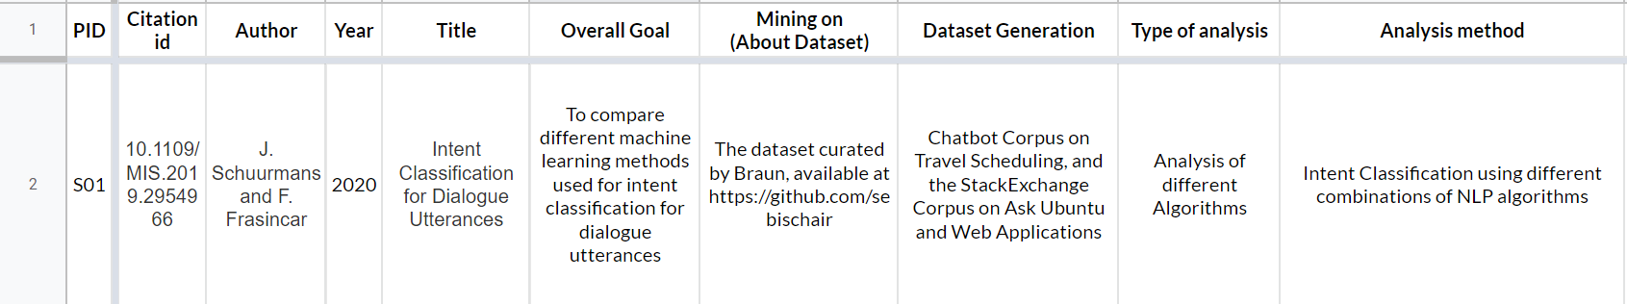
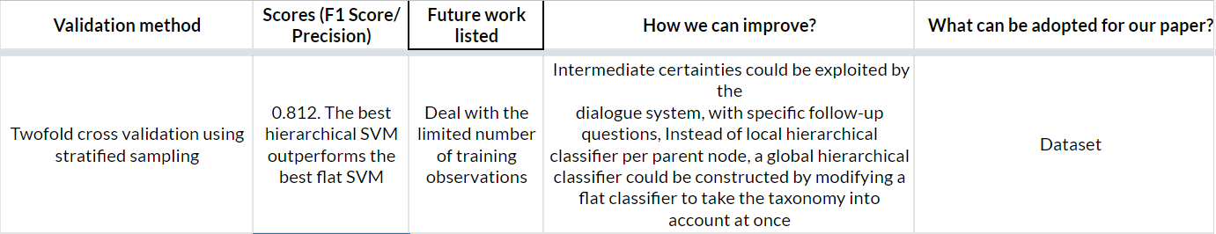
Literature Survey

Slide 4
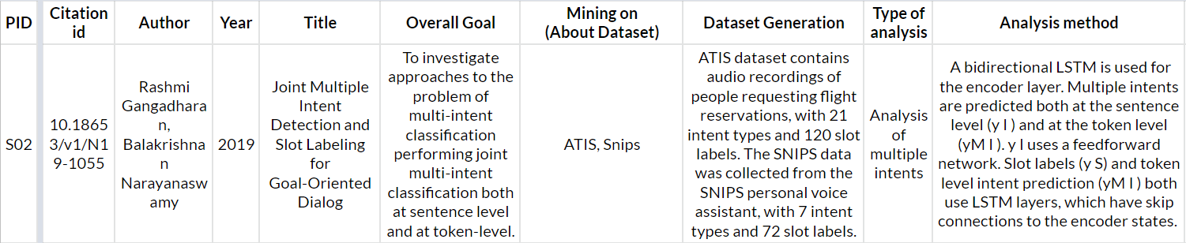
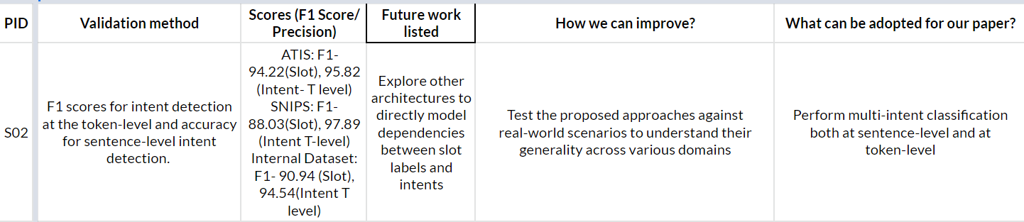
Literature Survey

Slide 5
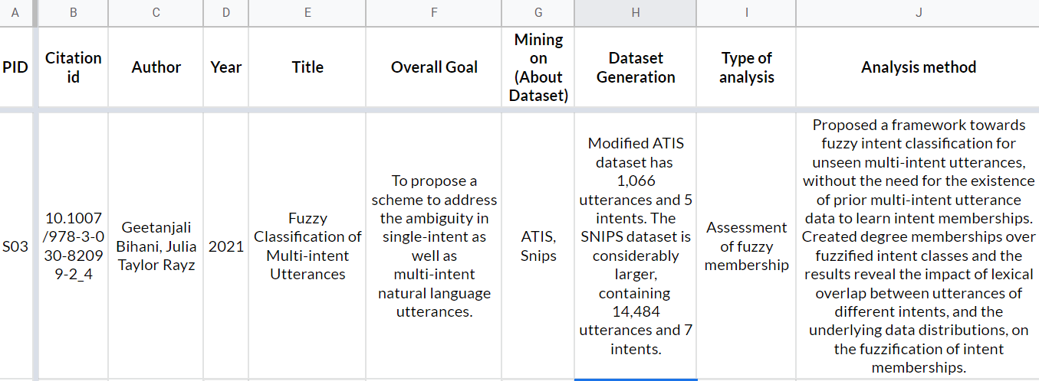
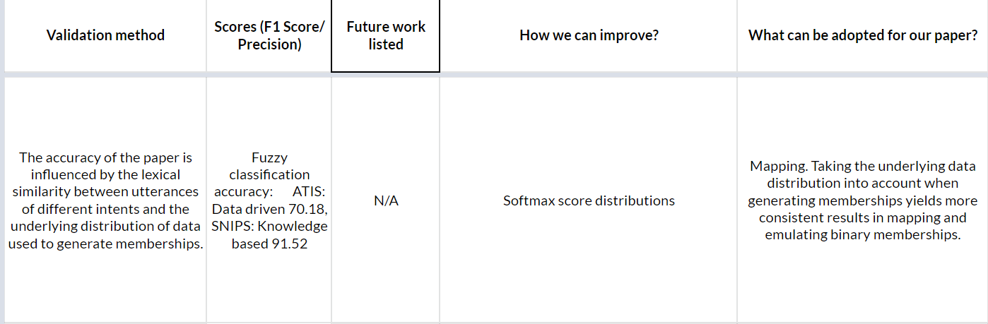
Literature Survey

Slide 6
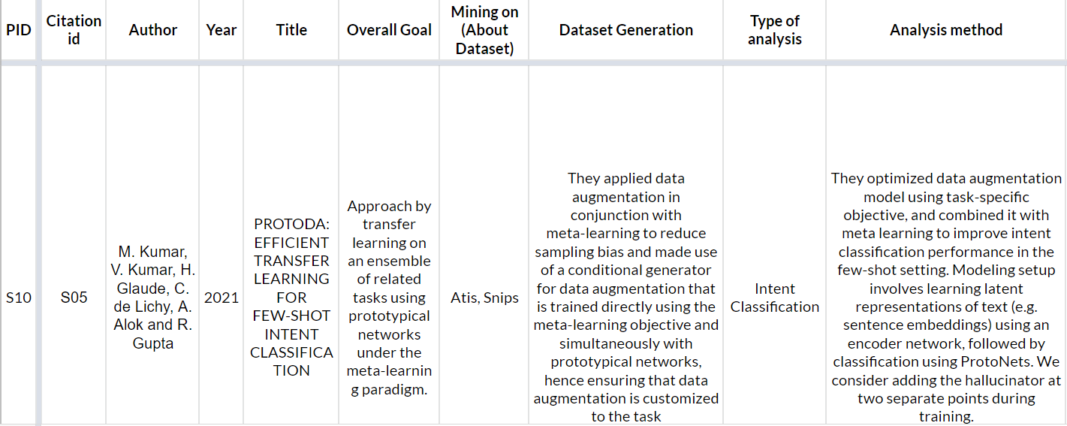
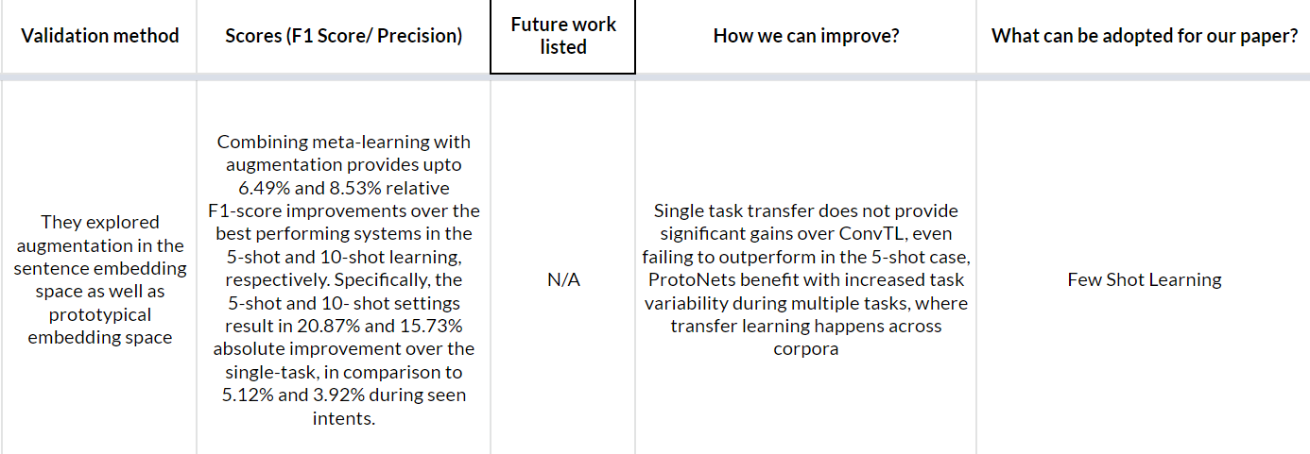
Literature Survey

Slide 7
Issues in solving the problem and Gaps from literature
In all the existing works, the authors have used AI and NLP algorithms only. So, any new type of query will not be answered.
We have to deal with the limited number of training observations.
A global hierarchical classifier could be constructed
More architectures have to be explored to directly model dependencies between slot labels and intents
Issues are there for multilingual sentence embeddings. Some languages are performing extremely well and some really poor.
Multi-intent classification will be used. So, in one query itself user can get multiple tasks done.
Our future work zero-shot learning and few-shot learning can be used for model training and validation which will ensure that our Chat-Bot can be used for multiple purposes and keeps on expanding its features.

Slide 8
Problem Statement and Objectives
Problem Statement: Multi Intent Classification in Chatbots.
Objectives:
Make a multi-purpose chatbot which will respond to all types of possible queries
Initially, we are implementing it for our college’s website , but it can be further extended.
Multi-intent classification will be used. So, in one query itself user can get multiple tasks done.
BERT and JSON responses will ensure that our Chatbot can be used for multiple purposes and keeps on expanding its features.

Slide 9
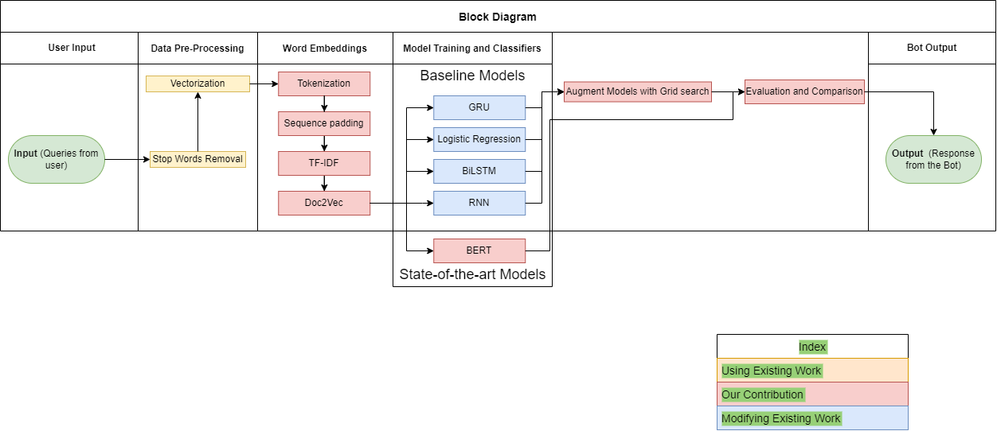
Block Diagram

Slide 10
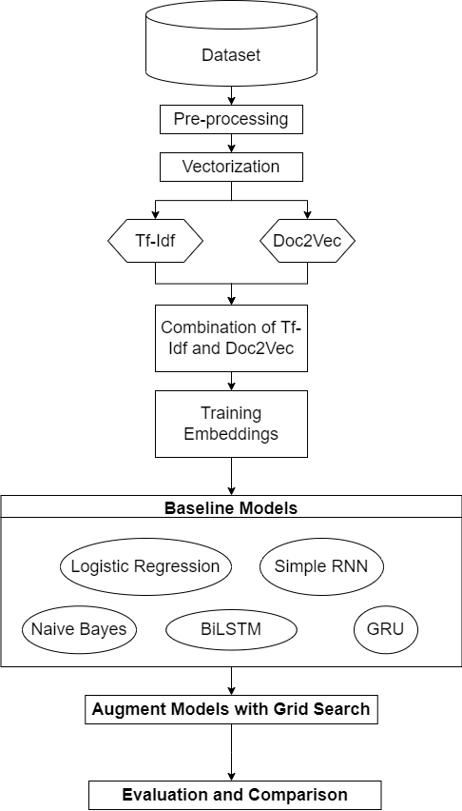
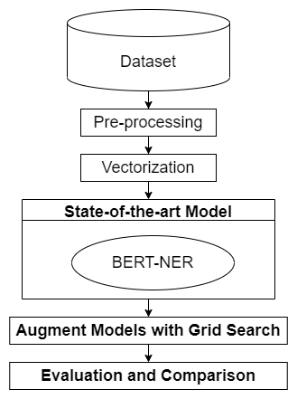
Flow Chart
Fig: Methodology Flowchart – State of the art Models
Fig: Methodology Flowchart – Baseline Models

Slide 11
Implementation details:
Stop words removal
Removing the words that occur commonly across the input text in the corpus.
Stemming and Lemmatization
Reducing a word to its word stem that affixes to suffixes and prefixes or to the roots of words known as a lemma.
Tokenization
Splitting a phrase, sentence, paragraph, or an entire text document into smaller units, such as individual words or terms. Each of these smaller units will be called tokens.
Sequence padding
Ensuring that all sequences in a list have the same length
Proposed System:
Data Pre-processing

Slide 12
Algorithm
Model Training and Classification:
Naive Bayes
The Naive Bayes classifier is based on the Bayes theorem which is used for predictive modeling.
It is used Where the dimensionality of the inputs is high and the predictors are independent.
It is a family of simple probabilistic classifiers ,and based on a common assumption that given the category variable, all features are independent of each other.
“Probabilistic classifiers” coupled with kernel density estimation is used to achieve higher accuracy levels in our project .
Bi-LSTM
Bi-Directional Long short-term memory (Bi-LSTM) is used for classifying, processing and making predictions based on time series data, since there can be lags of unknown duration between important events in a time series.
The primary difference between an LSTM model and a GRU model is, LSTM model has three gates: input, output, and forget gates whereas the GRU model has two gates.
Being an extension of the traditional LSTMs, Bidirectional LSTMs can improve model performance on sequence classification problems.
Bidirectional LSTMs train two instead of one LSTMs on the input sequence in the problems where all time=steps of the input sequence are available.

Slide 13
Algorithm
SVM
Support vector machines (SVMs) will be used for doing both classification and regression.
Here we have taken different kernels like Linear, Poly, Rbf and Sigmoid
GRU
GRU is an improved version of the RNN model.
We have replaced the SimpleRNN layer with a bidirectional GRU layer and kept the same number of units
Logistic Regression
Given an input variable, LR is the process for modelling the probability of a discrete outcome.
LR is our best working Baseline Model.
It models a binary outcome that can take two values such as true/false, yes/no, and so on
RNN
The RNNs are one of the the states of the algorithm in the deep learning since it is good for sequential data.
They have internal memory so they can remember the input from previous layers. This is the reason RNN have edge over regular RNN when it comes to sequential data like text data, sentiment analysis, music generation, weather forecasting, time series.
Here in this model, the first layer will be the embedding layer. Sentences will be represented as max length by embedding dim vectors and the next layer is a simple RNN layer. At last, the dense layers

Slide 14
Algorithm
Model Prediction:
BERT: We will be using BERT for the prediction of intents given to us through the API chatbot.
Precisely we will use Named Entity Recognition(NER) for the classification of words as B-per, B-org, O, I-per, B-Loc, and many more
The BERT will classify the query on the basis of different classes of intents present
The predicted intents have a mapping in the JSON responses. For each type of intent, there are responses mapped to it.
Hence we get responses as per the query made.

Slide 15
ATis Dataset
The ATIS dataset is a standard benchmark dataset widely used as an intent classification.
ATIS Stands for Airline Travel Information System.
It consists of audio recordings and corresponding manual transcripts about humans asking for flight information on automated airline travel inquiry systems.
The data consists of 17 unique intent categories.
ATIS dataset provides large number of messages and their associated intents that can be used in training a classifier and what makes it so effective is that the speech has many of the characteristics of spontaneous spoken language (e.g., disfluencies, false starts, and colloquial pronunciations)
Link: https://paperswithcode.com/dataset/atis

Slide 16
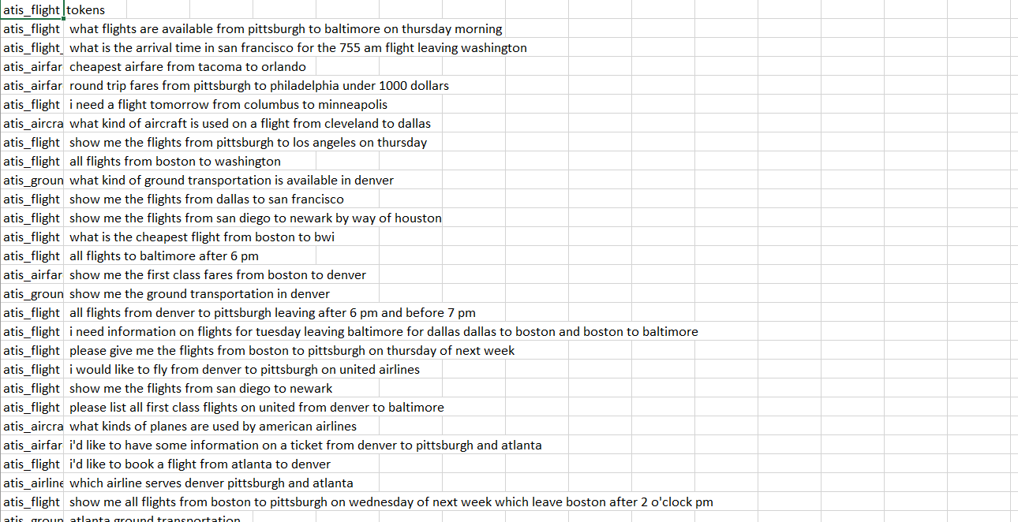
ATis Dataset

Slide 17
Snips Dataset
The SNIPS[7] Natural Language Understanding benchmark is a popularly used dataset
It contains 16,000 crowd sourced queries that is distributed among 7 user intents of various complexity:
SearchCreativeWork (e.g. Find me the I, Robot television show),
GetWeather (e.g. Is it windy in Boston, MA right now?),
BookRestaurant (e.g. I want to book a highly rated restaurant in Paris tomorrow night),
PlayMusic (e.g. Play the last track from Beyonc ́e off Spotify),
AddToPlaylist (e.g. Add Diamonds to my roadtrip playlist),
RateBook (e.g. Give 6 stars to Of Mice and Men),
SearchScreeningEvent (e.g. Check the showtimes for Wonder Woman in Paris).
The training set comprises of 13,084 utterances. Then there’s the validation set and the test set contain 700 utterances each, with 100 queries per intent.
Link: https://paperswithcode.com/dataset/snips

Slide 18
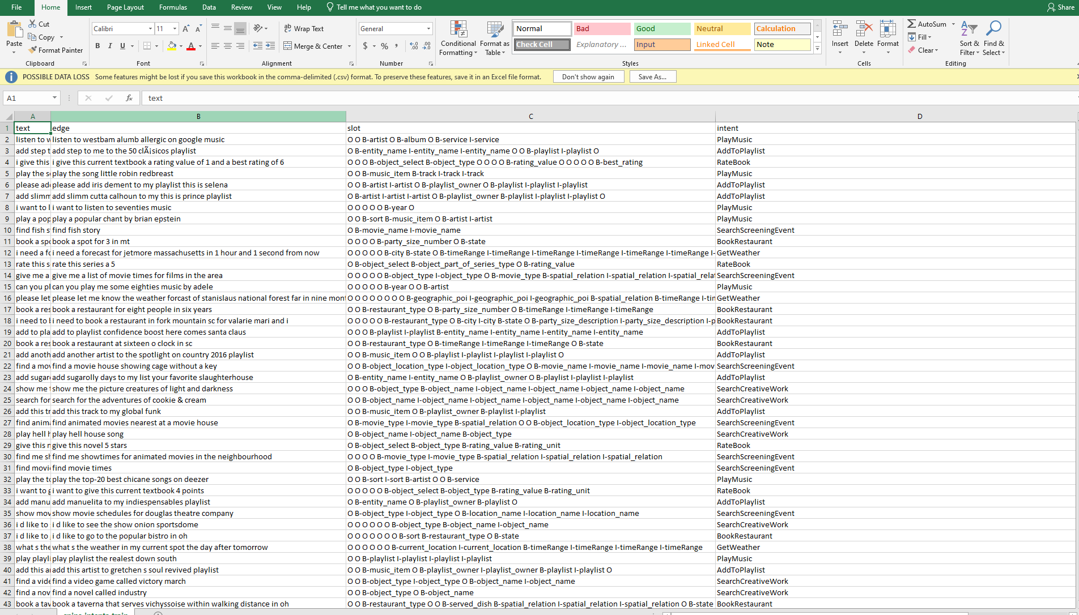
Snips Dataset

Slide 19
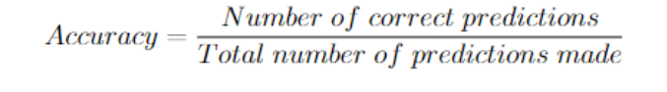



Evaluation Metrics with Formula
The measures that have been used to evaluate the performance of the models are -
accuracy and F1 score.
Accuracy refers to the ratio of correct predictions to the total number of instances present in the dataset. The accuracy is given by:
F1 score is defined as a weighted average of precision and recall. The formula is:
Where Precision is defined as:
The recall is given by the formula:
Where in the above equations, TP stands for True Positive, FP stands for False Positive and FN stands for False Negative

Slide 20
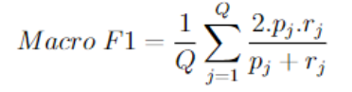

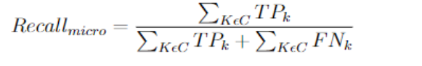

Evaluation Metrics with Formula
Macro-F1 is the harmonic mean between precision and recall.
Here, the average is calculated per label and it’s then averaged across all the labels. If pj and rj are the precision and recall for all λj ε h( xj ) from λj ε yi the macro- f1 is,
Micro-F1 Score is used for assessing the quality of multi-label binary problems. It measures the F1-score of the aggregated contributions of all classes. Because od perfect micro-precision and micro-recall, Micro f1-score is considered as the best value, and the worst value will be 0. Suppose, C is the Number of classes and K ε C
Micro F1-Score is defined as the harmonic mean of the precision and recall:
Weighted-F1 score is measured by taking the mean of all per-class F1 scores and each class’s support is considered.

Slide 21
Test Cases
Test Case Id | Module | Input | Expected Output
tc_0_1 | Data Extraction-ATIS | Dataset of CSV file | Array of sentences and related intents
tc_0_2 | Data Extraction-SNIPS | Dataset of CSV file | Array of sentences and related intents
tc_0_3 | Data Cleaning and Tokenization | Array of sentences | Array of tokenized words with removal of unnecessary words
tc_0_4 | Model training (baselines) | Cleaned tokenized words | Predicted the intents possible for that sentences
tc_0_5 | Bert Model | User input from API | Predicted response from Json response files

Slide 22
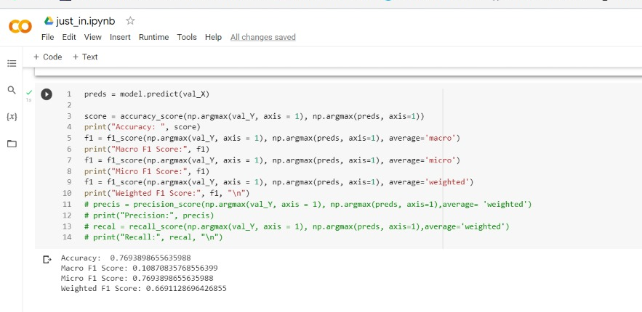
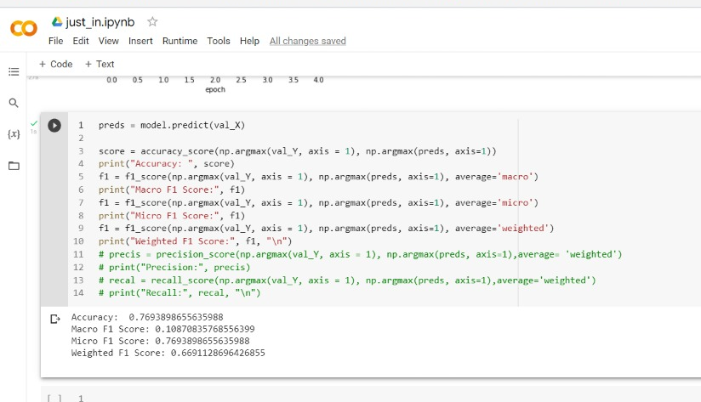
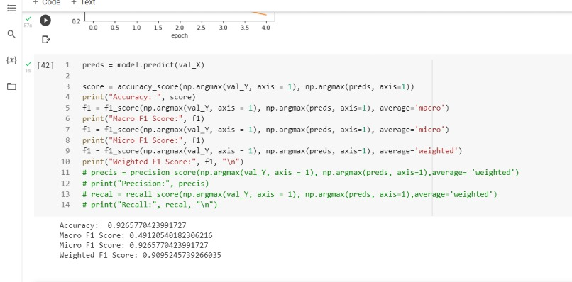
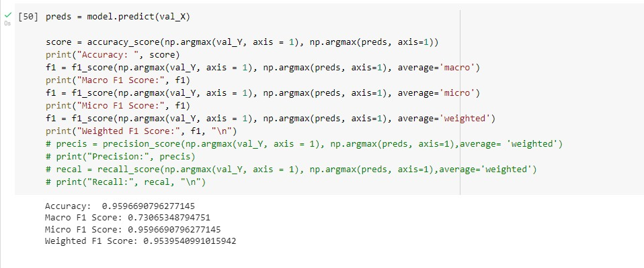
Screenshots:
Simple RNN: GRU:
F
BiLSTM: Logistic Regression:

Slide 23
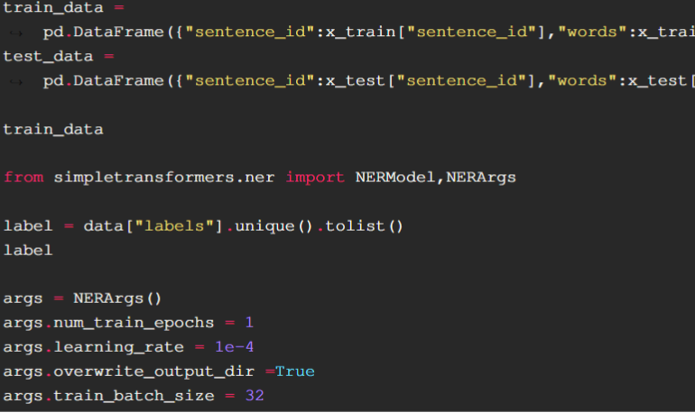
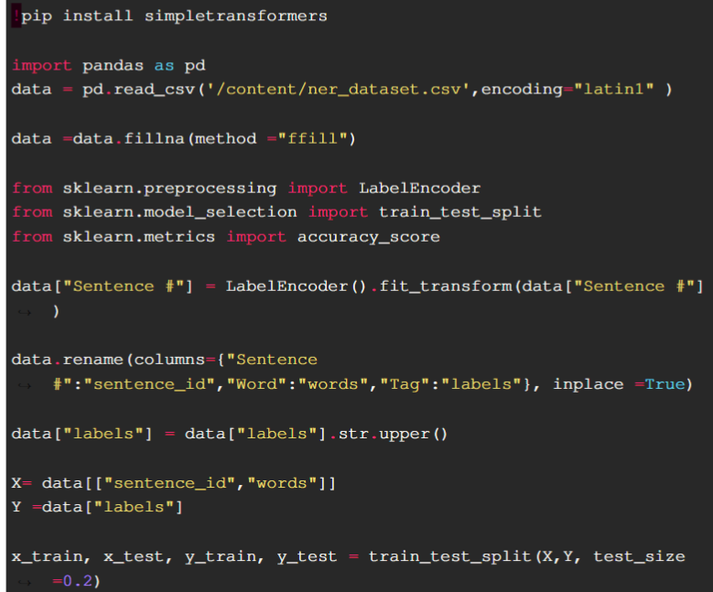
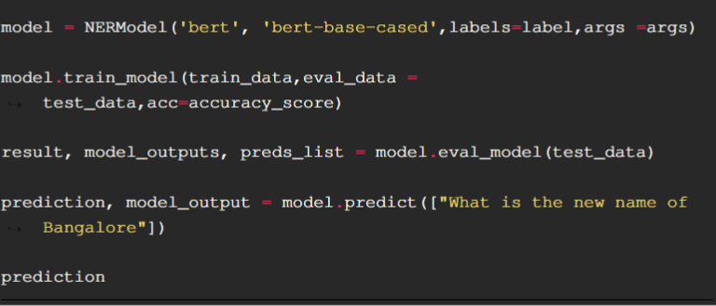
Screenshots:
BERT:

Slide 24
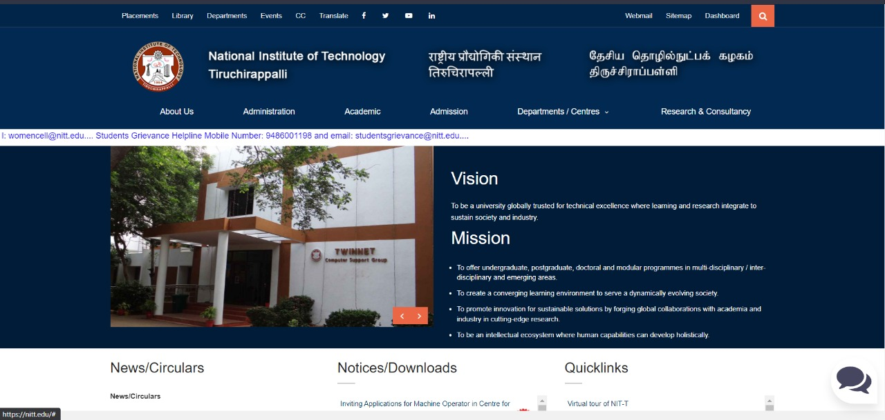
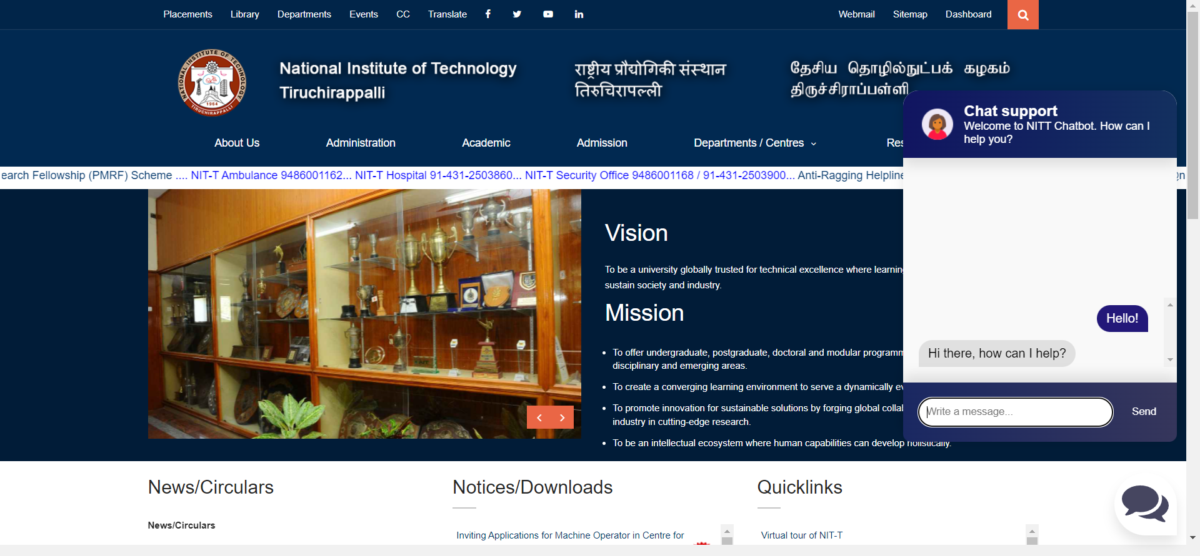
Chatbot Screenshot
Institute Website with Chatbot (Screenshot)

Slide 25
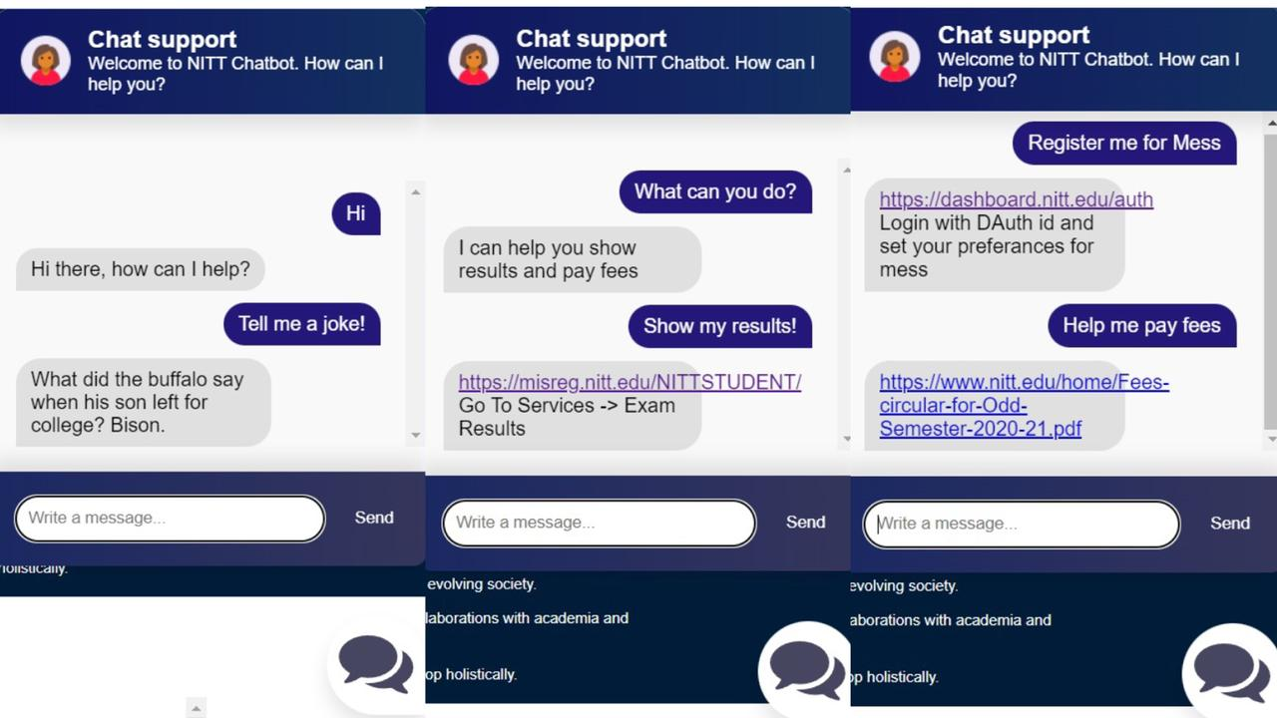
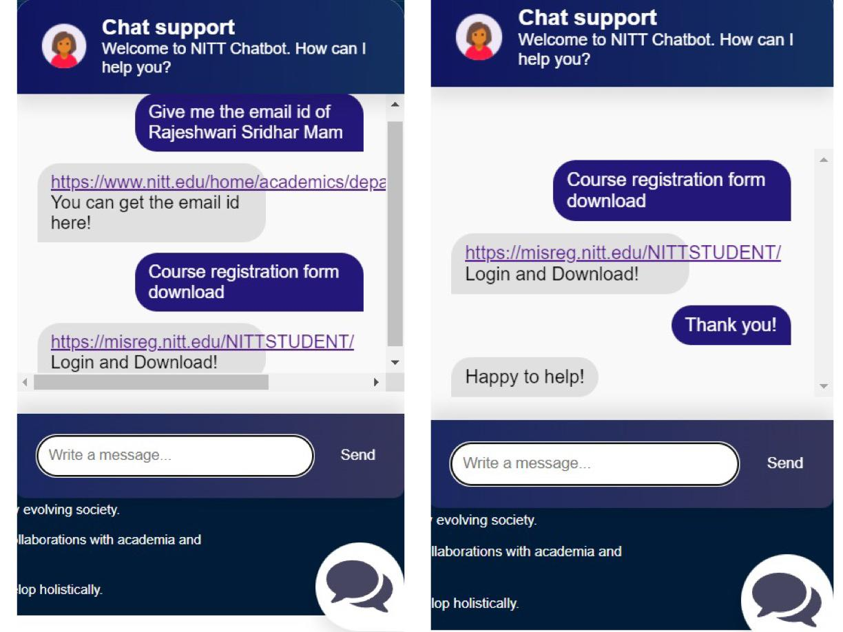
Chatbot OUTput

Slide 26
Evaluation Metrics TAble
Model | Accuracy | Macro F1 Score | Micro F1 Score | Weighted F1 Score
Simple RNN | 0.77 | 0.109 | 0.769 | 0.67
GRU | 0.78 | 0.11 | 0.78 | 0.683
Bi-LSTM | 0.925 | 0.456 | 0.925 | 0.91
Naive Bayes | 0.97 | 0.92 | 0.97 | 0.97
Logistic Regression | 0.98 | 0.98 | 0.97 | 0.97
Linear SVM | 0.978 | 0.93 | 0.978 | 0.978
Poly SVM | 0.921 | 0.689 | 0.991 | 0.913
Rbf SVM | 0.959 | 0.799 | 0.959 | 0.954
Sigmoid SVM | 0.915 | 0.713 | 0.915 | 0.91
Table: Evaluation Metrics Table of different models for ATIS Dataset

Slide 27
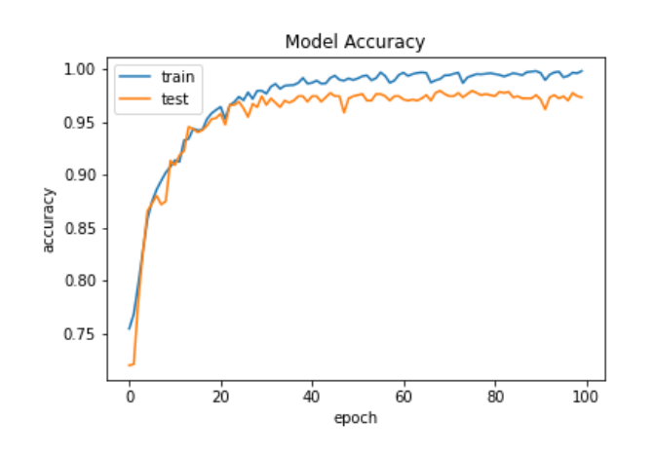
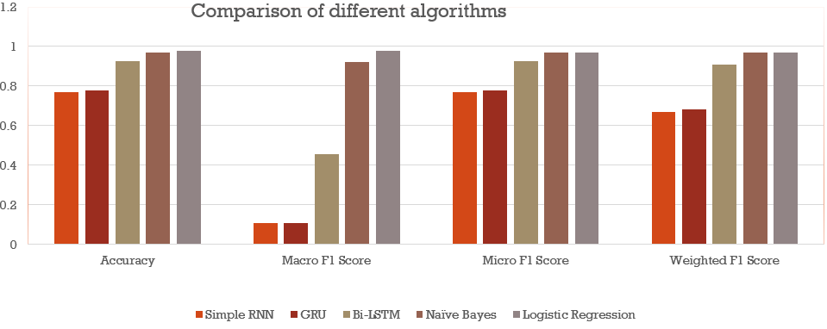
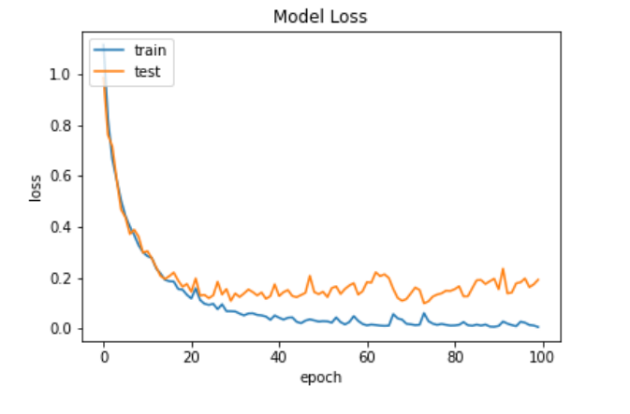
Result and Analysis:
Comparing Models:
Fig: Logistic Regression Accuracy - ATIS
Fig: Comparing Models for ATIS dataset
Fig: Logistic Regression Loss - ATIS

Slide 28
Evaluation Metrics TAble
Model | Accuracy | Macro F1 | Micro F1 | Weighted F1
Simple RNN | 0.97 | 0.97 | 0.97 | 0.96
GRU | 0.14 | 0.035 | 0.14 | 0.04
BiLSTM | 0.98 | 0.98 | 0.98 | 0.98
Logistic Regression | 0.99 | 0.98 | 0.99 | 0.98
Table: Evaluation Metrics Table of different models for SNIPS Dataset

Slide 29
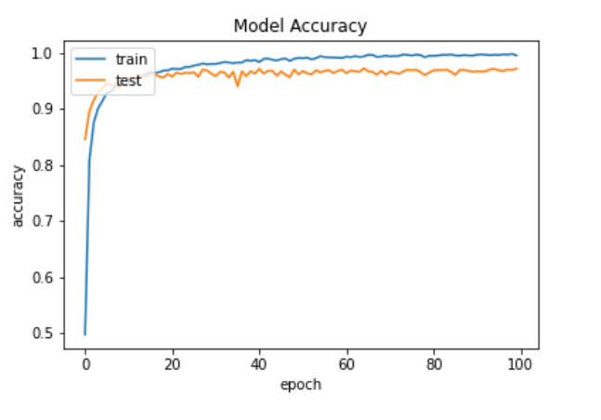
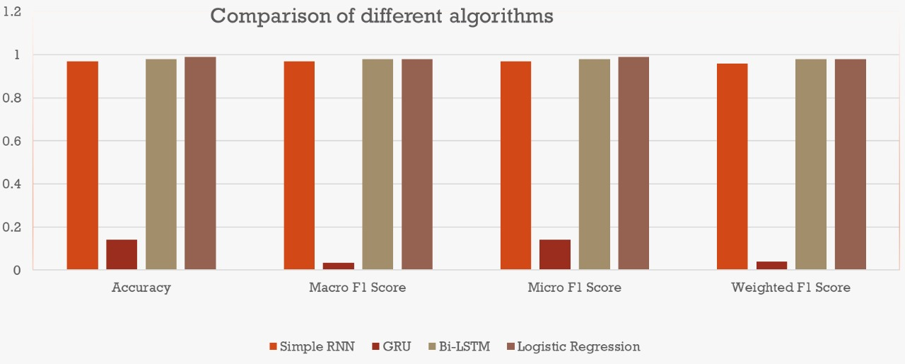
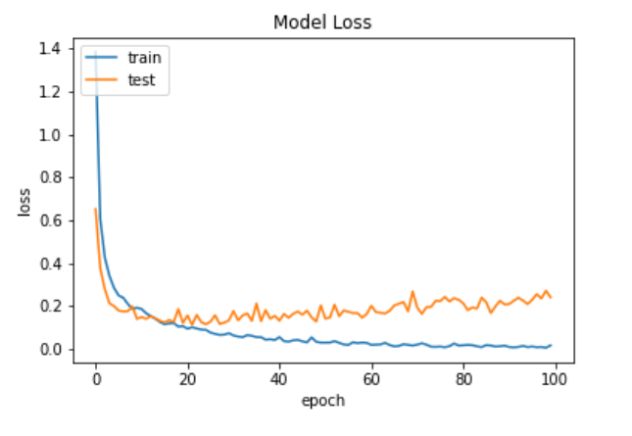
Result and Analysis:
Fig: Logistic Regression Accuracy - SNIPS
Fig: Comparing Models for SNIPS dataset
Fig: Logistic Regression Loss - SNIPS

Slide 30
Conclusion and Future Works:
All approaches were successfully implemented and we discovered that the Logistic Regression delivers the best result for across all the datasets.
It must be noted that the other approaches are not ineffective but for the purpose of single query classification, the neural network based models consume too much computing power and time and yet are marginally outperformed by logistic regression.
The NITT Chatbot was developed using the Flask App’s Back-end and HTML, CSS, JS in front-end.
It uses the BERT to classify user intent. It will re-direct the user to the required pages after taking their queries.
To conclude, this Chatbot is user-oriented and beneficial in guiding students with most accurate, up to date sources of information
Future Works:
Zero-shot and few-shot learning can be used for multi-purpose chatbot, it will keep on expanding the features.
Research into increasing the accuracy of classification while reducing the resource requirement for complicated questions can be done.
Another possible avenue of work is increasing the usability and intents of the chat-bot.
Chatbot Scope:
A channel for student-teacher communication can be implemented; that will make the student-teacher communication smooth and protected.
Student feedback option can be added. According to the feedback’s, more training data will be inserted.
Speech recognition by which students can use their voice to get answers.
Language Setting- Students can change the language according to their mother tongue and get a smooth experience without any language barrier.
Direct integration with services like Course Enrollment, fees payment and so on.

Slide 31
References
Charles T. Hemphill, John J. Godfrey, and George R. Doddington. “The ATIS Spoken Language Systems Pilot Corpus”. In: Speech and Natural Language: Proceedings of a Workshop Held at Hidden Valley, Pennsylvania, June 24-27,1990. 1990. URL: https://aclanthology.org/H90-1021.
Jian Hu et al. “Understanding User’s Query Intent with Wikipedia”. In: Proceedings of the 18th International Conference on World Wide Web. WWW ’09. Madrid, Spain: Association for Computing Machinery, 2009, pp. 471–480. ISBN: 9781605584874. DOI: 10 . 1145 / 1526709 . 1526773. URL: https : / / doi.org/10.1145/1526709.1526773.
Mark Kroll and Markus Strohmaier. “Analyzing Human Intentions in Natural ¨ Language Text”. In: Proceedings of the Fifth International Conference on Knowledge Capture. K-CAP ’09. Redondo Beach, California, USA: Association for Computing Machinery, 2009, pp. 197–198. ISBN: 9781605586588. DOI: 10 . 1145 / 1597735 . 1597780. URL: https : / / doi . org / 10 . 1145 / 1597735.1597780.
Edward Loper Steven Bird Ewan Klein. Natural Language Processing with Python. O’Reilly, 2009.
Yongli Zhang. “Support Vector Machine Classification Algorithm and Its Application”. In: Information Computing and Applications. Ed. by Chunfeng Liu, Leizhen Wang, and Aimin Yang. Berlin, Heidelberg: Springer Berlin Heidelberg, 2012, pp. 179–186. ISBN: 978-3-642-34041-3.

Slide 32
References
Jey Han Lau and Timothy Baldwin. “An Empirical Evaluation of doc2vec with Practical Insights into Document Embedding Generation”. In: (2016). DOI: 10.48550/ARXIV.1607.05368. URL: https://arxiv.org/abs/1607. 05368.
Alice Coucke et al. Snips Voice Platform: an embedded Spoken Language Understanding system for private-by-design voice interfaces. 2018. DOI: 10.48550/ ARXIV.1805.10190. URL: https://arxiv.org/abs/1805.10190.
Lian Meng and Minlie Huang. “Dialogue Intent Classification with Long ShortTerm Memory Networks”. In: Natural Language Processing and Chinese Computing. Ed. by Xuanjing Huang et al. Cham: Springer International Publishing, 2018, pp. 42–50. ISBN: 978-3-319-73618-1.
Shahzad Qaiser and Ramsha Ali. “Text Mining: Use of TF-IDF to Examine the Relevance of Words to Documents”. In: International Journal of Computer Applications 181 (July 2018). DOI: 10.5120/ijca2018917395.
Shuo Xu. “Bayesian Na¨ıve Bayes classifiers to text classification”. In: Journal of Information Science 44.1 (2018), pp. 48–59. DOI: 10.1177/0165551516677946. eprint: https : / / doi . org / 10 . 1177 / 0165551516677946. URL: https://doi.org/10.1177/0165551516677946.

Slide 33
References
Rashmi Gangadharaiah and Balakrishnan Narayanaswamy. “Joint Multiple Intent Detection and Slot Labeling for Goal-Oriented Dialog”. In: Proceedings of the 2019 Conference of the North American Chapter of the Association for Computational Linguistics: Human Language Technologies, Volume 1 (Long and Short Papers). Minneapolis, Minnesota: Association for Computational Linguistics, June 2019, pp. 564–569. DOI: 10.18653/v1/N19-1055. URL: https: //aclanthology.org/N19-1055.
Vraj Desai; Sidarth Wadhwa; Anurag A; Bhisham Bajaj. “Text-Based Intent Analysis using Deep Learning”. In: International Journal of Innovative Science and Research Technology 5 (2020), pp. 267–274. DOI: 10.38124/IJISRT20JUL342.
Jetze Schuurmans and Flavius Frasincar. “Intent Classification for Dialogue Utterances”. In: IEEE Intelligent Systems 35.1 (2020), pp. 82–88. DOI: 10.1109/ MIS.2019.2954966.
Alberto Benayas et al. “Unified Transformer Multi-Task Learning for Intent Classification With Entity Recognition”. In: IEEE Access 9 (2021), pp. 147306– 147314. DOI: 10.1109/ACCESS.2021.3124268.
Geetanjali Bihani and Julia Taylor Rayz. “Fuzzy Classification of Multi-intent Utterances”. In: NAFIPS. 2021.

Slide 34
References
Tzu-Yu Chen et al. “Multi-Modal Chatbot in Intelligent Manufacturing”. In: IEEE Access 9 (2021), pp. 82118–82129. DOI: 10.1109/ACCESS.2021. 3083518.
Zixian Feng et al. “An Evaluation of Chinese Human-Computer Dialogue Technology”. In: Data Intelligence 3.2 (June 2021), pp. 274–286. ISSN: 2641-435X. DOI: 10.1162/dint_a_00090. eprint: https://direct.mit.edu/ dint/article-pdf/3/2/274/1963473/dint\_a\_00090.pdf. URL: https://doi.org/10.1162/dint%5C_a%5C_00090.
Manoj Kumar et al. “ProtoDA: Efficient Transfer Learning for Few-Shot Intent Classification”. In: CoRR abs/2101.11753 (2021). arXiv: 2101.11753. URL: https://arxiv.org/abs/2101.11753.
Tulika Saha et al. “A Unified Dialogue Management Strategy for Multi-Intent Dialogue Conversations in Multiple Languages”. In: ACM Trans. Asian LowResour. Lang. Inf. Process. 20.6 (Sept. 2021). ISSN: 2375-4699. DOI: 10.1145/ 3461763. URL: https://doi.org/10.1145/3461763.
Anant Saraswat, Kumar Abhishek, and Sheshank Kumar. “Text Classification Using Multilingual Sentence Embeddings”. In: Evolution in Computational Intelligence. Ed. by Vikrant Bhateja et al. Singapore: Springer Singapore, 2021, pp. 527–536. ISBN: 978-981-15-5788-0.

Slide 35
Thank You!

