Slide 1
ASSIGNMENT WEEK 5
BUSINESS ANALYST LEARNTERNSHIP
PROBLEM STATEMENT: INDIAN MANAGER PROBLEMS
ANALYSIS OF THE RESPONSES
BY SUPRITA RAHA

Slide 2
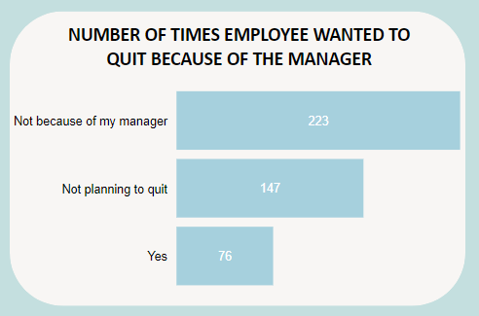
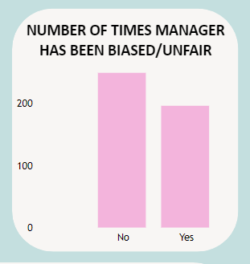
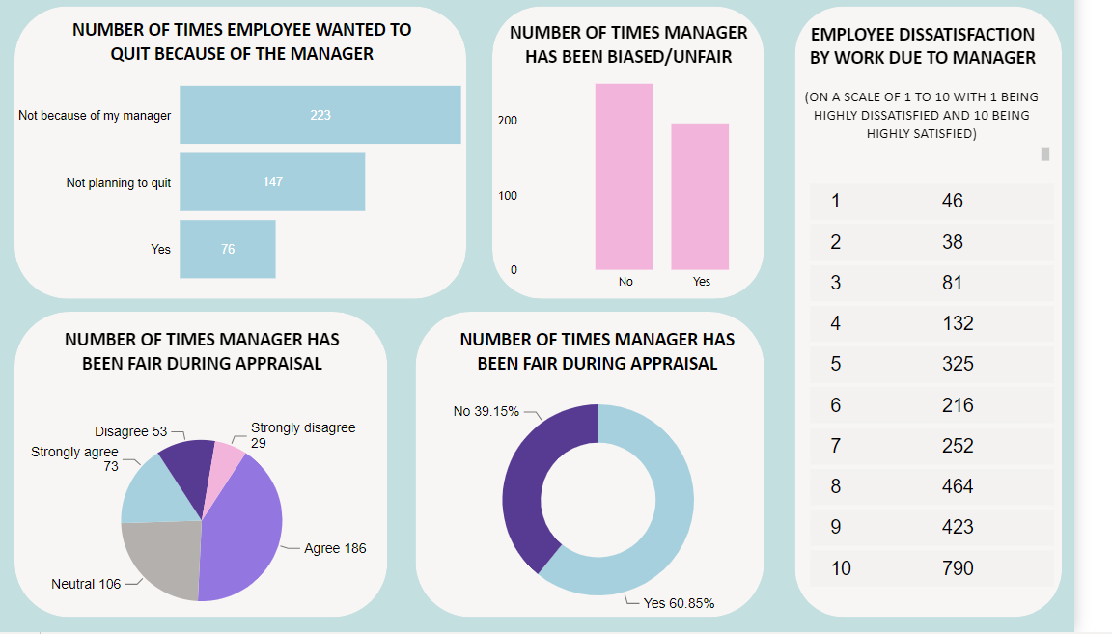
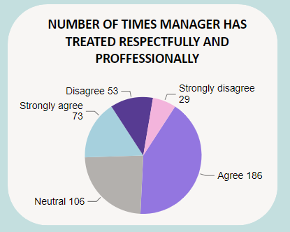
ANALYSIS:-
About 50% of the respondents are quitting the company citing other reasons as compared to the 17% who cited issues with the manager as the reason.
About 60.8% of the managers have been fair during the appraisal while the rest 39.2% were not fair according to the respondents.
Around 48.2% of the respondents agree to the professional treatment by their manager, 28.2% disagree while the rest are neutral.
More than 200 agree that their manager has not been biased towards them while the opposite is just below 200.

