Slide 1

Boston House Price Prediction
RNS INSTITUTE OF TECHNOLOGY
BENGALURU - 560098
DEPARTMENT OF INFORMATION SCIENCE & ENGINEERING
Presentation on Internship
SUPRITH SATISH
1RN19IS161
Inflow Technologies
Internal Guide
Ms. Priyanka
Asst. Prof, Dept of ISE, RNSIT
External Guide
Mr. Arib Nawal
Inflow Technologies, Bangalore

Slide 2
AGENDA
Abstract
About the Company
Literature Survey
Introduction
Requirements
Design
Implementation
Result Analysis
Conclusion and Future Enhancements
References
Q & A

Slide 3
ABSTRACT
“Boston House Price Prediction” is a Machine Learning based project which aims at predicting the Boston house prices based on set of features.
This model undergoes training with dataset values in order to predict the price values. It uses Linear Regression to implement the same.
We evaluate the performance and predictive power of a model that has been trained and tested on data collected from homes in suburbs of Boston, Massachusetts.
A model like this would be very valuable for a real estate agent who could make use of the information provided on a daily basis.

Slide 4
About the Company
Inflow Technologies is an IT Services Company registered under Govt. of India, Ministry of Micro, Small & Medium Enterprises. It also offers customized training programs, workshops and internship programs across engineering colleges in India.
Mission: To empower the students with necessary knowledge and industry skills for them to succeed in their future endeavors.
The Core Services they offer:
Software Development and Testing Services on cutting edge technologies for
small, mid-size and large enterprise clients.
Career Coaching, Mentoring, Consultation to IT professionals.
Technology trainings, Training on Leadership skills and Training on soft skills

Slide 5
LITERATURE SURVEY
Big Data Analytics: A review
Authors: Nada Elgendy and Ahmed Elragal, German University in Cairo(GUC), Egypt
Description: In the information era, enormous amounts of data have become available on hand to decision makers. Big data refers to datasets that are not only big, but also high in variety and velocity, which makes them difficult to handle using traditional tools and techniques.
Due to the rapid growth of such data, solutions need to be studied and provided in order to handle and extract value and knowledge from these datasets.
Data Analytics: A literature review perspective
Author: Sarah Al-Shiakhli, Luleå University of Technology, Sweden
Big data is currently a buzzword in both academia and industry, with the term being used to describe a broad domain of concepts, ranging from extracting data from outside sources, storing and managing it, to processing such data with analytical techniques and tools. This thesis work thus aims to provide a review of current big data analytics concepts in an attempt to highlight big data analytics’ importance to decision making.

Slide 6
INTRODUCTION
In this project, we will evaluate the performance and predictive power of a model that has been trained and tested on data collected from homes in suburbs of Boston, Massachusetts.
A model trained on this data that is seen as a good fit could then be used to make certain predictions about monetary value of a house.
The dataset for this project originates from the UCI Machine Learning Repository. The Boston housing data was collected and each of the entries represent aggregated data about 14 features for homes from various suburbs in Boston, Massachusetts.
The model can be also be used to predict the price of any house in the area based on attributes of the house.

Slide 7
Requirements
HARDWARE REQUIREMENTS RAM : 4 Gb Hard Disk : 4 GB Input device : Standard Keyboard and Mouse Output device : VGA and High Resolution Monitor
SOFTWARE REQUIREMENTS Operating system : Windows 10/Unix Os IDE : Google collab/Jupyter Notebook Tools/Technologies : Python, Pandas, Scikit-learn, Matplotlib, NumPy library

Slide 8
Design
Import & Clean the Data
Visualize & Analyze Data
Split the Data
Create & Train Model
Make Predictions
Evaluate Model

Slide 9
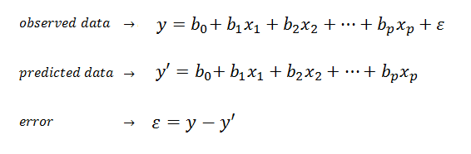
Implementation
Algorithm :
Linear Regression is a machine learning algorithm based on supervised learning.
It is mostly used for finding out the relationship between variables.
Linear regression performs the task to predict a dependent variable value (y) based on a given independent variable (x). So, this regression technique finds out a linear relationship between x (input) and y(output). Hence, the name is Linear Regression.

Slide 10
Libraries / APIs:
NumPy: NumPy is a general-purpose array-processing package. It provides a high-performance multidimensional array object, and tools for working with these arrays.
Pandas: Pandas is the most popular python library that is used for data analysis. It provides highly optimized performance with back-end source code is purely written in C or Python.
Matplotlib : Matplotlib is a comprehensive library for creating static, animated, and interactive visualizations in Python. Matplotlib consists of several plots like line, bar, scatter, histogram etc.
Scikit-learn: Scikit-learn is an open source Python library that implements a range of machine learning, pre-processing, cross-validation and visualization algorithms using a unified interface.

Slide 11
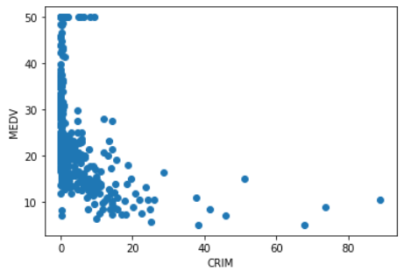
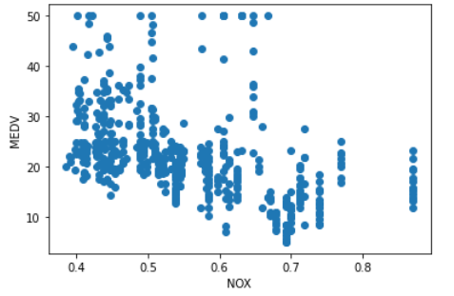
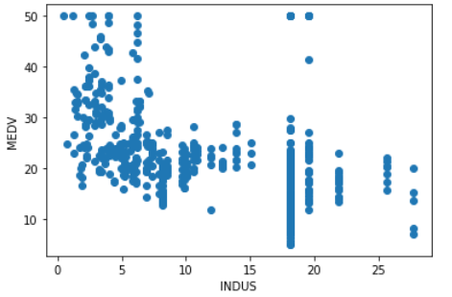
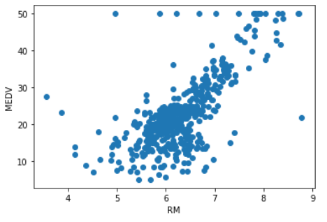
Result Analysis
Graphs :

Slide 12
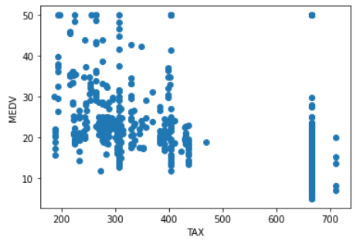
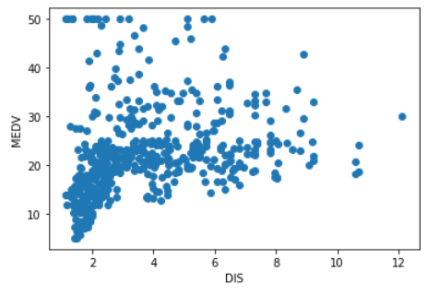
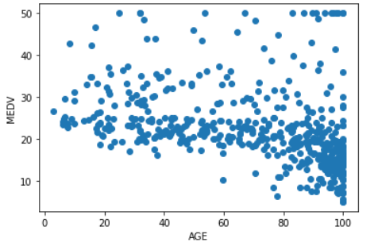
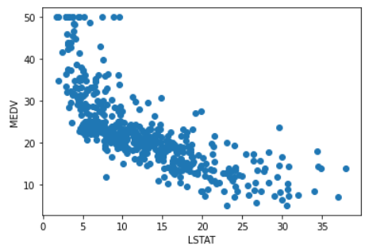

Slide 13
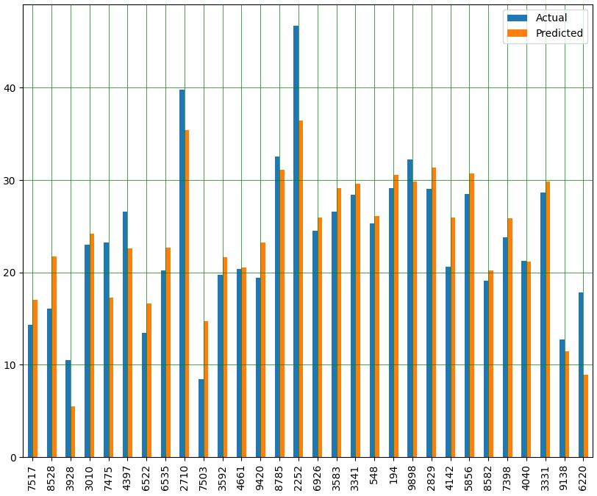
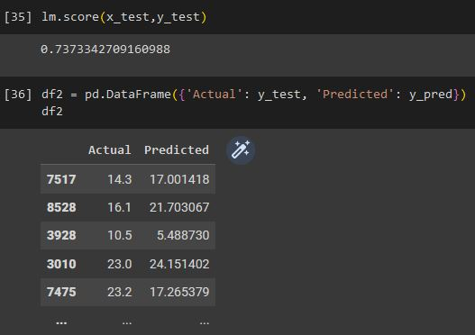
Snapshots :
Fig: Accuracy & Prediction
Fig: Result visualization

Slide 14
CONCLUSIONS
In this project, we analyzed the Boston House pricing dataset. We found that predicting the price of a house is highly dependent on the median value of the owner-occupied homes, the pupil-teacher ratio by town, the percentage of people with lower status, and the average number of rooms per dwelling. Linear Regression algorithm is used to find the result.
We achieved the goals that we had set for this project. We have gained the complete information about the linear regression algorithm. We initially explored the dataset given, observe the features and get relative relationships between them, Plotted charts and graphs to perform data analysis. And finally developed an optimal data model, which satisfies all the requirements and predicts the price of the house accurately.

Slide 15
Future Enhancements
Implement GUI for this project.
Understand and implement the same for prediction of prices in general and not specific to Boston.

Slide 16
REFERENCES
Machine Learning by Tom Mitchell
Machine Learning algorithms at www.medium.com
Dataset at www.kaggle.com

Slide 17
Question and Answer

Slide 18
THANK YOU

