Slide 1

PROJECT
Student Management System Using Python & MYSQL Database

Slide 2
Things we are going to discuss
Introduction
Objectives
Tools and Platform
Special Requirement
Data Flow Diagram
Figures
Conclusion
References

Slide 3

INTRODUCTION
Student Management System can handle all the details about a student. The details include student's personal details, academic details etc
The student management system is an automated version of manual Student Management System

Slide 4

OBJECTIVES
Student Management System is a management information system for education establishments to manage student data.
It provide capabilities for registering students in courses, admitting students, tracking student etc.
Ensure data integrity, privacy and security in an open-access environment.

Slide 5


TOOLS AND PLATFORM
We used Python to make this software
For saving the data of students we used MySQL database

Slide 6
SPECIFIC REQUIREMENTS
External interface
User interfaces-The software provides a good graphical interface for the front end which is self explanatory.
Hardware interfaces
Memory minimum of 4GB RAM
Hard disk of 30 GB
Monitor
Mouse
Keyboard
Software interfaces
Operating System Windows 11
Language Python
MySQL

Slide 7
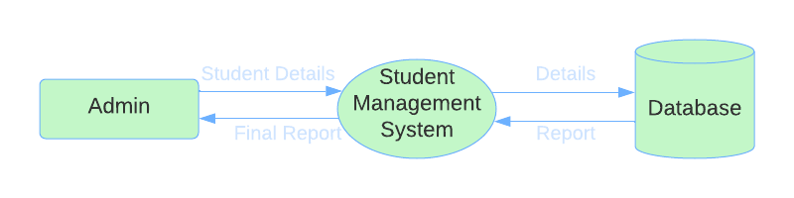
DATA FLOW DIAGRAM

Slide 8

FEATURES OF THE PROJECT
Create New Student Profile
Add Student Information
Add Students Photos
Update Student Information
Delete Student Information
Display specific Student Information
Export Data Into an Excel Sheet

Slide 9
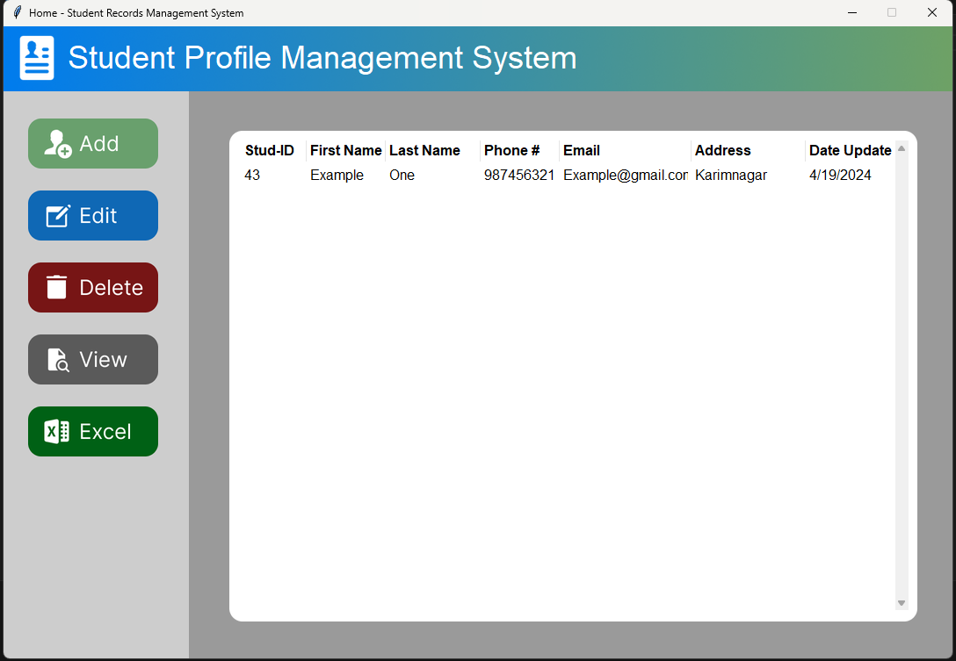
FIGURES
Home Page
Add New Student
View Student Details
Update Student Details
Delete Student Details
Export Data to Excel Sheet

Slide 10
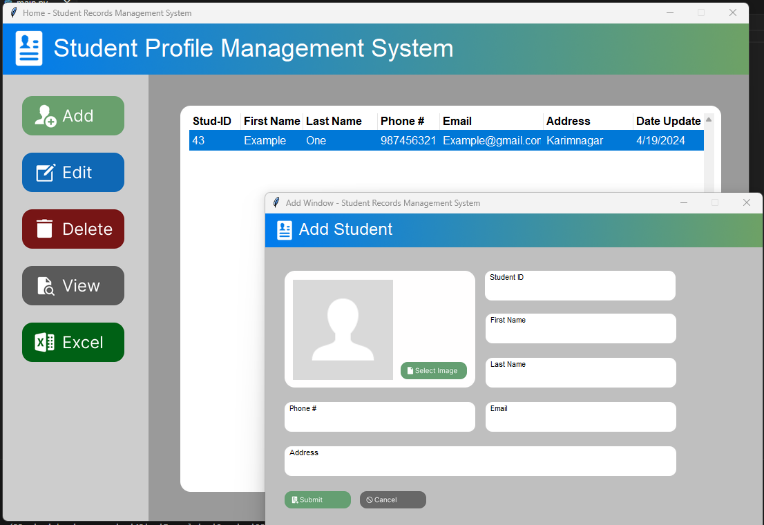
Inserting New Student Data:

Slide 11
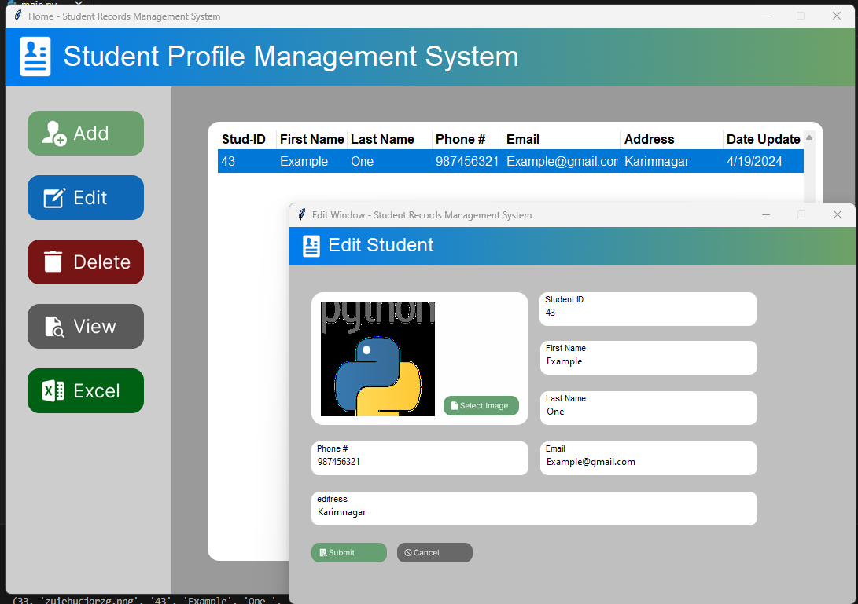
Updating Student Data:

Slide 12
CONCLUSION
After completing this project, it will be helpful to maintain all student data. So Management can show information about Any Student at any time.

Slide 13
REFERENCES
JAVA Point
Youtube
GeeksforGeeks
programiz

