Slide 1
Data Analysis & Visualization
SOCIAL MEDIA ANALYSIS

Slide 2

Table of contents
01
02
03
04
.
Exploratory Data Analysis
DATA INTEGRATION
Merging tables into a unified view for analysis and decision-making.
Unveiling Insights through Data Cleaning and Manipulation
SENTIMENT ANALYSIS
Analysis & Dashboard with Tableau
Unlocking Insights: Text Analysis and Visualization in python
Interactive Tableau Dashboard for actionable insights.

Slide 3
Preface:
Global Reach: OTT platforms offer content that can be accessed globally, breaking geographical barriers.
On-Demand Viewing: Users can watch their favourite shows and movies at any time, providing ultimate flexibility.
Diverse Content: These platforms host a wide variety of content, including movies, series, documentaries, and live events.
Cost-Effective: OTT services often provide cheaper alternatives to traditional cable subscriptions.
Multi-Device Access: Content can be streamed on various devices, such as smartphones, tablets, smart TVs, and computers.

Slide 4




Environment Setup
There are various approaches for setting up an environment for Data Analysis and Data Visualization. Some of them are:
Approach | Purpose
PostgreSQL | Exploratory Data Analysis (EDA)
Jupyter Notebook | Exploratory Data Analysis (EDA)
VS Code | Exploratory Data Analysis (EDA) & Visualisation
Ms Excel | Data Analysis & Exploratory Data Analysis (EDA)
TABLEAU | Data Visualisation
Among these, we have chosen PostgreSql, Ms Excel & Vs Code for Data Cleaning and Data Integration, VS code for E.D.A & Sentiment Analysis, and Tableau for Data Visualisation.

Slide 5

01
Data Cleaning
Data preprocessing

Slide 6





Data Cleaning
Ms Excel , PostgreSQL & Python(VS Code) is employed for Data Cleaning and
Data Integration.
Ms Excel :- month & year extraction and split column.
Postgresql :- Create a Database & Import the Data Tables(Amazon_prime,Disney_Plus & Netflix).
Duplicate value is checked but none were found.
OUTPUT:-
Followed the same steps for each Dataset. (Amazon_prime,Disney_Plus & Netflix)

Slide 7
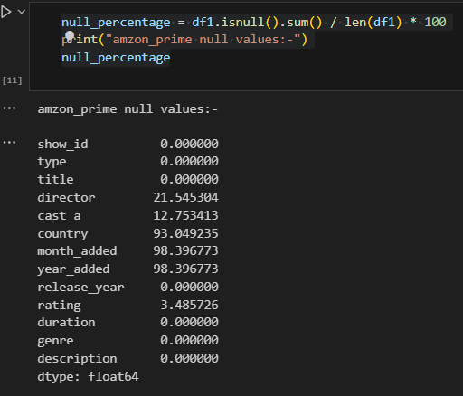
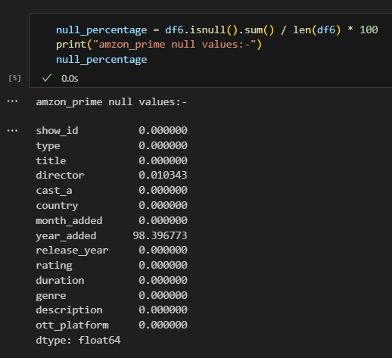


Null Values were checked with sql query for each column.
Null values were found & percentage of null values were found using python.–which were handled by imputation and deletion methods in sql.
Before:-
Imputation Method:-
After:-
Deletion Method:-
Remaining Null Values were resolved in python.
Same steps are followed for all Datasets For Data Cleaning.

Slide 8
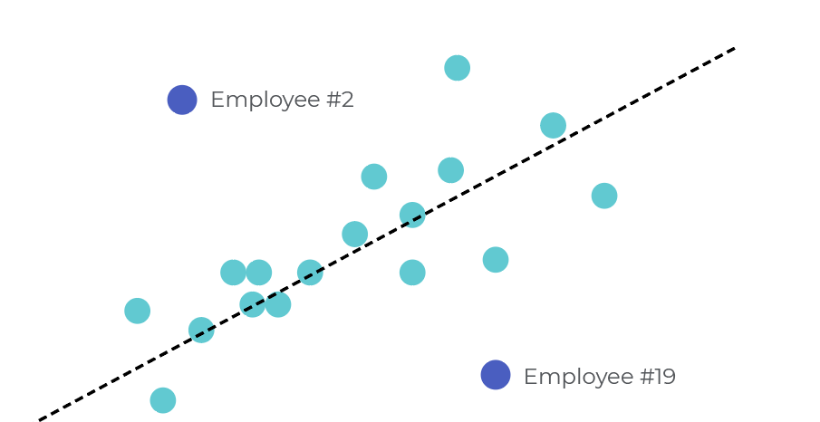

02
DATA INTEGRATION

Slide 9
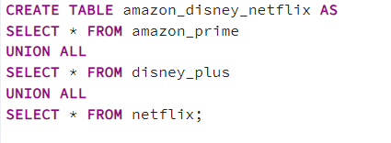



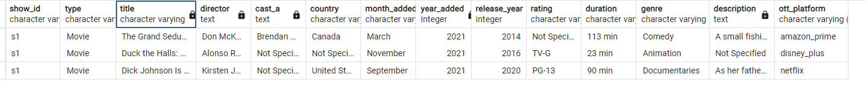
All 3 tables were merged into single table for unified view.
Data Manipulation is done.
OUTPUT:-

Slide 10


03
SENTIMENT ANALYSIS
NumPy for Data Manipulation & Analysis, Pandas for Metric Operations , matplotlib and seaborn for data visualization and TextBlob is for Test Analysis(SENTIMENT ANALYSIS) all these libraries were imported.
Data Integrated CSV file imported.

Slide 11

It is to be known that this dataset has 19,912 rows × 14 columns as determined by using df.shape
Checked for the Duplicate values, but none were found.
Checked for the Missing values, in the director column (1-0.005%) ,df = df.dropna(subset=['director’])
In year_column (9513-47.77%) missing values were replaced by using Imputation Method (df['year_added’]=year_added'].fillna('Not Specified’).
Utilised df.describe() to get the Statistical Summary.

Slide 12

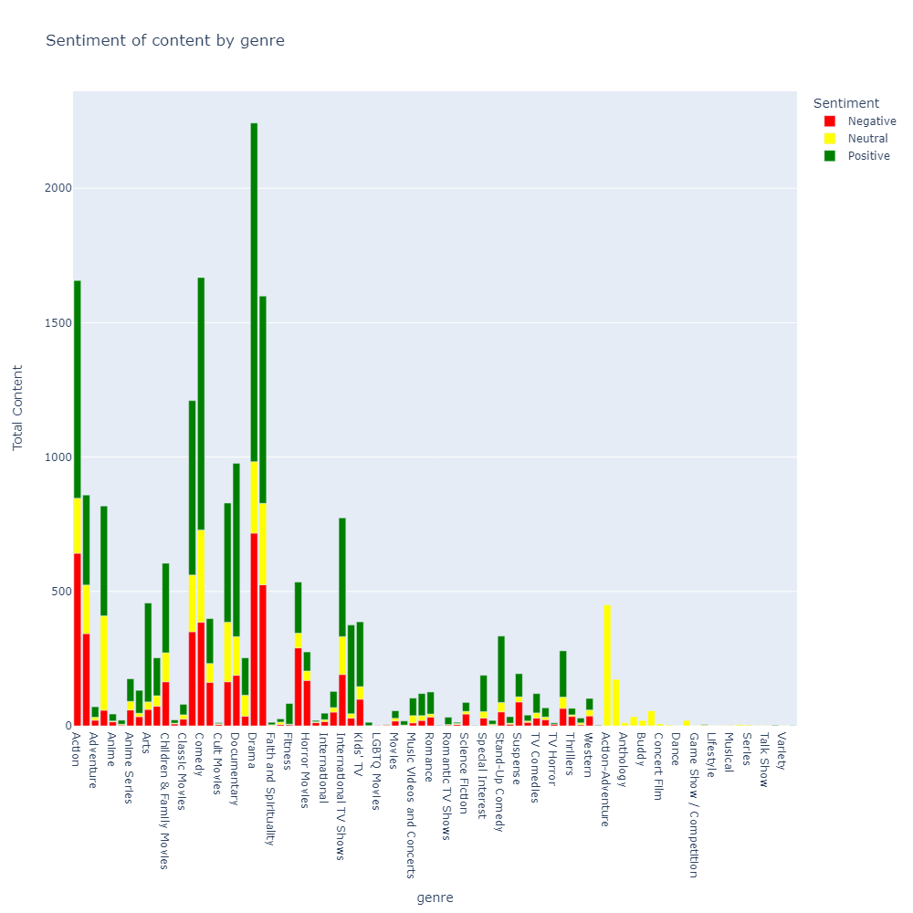
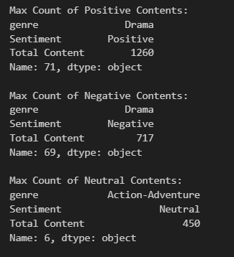
Text Analysis(Sentiment Analysis)

Slide 13

GeoSpatial Analysis
Install and import Geopandas Library.
'Naturalearth_lowres' is map dataset which is built-in dataset provided by GeoPandas.
The map dataset is read and GeoDataFrame is formed which is then compared with the our DataFrame to plot map.

Slide 14
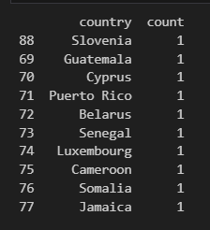
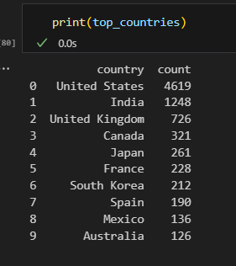
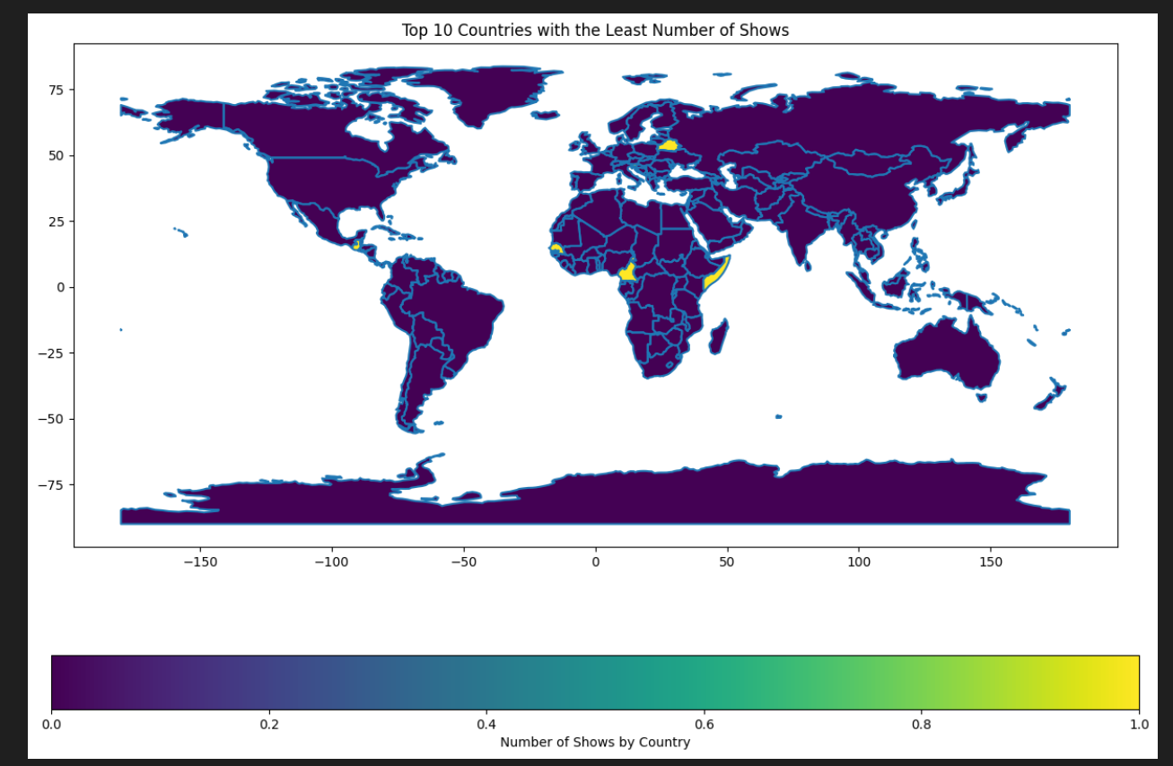
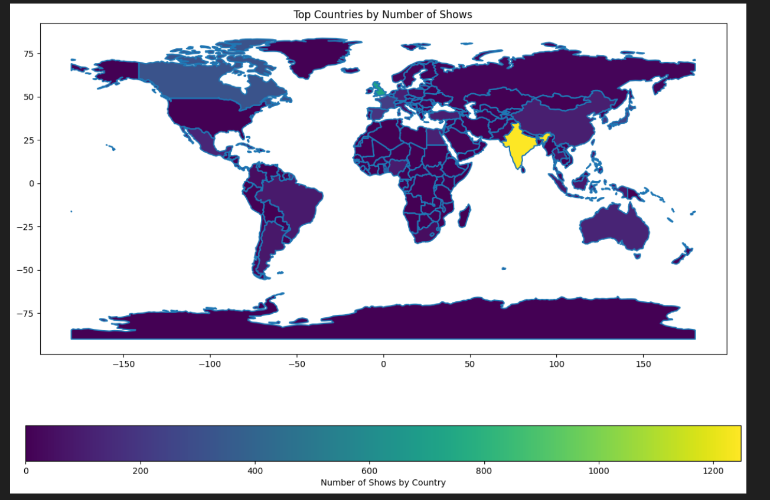



GeoSpatial Analysis
Top 10 Countries with lowest shows
Top 10 Countries with highest shows

Slide 15


04
Analysis & Dashboard with Tableau

Slide 16
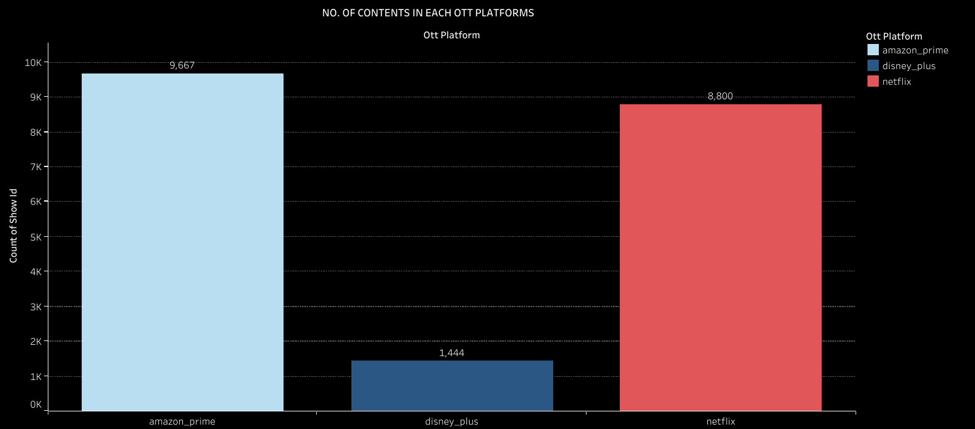
No. Of Contents In Each Ott_Platform
This Charts shows the No. of Contents In Each Ott_Platform.
Aamazon_prime has the most no. of contents i.e., 9667 No. And Netflix is following behind with 8800 No. of Contents.
Disney_Plus has least in No. of contents i.e., 1444.

Slide 17
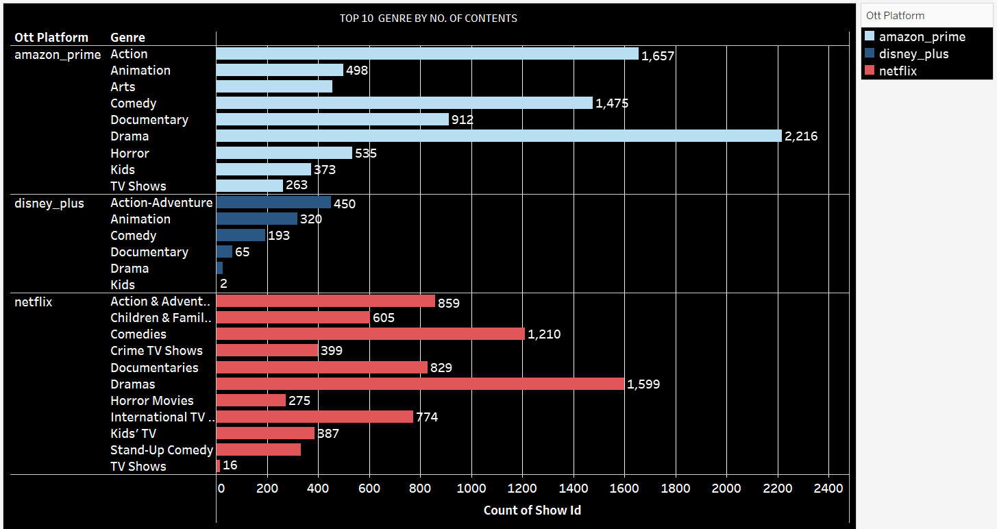
Top 10 Genre by No of contents in each ott_platform:
The above chart shows the “top 10 Genre” by No. of Contents In Each ott_platform.
In amazon_prime “Drama” is at Top with 2,216 contents, and “TV shows” has lowest No. i.e., 263.
In Disney_plus “Action-Adventure” holds Top Position with 450 Contents and “kids” settled at bottom having only 2 contents.
In Netflix “Drama” is on 1st place having 1,599 contents, and “TV Shows” is at last position having 16 contents.

Slide 18

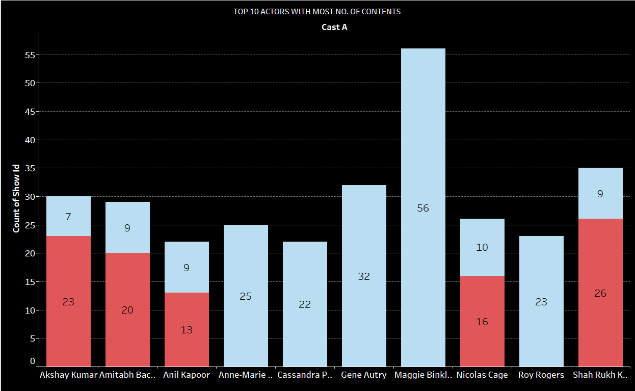



Top 10 Actors:
This chart shows the top 10 actors with most no. of contents in netflix and amazon_prime.
In amzon_prime ‘Maggie Binkley’ is in top having 56 contents and ‘Akshay Kumar’ is at bootom having 7 contents.
In netflix ‘Shahrukh Khan’ is in top having 26 contents and ‘Anil Kapoor’ is at bottom having 9 contents.

Slide 19
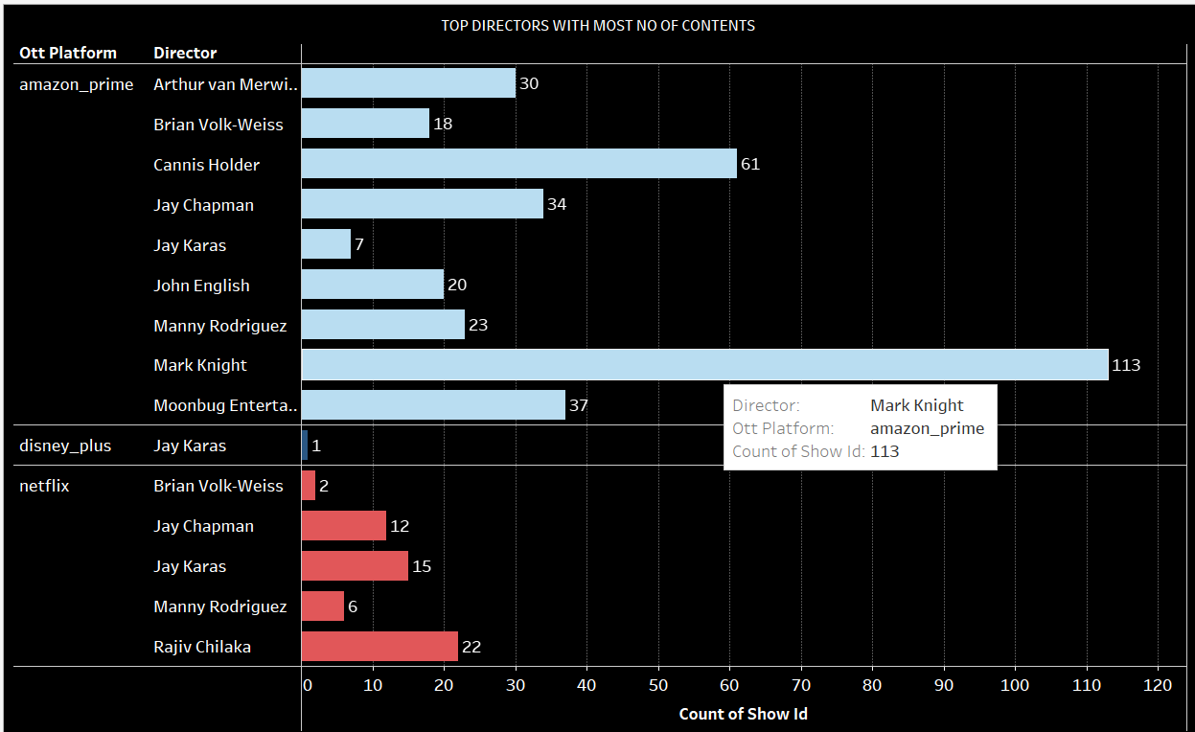
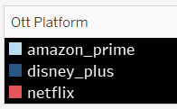

Top 10 directors:-
1. This Graph shows the Top 10 Directors BY No. of Contents In each ott platform.
2. In amazon prime ‘Mark Knight’ is on top with 113 contents and ‘ay karas’ is has least no. of contents i.e., 7.
3. In Disney plus jay karas has only 1 content.
4. In Netflix ‘Rajiv Chilaka’ has the highest no. of contents i.e, 22 and ‘brian volk-wiess’ has the least no. i.e., 2

Slide 20
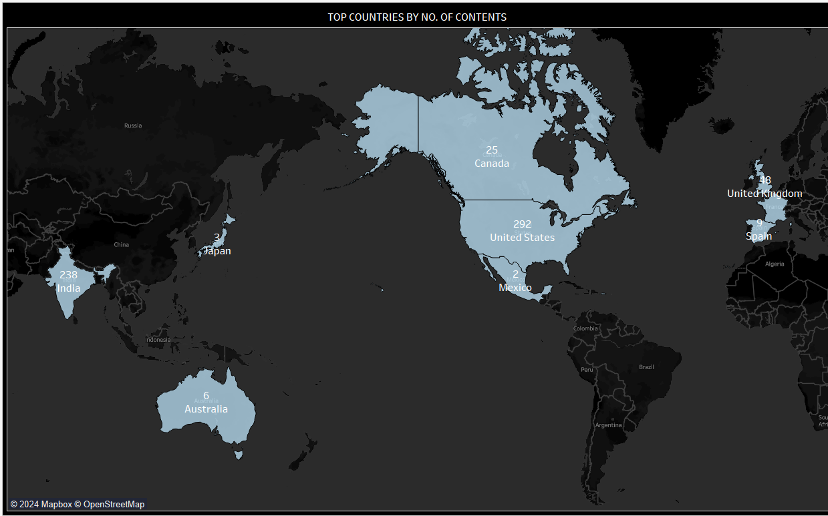
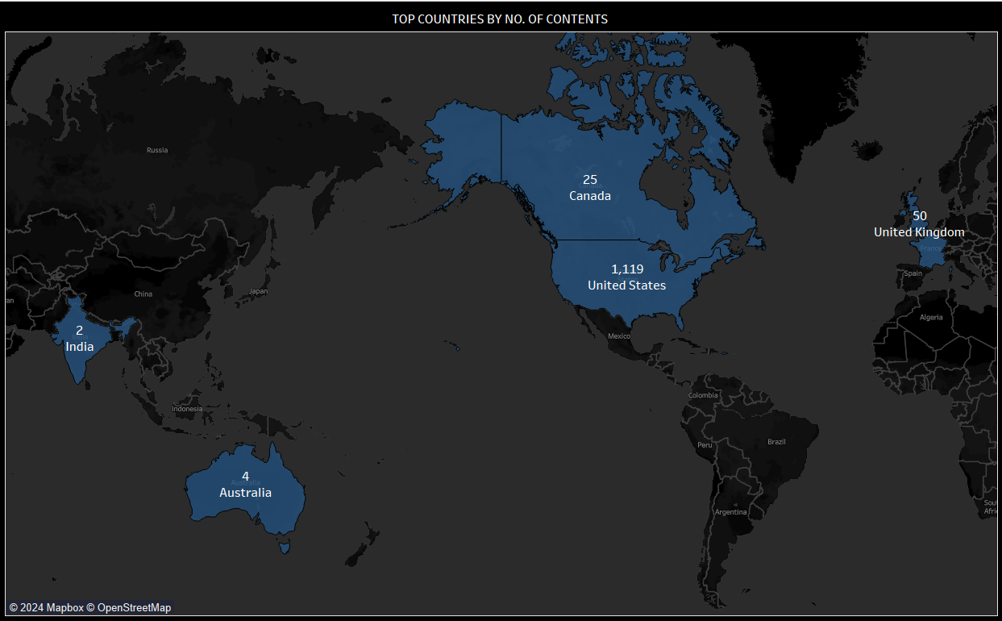

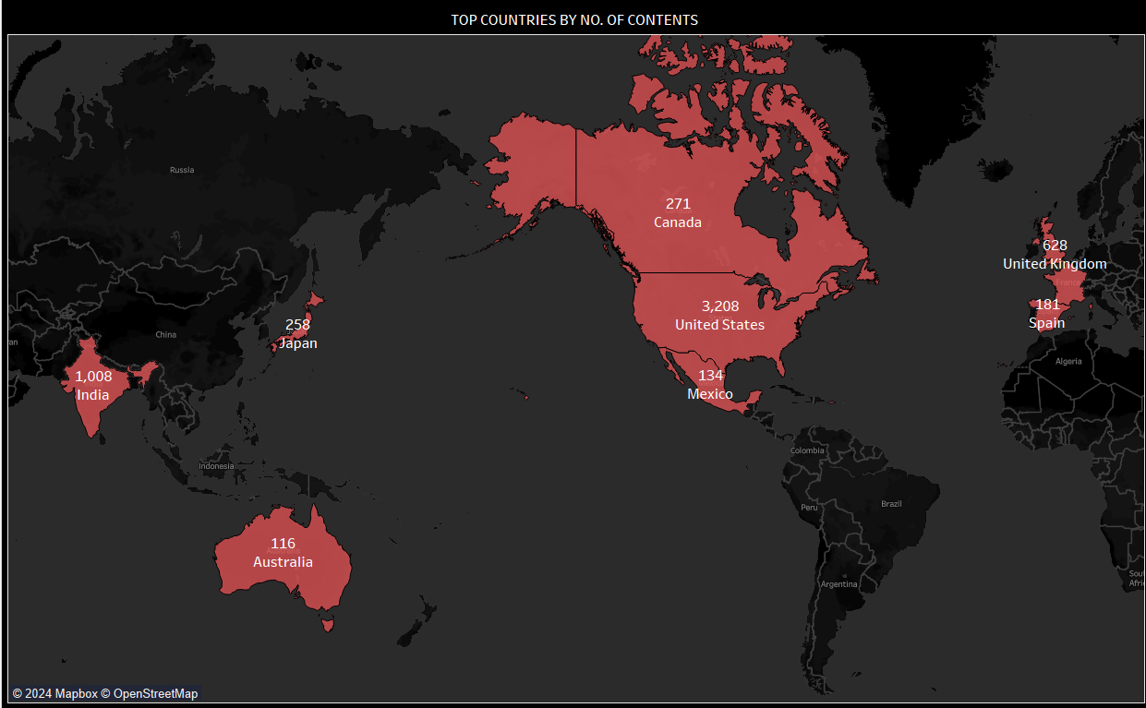
Top countries by no. of contents Produced:-
on amazon prime united States have produced most no of content i.e., 292 and India has produced 238 No. Contents.
on Disney plus united States have produced most no of content i.e., 1,119 and united Kingdom has produced 50 contents.
on Netflix united States have produced most no of content i.e., 3,208 and India holds the 2nd no. having 1,008 contents.
"From this analysis, we can conclude that the majority of revenue for OTT platforms comes from the United States."

Slide 21
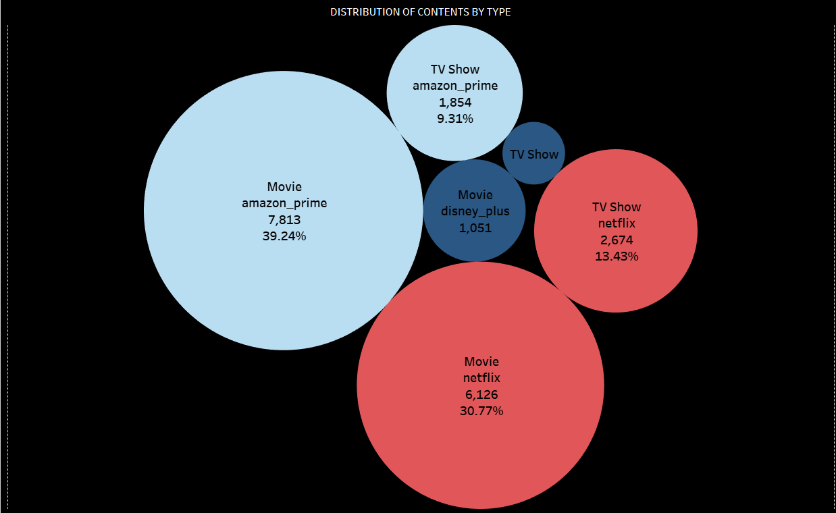
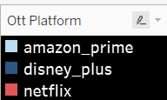
MOVIE and TV SHOWS DISTRIBUTION:
The Bubble chart illustrates the distribution of Movie and TV Shows.
On Amazon Prime, 'Movies' have the largest collection with 7,813 contents, accounting for 39.24% of the total content, while 'TV Shows' have 1,854 contents, making up 9.31% of the content.
Netflix also has a substantial movie library, consisting of 6,126 titles, which accounts for 30.77% of the content and for TV shows, Netflix offers 2,674 titles (13.43%),
On Disney plus, 'Movies' have the largest collection with 1051 contents, accounting for 5.28% of the total content, while 'TV Shows' have 393 contents, making up 1.97% of the content.

Slide 22
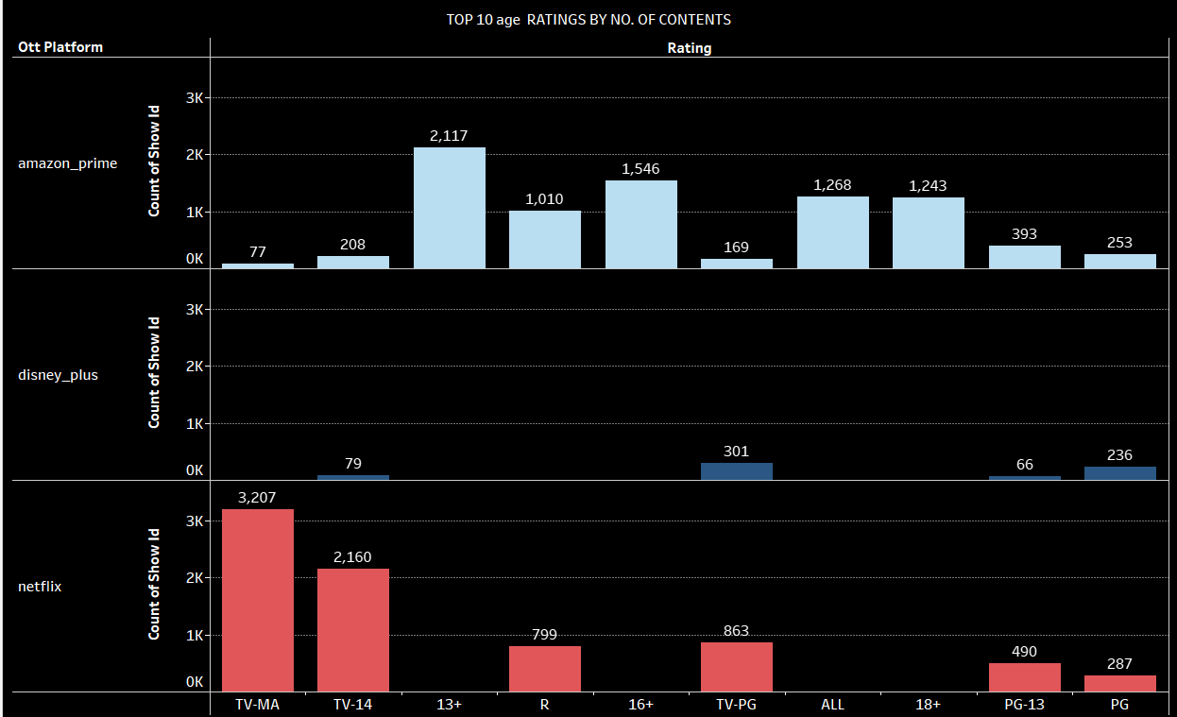
Top 10 content ratings by No. of contents :
The graph displays the top 10 age ratings by the number of contents available on various OTT platforms like Amazon Prime, Disney+, and Netflix.
Netflix has the highest number of contents rated TV-MA (3,207) and TV-14 (2,160), indicating a larger library of mature and teen-oriented content compared to Amazon Prime and Disney+.
Disney+ has a significant portion of its content rated TV-PG (301) and TV-G (236), suggesting a focus on family-friendly shows.
Amazon Prime offers a more diverse range of content across various age ratings, including TV-MA (2,117), R (1,546), PG-13 (1,243), and PG (253).

Slide 23
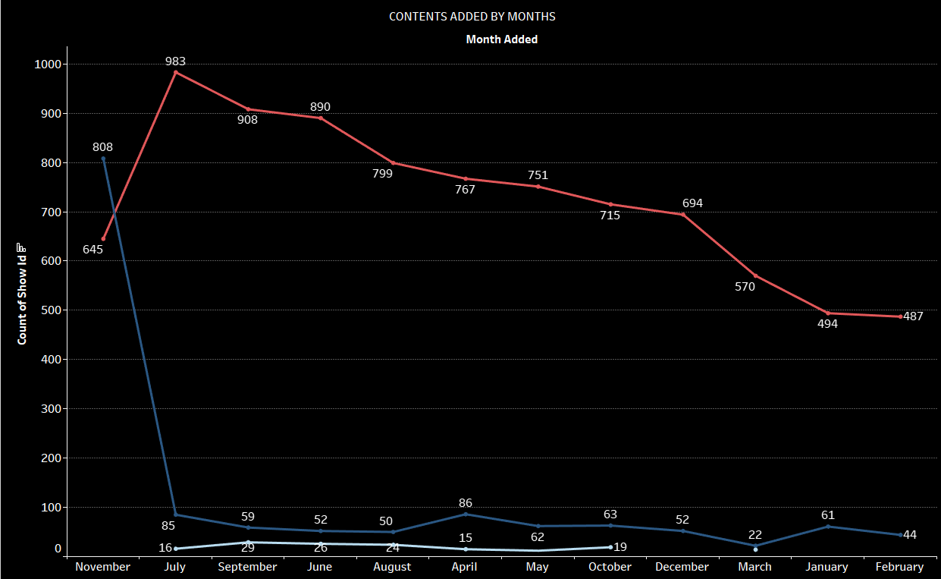

Content added by month wise :-
The graph shows the number of contents added to different OTT platforms (Amazon Prime, Disney+ and Netflix) by months.
The peak months for content addition are November for Amazon Prime (29 contents added), November for Disney+
(808 contents added), and July for Netflix (983 contents added).
The valley months for content addition are April for Amazon prime (15 contents added), March for Disney plus
(22 contents added), and February for Netflix (487 contents added).

Slide 24
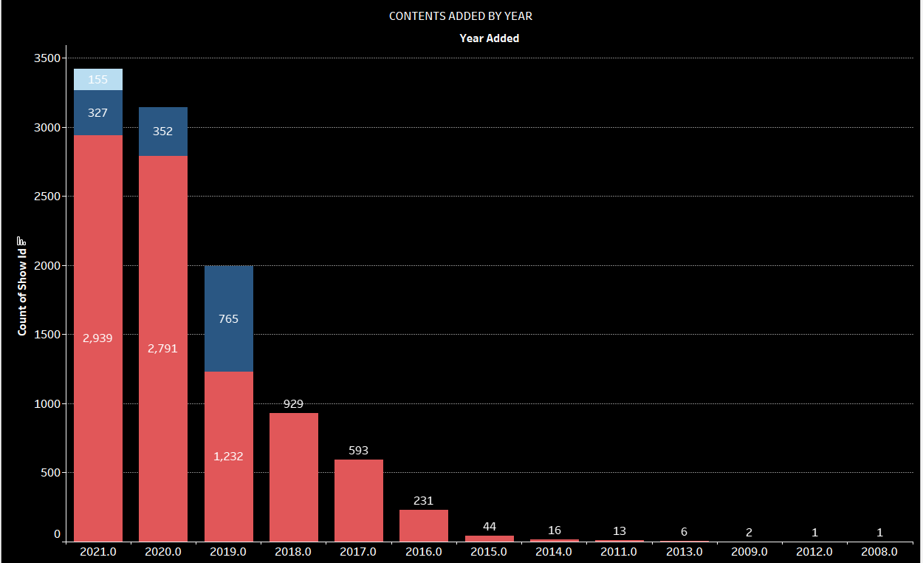

Contents added by year wise:-
The graph shows the number of contents added to different OTT platforms (Amazon Prime, Disney+, and Netflix) by year.
The peak year for content addition are 2021 for Amazon Prime (155 contents added), 2019 for Disney+
(765 contents added), and 2021 for Netflix (2,939 contents added).
The valley years for content addition are 2021 for Disney plus (327 contents added), and 2008 & 2012 for Netflix (only 1 content added).

Slide 25
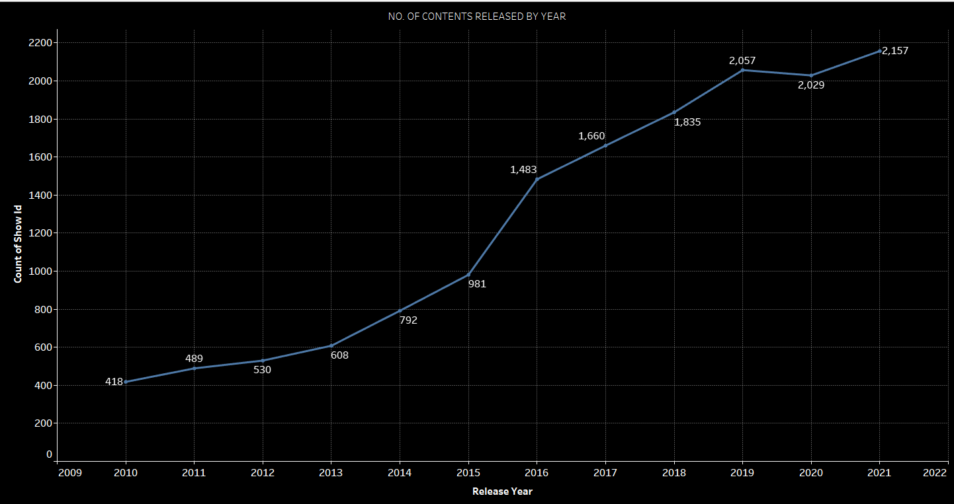
Content Released By Year:-
The graph shows the number of contents Released by Year.
The peak year for content released are 2021 (2,157 contents released).
The valley years for content released are 2010 (418 contents released).

Slide 26
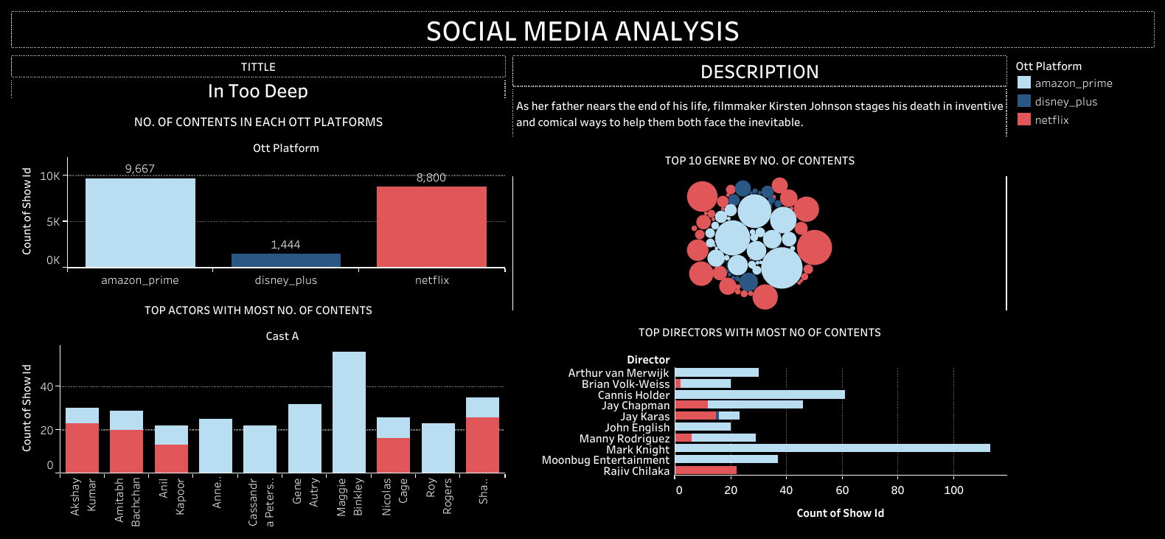
FINAL DASHBOARD OF Tableau:

Slide 27
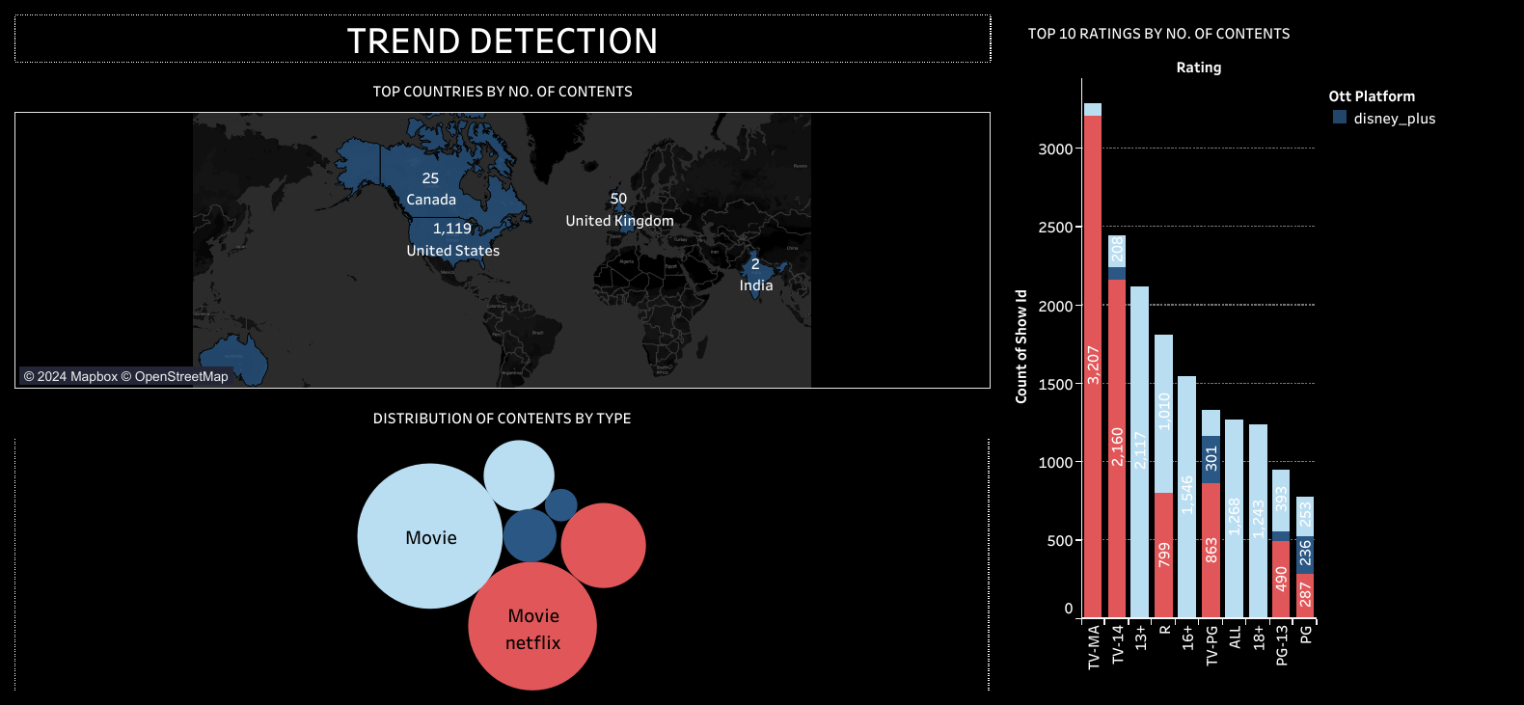
FINAL DASHBOARD OF Tableau:

Slide 28
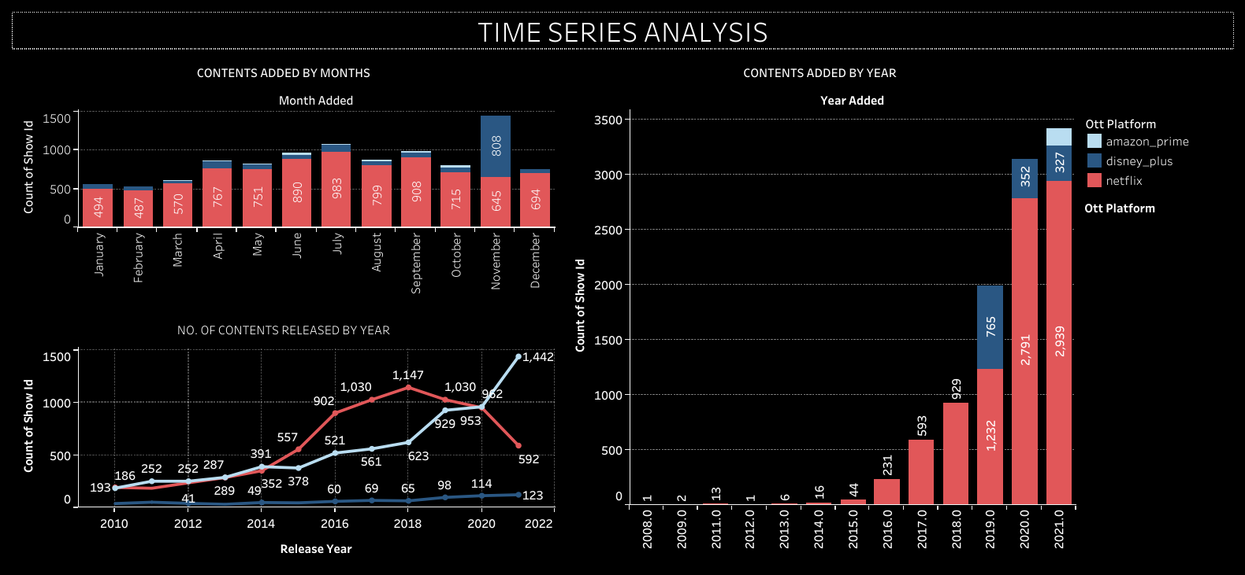
FINAL DASHBOARD OF Tableau:

Slide 29
Reference
https://github.com/AKMALMIRZA29/SOCIAL-MEDIA-ANALYSIS/upload/main

Slide 30
Thank
You!

